Slide 1
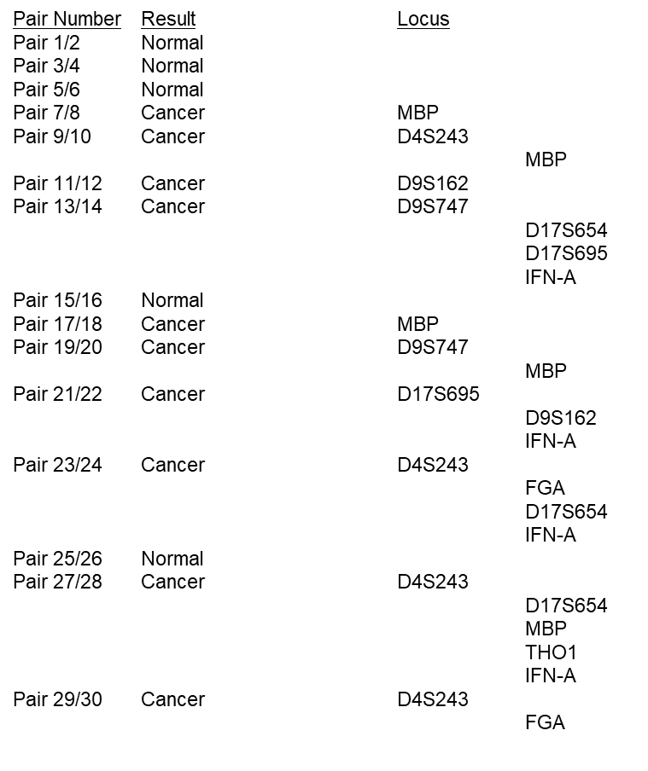
Table 4
Pair Number Result Locus
Pair 1/2 Normal
Pair 3/4 Normal
Pair 5/6 Normal
Pair 7/8 Cancer MBP
Pair 9/10 Cancer D4S243
MBP
Pair 11/Pair Number Result Locus
Pair 1/2 Normal
Pair 3/4 Normal
Pair 5/6 Normal
Pair 7/8 Cancer MBP
Pair 9/10 Cancer D4S243
MBP
Pair 11/12 Cancer D9S162
Pair 13/14 Cancer D9S747
D17S654
D17S695
IFN-A
Pair 15/16 Normal
Pair 17/18 Cancer MBP
Pair 19/20 Cancer D9S747
MBP
Pair 21/22 Cancer D17S695
D9S162
IFN-A
Pair 23/24 Cancer D4S243
FGA
D17S654
IFN-A
Pair 25/26 Normal
Pair 27/28 Cancer D4S243
D17S654
MBP
THO1
IFN-A
Pair 29/30 Cancer D4S243
FGA
12 Cancer D9S162
Pair 13/14 Cancer D9S747
D17S654
D17S695
IFN-A
Pair 15/16 Normal
Pair 17/18 Cancer MBP
Pair 19/20 Cancer D9S747
MBP
Pair 21/22 Cancer D17S695
D9S162
IFN-A
Pair 23/24 Cancer D4S243
FGA
D17S654
IFN-A
Pair 25/26 Normal
Pair 27/28 Cancer D4S243
D17S654
MBP
THO1
IFN-A
Pair 29/30 Cancer D4S243
FGA

