Slide 1
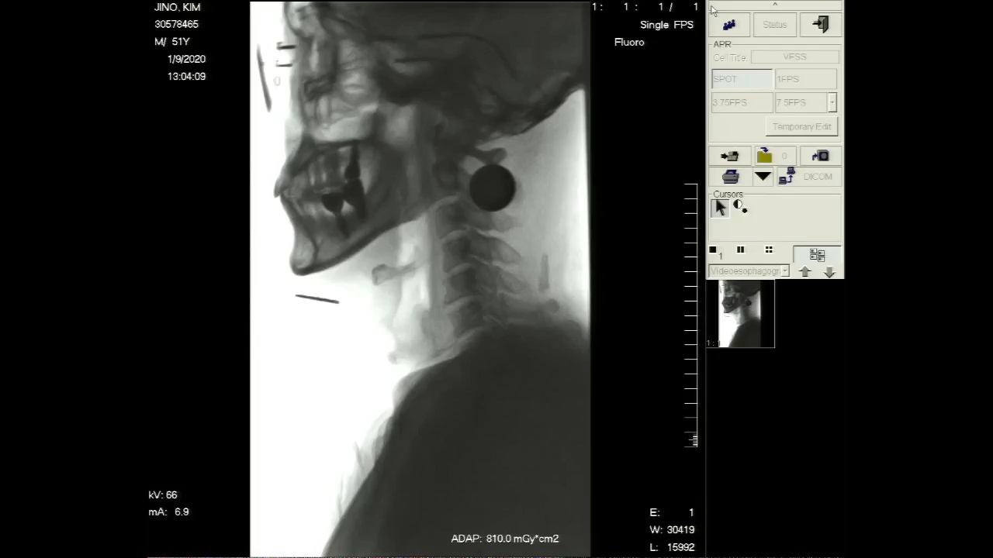
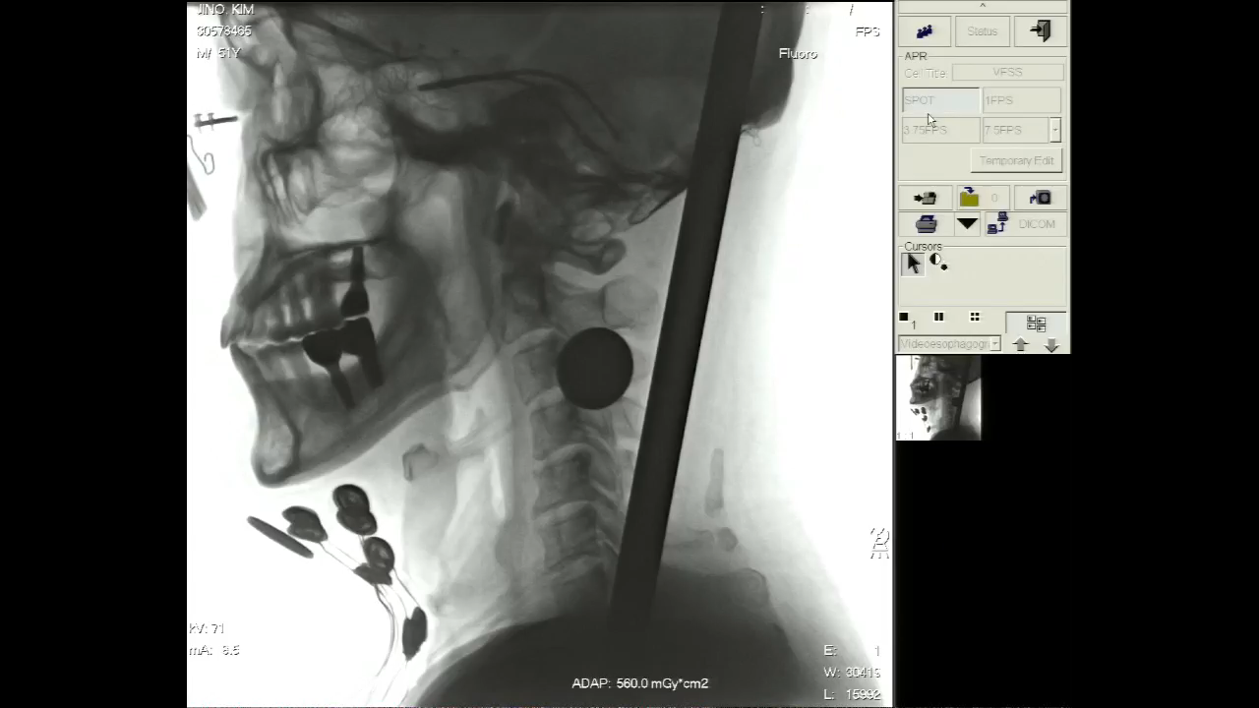
Thin fluid 5cc
First VFSS without NMES
Second VFSS with 4Ch NMES

Slide 2
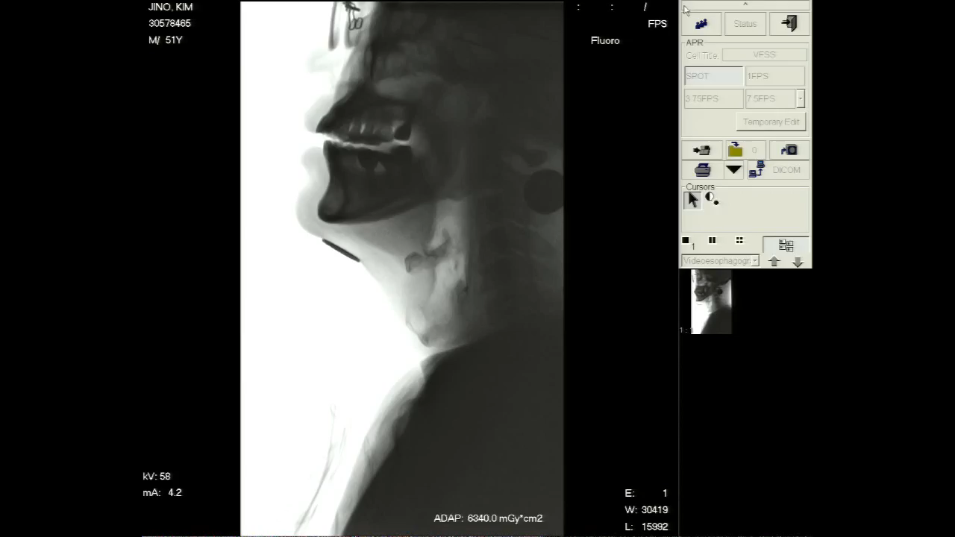
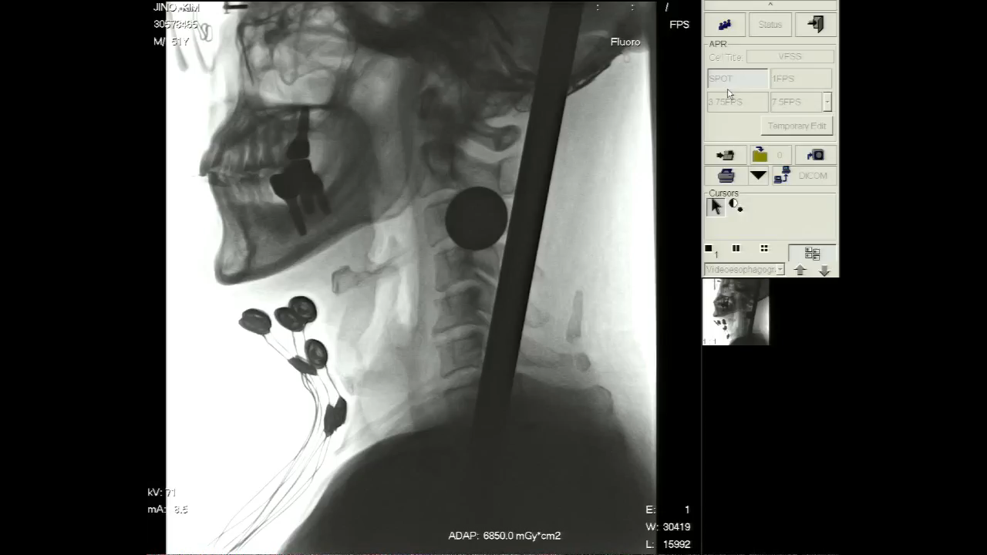
Extremely thick fluid 5cc
First VFSS without NMES
Second VFSS with 4Ch NMES

Slide 3
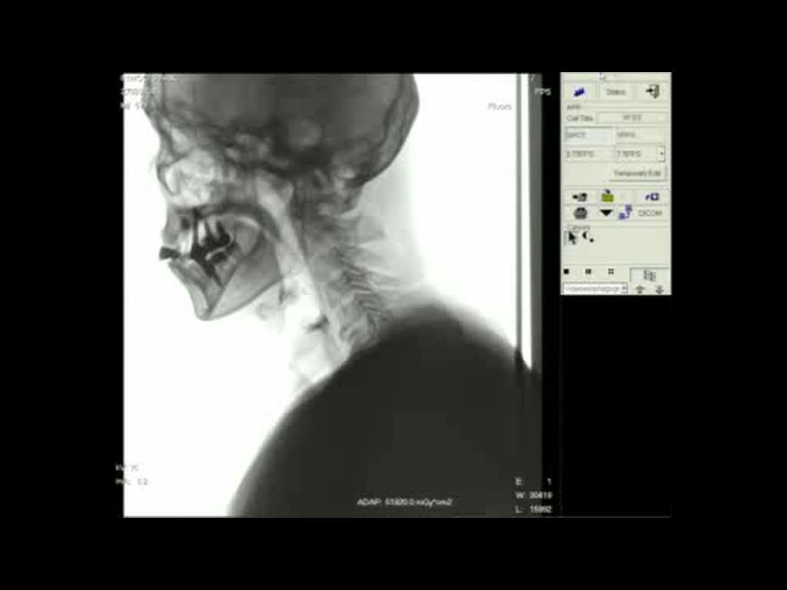
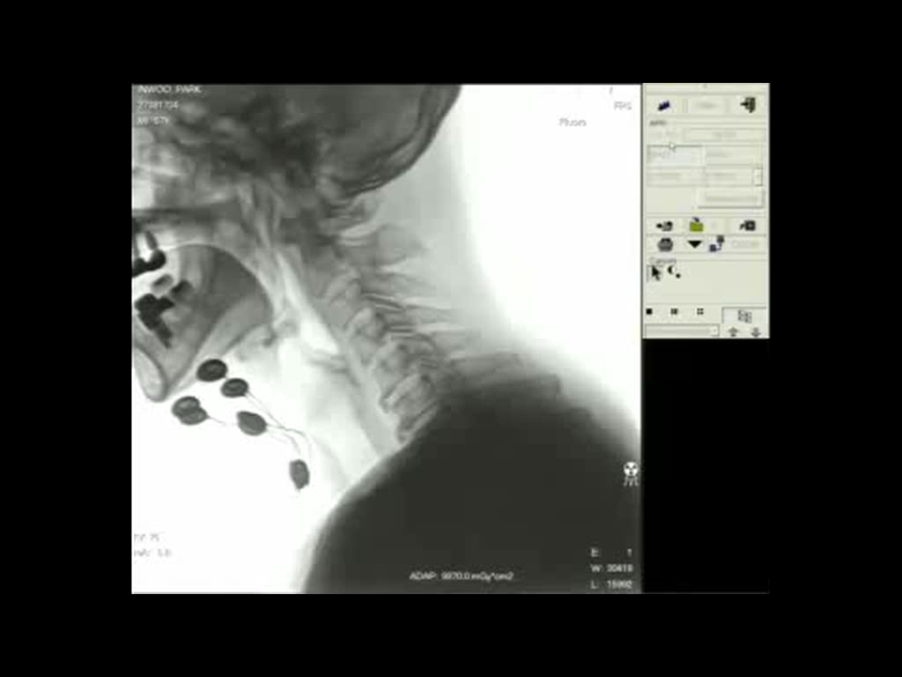
Thin fluid 5cc

Slide 4
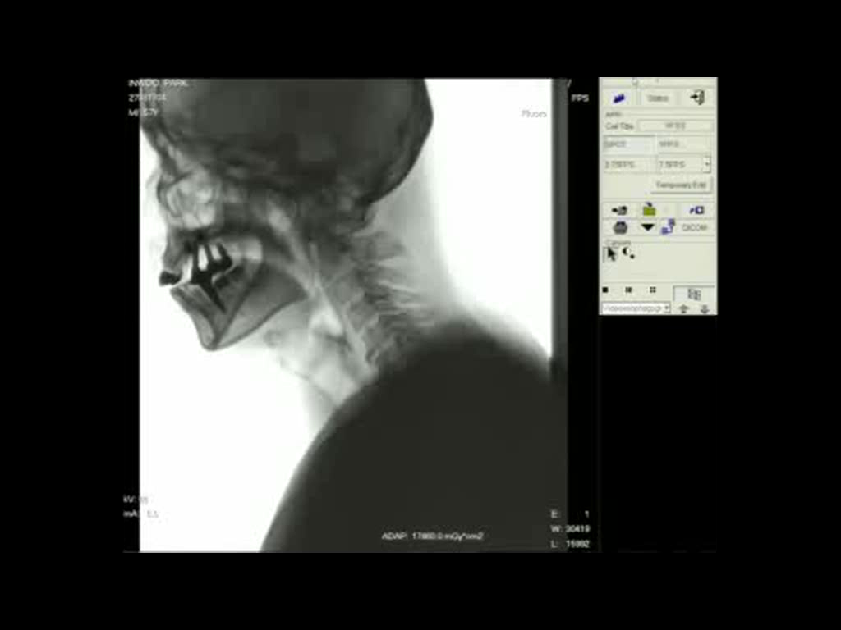
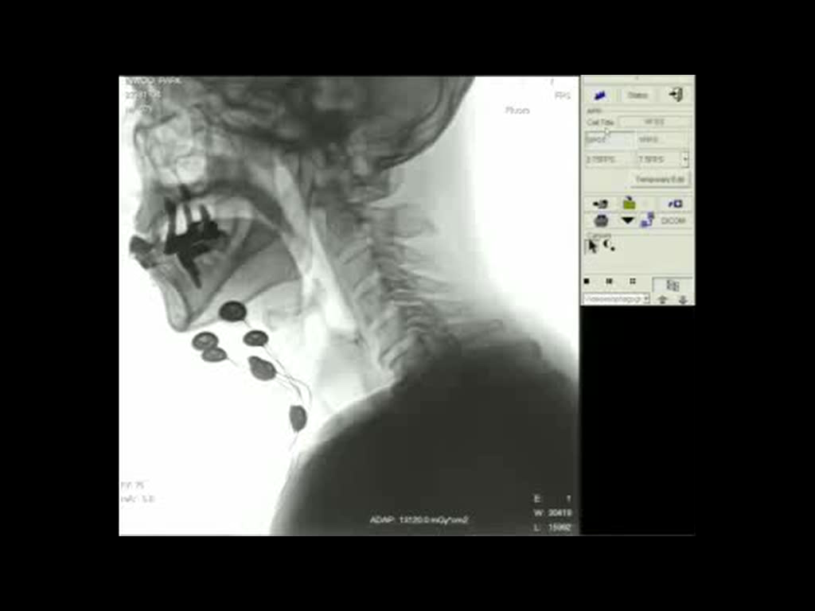
Extremely thick fluid fluid 5cc
First VFSS without NMES
Second VFSS with 4Ch NMES

Slide 5
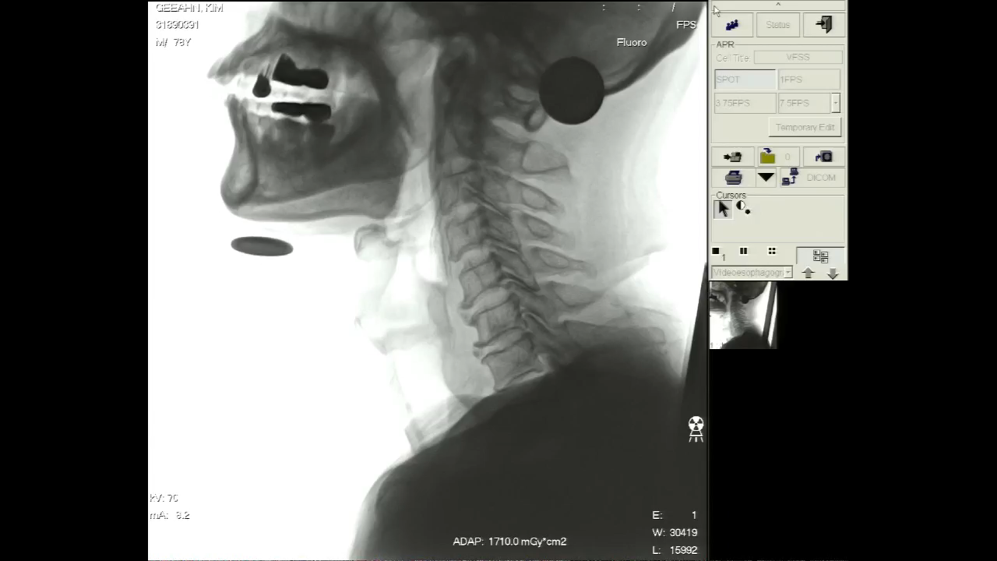
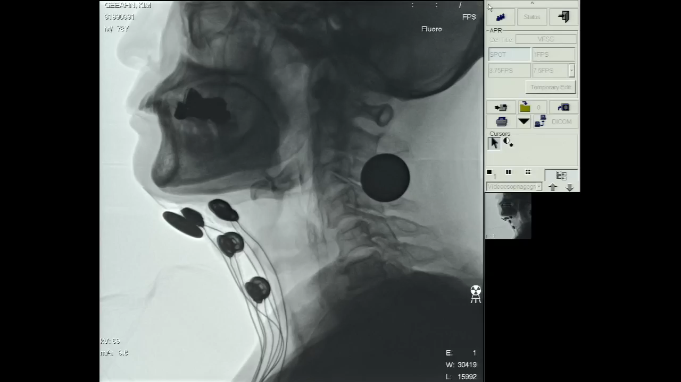
Thin fluid 5cc
First VFSS without NMES
Second VFSS with 4Ch NMES

