Slide 1
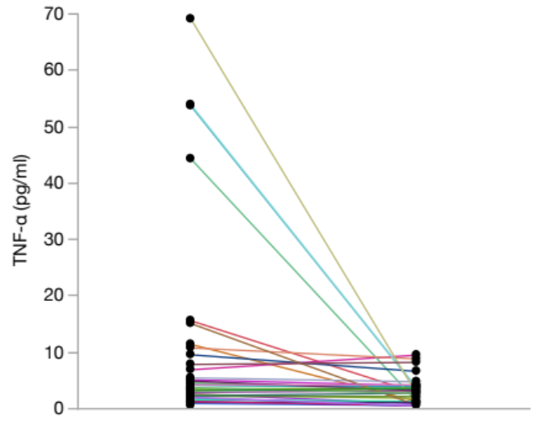
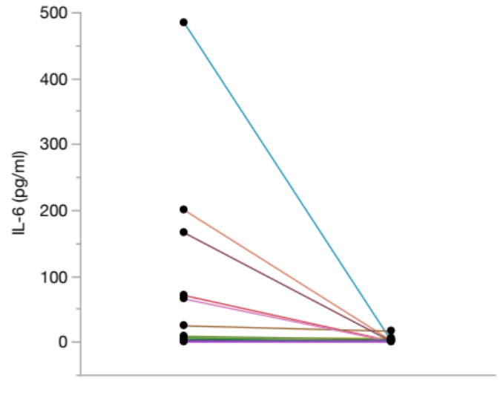
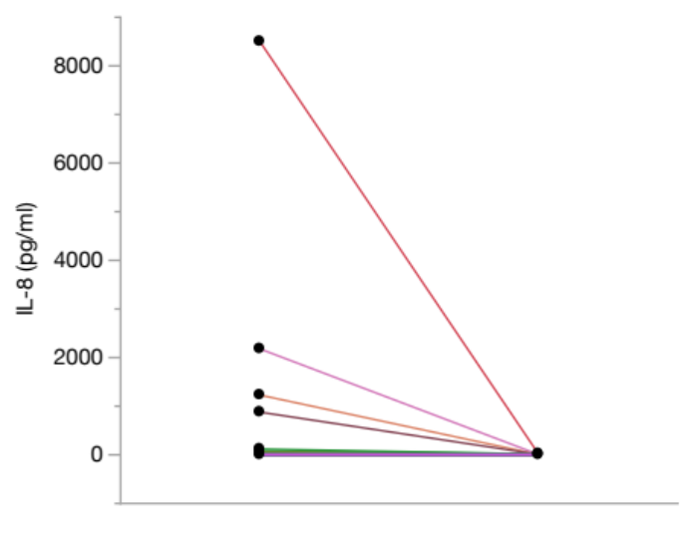
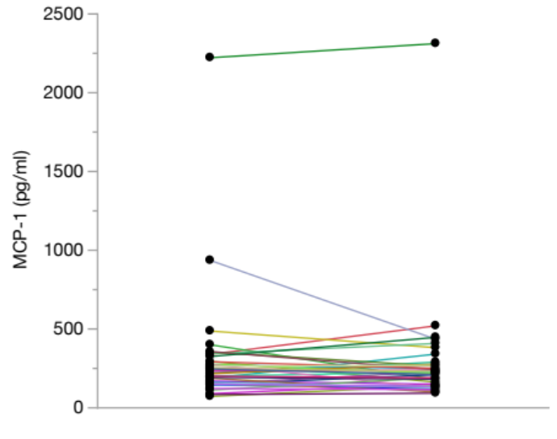
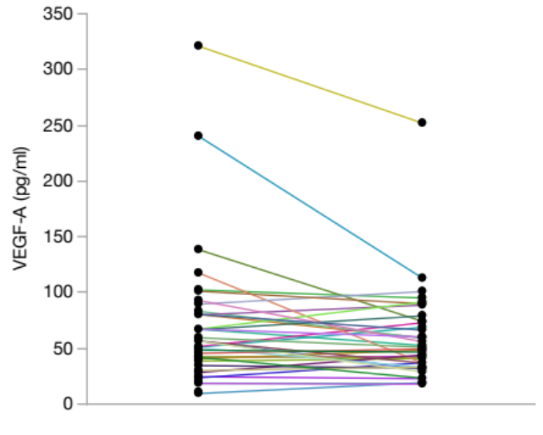
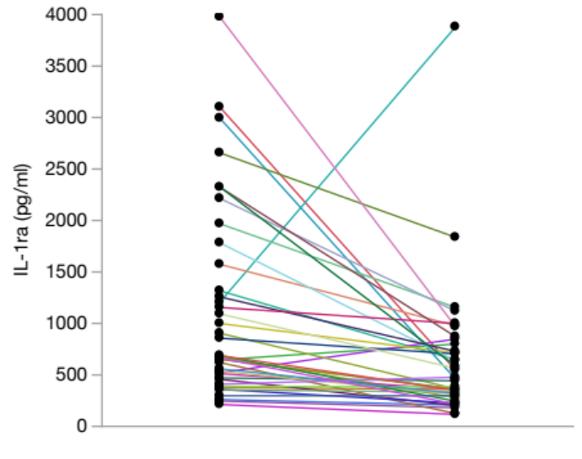
Additional file 3
P < 0.0001*
P = 0.0080*
P = 0.1623
Before Tx
3 M Post Tx
Before Tx
3 M Post Tx
Before Tx
3 M Post Tx
P = 0.4323
P = 0.0534
P < 0.0001*
Before Tx
3 M Post Tx
Before Tx
3 M Post Tx
Before Tx
3 M Post Tx

