Slide 1
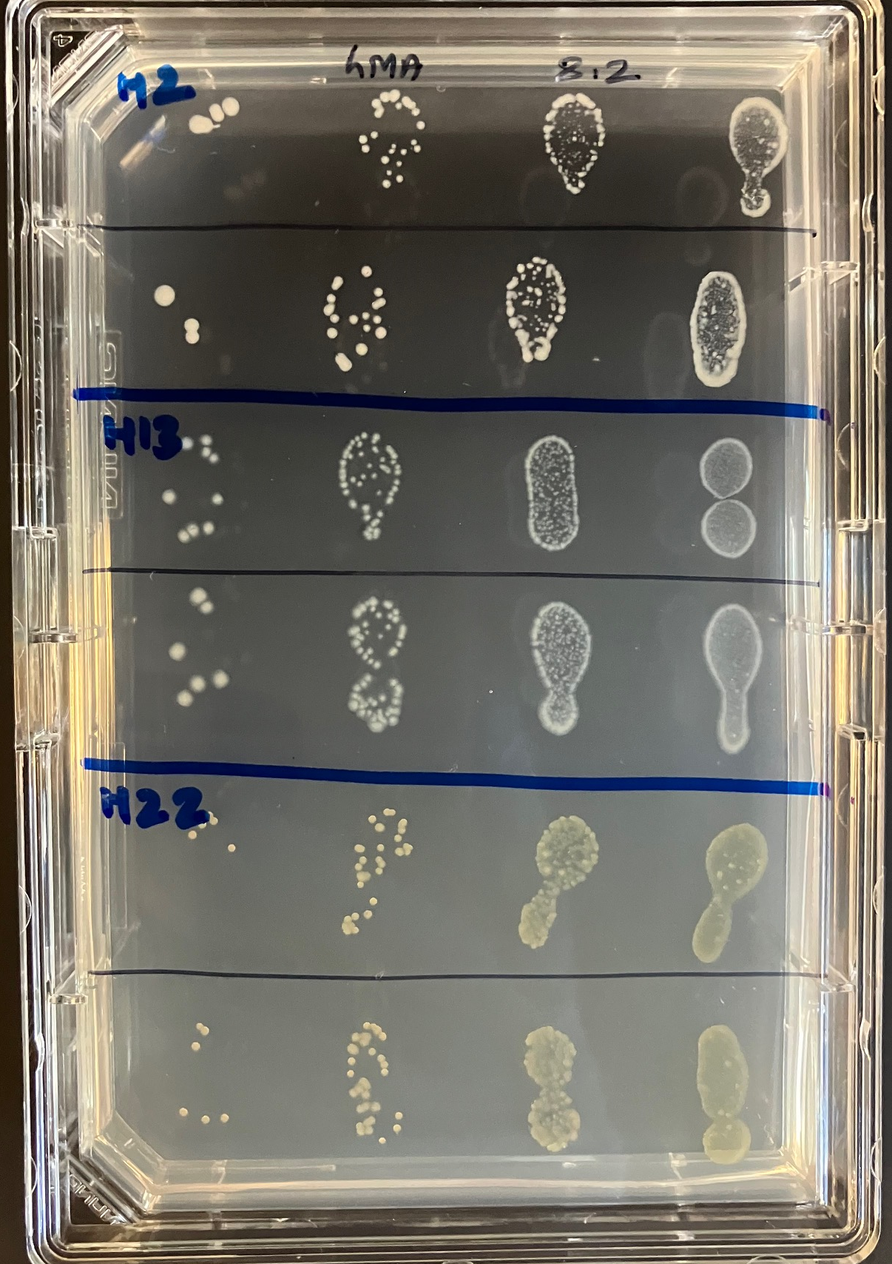
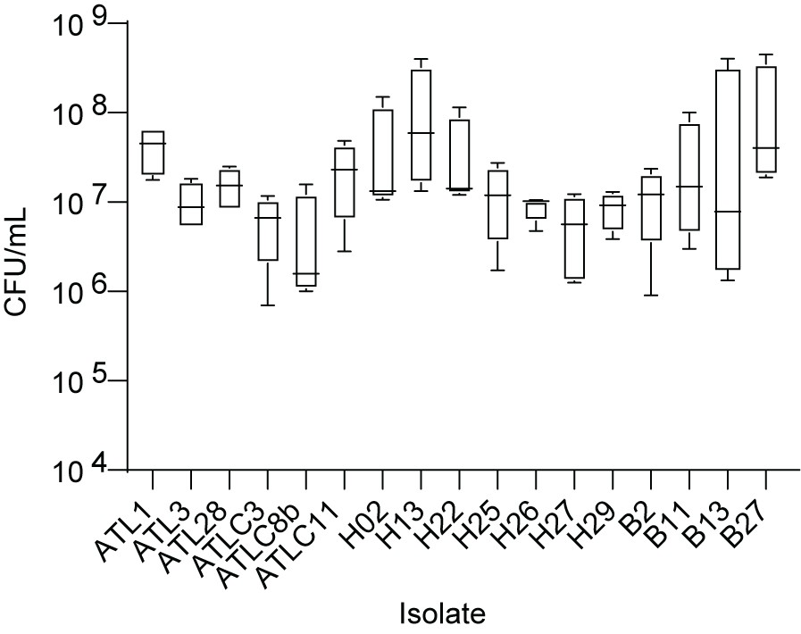
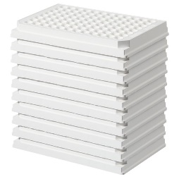
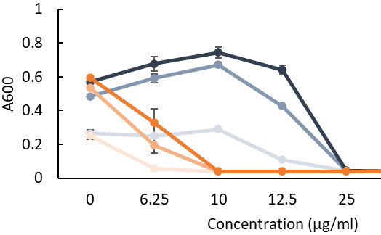
a
b
Isolates | OD600
ATLC3, ATLC8b, ATLC11, B2, B11 | 0.01
ATL1, ATL3, ATL28, H02, H13, H22, H25, H26, H27, H29, B13, B27 | 0.05
Establish OD600 for 10^7 cells/mL
c
Inhibitory compound screen (Biolog PM 11-13)
score inhibitors or pairs for selective performance (Matlab)
d
validate and optimize dosages
using plate reader
Media
Media + inhibitory compound
Select concentration and verify non-target inhibition in plate (CFU/mL)
Supplementary Fig. 1: Development of absolute quantification method using chemical selection (a) schematic overview of steps involved determining CFU/mL and chemical selection (b) Established OD600 for each isolate to attain ~10^7 cells/mL (c) CFU/mL measured at the established OD for each isolates by plating in hMA (n=4). One sample t-test was performed to compare mean of each isolate to 10^7; all isolate values reflect no significant deviation from target value. (d) coverage ratio calculated as a ratio of biofilm covered vs uncovered area for coupons grown in MB using the 17-member community in Fig. 2f. Error bar represent standard deviation calculated for a total imaging area of 1 cm²

Slide 2
Supplementary Fig. 2: Top-down assembly identifies media effect. Biofilm initiated with 17 members in three media with different nutrition level. Principal coordinate analysis (PCoA) based on (a) Morisita-Horn (b) Jaccard dissimilarity (refer to Fig. 3e for Bray-Curtis metric) and ellipse by media represent distinct community composition in 1% MB in ASW, verified by PERMANOVA analysis. Bonferroni correction was applied for pairwise analysis.

Slide 3
a
b
Supplementary Fig. 3: Growth and interaction in community members. (a) Growth curve generated by measuring OD600 for 72 hrs of 17 isolates used in the biofilm community in three different media: MB, VNSS and 1% MB in ASW. Each curve represents mean of 3 biological replicates with two technical replicates in each replicate. Shaded area represent standard deviation calculated from three replicates. (b) Interaction observed using coculture spotting assay compared to individual growth in two different media types. Plates were imaged at 2 days post spotting for half Marine Agar (hMA) and 4 days post spotting for 1% MB in ASW agar plates due to slow growth in latter media. Three spottings in three different plates were performed for each media type and only one representative image is presented. Scale bar = 5 mm.

Slide 4
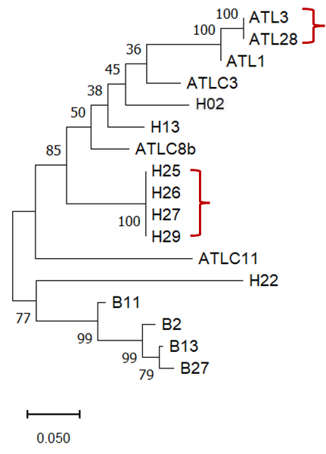
a
b
Supplementary Fig 4: Phylogenetic relatedness of the 17 isolates used in the biofilm community assembly. The phylogenetic relatedness is inferred using the Maximum Likelihood method and Tamura-Nei model based on (a) V3-V4 region of 16S rRNA gene (b) full 16S rRNA gene . The tree represents the highest log likelihood result of 1000 bootstrap and drawn to scale with branch lengths measured in the number of substitutions per site using MEGA 11. The parenthesis show isolate groups with the same branch length or 100% identical sequences.

Slide 6
Supplementary Fig. 5: Temporal effect on biofilm growth and β-diversity. (a) Top view of OCT image (5*5*2mm) displaying biofilm coverage observed in 14 member community without Pseudoalteromonases in 1% MB in ASW. (b) Abundance of H29 in 14-member community in Fig. 5a with replicates plotted separately. Principal coordinate analysis (PCoA) based on (c) Morisita-Horn [PERMANOVA; Pr(>F) = 0.423] and (d) Jaccard [PERMANOVA; Pr(>F) = 0.74] dissimilarity index testing day effect in 14-member community in Fig. 5a. Bray-Curtis dissimilarity and
PERMANOVA analysis shows absence of (e) replicate effect in the biofilm diversity in
14-member community in 1% MB in ASW (see Fig. 5c for day effect); ellipses are drawn
by replicates; PERMANOVA; Pr(>F) = 0.664 and (f) absence of day effect in the biofilm diversity in
17-member community in three different media (media effect in Fig. 3e); ellipses are
drawn by days; PERMANOVA; Pr(>F) = 0.892. (g) Total cell abundance in the 14-member biofilm community compared with the total abundance in single isolate biofilm. (h) Analysis of total abundance of only the chitinase producers in the biofilm initiated with 14-members in 1% MB in ASW in Fig. 5e shows an increasing trend but absence of significant increase in abundance of chitinase producers (One way ANOVA with Tukey pairwise comparison).

