Slide 1
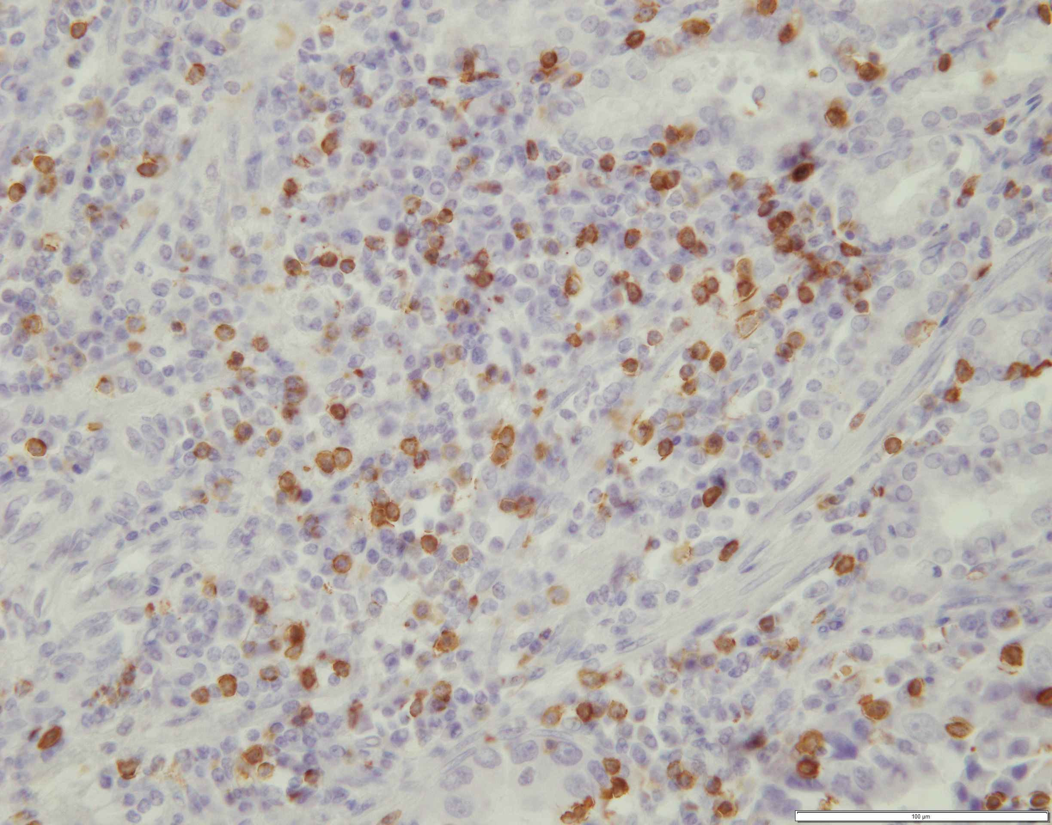
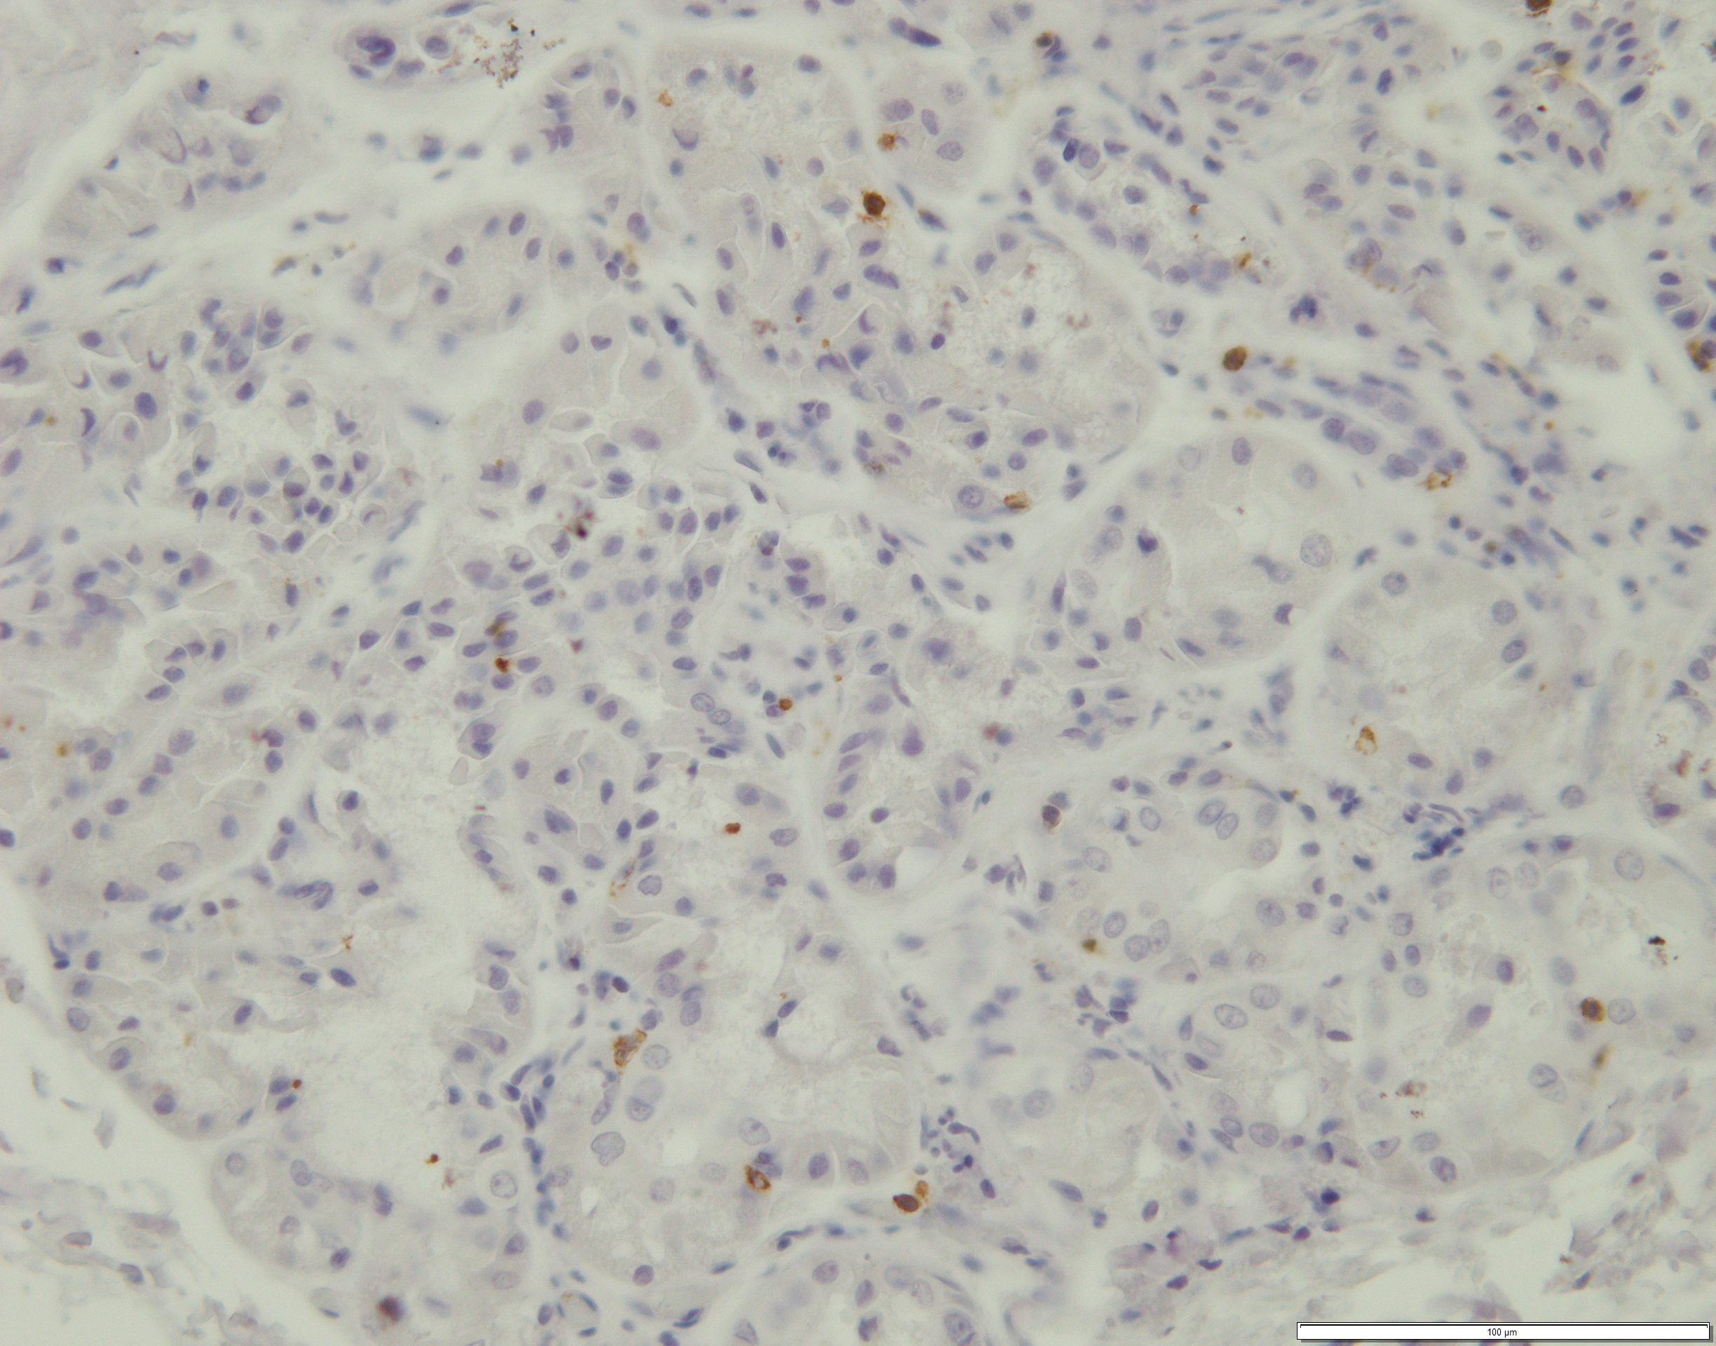
Supplementary File 2.
Representative high/low expression images of tumor-infiltrating CD8⁺ and CD4⁺ T cells(scale bar: 50 μm).
CD8
CD4
High
Low

