Slide 1
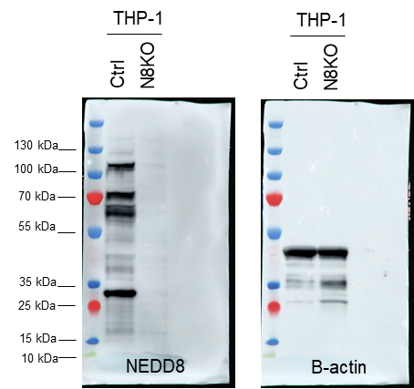
Uncut membranes for Figure 1A

