Slide 1
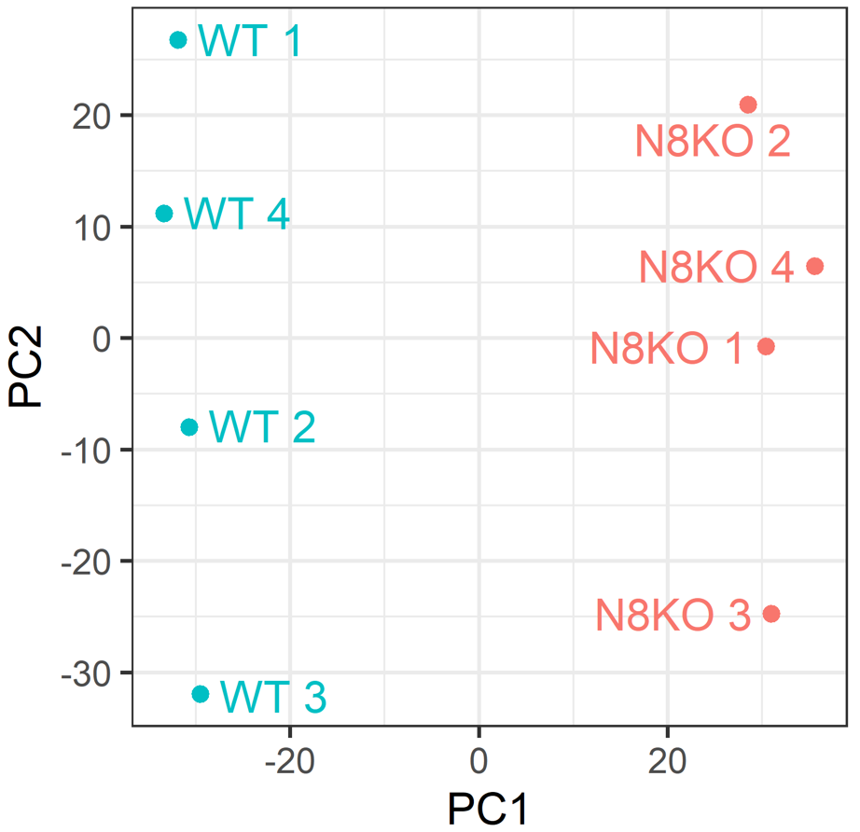
A
B
PCA analysis
(THP1 ctrl vs NEDD8 KO)
C
D
Figure S1

Slide 2
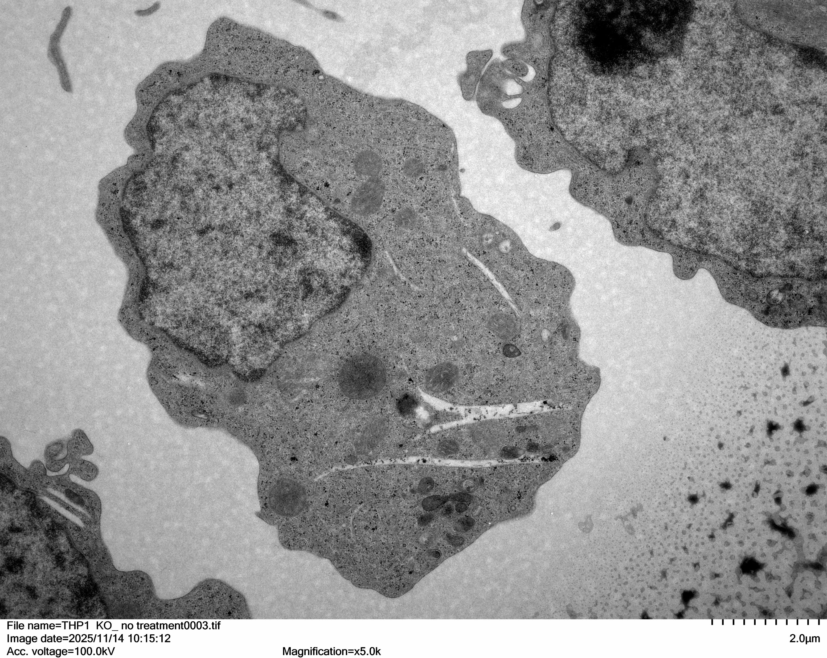
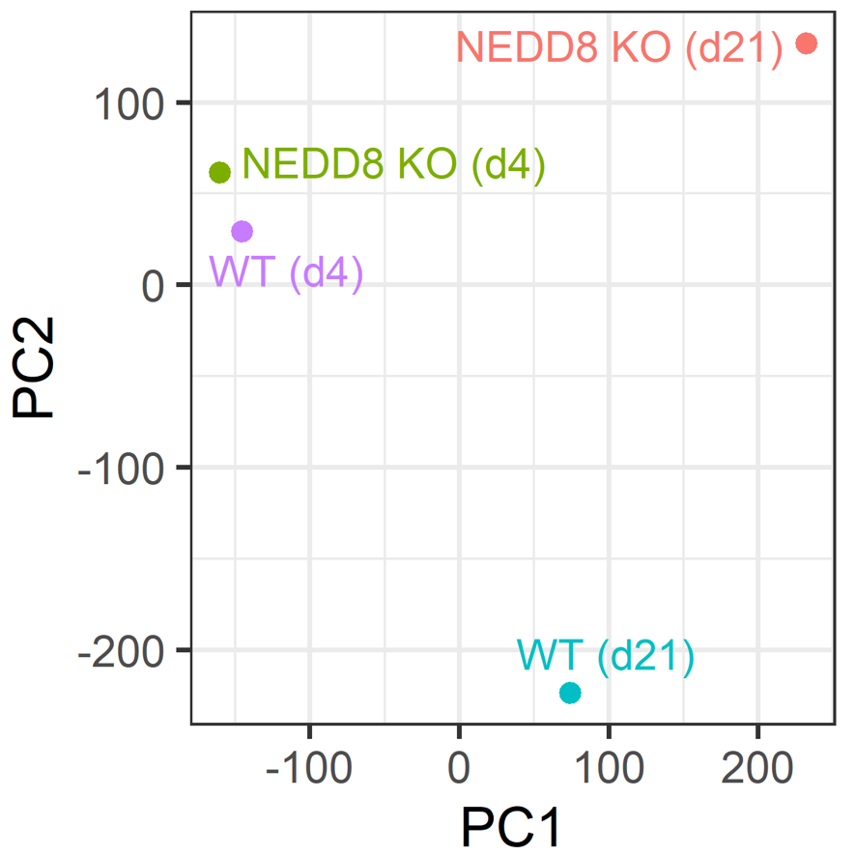
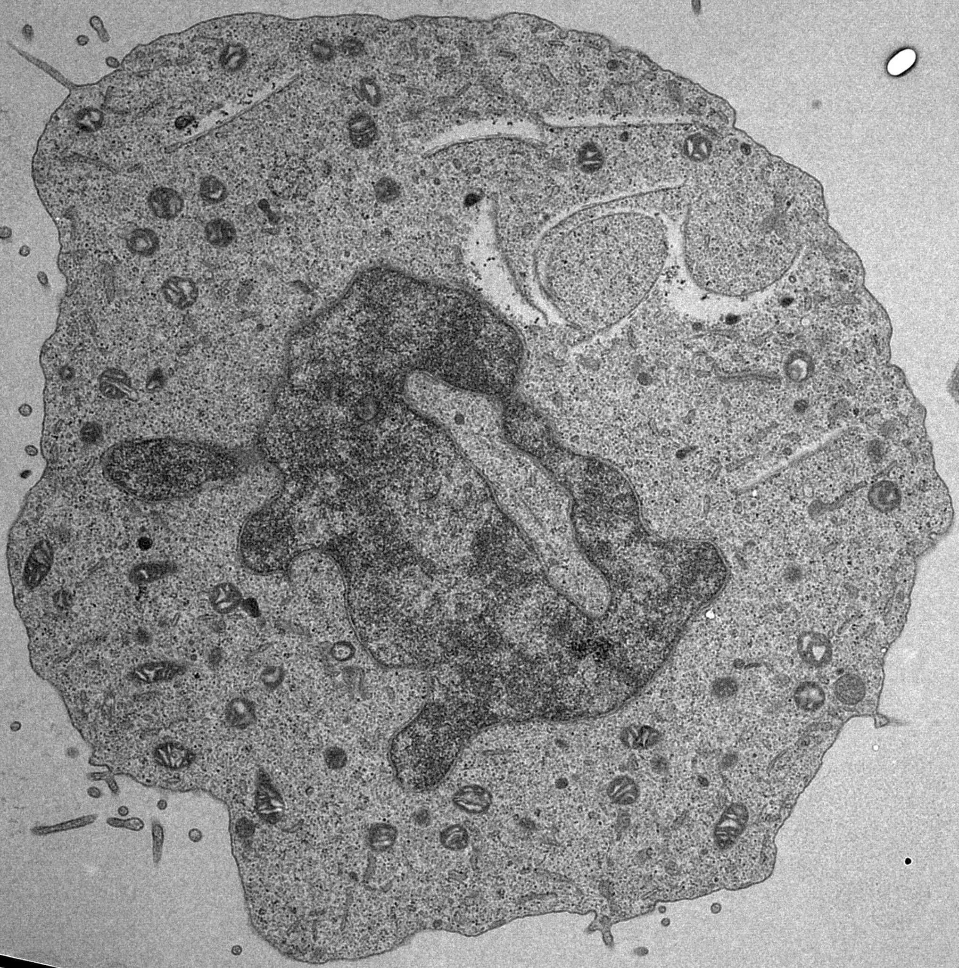
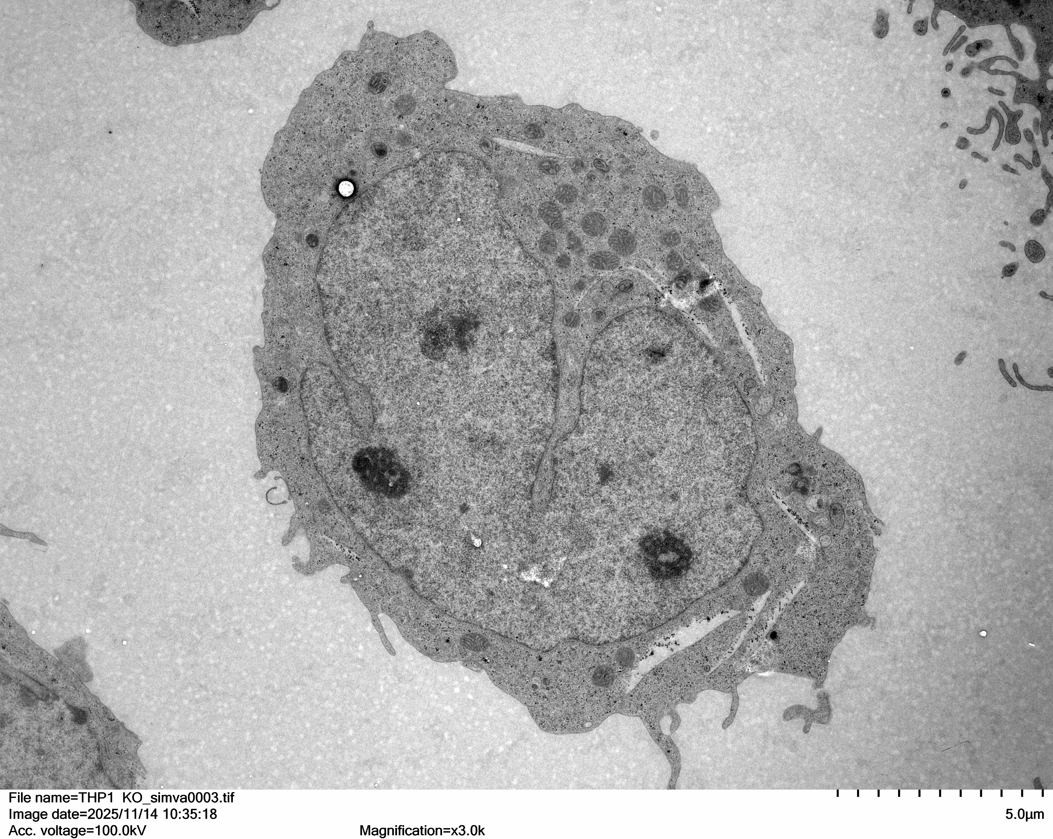
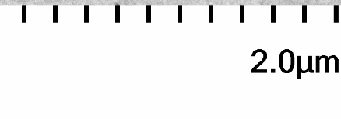
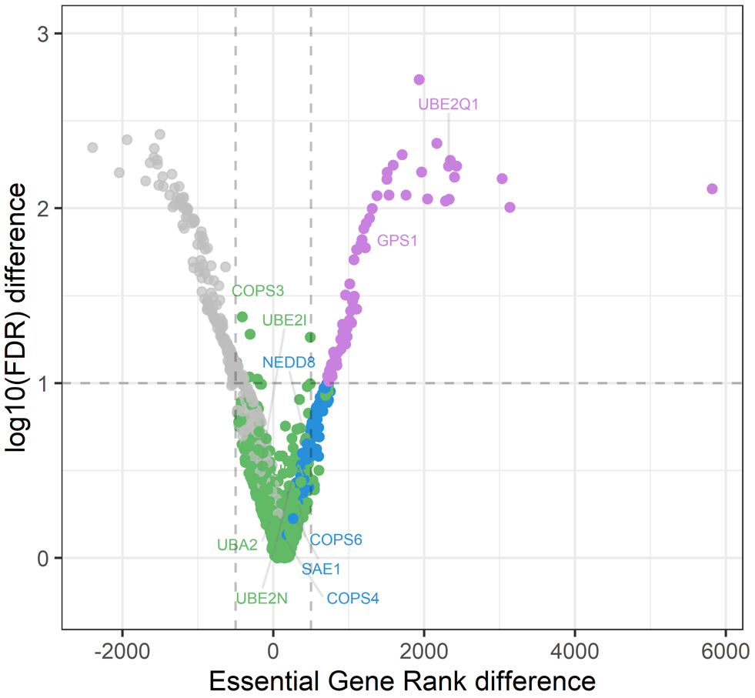
A
PCA analysis
(gRNA scores)
C
Control
NEDD8 KO
DMSO
Simvastatin
B
Post-translational modification genes
(gene essentiality in CRISPR screens)
Highly essential in Ctrl
Essential in KO
Essential in Ctrl and KO
Essential in Ctrl
Figure S2

Slide 3
A
B
C
D
E
Figure S3

Slide 4
A
B
C
D
E
Figure S4

