Slide 1

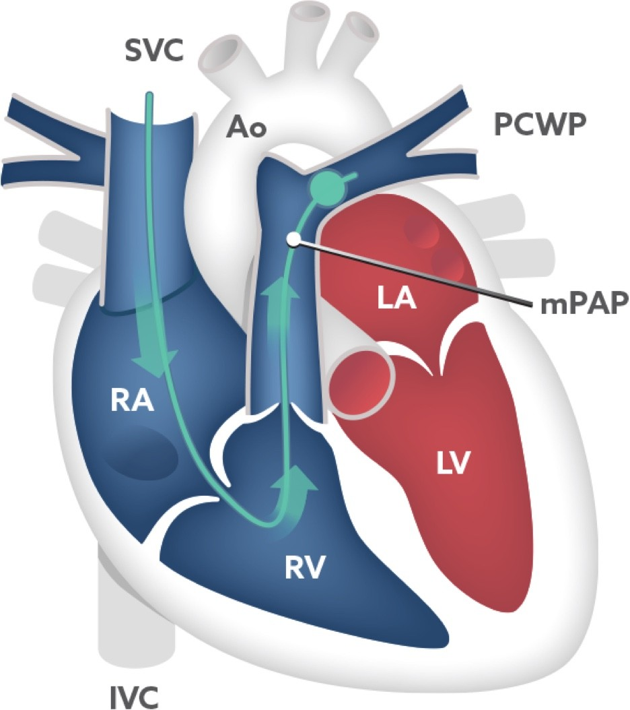
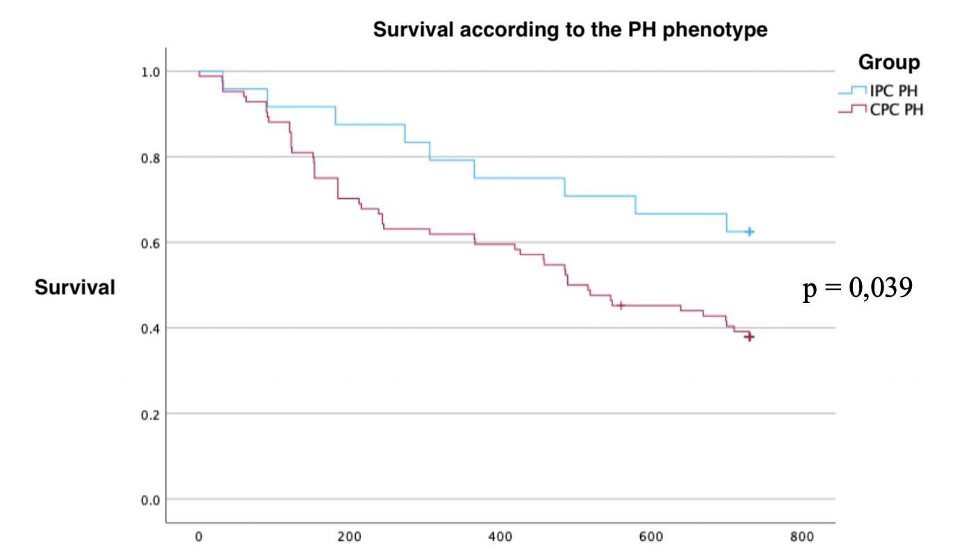
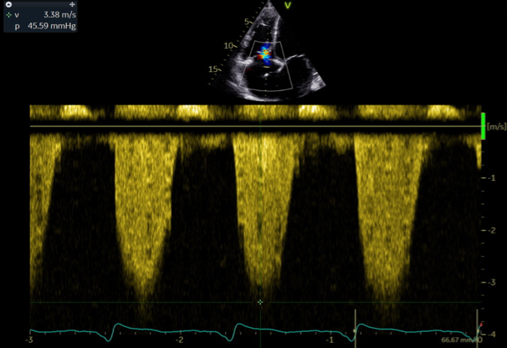
PH in advanced HFrEF. Consequences of the new definition.
Complete set of:
ECHO
LAB
PFT
CLINICAL
RHC
175 advanced HFrEF pts
NEW DEFINITION
↓ mPAP treshold
↓ PVR treshold
2022 ESC/ERS
PH Guidelines
Finding 1
Disproportionate increase in CPC PH
Finding 2
sPAP – only non-invasive predictor of CPC PH
Finding 3
CPC PH still reflecting worse prognosis
Conclusion: Disproportionate increase in CPC PH, with ability to predict worse prognosis

