Slide 1
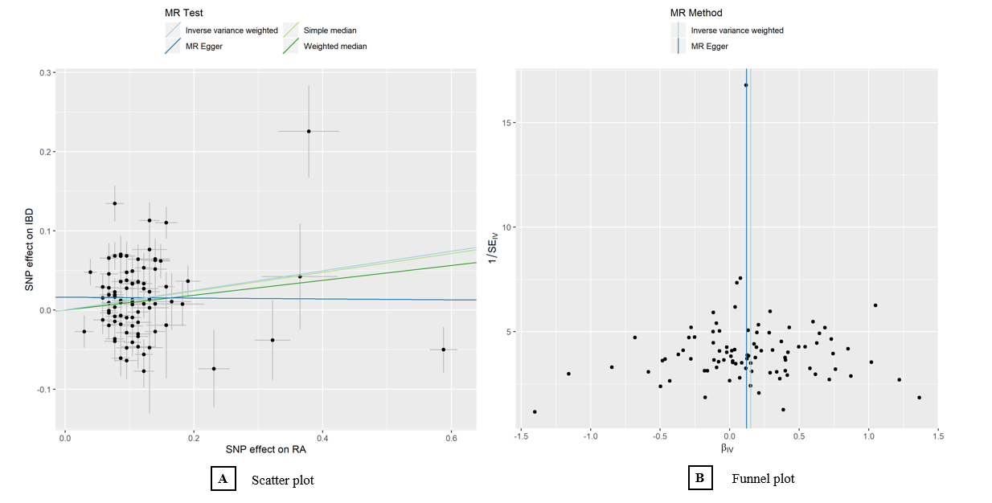
eFigure1. A. Scatter plot depicts the relationship of Instrument IBD (y-axis) and instrument RA (x-axis). B. Funnel plot gauges the reliability of analysis by presenting instrument precision (ie, instrument RA regression coefficients divided by the correspondent instrument IBD SEs) (y-axis) VS individual instrument ratio estimates in log odds ratio of IBD (x-axis). β_{IV} indicates odds ratio estimate per 1-ln increment in RA; IBD, inflammatory bowel disease; RA, rheumatoid arthritis.

Slide 2
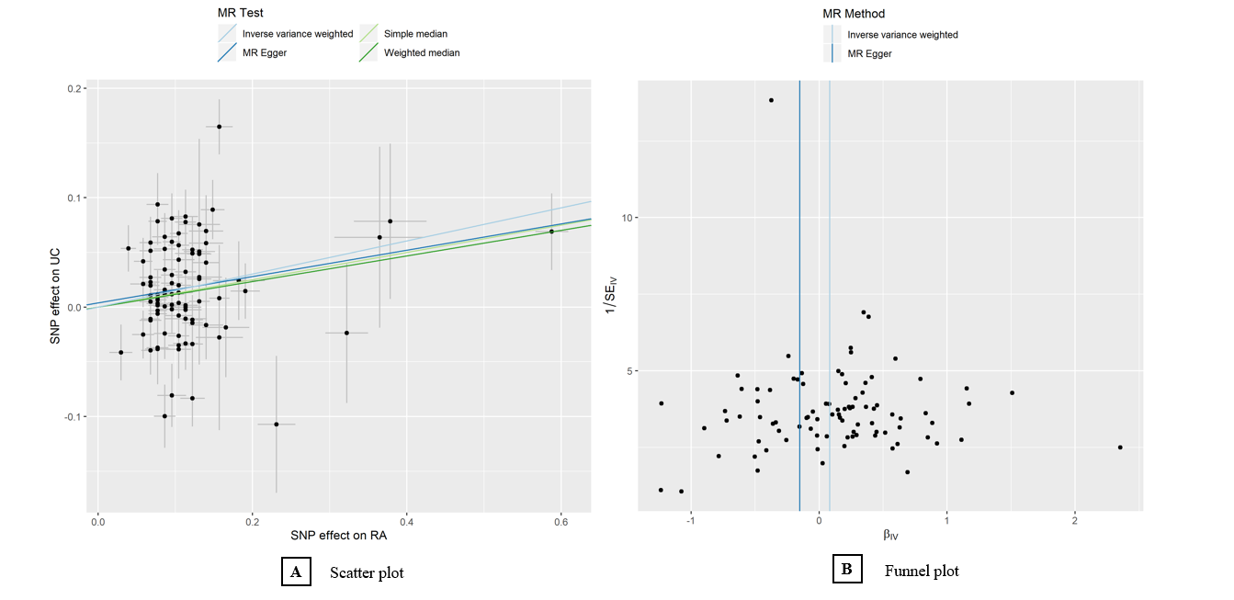
eFigure2. A. Scatter plot depicts the relationship of Instrument UC (y-axis) and instrument RA (x-axis). B. Funnel plot gauges the reliability of analysis by presenting instrument precision (ie, instrument RA regression coefficients divided by the correspondent instrument UC SEs) (y-axis) VS individual instrument ratio estimates in log odds ratio of UC (x-axis). β_{IV} indicates odds ratio estimate per 1-ln increment in RA; UC, ulcerative colitis; RA, rheumatoid arthritis.

