Slide 1
Chapter 7 Squirrels and Climate change 2100
Predictors used for SDMs
Source: Bioclim
By Moriz Steiner and Falk Huettmann

Slide 2
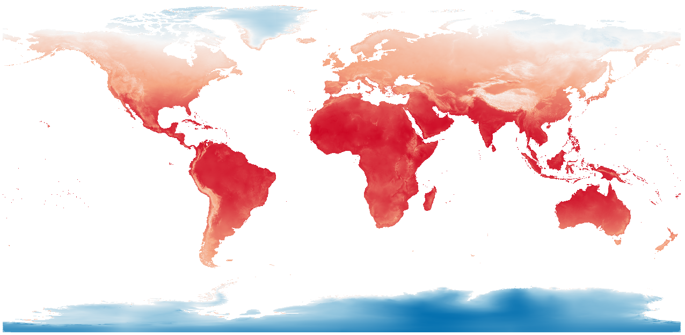
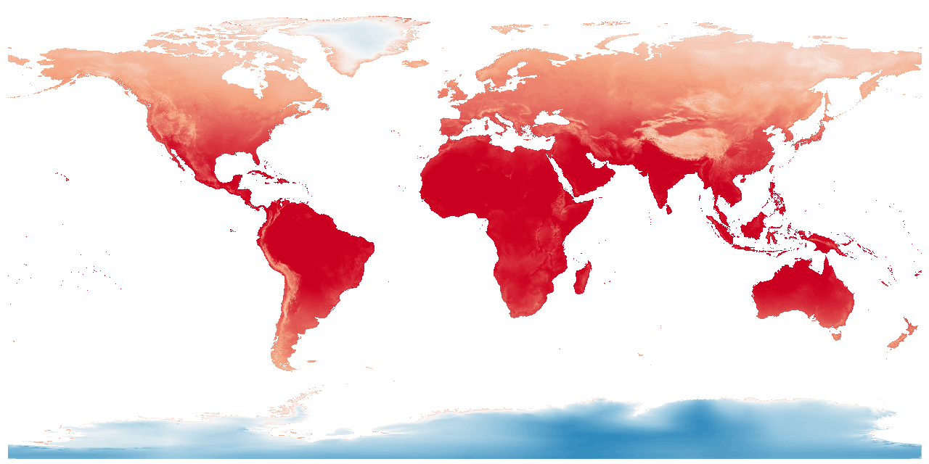
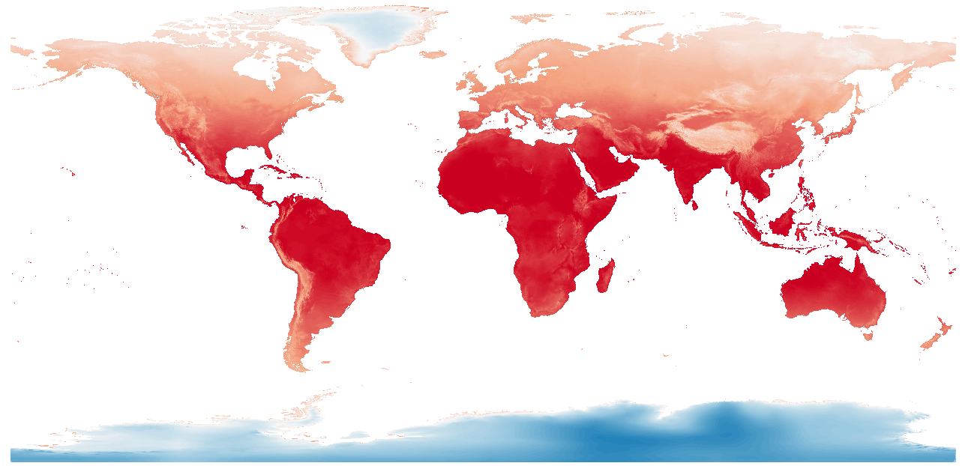
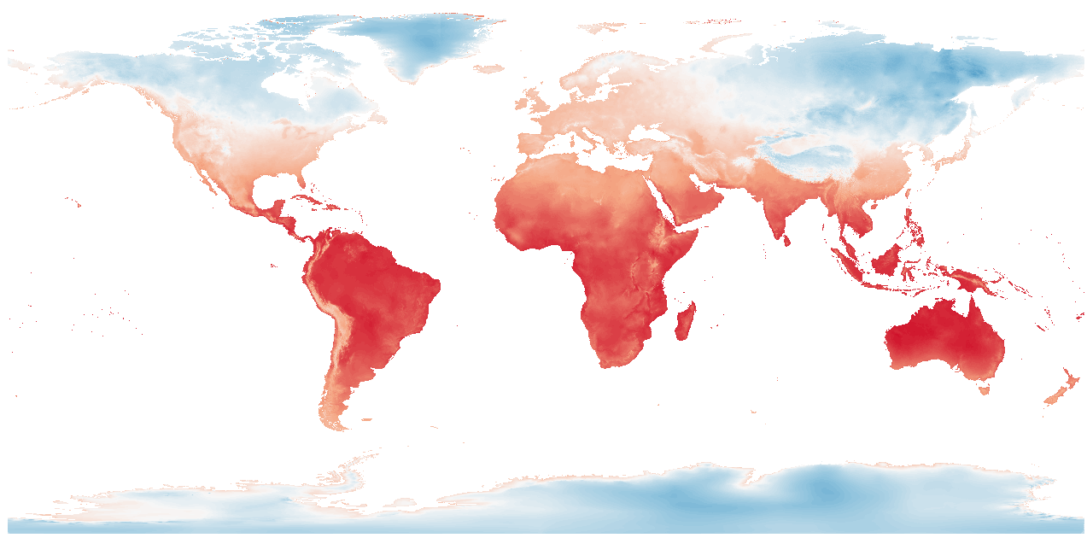
Bio 1
Current - 2000
IPSL -2100
MRI - 2100
Miroc - 2100

Slide 3
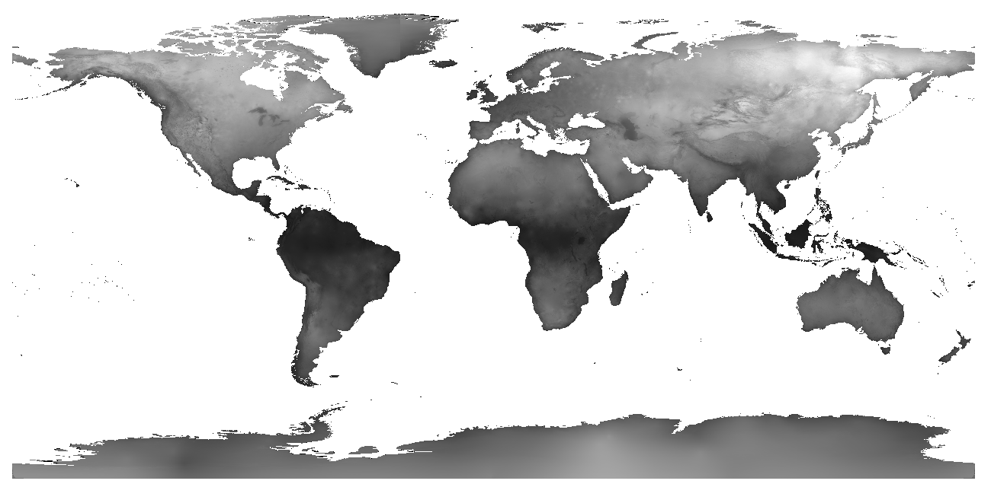
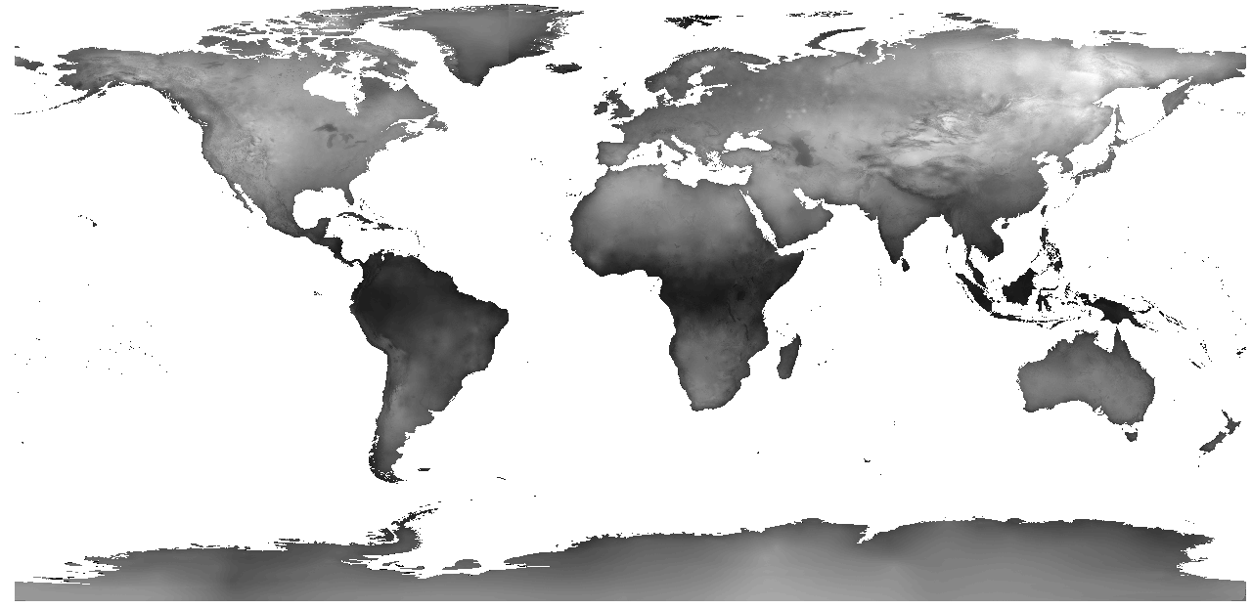
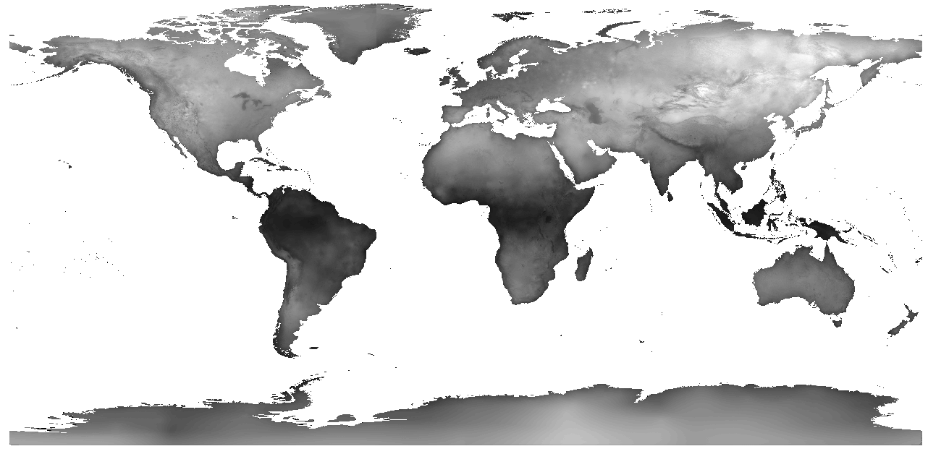
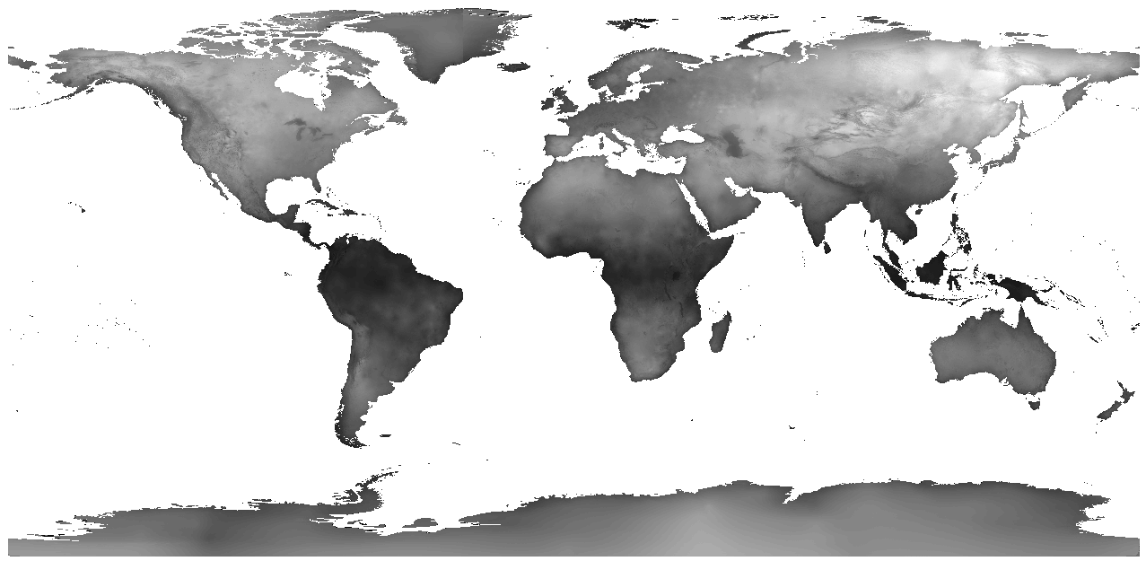
Bio 7
Current - 2000
IPSL -2100
MRI - 2100
Miroc - 2100

Slide 4
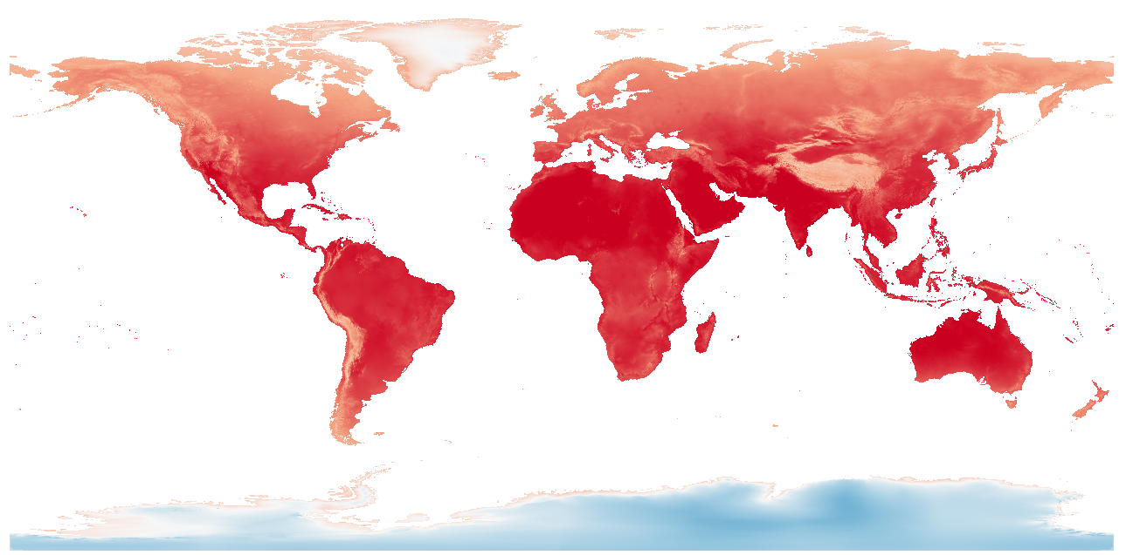
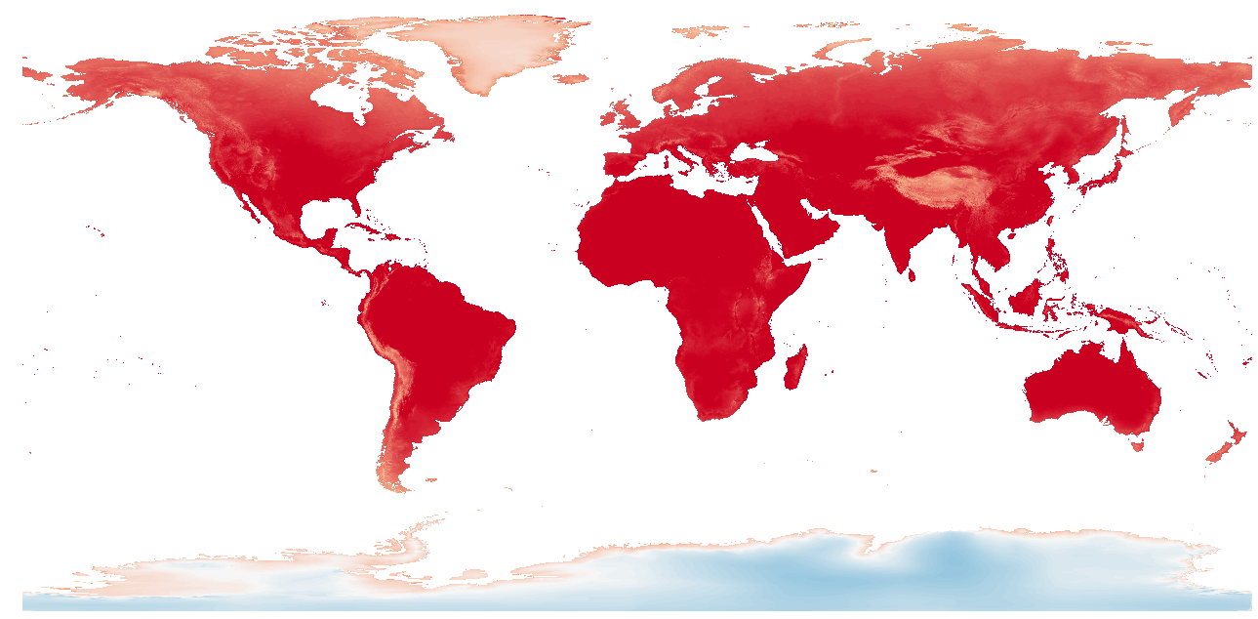
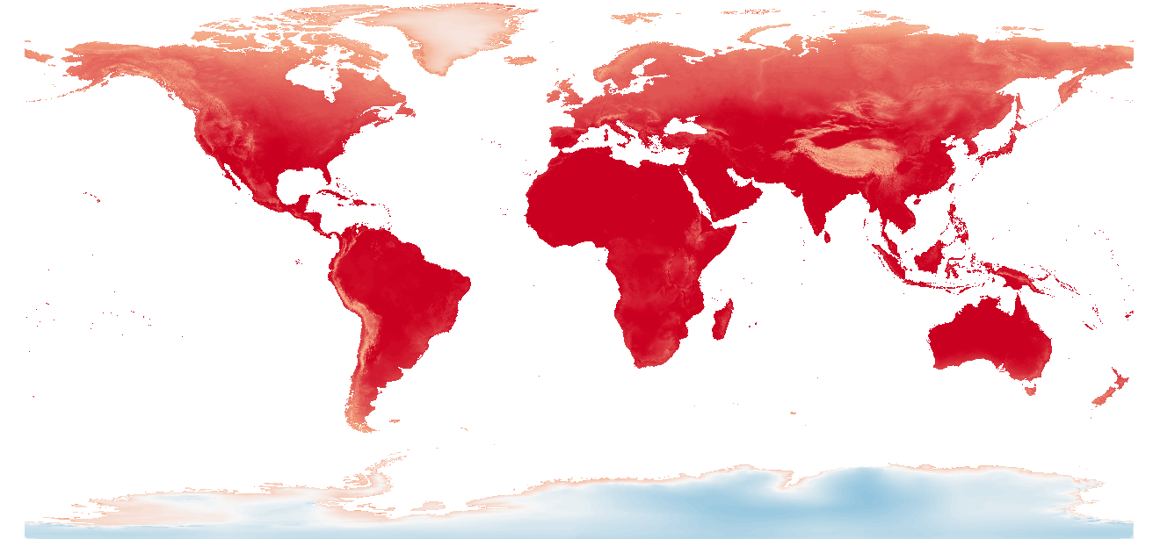
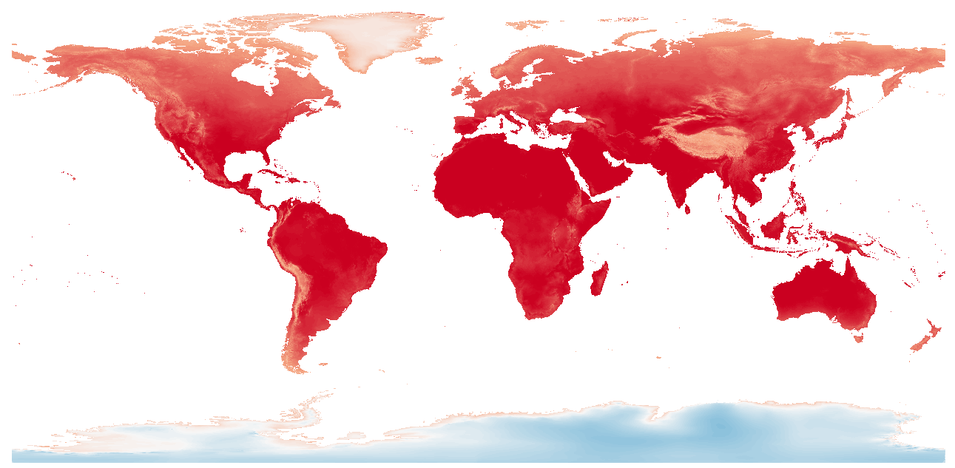
Bio 10
Current - 2000
IPSL -2100
MRI - 2100
Miroc - 2100

Slide 5
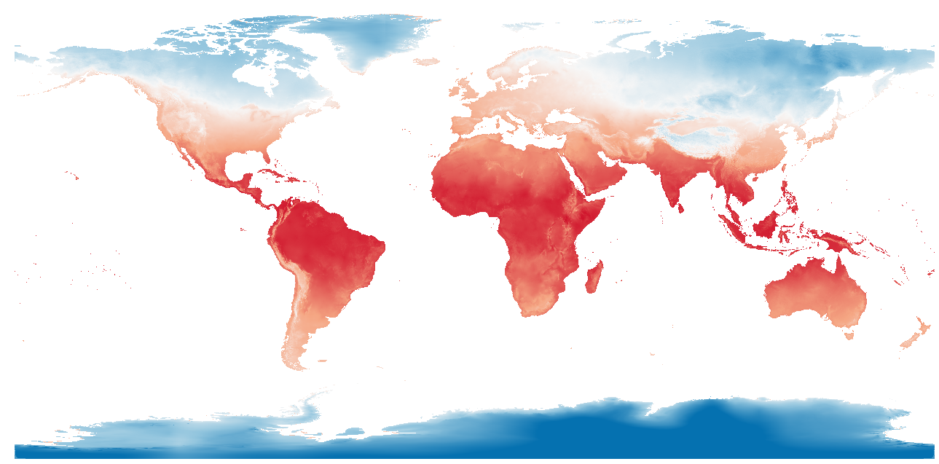
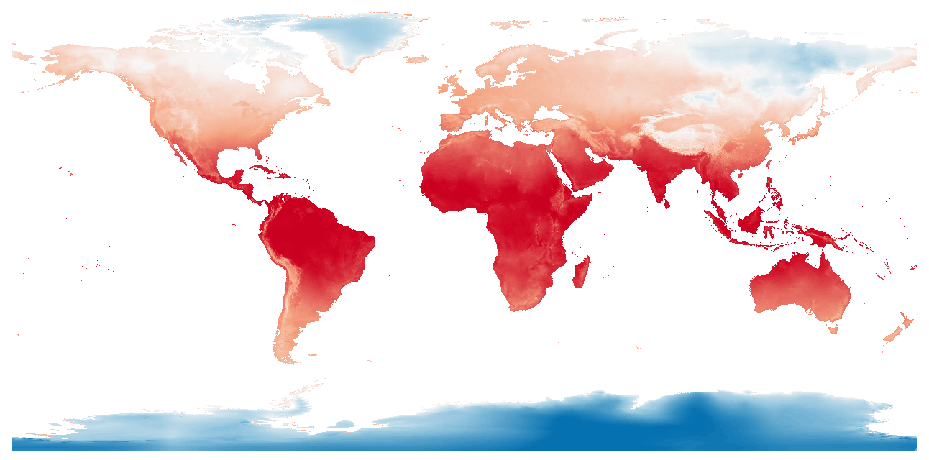
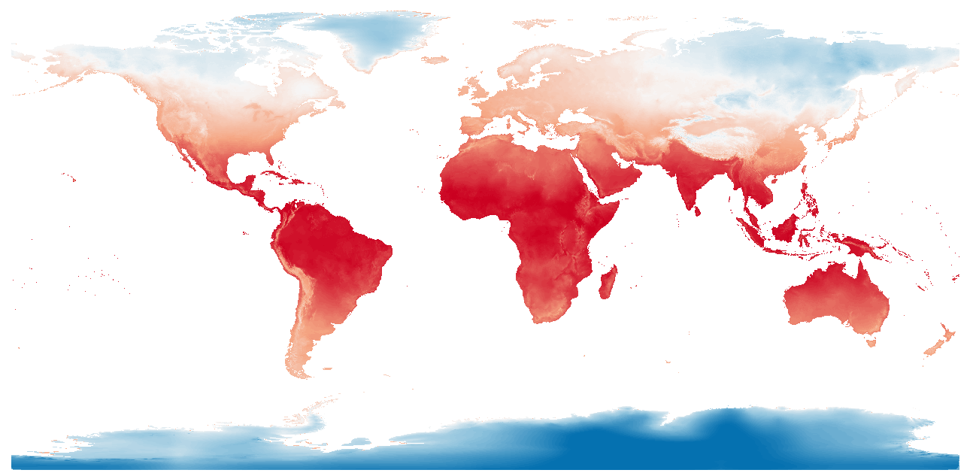
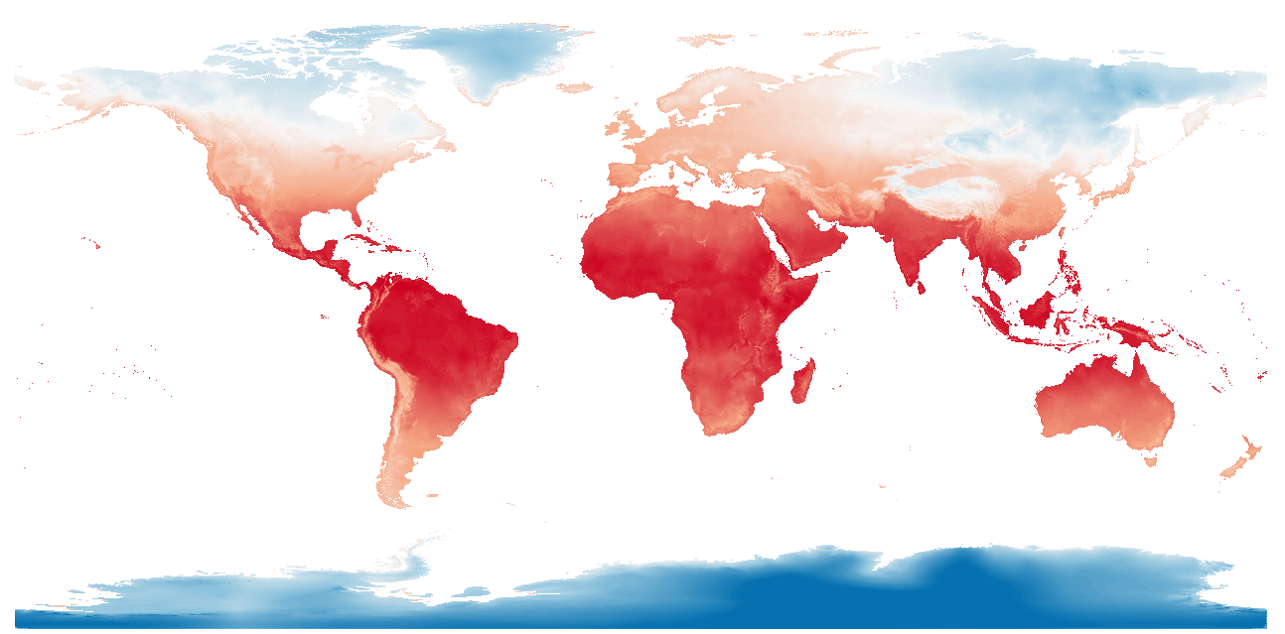
Bio 11
Current - 2000
IPSL -2100
MRI - 2100
Miroc - 2100

Slide 6
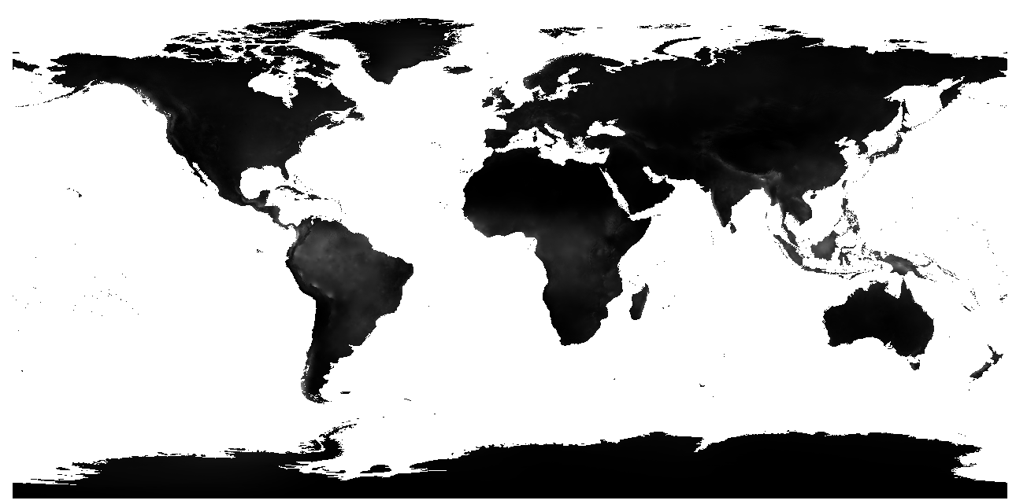
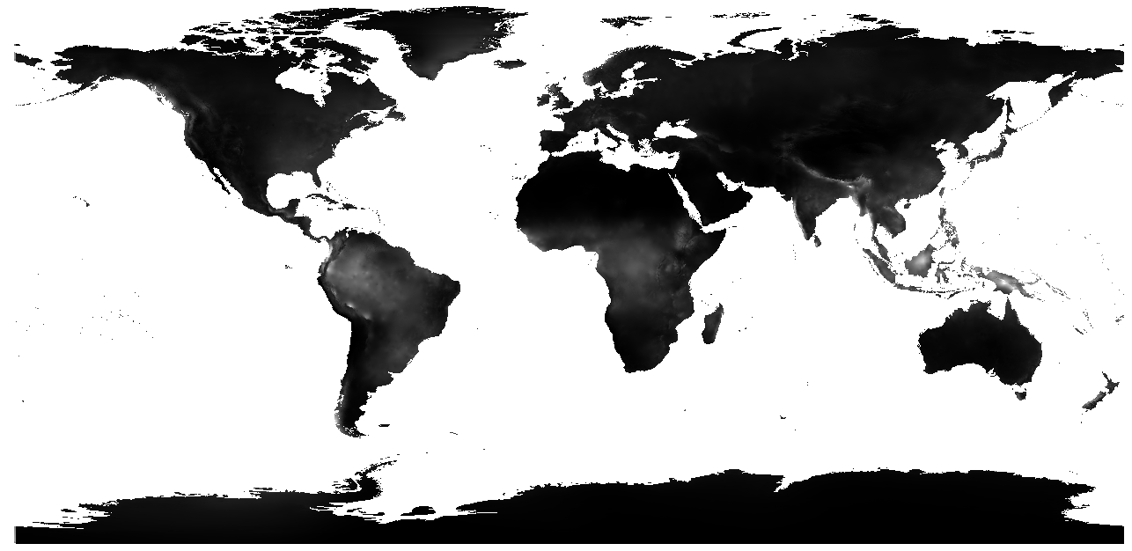
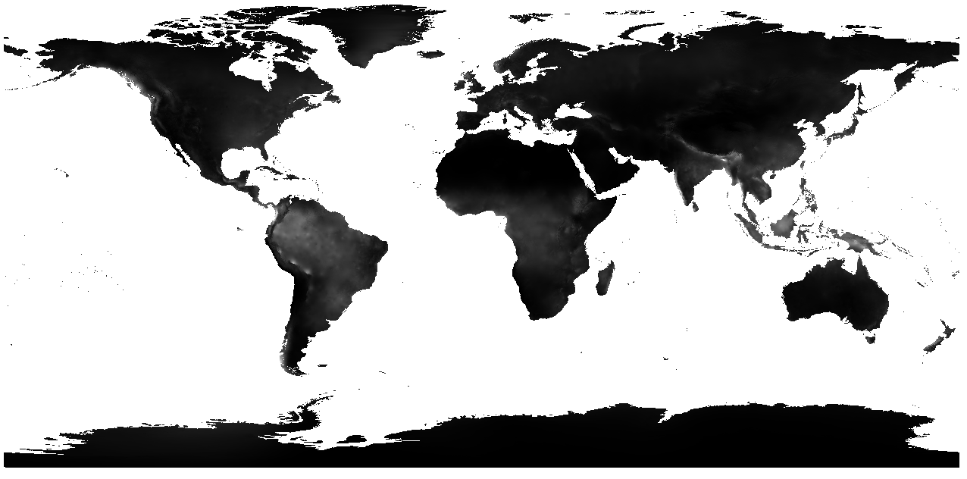
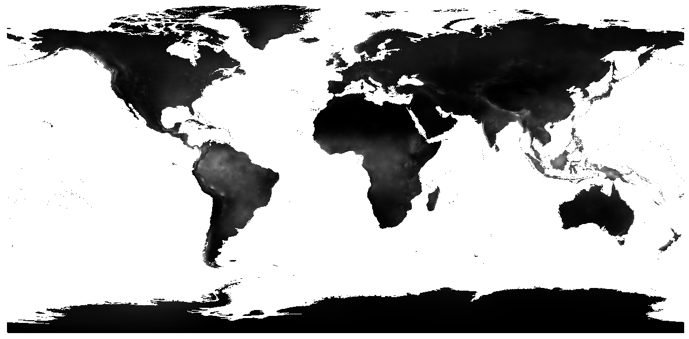
Bio 12
Current - 2000
IPSL -2100
MRI - 2100
Miroc - 2100

Slide 7




Bio 16
Current - 2000
IPSL -2100
MRI - 2100
Miroc - 2100

Slide 8

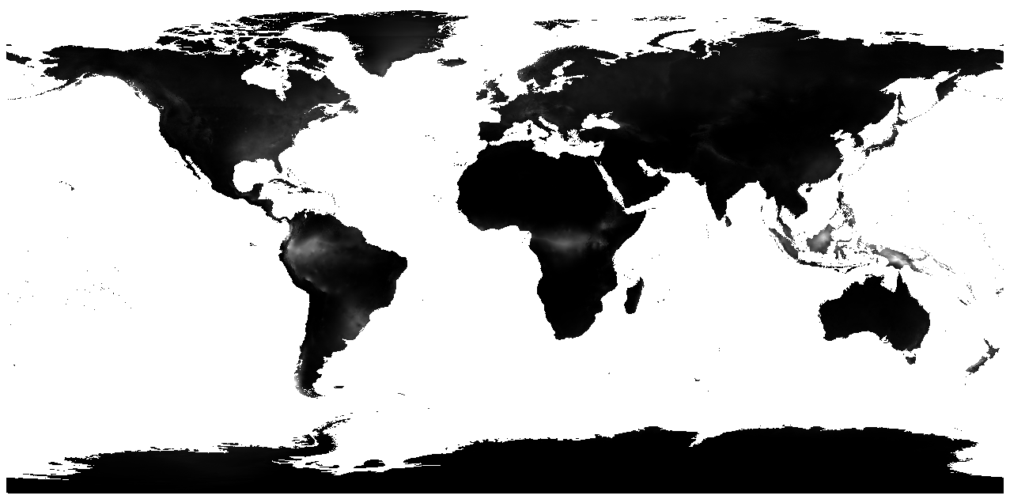


Bio 17
Current - 2000
IPSL -2100
MRI - 2100
Miroc - 2100

