Slide 1
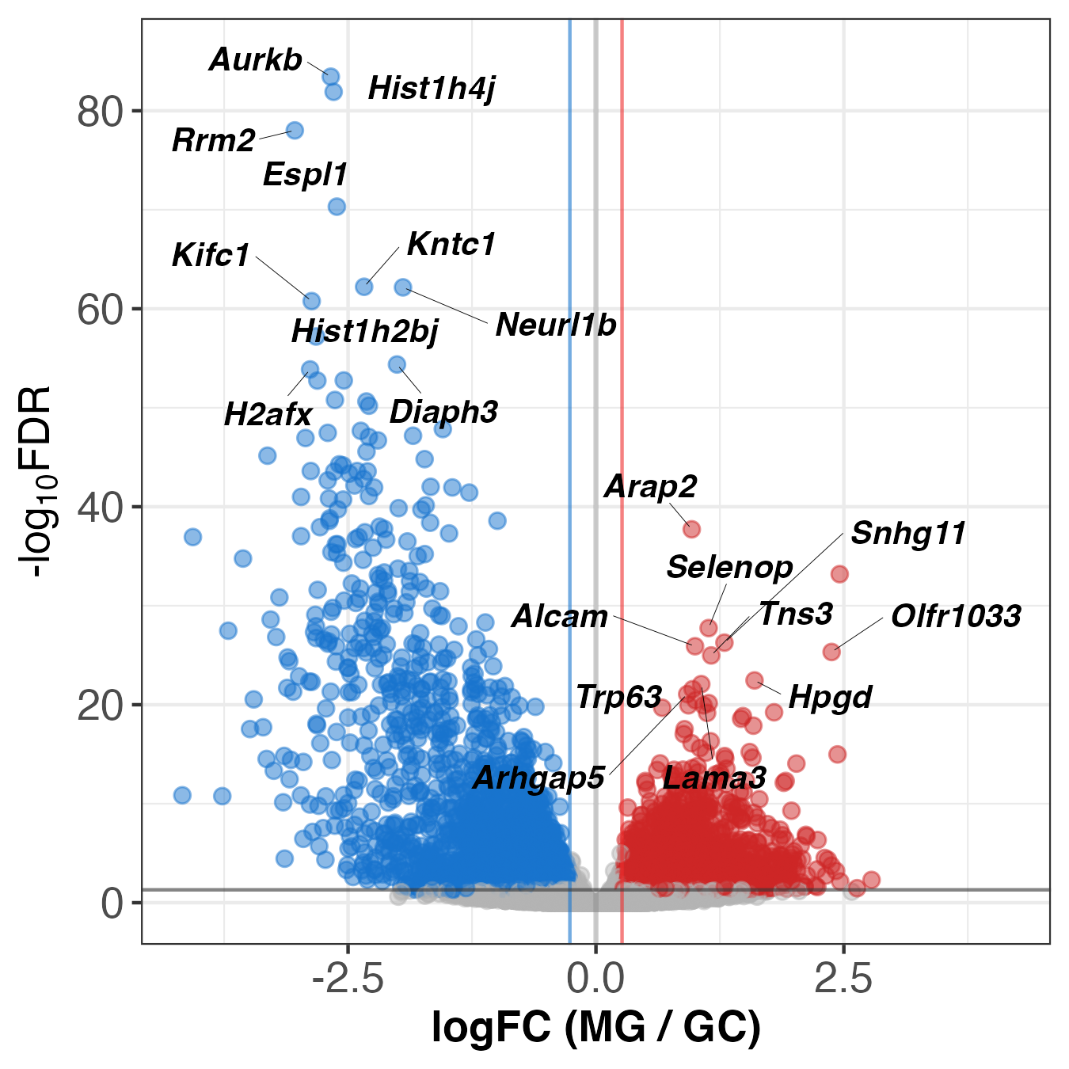
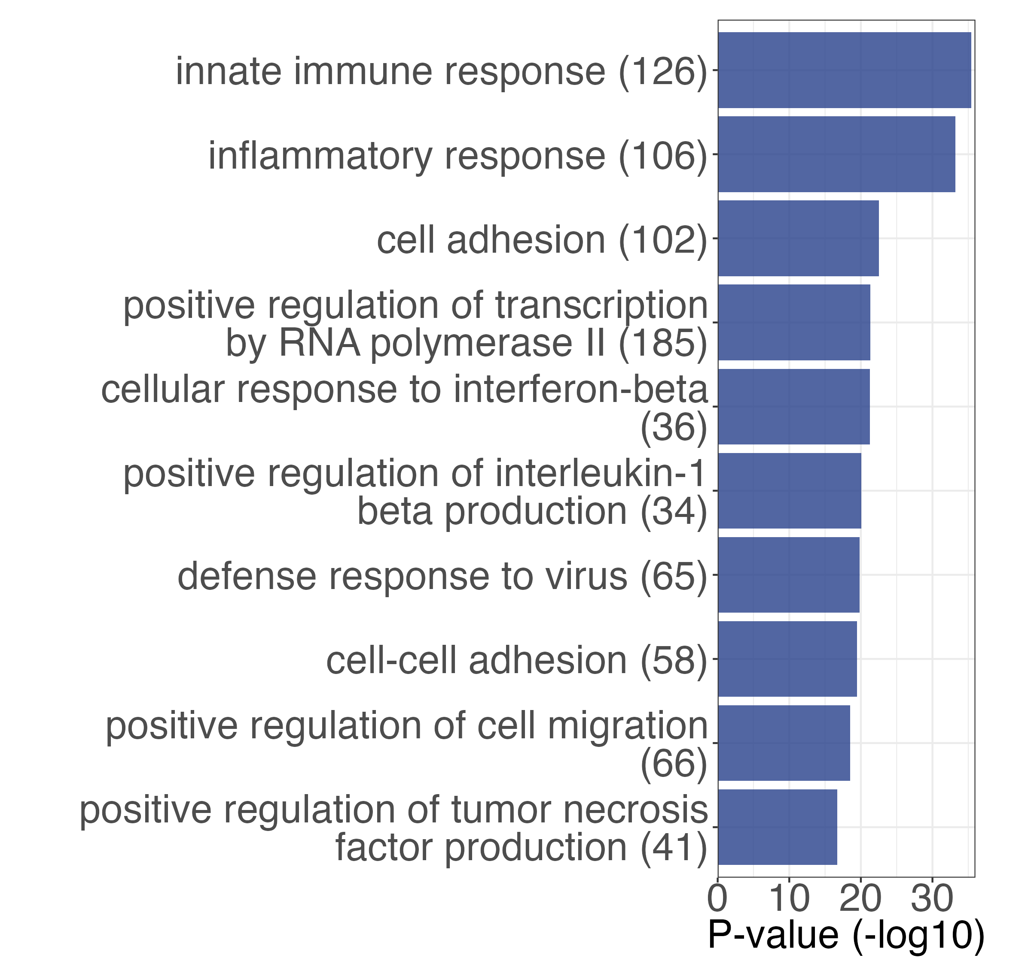
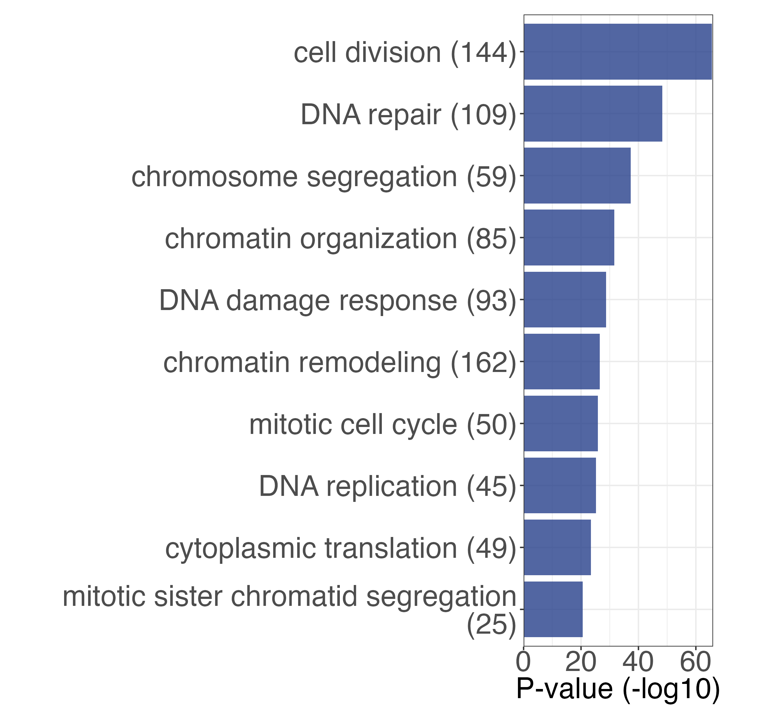
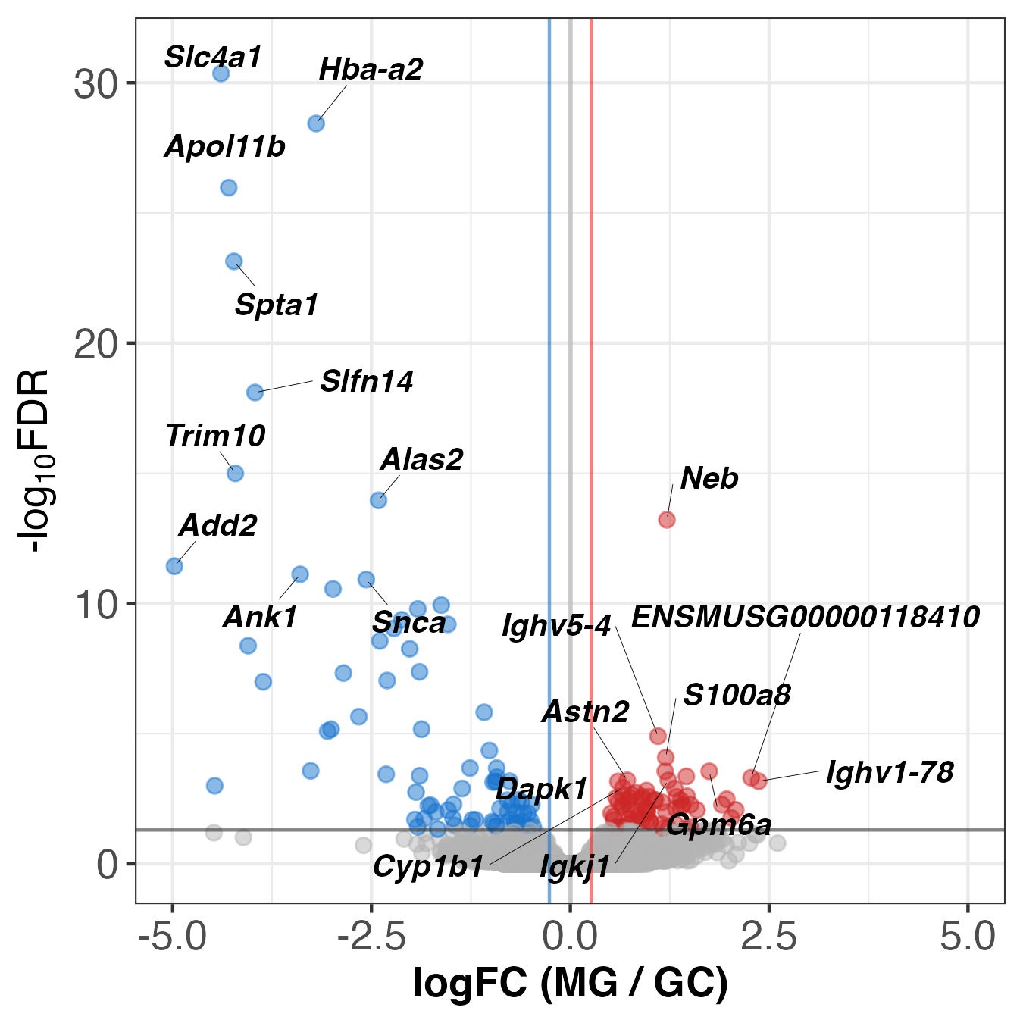
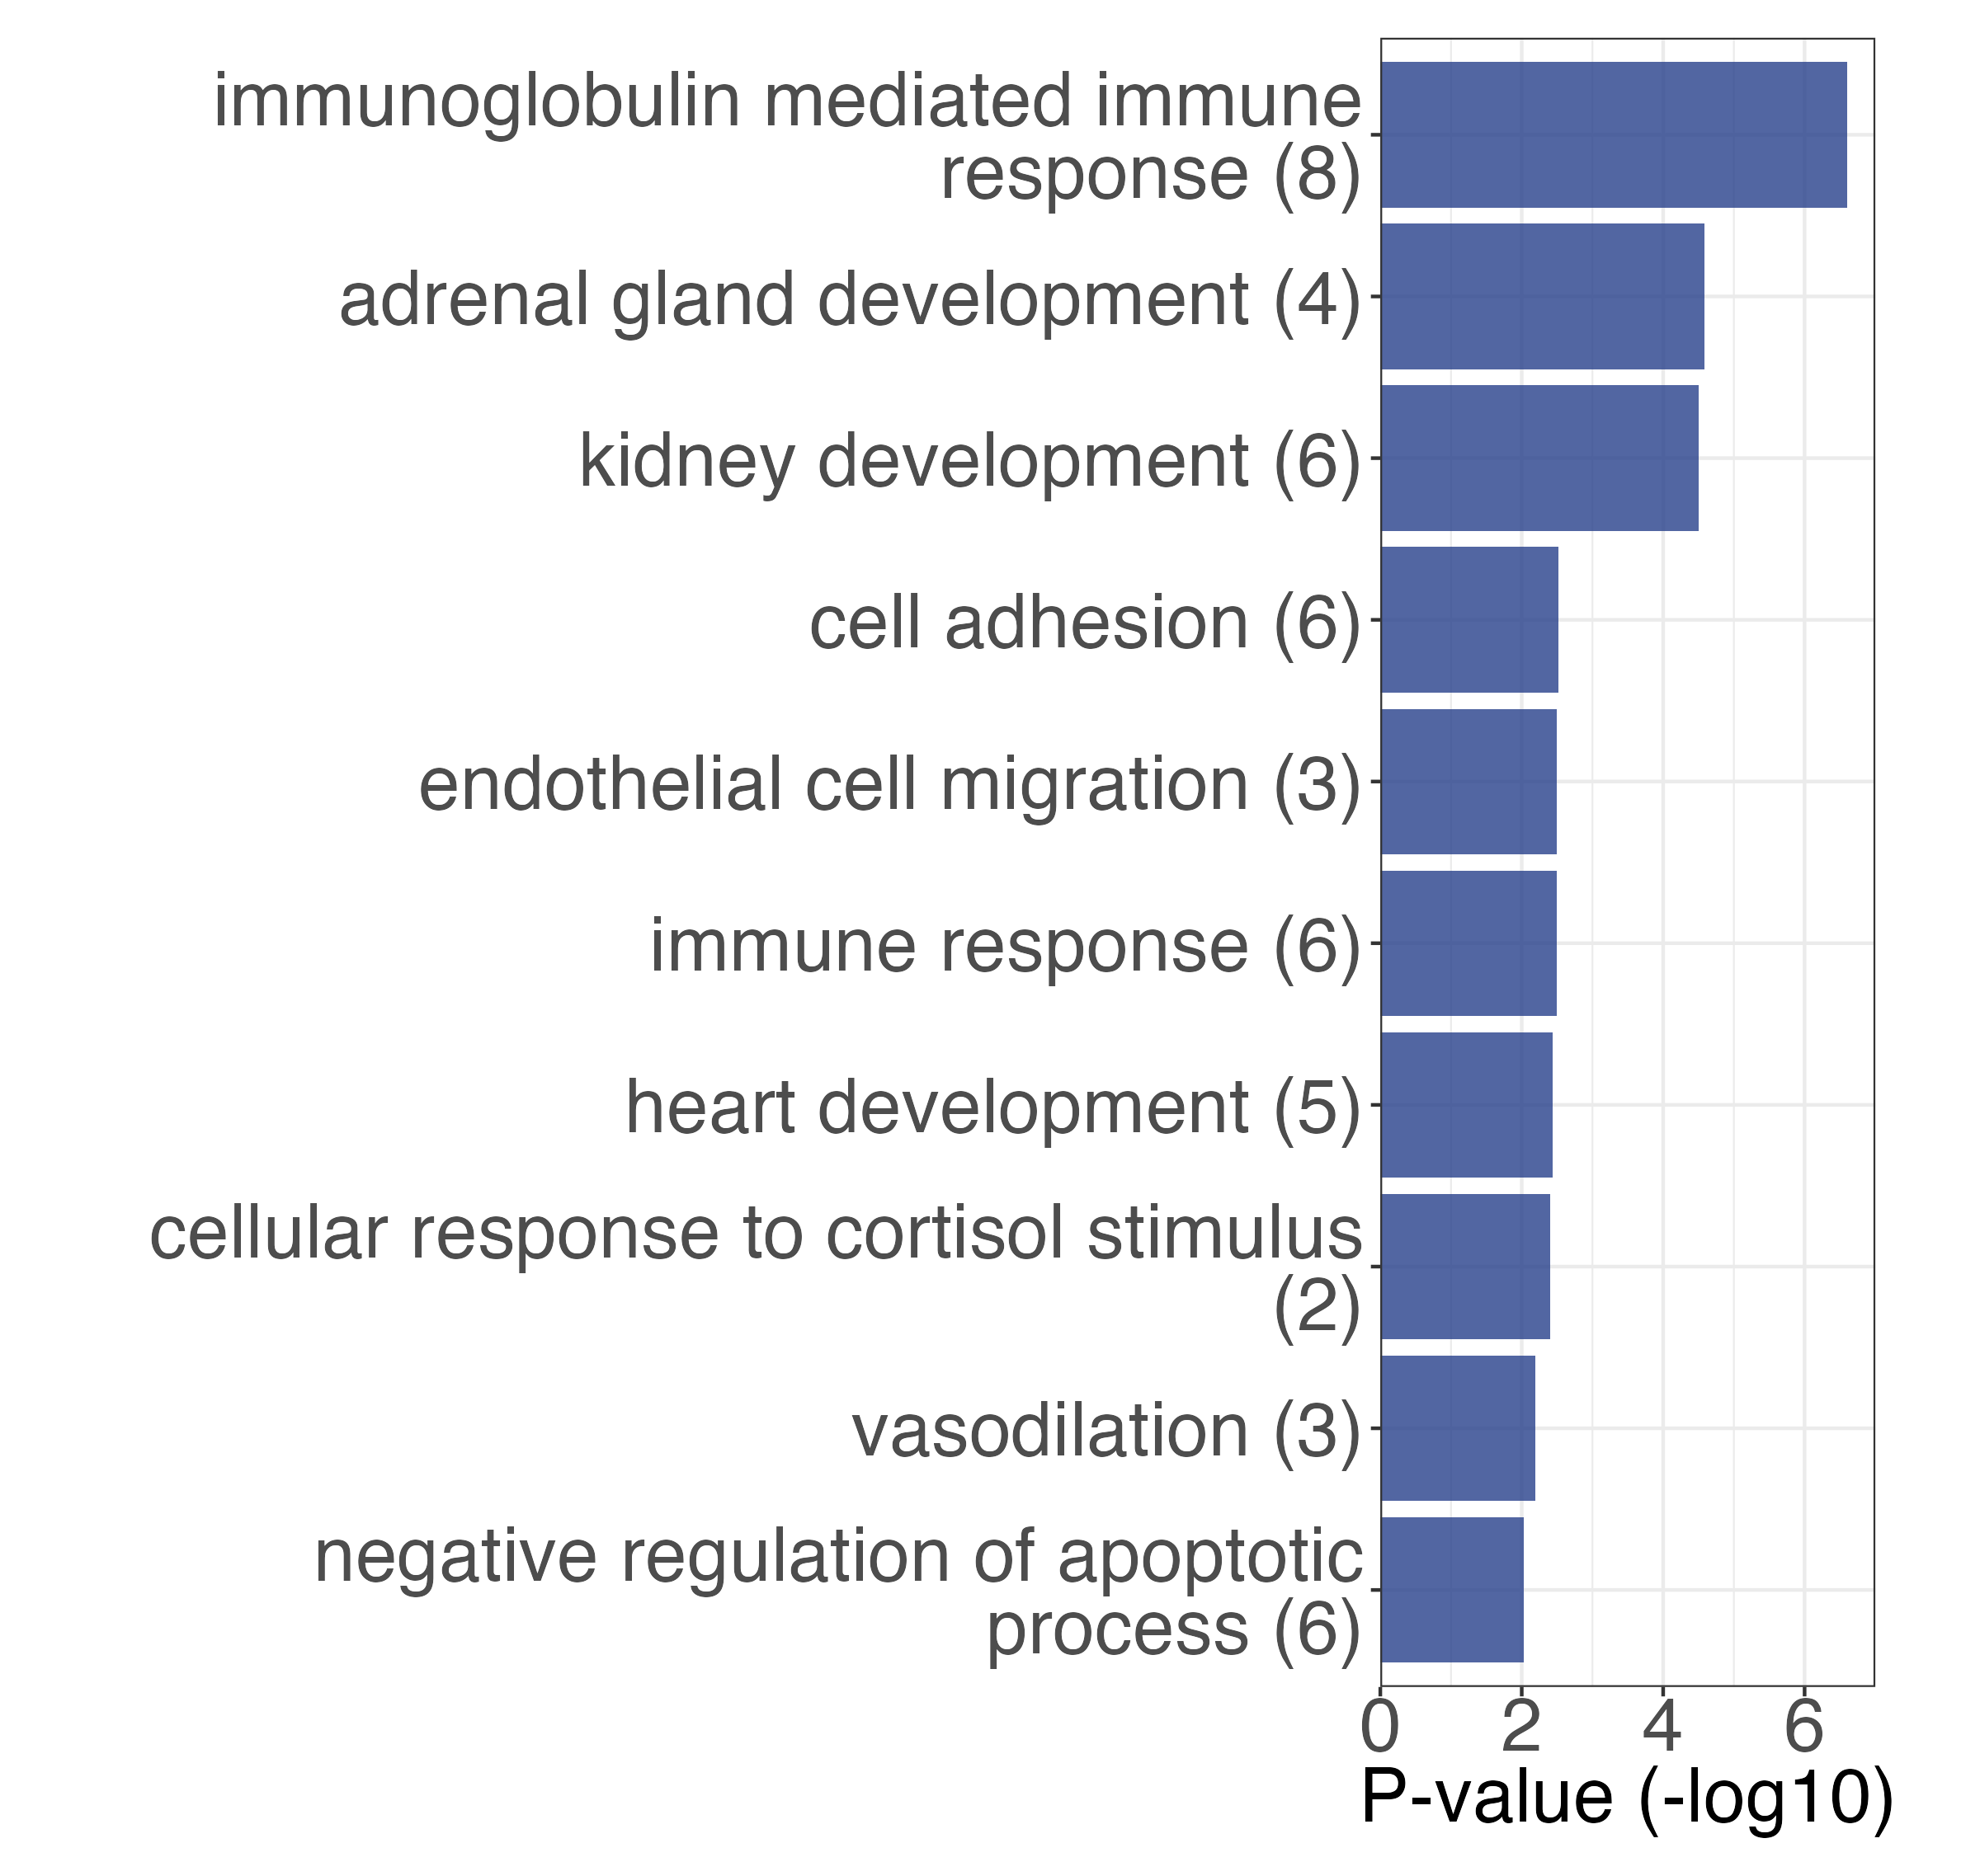
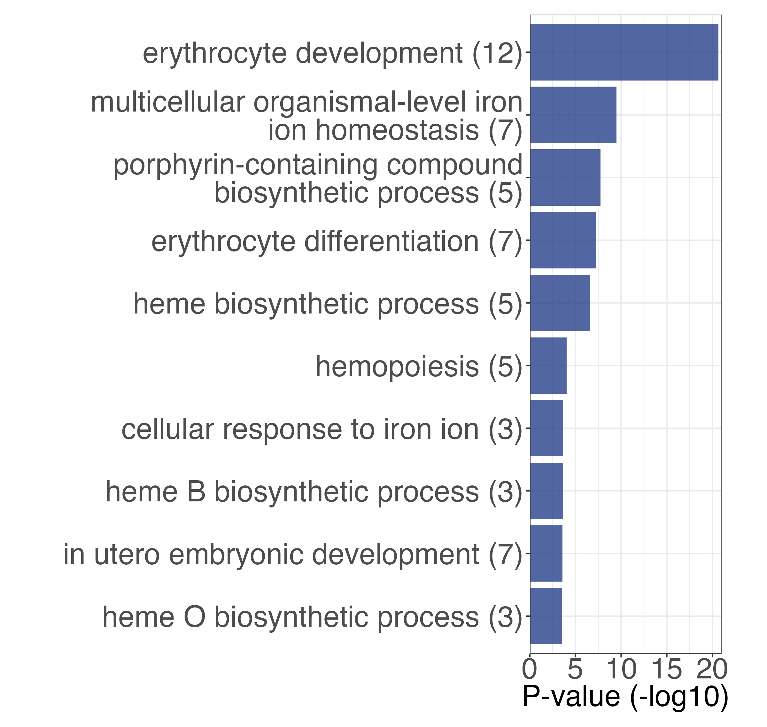
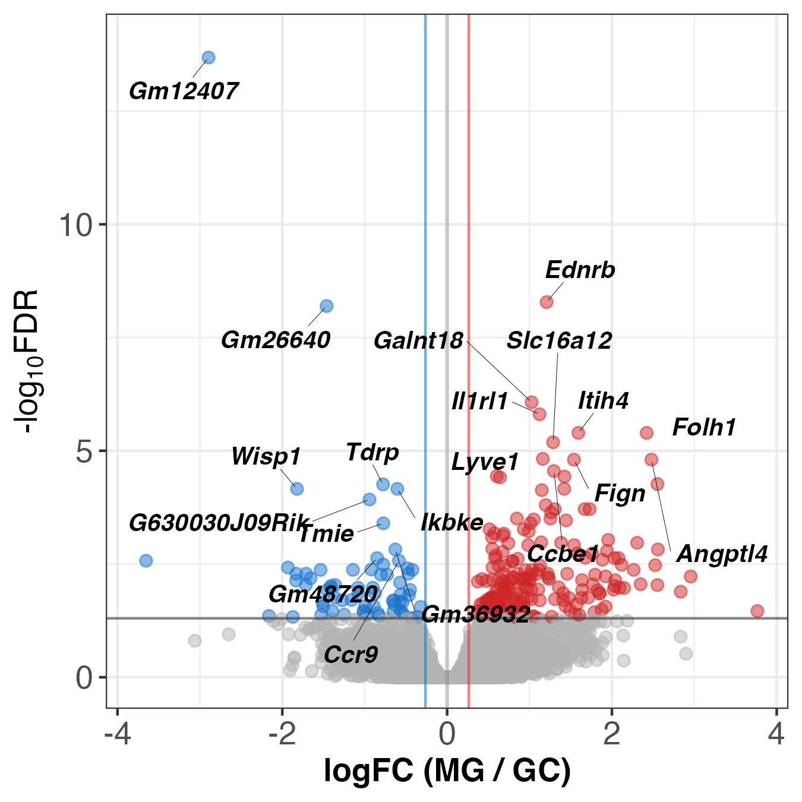
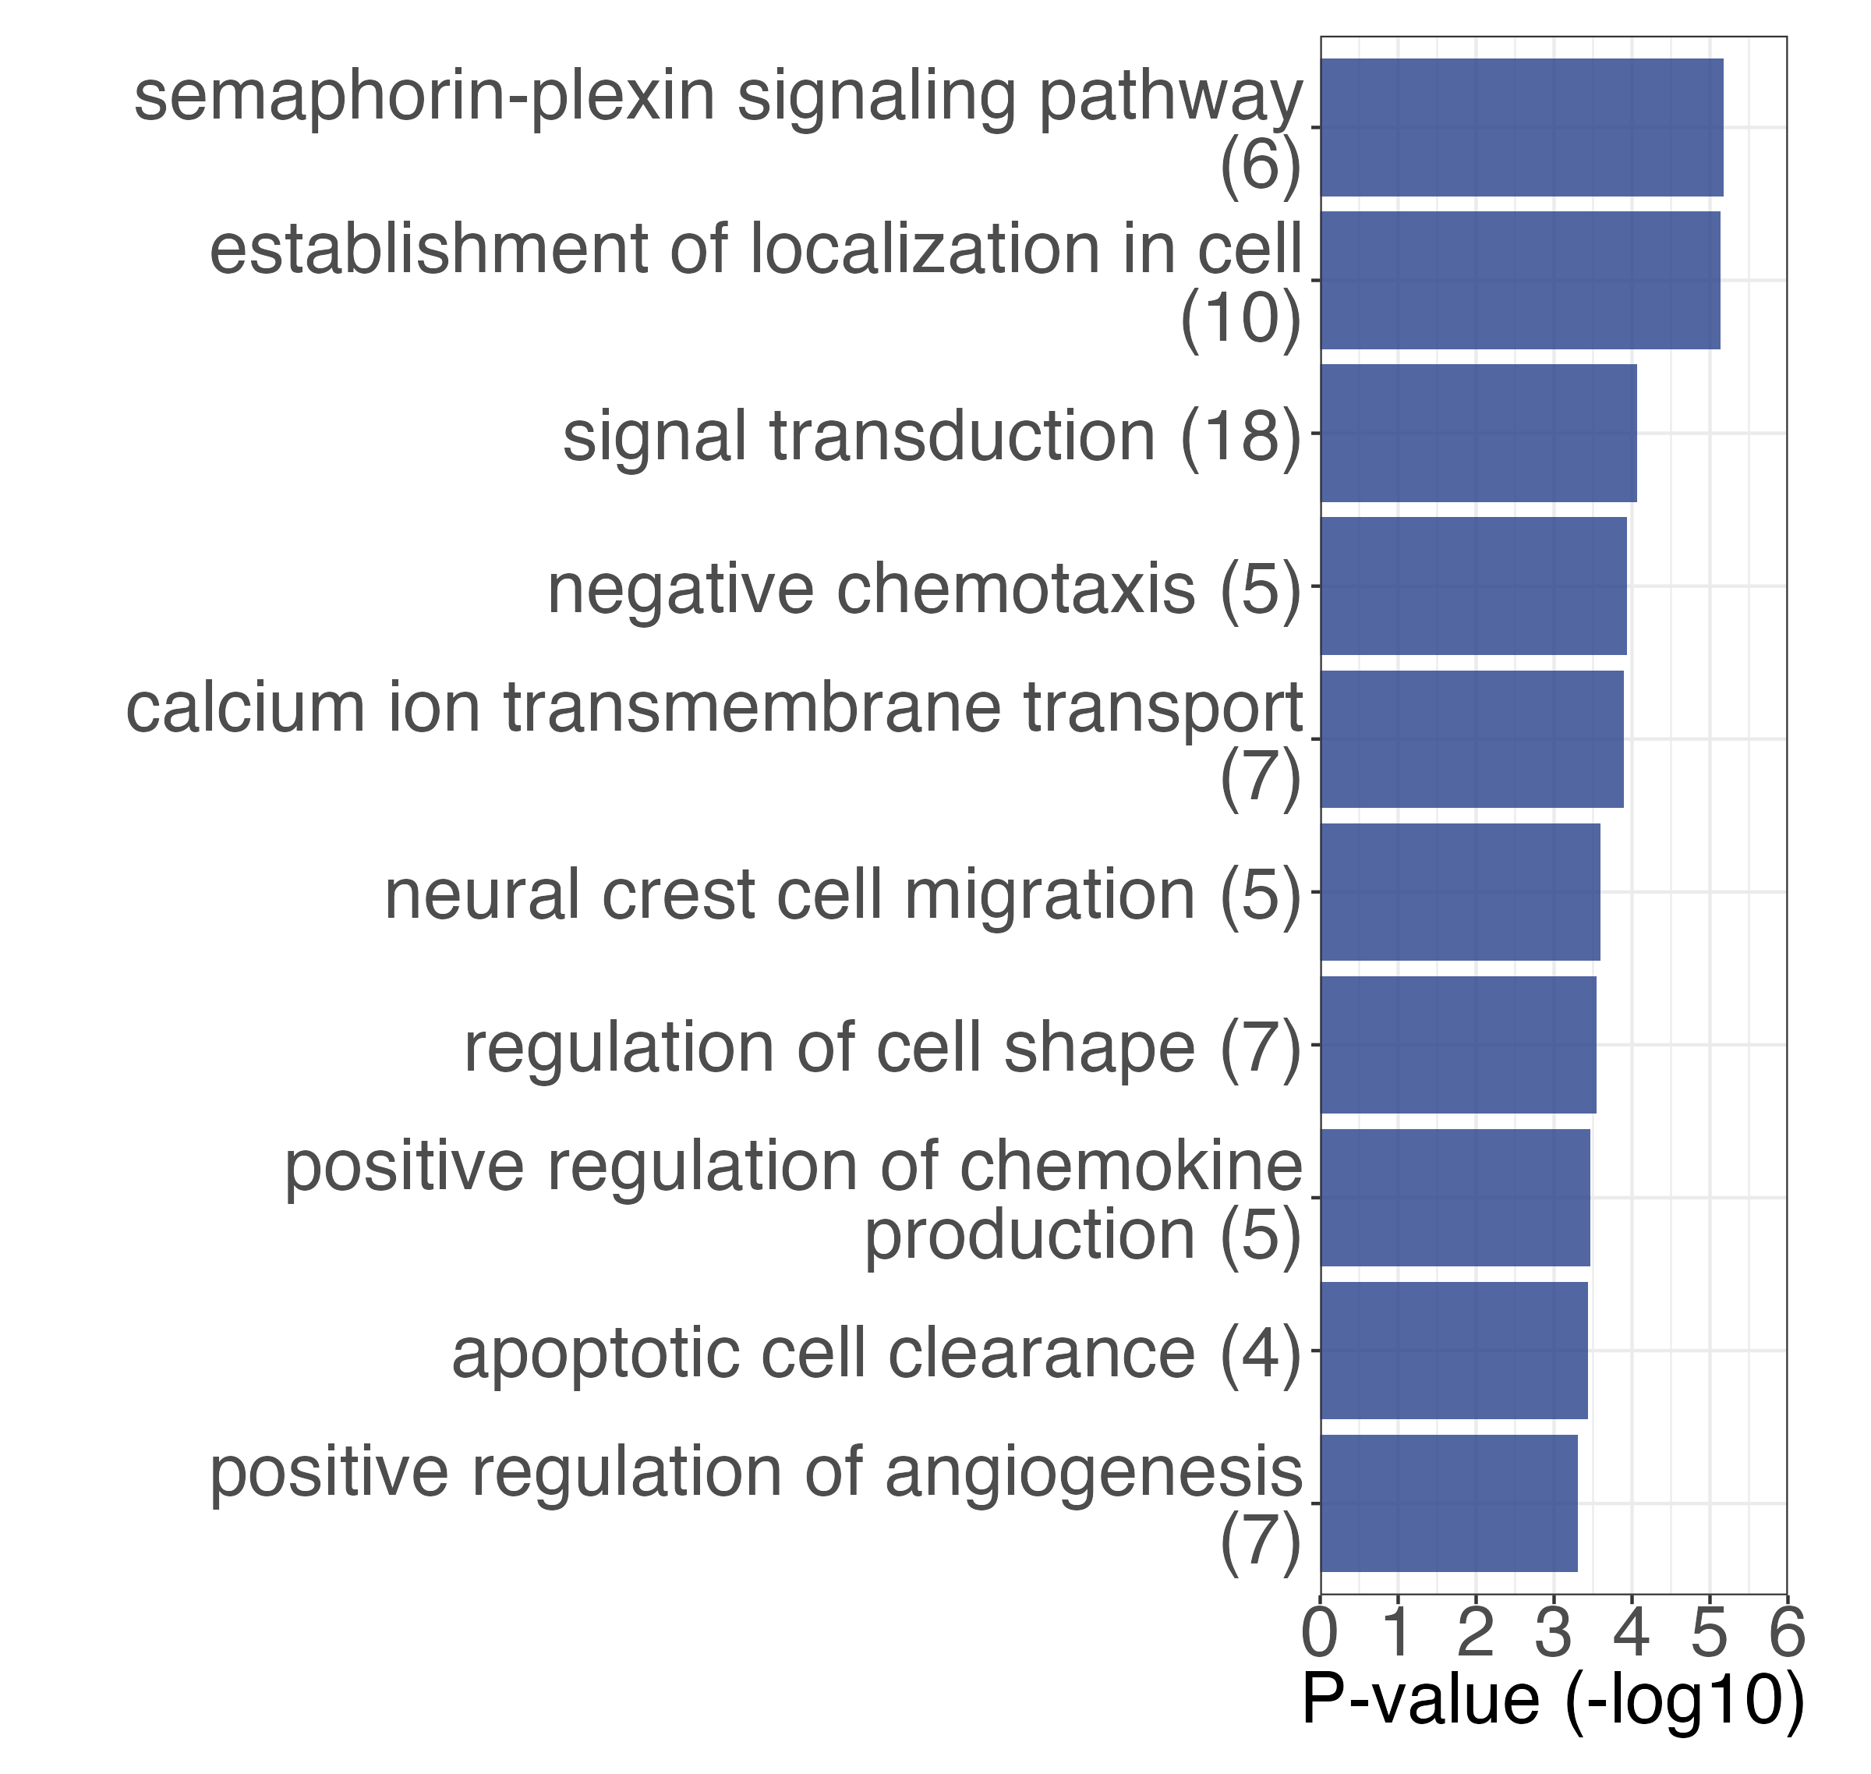
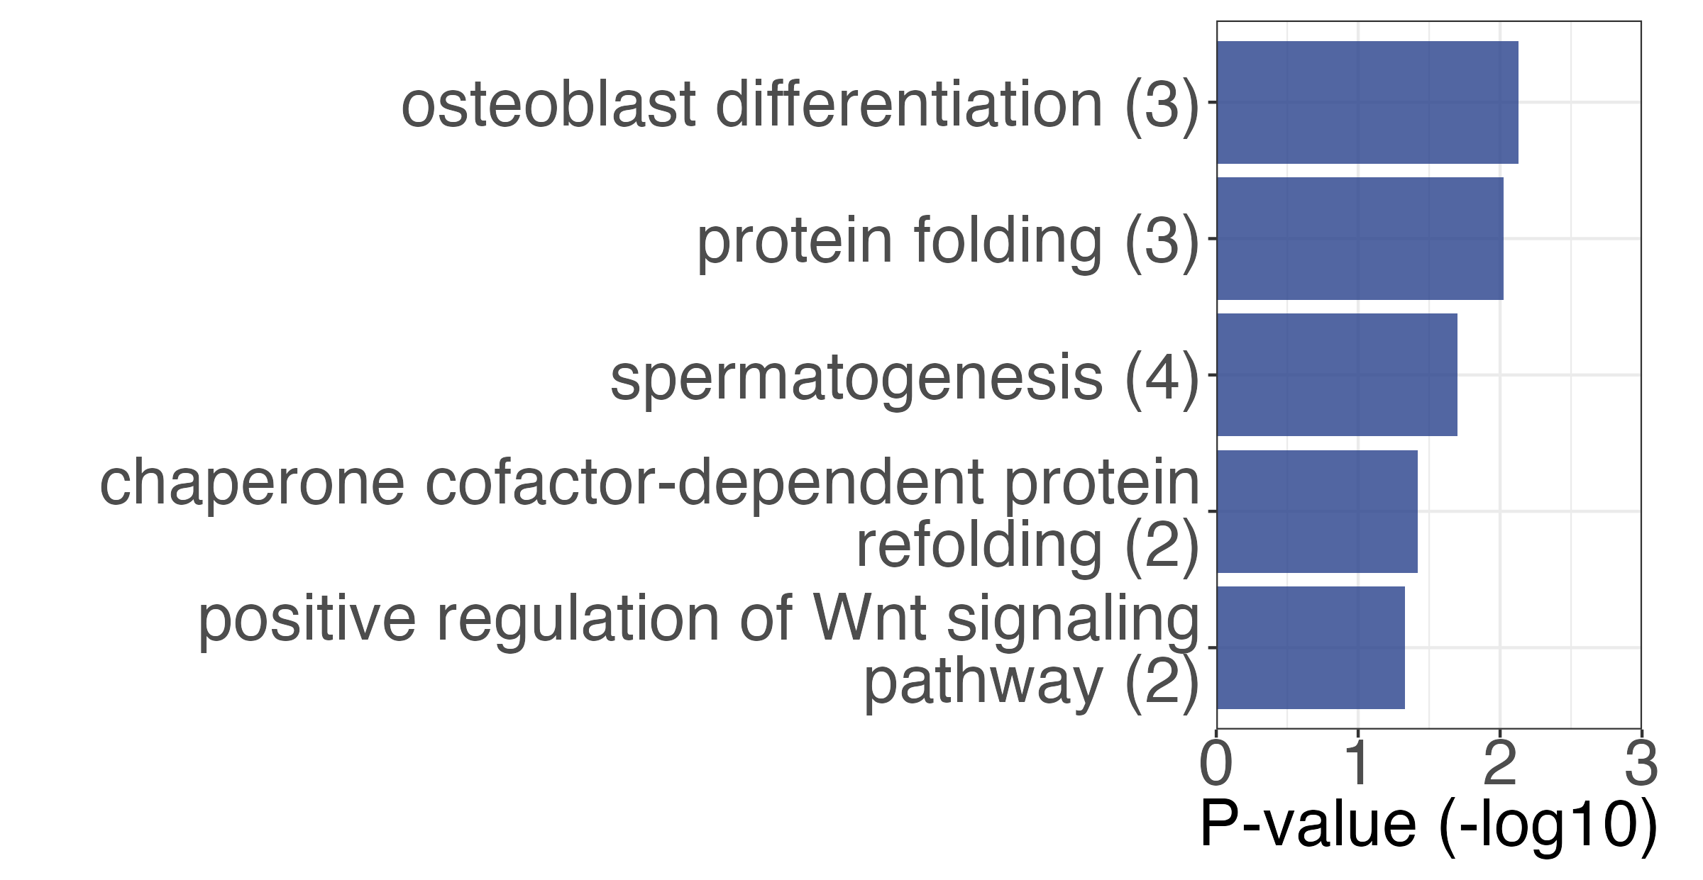
(A)
thymus
(i)
2,589 down-regulation
2,541 up-regulation
(ii) up-regulation DEGs
(iii) down-regulation DEGs
(B)
spleen
(i)
80 down-regulation
74 up-regulation
(ii) up-regulation DEGs
(iii) down-regulation DEGs
(C)
lymph nodes
(i)
68 down-regulation
203 up-regulation
(ii) up-regulation DEGs
(iii) down-regulation DEGs
Supplementary Figure 1. Comprehensive analysis differential expression genes (DEGs) between GC and MG from three organs of spaceflight mice. This panel shows the number of DEGs between ground control (GC) and microgravity (MG) conditions for each of the three organs (i, volcano plot), along with gene ontology biological process (GOBP) enrichment analysis for up-regulated genes (ii) and down-regulated genes (iii).

Slide 2
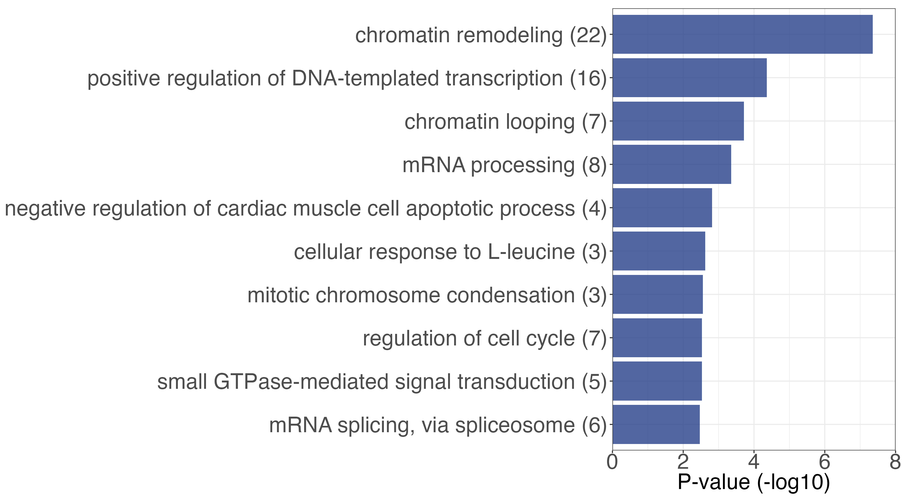
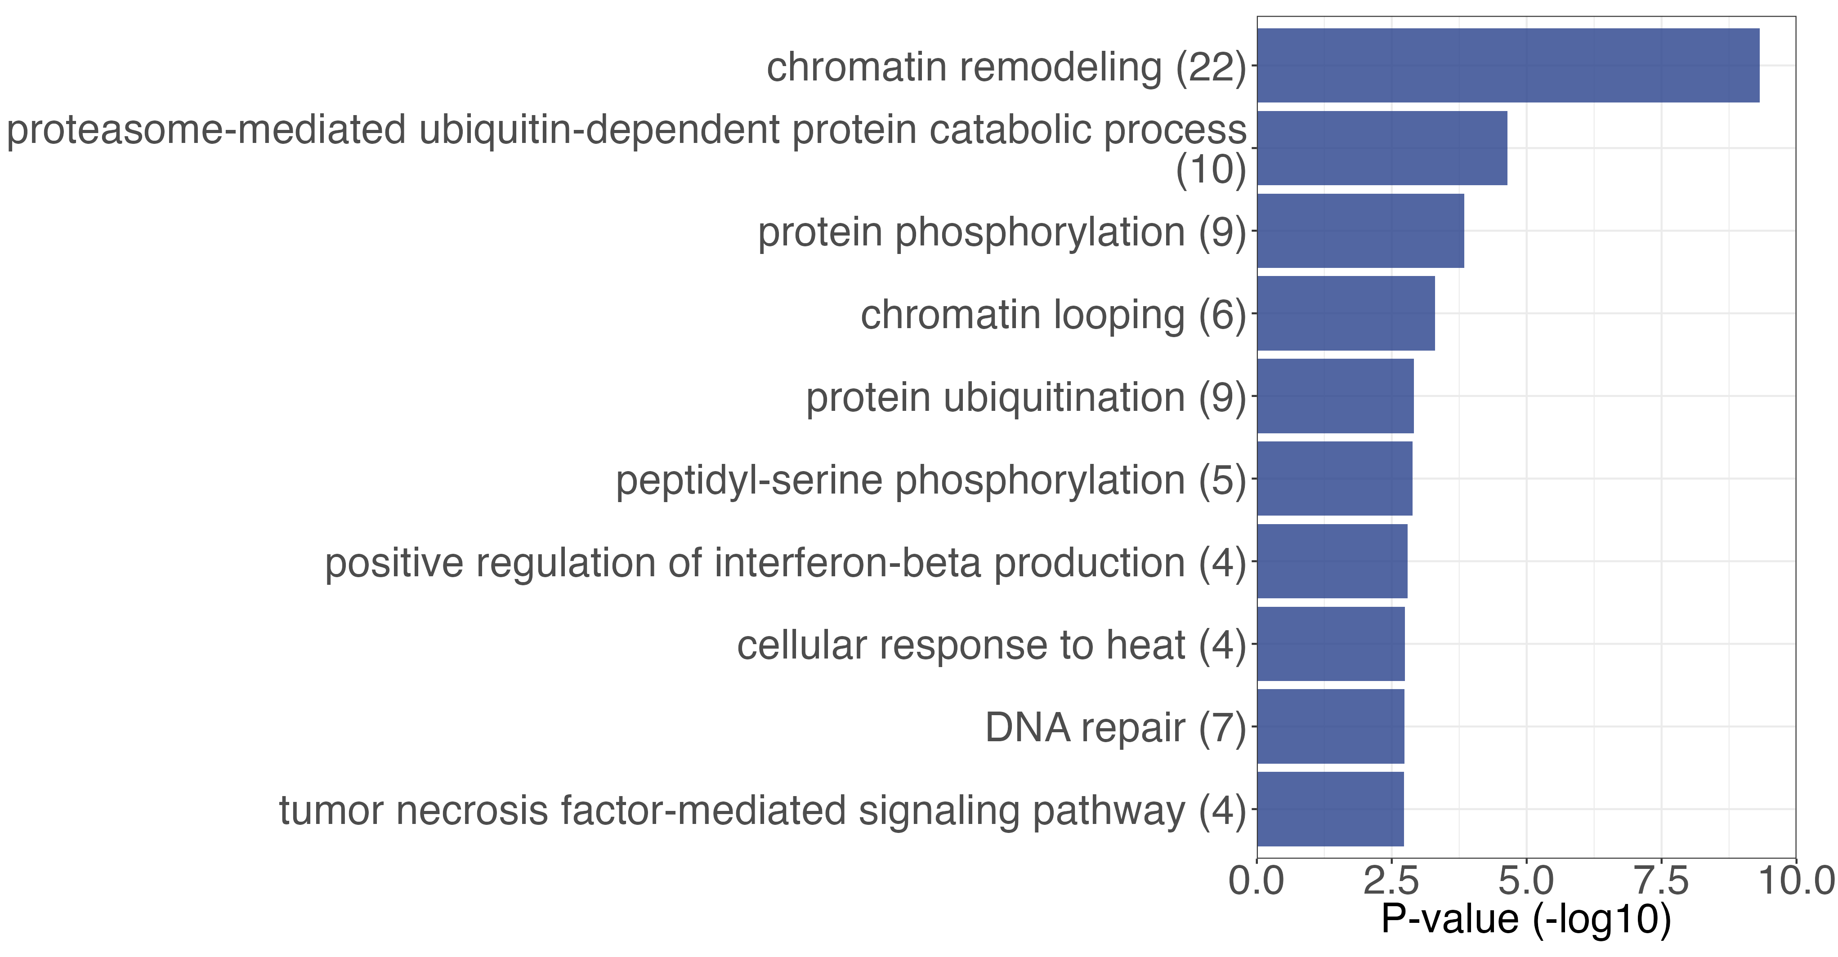
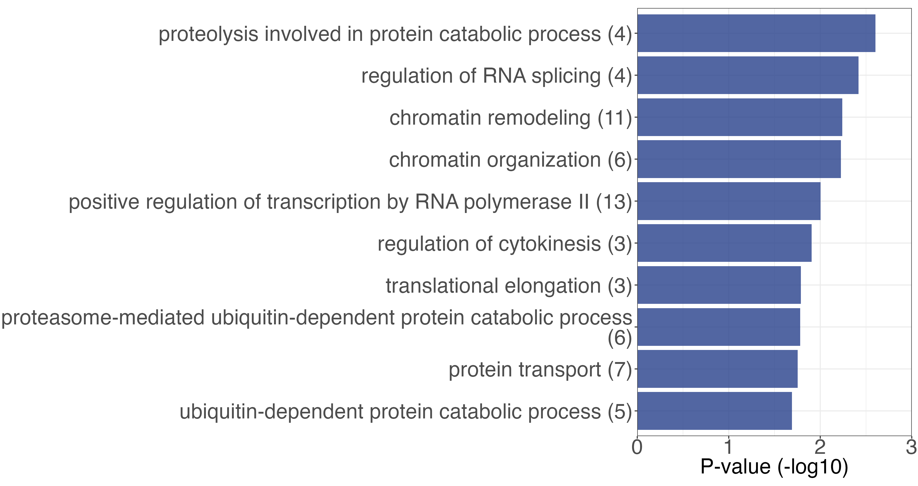
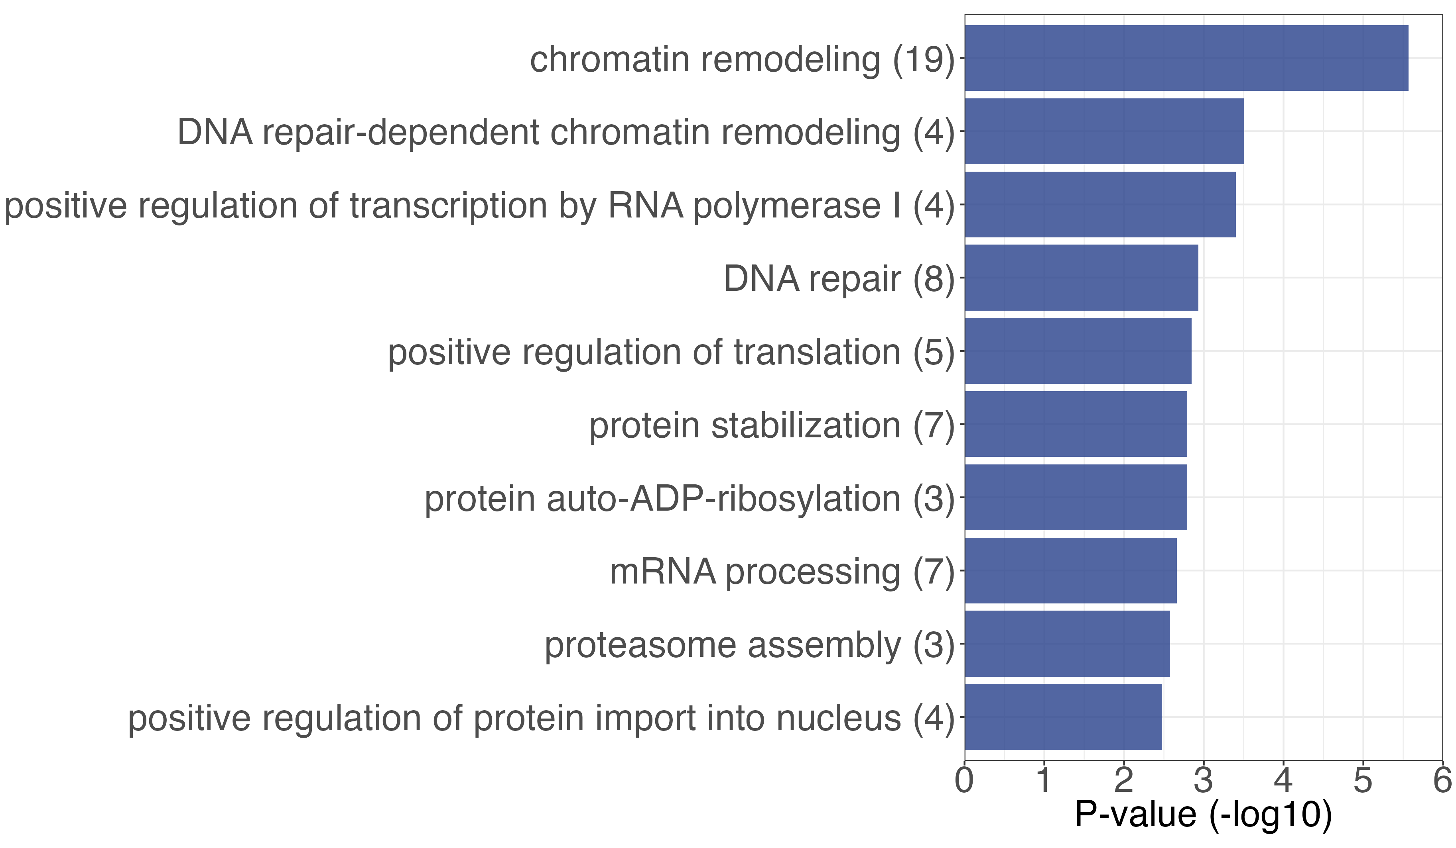
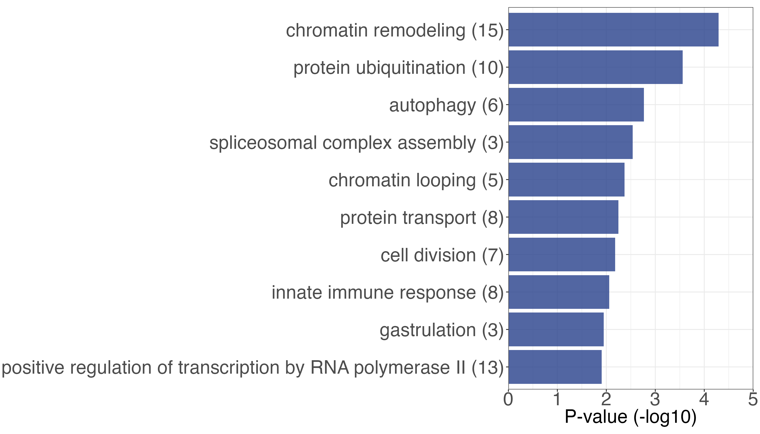
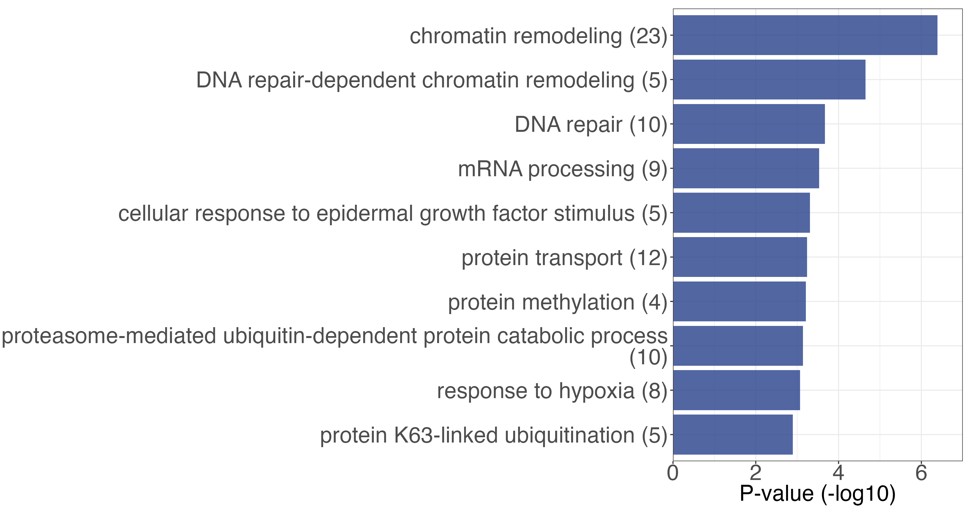
(A)
thymus
(i) IncIRGs
(ii) DecIRGs
(B)
spleen
(i) IncIRGs
(ii) DecIRGs
(C)
lymph nodes
(i) IncIRGs
(ii) DecIRGs
Supplementary Figure 2. Gene Ontology Enrichment Analysis of intron retention Genes (IRGs) Between GC and MG from three organs of spaceflight mice. This panel presents GOBP enrichment analysis for genes with increased intron retention (IncIR, i) and decreased intron retention (DecIR, ii) in three organs between GC and MG.

Slide 3
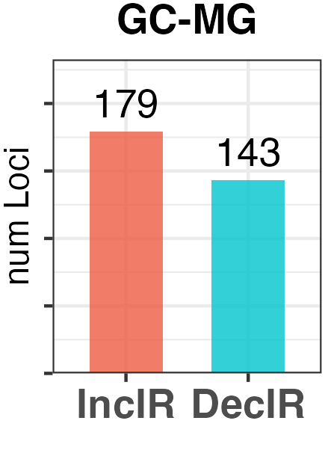
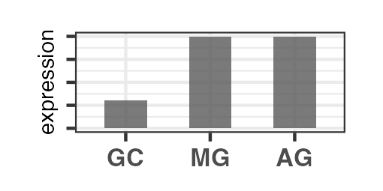
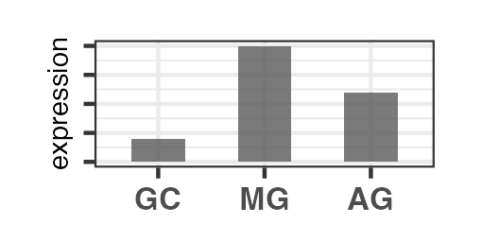
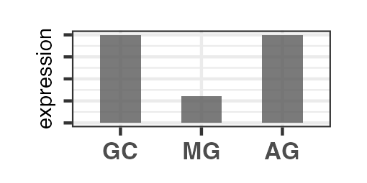
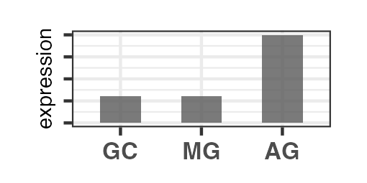
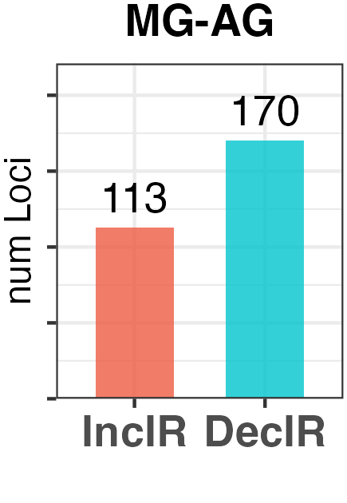
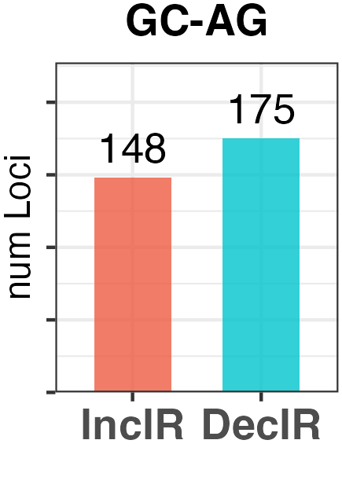
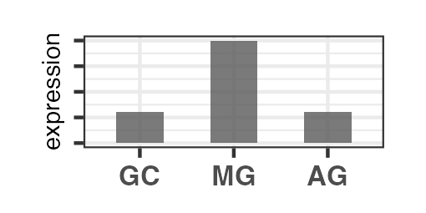
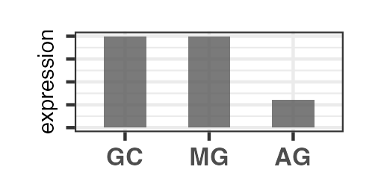
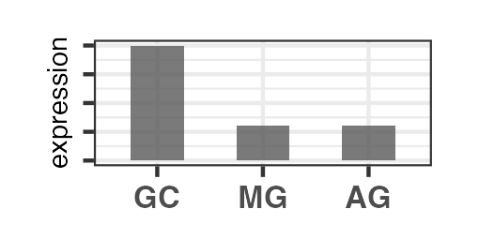
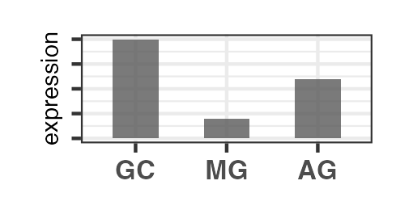
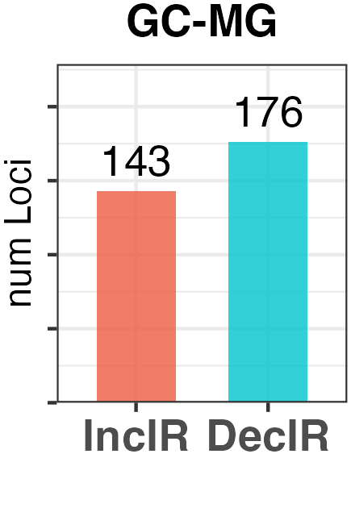
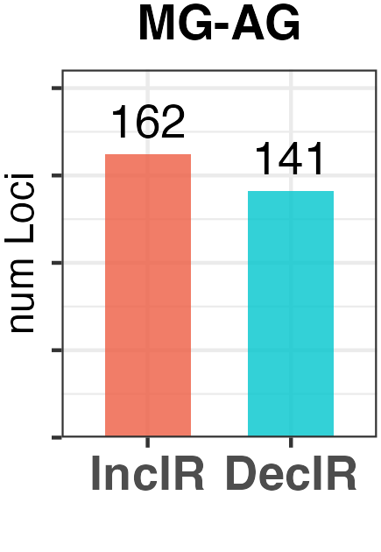
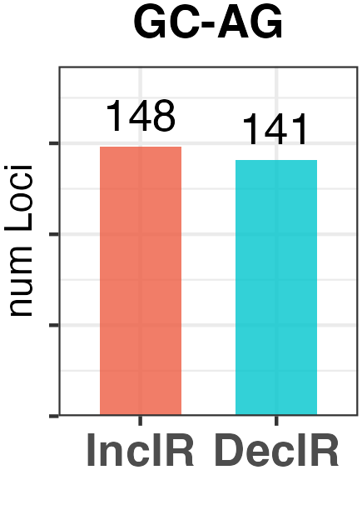
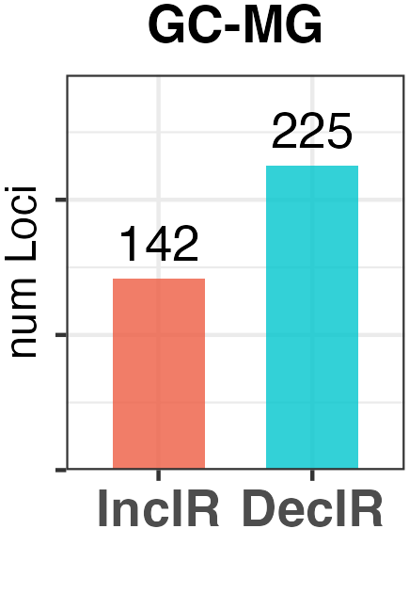
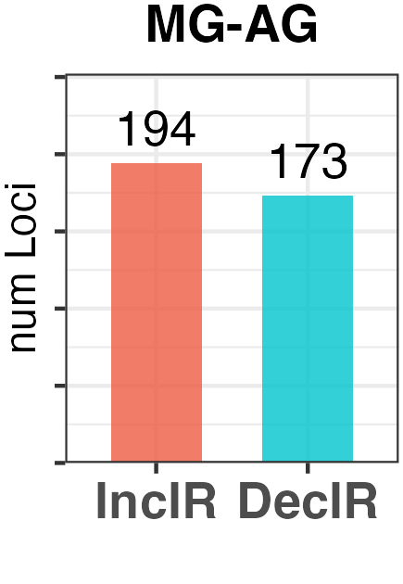
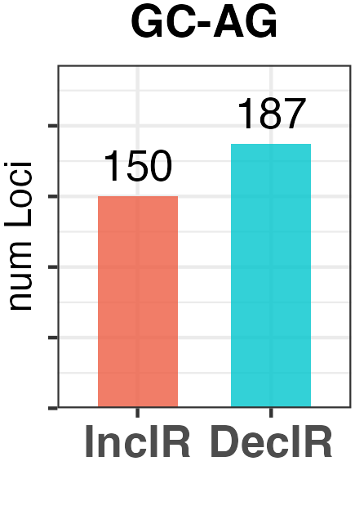
(A)
intron retention (TH)
(i)
(ii)
IncIR
(GC-AG)
(iii)
IncIR
(GC-AG)
Non-gravitational effects
Partial recovery
Complete recovery
Effects of centrifuges and others
68
110
77
3
0
0
1
37
IncIR
(GC-MG)
37
58
32
DecIR
(MG-AG)
DecIR
(GC-MG)
27
53
19
IncIR
(MG-AG)
Complete recovery
0
4
73
59
3
0
Partial recovery
1372
Effects of centrifuges and others
Non-gravitational effects
113
DecIR
(GC-AG)
DecIR
(GC-AG)
(B)
intron retention (SP)
(i)
(ii)
IncIR
(GC-AG)
(iii)
IncIR
(GC-AG)
Non-gravitational effects
Partial recovery
Complete recovery
Effects of centrifuges and others
83
93
64
1
0
0
6
49
IncIR
(GC-MG)
33
42
27
DecIR
(MG-AG)
DecIR
(GC-MG)
41
85
18
IncIR
(MG-AG)
Complete recovery
0
3
68
40
4
0
Partial recovery
70
Effects of centrifuges and others
Non-gravitational effects
97
DecIR
(GC-AG)
DecIR
(GC-AG)
(C)
intron retention (LN)
(i)
(ii)
IncIR
(GC-AG)
(iii)
IncIR
(GC-AG)
Non-gravitational effects
Partial recovery
Complete recovery
Effects of centrifuges and others
90
78
57
3
0
0
4
68
IncIR
(GC-MG)
26
54
34
DecIR
(MG-AG)
DecIR
(GC-MG)
60
88
30
IncIR
(MG-AG)
Complete recovery
0
2
80
69
4
0
Partial recovery
105
Effects of centrifuges and others
Non-gravitational effects
3
DecIR
(GC-AG)
DecIR
(GC-AG)
(D)
 | TH | SP | LN
Complete recovery (reverse V-shape type) | 58 | 42 | 54
Complete recovery (V-shape type) | 53 | 85 | 88
Non-gravitational effects (reverse V-shape type) | 77 | 64 | 57
Non-gravitational effects (V-shape type) | 59 | 40 | 69
Effects of centrifuges and others (reverse V-shape type) | 73 | 68 | 80
Effects of centrifuges and others (V-shape type) | 37 | 49 | 68
Supplementary Figure 3. Sub-categorization of intron retention (IR) fluctuation patterns. To precisely capture changes in recovered IR loci across the three tissues, data on significant IR events between Ground Control (GC) and Artificial Gravity (AG) were included. (A) This panel shows an expanded Venn diagram for the thymus from Figure 2A, with IncIR and DecIR loci between GC and AG. (i) Displays the number of significant IR loci within each group. (ii, iii) Presents sub-categorized IR expression fluctuation patterns through example bar charts and the corresponding number of loci for each pattern in Venn diagrams. (B-C) Venn diagram that expands upon Figure 2B to show significant IR changes between GC and AG for the spleen (B) and lymph node (C). (D) Table of the number of IR loci in each category

