Slide 1
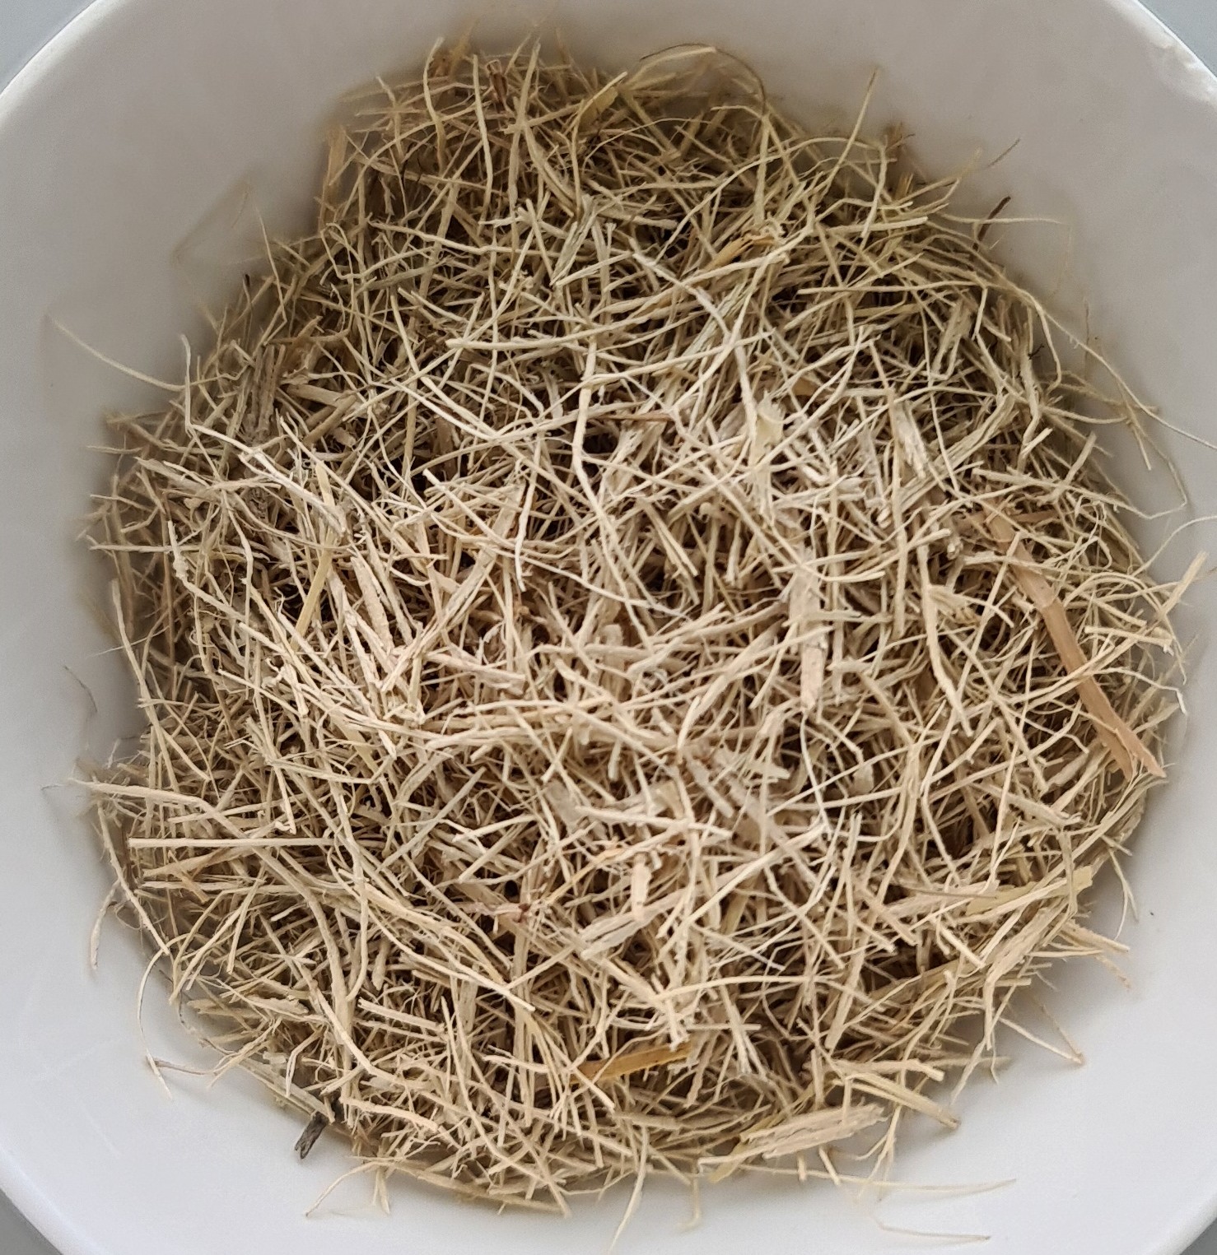
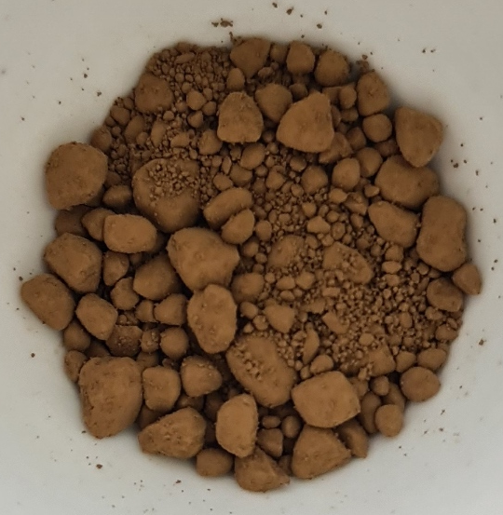
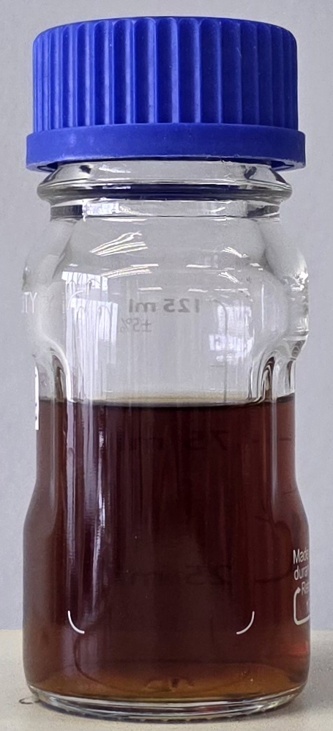
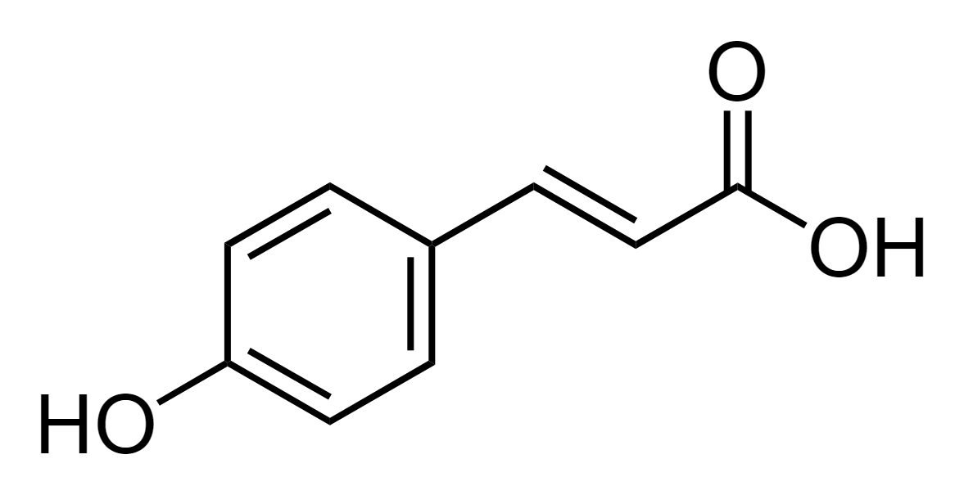
Sugarcane bagasse
Organosolv lignin
Crude depolymerized product
p-coumaric acid
Pretreatment
Depolymerization
70% (v/v) Ethanol
1% (w/w) H₂SO₄
170°C, 1 h
20 bar N₂
Methanol, DEE, Acetone, THF, Acetonitrile, Isopropanol
160-220°C, 1-5 h
10 bar N₂
Yield: 40.10%
Purity: 96.98%
Selectivity: 15.55%
Yield: 12.52%
Ni-Mo/Al₂O₃
= Selected catalyst
Non-noble metal catalysts
Ni, Co, Cu, Fe, Mo

