Slide 1
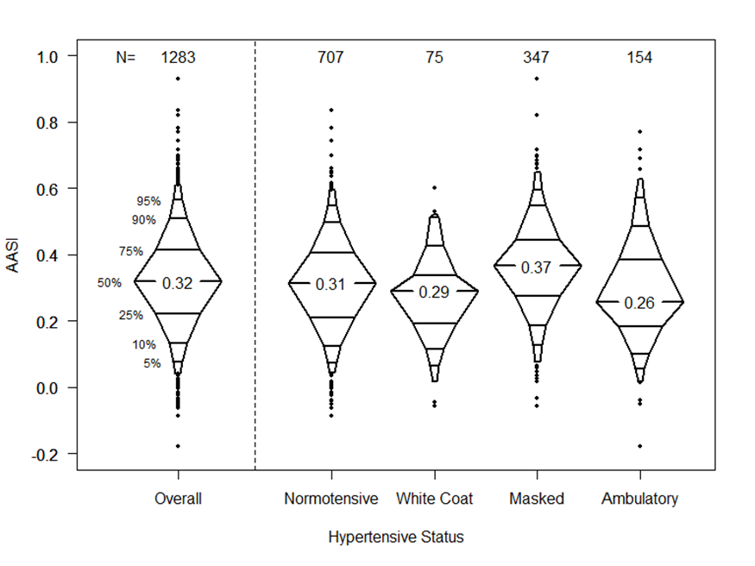
Ambulatory arterial stiffness index among children and adolescents with chronic kidney disease
Hypothesis: AASI is positively correlated with hypertensive phenotype, body mass index (BMI) and severity of CKD
DESIGN & OUTCOMES:
CKiD Study
ABPM
AASI associated with:
BMI
Masked Hypertension
ACEi/ARB use
Male sex
AASI
654 Children
1283 Study visits
eGFR 30-90
CONCLUSION: AASI is associated with MH and BMI in children and adolescents with CKD and may be a useful non-invasive measure of vascular stiffness in this population.
-----
Halbach et al. 2026

