Slide 1
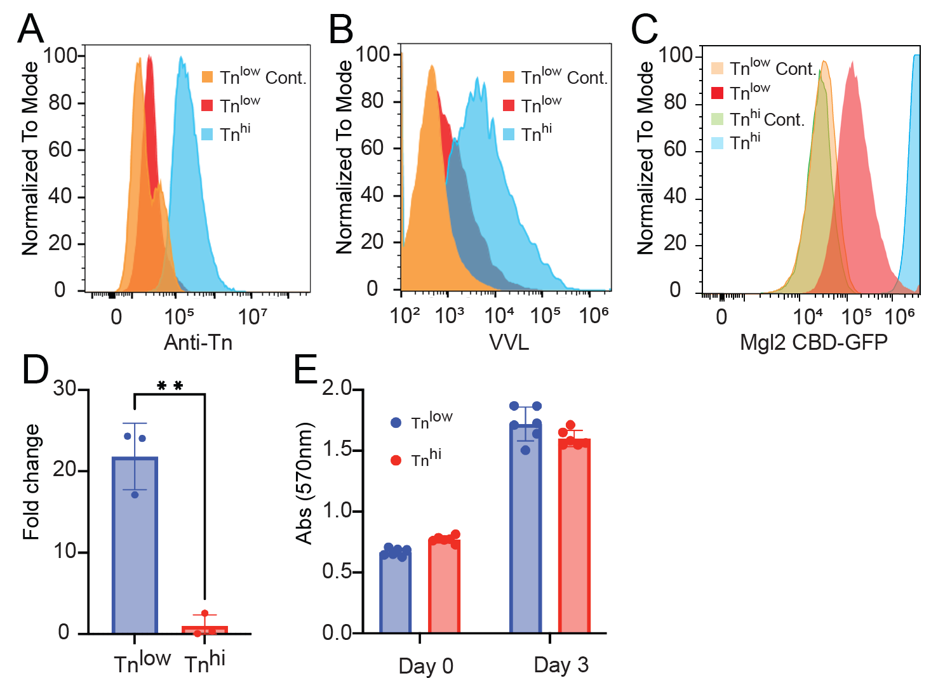
Notes:
Supplementary Fig. 1.

Slide 2
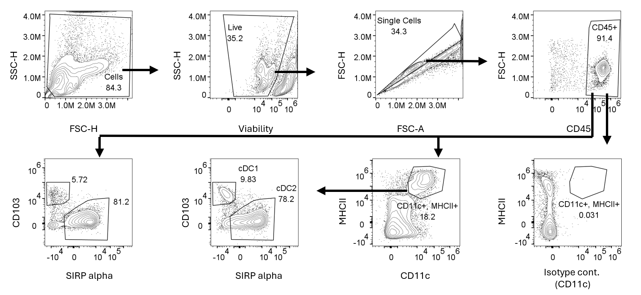
Notes:
Supplementary Fig. 2

Slide 3
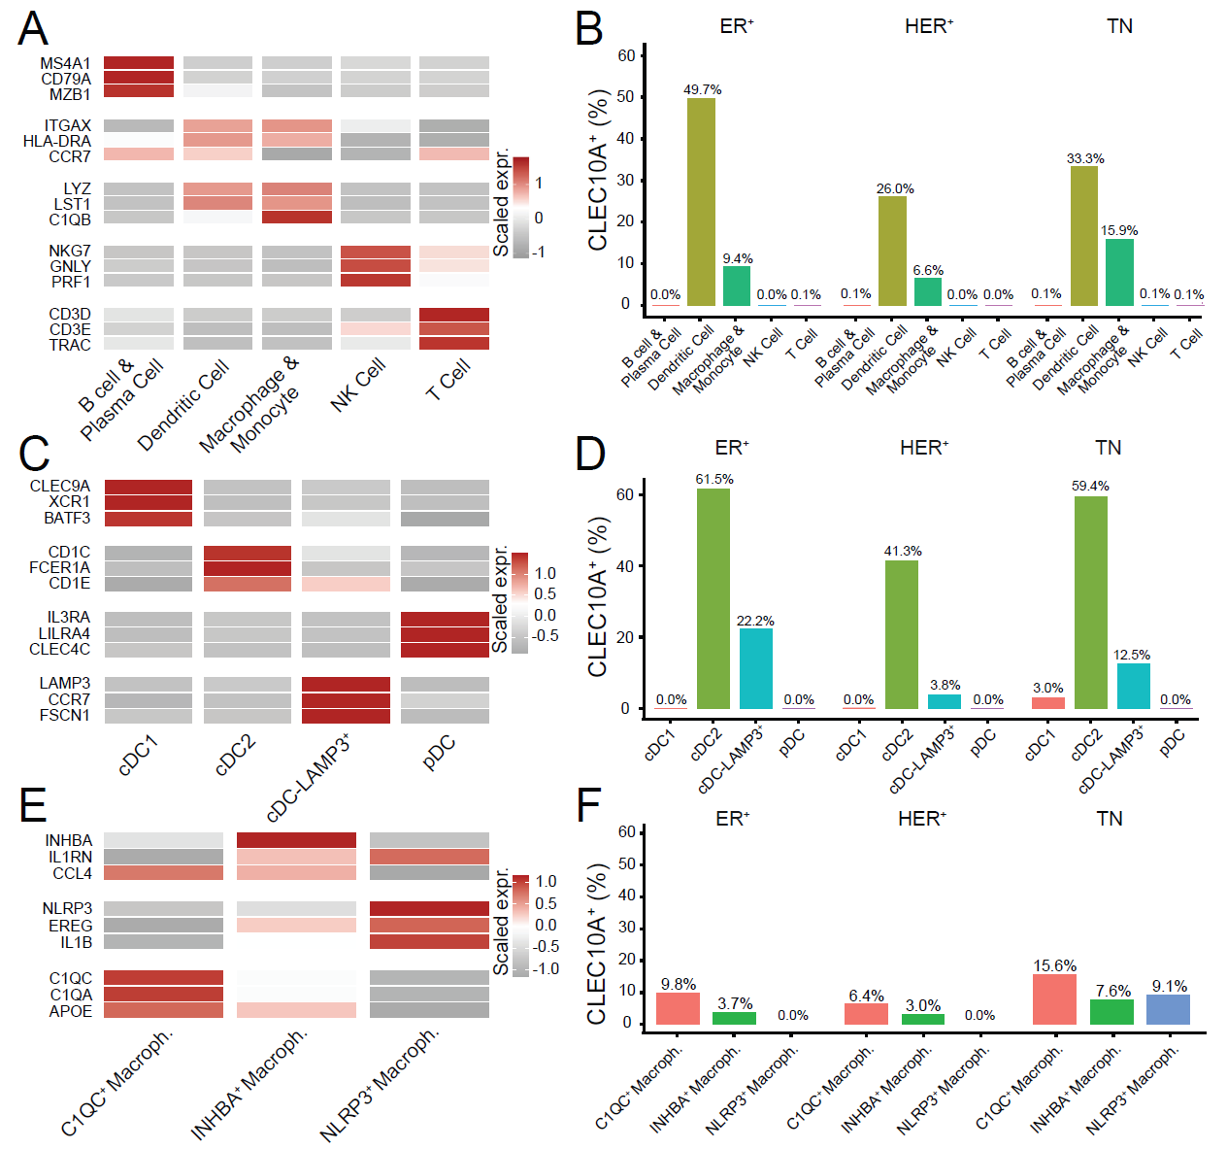
Notes:
Supplementary Fig. 3.

