Slide 1

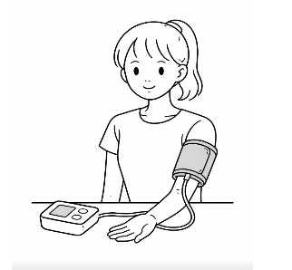
Blood pressure patterns in adolescents with premenstrual syndrome: office, home, and ambulatory blood pressure monitoring across the menstrual cycle
AIM: Compare BP profiles in adolescents with and without PMS and to assess phase-specific BP variations across the menstrual cycle.
DESIGN & OUTCOMES:
Study Population
Adolescents aged 12–18 years
Regular menstrual cycles for ≥3 months
Group 1
31 adolescents with PMS
Office blood pressure measurements
7- day home blood pressure measurements
Ambulatory blood pressure measurements
Distinct pattern in PMS (+) Group
PMS Assessment
Gençdoğan Premenstrual Syndrome Scale (PMSS)
PMS defined as:
≥50% of total score → PMS (+)
<50% of total score → PMS (−)
No significant differences between PMS (+) and PMS (−) groups in follicular:
SBP, DBP, MAP, pulse rate
Across auscultatory and oscillometric BP measurements
PMS (+) Group
Luteal vs Follicular phase:
↑ Morning SBP
↑ Average SBP (morning + evening)
↑ Pulse pressure
Late vs Mid Luteal phase:
↑ Morning DBP
PMS (+) Group
Luteal vs Follicular phase:
↓ DBP
↑ Pulse pressure
↑ Night-time heart rate
Measurement Timing
Assessed during:
Follicular phase
Luteal phase
Group 2
21 without PMS
Blood Pressure Measurements
Office BP (OBPM)
7-day Home BP (HBPM)
24-hour Ambulatory BP (ABPM)
BP: blood pressure, DBP: diastolic blood pressure, MAP: mean arterial pressure, SBP: systolic blood pressure.
Akbulut O. et al. 2026
CONCLUSION: Adolescents with PMS exhibit distinct BP patterns, with higher luteal SBP on HBPM, lower luteal DBP on ABPM, and increased night-time HR, suggesting early cardiovascular alterations possibly related to hormonal and RAAS effects.

