Slide 1
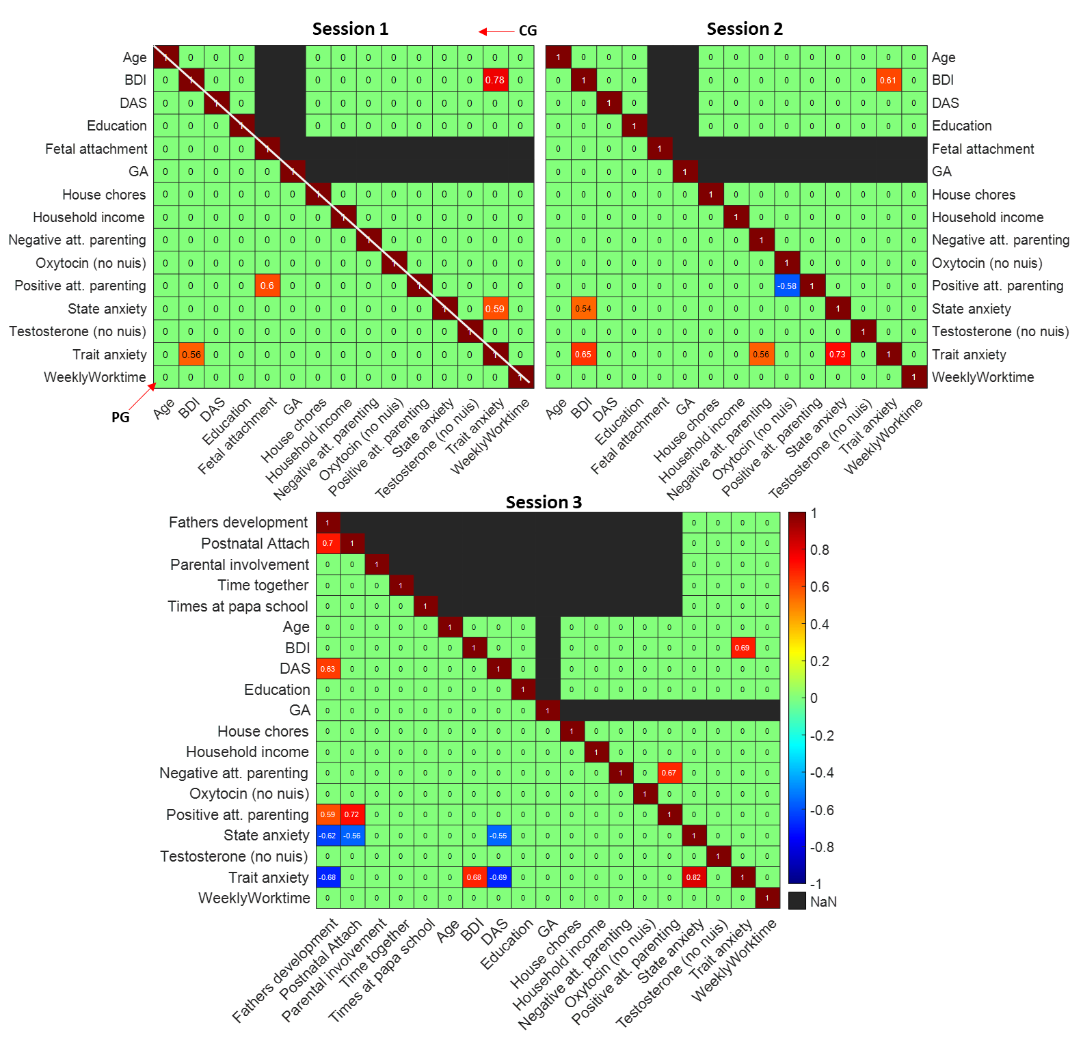
Supplementary figure S1. Cross-correlation between behavioural and hormonal traits. Pearson correlation coefficients are shown for all pairs of traits for each session. Top triangular elements of each matrix refer to data from the control group (CG), whereas the lower triangular elements refer to data from the fathers group (PG). P values for each coefficient were calculated, and those with p > 0.001 were zeroed out.

Slide 2
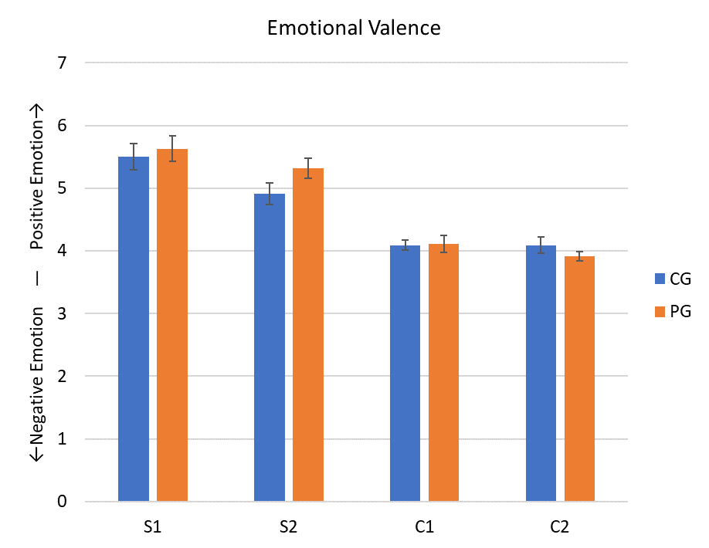
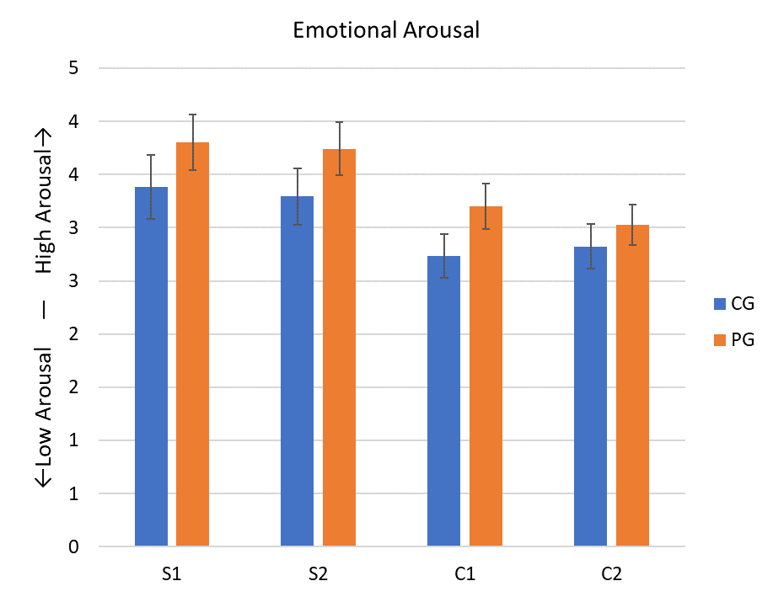
Supplementary figure S2. Emotional valence and arousal of the video stimuli used. After the 3rd session of recording, participants saw once again each of the stimulus videos used in the protocol, and rated them in two dimensions of emotion: valence (positive – negative; left graph), and arousal (high – low; right graph). N-way ANOVA revealed a significant effect in the valence rating due to the type of stimulus (infant or control video, F=140.19, p<0.0001), and an effect due to stimulus context (S1 or C1 vs S2 or C2, F=5.25, p=0.01). For arousal ratings, N-way ANOVA showed a significant group effect (papa or control, F=5.15, p=0.02), and due to the type of stimulus (infant or control video, F=25, p=0.0004). S1: infant video – interaction on knees; S2: infant video – changing diaper; C1: control video – opening box; C2: control video – wrapping box. Bars denote mean, error bars denote SEM.

Slide 3
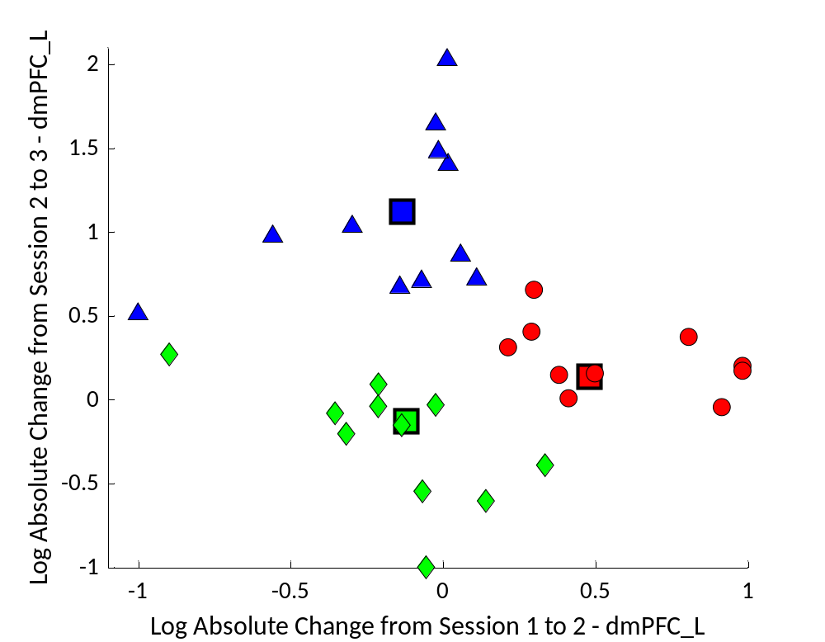
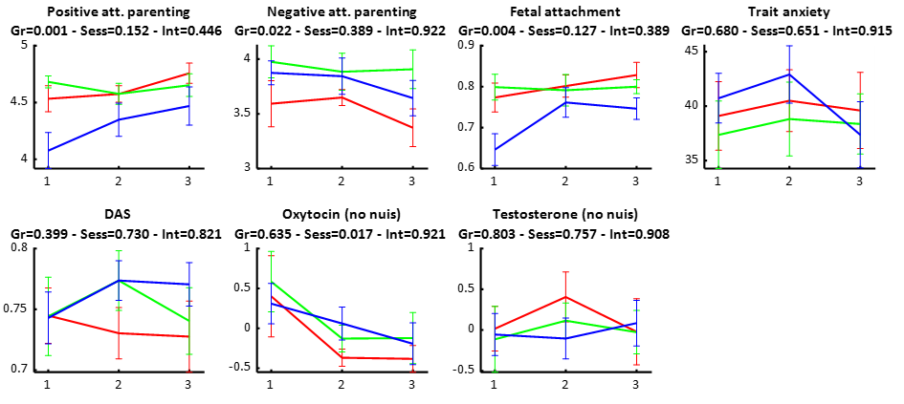
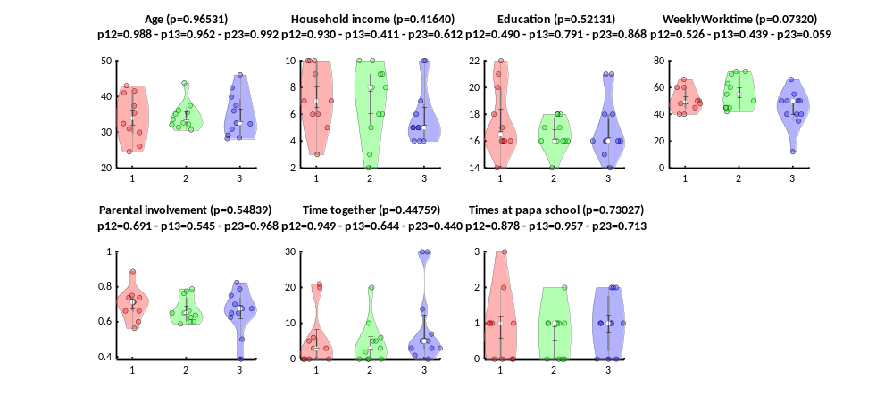
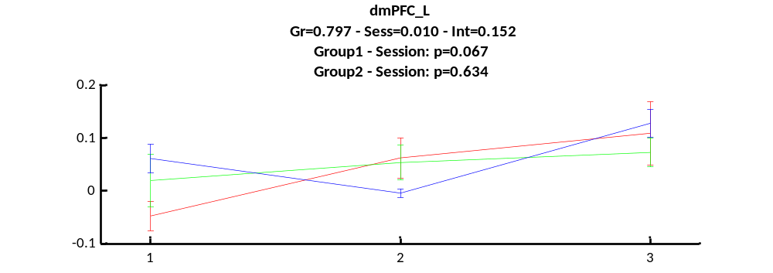
Supplementary figure S3. Clustering analysis of change in the left dorsomedial prefrontal cortex (dmPFC) in expectant fathers between sessions, k=3. When setting the group parameter to 3, we find similar results as with k=2, with the exception that the former Group 1 is now divided into two, relatively similar Group 1a and 1b. The former Group 2 is identical to this result’s Group 2. The remaining three groups behave similarly as with the groups found with k=3 and k=2. Bolded squares denote the group’s centroid. Error bars in line graphs are SEM.
Group 1a
Group 1b
Group 2

Slide 4
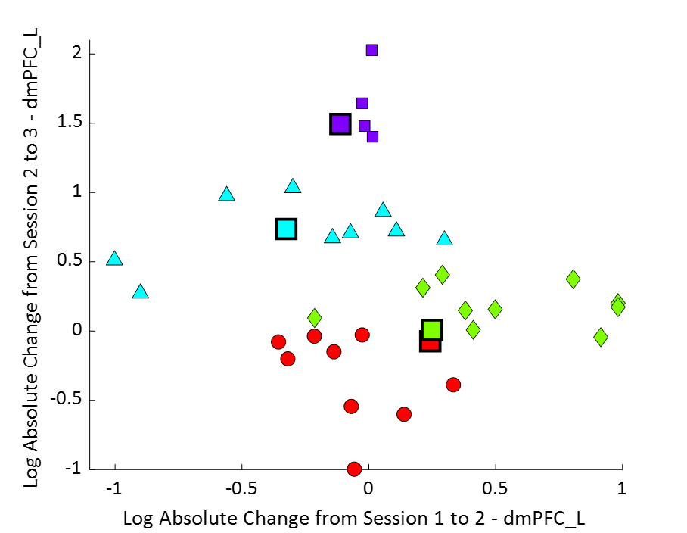
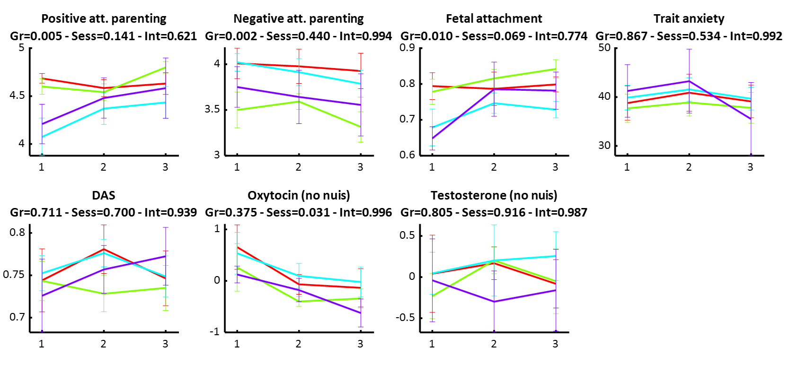
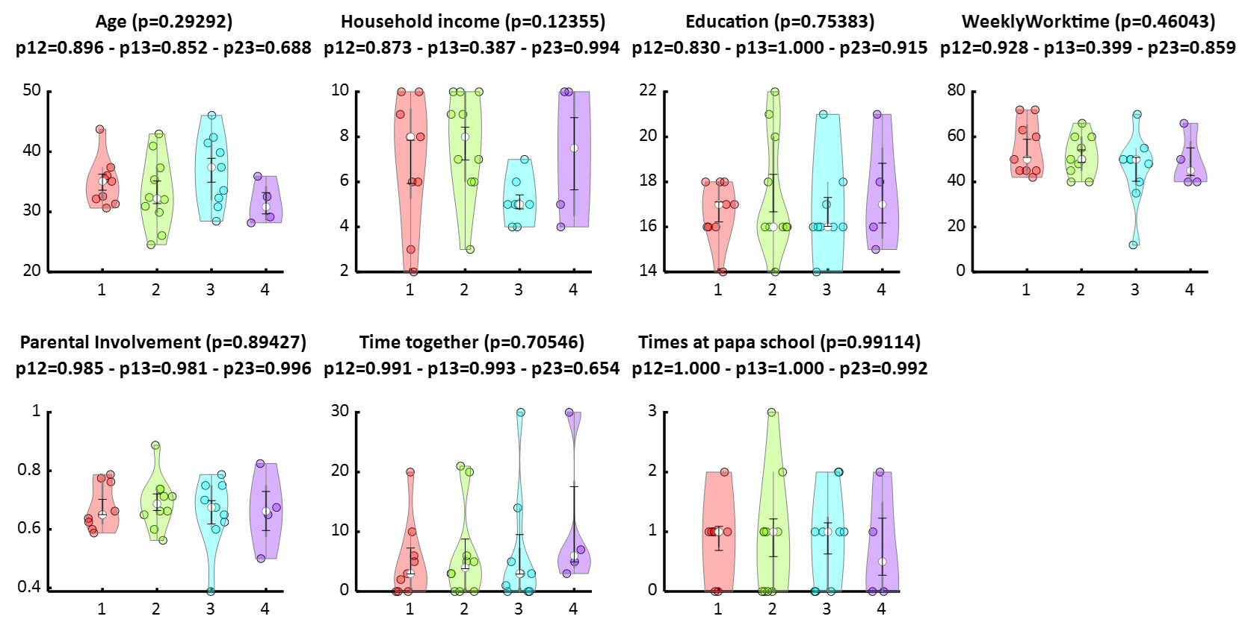
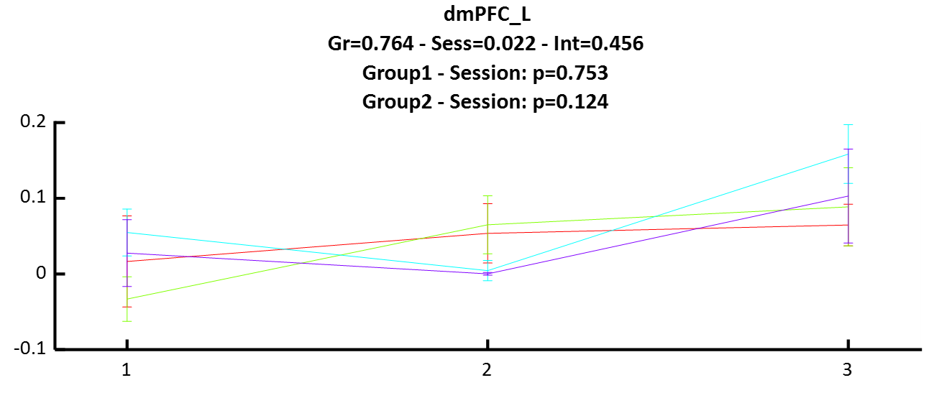
Supplementary figure S4. Clustering analysis of change in the left dorsomedial prefrontal cortex (dmPFC) in expectant fathers between sessions, k=4. When setting the group parameter to 4, one group (Group C) is composed only of four subjects. Insufficient samples makes statistical comparison difficult between groups. Bolded squares denote the group’s centroid. Error bars in line graphs are SEM.
Group A
Group B
Group C
Group D

Slide 5
Table S1. Peak activations (T values) for the session 2 all-subject contrast infant interaction videos > control videos. Labelling was conducted using AAL Neuroatlas. Only significant clusters with more than 3 voxels are shown. The activation maps were thresholded at p < 0.001 (uncorrected at the voxel level) combined with p < 0.05 (FWE-corrected at the cluster level).
Cluster 1 - Voxels in cluster: 617 -Peak at (-45 -76 -7) |  |  |  |  | Cluster 4 - Voxels in cluster: 58 -Peak at (-39 -1 56) |  |  |  |  | Cluster 9 - Voxels in cluster: 59 -Peak at (-9 59 20)
Peak T: 11.7101 Mean T: 5.0822 Std T: 1.479 |  |  |  |  | Peak T: 6.1601 Mean T: 3.9683 Std T: 0.6023 |  |  |  |  | Peak T: 4.9413 Mean T: 3.7067 Std T: 0.4089
Region | Voxels | Mean T | STD of T |  | Region | Voxels | Mean T | STD of T |  | Region | Voxels | Mean T | STD of T
Temporal_Mid_L | 253 | 5.119 | 1.4054 |  | Precentral_L | 57 | 3.9812 | 0.5995 |  | Frontal_Sup_Medial_L | 51 | 3.7248 | 0.4211
Temporal_Sup_L | 97 | 4.5175 | 0.8388 |  |  |  |  |  |  | Frontal_Sup_L | 8 | 3.5915 | 0.3185
SupraMarginal_L | 92 | 4.4658 | 0.9506 |  | Cluster 5 - Voxels in cluster: 72 -Peak at (48 5 50)
Occipital_Inf_L | 65 | 6.3014 | 2.0517 |  | Peak T: 6.0694 Mean T: 4.3537 Std T: 0.7778 |  |  |  |  | Cluster 10 - Voxels in cluster: 46 -Peak at (-54 11 8)
Occipital_Mid_L | 61 | 6.0189 | 1.5541 |  | Region | Voxels | Mean T | STD of T |  | Peak T: 4.8087 Mean T: 3.8654 Std T: 0.4109
Fusiform_L | 40 | 4.4823 | 1.0052 |  | Precentral_R | 61 | 4.4026 | 0.7936 |  | Region | Voxels | Mean T | STD of T
 |  |  |  |  | Frontal_Mid_R | 11 | 4.0827 | 0.6491 |  | Rolandic_Oper_L | 23 | 3.7212 | 0.3266
Cluster 2 - Voxels in cluster: 514 -Peak at (45 -67 -16) |  |  |  |  |  |  |  |  |  | Frontal_Inf_Oper_L | 21 | 4.0422 | 0.4453
Peak T: 9.5166 Mean T: 4.7419 Std T: 1.3439 |  |  |  |  | Cluster 6 - Voxels in cluster: 40 -Peak at (-27 -37 59)
Region | Voxels | Mean T | STD of T |  | Peak T: 5.693 Mean T: 4.0065 Std T: 0.5135 |  |  |  |  | Cluster 11 - Voxels in cluster: 48 -Peak at (3 -49 26)
Temporal_Mid_R | 203 | 4.7197 | 1.272 |  | Region | Voxels | Mean T | STD of T |  | Peak T: 4.7666 Mean T: 3.803 Std T: 0.4432
Temporal_Sup_R | 92 | 3.9831 | 0.538 |  | Postcentral_L | 25 | 4.0879 | 0.5849 |  | Region | Voxels | Mean T | STD of T
SupraMarginal_R | 74 | 4.118 | 0.6035 |  | Parietal_Sup_L | 14 | 3.862 | 0.3525 |  | Cingulum_Post_L | 19 | 3.6933 | 0.3574
Occipital_Inf_R | 50 | 6.3199 | 1.5663 |  |  |  |  |  |  | Precuneus_R | 13 | 3.8969 | 0.4992
Temporal_Inf_R | 44 | 5.4106 | 1.6711 |  | Cluster 7 - Voxels in cluster: 58 -Peak at (45 20 26) |  |  |  |  | Cingulum_Post_R | 10 | 4.0371 | 0.5074
Fusiform_R | 32 | 5.1172 | 1.2761 |  | Peak T: 5.2474 Mean T: 3.8994 Std T: 0.4682 |  |  |  |  | Cingulum_Mid_R | 6 | 3.5567 | 0.2723
Occipital_Mid_R | 15 | 5.0307 | 1.1503 |  | Region | Voxels | Mean T | STD of T
 |  |  |  |  | Frontal_Inf_Tri_R | 46 | 3.9292 | 0.4726 |  | Cluster 12 - Voxels in cluster: 39 -Peak at (9 53 23)
Cluster 3 - Voxels in cluster: 334 -Peak at (12 -88 20) |  |  |  |  | Frontal_Inf_Oper_R | 12 | 3.7852 | 0.4518 |  | Peak T: 4.621 Mean T: 3.6542 Std T: 0.3427
Peak T: 8.8313 Mean T: 5.2276 Std T: 1.3609 |  |  |  |  |  |  |  |  |  | Region | Voxels | Mean T | STD of T
Region | Voxels | Mean T | STD of T |  | Cluster 8 - Voxels in cluster: 111 -Peak at (6 50 -10) |  |  |  |  | Frontal_Sup_Medial_R | 37 | 3.6611 | 0.3439
Calcarine_L | 78 | 5.4491 | 1.4077 |  | Peak T: 5.1865 Mean T: 3.995 Std T: 0.5201
Calcarine_R | 71 | 5.4315 | 1.2199 |  | Region | Voxels | Mean T | STD of T
Cuneus_L | 61 | 5.2641 | 1.1565 |  | Frontal_Med_Orb_L | 51 | 3.9689 | 0.5042
Cuneus_R | 59 | 5.1929 | 1.6627 |  | Frontal_Med_Orb_R | 41 | 4.0805 | 0.5366
Occipital_Sup_L | 39 | 5.0389 | 1.3181 |  | Rectus_R | 7 | 4.3798 | 0.5271
Occipital_Sup_R | 16 | 4.6392 | 0.9778 |  | Rectus_L | 6 | 3.7133 | 0.2129
Occipital_Mid_L | 5 | 3.6733 | 0.5846 |  | Cingulum_Ant_L | 4 | 3.4977 | 0.1765

Slide 6
Table S2. Peak activations (T values) for the session 3 all-subject contrast infant interaction videos > control videos. Labelling was conducted using AAL Neuroatlas. Only significant clusters with more than 3 voxels are shown. The activation maps were thresholded at p < 0.001 (uncorrected at the voxel level) combined with p < 0.05 (FWE-corrected at the cluster level).
Cluster 1 - Voxels in cluster: 722 - Peak at (-45 -76 -7) |  |  |  |  | Cluster 5 - Voxels in cluster: 304 - Peak at (-3 -49 32) |  |  |  |  | Cluster 10 - Voxels in cluster: 23 - Peak at (3 23 20)
Peak T: 9.31 Mean T: 4.69 Std T: 1.21 |  |  |  |  | Peak T: 6.01 Mean T: 4.10 Std T: 0.59 |  |  |  |  | Peak T: 4.64 Mean T: 3.65 Std T: 0.35
Region | Voxels | Mean T | STD of T |  | Region | Voxels | Mean T | STD of T |  | Region | Voxels | Mean T | STD of T
Temporal_Mid_L | 268 | 4.8499 | 1.1655 |  | Precuneus_L | 105 | 4.0651 | 0.5881 |  | Cingulum_Ant_L | 10 | 3.4769 | 0.1867
SupraMarginal_L | 132 | 4.1162 | 0.6269 |  | Cingulum_Post_L | 70 | 4.3364 | 0.6575 |  | Cingulum_Mid_L | 8 | 3.6887 | 0.3028
Temporal_Sup_L | 103 | 4.3237 | 0.8006 |  | Precuneus_R | 51 | 4.0176 | 0.5608 |  | Cingulum_Ant_R | 5 | 3.9212 | 0.521
Occipital_Inf_L | 68 | 6.2276 | 1.4554 |  | Cingulum_Post_R | 32 | 4.2315 | 0.452
Occipital_Mid_L | 64 | 5.1411 | 1.2565 |  | Cingulum_Mid_L | 24 | 3.8605 | 0.4806 |  | Cluster 11 - Voxels in cluster: 29 - Peak at (12 8 11)
Fusiform_L | 41 | 4.431 | 0.9019 |  | Cingulum_Mid_R | 22 | 3.831 | 0.5421 |  | Peak T: 4.63 Mean T: 3.73 Std T: 0.33
Angular_L | 31 | 3.5183 | 0.1887 |  |  |  |  |  |  | Region | Voxels | Mean T | STD of T
Temporal_Inf_L | 9 | 3.9326 | 0.5676 |  | Cluster 6 - Voxels in cluster: 67 - Peak at (-36 23 2) |  |  |  |  | Caudate_R | 27 | 3.7611 | 0.3272
 |  |  |  |  | Peak T: 5.80 Mean T: 4.02 Std T: 0.69
Cluster 2 - Voxels in cluster: 747 - Peak at (42 -73 -10) |  |  |  |  | Region | Voxels | Mean T | STD of T |  | Cluster 12 - Voxels in cluster: 23 - Peak at (15 -73 -10)
Peak T: 7.73 Mean T: 4.53 Std T: 0.97 |  |  |  |  | Insula_L | 27 | 4.1656 | 0.7746 |  | Peak T: 4.59 Mean T: 3.71 Std T: 0.43
Region | Voxels | Mean T | STD of T |  | Frontal_Inf_Tri_L | 23 | 4.1569 | 0.6497 |  | Region | Voxels | Mean T | STD of T
Temporal_Mid_R | 256 | 4.6945 | 1.0576 |  | Frontal_Inf_Orb_L | 17 | 3.6109 | 0.3878 |  | Lingual_R | 14 | 3.6978 | 0.4389
Temporal_Sup_R | 238 | 4.2737 | 0.8127 |  |  |  |  |  |  | Vermis_6 | 7 | 3.7754 | 0.4879
SupraMarginal_R | 118 | 4.2669 | 0.6948 |  | Cluster 7 - Voxels in cluster: 294 - Peak at (45 5 47)
Occipital_Inf_R | 53 | 5.2802 | 1.1956 |  | Peak T: 5.79 Mean T: 3.90 Std T: 0.54 |  |  |  |  | Cluster 13 - Voxels in cluster: 51 - Peak at (-39 -1 -16)
Temporal_Inf_R | 36 | 4.7761 | 1.0067 |  | Region | Voxels | Mean T | STD of T |  | Peak T: 4.57 Mean T: 3.78 Std T: 0.41
Fusiform_R | 23 | 4.6029 | 0.7449 |  | Frontal_Inf_Tri_R | 101 | 3.9096 | 0.5044 |  | Region | Voxels | Mean T | STD of T
Occipital_Mid_R | 11 | 5.1795 | 0.8218 |  | Precentral_R | 44 | 4.3367 | 0.7008 |  | Insula_L | 15 | 3.718 | 0.3834
Rolandic_Oper_R | 7 | 3.936 | 0.5051 |  | Frontal_Inf_Orb_R | 44 | 3.753 | 0.418 |  | Temporal_Sup_L | 9 | 3.5688 | 0.3339
 |  |  |  |  | Frontal_Mid_R | 43 | 3.8055 | 0.4336 |  | Temporal_Pole_Sup_L | 4 | 3.7173 | 0.2766
Cluster 3 - Voxels in cluster: 249 - Peak at (9 -88 17) |  |  |  |  | Insula_R | 31 | 3.5871 | 0.3179
Peak T: 7.04 Mean T: 4.59 Std T: 0.91 |  |  |  |  | Frontal_Inf_Oper_R | 25 | 4.0086 | 0.5481 |  | Cluster 14 - Voxels in cluster: 21 - Peak at (3 -10 32)
Region | Voxels | Mean T | STD of T |  | Frontal_Mid_Orb_R | 5 | 3.6611 | 0.2445 |  | Peak T: 4.43 Mean T: 3.72 Std T: 0.37
Calcarine_R | 74 | 4.5393 | 0.8428 |  |  |  |  |  |  | Region | Voxels | Mean T | STD of T
Calcarine_L | 68 | 4.4486 | 0.852 |  | Cluster 8 - Voxels in cluster: 93 - Peak at (6 53 23) |  |  |  |  | Cingulum_Mid_L | 13 | 3.5041 | 0.1996
Cuneus_R | 34 | 4.9184 | 1.0046 |  | Peak T: 5.30 Mean T: 3.92 Std T: 0.50 |  |  |  |  | Cingulum_Mid_R | 8 | 4.0725 | 0.3073
Occipital_Sup_L | 33 | 4.4204 | 0.8818 |  | Region | Voxels | Mean T | STD of T
Cuneus_L | 29 | 5.0676 | 0.94 |  | Frontal_Sup_Medial_R | 75 | 3.9917 | 0.5072 |  | Cluster 15 - Voxels in cluster: 24 - Peak at (42 2 13)
Occipital_Sup_R | 8 | 4.0774 | 0.8989 |  | Cingulum_Ant_R | 10 | 3.7954 | 0.4318 |  | Peak T: 4.35 Mean T: 3.78 Std T: 0.33
 |  |  |  |  | Frontal_Sup_R | 5 | 3.4342 | 0.1572 |  | Region | Voxels | Mean T | STD of T
Cluster 4 - Voxels in cluster: 472 - Peak at (-3 53 -10) |  |  |  |  |  |  |  |  |  | Insula_R | 15 | 3.8029 | 0.3423
Peak T: 6.44 Mean T: 4.06 Std T: 0.63 |  |  |  |  | Cluster 9 - Voxels in cluster: 52 - Peak at (-48 11 11)
Region | Voxels | Mean T | STD of T |  | Peak T: 4.75 Mean T: 3.63 Std T: 0.35
Frontal_Sup_Medial_L | 159 | 4.0846 | 0.6777 |  | Region | Voxels | Mean T | STD of T
Cingulum_Ant_L | 100 | 3.9146 | 0.443 |  | Frontal_Inf_Oper_L | 25 | 3.6832 | 0.4204
Frontal_Med_Orb_L | 77 | 4.5557 | 0.7014 |  | Rolandic_Oper_L | 22 | 3.5779 | 0.2542
Frontal_Sup_L | 55 | 3.7423 | 0.4039
Frontal_Med_Orb_R | 45 | 4.0094 | 0.5106
Frontal_Mid_L | 18 | 3.6911 | 0.3148
Rectus_L | 6 | 4.2689 | 0.8264
Rectus_R | 5 | 4.203 | 0.4755

Slide 7
Table S3 – Statistics for Clustering Analysis. Values shown are mean ± SEM.
 |  | Group 1 |  |  | Group 2 |  | ANOVA F values
Covariate | Session 1 | Session 2 | Session 3 | Session 1 | Session 2 | Session 3 | Group | Session | Interaction
Positive att. parenting | 4.65 ± 0.051 | 4.58 ± 0.064 | 4.73 ± 0.066 | 4.05 ± 0.154 | 4.35 ± 0.140 | 4.44 ± 0.164 | 21.35 (p=0.0000) | 2.73 (p=0.0703) | 2.01 (p=0.1406)
Negative att. parenting | 3.76 ± 0.140 | 3.78 ± 0.107 | 3.65 ± 0.147 | 3.91 ± 0.112 | 3.83 ± 0.159 | 3.66 ± 0.155 | 0.38 (p=0.5405) | 0.96 (p=0.3855) | 0.12 (p=0.8862)
Foetal attachment | 0.79 ± 0.025 | 0.80 ± 0.025 | 0.82 ± 0.017 | 0.65 ± 0.038 | 0.76 ± 0.035 | 0.74 ± 0.026 | 15.12 (p=0.0002) | 2.94 (p=0.0577) | 1.45 (p=0.2391)
Trait anxiety | 37.55 ± 2.297 | 39.15 ± 2.365 | 38.20 ± 2.249 | 41.58 ± 2.347 | 43.42 ± 2.580 | 38.75 ± 3.224 | 1.95 (p=0.1658) | 0.60 (p=0.5513) | 0.32 (p=0.7241)
DAS | 0.75 ± 0.021 | 0.75 ± 0.018 | 0.74 ± 0.020 | 0.74 ± 0.021 | 0.77 ± 0.016 | 0.76 ± 0.023 | 0.12 (p=0.7328) | 0.43 (p=0.6547) | 0.22 (p=0.7991)
Intimacy | 2.51 ± 0.105 | 2.42 ± 0.146 | 2.16 ± 0.177 | 2.65 ± 0.095 | 2.44 ± 0.197 | 2.10 ± 0.253 | 0.04 (p=0.8340) | 3.57 (p=0.0322) | 0.16 (p=0.8502)
Oxytocin (no nuis) | 0.39 ± 0.318 | -0.27 ± 0.110 | -0.27 ± 0.200 | 0.50 ± 0.312 | 0.07 ± 0.198 | -0.15 ± 0.254 | 0.88 (p=0.3498) | 3.95 (p=0.0228) | 0.13 (p=0.8802)
Testosterone (no nuis) | -0.11 ± 0.261 | 0.12 ± 0.142 | -0.09 ± 0.246 | 0.04 ± 0.266 | 0.15 ± 0.352 | 0.19 ± 0.288 | 0.54 (p=0.4628) | 0.21 (p=0.8144) | 0.11 (p=0.8943)
Covariate (at session 3) | Group 1 | Group 2 | F values (Group)
Age | 34.03 ± 1.107 | 35.39 ± 1.746 | 0.48 (p=0.4947)
Household income | 7.20 ± 0.569 | 5.83 ± 0.613 | 2.43 (p=0.1294)
Education | 17.05 ± 0.462 | 17.00 ± 0.628 | 0.00 (p=0.9486)
Weekly worktime | 53.90 ± 2.396 | 44.67 ± 3.807 | 4.68 (p=0.0385)
Parental involvement | 0.68 ± 0.018 | 0.66 ± 0.035 | 0.20 (p=0.6588)
Time together | 5.45 ± 1.560 | 8.42 ± 3.105 | 0.90 (p=0.3501)
Times at papa school | 0.85 ± 0.182 | 0.92 ± 0.229 | 0.05 (p=0.8222)
 | Group 1 |  |  | Group 2 |  |  | ANOVA F values (session) |  | ANOVA F values (intergroup)
ROI | Session 1 | Session 2 | Session 3 | Session 1 | Session 2 | Session 3 | Group 1 | Group 2 | Group | Session | Interaction
dmPFC_L | -0.01 ± 0.032 | 0.06 ± 0.027 | 0.07 ± 0.029 | 0.05 ± 0.029 | 0.00 ± 0.010 | 0.15 ± 0.036 | 2.14 (p=0.1265) | 8.44 (p=0.0011) | 1.20 (p=0.2753) | 5.60 (p=0.0051) | 2.88 (p=0.061)

