Slide 1
Supplemental Figures and Legends

Slide 2
Supplemental Figure 1

Slide 3
Supplemental Figure 1. Open field data for animals injected with LPS that received Tak-242 (a-d), morphine (e-h), or modafinil (i-l) as compared to their vehicle controls. No differences were found in open field behavior with these measures except the animals receiving morphine showed less time in the center. *, p<0.05

Slide 4
Supplemental Figure 2

Slide 5
Supplemental Figure 2. Percent change in running wheel behavior for those that received chronic stress combined with LPS compared to LPS alone. Chronic stress showed a short decrease in wheel running. After injection of LPS, wheel running was similar between the two groups with short reduction in behavior.

Slide 6

Supplemental Figure 3
Induction
Short-term*
Long-term*
Control (n=12)
Stress Only (n=9)
0.1 mg/kg LPS (n=15)
Stress + 0.01 mg/kg LPS (n=16)
Distance (% of baseline)
B
Stress
D0
D1
D2
D3
D4
D5
D6
D7
D8
D9
D10
D11
LPS

Slide 7
Supplemental Figure 3. Percent change in running wheel behavior for additional control groups for the model. The control group was added for comparison. The animals that received stress only showed a short-duration decrease in wheel running behavior. The group received 0.1 mg/kg >:S and the stress_ 0.01 mg/kg LPS showed a short-duration decrease in wheel running that was similar between group.

Slide 8
Supplemental Figure 4

Slide 9
Supplemental Figure 4. Open field data on Day 1, Day 5 and Day 10 for the groups that stress+LPS and stress+saline and stress+saline+rest. Open field on Day 1 and 5 are compared to the same animals prior to induction of the model. A separate control group is shown for open field data on Day 10 for comparison.

Slide 10
Supplemental Figure 5

Slide 11
Supplemental Figure 5. Muscle withdrawal threshold data separated by sex for the control, stress+LPS, stress+saline, and stress+saline+rest groups. Both male and female mice showed a decrease in withdrawal threshold in the group that received stress+saline+rest. The male mice also showed a decrease in withdrawal threshold after receiving stress+saline.

Slide 12
Supplemental Figure 6
CD3+
CD183+
CD184+
% of CD45+
% of CD4+
% of CD4+
Control
Stress
+LPS
Stress
+Saline
Stress
+Saline
+Rest
Control
Stress
+LPS
Stress
+Saline
Stress
+Saline
+Rest
Control
Stress
+LPS
Stress
+Saline
Stress
+Saline
+Rest
CD11b+
Ly6C-Low
Ly6C-Mid
Ly6C-High
% of CD3-
% of CD11b+
% of CD11b+
% of CD11b+
Control
Stress
+LPS
Stress
+Saline
Stress
+Saline
+Rest
Control
Stress
+LPS
Stress
+Saline
Stress
+Saline
+Rest
Control
Stress
+LPS
Stress
+Saline
Stress
+Saline
+Rest
Control
Stress
+LPS
Stress
+Saline
Stress
+Saline
+Rest
CD11c+
CD19+
% of CD3-
% of CD3-
Control
Stress
+LPS
Stress
+Saline
Stress
+Saline
+Rest
Control
Stress
+LPS
Stress
+Saline
Stress
+Saline
+Rest
CD49b+
CD11b+CD27-
CD11b+CD27+
CD11b-CD27-
% of CD3-
% of CD49b+
% of CD49b+
% of CD49b+
Control
Stress
+LPS
Stress
+Saline
Stress
+Saline
+Rest
Control
Stress
+LPS
Stress
+Saline
Stress
+Saline
+Rest
Control
Stress
+LPS
Stress
+Saline
Stress
+Saline
+Rest
Control
Stress
+LPS
Stress
+Saline
Stress
+Saline
+Rest

Slide 13
Supplemental Figure 6. Additional results from flow cytometry data for the control, stress+LPS, stress+saline, and stress+saline+rest group.

Slide 14
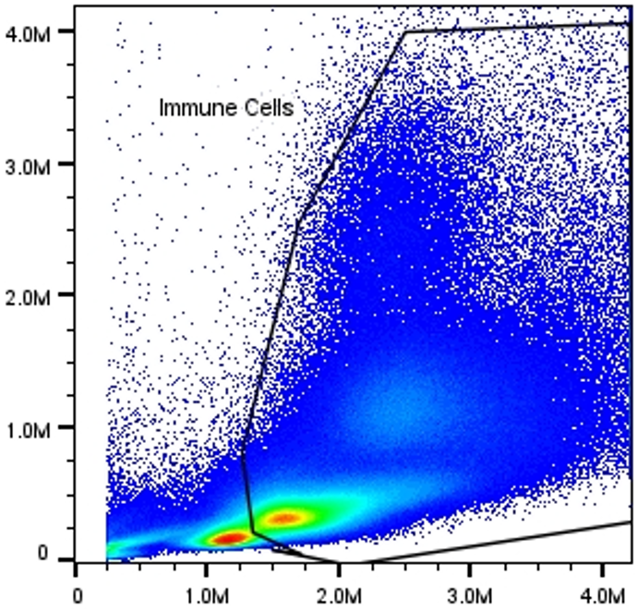
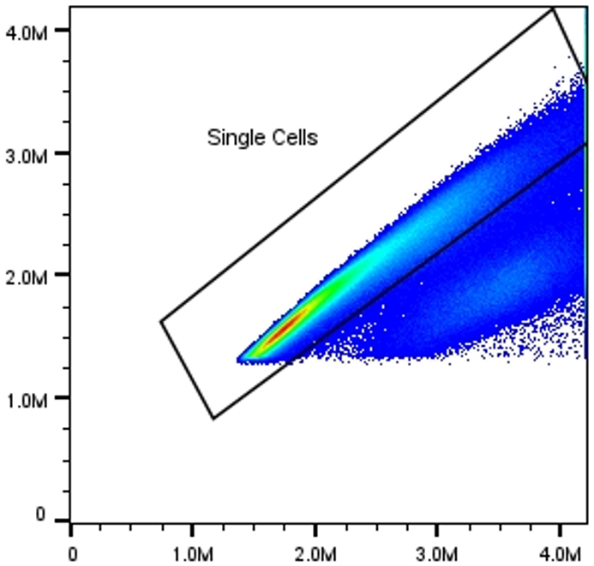
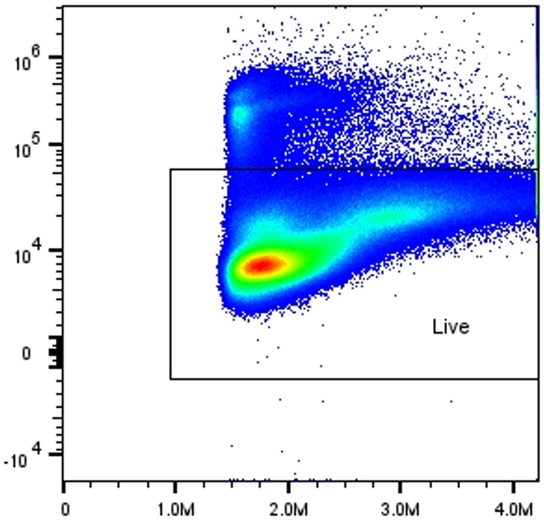
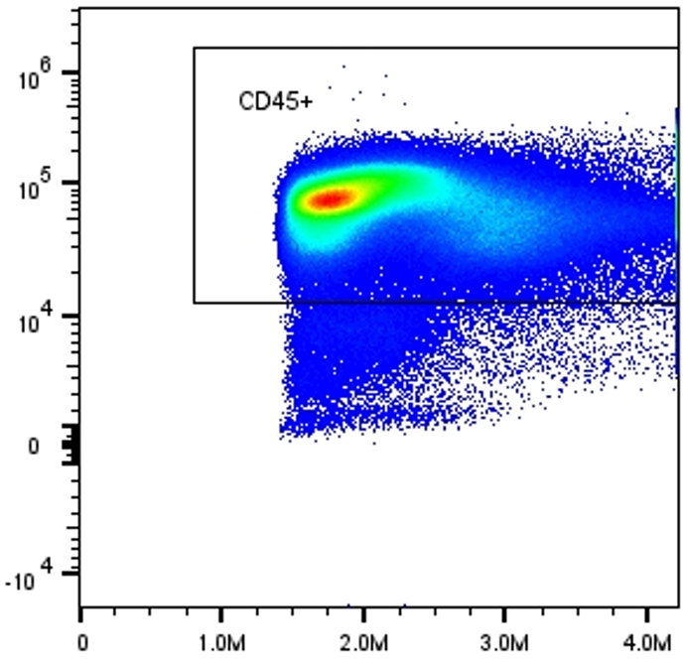
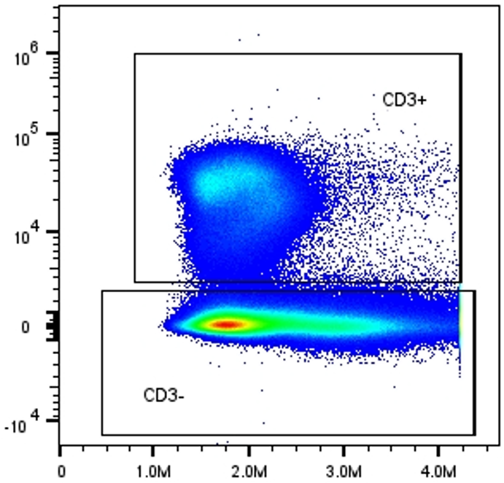
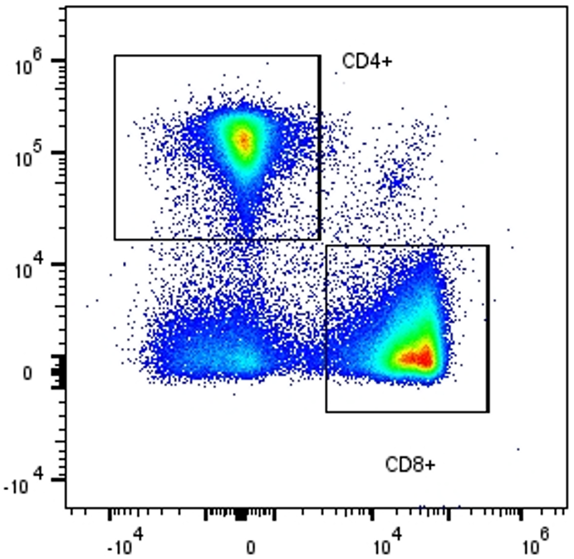
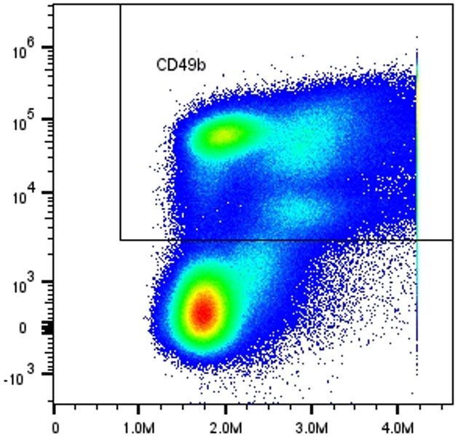
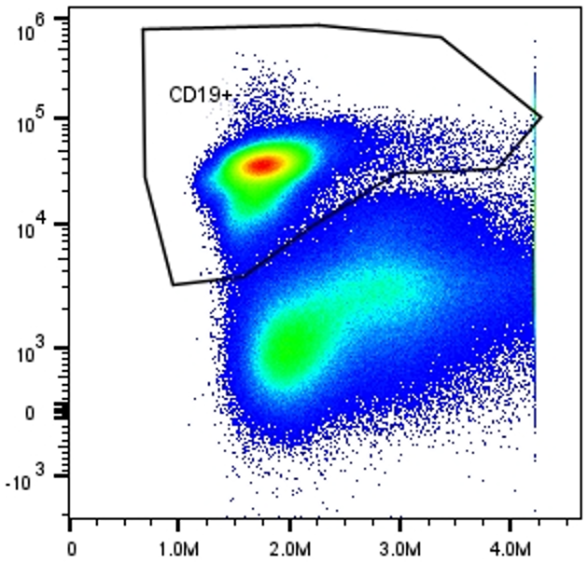
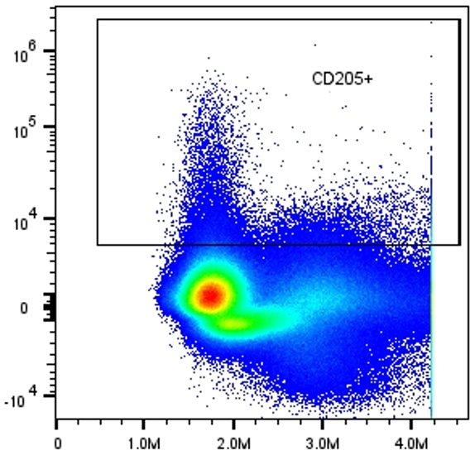
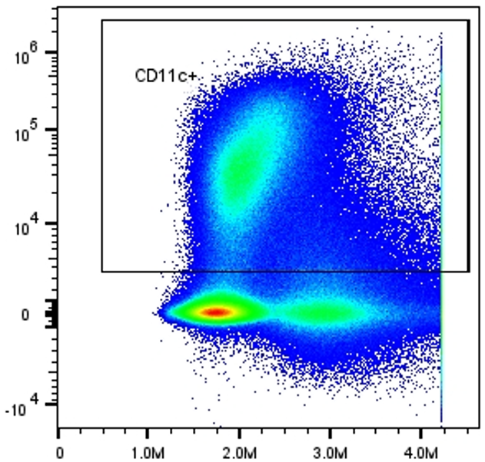
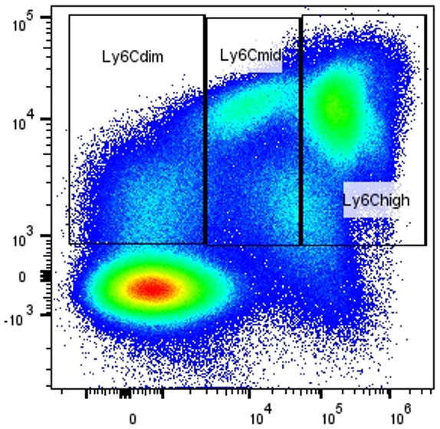
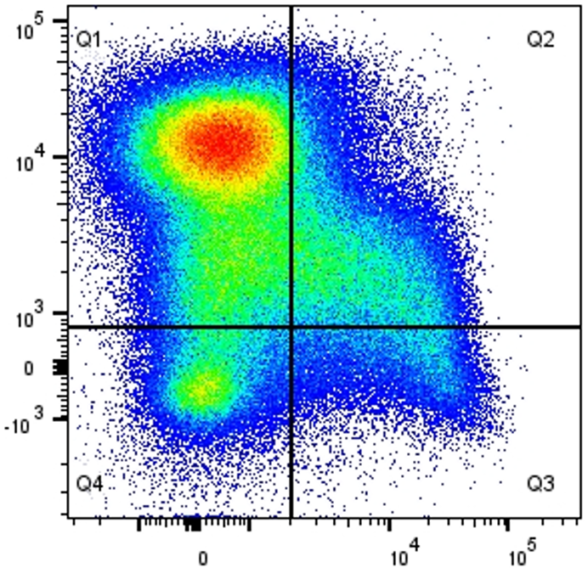
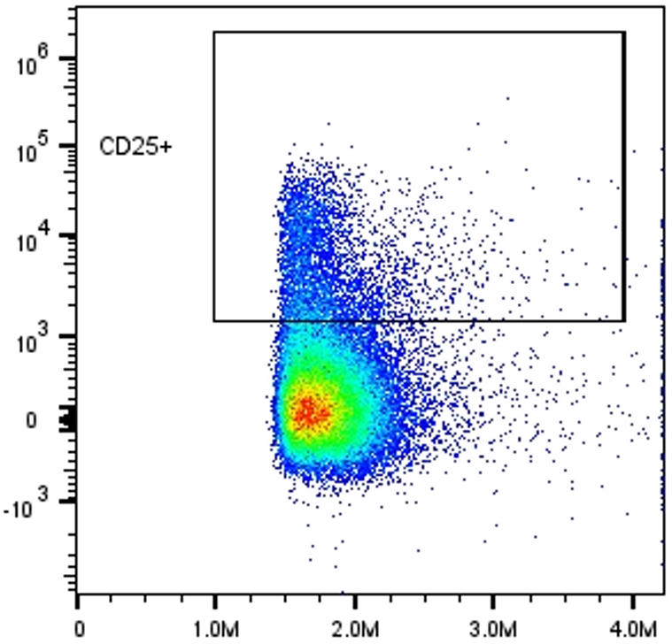
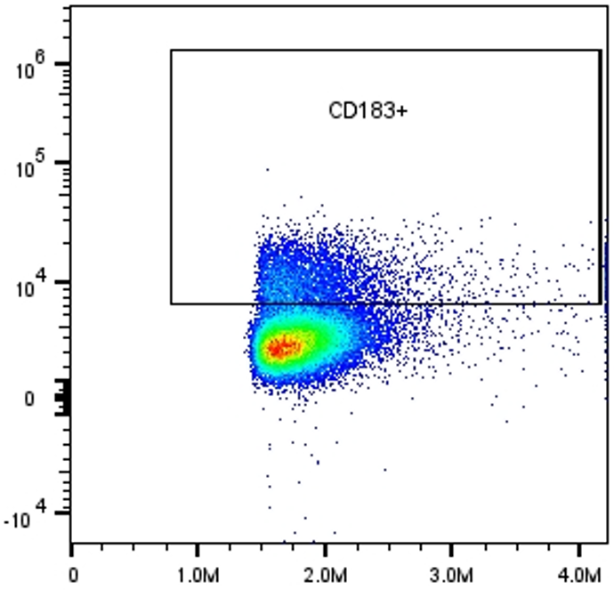
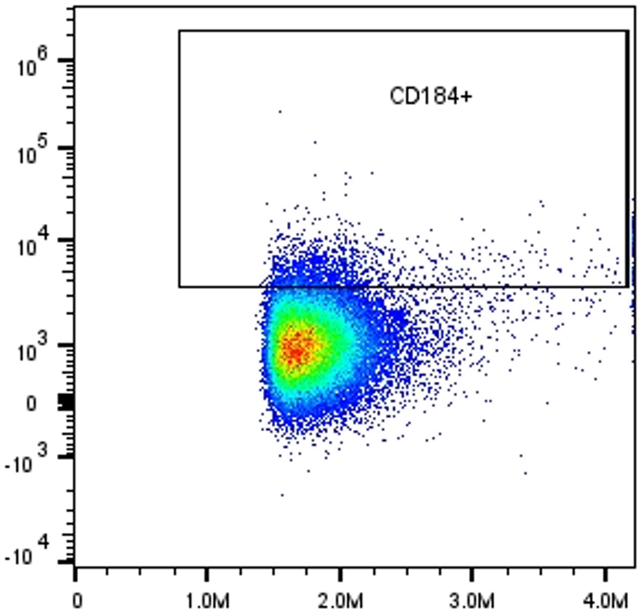
Supplemental Figure 7
Immune Cells
Single Cells
Live Cells
CD45+
CD3+/-
CD3+
CD4+/CD8+
CD3-
CD49b+
CD19+
CD205+
CD11c+
CD11b/Ly6c
CD11b
CD4+
CD49b+
Ly6c
CD11b/CD27
CD25+
CD183+
CD184+
CD11b
CD27

Slide 15
Supplemental Figure 7. Complete gating strategy for the flow cytometry experiments

Slide 16
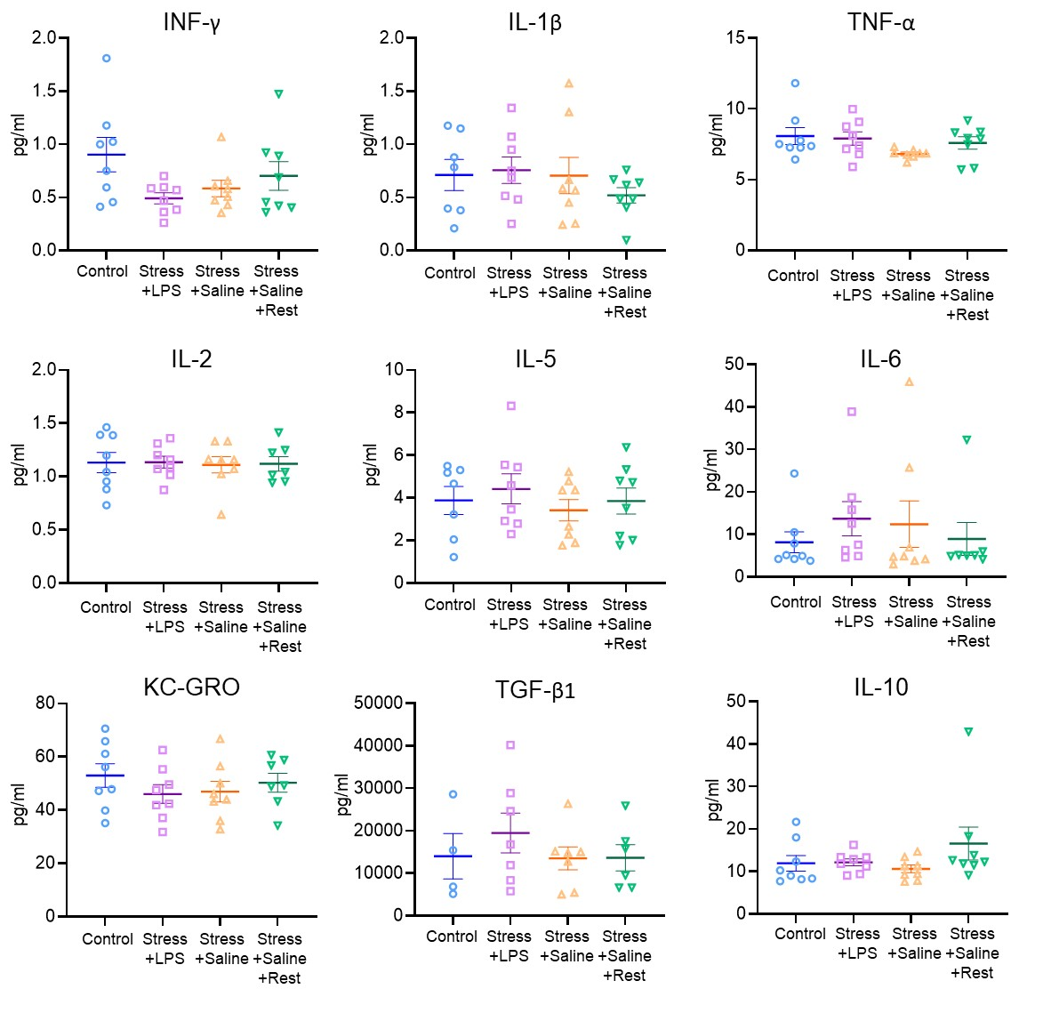
Supplemental Figure 8

Slide 17
Supplemental Figure 8. Results from the cytokine analysis in plasma.

