Slide 1
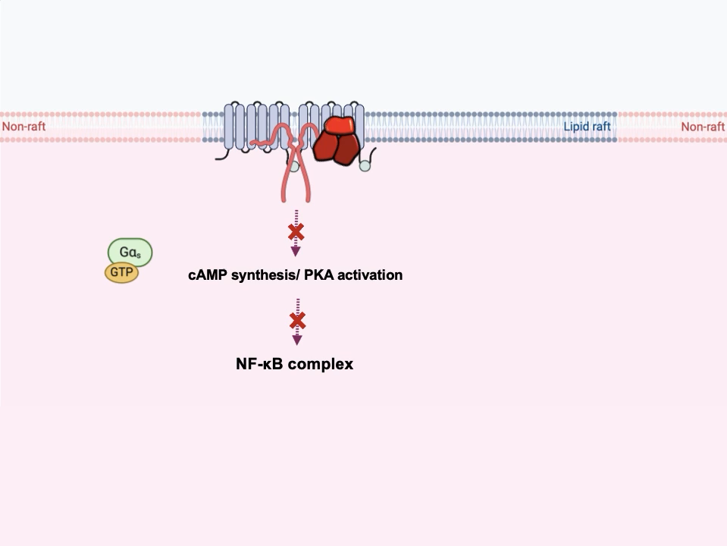

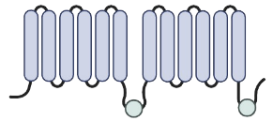
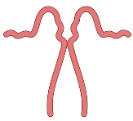
Abstract Animation
CAP1
Adenyl cyclase
(AC)
Caveoline
triple complex

