Slide 1
MEDA-PKD: A Dynamic, Real-Time Analytics Platform for Precision Care in Autosomal Dominant Polycystic Kidney Disease
Supplemental Figures
Suppl. Fig. 1: Outline of the technical infrastructure and data sources underlying MEDA-PKD
Suppl. Fig. 2: Filters available in the online tool
Suppl. Fig. 3: Cohort statistics
Suppl. Fig. 4: Supplements to baseline characteristics and extrarenal manifestations
Suppl. Fig. 5: Dashboard Family History
Suppl. Fig. 6: Dashboard “Medication“ providing information on usage of the most important drug classes in ADPKD.
Suppl. Fig. 7: Dashboard “Lifestyle“ providing information on smoking, coffee and alcohol consumption.
Suppl. Fig. 8: Total kidney volume, arterial hypertension and urological complications.
Suppl. Fig. 9: Individual patient-level eGFR trajectories including treatment effects.
Suppl. Fig. 10: Treatment effect of tolvaptan by sex.
Suppl. Fig. 11: The impact of tolvaptan on quality of life as assessed by the SF-12 questionnaire
Suppl. Fig. 12: Dashboard „Lab Values“

Slide 2
Suppl. Fig. 1: Outline of the technical infrastructure and data sources underlying MEDA-PKD
Graph modified and updated from Schmidt et al. Frontiers in Medicine 2024, https://doi.org/10.3389/fmed.2024.1430676
MEDA unifies various internal and external datasources into a normalized PostgreSQL database as a basis for Shiny-driven visualization and analysis. This process is automated through Jenkins. Additional datasources can be integrated into this workflow at any time.

Slide 3
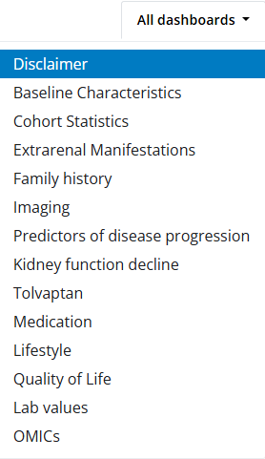
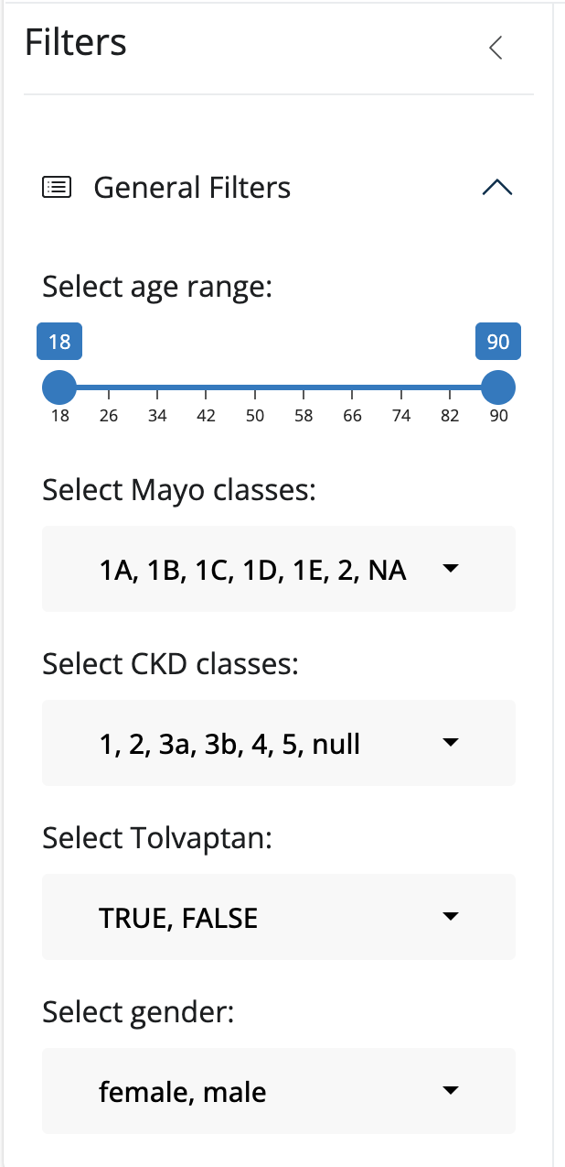
A
B
Suppl. Fig. 2: Filters available in the online tool
A MEDA-PKD provides several dashboards containing specific sets of information. All of the visualizations are updated in a real-time manner upon entry of new data into the database or automatic extraction of data (e.g. lab values) from the clinical information system. These tabs include General patient characteristics,cohort statistics family history, medication, extrarenal manifestations, imaging, predictors of disease progression (e.g. genotype, Mayo Imaging Class), annual eGFR decline, information on tolvaptan use, general lifestyle characteristics, quality of life and lab values.Besides, visualizations of serum proteome data linked to key clinical outcome parameters are accessible.
B To ensure a dynamic and versatile platform for the user, all dashboards can be filtered based on key clinical
characteristics such as age, Mayo Imaging Class, CKD stage, Tolvaptan usage and sex.

Slide 4
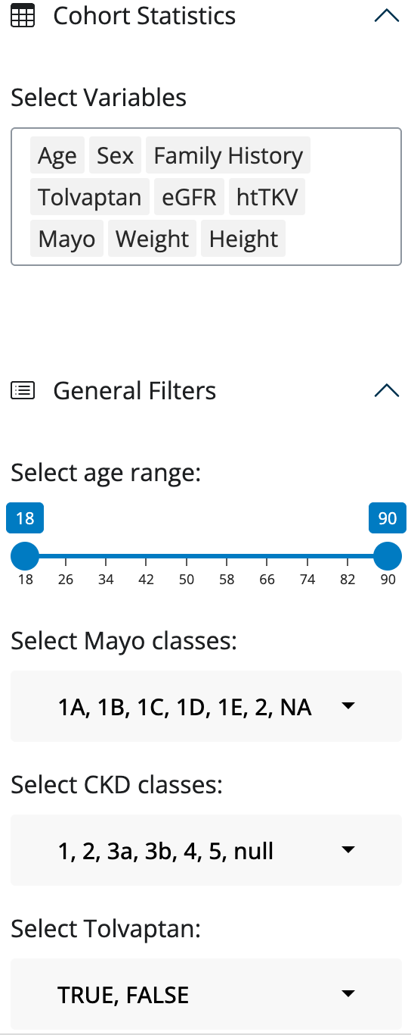
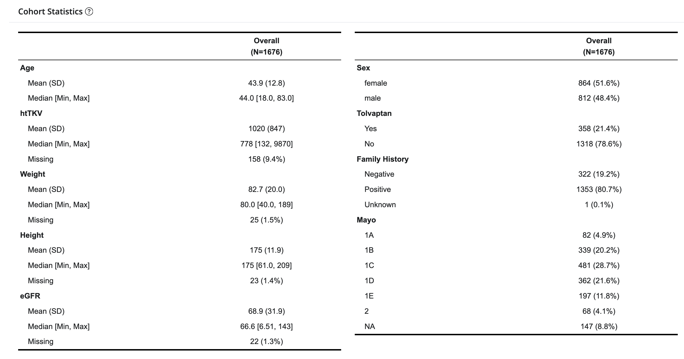
A
B
Suppl. Fig. 3: Cohort statistics
A Cohort statistics table as shown in the online MEDA-PKD tool when using default settings.
B This table can be adapted by filtering the cohort or adding / removing individual characteristics to be shown.

Slide 5
Suppl. Fig. 4: Supplements to baseline characteristics and extrarenal manifestations
A Distribution of patient recruitment across Germany. In total, data on 1676 patients was collected as of October 12, 2025 across 7 federal states including 16,879 serum creatinine values.
B Age at first diagnosis of ADPKD by sex.
C Echocardiographic findings in female and male patients
D Intracranial aneurysms and hemorrhage in male and female patients

Slide 6
Suppl. Fig. 5: Dashboard Family History
A Family history of cohort participants.
B Fraction of patients reporting early onset of dialysis in an affected parent.
C Fraction of patients reporting early kidney transplantation in an affected parent.

Slide 7
Suppl. Fig. 6: Dashboard “Medication“ providing information on usage of the most important drug classes in ADPKD.
A Antihypertensive medication classes.
B Pain medication.
C Statin treatment

Slide 8
Suppl. Fig. 7: Dashboard “Lifestyle“ providing information on smoking, coffee and alcohol consumption.
A Proportion of active smokers in the cohort.
B Pack years. NA are non-smokers: participants who never smoked, neither in the past nor at inclusion.
C Coffee consumption in cups per day.
D Alcohol consumption in grams per day.

Slide 9
Suppl. Fig. 8: Total kidney volume, arterial hypertension and urological complications.
A Height-adjusted total kidney volume (htTKV) by sex and age (Dashboard „Imaging“)
B Urological complications in the entire cohort (hemorrhagic events involving gross hematuria or cyst hemorrhages,
cyst infections, or flank pain related to cysts; Dashboard „Predictors of Disease Progression).
C Arterial hypertension in the entire cohort (Dashboard „Predictors of Disease Progression).
D Urological complications (hemorrhagic events involving gross hematuria or cyst hemorrhages, cyst infections, or flank pain related to cysts) classified by age of first onset as defined in the PROPKD score. Only data from patients who had reached the age of 35 years is included (percentage calculated towards the entire cohort).
E Arterial hypertension classified by age of first onset as defined in the PROPKD score. Only data from patients who had reached the age of 35 years is included. (percentage calculated towards the entire cohort).
F Type of urological complication.

Slide 10
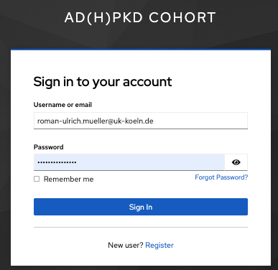
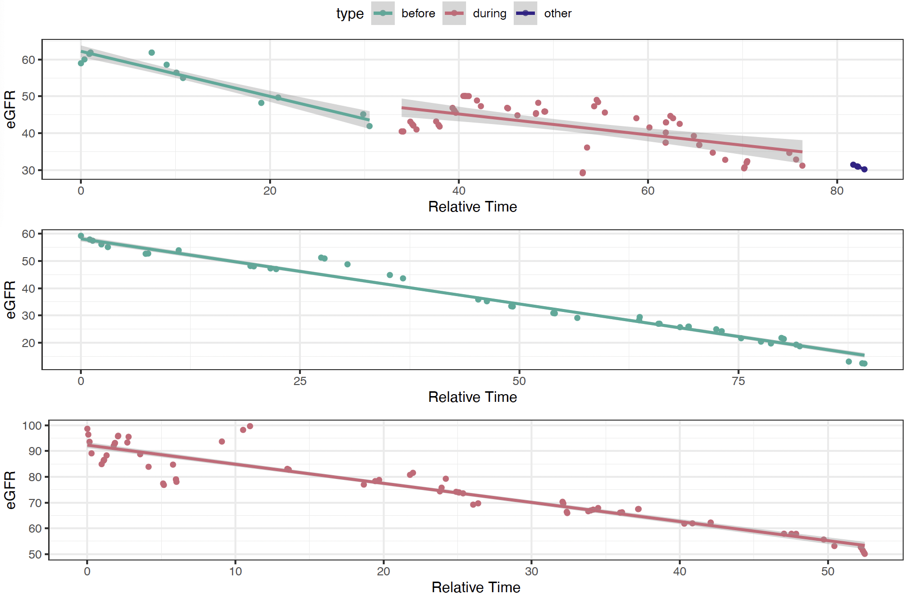
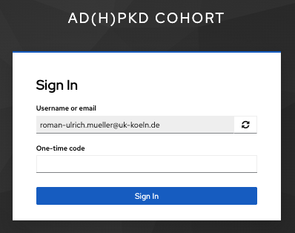
A
B
Step 1
C
Step 2
Suppl. Fig. 9: Individual patient-level eGFR trajectories including treatment effects.
A MEDA dual authentication log-in using Microsoft Authenticator allows study centers to view individual patient-level data
of their patients.
B In this regard, individual eGFR slopes are an important feature, e.g. to assess progression and potential future onset of
kidney failure.
C Besides, MEDA can visualize periods on and off treatment (before, during; shown for tolvaptan) to depict individual treatment
response. Creatinine values for which treatment status is unknown are shown as „other“.

Slide 11
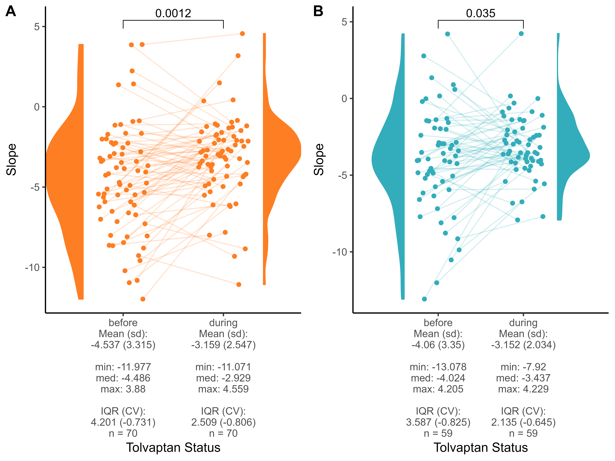
Suppl. Fig. 10: Treatment effect of tolvaptan by sex.
A Longitudinal paired analysis of eGFR slopes before and on tolvaptan in male patients only (using all eGFR values available)
B Longitudinal paired analysis of eGFR slopes before and on tolvaptan in female patients only (using all eGFR values available)

Slide 12
A
B
Suppl. Fig. 11: The impact of tolvaptan on quality of life as assessed by the SF-12 questionnaire
A Physical health score using all questionnaires filled while off or on tolvaptan.
B Mental health score using all questionnaires filled while off or on tolvaptan.
C Physical health score comparing the first questionnaire filled by patients never on tolvaptan compared to the first questionnaire on tolvaptan of patients who ever took tolvaptan
D Mental health score as in C
Green-shaded area depicts distribution in the normal population.
C
D

Slide 13
Suppl. Fig. 12: Dashboard „Lab Values“
A-D Standard parameters always shown in the dashboard are urine volume, urine osmolarity, ASAT and ALAT and their relation
to tolvaptan status at time of measurement.
E-G The user can select any of the 212 routine lab variables to visualize their relation to sex, Mayo Imaging Class and CKD stage.

