Slide 1
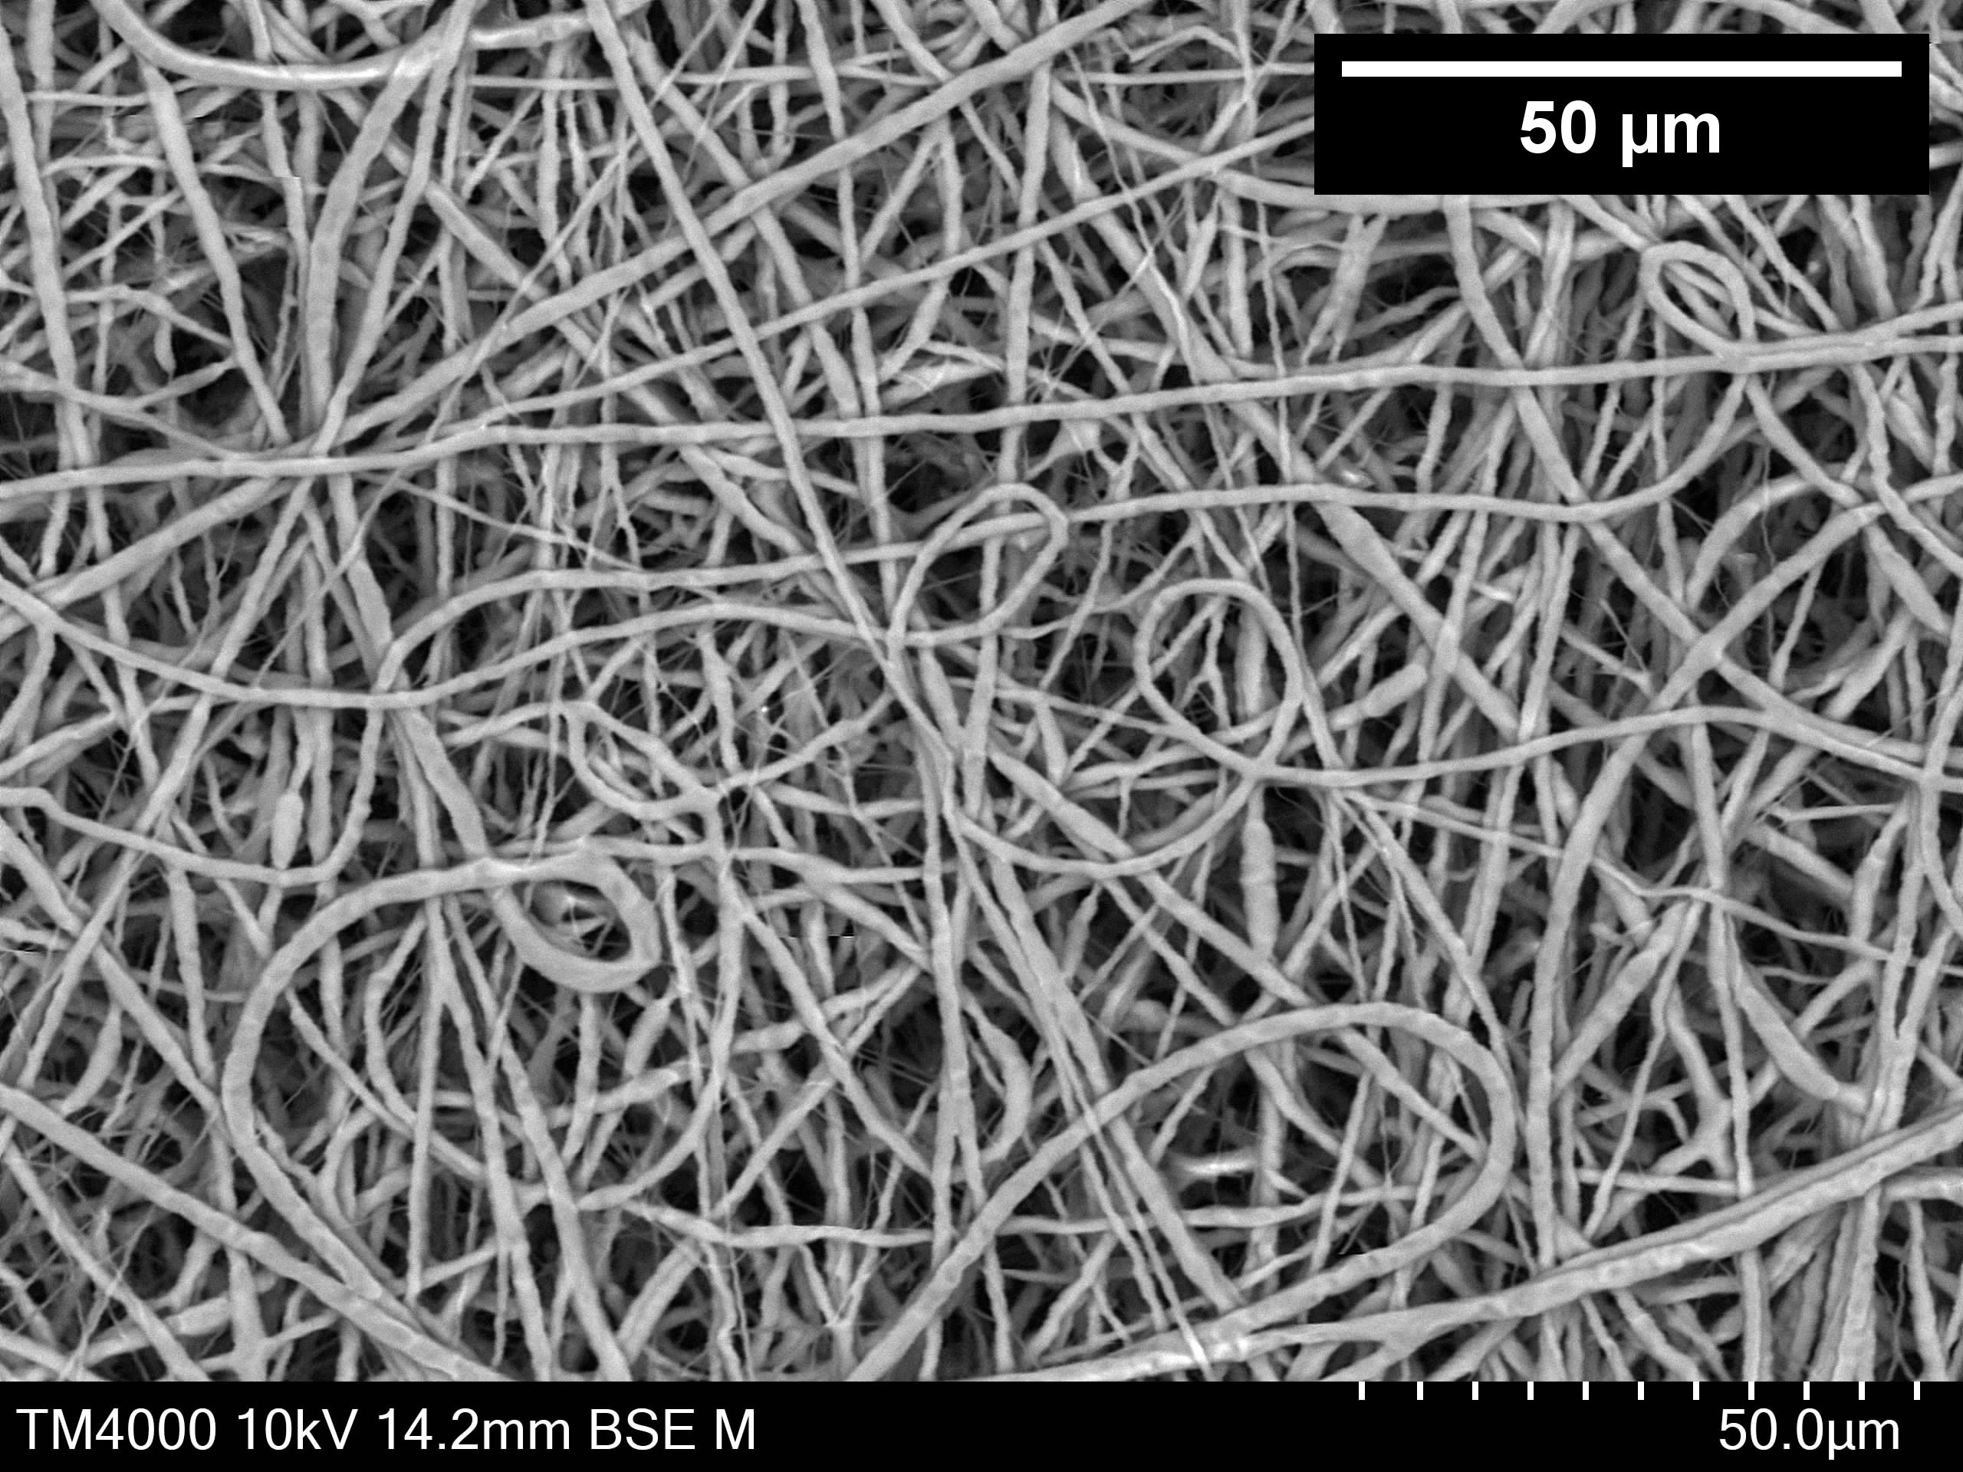
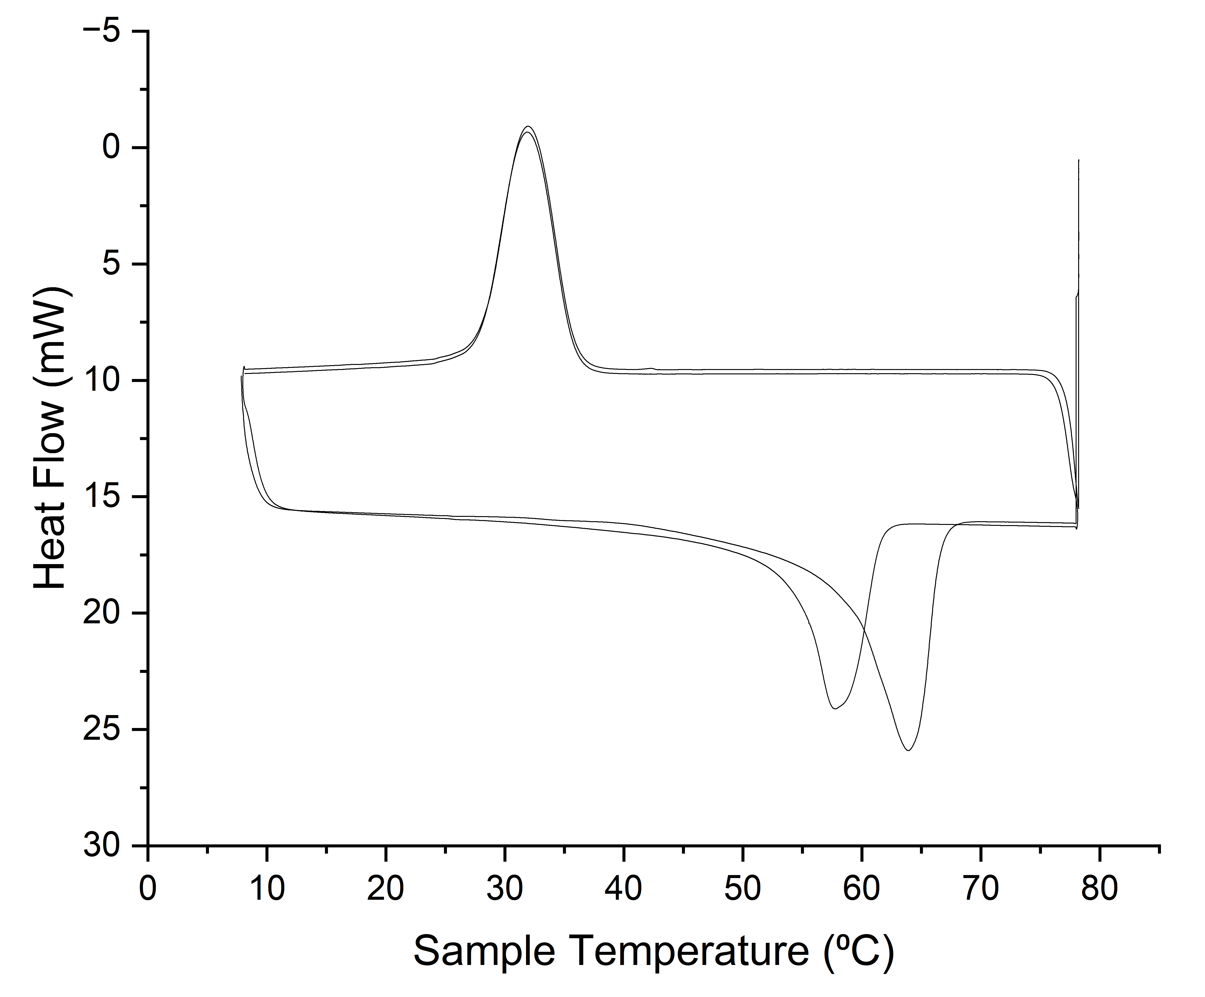
a.
b.
Measurement | Strain range (%) | Scaffold
Fibre Diameter (µm) | - | 1.84 ± 0.45
Scaffold thickness (µm) | - | 68.49 ± 0.57
Porosity (%) | - | 94.28 ± 0.07
Contact angle at 0.2s (°) | - | 101.38 ± 0.47
Ultimate tensile strength (MPa) | - | 4.95 ± 0.98
Incremental Young‘s Moduli (MPa) | 0-5 | 14.07 ± 1.50
Incremental Young‘s Moduli (MPa) | 5-10 | 13.12 ± 1.77
 | 10-15 | 8.32 ± 1.9
 | 15-20 | 6.38 ± 1.07
Crystallinity (%) | - | 44.89 ± 0.83
Melting Temperature (°C) | - | 62.48 ± 0.78
c.
d.
Stress v. Strain
Heat Flow v. Temperature
Ultimate Tensile Strength (MPa)
Crystallization (Exothermic peak)
ε
Melting (Endothermic peak)
Supplementary Figure 1 - Scaffold Characteristics: A. SEM image of the electrospun scaffold. B. Table presenting a summary of the physical and mechanical characteristics of the scaffold C. Representative stress versus strain curve of the scaffold. D. Representative DSC plot of the scaffold. Data represented as mean ± SD, n=6

