Slide 1
Shaller et al.
Supplementary Figures

Slide 2
Infant treatment
a
b
Juvenile treatment
c
Adult treatment
Supplementary Figure 1: Elevated plus maze performance across male and female cohorts following chemogenetic inhibition of OT-expressing neurons.
The number of entries into the open arms and the time spent in the open arms were quantified after inhibition at the neonatal stage (a), juvenile stage (b), and young adult stage (c). Data are presented as median and interquartile range. Statistical significance between groups was assessed using the Wilcoxon–Mann–Whitney test.

Slide 3
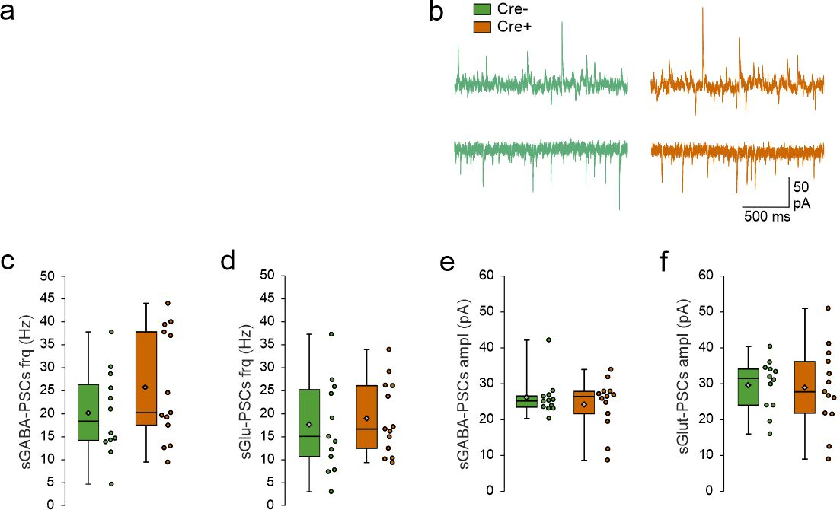
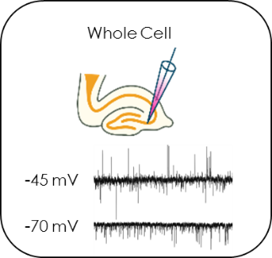
Supplementary Figure 2: Spontaneous Glutamatergic and GABAergic synaptic activity of CA3 pyramidal neurons in the anterior hippocampus region in mice following chemoinhibition of OT-expressing neurons during infancy (Cre+) compared to controls (Cre-) mice.
a) Schematic representation of the experimental protocol. Whole-cell recordings performed on CA3 pyramidal neurons were performed at a holding potential of −45 and -70 mV. The glutamatergic synaptic currents are inwards at -70 mV and the GABAergic synaptic currents are outwards at -45 mV. b) Examples of whole-cell recordings performed on CA3 pyramidal neurons at a holding potential of −45 and -70 mV at P50. c-d) Box plots of the frequency of GABA-sPSCs (c) and Glut-sPSCs (d). e-f) Box plots of the amplitude of GABA-sPSCs (e) and Glut-sPSCs (f).
Cre+ (N= 4, n=12) and Cre- (N=4, n=13) have been analyzed, with N: number of mice and n: number of recorded cells. Data represented in whisker-plots report the different values of recorded cells with mean ±SEM, with scattered plots showing individual data points: sGABA frq Cre- (20.1 ± 2.7); sGABA frq Cre+ (25.7± 3.3); sGlut frq Cre- (17.8 ± 2.8); sGlut frq Cre+ (18.9 ± 2.2); sGABA Ampl Cre- (25.7± 1.5); sGABA Ampl Cre+ (23.8 ± 2); sGlut Ampl Cre- (29.5± 2); sGlut Ampl Cre+ (28.8 ± 3.1).
Statistical significance between groups was determined Mann Whitney test

Slide 4
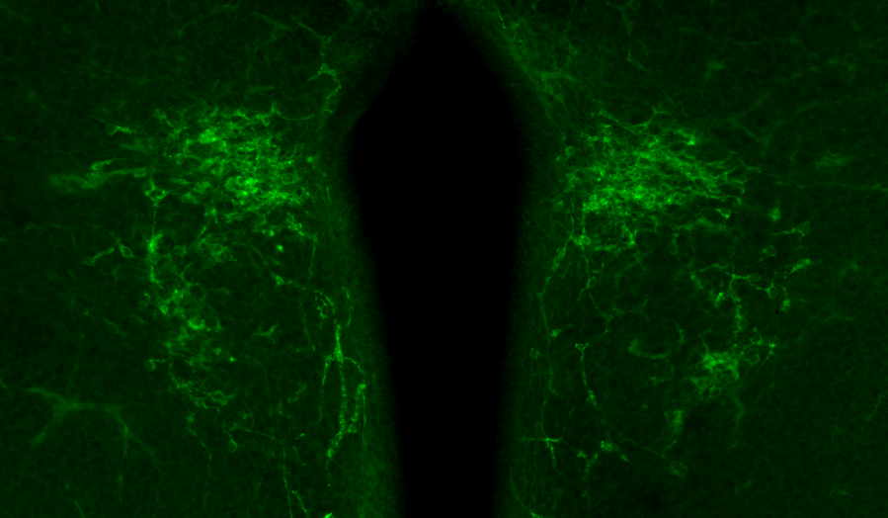
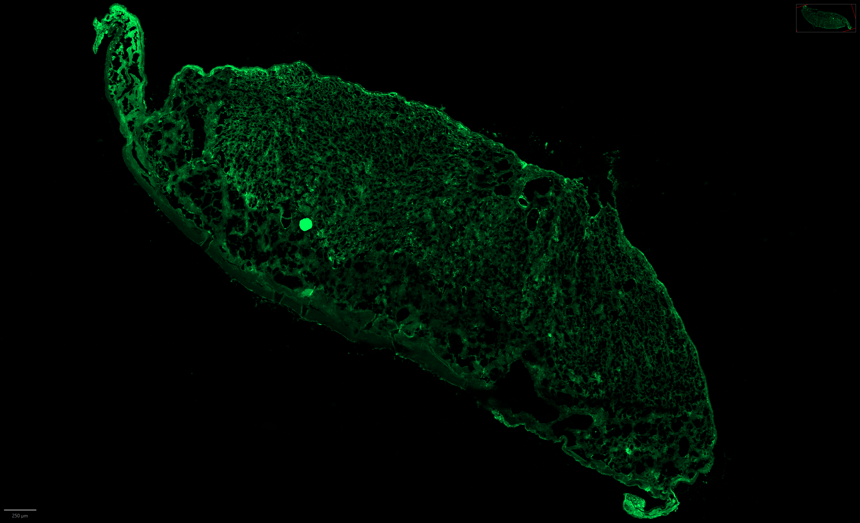
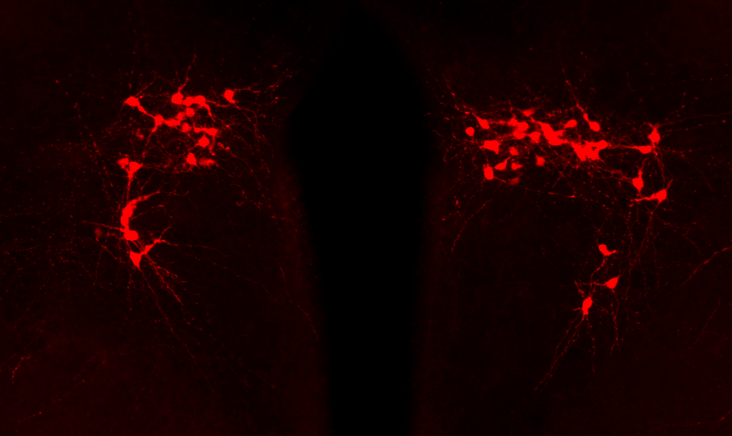
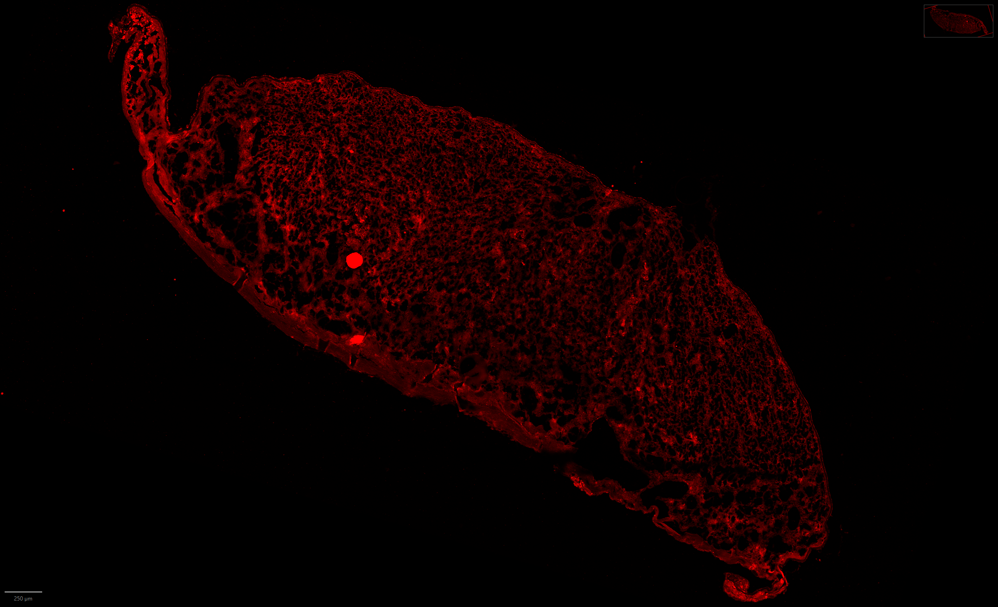
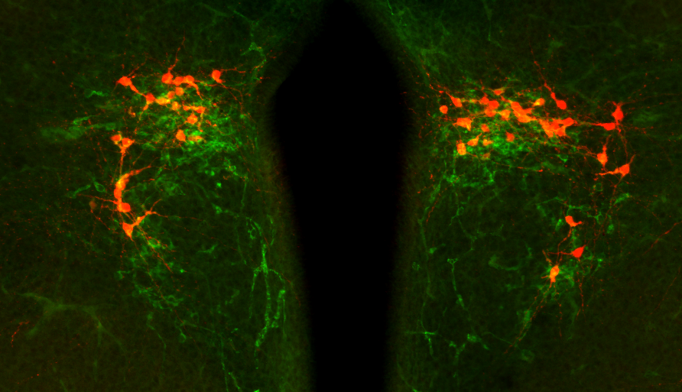
a
OT
d
OT
100 µm
b
TdTomato
250 µm
e
TdTomato
c
Merge
Supplementary Figure 3: Fetal oxytocin expression in the brain and placenta of E18.5 OT-Cre::Ai14 fetuses.
OT-Cre::Ai14 fetuses were generated by crossing an Ai14 (RCL-tdTomato) female with an OT-Cre male, allowing the visualization of OT expression via tdTomato fluorescence in fetal brain and placenta, but not in maternal tissues. OT expression, irrespective of maternal or fetal origin, was detected using an anti-OT antibody (green). (a, d) Immunohistochemistry using an anti-OT antibody in the brain (a) and placenta (d) of E18.5 fetuses. (b, e) Immunohistochemistry using an anti-tdTomato antibody in the brain (b) and placenta (e) of E18.5 fetuses. (c) Merged image in the brain.

