Slide 1
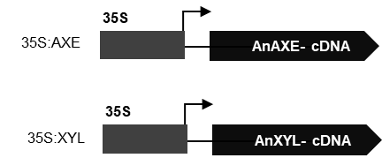
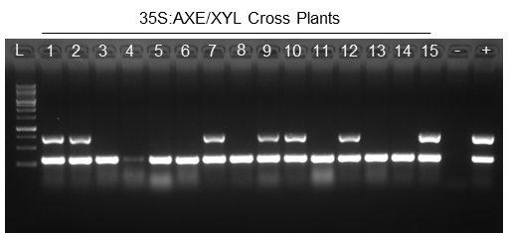
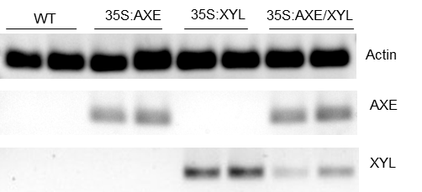
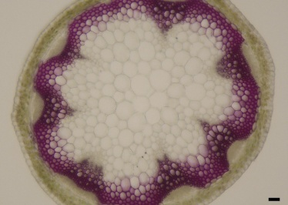
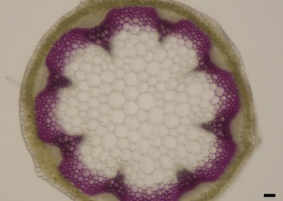
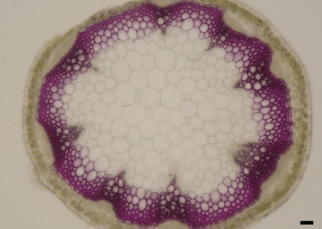
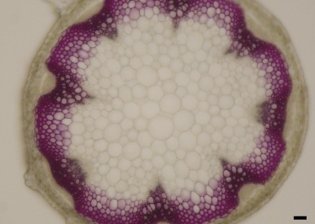
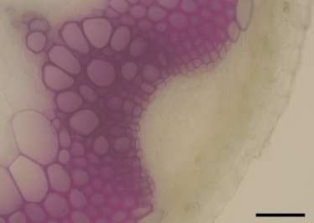
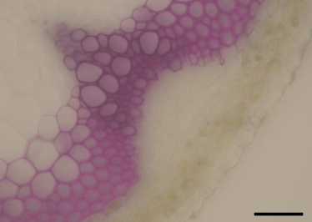
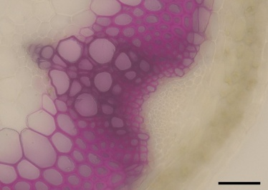
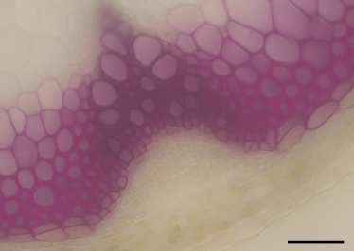
(a)
(b)
(c)
(d)
(e)
WT
35S:AXE
35S:XYL
35S:AXE/XYL
(f)
WT
35S:AXE
35S:XYL
35S:AXE/XYL
Supplementary Figure 1. Schematics of construct, genotyping, gene expression and anatomical studies
(a) Schematic representation of the gene constructs, the construct contains the Cam35S (35S) Promoter driving expression of AnAXE1 from Aspergillus niger and AnXYL from Aspergillus nidulans (b) DNA was isolated from transgenic lines expressing and its integration was confirmed amplifying using gene specific primer of AXE and XYL on PCR and run on agarose gel, L represents 1Kb DNA Ladder;1-15 are the 35S:AXE/XYL cross line (hemizygous); - represent as blank; + as combine DNA positive control of both parents, 700 bp band represent AXE, 300 bp represent XYL gene and (c) RT-qPCR based amplified product was run on agarose gel using ACTIN as reference gene. Six-week Arabidopsis WT and transgenic plant cross-sections were stained by Phloroglucinol-HCl (Wiesner) Staining Panel (d): 10X, Panel (e): 40X. Scale bar = 50 µm. (f) esterase activity was measured using p-nitrophenyl acetate as the substrate, and the product, p-nitrophenol, was monitored at 400 nm. Data presented as mean ± standard deviation (SD), n = 3-4 biological replicates. Statistical significance determined by Student's t-test at ***p ≤ 0.001, **p ≤ 0.01, *p ≤ 0.05).

Slide 2
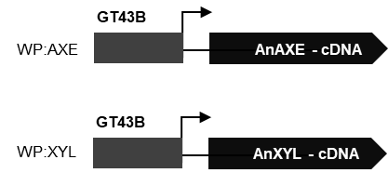
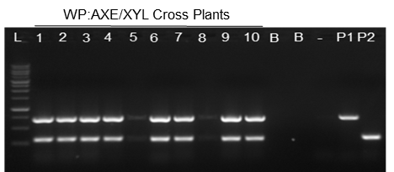
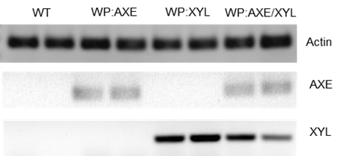
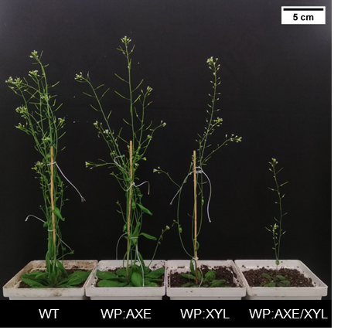
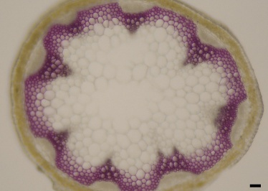
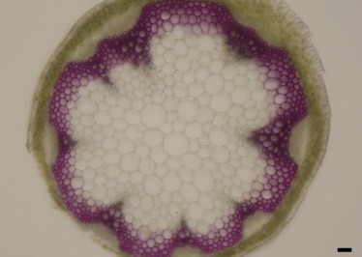
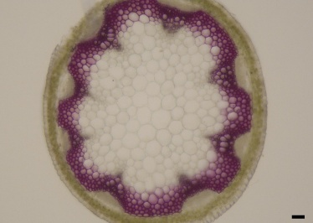
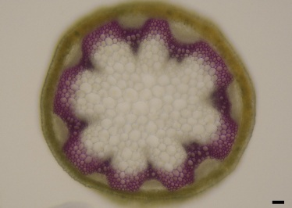
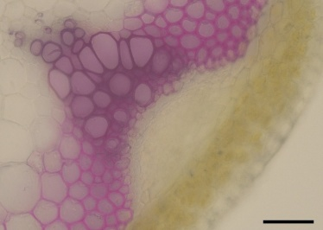
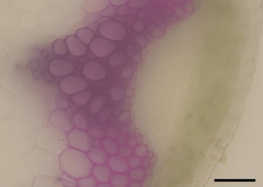
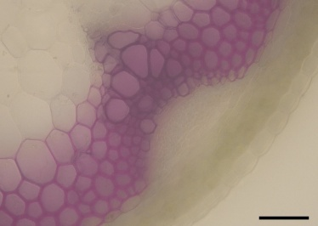
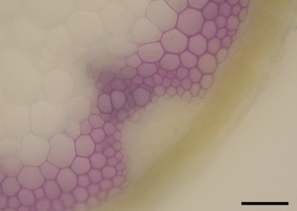
(a)
(b)
(c)
(d)
(e)
(f)
(g)
(h)
(i)
(j)
WT
WP:AXE
WP:XYL
WP:AXE/XYL
WT
WP:AXE
WP:XYL
WP:AXE/XYL

Slide 3
Supplementary Figure 2. Morphology, Gene Expression, Enzyme Activity, and Anatomical Analysis.
(a) Schematic representation of the gene constructs, containing GT43B (WP) Promoter driving expression of AnAXE from Aspergillus niger and AnXYL from Aspergillus nidulans (b) PCR amplified product on gel L= 1Kb DNA Ladder;1-10 = WP:AXE/XYL cross line; - represent as blank; P1 is WP:AXE parent represented 700 bp band, P2 is WP:XYL as 300 bp band (c) RT-qPCR amplified product run on gel of ACTIN, AXE and XYL (d) relative gene expression levels in inflorescence stem tissue of AXE were calculated by normalizing to the WP:AXE/XYL. Actin was used as a reference gene. (e) relative gene expression levels in inflorescence stem tissue of XYL were calculated by normalising to the WP:AXE/XYL. Actin was used as a reference gene. (f) esterase activity was measured on an acetylated Birchwood xylan substrate, and the released acetic acid was quantified using the Megazyme K-ACET kit. (g) Xylanase activity was assessed using XylX6 as a substrate (from Xylanase Assay kit K-XylX6-2V, Megazyme, Ireland), and the 4-nitrophenol released was measured at 400 nm. (h) representative image illustrating the morphology of a six-week-old plant expressing AXE and WP (pGT43B) promoter with WT. Bar = 5 cm. 6-week Arabidopsis WT and transgenic plant cross-section stained by Phloroglucinol-HCl (Wiesner) Staining Panel (i): 10X, Panel (j): 40X. Arrow denotes the undeveloped xylem. Scale bar = 50 µm. Data presented as mean ± standard deviation (SD) from 3-4 biological replicates. Statistical significance determined by Student's t-test, ***p ≤ 0.001, **p ≤ 0.01, *p ≤ 0.05).

Slide 4
(a)
(b)
(c)
(d)
(e)
(f)
Supplementary Figure 3. Plant cell wall composition on AIR samples prepared from Arabidopsis inflorescence stem
(a) Acetic acid content by saponification (b) Acetyl to xylose ratio (c) Xylose content by 1.3M HCL Acid hydrolysis (d) Total Carbohydrate content estimated by Phenol-Sulphuric acid method (e) Cellulose content by Updegraff’s method (f) Lignin content by acetyl bromide method. Data presented as mean ± standard deviation (SD) from 3-4 biological replicates. Statistical significance determined by Student's t-test, where ***p ≤0.001 **p≤0.01, *p≤0.05).

Slide 5
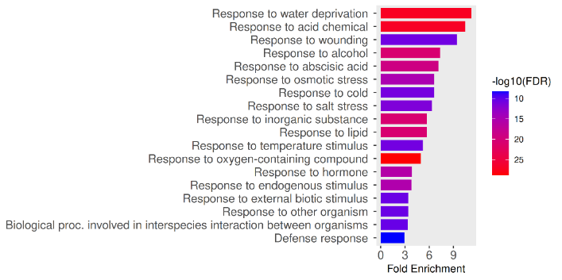
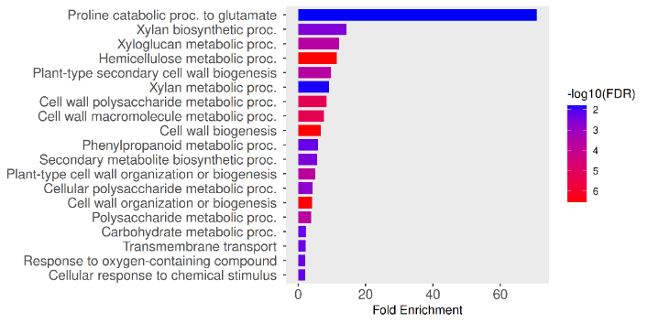
(a)
(b)
Top 20 UP GO- Biological Process (BP)
Top 20 DOWN GO- Biological Process (BP)
(c)
S.no | ID | Description | log2FoldChange
1 | AT5G01620 | TRICHOME BIREFRINGENCE-LIKE 35 | -6.645
2 | AT4G03210 | xyloglucan endotransglucosylase/hydrolase 9 | -2.085
3 | AT1G11545 | xyloglucan endotransglucosylase/hydrolase 8 | -1.799
4 | AT4G14130 | xyloglucan endotransglucosylase/hydrolase 15 | -1.318
5 | AT4G30270 | xyloglucan endotransglucosylase/hydrolase 24 | -1.313
6 | AT3G23730 | xyloglucan endotransglucosylase/hydrolase 16 | -1.311
7 | AT1G32170 | xyloglucan endotransglucosylase/hydrolase 30 | -1.29
8 | AT5G01360 | trichome birefringence-like protein (DUF828)/ TBL3 | -1.275
9 | AT1G73140 | trichome birefringence-like protein (DUF828)/ TBL31 | -1.239
10 | AT3G55990 | trichome birefringence-like protein (DUF828)/ TBL29/ESK1 | -1.223
11 | AT4G09990 | glucuronoxylan 4-O-methyltransferase-like protein (DUF579) | -1.145
12 | AT1G70230 | TRICHOME BIREFRINGENCE-LIKE 27 | -1.068
(d)
S.no | ID | Description | log2FoldChange
1 | AT1G16490 | myb domain protein 58 | -1.455
2 | AT3G21240 | 4-coumarate (4CL2) | -1.354
3 | AT1G51680 | 4-coumarate (4CL1) | -1.264
4 | AT4G22680 | myb domain protein 85 | -1.213
5 | AT4G01070 | UDP-Glycosyltransferase superfamily protein | -1.115
6 | AT4G36220 | ferulic acid 5-hydroxylase 1 | -1.096
7 | AT3G10340 | phenylalanine ammonia-lyase 4 | -1.095
8 | AT4G38620 | myb domain protein 4 | -1.074

Slide 6
Supplementary Figure 4. RNA sequencing analysis of WT and WP:AXE/XYL plants
RNA-seq analysis was performed on six-week-old stems of WT (as control) and WP:AXE/XYL. (a) Volcano plot shows the distribution of gene expression between WT and WP:AXE/XYL. The y-axis illustrates −log₁₀ p-values (FDR), and the x-axis corresponds to a log₂ fold gene expression. N represents the number of genes significantly upregulated and downregulated (b) GO analysis of the top 20 up- and down-regulated biological process categories was performed using ShinyGO 0.77 (http://bioinformatics.sdstate.edu/go/). Data represent mean ± SE, n = 3 biological replicates. (c) Differentially expressed genes involved in the cell wall polysaccharide metabolic process of WP:AXE/XYL side stem (c) Differentially expressed genes involved in Phenylpropanoid metabolic process. of WP:AXE/XYL side stem.

Slide 7
Supplementary Figure 5. Xylo-oligosaccharide analysis by MALDI-TOF on AIR of Arabidopsis inflorescence stem through xylanase (GH11) digestion.
Data represent mean ± SD, n = 3 replicates, Student’s t-test at ***p ≤ 0.001, **p ≤ 0.01, *p ≤ 0.05, applied between genotypes. % difference representation is compared to wild-type plants.

Slide 8
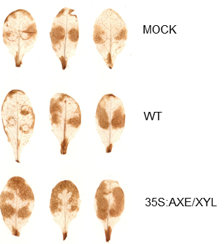
Supplementary Figure 6. Picture of Arabidopsis leaf after DAB staining
H2O2 accumulation measured by DAB staining at 30 min in four-week-old Arabidopsis rosette leaves due to infiltration of xylanase digestion supernatant of WT, 35S:AXE/XYL in WT leaves. Buffer was infiltrated as a mock control.

