Slide 1
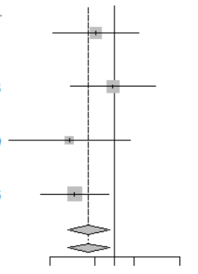
Subgroup | n |  | HR (95%CI) | P value
CCND1 amplification − | 49 |  | Reference
amplification + | 5 |  | 0. 51 (0.11–2.33) | 0.40
ESR1 wild-type | 51 |  | Reference
mutant | 3 |  | 0.94 (0.20–4.25) | 0.94
PIK3CA wild-type | 51 |  | Reference
mutant | 3 |  | 0.20 (0.02–1.72) | 0.14
TP53 wild-type | 47 |  | Reference
mutant | 7 |  | 0.24 (0.07–0.81) | 0.02
0.1
0.5
1
2
10

