Slide 1
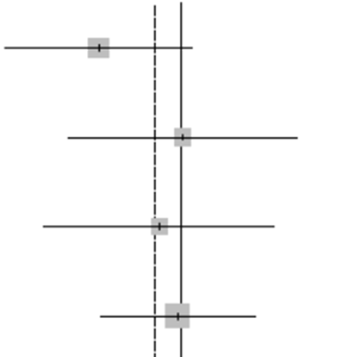
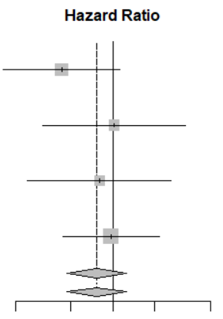
Subgroup | n |  | HR (95%CI) | P value
CCND1 amplification − | 49 |  | Reference
amplification + | 5 |  | 0.43 (0.17–1.13) | 0.09
ESR1 wild-type | 51 |  | Reference
mutant | 3 |  | 1.02 (0.31–3.3) | 0.98
PIK3CA wild-type | 51 |  | Reference
mutant | 3 |  | 0.8 (0.25–2.63) | 0.72
TP53 wild-type | 47 |  | Reference
mutant | 7 |  | 0.97 (0.43–2.16) | 0.94
0.2
0.5
1
2
5

