Slide 1
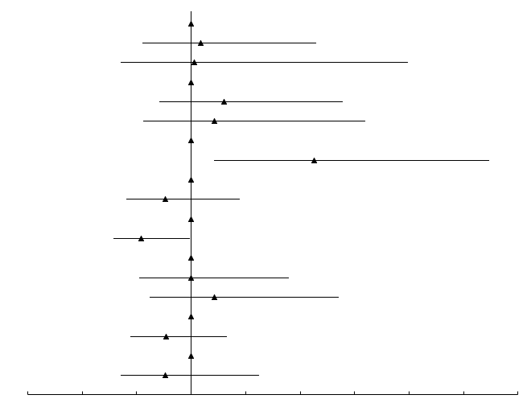
Subgroup | n |  | HR (95%CI) | P value
Site of Metastasis Bone-only | 13 |  | reference
Visceral metastasis | 45 |  | 1.09 (0.56–2.14) | 0.80
Other | 6 |  | 1.03 (0.36–3.00) | 0.96
Prior treatment line 1 | 34 |  | reference
2 | 20 |  | 1.30 (0.71–2.34) | 0.40
≥ 3 | 10 |  | 1.21 (0.57–2.60) | 0.62
Prior ET TAM or AI | 28 |  | reference
Fulvestrant | 36 |  | 2.13 (1.21–3.73) | 0.01
Prior history of CT for MBC yes | 14 |  | reference
no | 50 |  | 0.77 (0.41–1.44) | 0.41
ECOG-PS 0 | 43 |  | reference
1 | 21 |  | 0.54 (0.30–0.99) | 0.05
Number of Metastasis 1 | 28 |  | reference
2 | 21 |  | 1.00 (0.53–1.90) | 1.00
≥ 3 | 15 |  | 1.21 (0.63–2.35) | 0.60
Menopausal Status Premenopausal | 24 |  | reference
Postmenopausal | 40 |  | 0.77 (0.45–1.33) | 0.34
Disease free interval < 36 months | 11 |  | Reference
≥ 36 months | 29 |  | 0.76 (0.36–1.62) | 0.48
－0.5 0 0.5 1 1.5 2 2.5 3 3.5 4

