Slide 1
Fig. 5a
Vector
Vector
Vector
Vector
Δ284-319
Δ284-319
Δ284-319
Δ284-319
Wild-type
Wild-type
Wild-type
Wild-type
Dox
- - - + + +
- - - + + +
p-C/EBPβ
C/EBPβ
GAPDH
TPC-1
SNU-790

Slide 2
p-C/EBPβ
C/EBPβ

Slide 3
p-C/EBPβ
GAPDH

Slide 4
Fig. 6a
Vector
Wild-type
Δ284-319
OFF
ON
OFF
ON
ON
OFF
ON
ON
ON
ON
ON
ON
Dox
Days
0 1 2 3
0 1 2 3
0 1 2 3
C/EBPβ
GAPDH

Slide 5
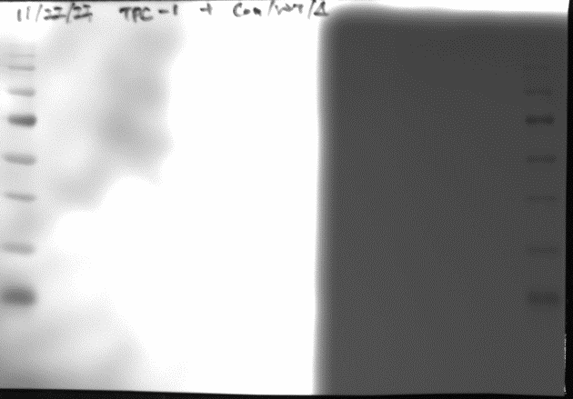
C/EBPβ
C/EBPβ
GAPDH

Slide 6
Vector
Wild-type
Δ284-319
OFF
washoff
OFF
washoff
washoff
OFF
washoff
washoff
washoff
ON
ON
ON
Dox
Days
0 1 2 3
0 1 2 3
0 1 2 3
C/EBPβ
GAPDH
TPC-1

Slide 7
C/EBPβ
C/EBPβ
GAPDH

Slide 8
Vector
Wild-type
Δ284-319
OFF
ON
OFF
ON
ON
OFF
ON
ON
ON
ON
ON
ON
Dox
Days
0 1 2 3
0 1 2 3
0 1 2 3
C/EBPβ
GAPDH

Slide 9
C/EBPβ
GAPDH
GAPDH

Slide 10
Vector
Wild-type
Δ284-319
OFF
washoff
OFF
washoff
washoff
OFF
washoff
washoff
washoff
ON
ON
ON
Dox
Days
0 1 2 3
0 1 2 3
0 1 2 3
C/EBPβ
GAPDH
SNU-790

Slide 11
C/EBPβ
GAPDH
GAPDH

Slide 12
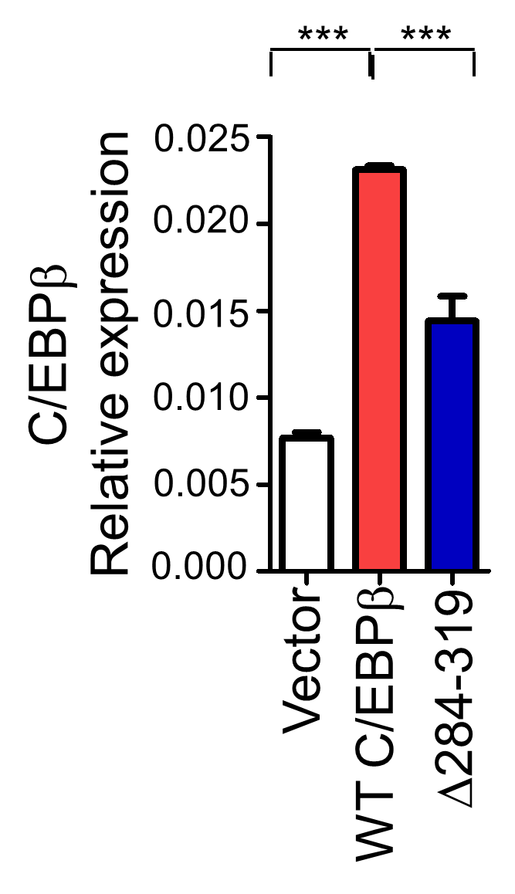
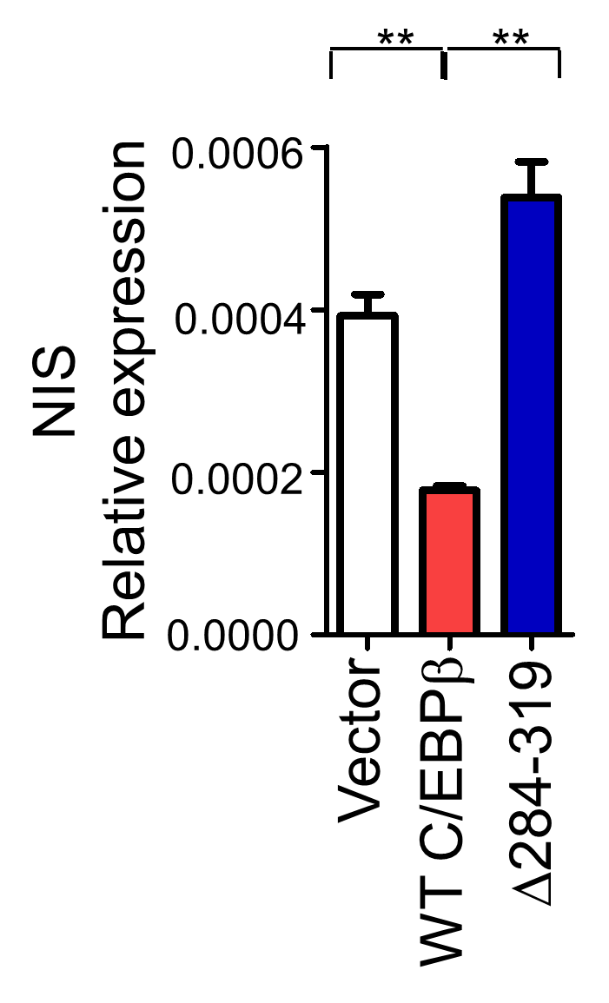
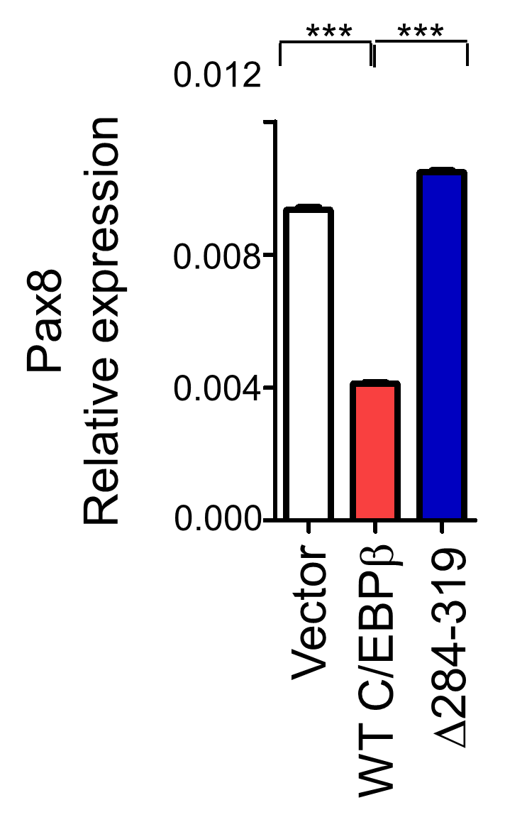
Fig. 5g
Vector | 0.007239 | 0.008258 | 0.00879 | 0.007759 | 0.006479 | 0.007922 | 0.008609 | 0.006302
WT C/EBPb | 0.022876 | 0.023357 | 0.023848 | 0.023035 | 0.022406
Δ284-319 | 0.016176 | 0.011281 | 0.017579 | 0.016289 | 0.010672
Vector | 0.00044 | 0.000388 | 0.00035
WT C/EBPb | 0.000189 | 0.000173 | 0.000171
Δ284-319 | 0.000597 | 0.000452 | 0.000565
Vector | 0.093428 | 0.092783 | 0.090873 | 0.094078 | 0.096055
WT C/EBPb | 0.041521 | 0.03983 | 0.04181 | 0.041235 | 0.04181
Δ284-319 | 0.103665 | 0.105112 | 0.105112 | 0.103665 | 0.106579

Slide 13
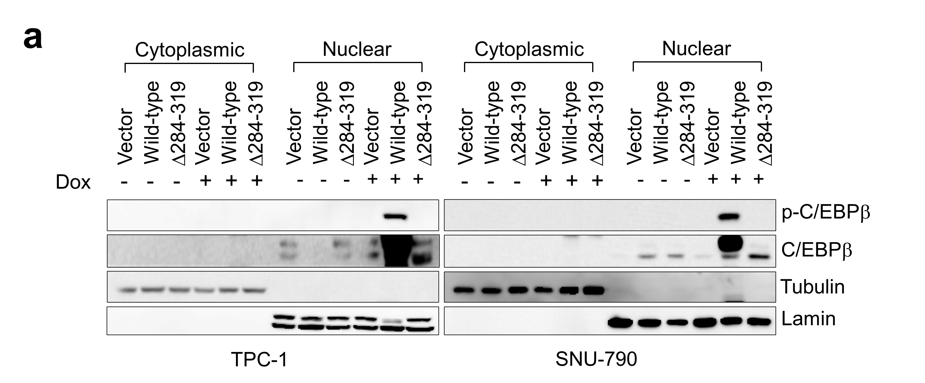
Supplementary Fig. 7a

Slide 14
p-C/EBPβ
C/EBPβ

Slide 15
Tubulin
p-C/EBPβ
Lamin

Slide 16
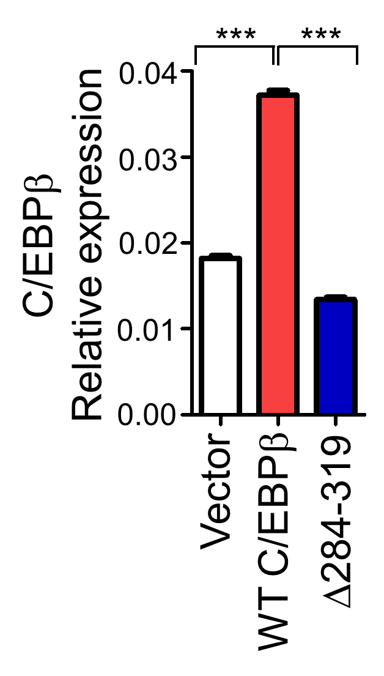
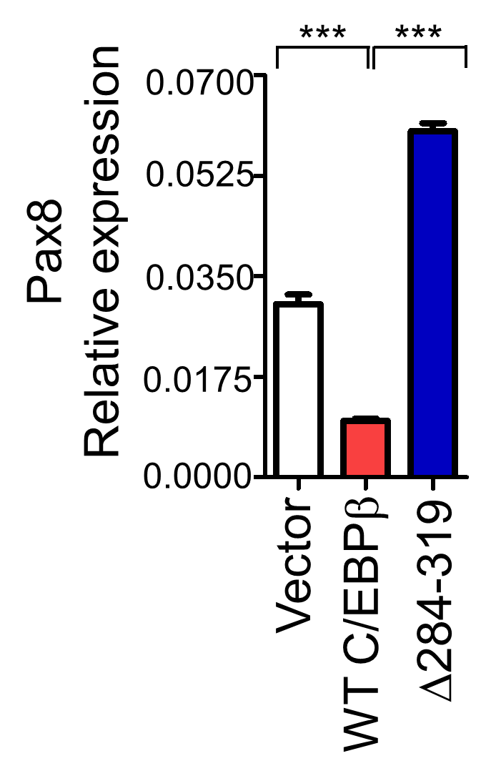
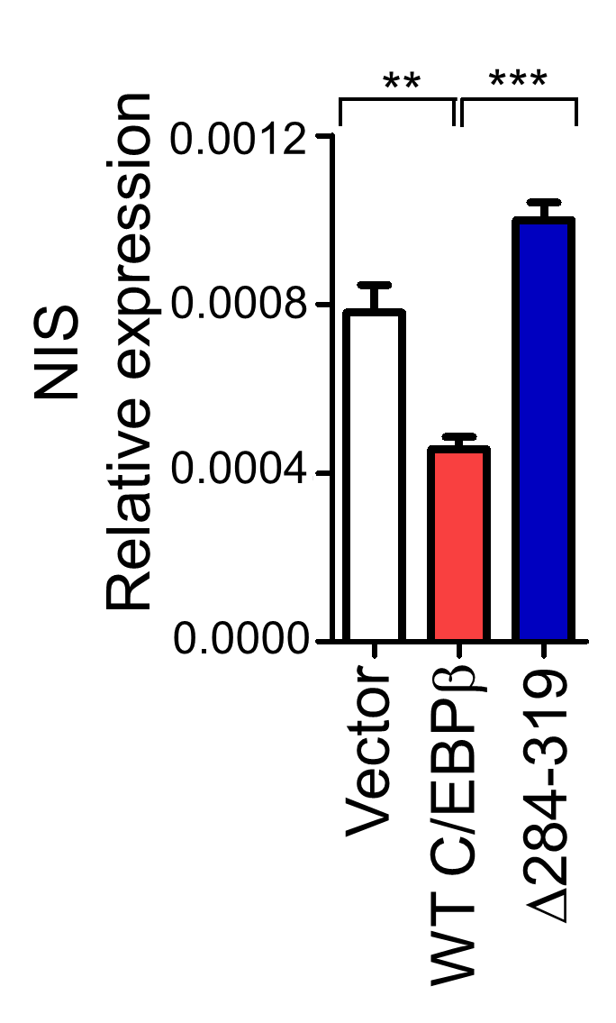
Supplementary Fig. 7c
Vector | 0.017701 | 0.019104 | 0.017948 | 0.017337 | 0.018972
WT C/EBPb | 0.038473 | 0.035897 | 0.036651 | 0.038473 | 0.036651
Δ284-319 | 0.013508 | 0.014378 | 0.013322 | 0.012691 | 0.013139
Vector | 0.02683 | 0.028756 | 0.027017 | 0.033032 | 0.035158
WT C/EBPb | 0.010672 | 0.010309 | 0.010525 | 0.008851 | 0.008912
Δ284-319 | 0.05954 | 0.05872 | 0.061214 | 0.05672 | 0.065154
Vector | 0.001032 | 0.000672 | 0.000735 | 0.000715 | 0.00075
WT C/EBPb | 0.000434 | 0.000557 | 0.000437 | 0.00038 | 0.000475
Δ284-319 | 0.00093 | 0.001106 | 0.000886 | 0.00099 | 0.001084

