Slide 1
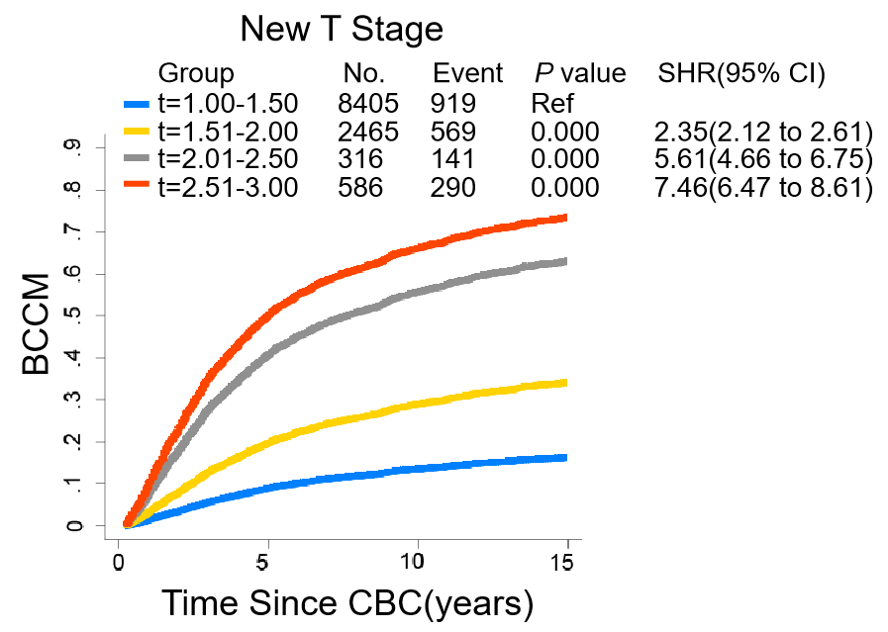
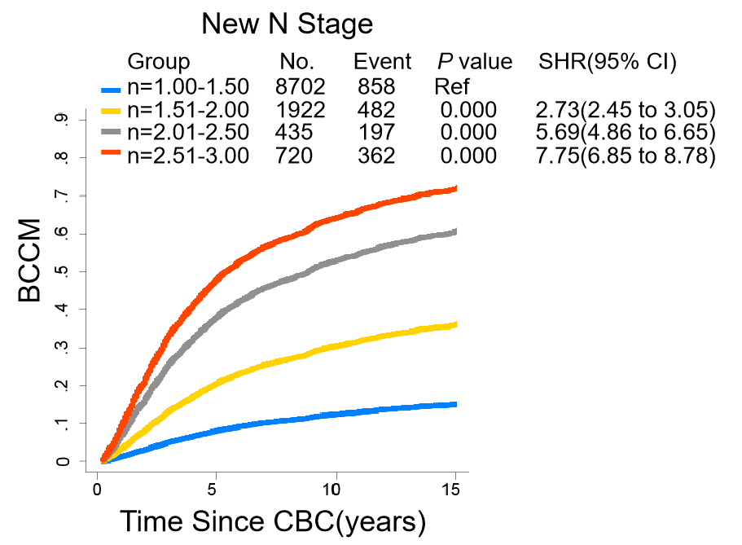
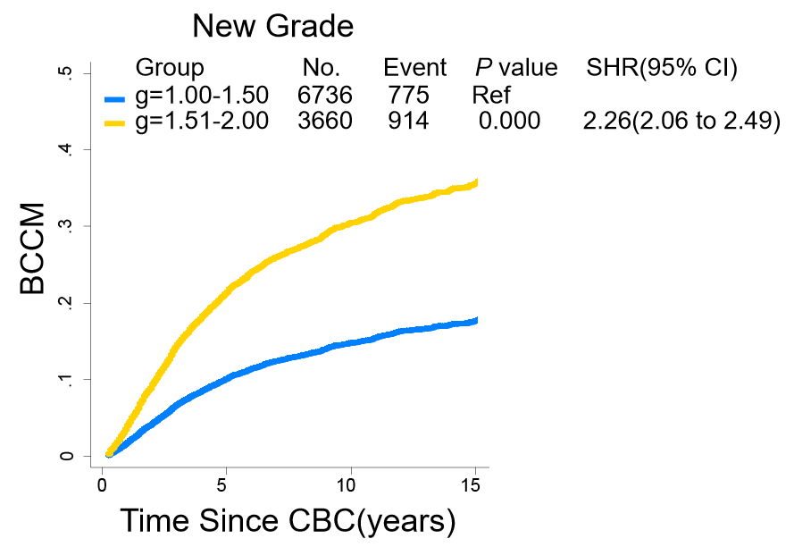
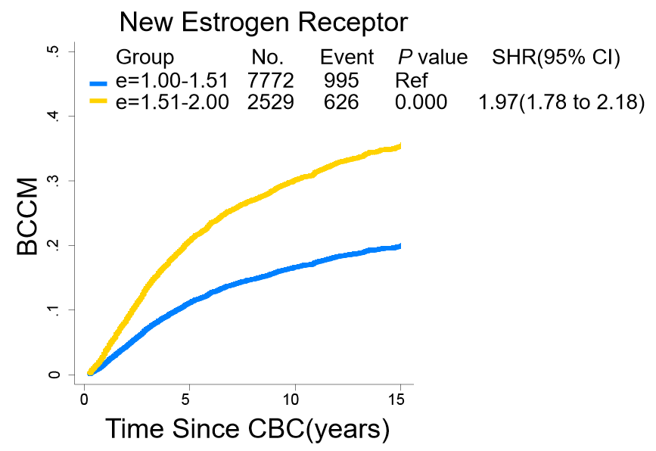
A
T^{DR} Stage
B
N^{DR} Stage
Grade^{DR}
ER^{DR} Status
C
D
Figure S1. The BCCM curves of DR clinical features in MBBC

