Slide 1
Supplementary Figure 1. HER2 gene expression in patients with and without pCR
P=0.003
TPM

Slide 2
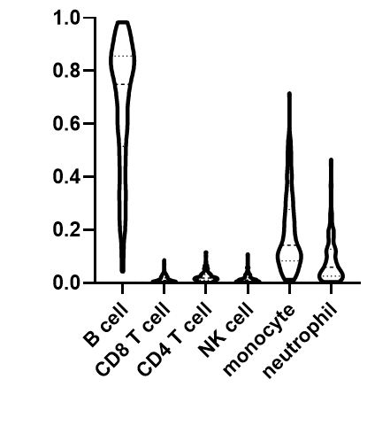
Supplementary Figure 2. The average proportion and spectrum of the infiltrated immune cell types
proportion

Slide 3

Supplementary Figure 3. illustration of this study. The signature of the mature B-cell/MHC II antigen presentation predicts the best pCR rate and the favorable survival
Her2-positive breast cancer
Pathologic complete response
Key factor?
ER/PR status
Gene mutation
Tumor infiltration lymphocyte (TIL)
others
RNA sequencing / Immunochemical stain
Antigen presenting B cell: independent factor
immunofluorescence study
Gene expression signature
Mechanism
CD4
Response/Survival
Antigen presentation
Mature B cell
Recurrence-free survival
pCR rate
CD8
Time
Cancer cell
Mature B/MHC II signature
Non-Mature B/MHC II signature

