Slide 1

THORACIC EXTENSION

Slide 2
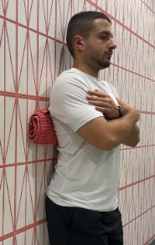

THORACIC EXTENSION
Position
Stand against the wall with a towel placed on the upper/medium/lower thoracic spine
Key points
Place your hands behind yourt neck for upper spine
Place your hands crossed over your shoulder for médium spine
Place your hands crossed over the same segment for lower spine
SETS | REPS | TUT | REST
3 upper spine | 6 | 30-45” | 1’
3 medium spine | 6 | 30-45” | 1’
3 lower spine | 6 | 30-45” | 1’

Slide 3
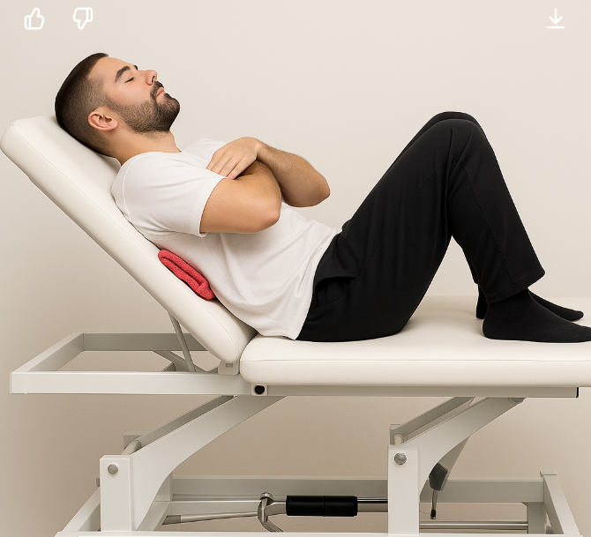

THORACIC EXTENSION
Position
Supine position with a towel placed on the upper/medium/lower thoracic spine and the table at 45º
Key points
Place your hands behind yourt neck for upper spine
Place your hands crossed over your shoulder for médium spine
Place your hands crossed over the same segment for lower spine
SETS | REPS | TUT | REST
3 upper spine | 6 | 30-45” | 1’
3 medium spine | 6 | 30-45” | 1’
3 lower spine | 6 | 30-45” | 1’

Slide 4

THORACIC EXTENSION
Position
Supine position with a towel placed on the upper/medium/lower thoracic spine and the table between 20 and 45º
Key points
Place your hands behind yourt neck for upper spine
Place your hands crossed over your shoulder for médium spine
Place your hands crossed over the same segment for lower spine
SETS | REPS | TUT | REST
3 upper spine | 6 | 30-45” | 1’
3 medium spine | 6 | 30-45” | 1’
3 lower spine | 6 | 30-45” | 1’

Slide 5

THORACIC EXTENSION
Position
Supine position with a towel placed on the upper/medium/lower thoracic spine and the table between 0º and 20º
Key points
Place your hands behind yourt neck for upper spine
Place your hands crossed over your shoulder for médium spine
Place your hands crossed over the same segment for lower spine
SETS | REPS | TUT | REST
3 upper spine | 6 | 30-45” | 1’
3 medium spine | 6 | 30-45” | 1’
3 lower spine | 6 | 30-45” | 1’

Slide 6

THORACIC EXTENSION
Position
Supine position with a towel placed on the upper and medium thoracic spine and the table between 0º and 20º
Create coupled movements:
Extension + left side bending + right rotation
Extension + right side bending + left rotation
Key points
Place your hands behind yourt neck for upper spine
Place your hands crossed over your shoulder for médium spine
Mantain hip flexión to protect lumbar spine.
SETS | REPS | TUT | REST
4 upper spine | 8-12 | 5-10-5 | 1’ 30”
4 medium spine | 8-12 | 5-10-5 | 1’ 30”

Slide 7

THORACIC EXTENSION
Position
Supine position with a towel placed on the upper and medium thoracic spine
Create coupled movements:
Extension + left side bending + right rotation + arm flexion
Extension + right side bending + left rotation + arm flexion
Key points
Place your hands behind yourt neck for upper spine
Place your hands crossed over your shoulder for médium spine
Mantain hip flexión to protect lumbar spine.
SETS | REPS | TUT | REST
4 upper spine | 8-12 | 5-10-5 | 1’ 30”
4 medium spine | 8-12 | 5-10-5 | 1’ 30”

Slide 8
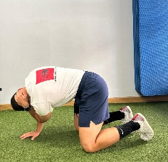
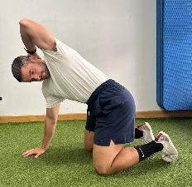


THORACIC EXTENSION
Position
Quadruped position with hands at shoulder heigh. Grab your neck with your hand and bend your elbow. In this position rotate your torso until you feel restriction.
Key points
Mantain double chin position to relieve cervical stress
Mantain core activation for good lower back control
SETS | REPS | TUT | REST
4 right side | 8-12 | 5-5-5 | 1’
4 left side | 8-12 | 5-5-5 | 1’
Increase to 6 sets in the second session

Slide 9
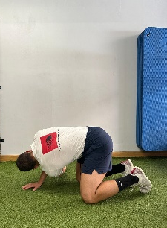
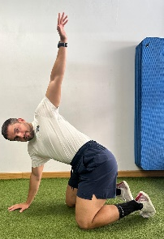

THORACIC EXTENSION
Position
Quadruped position with hands at shoulder heigh. Grab your neck with your hand and bend your elbow. In this position rotate your torso until you feel restriction with the arm extended.
Key points
Mantain double chin position to relieve cervical stress
Mantain core activation for good lower back control
SETS | REPS | TUT | REST
4 right side | 8-12 | 5-5-5 | 1’
4 left side | 8-12 | 5-5-5 | 1’
Increase to 6 sets in the second session

Slide 10
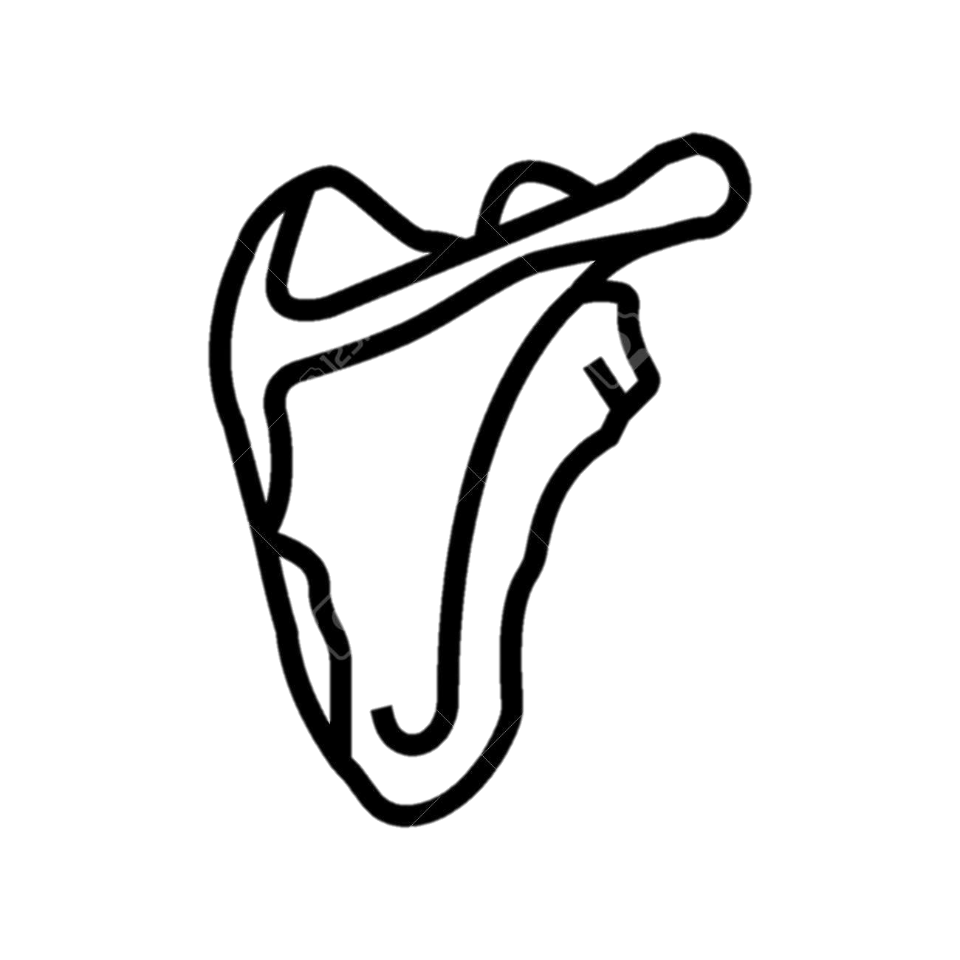
SCAPULAR PATTERN CONTROL

Slide 11
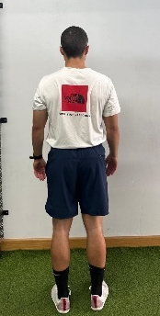
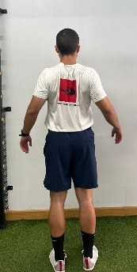

SCAPULAR PATTERN CONTROL
Position
In standing position, start with your shoulders slightly forward. Then bring your chest out by squeezing your scapulas.
Key points
Do not lift your shoulders.
Pull shoulders back and sligthly down
SETS | REPS | TUT | REST
4 - 1st session | 8-12 | 5-5-5 | 1’ 30”
6 - 2st session | 8-12 | 5-5-5 | 1’ 30”

Slide 12
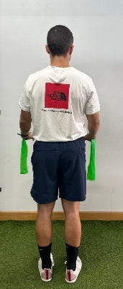
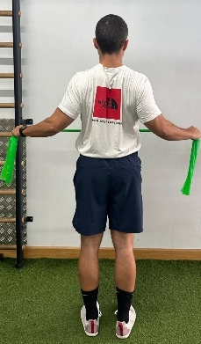
SCAPULAR PATTERN CONTROL
Position
In standing position, start with your shoulders slightly forward and a elastic band in your hands. Then bring your chest out by squeezing your scapulas.
Key points
Do not lift your shoulders.
Pull shoulders back and sligthly down
Try to “break” the elastic band
RPE-RIR | SETS | REPS | TUT | REST
RPE 7 RIR < 3 | 4 – 1st session | 8-12 | 5-5-5 | 1’ 30”
RPE 7 RIR < 3 | 6 – 2nd session | 8-12 | 5-5-5 | 1’ 30”

Slide 13
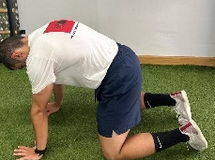
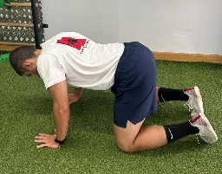

SCAPULAR PATTERN CONTROL
Position
In quadruped position, start with your shoulders slightly forward. Then bring your chest out by squeezing your scapulas.
Key points
Do not lift your shoulders.
Pull shoulders back and sligthly down
Activate your core to keep lumbar spine stable
SETS | REPS | TUT | REST
4 - 1st session | 8-12 | 5-5-5 | 1’ 30”
6 - 2st session | 8-12 | 5-5-5 | 1’ 30”

Slide 14
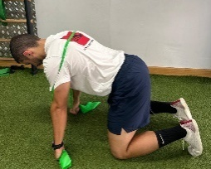
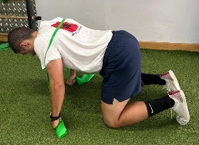

SCAPULAR PATTERN CONTROL
Position
In quadruped position, start with your shoulders slightly forward and a elastic band in your hands. Then bring your chest out by squeezing your scapulas.
Key points
Do not lift your shoulders.
Pull shoulders back and sligthly down
Try to “break” the elastic band
Activate your core to keep lumbar spine stable
RPE-RIR | SETS | REPS | TUT | REST
RPE 7 RIR < 3 | 4 – 1st session | 8-12 | 5-5-5 | 1’ 30”
RPE 7 RIR < 3 | 6 – 2nd session | 8-12 | 5-5-5 | 1’ 30”

Slide 15
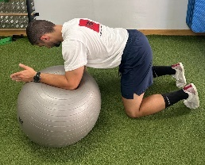
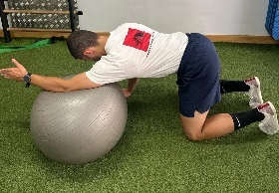

SCAPULAR PATTERN CONTROL
Position
In quadruped position, with one hand on the floor and the other forearm placed on the fitball. Flex the shoulder with the help of the ball’s rotation
Key points
Press the fitball with your forearm to improve muscle activation and facilitate the movement
Activate your core to keep lumbar spine stable
RPE-RIR | SETS | REPS | TUT | REST
RPE 7 RIR < 3 | 4 – per side 1st session | 8-12 | 5-5-5 | 1’ 30”
RPE 7 RIR < 3 | 6 – per side 2nd session | 8-12 | 5-5-5 | 1’ 30”

Slide 16
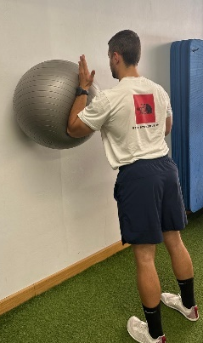
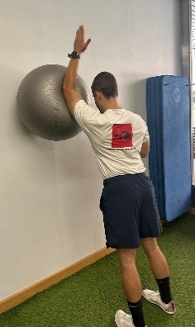

SCAPULAR PATTERN CONTROL
Position
In standing position, with one hand on the wall and the other forearm placed on the fitball. Flex the shoulder with the help of the ball’s rotation
Key points
Press the fitball with your forearm to improve muscle activation and facilitate the movement
Activate your core to keep lumbar spine stable
RPE-RIR | SETS | REPS | TUT | REST
RPE 7 RIR < 3 | 4 – per side 1st session | 8-12 | 5-5-5 | 1’ 30”
RPE 7 RIR < 3 | 6 – per side 2nd session | 8-12 | 5-5-5 | 1’ 30”

Slide 17
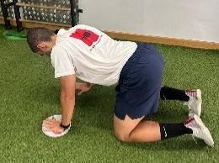
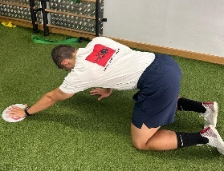

SCAPULAR PATTERN CONTROL
Position
In quadruped position, with one hand on the floor and the other hand placed on the slider. Flex the shoulder with the help of the slider
Key points
Activate scapular retractors of both shoulders during the flexion movement
Activate your core to keep lumbar spine stable
RPE-RIR | SETS | REPS | TUT | REST
RPE 7 RIR < 3 | 4 – per side 1st session | 8-12 | 5-5-5 | 1’ 30”
RPE 7 RIR < 3 | 6 – per side 2nd session | 8-12 | 5-5-5 | 1’ 30”

Slide 18
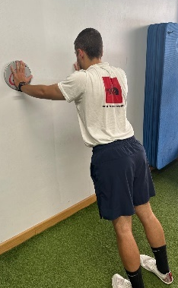
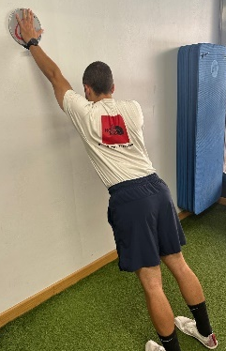

SCAPULAR PATTERN CONTROL
Position
In standing position, with one hand on the wall and the other hand placed on the slider. Flex the shoulder with the help of the slider
Key points
Activate scapular retractors of both shoulders during the flexion movement
Activate your core to keep lumbar spine stable
RPE-RIR | SETS | REPS | TUT | REST
RPE 7 RIR < 3 | 4 – per side 1st session | 8-12 | 5-5-5 | 1’ 30”
RPE 7 RIR < 3 | 6 – per side 2nd session | 8-12 | 5-5-5 | 1’ 30”

Slide 19
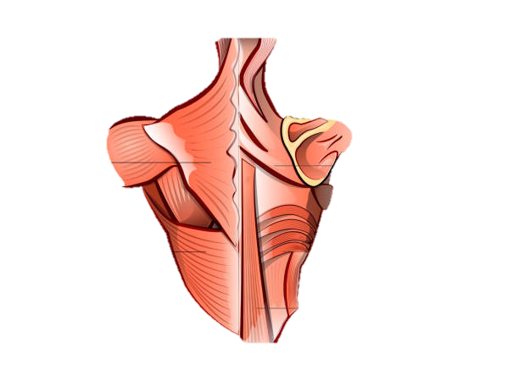
SCAPULAR RETRACTORS STRENGTHENING

Slide 20
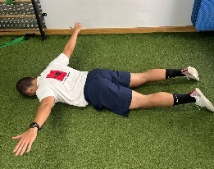

RETRACTORS STRENGTHENING
Position
Lying on the tummy, forehead on the floor and arms extended. Lift the hands off the floor by squeezing shoulder scapulas together
Key points
Reduce shoulder range of motion in case of pain
Imagine lifting your chest slightly off the floor
RPE-RIR | SETS | REPS | TUT | REST
RPE 7 RIR < 3 | 4 – 1st session | 8-12 | 5-5-5 | 1’ 30”
RPE 7 RIR < 3 | 6 – 2nd session | 8-12 | 5-5-5 | 1’ 30”

Slide 21
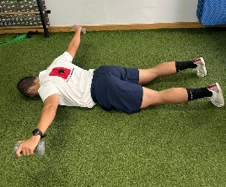

RETRACTORS STRENGTHENING
Position
Lying on the tummy, forehead on the floor and arms extended. Lift the dumbbells off the floor by squeezing shoulder scapulas together
Key points
Reduce shoulder range of motion in case of pain
Imagine lifting your chest slightly off the floor
RPE-RIR | SETS | REPS | TUT | REST
RPE 7 RIR < 3 | 4 – 1st session | 8-12 | 5-5-5 | 1’ 30”
RPE 7 RIR < 3 | 6 – 2nd session | 8-12 | 5-5-5 | 1’ 30”

Slide 22
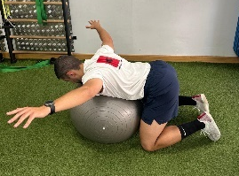

RETRACTORS STRENGTHENING
Position
In quadruped position, with your abdomen supoorted on a fitball extend the arms in a “Y” position. Lift your hands while squeezing your scapulas
Key points
Extend the thoracic spine
Imagine lifting your chest slightly off the fitball
A bench can be used insted of fitball
RPE-RIR | SETS | REPS | TUT | REST
RPE 7 RIR < 3 | 4 – 1st session | 8-12 | 5-5-5 | 1’ 30”
RPE 7 RIR < 3 | 6 – 2nd session | 8-12 | 5-5-5 | 1’ 30”
120º of shoulder abduction

Slide 23
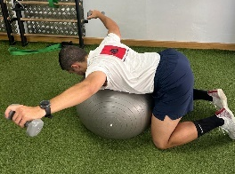

RETRACTORS STRENGTHENING
Position
In quadruped position, with your abdomen supoorted on a fitball extend the arms in a “Y” position. Lift the dumbbells while squeezing your scapulas
Key points
Extend the thoracic spine
Imagine lifting your chest slightly off the fitball
A bench can be used insted of fitball
RPE-RIR | SETS | REPS | TUT | REST
RPE 7 RIR < 3 | 4 – 1st session | 8-12 | 5-5-5 | 1’ 30”
RPE 7 RIR < 3 | 6 – 2nd session | 8-12 | 5-5-5 | 1’ 30”
120º of shoulder abduction

Slide 24
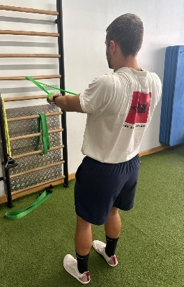
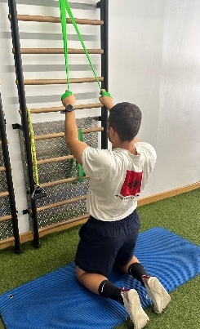

RETRACTORS STRENGTHENING
Position
Rowing and lat pulldown exercises without flexing the elbows.
Push the chest out and squeeze the scapulas together, and on the way back, separate the scapulas and let your chest sink
Key points
Extend the thoracic spine
Reduce the resistance or the range of motion in case of pain
RPE-RIR | SETS | REPS | TUT | REST
RPE 7 RIR < 3 | 4 – rowing 4 – lat pulldown 1st session | 8-12 | 5-5-5 | 1’ 30”
RPE 7 RIR < 3 | 6 – rowing 6 – lat pulldown 1st sesión | 8-12 | 5-5-5 | 1’ 30”

Slide 25
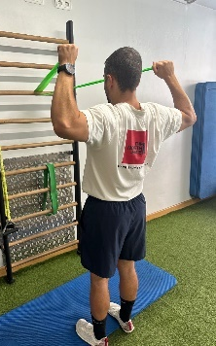

RETRACTORS STRENGTHENING
Position
In standing position. grab the band at chest height. From there, squeeze your scapulas together and then bring your hands up to eye level, keeping your shoulders in external rotation and maximum abduction
Key points
Activate your core to keep lumbar spine stable
Reduce the resistance or the range of motion in case of pain
RPE-RIR | SETS | REPS | TUT | REST
RPE 7 RIR < 3 | 4 – 1st session | 8-12 | 5-5-5 | 1’ 30”
RPE 7 RIR < 3 | 6 – 2nd session | 8-12 | 5-5-5 | 1’ 30”

Slide 26
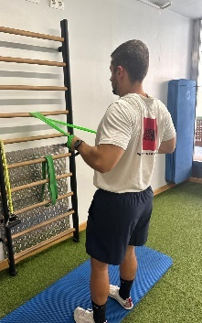

RETRACTORS STRENGTHENING
Position
Rowing exercise in standing position.
Key points
Activate your core to keep lumbar spine stable
Reduce the resistance or the range of motion in case of pain
RPE-RIR | SETS | REPS | TUT | REST
RPE 7 RIR < 3 | 4 – 1st session | 8-12 | 5-5-5 | 1’ 30”
RPE 7 RIR < 3 | 6 – 2nd session | 8-12 | 5-5-5 | 1’ 30”

Slide 27
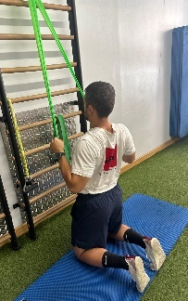

RETRACTORS STRENGTHENING
Position
Lat pulldown in keeling position
Key points
Activate your core to keep lumbar spine stable
Reduce the resistance or the range of motion in case of pain
RPE-RIR | SETS | REPS | TUT | REST
RPE 7 RIR < 3 | 4 – 1st session | 8-12 | 5-5-5 | 1’ 30”
RPE 7 RIR < 3 | 6 – 2nd session | 8-12 | 5-5-5 | 1’ 30”

Slide 28
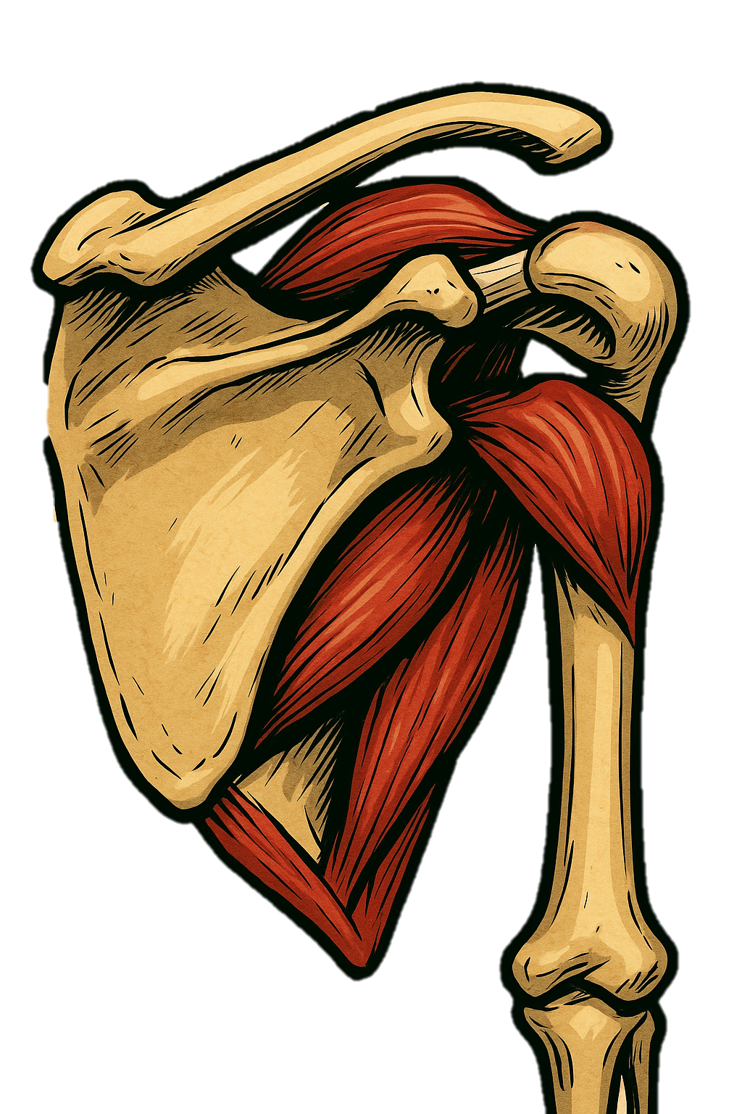
ROTATOR CUFF STRENGTHENING

Slide 29
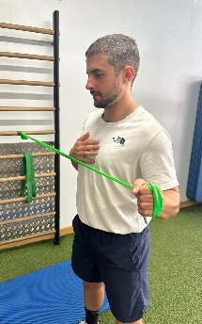
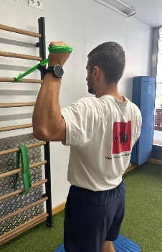

ROTATOR CUFF STRENGTHENING
ROTATOR CUFF STRENGTHENING
Position
In standing position, isometric exercise at 0º and 90º of shoulder abduction. To créate tensión on the band, pre-position it and take a step back to increse the resistance.
Key points
Follow the scapular plane at 90º of abduction
RPE-RIR | SETS | REPS | TUT | REST
RPE 7 | 6 – per side at 0º abd 6 – per side at 90º abd 1st session | 1 | 30-40” | 1’ 30”
RPE 7 | 8 – per side at 0º abd 8 – per side at 90º abd 2st session | 1 | 30-40” | 1’ 30”

Slide 30
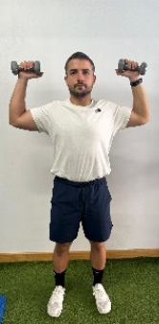
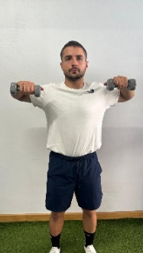
ROTATOR CUFF STRENGTHENING
ROTATOR CUFF STRENGTHENING
Position
In standing position, perform internal and external rotation of the shoulder with dumbbells
Key points
Activate scapular retractors of both shoulders during the movement
Shoulders in scapular plane
Activate your core to keep lumbar spine stable
RPE-RIR | SETS | REPS | TUT | REST
RPE 7 RIR < 3 | 4 – 1st session | 8-12 | 5-5-5 | 1’ 30”
RPE 7 RIR < 3 | 6 – 2nd session | 8-12 | 5-5-5 | 1’ 30”

Slide 31
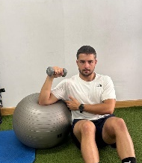
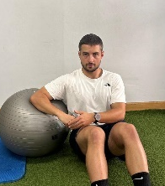

ROTATOR CUFF STRENGTHENING
ROTATOR CUFF STRENGTHENING
Position
Seated with the elbow resting on the fitball, perform internal and external rotation
Key points
Activate scapular retractors of both shoulders during the movement
Squeeze the fitball with your elbow
Shoulders in scapular plane
A bench can be used insted of fitball
RPE-RIR | SETS | REPS | TUT | REST
RPE 7 RIR < 3 | 4 – per side 1st session | 8-12 | 5-5-5 | 1’ 30”
RPE 7 RIR < 3 | 6 – per side 2nd session | 8-12 | 5-5-5 | 1’ 30”

Slide 32
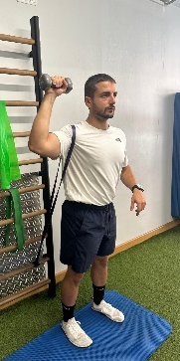
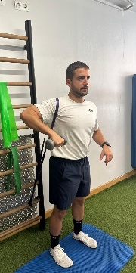

ROTATOR CUFF STRENGTHENING
ROTATOR CUFF STRENGTHENING
Position
In a standing position, with a resistance band tied low and looped around the head of the humerus, hold a dumbbell and perform internal and external rotation
Key points
Activate scapular retractors of both shoulders during the movement
Shoulders in scapular plane
Activate your core to keep lumbar spine stable
RPE-RIR | SETS | REPS | TUT | REST
RPE 7 RIR < 3 | 4 – 1st session | 8-12 | 5-5-5 | 1’ 30”
RPE 7 RIR < 3 | 6 – 2nd session | 8-12 | 5-5-5 | 1’ 30”

