Slide 1
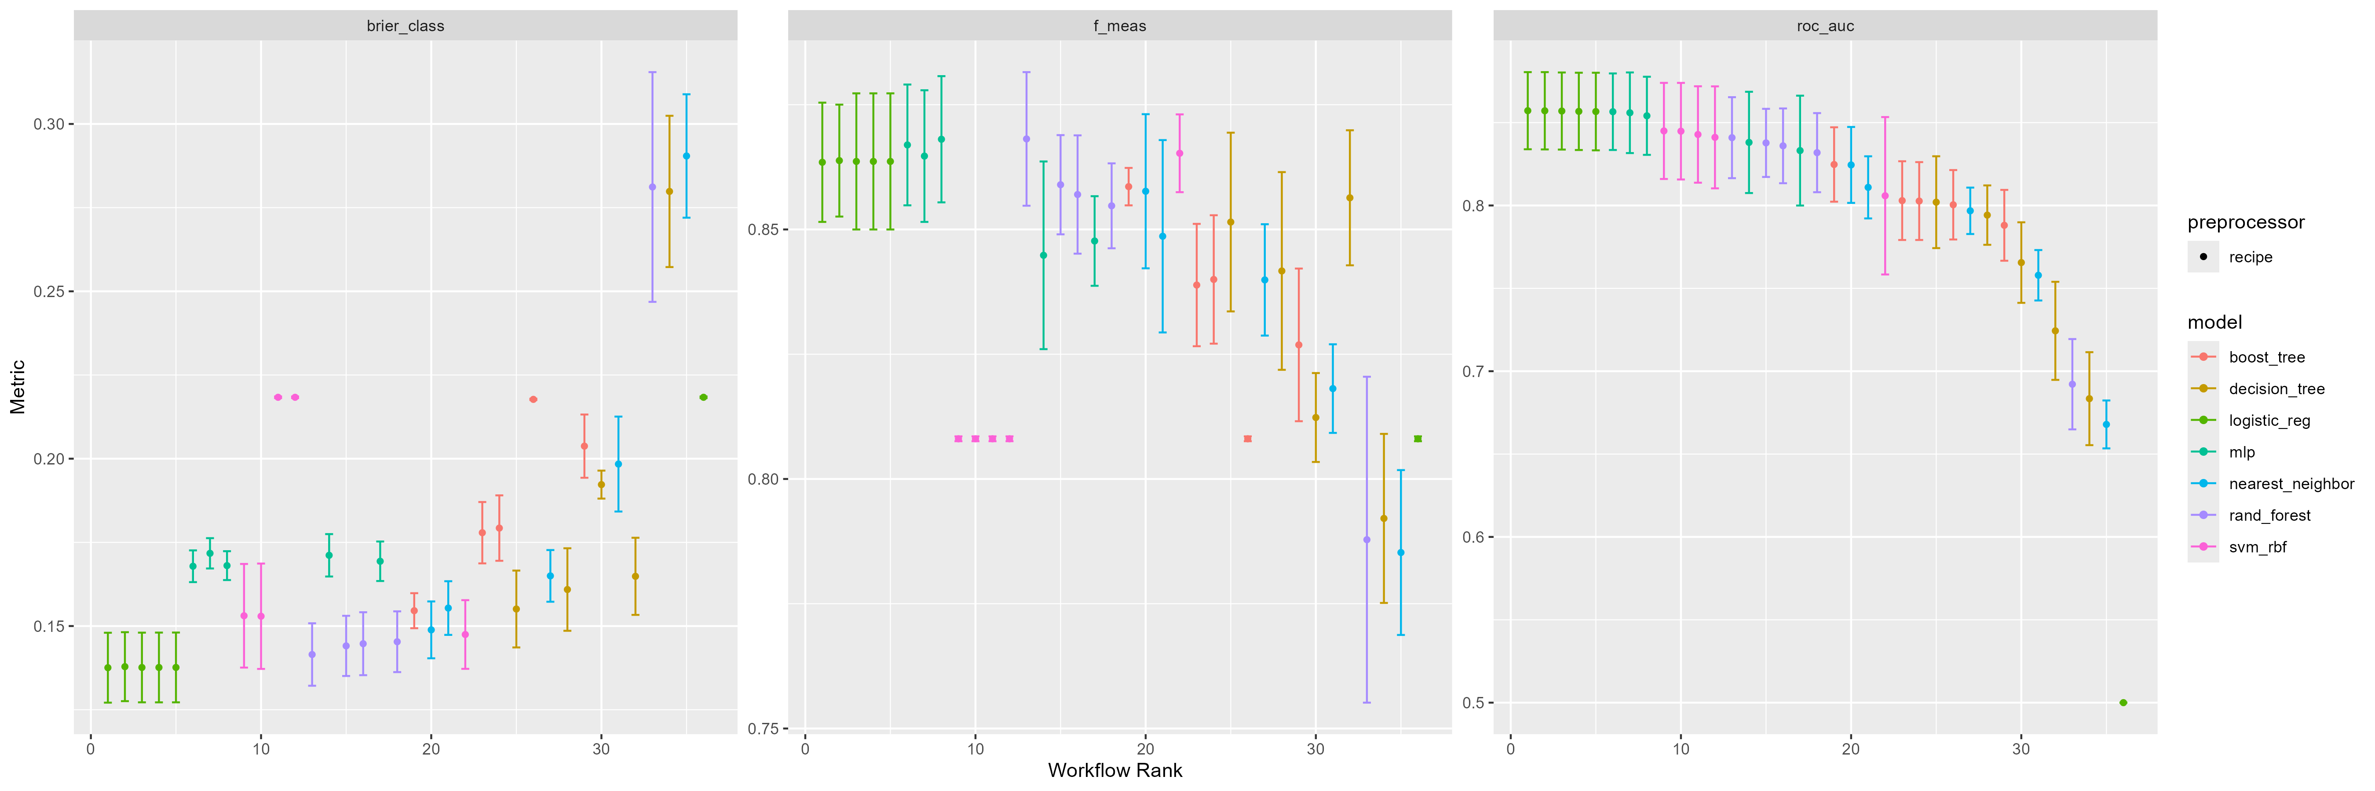
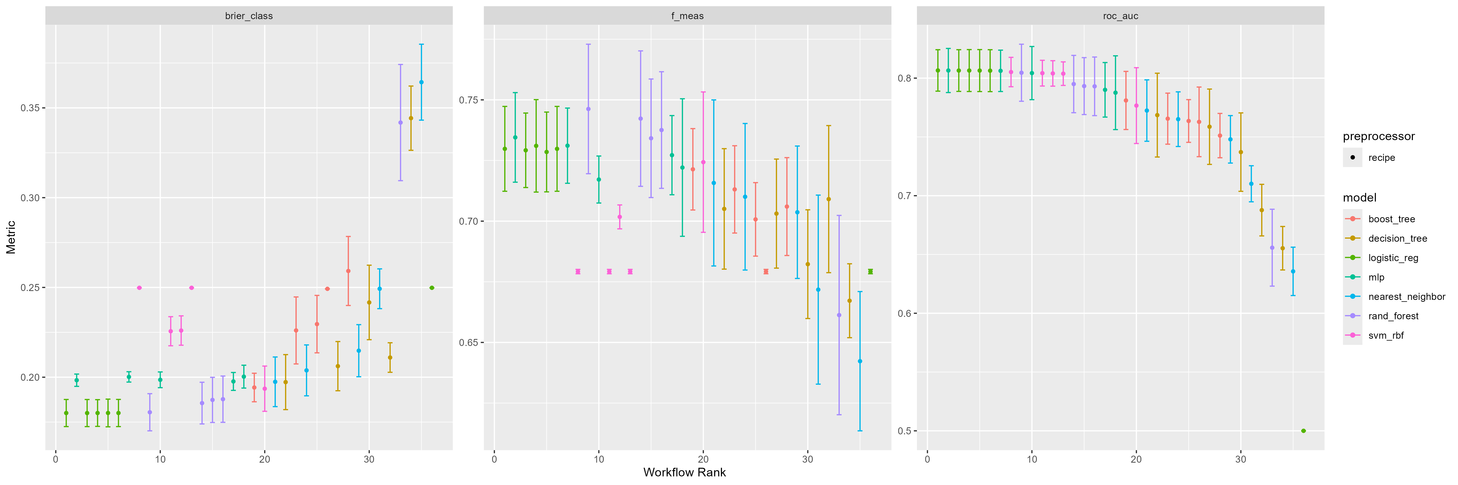
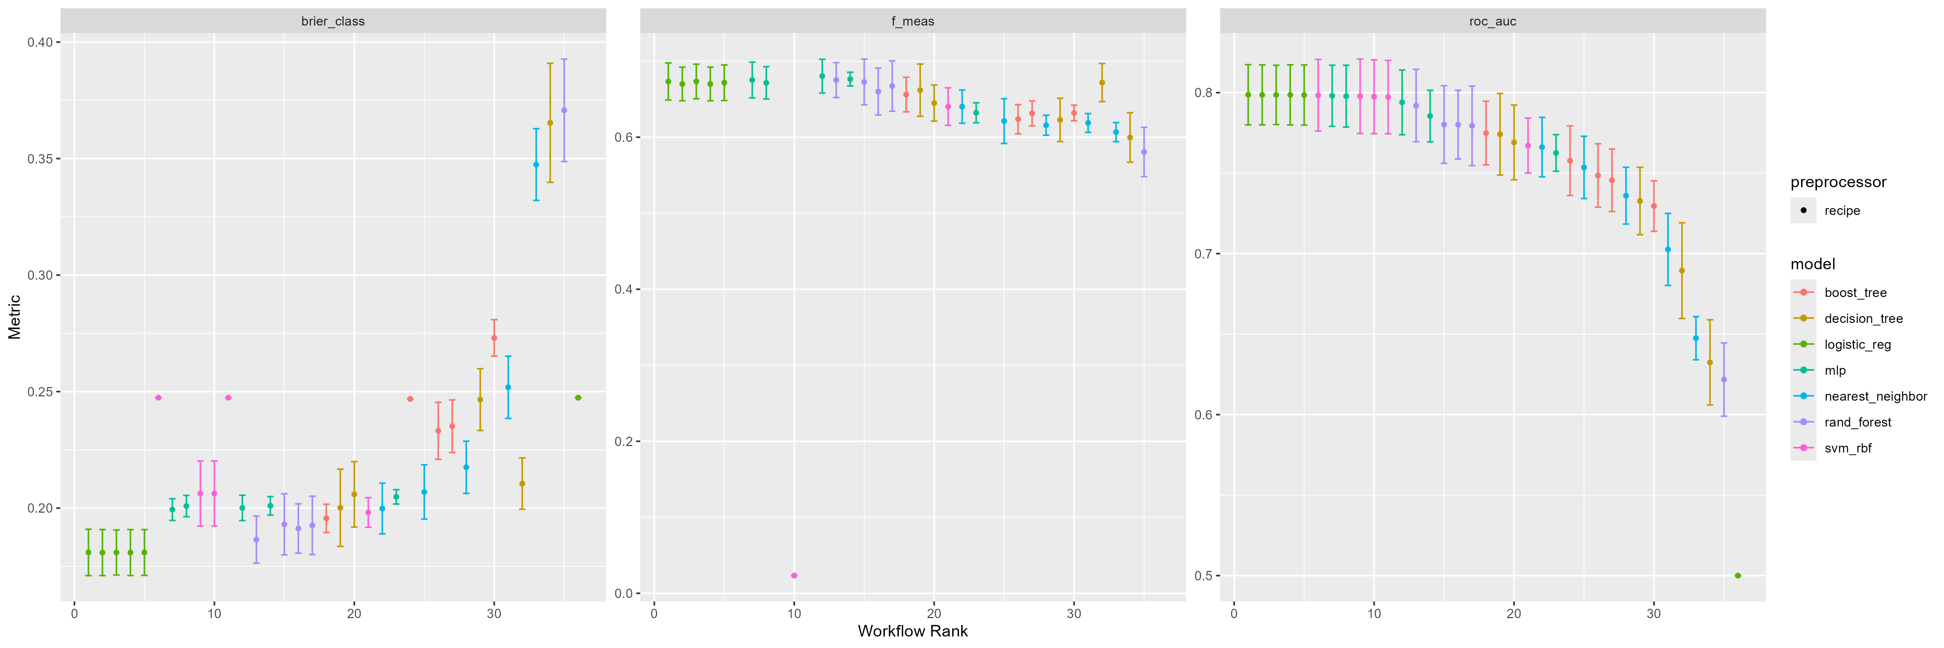
A
5-Fold Cross-Validation Model Comparison (12-Month)
B
5-Fold Cross-Validation Model Comparison (24-Month)
C
5-Fold Cross-Validation Model Comparison (36-Month)
Figure S1. Model selection using five-fold cross-validation at different time points.
(A) 12-month prediction.
(B) 24-month prediction.
(C) 36-month prediction.
Models were compared using multiple performance metrics, including ROC AUC, F1 score, and Brier score. Logistic regression was selected as the final model based on overall performance and interpretability.

Slide 2
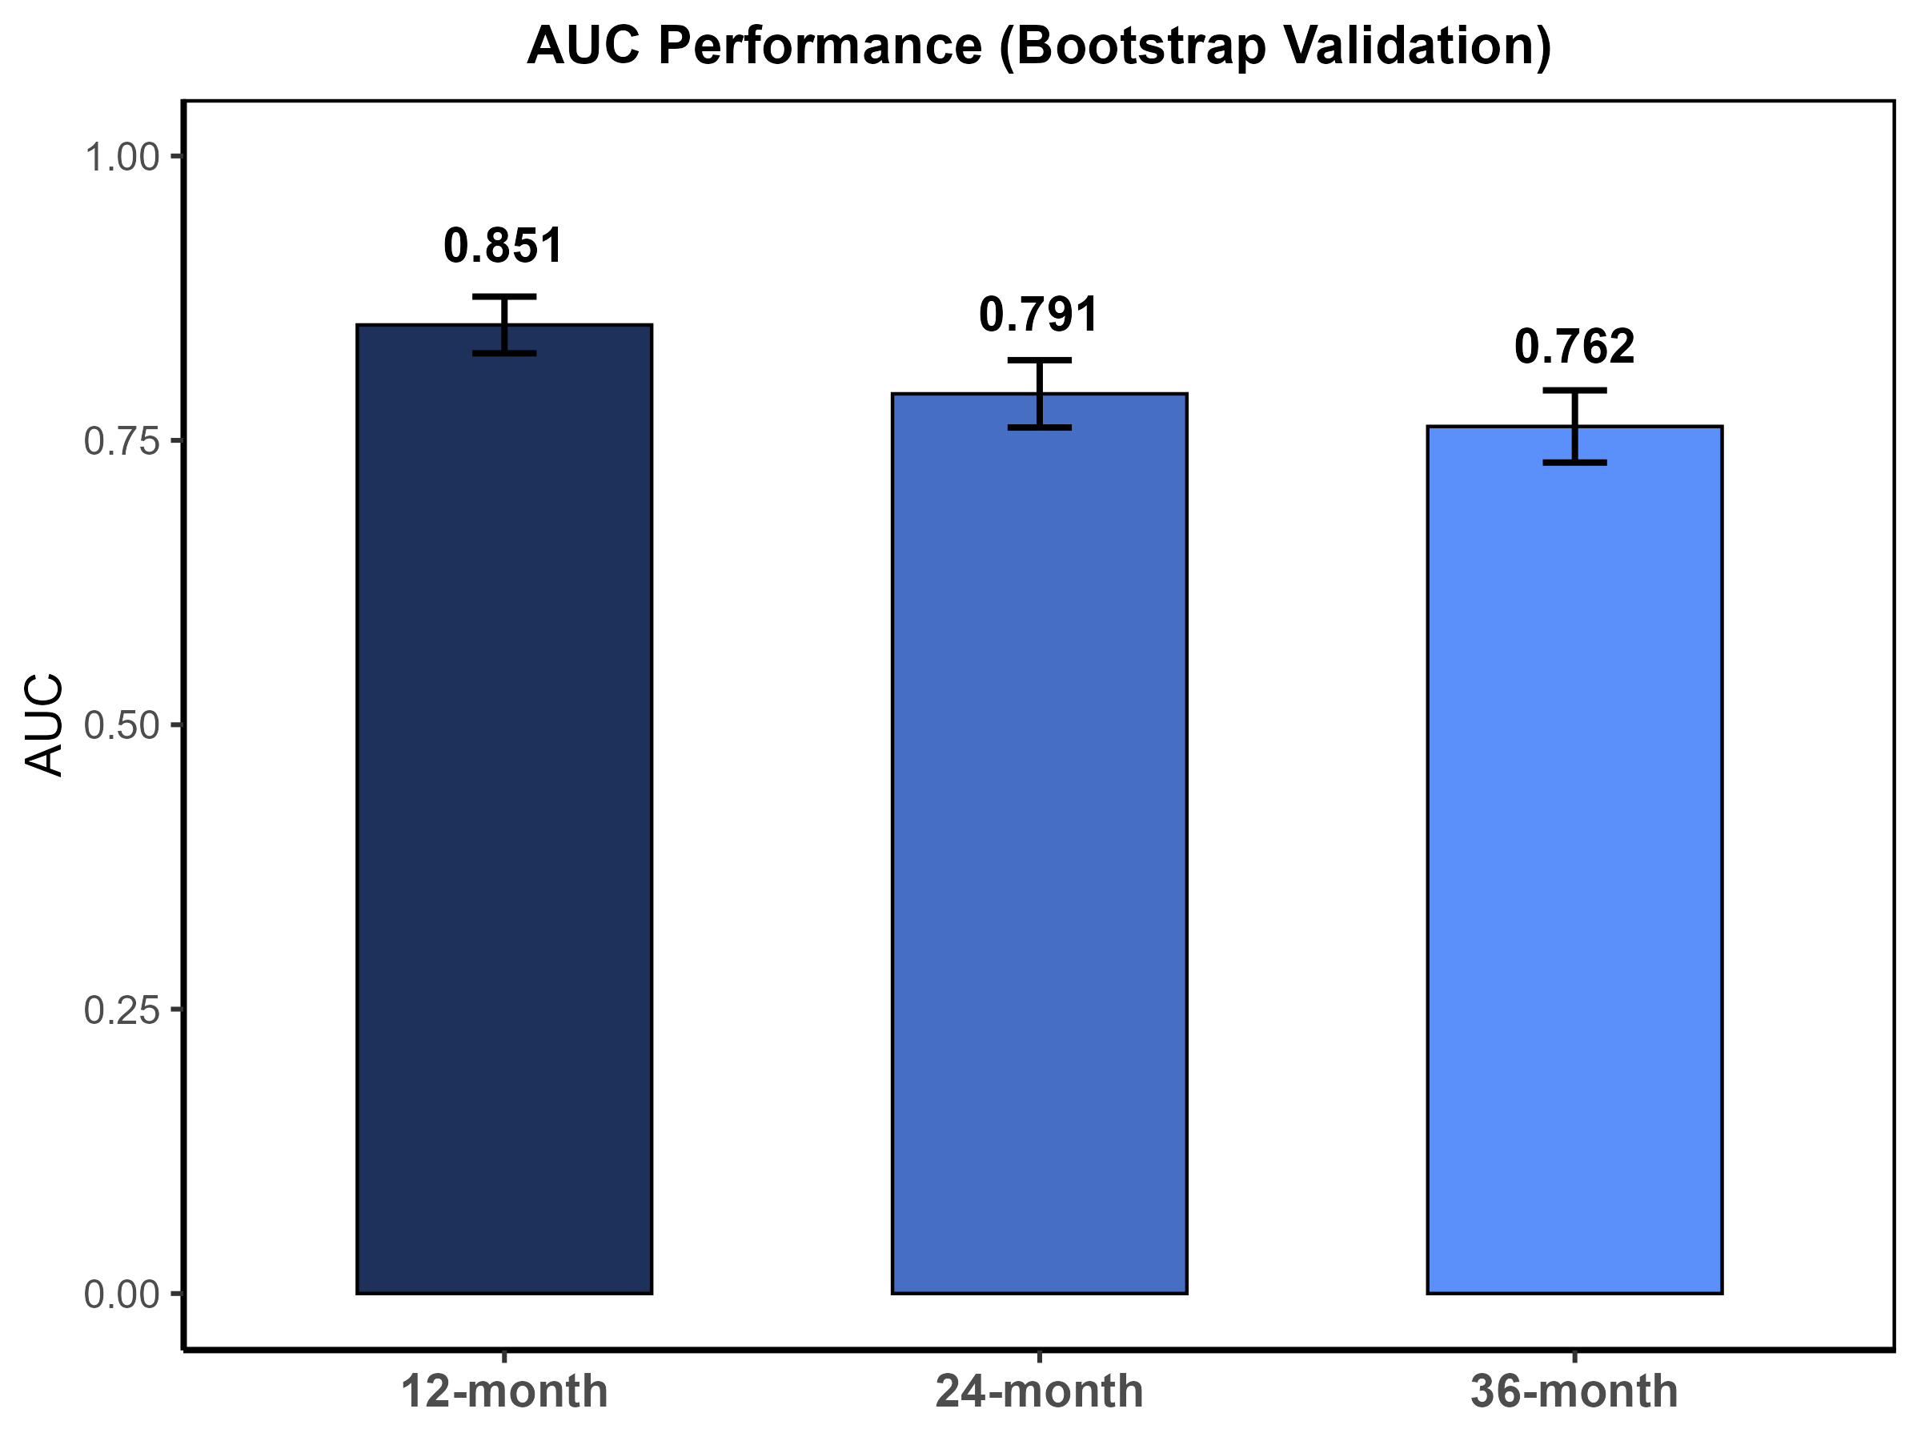
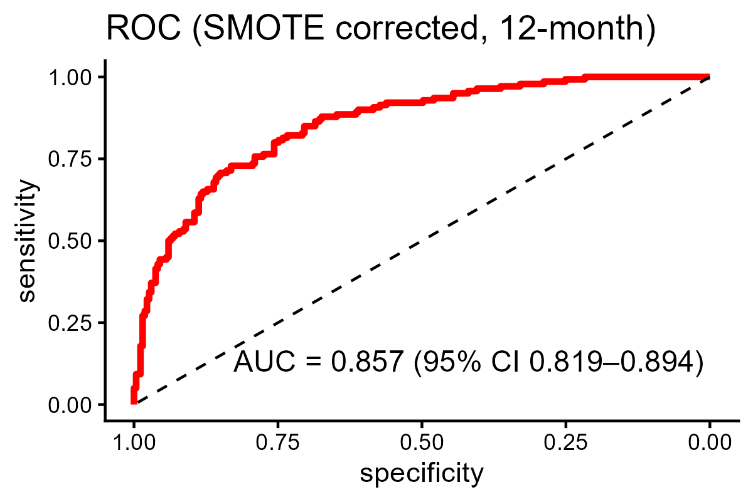
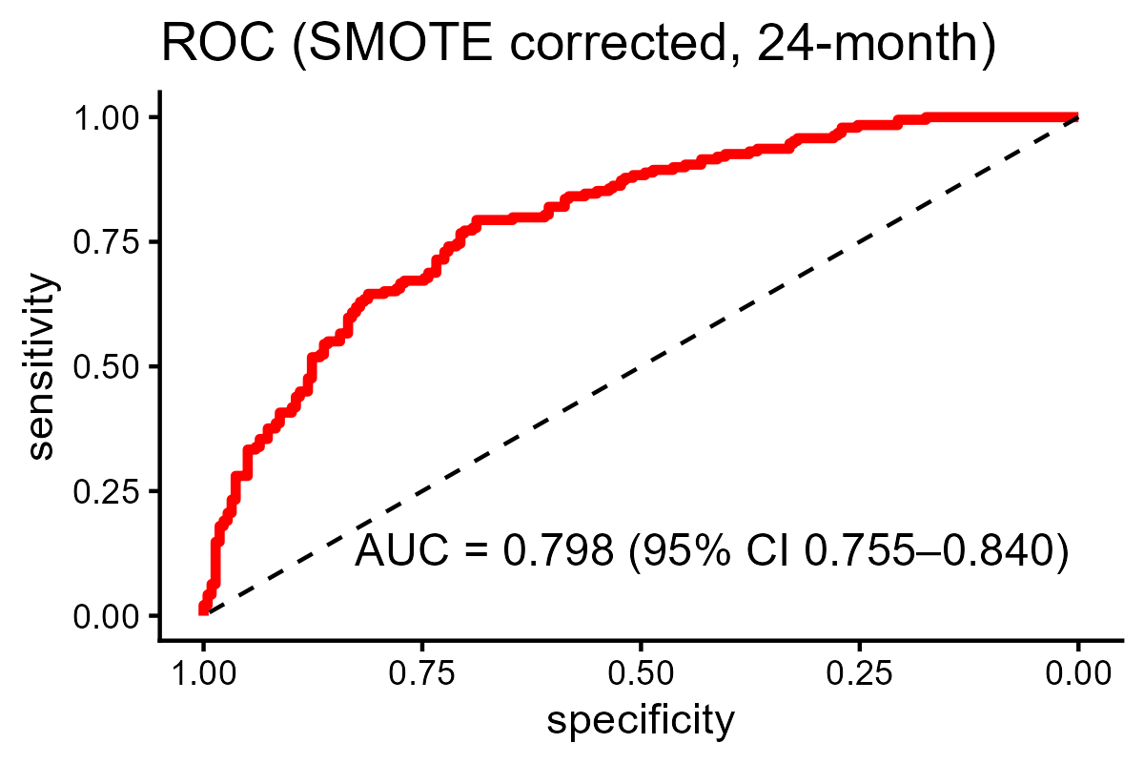
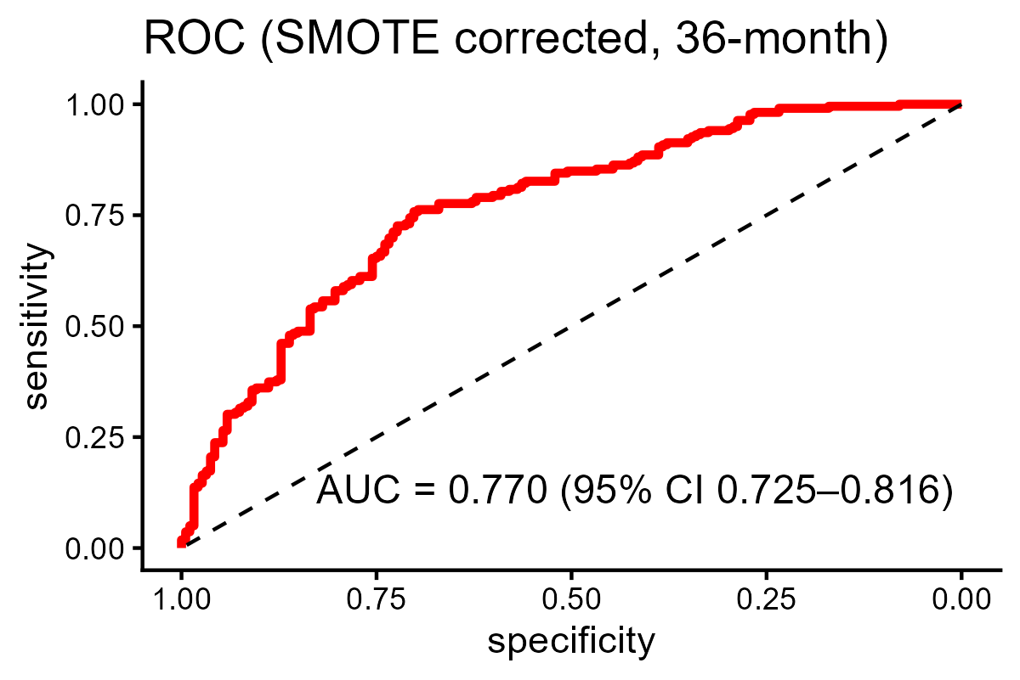
A
B
C
D
Figure S2. Robustness analysis of the integrated model.
(A) Bootstrap validation showing AUC performance at 12, 24, and 36 months.
(B–D) ROC curves after SMOTE correction at 12, 24, and 36 months.

