Slide 1
Subcutaneous adipocyte glucocorticoid signalling and insulin dynamics after modest weight gain in South Asian and White European men - electronic supplementary material
Xuan Gao, Robin Lengton, Jenny A. Visser, James McLaren, Naveed Sattar, Dilys J. Freeman, Mariëtte R. Boon, Jason M.R. Gill
Notes:
Good morning, everyone. I’m Galvin, an affiliate Clinical Research Fellow at the University of Glasgow. Today, I’m pleased to present our initial analysis of the GlasVEGAS glucocorticoid sub-study results.

Slide 2
ESM Table 1
Pairwise correlations between baseline expression and absolute change (Δ = WG − BL) in relative gene expression normalised to PPIA. Pearson correlation coefficients (r) with 95% confidence intervals and two-tailed p values are shown. Superscripts denote sample sizes: ᵃn = 20 WE, 14 SA; ᵇn = 21 WE, 14 SA.
BL vs delta | N | r | 95% CI for ρ | P
SREBF1 | a | -0.48 | (-0.702, -0.165) | 0.004
HIF1A | a | -0.53 | (-0.739, -0.239) | 0.001
LDLR | a | -0.77 | (-0.882, -0.591) | <0.001
INSR | a | -0.60 | (-0.779, -0.326) | <0.001
ADIPOQ | a | -0.49 | (-0.710, -0.182) | 0.003
LPL | a | -0.44 | (-0.678, -0.121) | 0.009
LEP | a | 0.19 | (-0.163, 0.493) | 0.29
TNF | a | -0.08 | (-0.408, 0.264) | 0.65
BSCL2 | a | -0.84 | (-0.920, -0.708) | <0.001
CASP1 | a | -0.79 | (-0.889, -0.611) | <0.001
EPAS1 | a | -0.43 | (-0.671, -0.109) | 0.011
HOXC13 | a | -0.54 | (-0.741, -0.243) | 0.001
KLF14 | a | 0.14 | (-0.205, 0.459) | 0.42
PPARG | a | -0.64 | (-0.805, -0.386) | <0.001
SIRT1 | a | -0.68 | (-0.827, -0.441) | <0.001
TCF7L2 | a | -0.57 | (-0.763, -0.290) | <0.001
TGFB1 | a | -0.19 | (-0.496, 0.159) | 0.28
TLR2 | a | -0.78 | (-0.886, -0.602) | <0.001
APOE | a | -0.86 | (-0.925, -0.727) | <0.001
CIDEA | a | -0.54 | (-0.740, -0.241) | 0.001
ESR | a | -0.57 | (-0.764, -0.293) | <0.001
GHR | a | -0.67 | (-0.823, -0.431) | <0.001
PIK3R1 | a | -0.44 | (-0.680, -0.124) | 0.009
PLIN2 | a | -0.77 | (-0.877, -0.576) | <0.001
FKBP5 | b | -0.66 | (-0.815, -0.420) | <0.001
TSC22D3 | b | -0.62 | (-0.789, -0.359) | <0.001
HSD11B1 | b | -0.49 | (-0.706, -0.184) | 0.003
HSD11B2 | b | -0.60 | (-0.779, -0.337) | <0.001
IL6 | b | -0.61 | (-0.785, -0.349) | <0.001

Slide 3
ESM Table 2.
Oldham’s method analysis of the association between the baseline–weight gain mean (M = (BL + WG)/2) and within-person change (Δ = WG − BL) in gene expression. Values are Spearman correlation coefficients (ρ) with 95% confidence intervals, two-tailed p values and sample sizes. Superscripts denote sample sizes: ᵃn = 20 WE, 14 SA; ᵇn = 21 WE, 14 SA.
Mean vs delta | N | r | 95% CI for ρ | P
SREBF1 | a | 0.36 | (0.019, 0.619) | 0.039
HIF1A | a | 0.23 | (-0.118, 0.527) | 0.19
LDLR | a | -0.38 | (-0.635, -0.045) | 0.028
INSR | a | -0.06 | (-0.393, 0.281) | 0.72
ADIPOQ | a | 0.20 | (-0.153, 0.501) | 0.27
LPL | a | 0.19 | (-0.155, 0.499) | 0.27
LEP | a | 0.50 | (0.194, 0.717) | 0.003
TNF | a | 0.27 | (-0.072, 0.560) | 0.12
BSCL2 | a | -0.28 | (-0.561, 0.069) | 0.12
CASP1 | a | -0.35 | (-0.618, -0.018) | 0.04
EPAS1 | a | 0.26 | (-0.088, 0.548) | 0.14
HOXC13 | a | 0.52 | (0.225, 0.732) | 0.001
KLF14 | a | 0.50 | (0.197, 0.718) | 0.003
PPARG | a | 0.01 | (-0.333, 0.343) | 0.97
SIRT1 | a | -0.22 | (-0.518, 0.130) | 0.22
TCF7L2 | a | -0.05 | (-0.380, 0.295) | 0.79
TGFB1 | a | 0.51 | (0.210, 0.725) | 0.002
TLR2 | a | -0.43 | (-0.672, -0.109) | 0.011
APOE | a | -0.68 | (-0.826, -0.441) | <0.001
CIDEA | a | -0.12 | (-0.438, 0.231) | 0.51
ESR | a | 0.18 | (-0.170, 0.487) | 0.31
GHR | a | -0.26 | (-0.547, 0.089) | 0.14
PIK3R1 | a | 0.14 | (-0.209, 0.456) | 0.43
PLIN2 | a | -0.40 | (-0.652, -0.074) | 0.018
FKBP5 | b | -0.21 | (-0.509, 0.131) | 0.22
TSC22D3 | b | -0.12 | (-0.433, 0.225) | 0.51
HSD11B1 | b | -0.16 | (-0.464, 0.188) | 0.38
HSD11B2 | b | -0.09 | (-0.408, 0.254) | 0.62
IL6 | b | -0.04 | (-0.366, 0.300) | 0.83

Slide 4
ESM Table 3. Extended version of Table 2.
Pairwise Pearson correlations between baseline FKBP5 and GILZ expression in subcutaneous adipose tissue and indices of body composition, adipocyte morphology and metabolic function. Correlation coefficients (r) with 95% confidence intervals and two-tailed p values are shown for all tested associations (significant and non-significant). Results are pooled across ethnicities unless otherwise stated. Abbreviations: WE, White European; SA, South Asian.
Baseline | Univariable correlate | Gene | N | r | 95% CI for r | P
Age and anthropometric/body composition data | Age (years) | FKBP5 | 35 | 0.123 | (-0.220, 0.438) | 0.48
 | BMI (kg.m⁻²) | FKBP5 | 35 | 0.167 | (-0.176, 0.474) | 0.34
 | Waist (cm) | FKBP5 | 35 | 0.075 | (-0.265, 0.398) | 0.67
 | Systolic blood pressure (mmHg) | FKBP5 | 35 | 0.297 | (-0.040, 0.574) | 0.083
 | Diastolic blood pressure (mmHg) | FKBP5 | 35 | 0.286 | (-0.052, 0.565) | 0.096
 | Whole body lean tissue (l) | FKBP5 | 33 | 0.294 | (-0.055, 0.579) | 0.096
 | Whole body adipose tissue (l) | FKBP5 | 33 | -0.301 | (-0.584, 0.048) | 0.089
 | Upper body adipose tissue (l) | FKBP5 | 33 | -0.251 | (-0.547, 0.101) | 0.16
 | Lower body adipose tissue (l) | FKBP5 | 33 | -0.328 | (-0.603, 0.018) | 0.063
 | Abdominal subcutaneous adipose tissue (ASAT) (l) | FKBP5 | 33 | -0.348 | (-0.618, -0.006) | 0.047
 | Visceral adipose tissue (VAT) (l) | FKBP5 | 33 | -0.241 | (-0.540, 0.112) | 0.18
 | Liver fat fraction (%) | FKBP5 | 32 | -0.351 | (-0.623, -0.003) | 0.049
 | Muscle fat fraction (%) | FKBP5 | 25 | 0.05 | (-0.352, 0.437) | 0.81
 | VAT/ASAT ratio | FKBP5 | 33 | -0.009 | (-0.351, 0.335) | 0.96
Metabolic data | Fasting Glucose (mmol.l⁻¹) | FKBP5 | 35 | -0.28 | (-0.561, 0.059) | 0.10
 | Postprandial glucose (mmol.l⁻¹) | FKBP5 | 35 | -0.219 | (-0.515, 0.123) | 0.21
 | Fasting insulin (µU.ml⁻¹) | FKBP5 | 35 | -0.038 | (-0.367, 0.299) | 0.83
 | Postprandial insulin (µU.ml⁻¹) | FKBP5 | 35 | -0.266 | (-0.550, 0.074) | 0.12
 | Fasting C-peptide (nmol·l-1) | FKBP5 | 35 | -0.094 | (-0.415, 0.247) | 0.59
 | Postprandial C-peptide (nmol·l⁻¹) | FKBP5 | 35 | -0.303 | (-0.578, 0.033) | 0.077
 | HOMA_{IR} | FKBP5 | 34 | -0.135 | (-0.453, 0.212) | 0.45
 | Matsuda Insulin Sensitivity Index | FKBP5 | 35 | 0.149 | (-0.194, 0.460) | 0.39
 | Insulin secretion-sensitivity index-2 | FKBP5 | 35 | -0.056 | (-0.382, 0.282) | 0.75
 | Fasting triglycerides (mmol.l-1) | FKBP5 | 35 | -0.149 | (-0.460, 0.194) | 0.39
 | Postprandial triglycerides (mmol.l⁻¹) | FKBP5 | 35 | -0.254 | (-0.541, 0.087) | 0.14
Subcutaneous abdominal adipocyte size | Mean adipocyte diameter (μm) | FKBP5 | 30 | -0.423 | (-0.680, -0.074) | 0.020
 | Proportion of very small adipocytes (% cells) | FKBP5 | 30 | 0.089 | (-0.280, 0.436) | 0.64
 | Proportion of small adipocytes (% cells) | FKBP5 | 30 | 0.419 | (0.069, 0.677) | 0.021
 | Proportion of medium adipocytes (% cells) | FKBP5 | 30 | -0.265 | (-0.571, 0.106) | 0.16
 | Proportion of large adipocytes (% cells) | FKBP5 | 30 | -0.357 | (-0.635, 0.004) | 0.053
 | Volume of very small adipocytes (nl per 100 total cells) | FKBP5 | 30 | 0.172 | (-0.201, 0.501) | 0.36
 | Volume of small adipocytes (nl per 100 total cells) | FKBP5 | 30 | 0.328 | (-0.036, 0.616) | 0.077
 | Volume of medium adipocytes (nl per 100 total cells) | FKBP5 | 30 | -0.283 | (-0.584, 0.086) | 0.13
 | Volume of large adipocytes (nl per 100 total cells) | FKBP5 | 30 | -0.315 | (-0.606, 0.051) | 0.090
Age and anthropometric/body composition data | Age (years) | GILZ | 35 | -0.049 | (-0.376, 0.289) | 0.78
 | BMI (kg.m⁻²) | GILZ | 35 | 0.36 | (0.031, 0.619) | 0.033
 | Waist (cm) | GILZ | 35 | 0.185 | (-0.158, 0.489) | 0.29
 | Systolic blood pressure (mmHg) | GILZ | 35 | 0.321 | (-0.014, 0.591) | 0.060
 | Diastolic blood pressure (mmHg) | GILZ | 35 | 0.053 | (-0.286, 0.379) | 0.76
 | Whole body lean tissue (l) | GILZ | 33 | 0.405 | (0.071, 0.657) | 0.019
 | Whole body adipose tissue (l) | GILZ | 33 | -0.291 | (-0.577, 0.058) | 0.10
 | Upper body adipose tissue (l) | GILZ | 33 | -0.253 | (-0.548, 0.099) | 0.16
 | Lower body adipose tissue (l) | GILZ | 33 | -0.304 | (-0.586, 0.043) | 0.085
 | Abdominal subcutaneous adipose tissue (ASAT) (l) | GILZ | 33 | -0.244 | (-0.542, 0.108) | 0.17
 | Visceral adipose tissue (VAT) (l) | GILZ | 33 | -0.315 | (-0.594, 0.031) | 0.074
 | Liver fat fraction (%) | GILZ | 32 | -0.384 | (-0.646, -0.041) | 0.030
 | Muscle fat fraction (%) | GILZ | 25 | -0.233 | (-0.575, 0.178) | 0.26
 | VAT/ASAT ratio | GILZ | 33 | -0.206 | (-0.513, 0.148) | 0.25
Metabolic data | Fasting Glucose (mmol.l⁻¹) | GILZ | 35 | -0.139 | (-0.451, 0.204) | 0.43
 | Postprandial glucose (mmol.l⁻¹) | GILZ | 35 | -0.269 | (-0.552, 0.071) | 0.12
 | Fasting insulin (µU.ml⁻¹) | GILZ | 35 | 0.006 | (-0.328, 0.338) | 0.97
 | Postprandial insulin (µU.ml⁻¹) | GILZ | 35 | -0.237 | (-0.529, 0.104) | 0.17
 | Fasting C-peptide (nmol·l-1) | GILZ | 35 | -0.039 | (-0.368, 0.298) | 0.82
 | Postprandial C-peptide (nmol·l⁻¹) | GILZ | 35 | -0.337 | (-0.603, -0.004) | 0.048
 | HOMA_{IR} | GILZ | 34 | -0.078 | (-0.406, 0.267) | 0.66
 | Matsuda Insulin Sensitivity Index | GILZ | 35 | 0.068 | (-0.271, 0.392) | 0.70
 | Insulin secretion-sensitivity index-2 | GILZ | 35 | -0.131 | (-0.445, 0.212) | 0.46
 | Fasting triglycerides (mmol.l-1) | GILZ | 35 | -0.383 | (-0.635, -0.057) | 0.023
 | Postprandial triglycerides (mmol.l⁻¹) | GILZ | 35 | -0.39 | (-0.640, -0.066) | 0.020
Subcutaneous abdominal adipocyte size | Mean adipocyte diameter (μm) | GILZ | 30 | -0.341 | (-0.625, 0.022) | 0.065
 | Proportion of very small adipocytes (% cells) | GILZ | 30 | -0.027 | (-0.384, 0.336) | 0.89
 | Proportion of small adipocytes (% cells) | GILZ | 30 | 0.375 | (0.017, 0.648) | 0.041
 | Proportion of medium adipocytes (% cells) | GILZ | 30 | -0.255 | (-0.564, 0.116) | 0.17
 | Proportion of large adipocytes (% cells) | GILZ | 30 | -0.285 | (-0.585, 0.084) | 0.13
 | Volume of very small adipocytes (nl per 100 total cells) | GILZ | 30 | 0.06 | (-0.307, 0.412) | 0.75
 | Volume of small adipocytes (nl per 100 total cells) | GILZ | 30 | 0.302 | (-0.066, 0.597) | 0.11
 | Volume of medium adipocytes (nl per 100 total cells) | GILZ | 30 | -0.279 | (-0.581, 0.090) | 0.14
 | Volume of large adipocytes (nl per 100 total cells) | GILZ | 30 | -0.253 | (-0.562, 0.118) | 0.18

Slide 5
ESM Table 4. Extended version of Table 3.
Pairwise Pearson correlations between within-person change in gene expression with weight gain (Δ = WG − BL) and within-person changes in metabolic variables. Correlation coefficients (r) with 95% confidence intervals and two-tailed p values are shown for all tested associations (significant and non-significant). Results are pooled across ethnicities unless otherwise stated. Abbreviations: WE, White European; SA, South Asian.
Baseline | Univariable correlate | Gene | N | r | 95% CI for r | P
Change in age and anthropometric/body composition data | Change in BMI (kg.m⁻²) | Change in FKBP5 expression | 35 | 0.003 | (-0.331, 0.336) | 0.99
 | Change in waist (cm) | Change in FKBP5 expression | 35 | -0.132 | (-0.446, 0.210) | 0.45
 | Change in systolic blood pressure (mmHg) | Change in FKBP5 expression | 35 | -0.042 | (-0.370, 0.295) | 0.81
 | Change in diastolic blood pressure (mmHg) | Change in FKBP5 expression | 35 | 0.231 | (-0.111, 0.524) | 0.18
 | Change in whole body lean tissue (l) | Change in FKBP5 expression | 33 | -0.16 | (-0.477, 0.194) | 0.37
 | Change in whole body adipose tissue (l) | Change in FKBP5 expression | 33 | 0.123 | (-0.230, 0.447) | 0.50
 | Change in upper body adipose tissue (l) | Change in FKBP5 expression | 33 | 0.166 | (-0.188, 0.482) | 0.36
 | Change in lower body adipose tissue (l) | Change in FKBP5 expression | 33 | 0.054 | (-0.294, 0.390) | 0.76
 | Change in abdominal subcutaneous adipose tissue (ASAT) (l) | Change in FKBP5 expression | 33 | 0.099 | (-0.253, 0.428) | 0.58
 | Change in visceral adipose tissue (VAT) (l) | Change in FKBP5 expression | 33 | 0.082 | (-0.269, 0.413) | 0.65
 | Change in liver fat fraction (%) | Change in FKBP5 expression | 32 | 0.163 | (-0.197, 0.484) | 0.37
 | Change in muscle fat fraction (%) | Change in FKBP5 expression | 25 | -0.02 | (-0.412, 0.378) | 0.92
 | Change in VAT/ASAT ratio | Change in FKBP5 expression | 33 | -0.059 | (-0.394, 0.290) | 0.74
Change in metabolic data | Change in fasting Glucose (mmol.l⁻¹) | Change in FKBP5 expression | 35 | -0.321 | (-0.591, 0.013) | 0.060
 | Change in postprandial glucose (mmol.l⁻¹) | Change in FKBP5 expression | 35 | 0.089 | (-0.252, 0.410) | 0.61
 | Change in fasting insulin (µU.ml⁻¹) | Change in FKBP5 expression | 35 | 0.043 | (-0.295, 0.371) | 0.81
 | Change in postprandial insulin (µU.ml⁻¹) | Change in FKBP5 expression | 35 | 0.455 | (0.144, 0.685) | 0.006
 | Change in fasting C-peptide (nmol·l⁻¹) | Change in FKBP5 expression | 35 | 0.112 | (-0.230, 0.429) | 0.52
 | Change in postprandial C-peptide (nmol·l⁻¹) | Change in FKBP5 expression | 35 | 0.335 | (0.002, 0.601) | 0.049
 | Change in HOMA_{IR} | Change in FKBP5 expression | 34 | 0.071 | (-0.274, 0.399) | 0.69
 | Change in Matsuda Insulin Sensitivity Index | Change in FKBP5 expression | 35 | -0.184 | (-0.488, 0.159) | 0.29
 | Change in insulin secretion-sensitivity index-2 | Change in FKBP5 expression | 35 | 0.018 | (-0.317, 0.349) | 0.92
 | Change in fasting triglycerides (mmol.l⁻¹) | Change in FKBP5 expression | 35 | 0.088 | (-0.252, 0.410) | 0.61
 | Change in postprandial triglycerides (mmol.l⁻¹) | Change in FKBP5 expression | 35 | -0.006 | (-0.339, 0.328) | 0.97
Change in subcutaneous abdominal adipocyte size | Change in mean adipocyte diameter (μm) | Change in FKBP5 expression | 30 | -0.135 | (-0.472, 0.237) | 0.48
 | Change in proportion of very small adipocytes (% cells) | Change in FKBP5 expression | 30 | 0.194 | (-0.179, 0.518) | 0.31
 | Change in proportion of small adipocytes (% cells) | Change in FKBP5 expression | 30 | -0.004 | (-0.364, 0.357) | 0.98
 | Change in proportion of medium adipocytes (% cells) | Change in FKBP5 expression | 30 | -0.083 | (-0.430, 0.286) | 0.67
 | Change in proportion of large adipocytes (% cells) | Change in FKBP5 expression | 30 | 0.03 | (-0.334, 0.386) | 0.88
 | Change in volume of very small adipocytes (nl per 100 total cells) | Change in FKBP5 expression | 30 | 0.235 | (-0.137, 0.549) | 0.21
 | Change in volume of small adipocytes (nl per 100 total cells) | Change in FKBP5 expression | 30 | -0.18 | (-0.507, 0.193) | 0.34
 | Change in volume of medium adipocytes (nl per 100 total cells) | Change in FKBP5 expression | 30 | -0.069 | (-0.419, 0.299) | 0.72
 | Change in volume of large adipocytes (nl per 100 total cells) | Change in FKBP5 expression | 30 | -0.084 | (-0.432, 0.284) | 0.66
Change in age and anthropometric/body composition data | Change in BMI (kg.m⁻²) | Change in GILZ expression | 35 | -0.185 | (-0.488, 0.158) | 0.29
 | Change in waist (cm) | Change in GILZ expression | 35 | -0.296 | (-0.573, 0.041) | 0.084
 | Change in systolic blood pressure (mmHg) | Change in GILZ expression | 35 | -0.093 | (-0.414, 0.248) | 0.60
 | Change in diastolic blood pressure (mmHg) | Change in GILZ expression | 35 | 0.071 | (-0.269, 0.395) | 0.69
 | Change in whole body lean tissue (l) | Change in GILZ expression | 33 | -0.329 | (-0.604, 0.016) | 0.061
 | Change in whole body adipose tissue (l) | Change in GILZ expression | 33 | 0.094 | (-0.257, 0.424) | 0.60
 | Change in upper body adipose tissue (l) | Change in GILZ expression | 33 | 0.069 | (-0.281, 0.403) | 0.70
 | Change in lower body adipose tissue (l) | Change in GILZ expression | 33 | 0.105 | (-0.247, 0.433) | 0.56
 | Change in abdominal subcutaneous adipose tissue (ASAT) (l) | Change in GILZ expression | 33 | 0.084 | (-0.267, 0.416) | 0.64
 | Change in visceral adipose tissue (VAT) (l) | Change in GILZ expression | 33 | 0.15 | (-0.204, 0.469) | 0.41
 | Change in liver fat fraction (%) | Change in GILZ expression | 32 | -0.05 | (-0.392, 0.304) | 0.78
 | Change in muscle fat fraction (%) | Change in GILZ expression | 25 | 0.201 | (-0.211, 0.553) | 0.34
 | Change in VAT/ASAT ratio | Change in GILZ expression | 33 | -0.076 | (-0.409, 0.274) | 0.67
Change in metabolic data | Change in fasting Glucose (mmol.l⁻¹) | Change in GILZ expression | 35 | -0.4 | (-0.647, -0.077) | 0.017
 | Change in postprandial glucose (mmol.l⁻¹) | Change in GILZ expression | 35 | -0.019 | (-0.350, 0.317) | 0.92
 | Change in fasting insulin (µU.ml⁻¹) | Change in GILZ expression | 35 | 0.072 | (-0.268, 0.395) | 0.68
 | Change in postprandial insulin (µU.ml⁻¹) | Change in GILZ expression | 35 | 0.335 | (0.001, 0.601) | 0.049
 | Change in fasting C-peptide (nmol·l⁻¹) | Change in GILZ expression | 35 | 0.12 | (-0.222, 0.436) | 0.49
 | Change in postprandial C-peptide (nmol·l⁻¹) | Change in GILZ expression | 35 | 0.191 | (-0.152, 0.493) | 0.27
 | Change in HOMA_{IR} | Change in GILZ expression | 34 | 0.108 | (-0.239, 0.430) | 0.55
 | Change in Matsuda Insulin Sensitivity Index | Change in GILZ expression | 35 | 0.079 | (-0.261, 0.401) | 0.65
 | Change in insulin secretion-sensitivity index-2 | Change in GILZ expression | 35 | 0.07 | (-0.269, 0.394) | 0.69
 | Change in fasting triglycerides (mmol.l⁻¹) | Change in GILZ expression | 35 | -0.087 | (-0.409, 0.253) | 0.62
 | Change in postprandial triglycerides (mmol.l⁻¹) | Change in GILZ expression | 35 | -0.2 | (-0.500, 0.143) | 0.25
Change in subcutaneous abdominal adipocyte size | Change in mean adipocyte diameter (μm) | Change in GILZ expression | 30 | -0.065 | (-0.415, 0.303) | 0.74
 | Change in proportion of very small adipocytes (% cells) | Change in GILZ expression | 30 | 0.033 | (-0.331, 0.388) | 0.86
 | Change in proportion of small adipocytes (% cells) | Change in GILZ expression | 30 | 0.042 | (-0.323, 0.396) | 0.83
 | Change in proportion of medium adipocytes (% cells) | Change in GILZ expression | 30 | -0.105 | (-0.448, 0.265) | 0.58
 | Change in proportion of large adipocytes (% cells) | Change in GILZ expression | 30 | 0.044 | (-0.322, 0.398) | 0.82
 | Change in volume of very small adipocytes (nl per 100 total cells) | Change in GILZ expression | 30 | 0.056 | (-0.310, 0.408) | 0.77
 | Change in volume of small adipocytes (nl per 100 total cells) | Change in GILZ expression | 30 | -0.119 | (-0.459, 0.252) | 0.53
 | Change in volume of medium adipocytes (nl per 100 total cells) | Change in GILZ expression | 30 | -0.111 | (-0.453, 0.260) | 0.56
 | Change in volume of large adipocytes (nl per 100 total cells) | Change in GILZ expression | 30 | 0 | (-0.361, 0.360) | 0.99

Slide 6
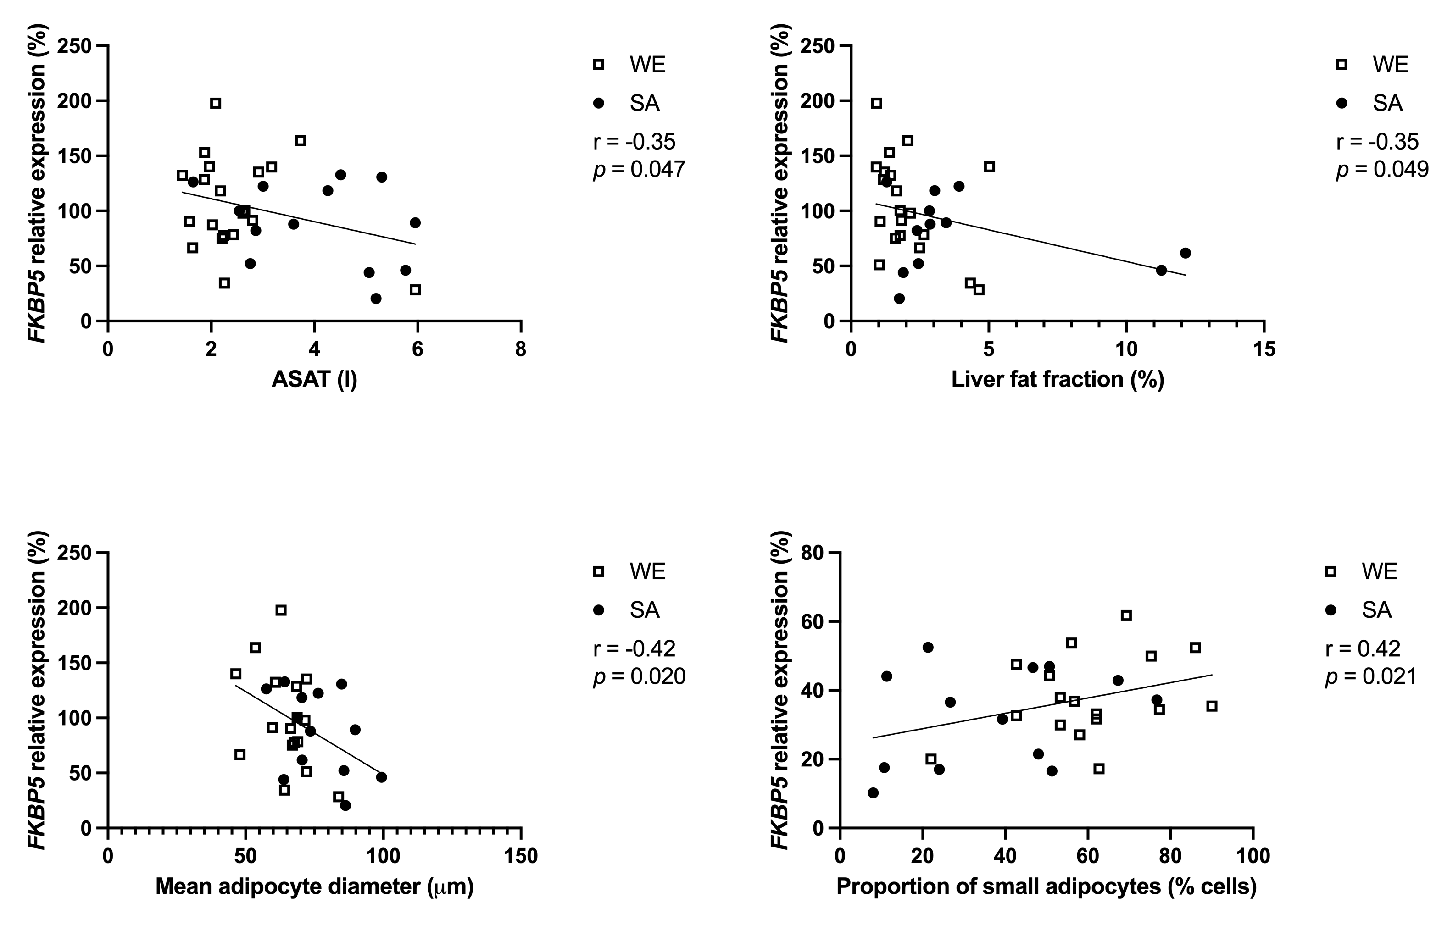
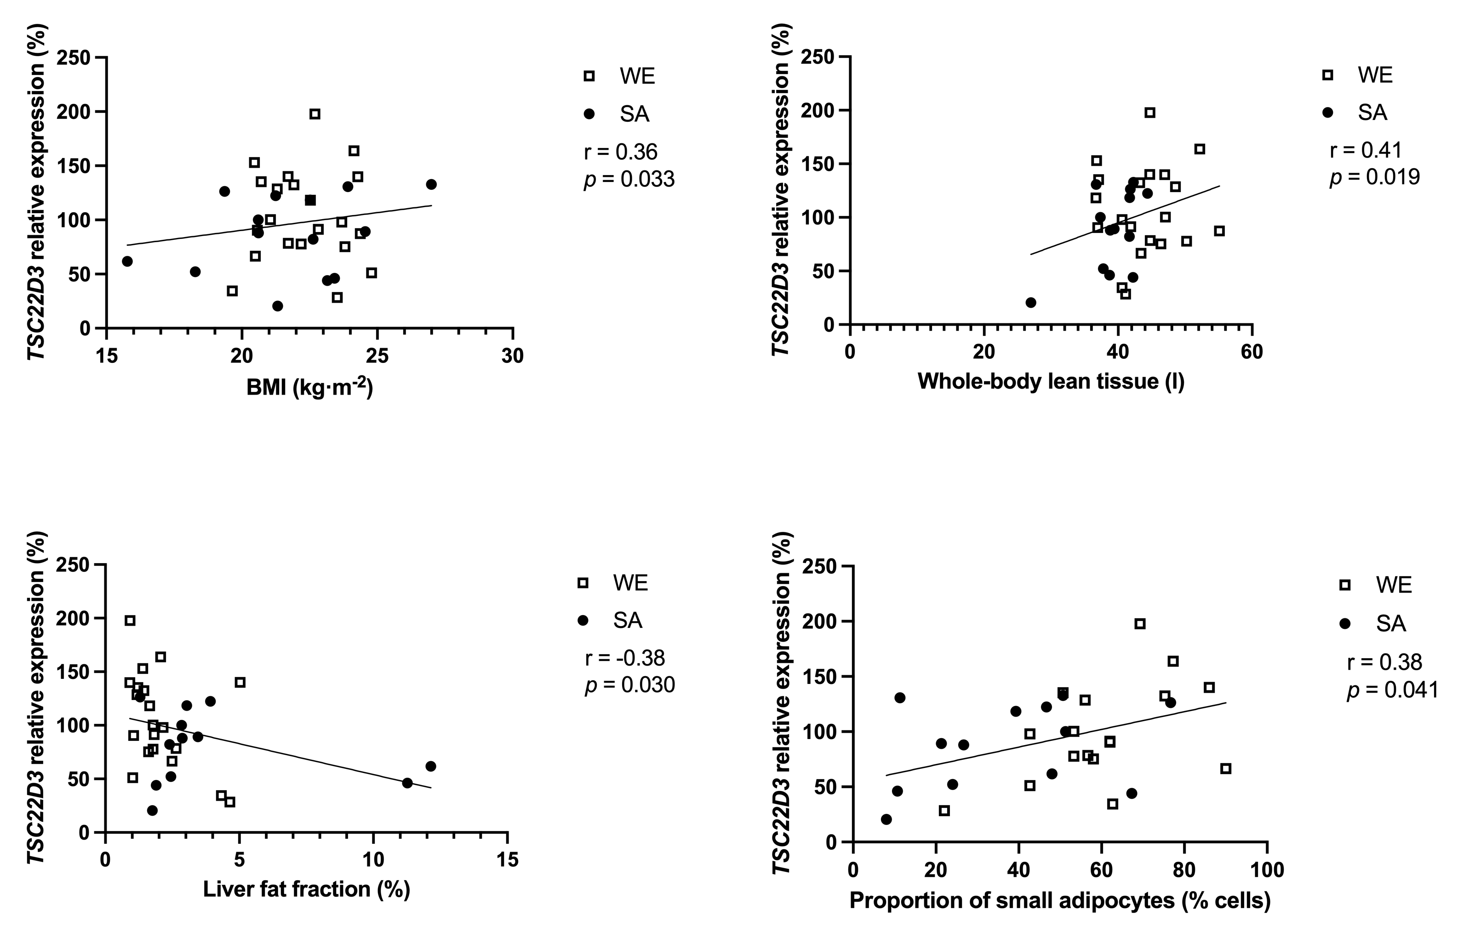
ESM Fig. 1 (Appendix Fig. 1).
Scatterplots of baseline FKBP5 and GILZ(TSC22D3) expression in subcutaneous adipose tissue versus body composition and adipocyte size measures. Baseline gene expression (y-axis) is plotted against BMI, ASAT volume, mean adipocyte diameter and percentage of large adipocytes (x-axis). Solid lines show fitted linear regressions; shaded areas indicate 95% confidence bands. Panel annotations report Pearson correlation coefficients (r) and two-tailed p values. Sample size is pooled across WE and SA, with group sizes indicated in the figure (WE = 21/20; SA = 14).

Slide 7
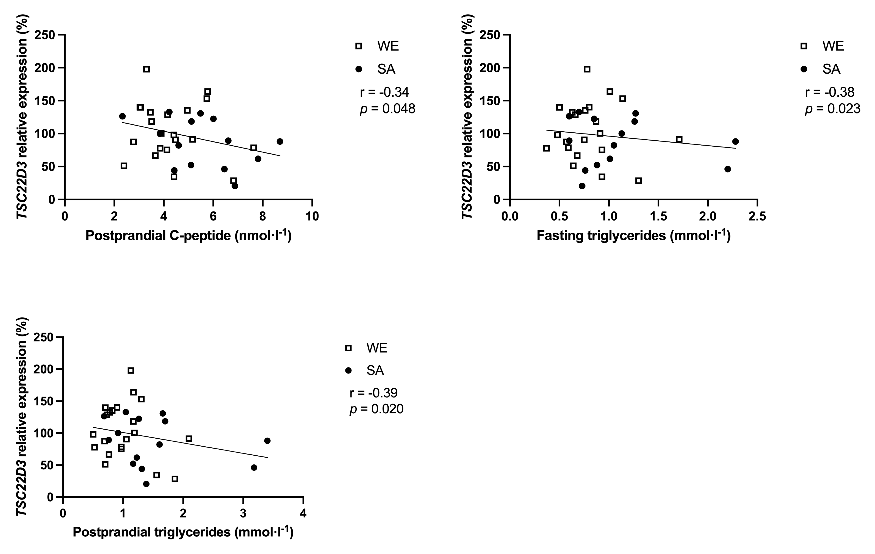
ESM Fig. 2 (Appendix Fig. 2).
Scatterplots of baseline GILZ (TSC22D3) expression versus metabolic parameters. Baseline gene expression (y-axis) is plotted against fasting glucose, postprandial C-peptide AUC, triglycerides at 0 min and triglyceride AUC (x-axis). Solid lines show fitted linear regressions; shaded areas indicate 95% confidence bands. Panel annotations report Pearson correlation coefficients (r) and two-tailed p values. Sample size is pooled across WE and SA, with group sizes indicated in the figure (WE = 21/20; SA = 14).

Slide 8
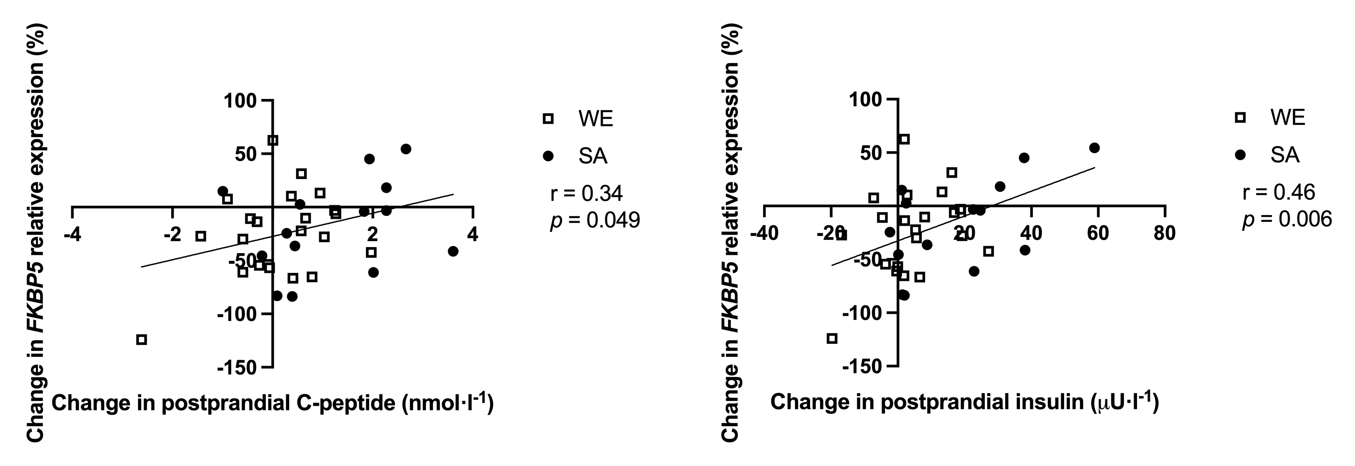
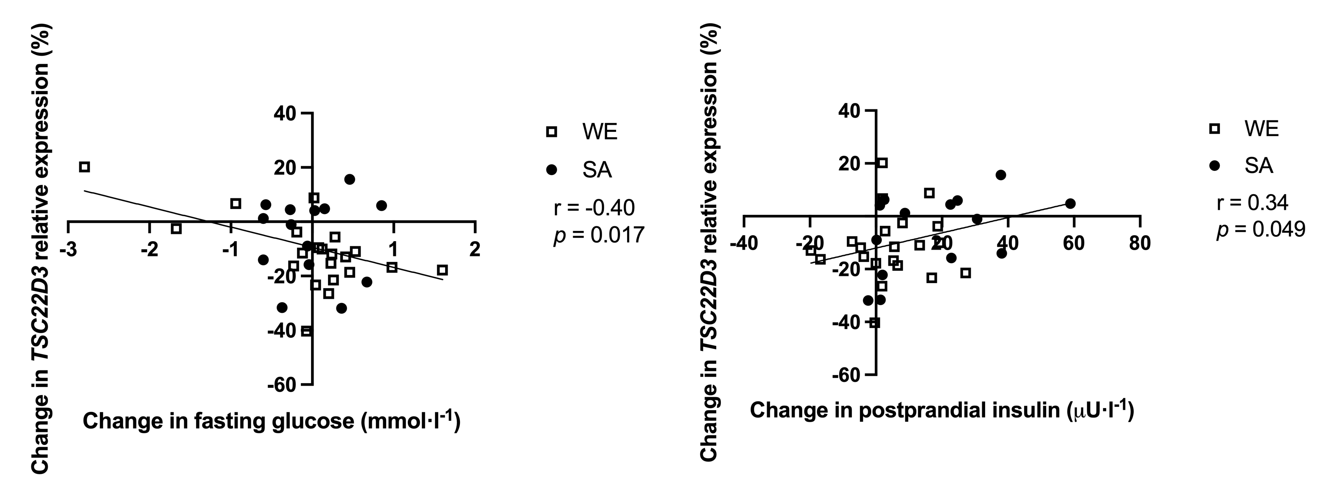
ESM Fig. 3 (Appendix Fig. 3).
Scatterplots of within-person changes in FKBP5 and GILZ expression with weight gain versus changes in metabolic measures. Weight gain–induced changes in gene expression (Δ = WG − BL; y-axis) are plotted against concurrent changes in metabolic measures (x-axis), including Δpostprandial C-peptide AUC, Δpostprandial insulin AUC, Δfasting glucose and Δtriglyceride AUC. Solid lines show fitted linear regressions; shaded areas indicate 95% confidence bands. Panel annotations report Pearson correlation coefficients (r) and two-tailed p values. Sample size is pooled across WE and SA, with group sizes indicated in the figure (WE = 21/20; SA = 14).

