Slide 1
Fig. S1
A
MII oocyte
zygote
early 2-cell
2-cell
4-cell
8-cell
ICM
mESC
heart
kidney
liver
duodenum
Gene expression
(FPKM)
stomach
lung
spleen
thymus
Stages
B
Genes
C
80
4-cell
8-cell
Total Gene list
mESC
ICM
20
2-cell
liv2
liv1
kid2
sto1
du2
Active
C1>>C2
Silent
kid1
spl2
spl1
Principal component 2 (15.7%)
he1
he2
sto2
du1
Active
Silent
Active
Silent
lung2
thy1
thy2
-40
lung1
Active
Silent
Active
Silent
Active
Silent
Active
Silent
zygote
early 2-cell
0
3
1
2
4
5
6
7
-100
-120
MII oocyte
-40
0
40
80
Gene classes
-80
Principal component 1 (43.5%)
Fig. S1 Dissecting gene expression pattern during embryonic development and identify ZGA genes. (A) Hierarchical clusters for samples from mouse early embryos and tissues (GEO: GSE66390 and ENCODE). Each row is a gene and each column is a developmental stage. Each value is the FPKM of the gene. MII oocyte: metaphase II oocyte, ICM: inner cell mass, mESC: mouse embryonic stem cells. (B) Separation of mouse embryonic developmental stages by principal component analysis. Principal component 1 explains 43.5% variation. Principal component 2 explains 15.7% variation. Remaining components explains 40.8% variation. (C) Algorithmic workflow of gene screening and classification. High-exp and no-exp represent the thresholds of gene expression and silence, respectively, for each cluster. The first class (class 0) and last class (class 7) are discarded due to the stability of their gene expression levels during development.

Slide 2
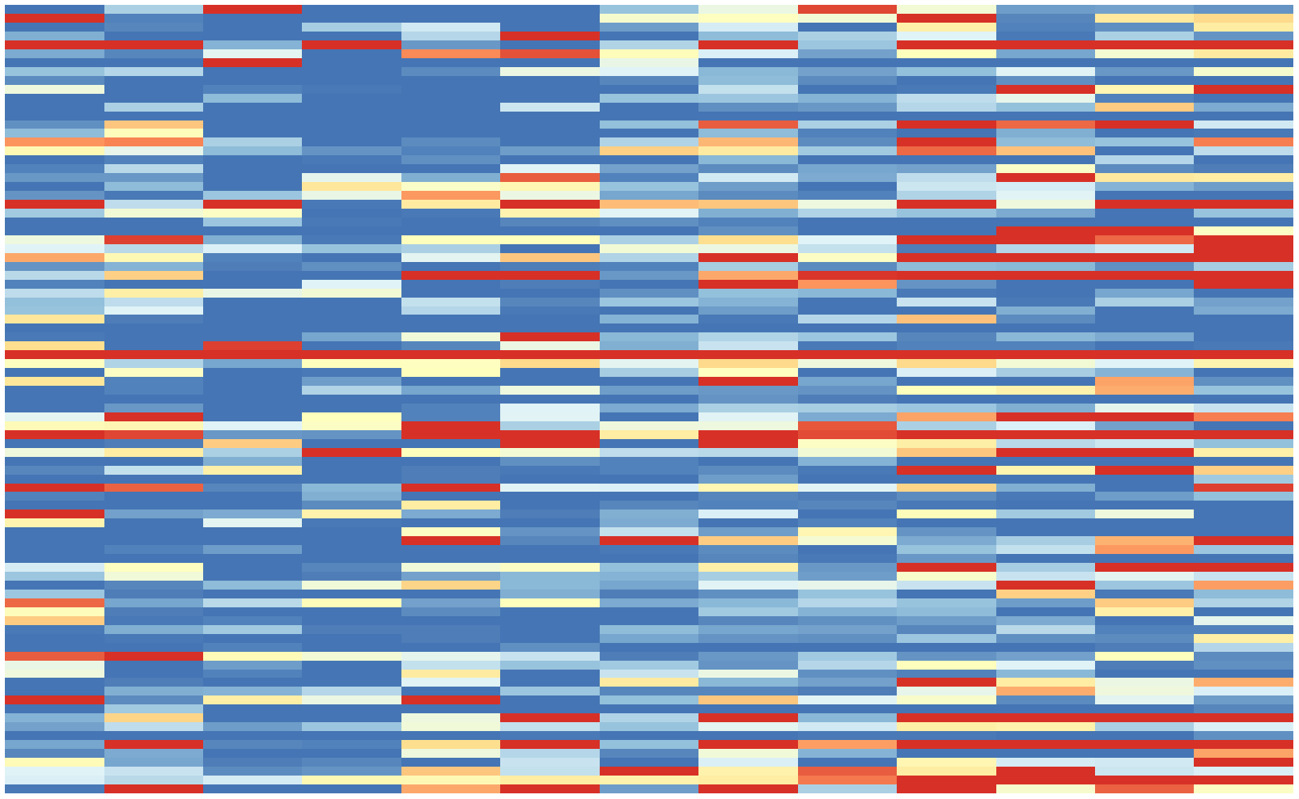
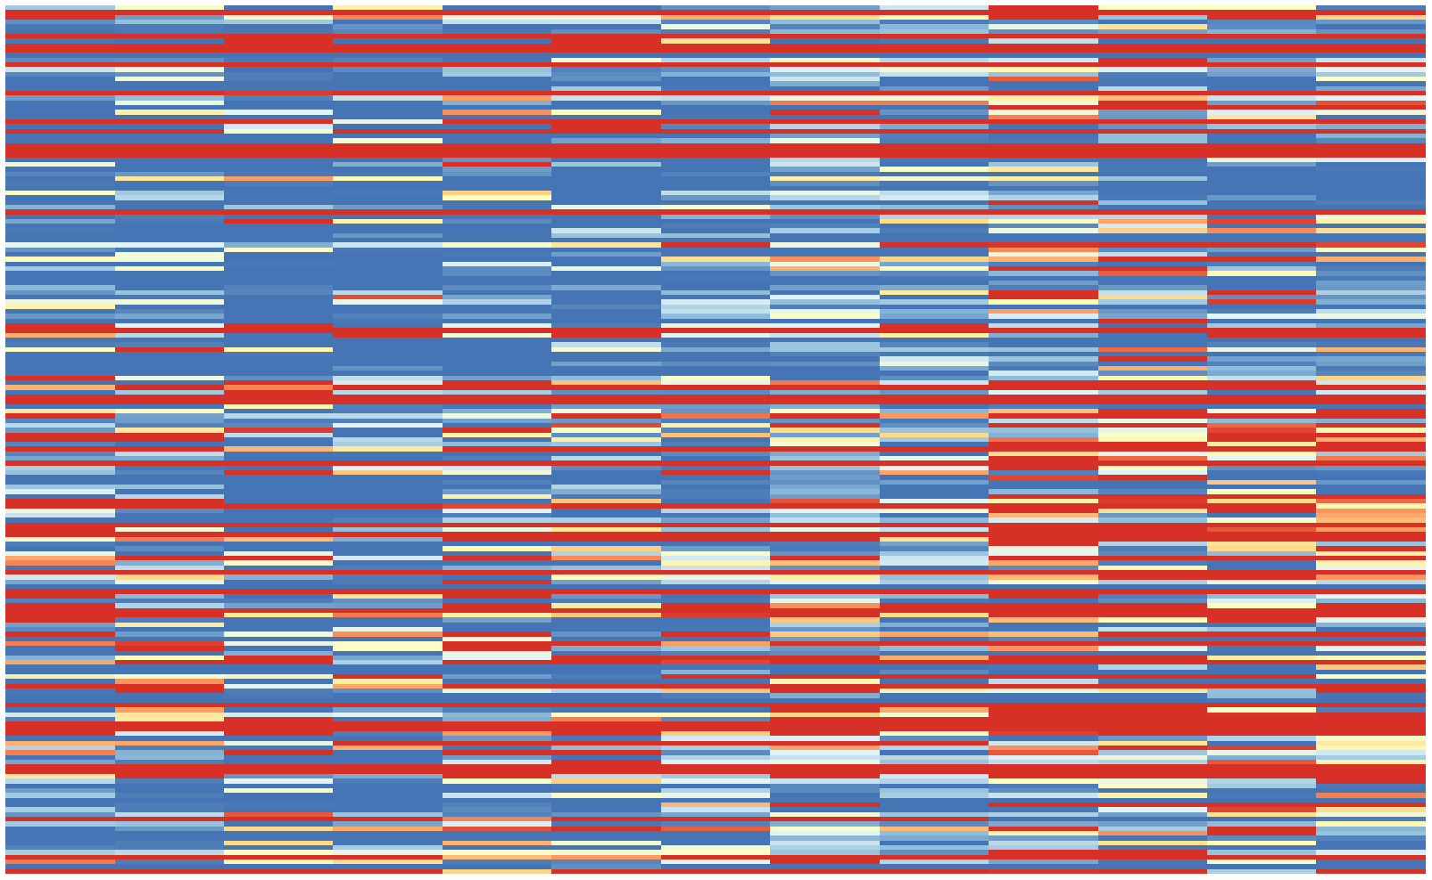
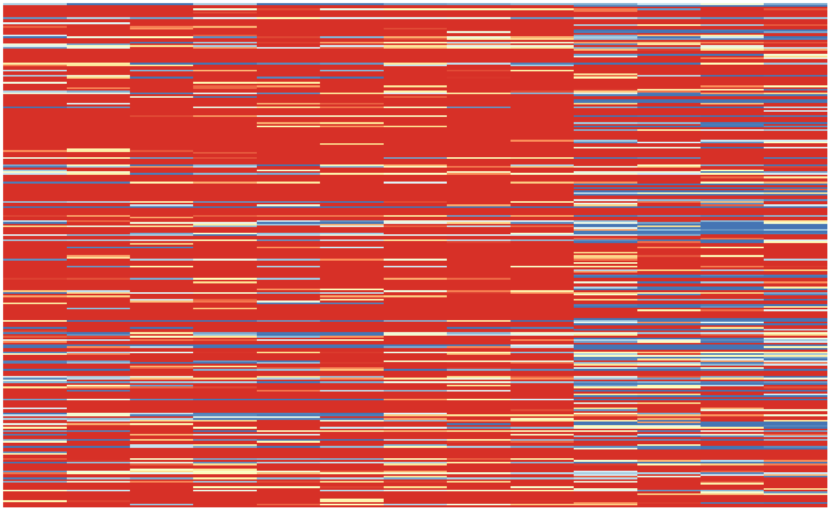
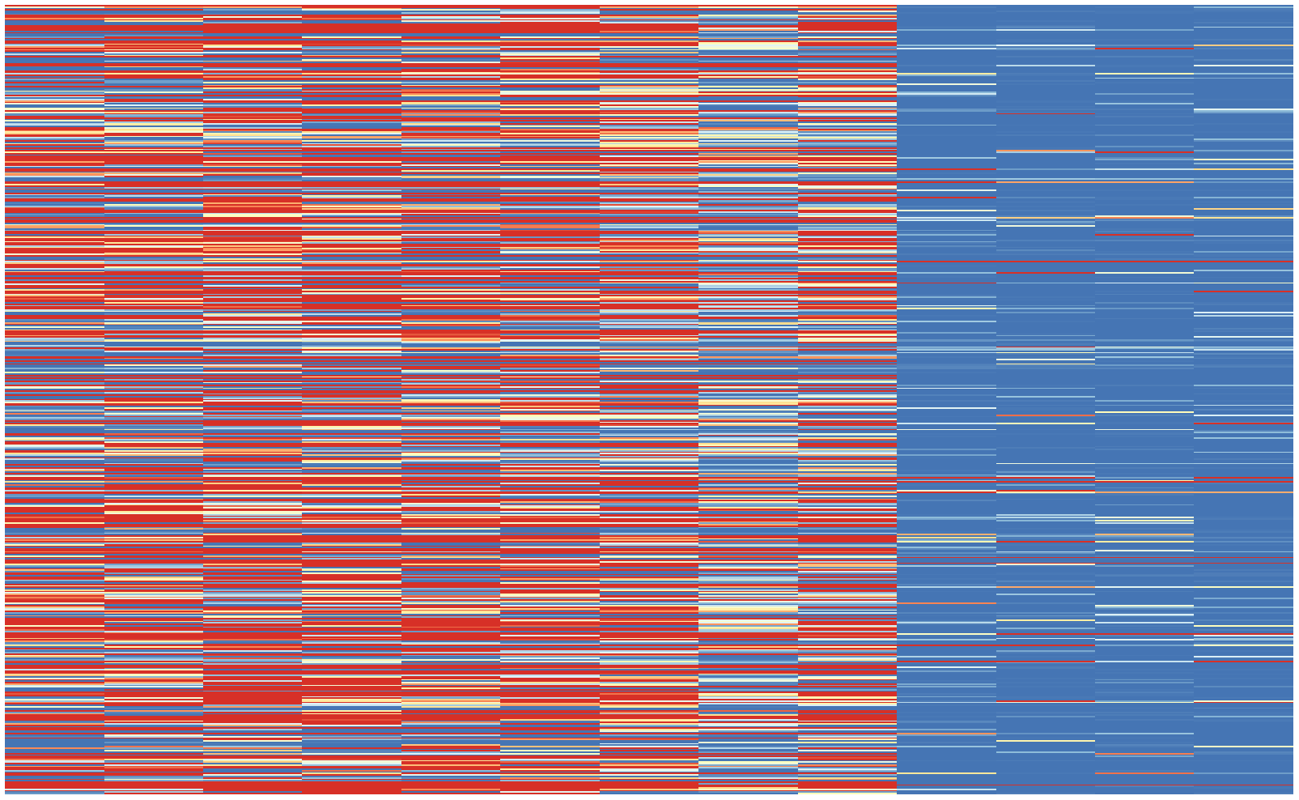
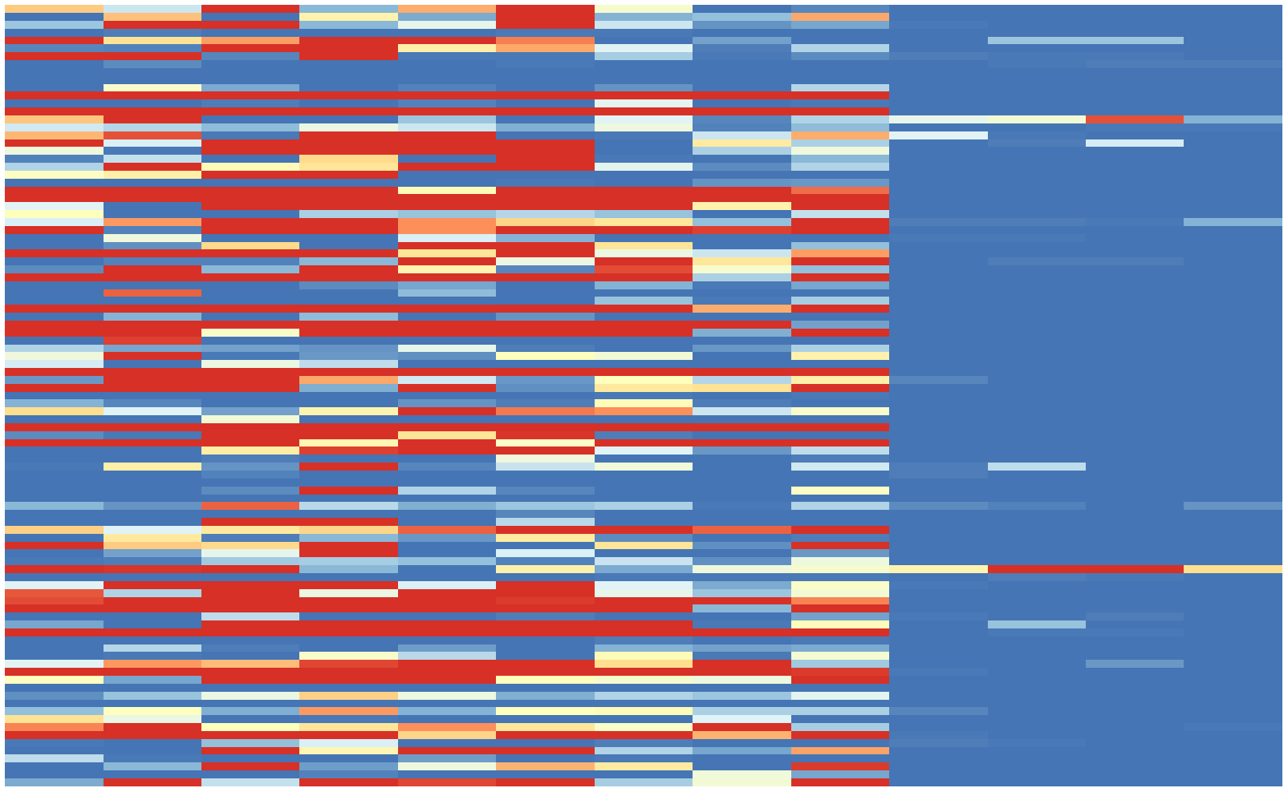
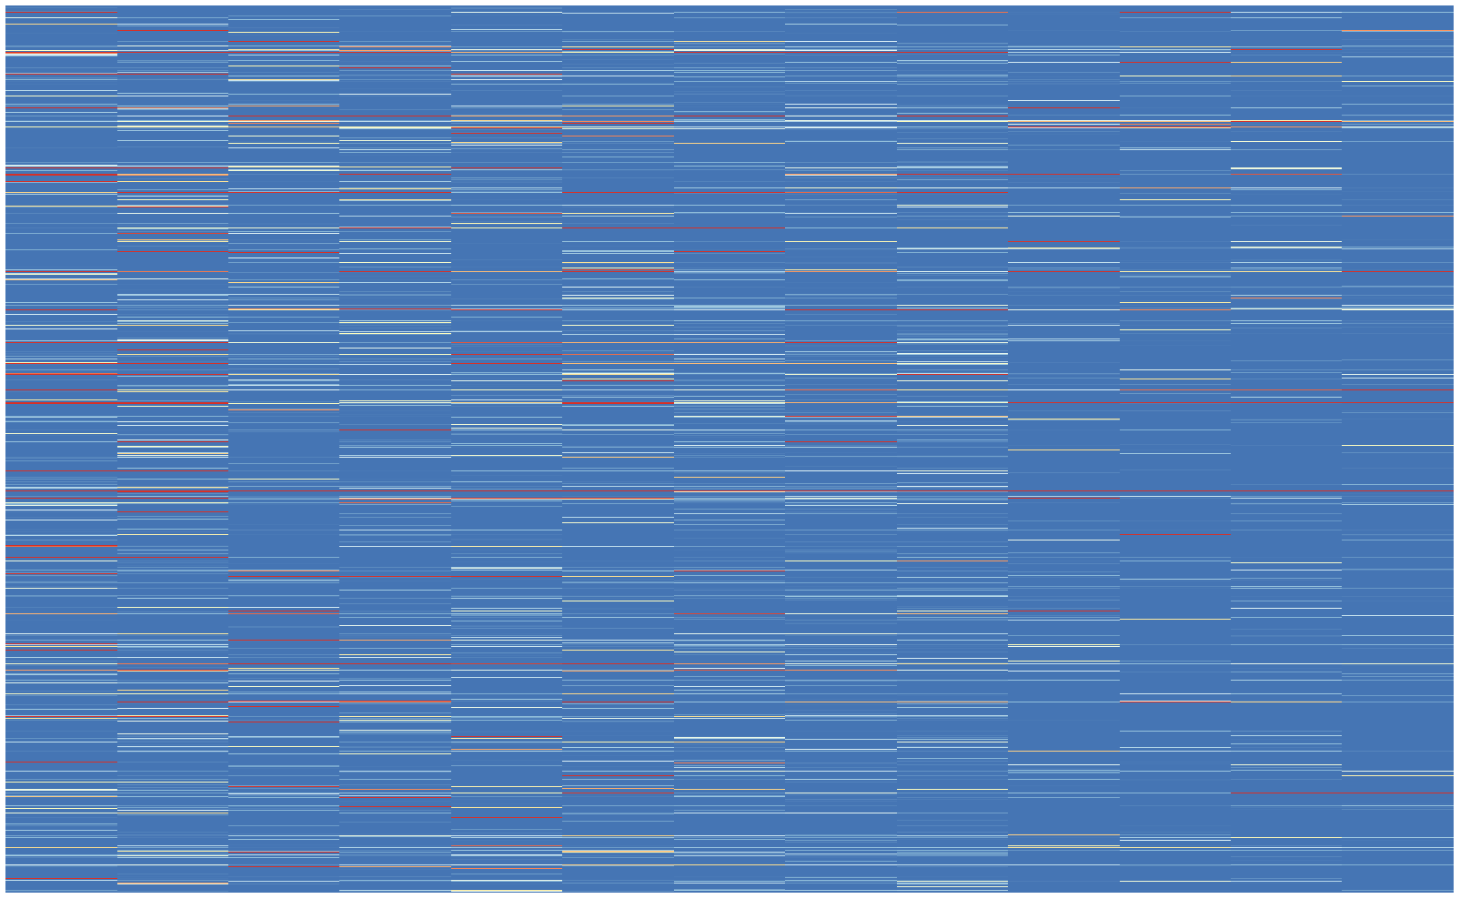
Fig. S2
A
C
Mta2
B
class1
class2
class3
class4
class5
class6
D
FPKM
>10
8
6
4
2
0
0.43
0.36
0.63
23.54
53.38
1.41
2-cell
Foldchange (ctrl/α-AM treated)
α-AM 2-cell
E
F
Xist
G
Nanog
>5
4
3
log2(FPKM+1)
2
119 ZGA genes exclusively identified in this study
1
0
zygote
2-cell
4-cell
8-cell
ICM
mESC
MII oocyte
Early 2cell
I
H
ZGA genes identified by Lu. et al
ZGA genes identified by Fan. et al
2-cell
α-AM 2-cell
Expression level (FPKM)
ZGA genes identified by Abe. et al
ZGA genes identified by Park. et al

Slide 3
Fig. S2 Comparison of identified mouse ZGA genes. (A) Pearson correlation coefficient of cells from scRNA-seq data for samples in 2-cell embryos and 2-cell embryos with α-Amanitin (GEO: GSE71434). (B) Expression level (FPKM) in 6 classes using expression profiles from scRNA-seq data (GEO: GSE53386). (C) Expression levels (FPKM) of Mta2 (ZGA gene identified by all methods). (D) Expression levels of Mta2 in normal 2-cell embryos and 2-cell embryos treated with α–Amanitin. (E) Expression levels of 119 ZGA genes exclusively identified by our method in early developmental stages (GEO: GSE66390). (F) Expression levels of some ZGA genes exclusively identified by our method for samples in 2-cell embryos and 2-cell embryos with α-Amanitin. (G) Expression levels of Xist. (H) Expression levels of Nanog. (I) Expression of ZGA genes detected in previous studies but not by our method.

Slide 4
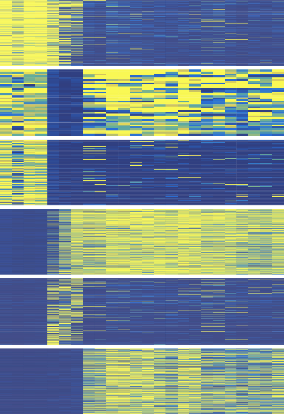
Fig. S3
A
B
ZGA
ESC
>10
1
36
genes
8
class1
class2
class3
2
114
genes
6
5
4
3
461
genes
2
89
36
190
109
394
67
249
0
Expression level
FPKM
class4
class5
class6
4
887
genes
11
171
5
465
genes
813
74
497
454
108
1212
478
6
649
genes
ICM
human
mouse
4-cell
hES
8-cell
MII oocyte
2-cell 2PN
GV oocyte
liver
spleen
thyroid gland
lung
thoracic aorta
leg skin
pancreas
sigmoid colon
Fig. S3. Gene expression pattern is conserved during embryonic development across diverse datasets. (A) Expression patterns of the genes in 6 classes, determined from bulk RNA-seq data on human early developmental stages and tissues (GEO:GSE101571). MII oocyte: metaphase II oocyte, GV: germinal vesicle, ICM: inner cell mass, hES: human embryonic stem. (B) Overlap of the genes in 6 classes identified in humans and mice.

Slide 5
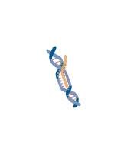
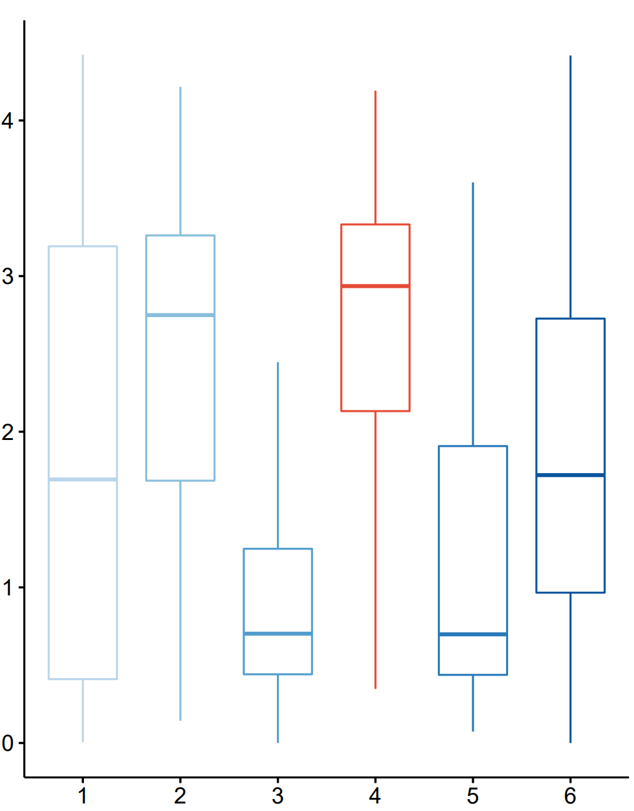





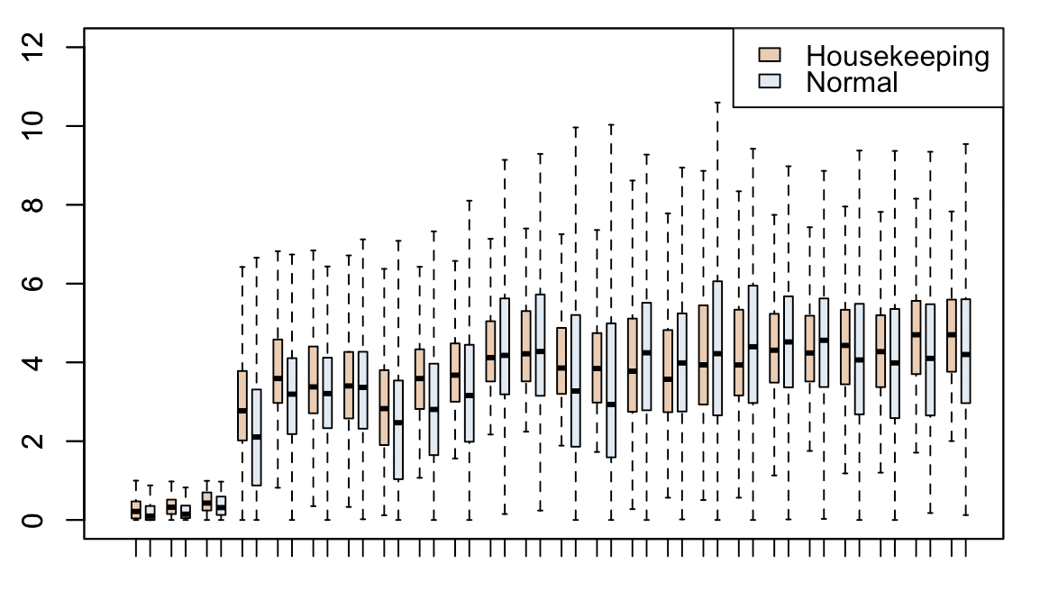
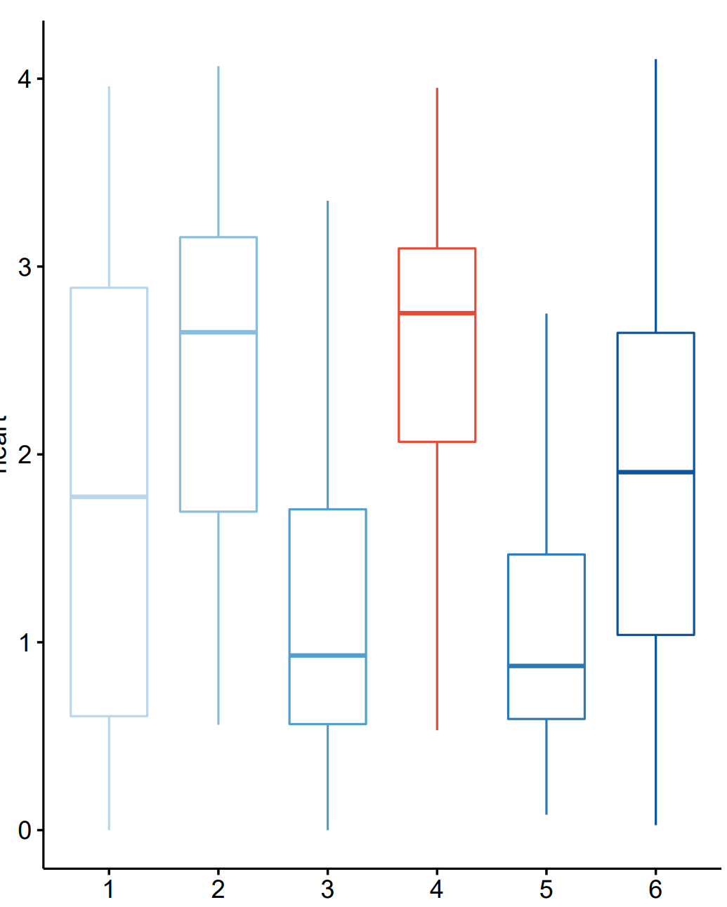
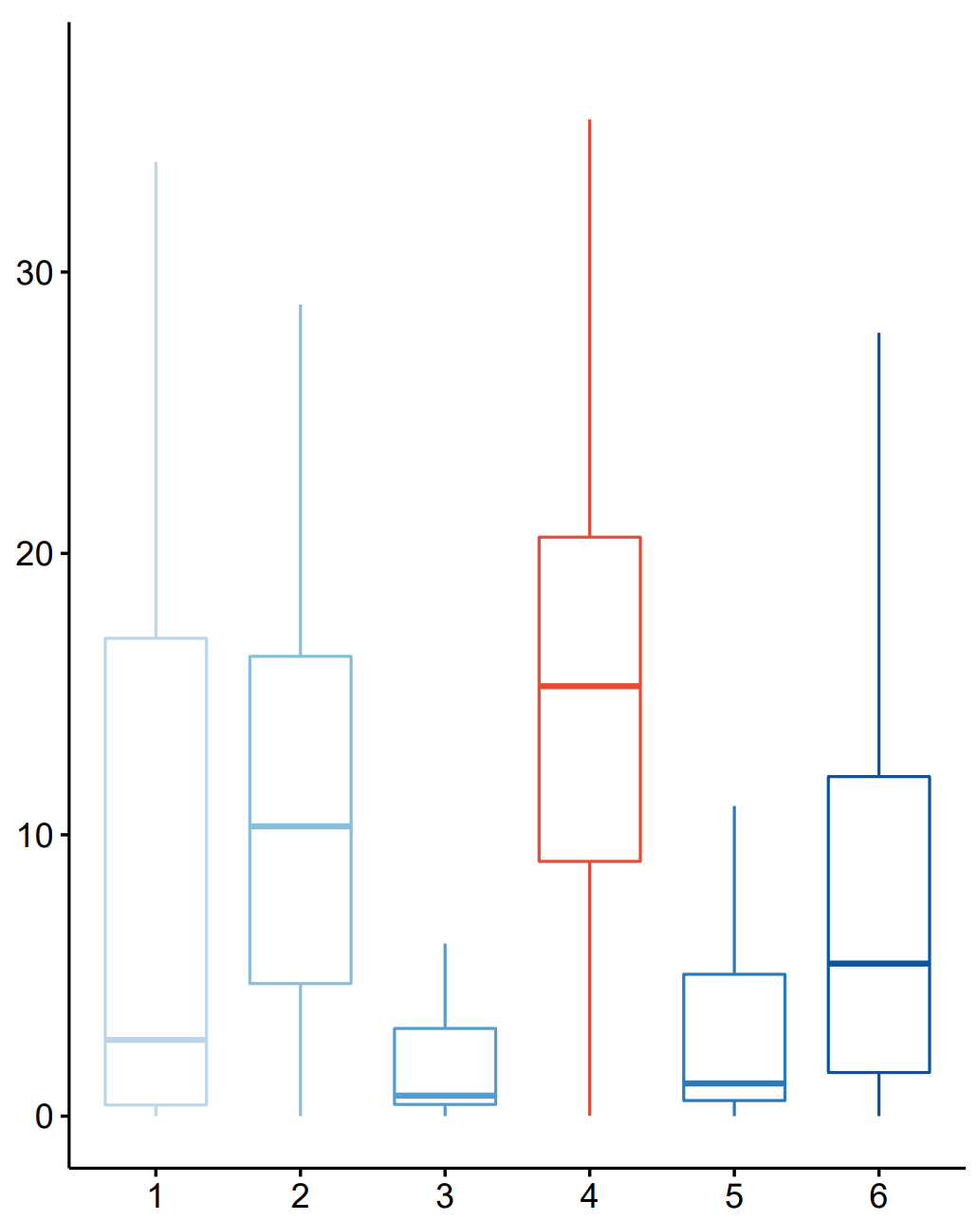
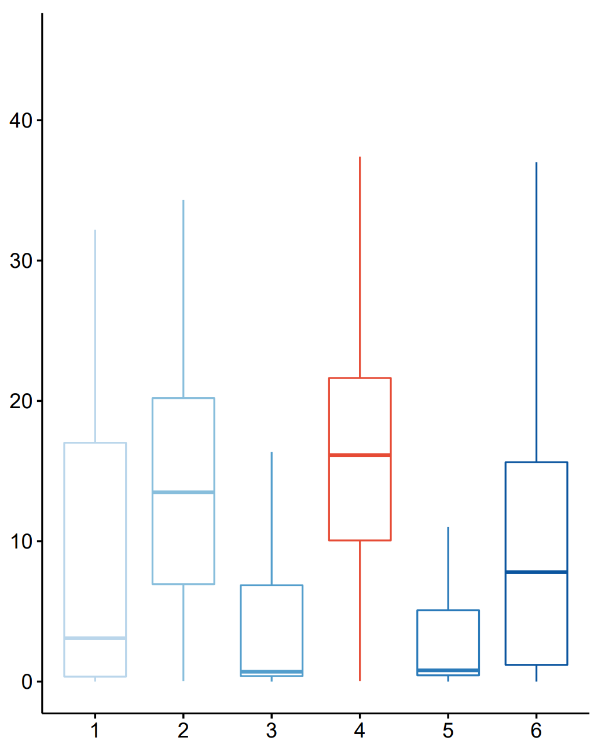
Fig. S4
A
S-ZGA genes: Activated at ZGA and kept expressed. Function as the protagonist.
Gene expression
Other genes: Only expressed at certain stages. Perform different functions.
ZGA
stage
C
4
Early Embryo
Mature
3
ATAC-seq signal in liver
B
2
ZGA
ESC
1
***
0
1
2
3
4
5
6
***
***
*
***
***
*
4
Gene class
***
**
***
***
Expression level
***
3
ATAC-seq signal in heart
2
***
1
***
***
0
Development stages
1
2
3
4
5
6
D
E
F
Gene class
G
H
class
1
2
3
4
5
6
30
40
20
30
15
20
H3K4me3 ChIP-seq signal in heart
H3K4me3 signal
H3K4me3 ChIP-seq signal in liver
20
10
10
10
5
0
E2C | 2C | 4C | 8C | ICM
0
1
2
3
4
5
6
0
Gene class
1
2
3
4
5
6
Gene class

Slide 6
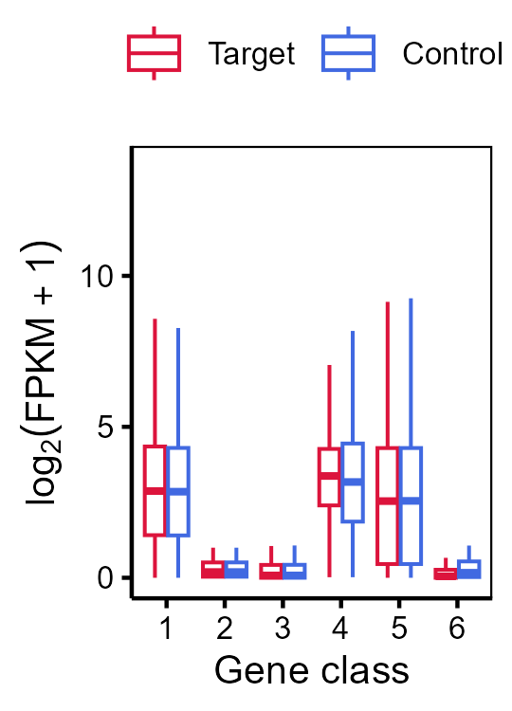
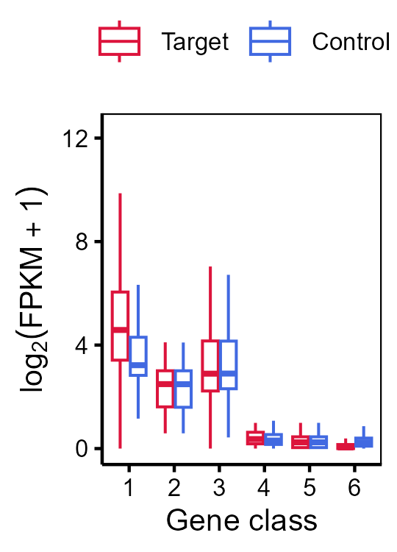
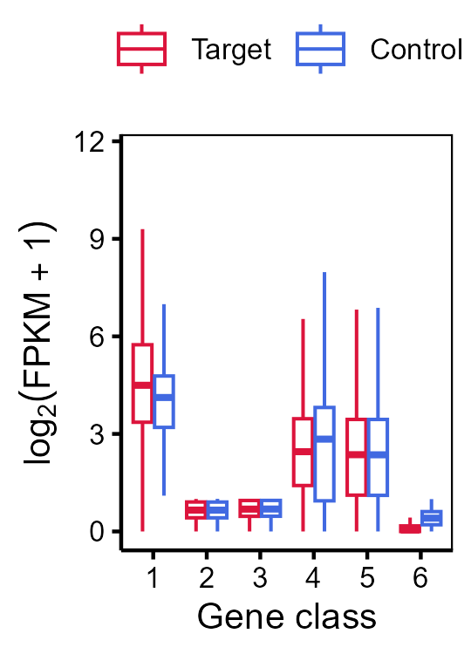
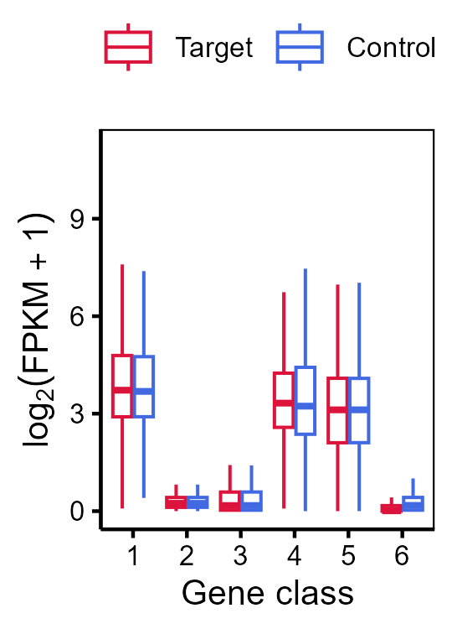
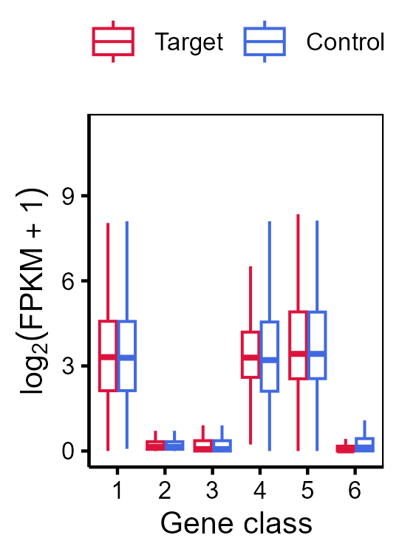
I
Early_2 cell
2 cell
4 cell
8 cell
ICM
J
Target
K
Control
L
Percentage of housekeeping gene
E2C
2C
4C
8C
ICM
Fig. S4 Sustained ZGA genes. (A) Schematic representation of the mouse S-ZGA genes. (B) Properties of S-ZGA genes. Boxplot showing the expression level (log2 (FPKM + 1)) of housekeeping and non-housekeeping genes of S-ZGA genes identified in mouse early developmental stages and tissues. (C) Boxplot of ATAC-seq (resources: ENCODE) signal in ±1 kb around TSS of genes in 6 classes in liver (left) and heart (right). (D) Percentages of mouse promoters (±2 kb around TSS) in the ATAC-peaks at early 2-cell and 2-cell stages. The numbers in the bar plot are the number of mouse promoters in ATAC-peaks. (E) Percentages of human promoters in the ATAC-peaks in 4-cell and 8-cell embryos. The numbers in the bar plot are the number of human promoters in ATAC-peaks. (F) Percentages of mouse promoters in the H3K4me3 peaks in early 2-cell and 2-cell embryos. The numbers in the bar plot are the number of mouse promoters in H3K4me3 peaks (GEO: GSE71434). (G) Boxplot of H3K4me3 ChIP-Seq signal in ±1 kb around TSS regions of genes in 6 classes from early 2-cell to ICM stage. (H) Boxplot of H3K4me3 ChIP-Seq signal in promoter regions of genes in 6 classes in liver(left) and heart(right). (I) Median FPKM expression across stages (E2C to ICM) reveals class-specific activation timing. Red indicates genes identified in class1-6, while blue represents genes with similar expression levels that were screened.(see Methods). (J-K) Boxplot of H3K4me3 ChIP-Seq signal in ±1 kb around TSS regions of genes in 6 classes from early 2-cell to ICM stage. (J) Signals from genes originally assigned to Class 1–6 based on unsupervised clustering of transcriptomic profiles (see Methods). (K) Signals from a control set of genes matched for expression level (FPKM) at each stage but randomly selected outside the original class definitions. (L) Percentage of housekeeping genes in target (Class 1–6) and expression-matched control groups across different developmental stages (E2C to ICM).

Slide 7
Fig. S5
A
B
C
1.0
p = 0.02
0.8
N.S.
0.6
N.S.
Density of DNA methylation of promoters
N.S.
N.S.
0.4
N.S.
0.2
0.0
1
2
3
4
5
6
D
E
Gene class
12
12
10
10
8
8
Rep2 H3K9me3 density of promoters in 2-cell
6
6
Rep1 H3K9me3 density of promoters in 2-cell
4
4
2
2
0
1
2
3
4
5
6
0
1
2
3
4
5
6
Gene class
Gene class
Fig. S5 The features and epigenetic properties of mouse ZGA genes. (A) Percentages of mouse promoters in the H3K27me3 peaks at 2-cell stage (GEO: GSE76687). The numbers in the bar plot are the number of mouse promoters in H3K27me3 peaks. (B) Density of DNA methylation of mouse promoters in 2-cell embryos (GEO: GSE56697). (C) Percentage of mouse promoters with demethylation in 2-cell embryos. The numbers in the bar plot are the number of mouse genes with demethylation. (D-E) Bar plot showing density of promoters in H3K9me3 peaks at 2-cell embryos of genes in 6 classes.

Slide 8
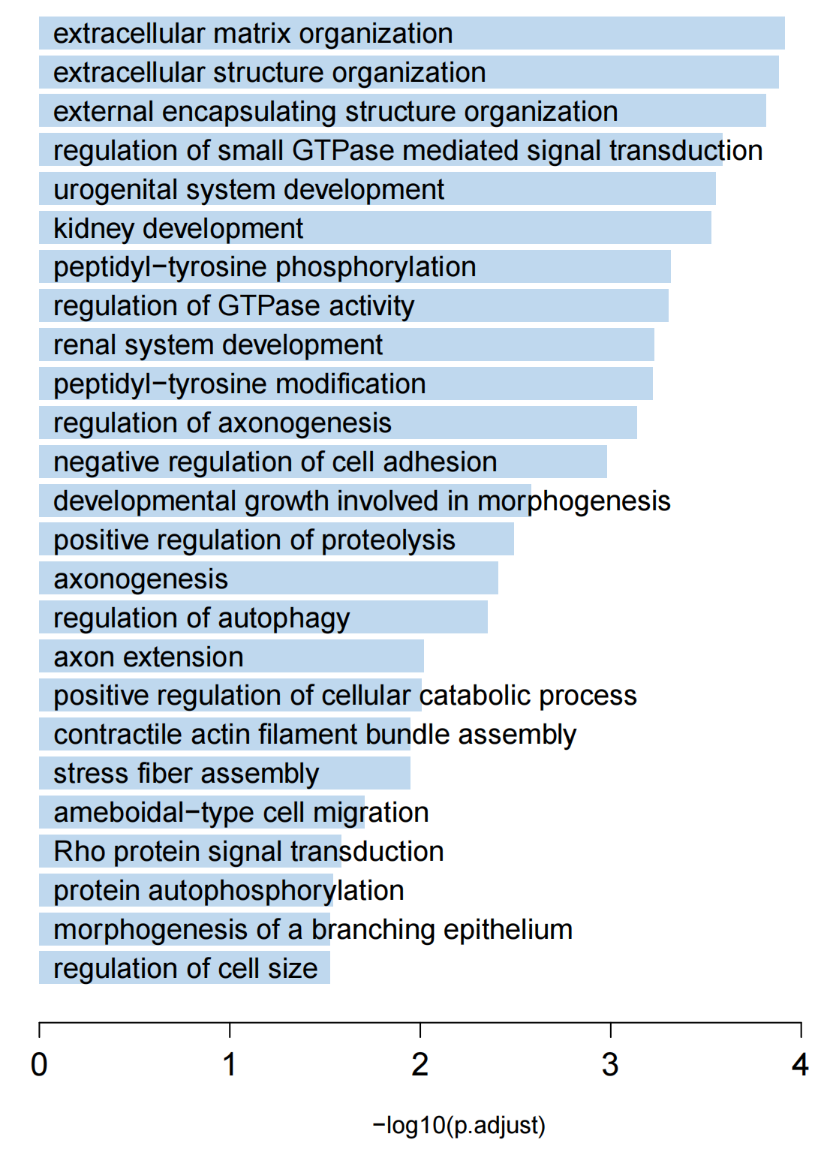
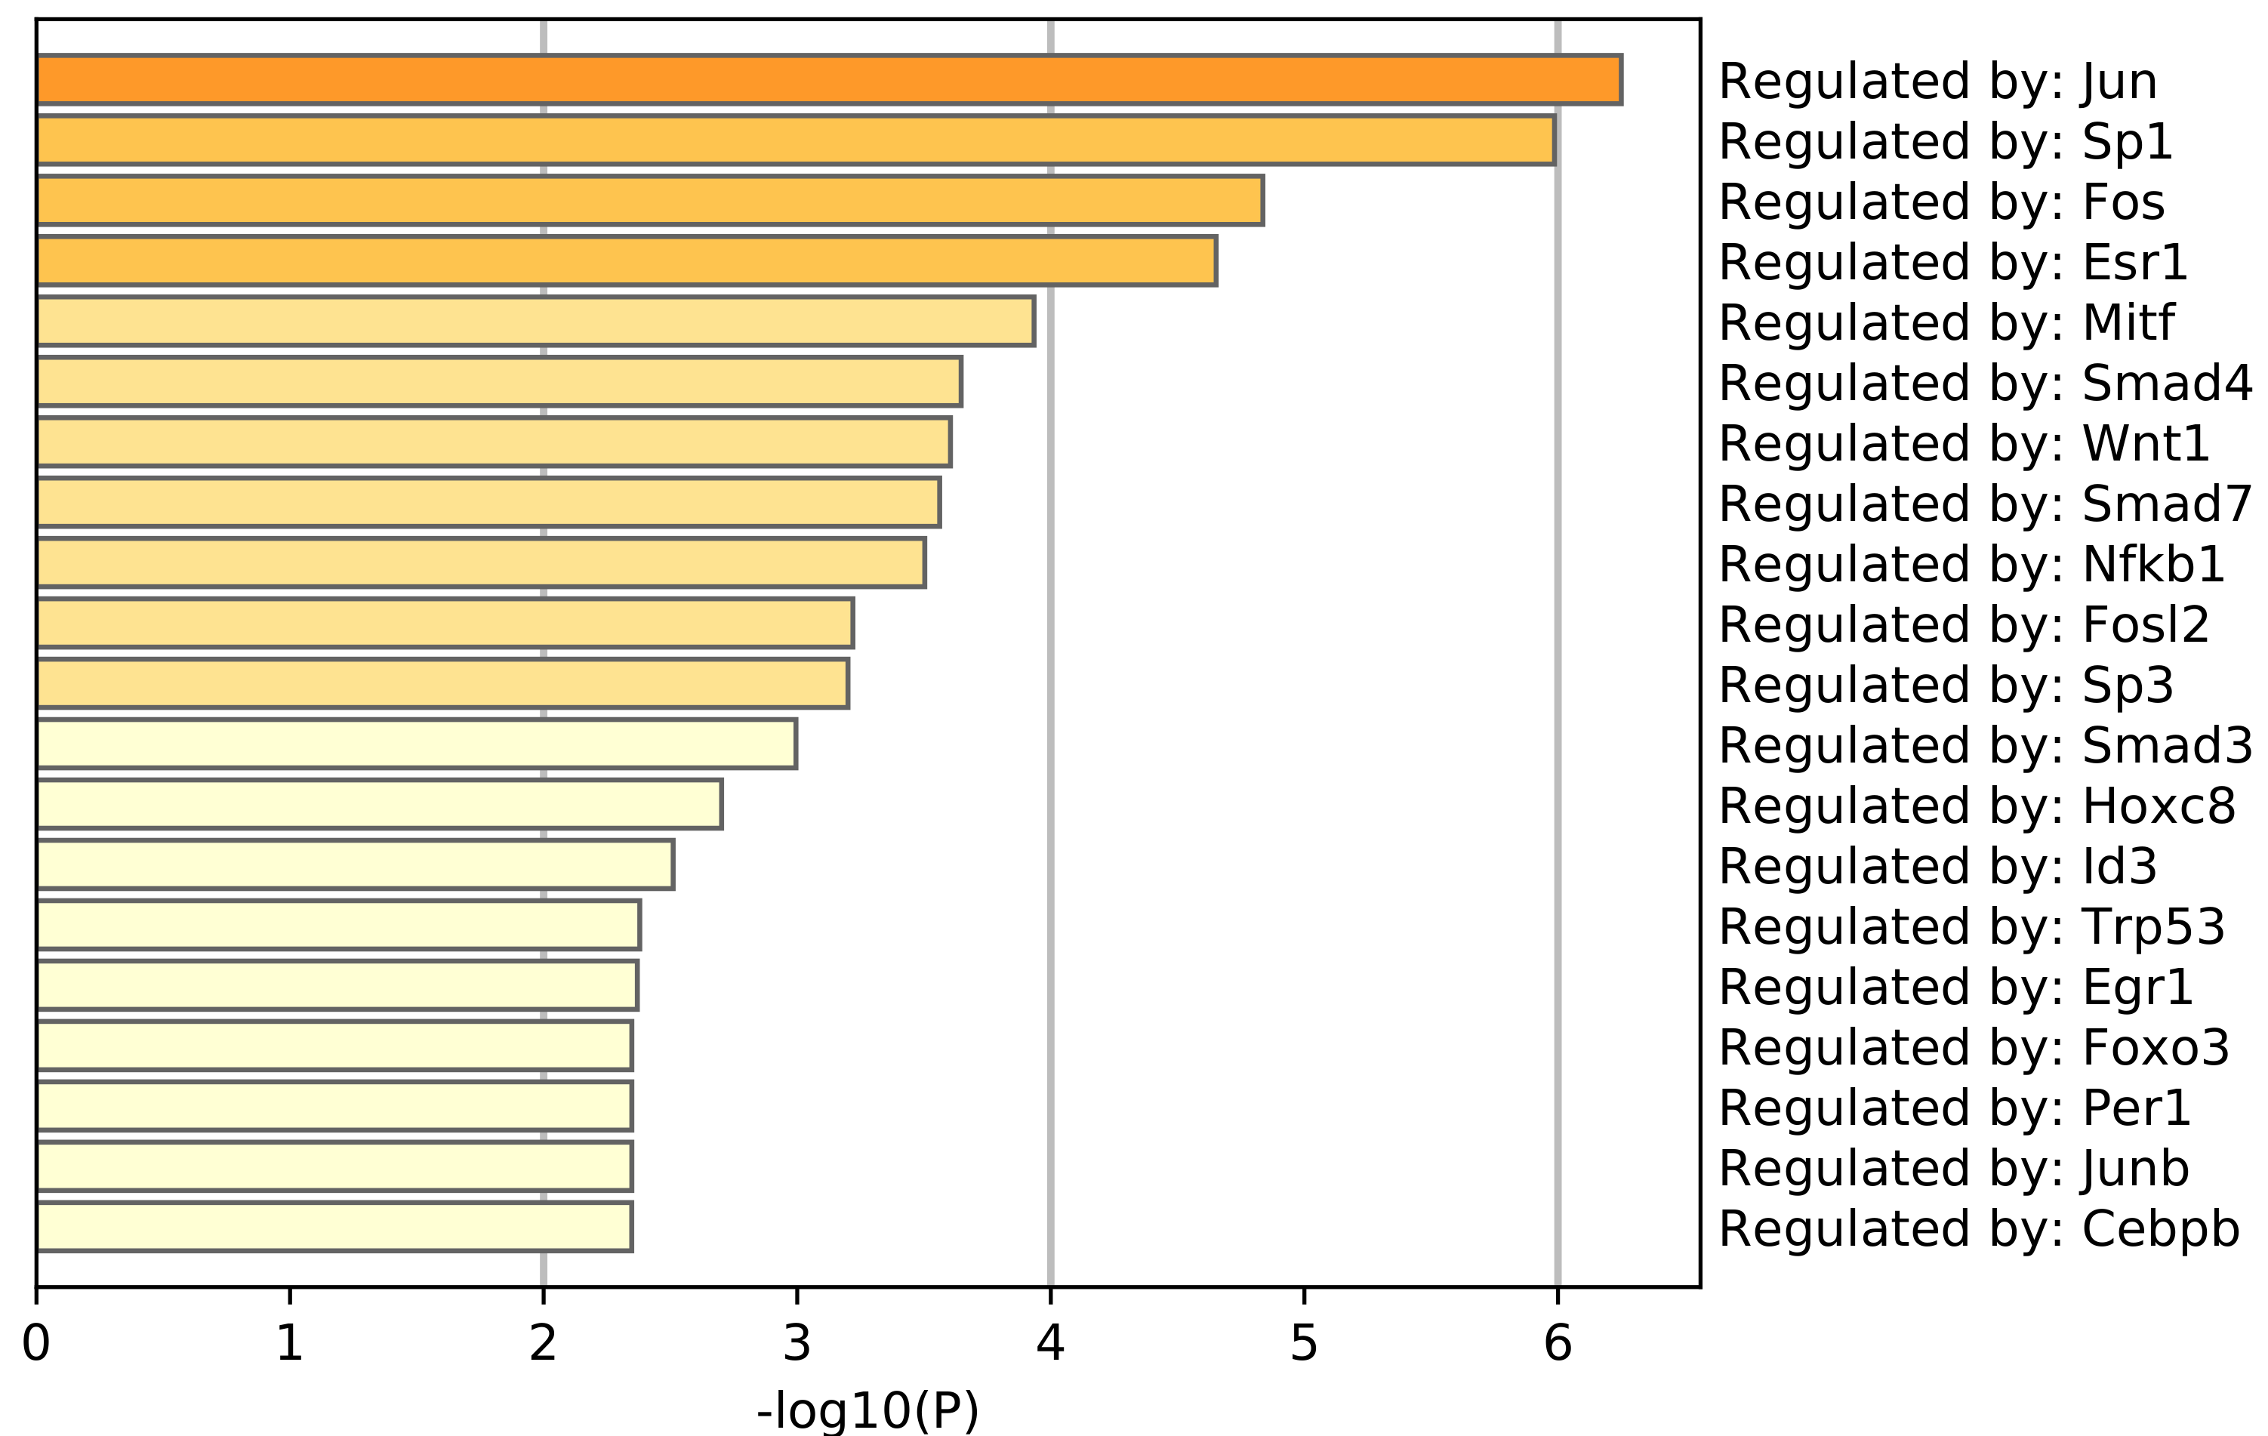
Fig. S6
A
B
C
p = 8.4e−06
200
150
SNP number in promoters
100
50
0
S-ZGA Genes
(n=887)
Other Genes
(n=20282)
D
p=5.95e-12
p = 1.93e-3
Ratio of genes related to phenotype
Ratio of cell senescence genes
S-ZGA
(n=887)
Other
(n=20282)
S-ZGA
(n=887)
Other
(n=20282)
Fig. S6 The function of human S-ZGA genes. (A) Top25 GO term enrichment for genes in human S-ZGA genes. (B) Barplot showing enriched TF recorded in TARGET database across S-ZGA genes, calculated by metascape, colored by p-values. (C) Boxplot showing the number of SNP recorded in ALFA within ±1 kb around TSS of human genes in S-ZGA genes and other genes. (D) Percentages of human phenotype related genes from Human Phenotype Ontology (HPO) database in S-ZGA genes and other genes. (E) Percentages of housekeeping genes from Cell Senescence Gene database in S-ZGA genes and other genes.

Slide 9
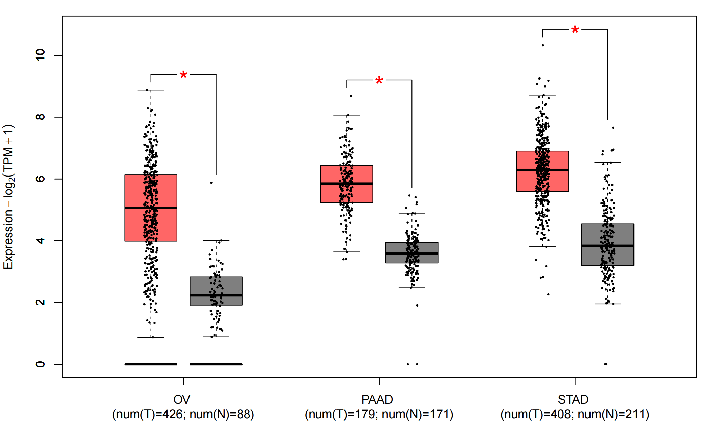
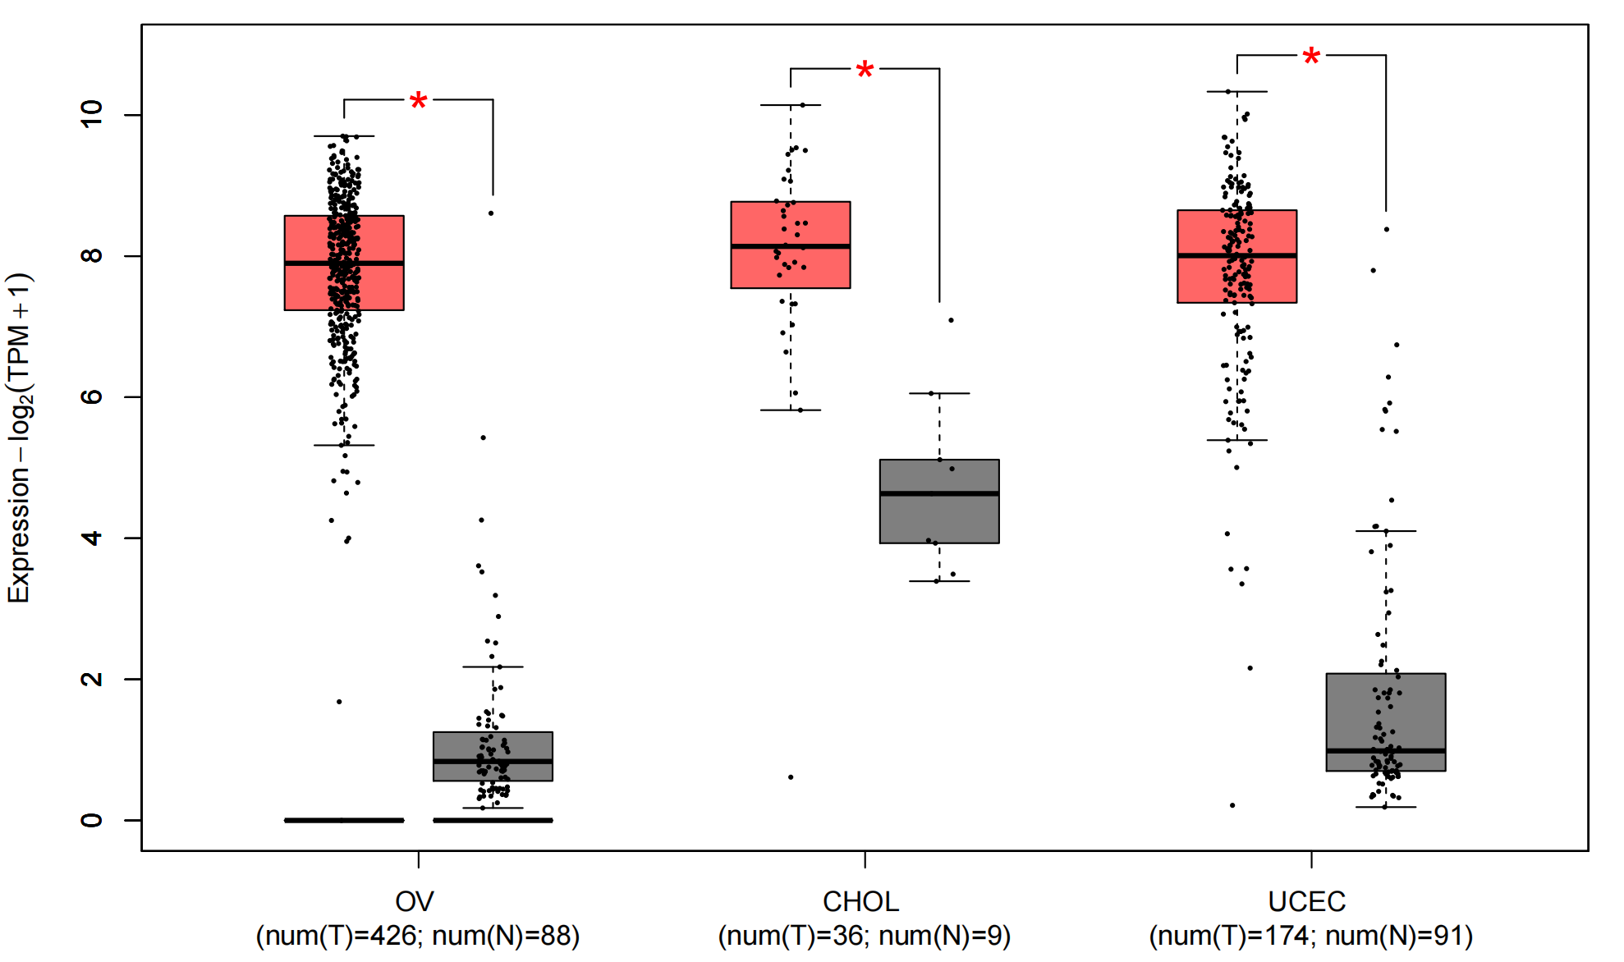
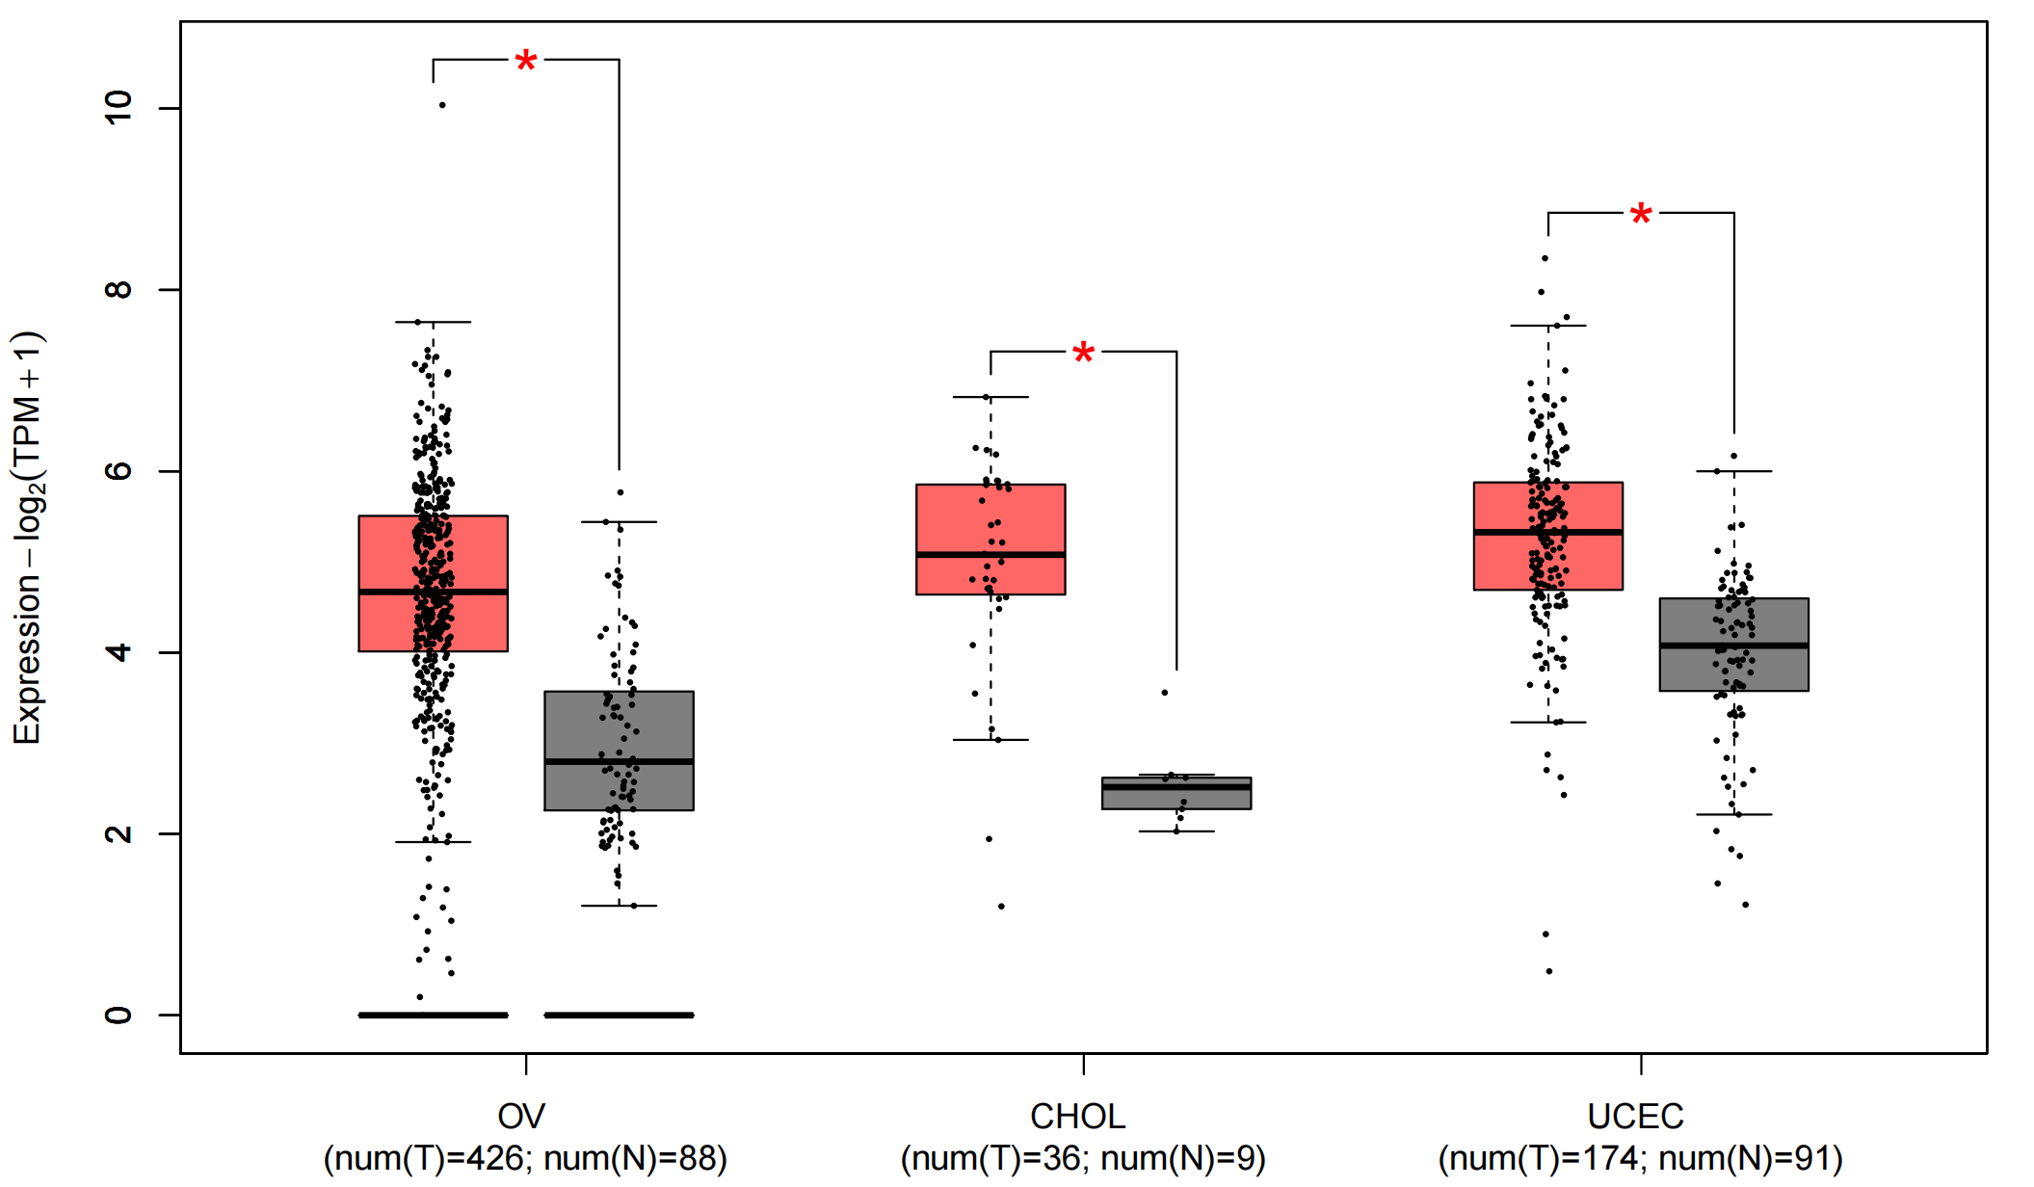
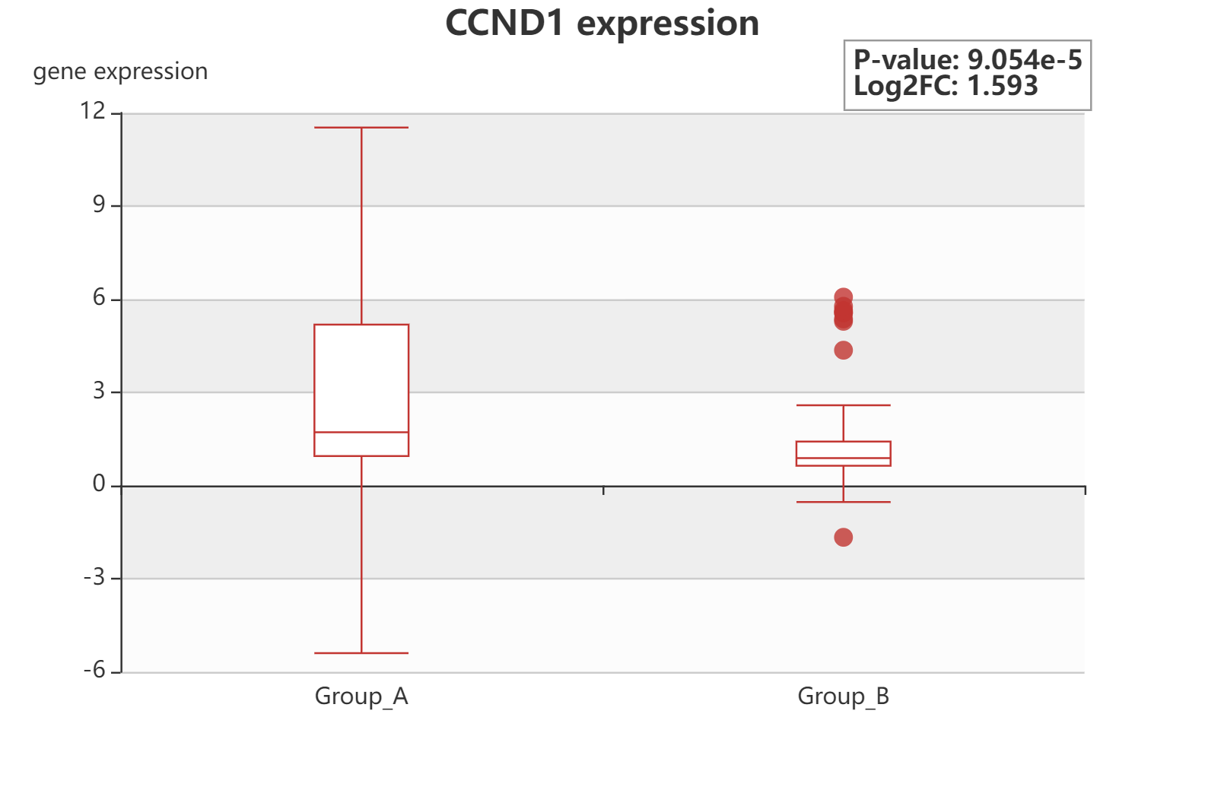
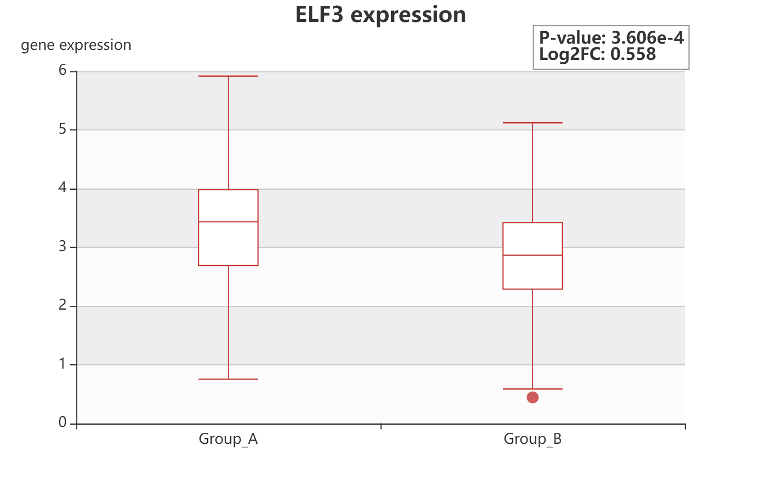
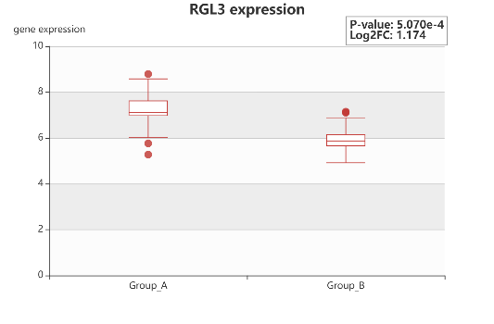
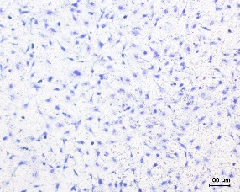
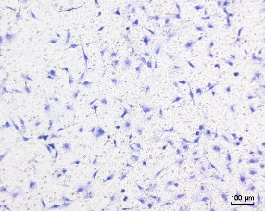
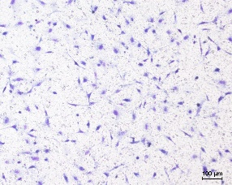
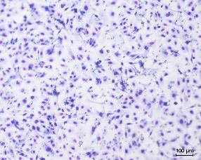
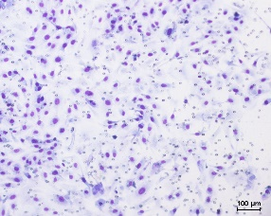
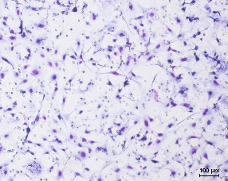
Fig. S7
A
CCND1
ELF3
RGL3
B
CCND1 expression in breast cancer
（EXP00389）
ELF3 expression in breast cancer
（EXP00389）
RGL3 expression in colorectal cancer
（EXP00364）
primary tumor with metastasis
primary tumor without metastasis
primary tumor with metastasis
primary tumor without metastasis
primary tumor with metastasis
primary tumor without metastasis
C
HIST1H3D
log₁₀(HR)
CD276
1.0
0.5
0.0
-0.5
-1.0
NOTCH3
POLE
CARM1
PLK2
ELF3
CCND1
ACC
GBM
KICH
KIRC
KIRP
LGG
LIHC
OV
UCS
UVM
BLCA
DLBC
LAML
LUAD
LUSC
TGCT
BRCA
ESCA
THCA
CESC
CHOL
PRAD
READ
HNSC
PAAD
SARC
PCPG
THYM
COAD
MESO
SKCM
UCEC
D
STAD
E
NC
siCCND1 #1
siCCND1 #2
Migration
Invasion

Slide 10
Fig. S7 The role of S-ZGA genes in cancer. (A) Differential expression of CCND1 (left), ELF3 (middle), and RGL3 (right) in tumor and matched normal samples from GEPIA2. OV: Ovarian serous cystadenocarcinoma; PAAD: Pancreatic adenocarcinoma; STAD: Stomach adenocarcinoma; CHOL: Cholangiocarcinoma; UCEC: Uterine Corpus Endometrial Carcinoma. (B) The expression of CCND1 (left), ELF3 (middle), and RGL3 (right) in primary tumor with and without metastasis from Human Cancer Metastasis Database (HCMDB). The numbers in parentheses represent exp ID in HCMDB. The selected cancer types represent the conditions with the highest statistical significance for differential expression in the HCMDB analysis. (C) The survival map for selected S-ZGA genes from GEPIA2 database. The heatmap shows hazard ratios at logarithmic scale (log10). Red and blue blocks represent higher and lower risks, respectively. Framed rectangles indicate significantly unfavorable and favorable results in prognostic analyses. (D) qPCR analysis of relative expression of CCND1 (left), ELF3 (middle), and RGL3 (right) mRNA in SKOV3 cells treated with siRNA. (E) Representative images of SKOV3 cells treated with siRNA targeting CCND1 or negtive control in migration and invasion assays(Left), Quantification(Right) represent mean ± SD. Unparied t test, *p < 0.05,**p < 0.01, ***p < 0.001, Scale bar, 100μm.

Slide 11
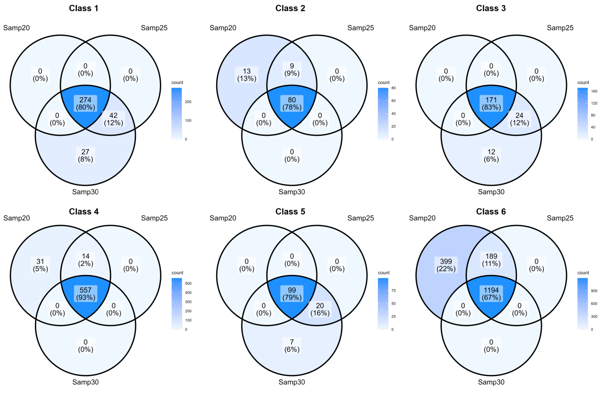
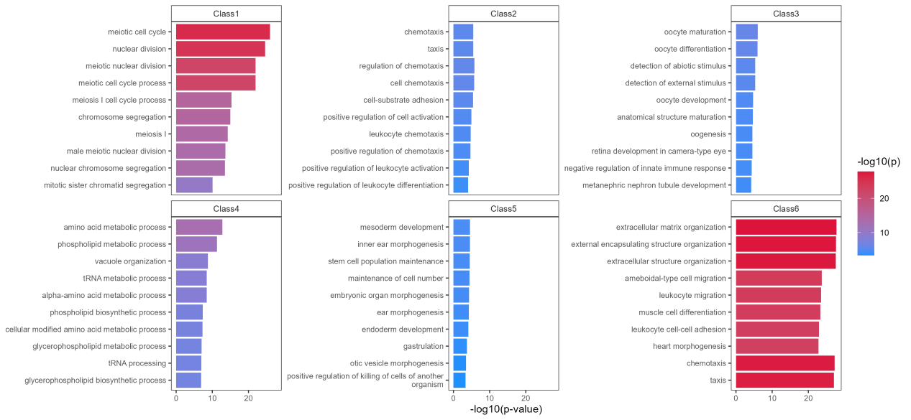
Fig. S8
A
B

Slide 12
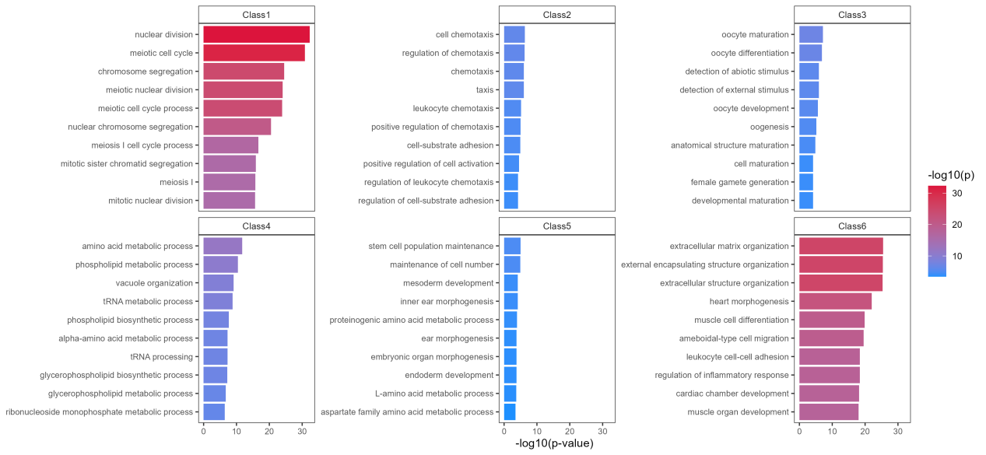
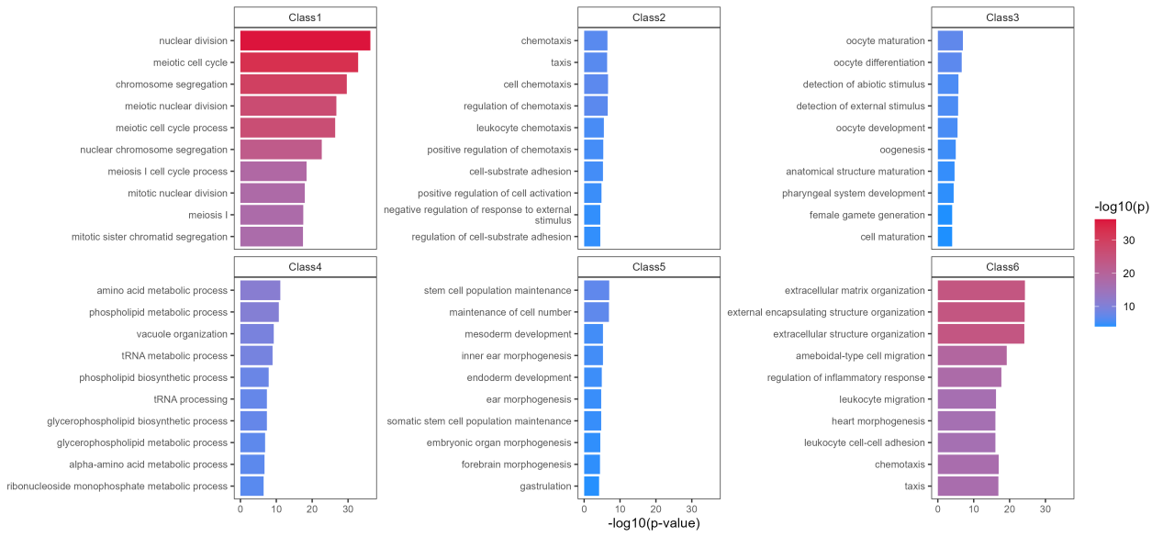
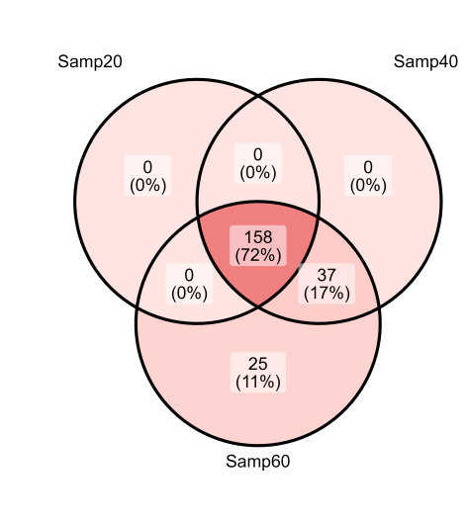
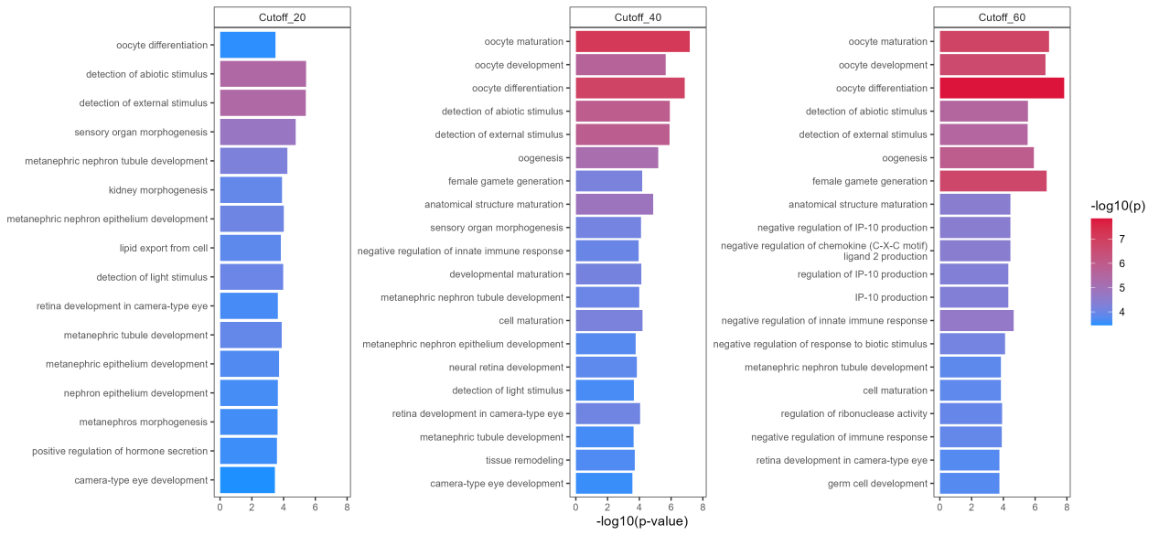
C
D
E

Slide 13
Fig. S8 Robustness of threshold for key gene screening at different developmental Stages.
(A) The number of overlapping genes identified by different parameter choices (20%, 25% and 30%). (B) The GO enrichment of sample proportion threshold 20%. (C) The GO enrichment of sample proportion threshold 25%. (D) The GO enrichment of sample proportion threshold 30%. (E) The number of overlapping class 3 genes identified by setting different parameter choices (20%, 40% and 60%) of 2-cell to ESC-stages. (F) The GO enrichment of class 3 genes identified by setting different parameter.

