Slide 1
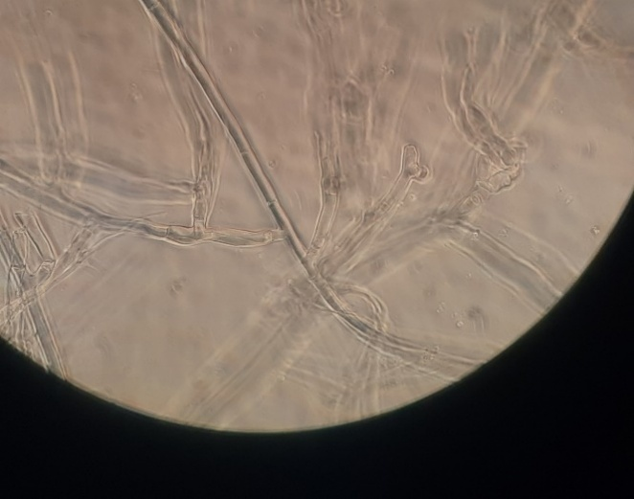
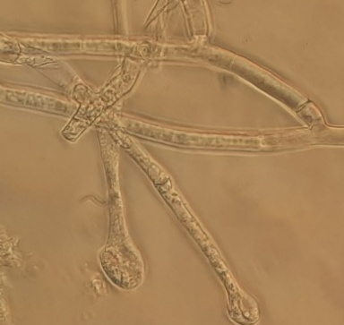
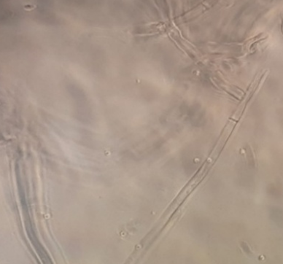
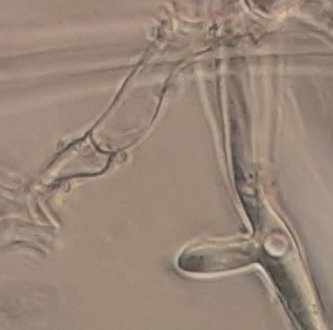
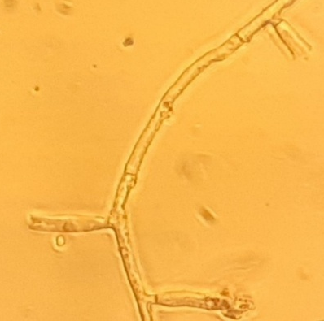
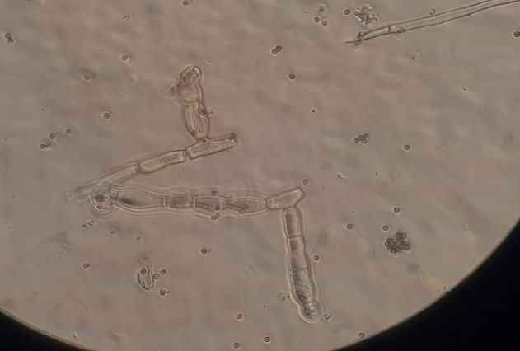
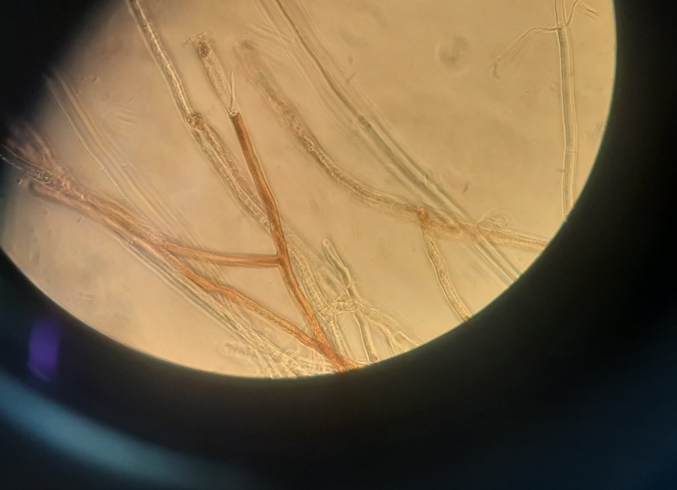
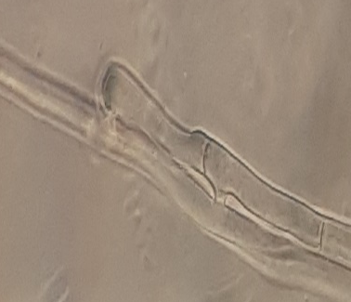
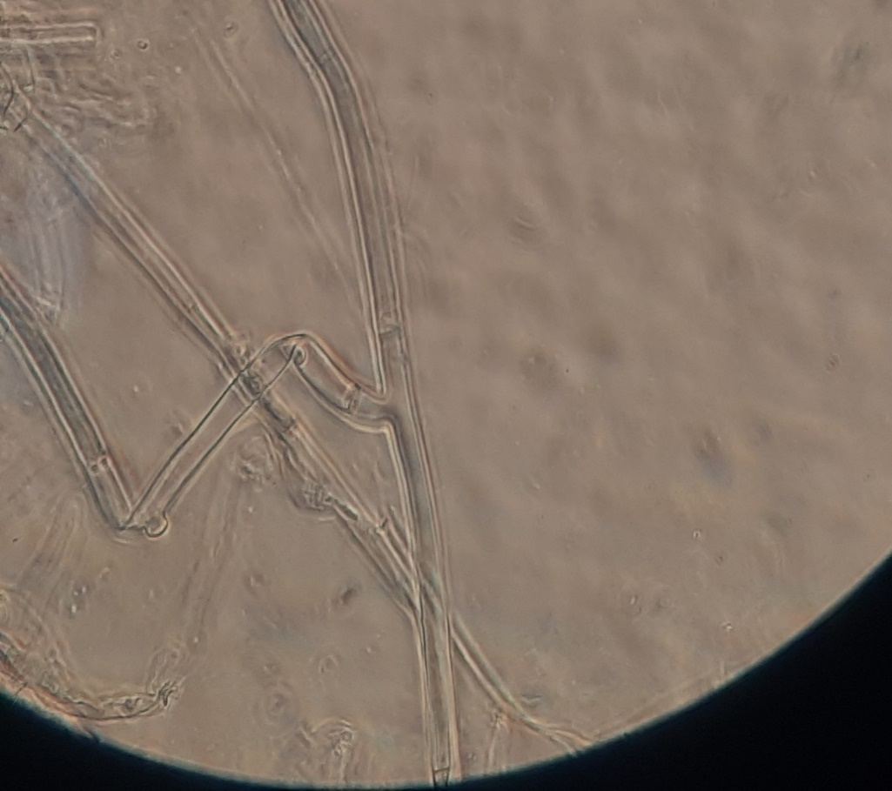
Coniothyrium sp. isolate E1P
Xylaria juruensis isolate E4P
Aspergillus terreus isolate E10P
Epicoccum sp. isolate E13P
Rhizoctonia solani (Control)
Aspergillus welwitschiae isolate E16P
Fusarium proliferatum isolate E25P
Fusarium solani sp. isolate E26P
Epicoccum sp. isolate JPE2
Supplimentry File 1 Microscopic illustration on interaction of endophytic fungi and Rhizoctonia solani

Slide 2
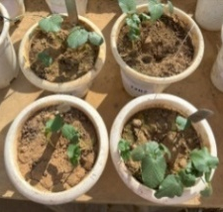
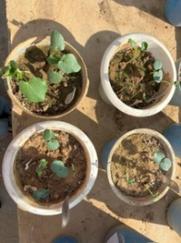
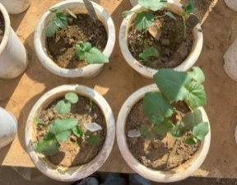
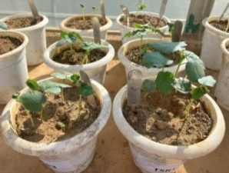
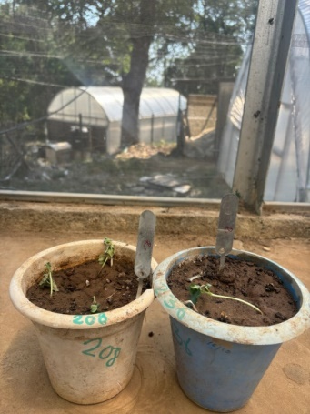
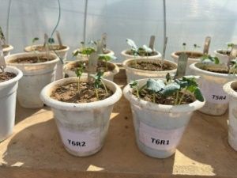
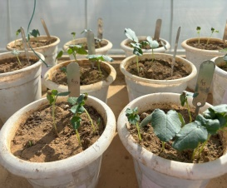
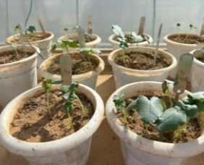
Coniothyrium sp. isolate E1P
Xylaria juruensis isolate E4P
Aspergillus terreus isolate E10P
Epicoccum sp. isolate E13P
Rhizoctonia solani (Control)
Aspergillus welwitschiae isolate E16P
Fusarium proliferatum isolate E25P
Fusarium solani sp. isolate E26P
Epicoccum sp. isolate JPE2
Supplimentry File 2 Evaluation of liquid formulations of endophytic fungi against damping off disease of okra under glasshouse conditions

