Slide 1
Supplementary Table 1 :Parasites/µL cut off using Logistic regression
Year | Parasites/µL cut off | Malaria Positive | Malaria Positive by 2500 p/µL | Sensitivity | Specificity | Lambda (UL - LL)
2005 | 2000 p/µL | 74 | 73 | 89.66 | 90.24 | 81.11 (77.96,84.25)
2006 | 1300 p/µL | 47 | 43 | 81.05 | 80.95 | 60.57 (60.44,60.7)
2007 | 900 p/µL | 56 | 46 | 91.86 | 91.23 | 84.99 (82.91,87.04)
2008 | 2500 p/µL | 129 | 129 | 87.23 | 86.08 | 87.29 (85.67,88.9)
2009 | 1800 p/µL | 105 | 102 | 87.84 | 88.1 | 82.38 (80.83,83.93)
2010 | 3000 p/µL | 133 | 137 | 89.06 | 88.96 | 89.96 (88.8,91.11)
2011 | 1200 p/µL | 123 | 119 | 87.93 | 87.81 | 91.07 (90.27,91.89)
2012* | 1000 p/µL | 18 | 16 | 95.39 | 94.44 | 65.01 (55.3,74.56)
2013 | 2500 p/µL | 173 | 173 | 87.09 | 86.74 | 90.56 (90.15,90.99)
2014 | 3500 p/µL | 207 | 211 | 85.25 | 85.41 | 88.17 (87.65,88.67)
2015 | 3500 p/µL | 156 | 158 | 87.27 | 87.47 | 83.56 (82.38,84.69)
2016 | 1500 p/µL | 104 | 101 | 92.95 | 91.99 | 85.37 (83.32,87.44)
2017 | 500 p/µL | 62 | 59 | 94.67 | 95.04 | 92.80 (91.73,93.84)
*Excluded in the main analysis due to health workers' strike.

Slide 2
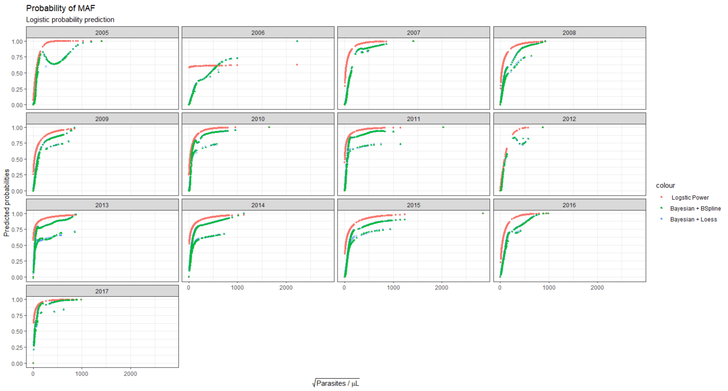
Supplementary Figure 1: Distribution of predicted probabilities

Slide 3
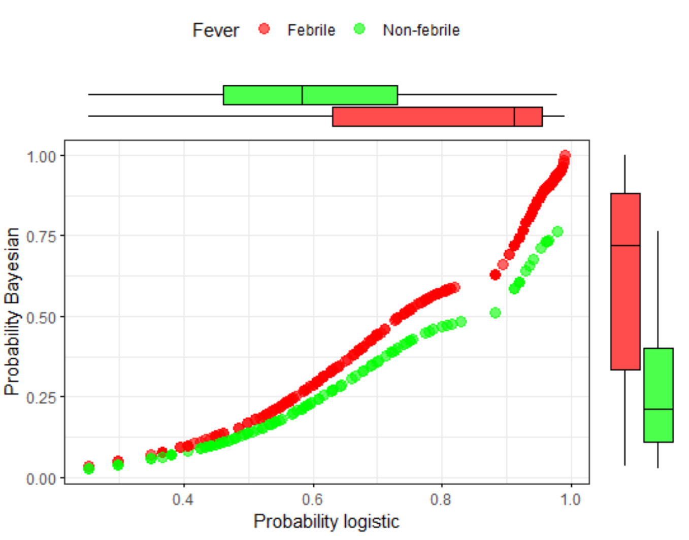
Supplementary Figure 2: Comparison of probabilities for Bayesian and Logistic, Junju 2008

Slide 4
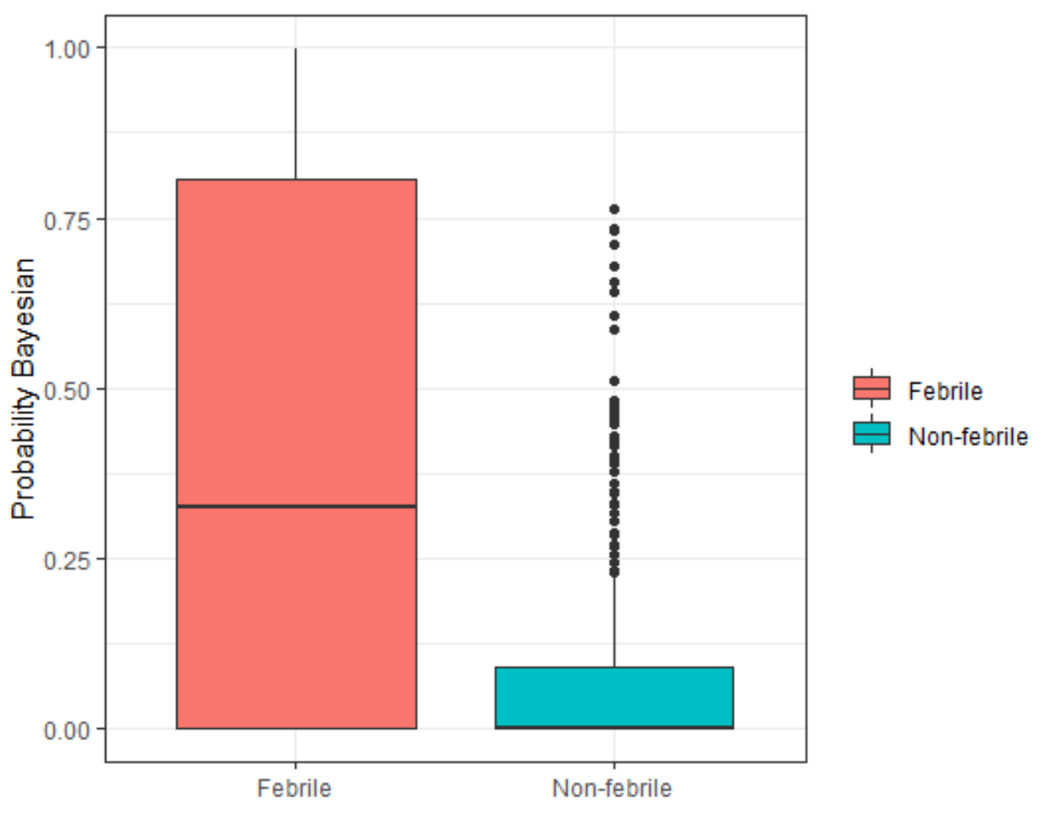
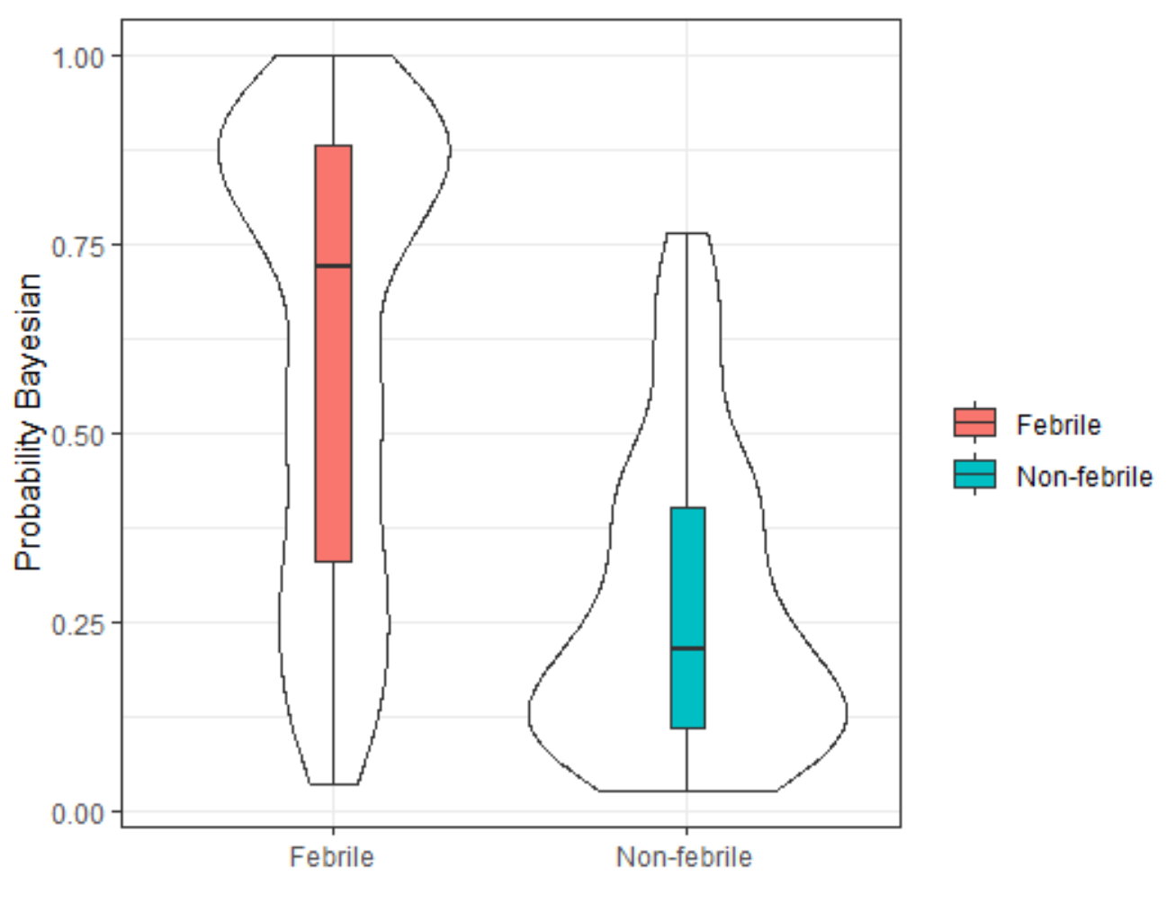
Supplementary Figure 3: Comparison of probability of febrile and non-febrile
All participants
Parasite positive participants

Slide 5
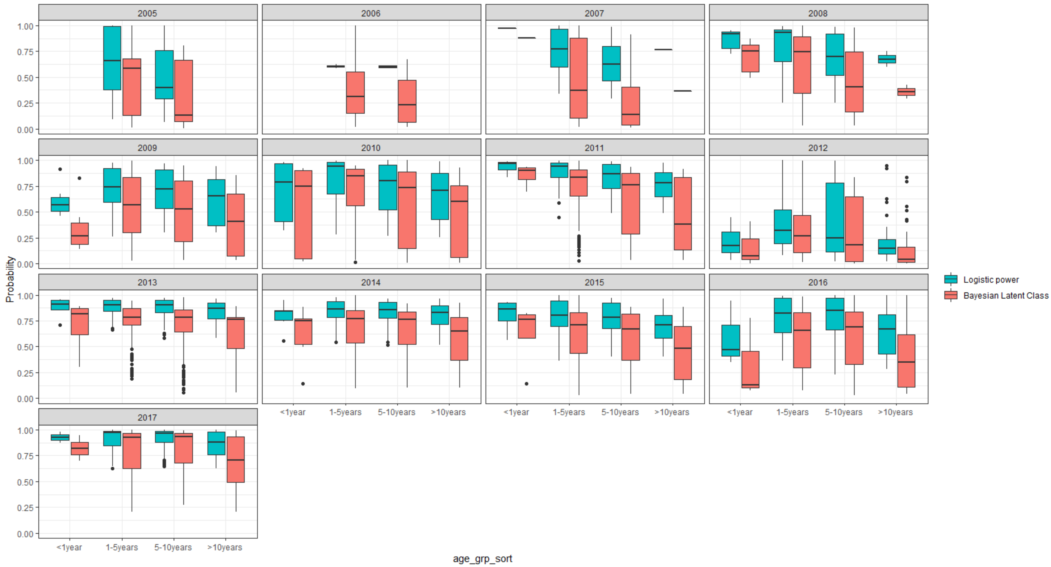
Supplementary Figure 4: Predicted probabilities over age groups

Slide 6
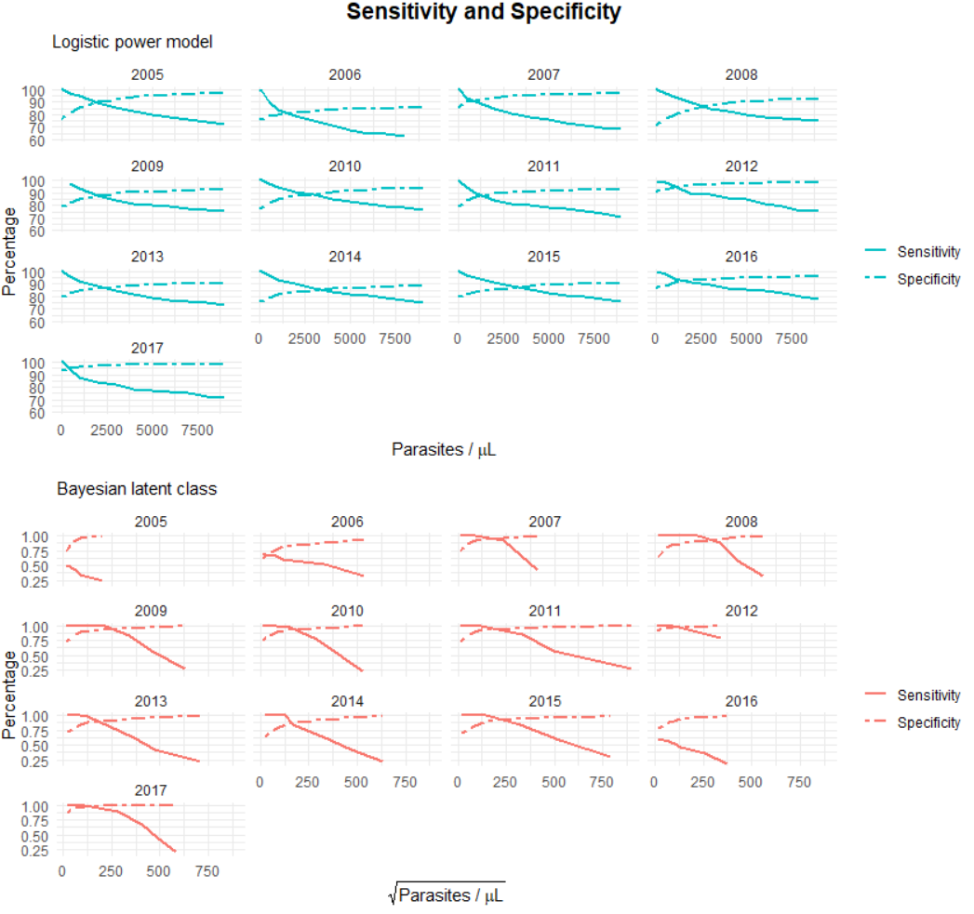
Supplementary Figure 5: Sensitivity and specificity of the different years

Slide 7
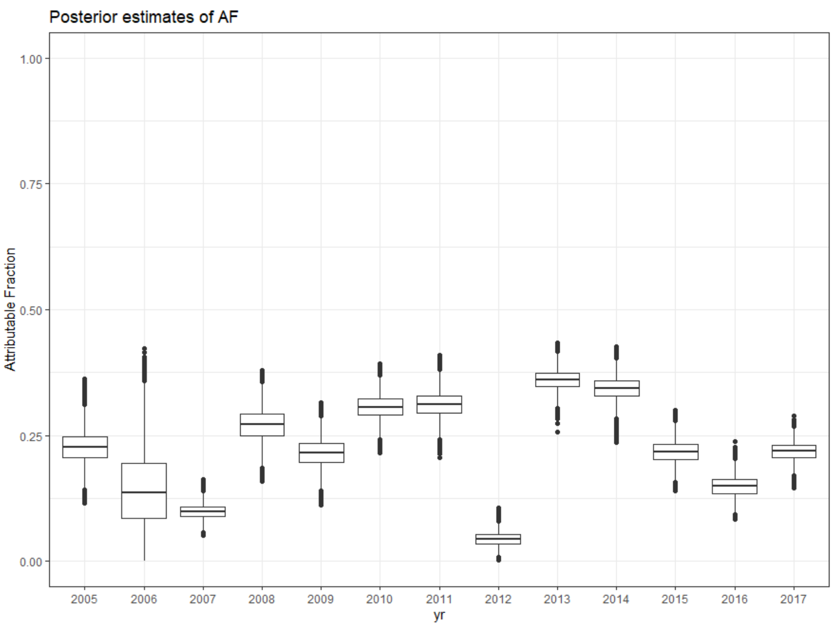
Supplementary Figure 6: Posterior estimates of AF

