Slide 1
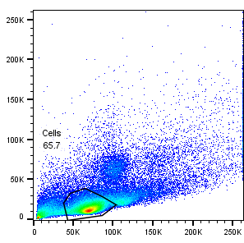
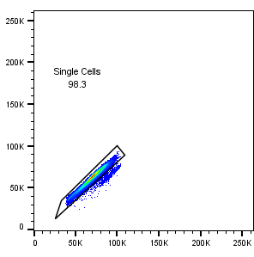
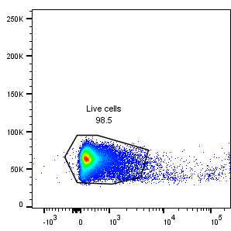
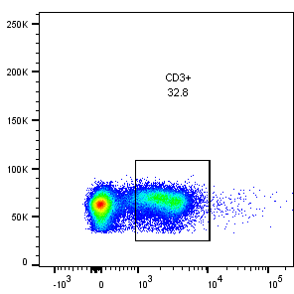
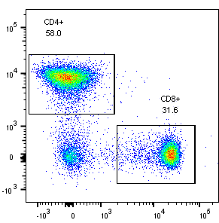
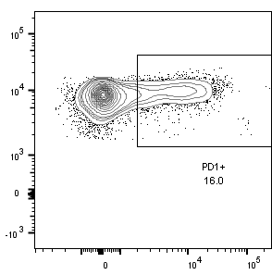
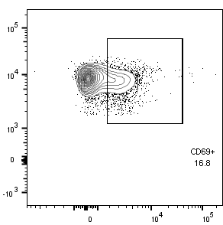
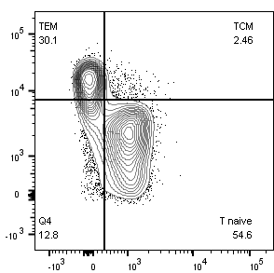
Supplementary Figure 3
SSC-A
FSC-H
FSC-H
FSC-H
FSC-A
FSC-A
Zombie
CD3
CD4+ or CD8+ cell populations :
1
2
3
TEM
TCM
CD4
CD4
CD4
CD44
T Naive
CD8
PD-1
CD69
CD62L

