Slide 1
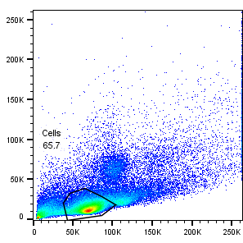
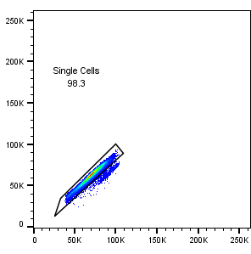
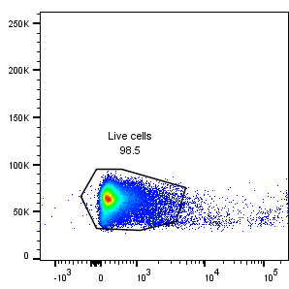
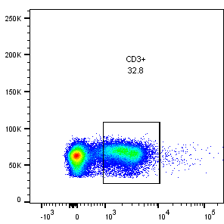
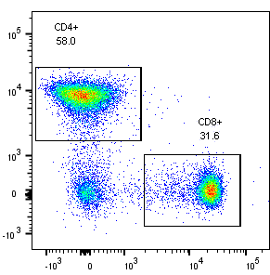
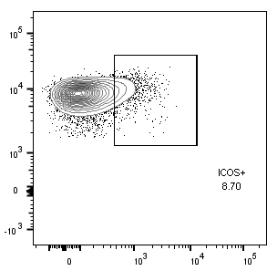
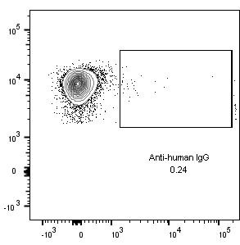
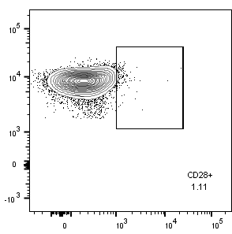
Supplementary Figure 4
SSC-A
FSC-H
FSC-H
FSC-H
FSC-A
FSC-A
Zombie
CD3
CD4+ or CD8+ cell populations :
1
2
3
CD4
CD4
CD4
CD4
CD8
ICOS
Anti-human IgG Fc
CD28

