Slide 1
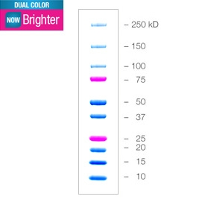
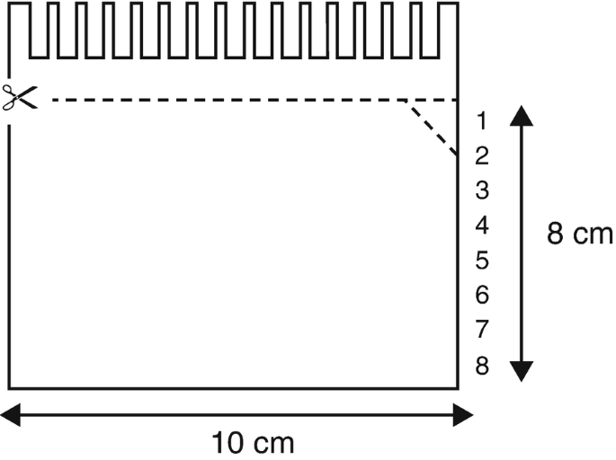
L | BP 1-1 | BP 2-1 | BP 3-1 | BP 4-1 | L | BP 1-2 | BP 2-2 | BP 3-2 | BP 4-2 | L | BP 1-3 | BP 2-3 | BP 3-3 | BP 4-3
L | BP 1-4 | BP 2-4 | BP 3-4 | BP 4-4 | L | BP 1-5 | BP 2-5 | BP 3-5 | BP 4-5 | L | BP 1-6 | BP 2-6 | BP 3-6 | BP 4-6

Slide 2
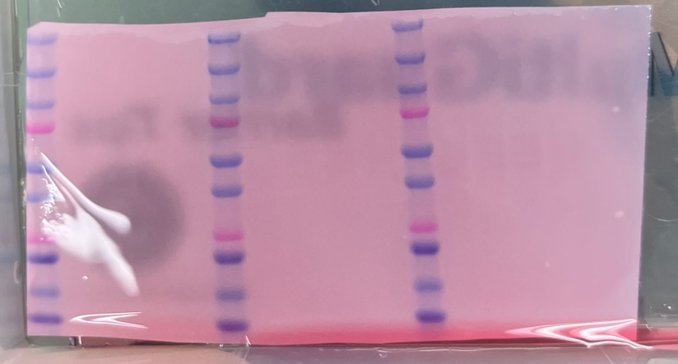
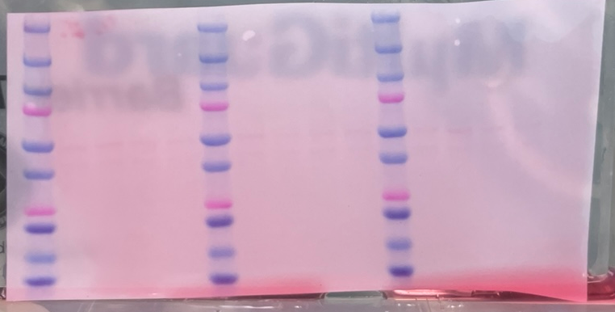
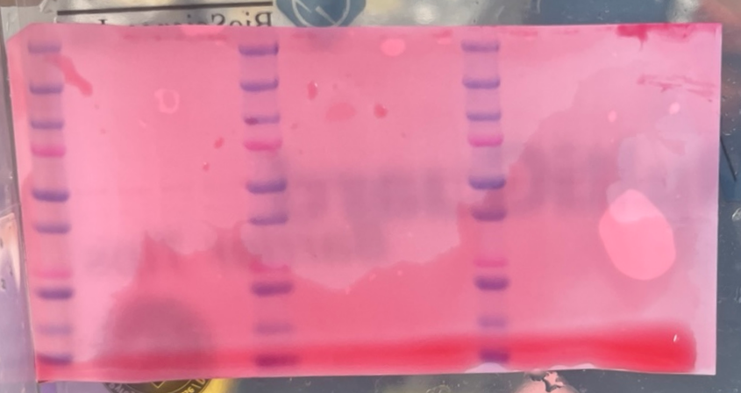
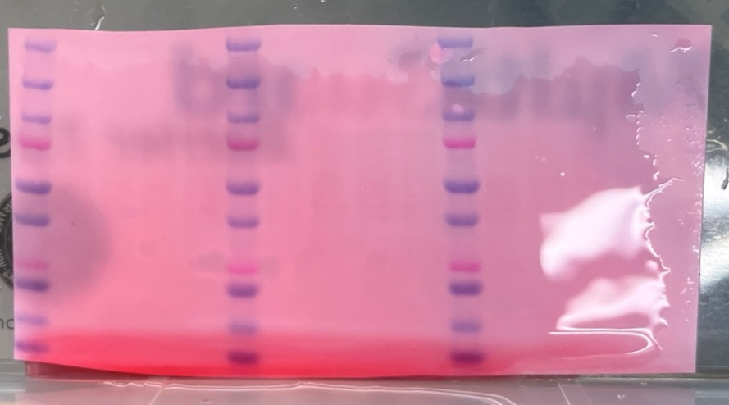
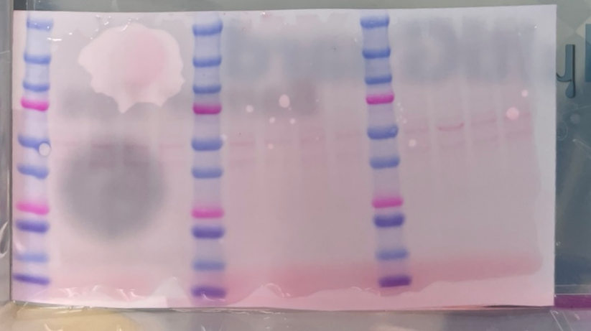
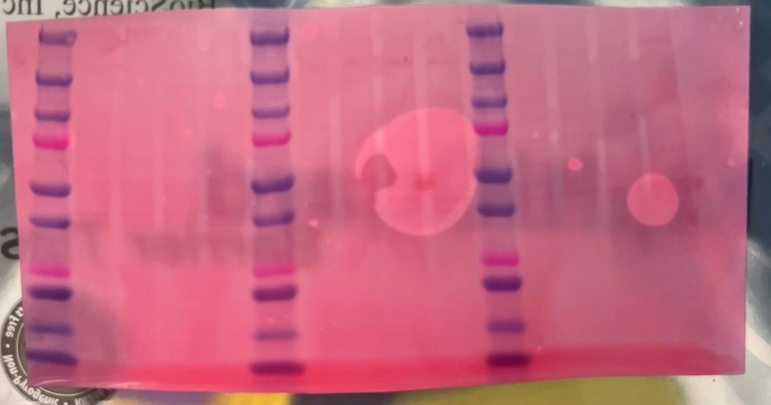
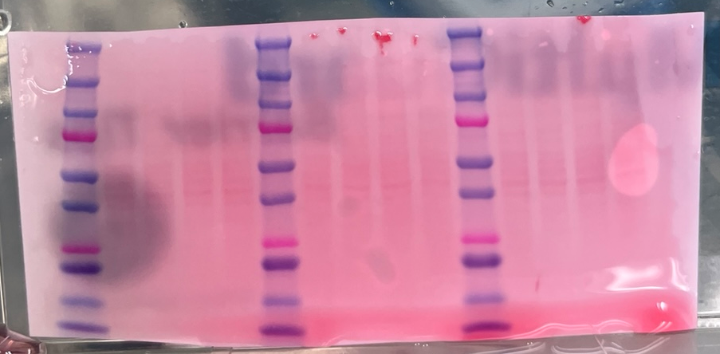
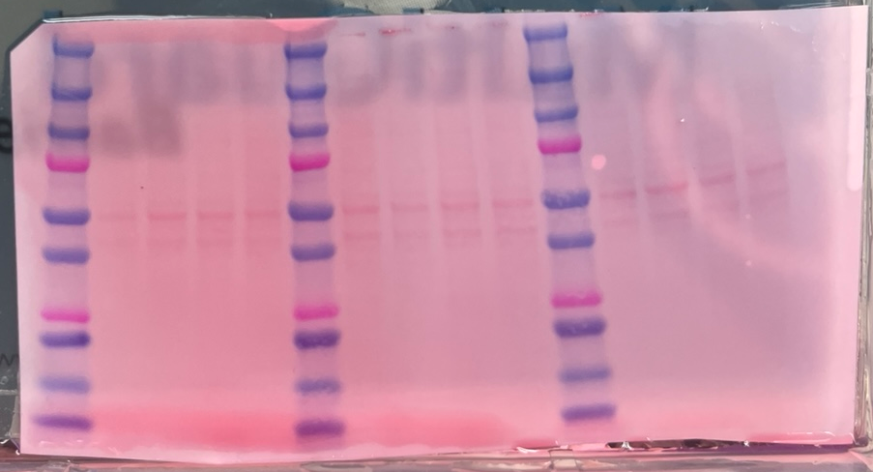
APP ZIP7-1 | APP ZIP7-2 | APP ZIP7-3 | APP ZIP7-4 | APP ZIP7-5 | APP ZIP7-6
Aβ1-42 IDE -1 | Aβ1-42 IDE -2 | Aβ1-42 IDE -3 | Aβ1-42 IDE -4 | Aβ1-42 IDE -5 | Aβ1-42 IDE -6
AQP4 NEP-1 | AQP4 NEP-2 | AQP4 NEP-3 | AQP4 NEP-4 | AQP4 NEP-5 | AQP4 NEP-6
BACE1 MT3 -1 | BACE1 MT3 -2 | BACE1 MT3 -3 | BACE1 MT3 -4 | BACE1 MT3 -5 | BACE1 MT3 -6

Slide 3
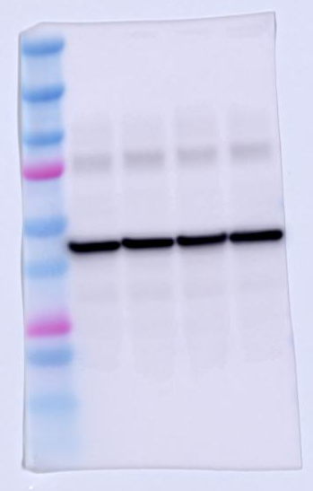
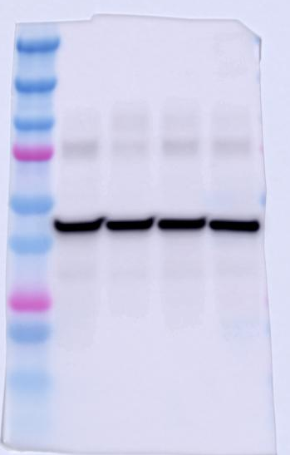
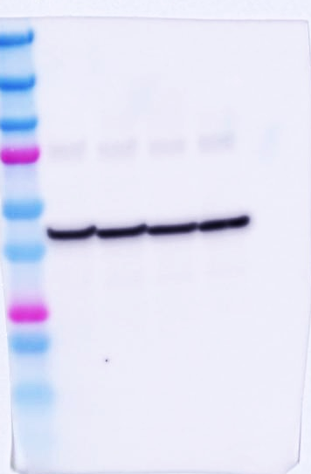
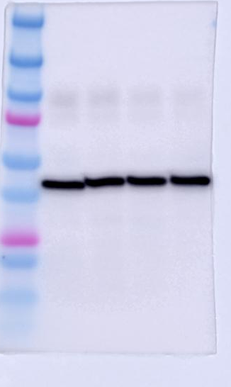
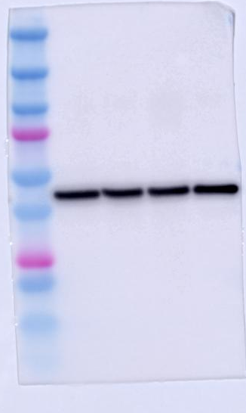
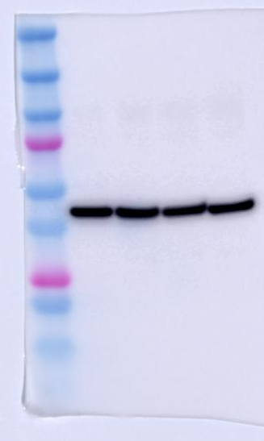
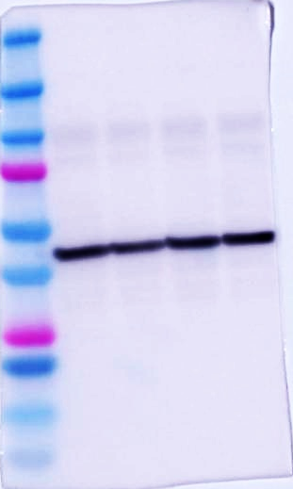
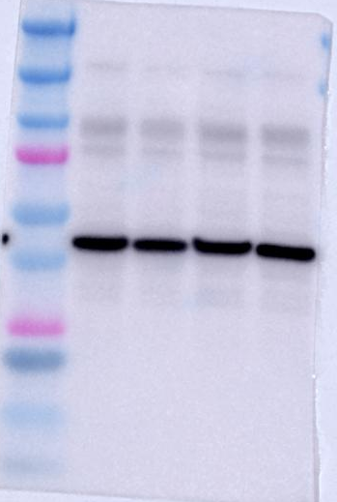
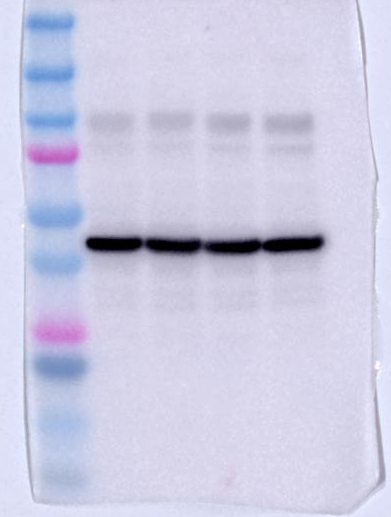
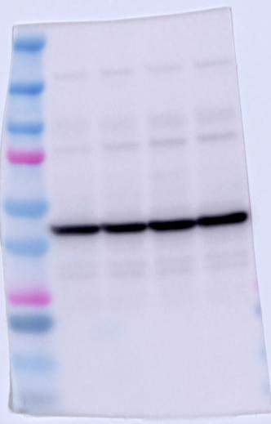
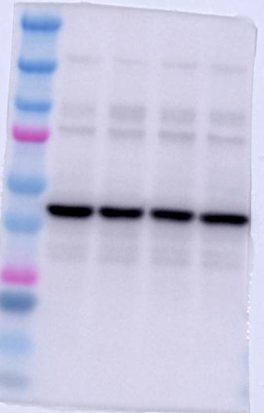
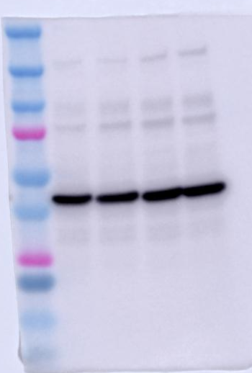
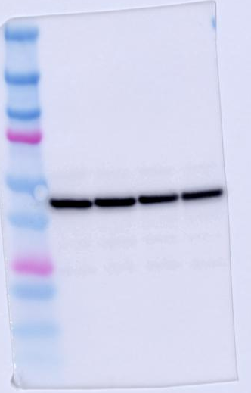
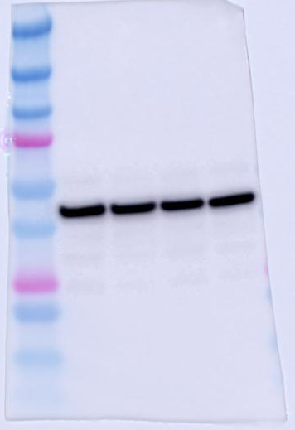
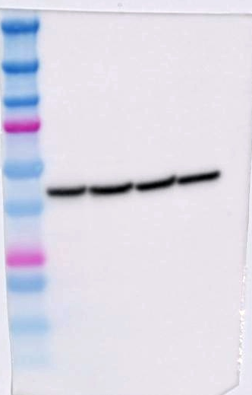
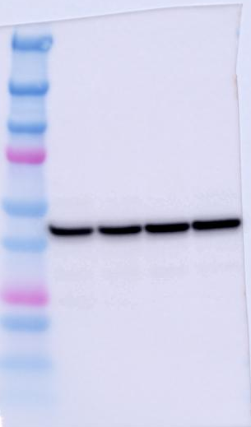
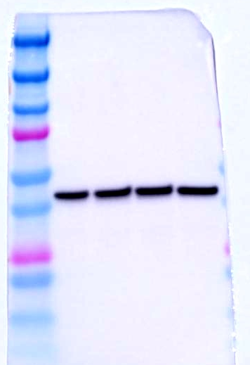
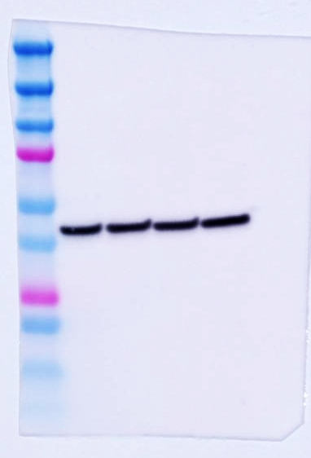
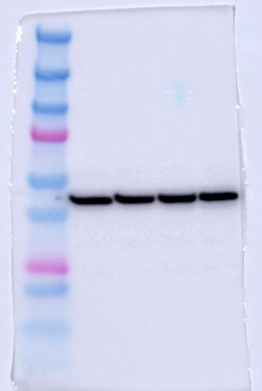
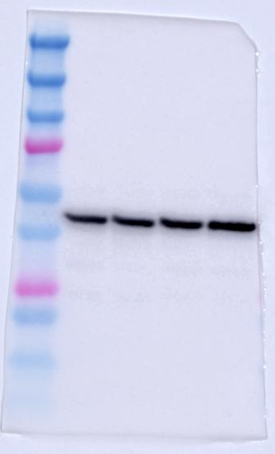
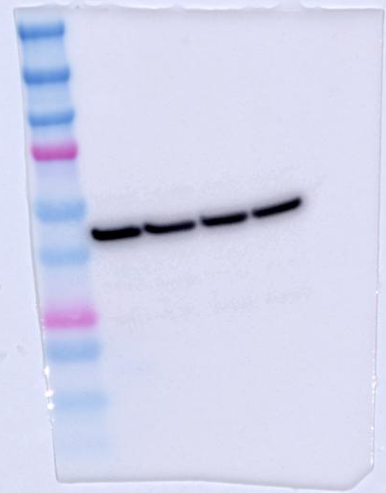
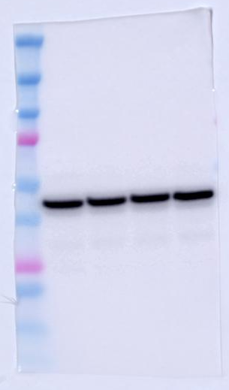
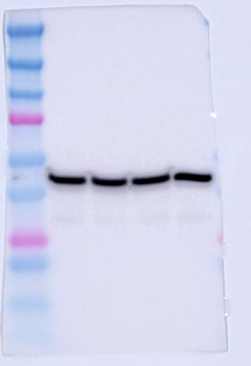
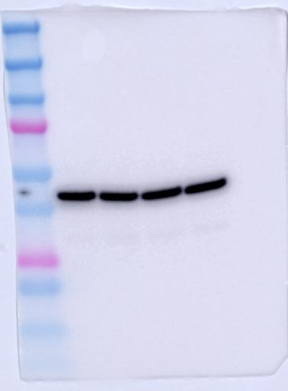
Β-Actin
(43 kDa)
APP ZIP7-1 | APP ZIP7-2 | APP ZIP7-3 | APP ZIP7-4 | APP ZIP7-5 | APP ZIP7-6
MA1-140 anti-mouse, mono
(1st 1:5,000, 2nd 1:5,000)
Aβ1-42 IDE -1 | Aβ1-42 IDE -2 | Aβ1-42 IDE -3 | Aβ1-42 IDE -4 | Aβ1-42 IDE -5 | Aβ1-42 IDE -6
AQP4 NEP-1 | AQP4 NEP-2 | AQP4 NEP-3 | AQP4 NEP-4 | AQP4 NEP-5 | AQP4 NEP-6
BACE1 MT3 -1 | BACE1 MT3 -2 | BACE1 MT3 -3 | BACE1 MT3 -4 | BACE1 MT3 -5 | BACE1 MT3 -6

Slide 4
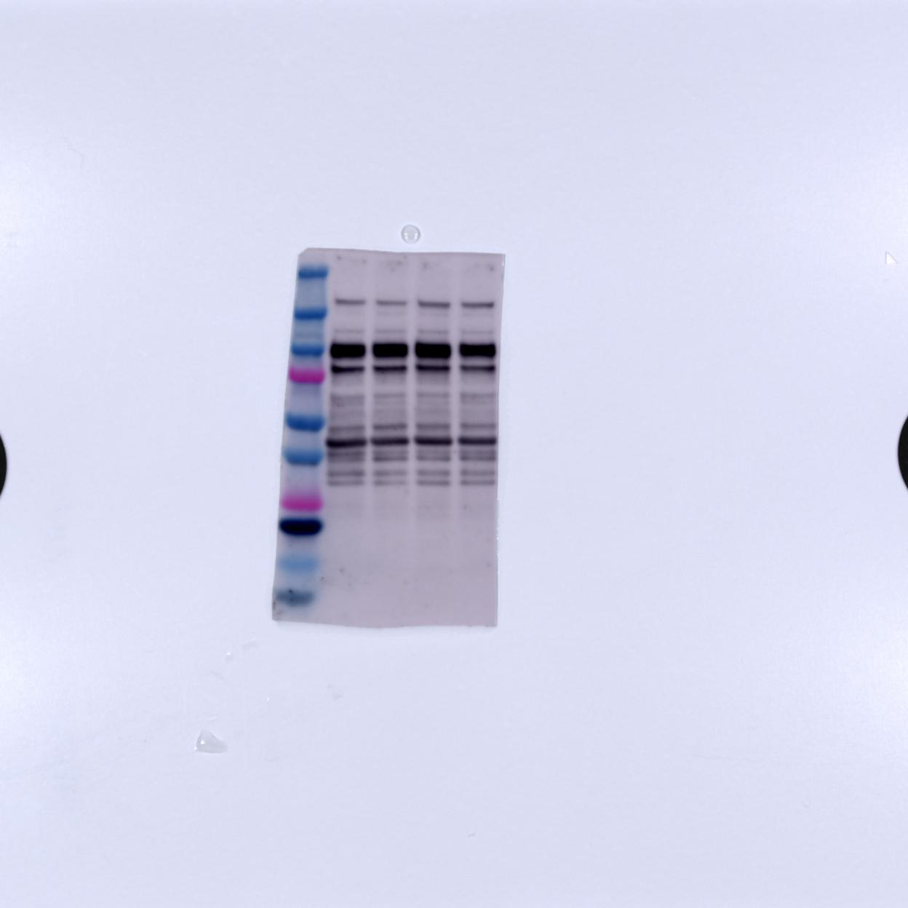
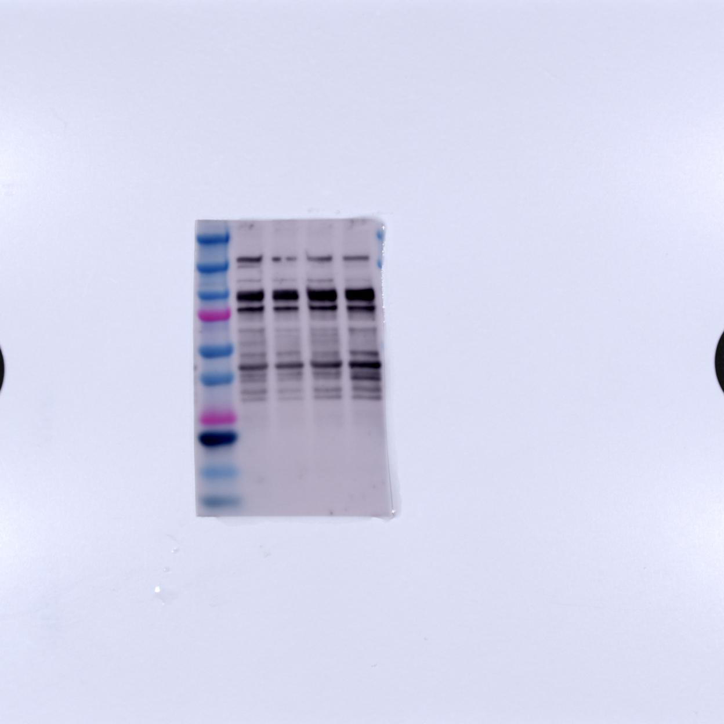
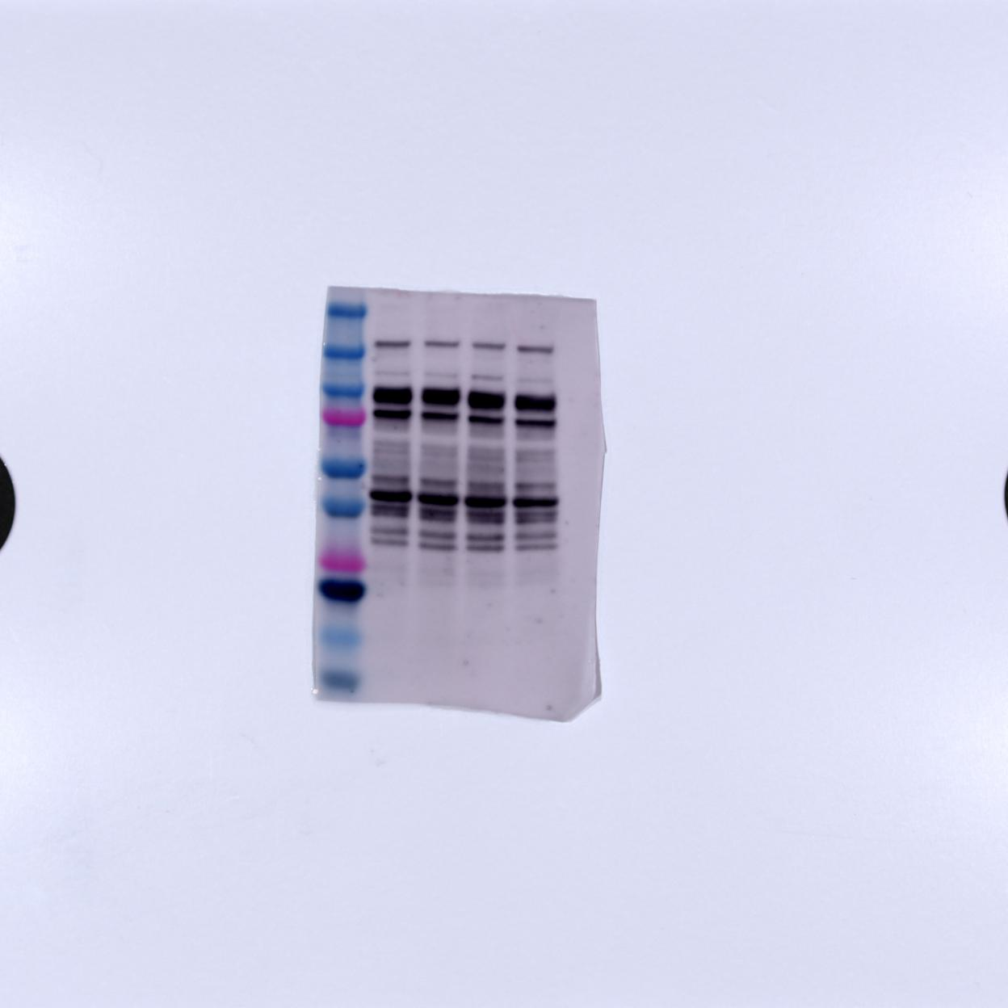
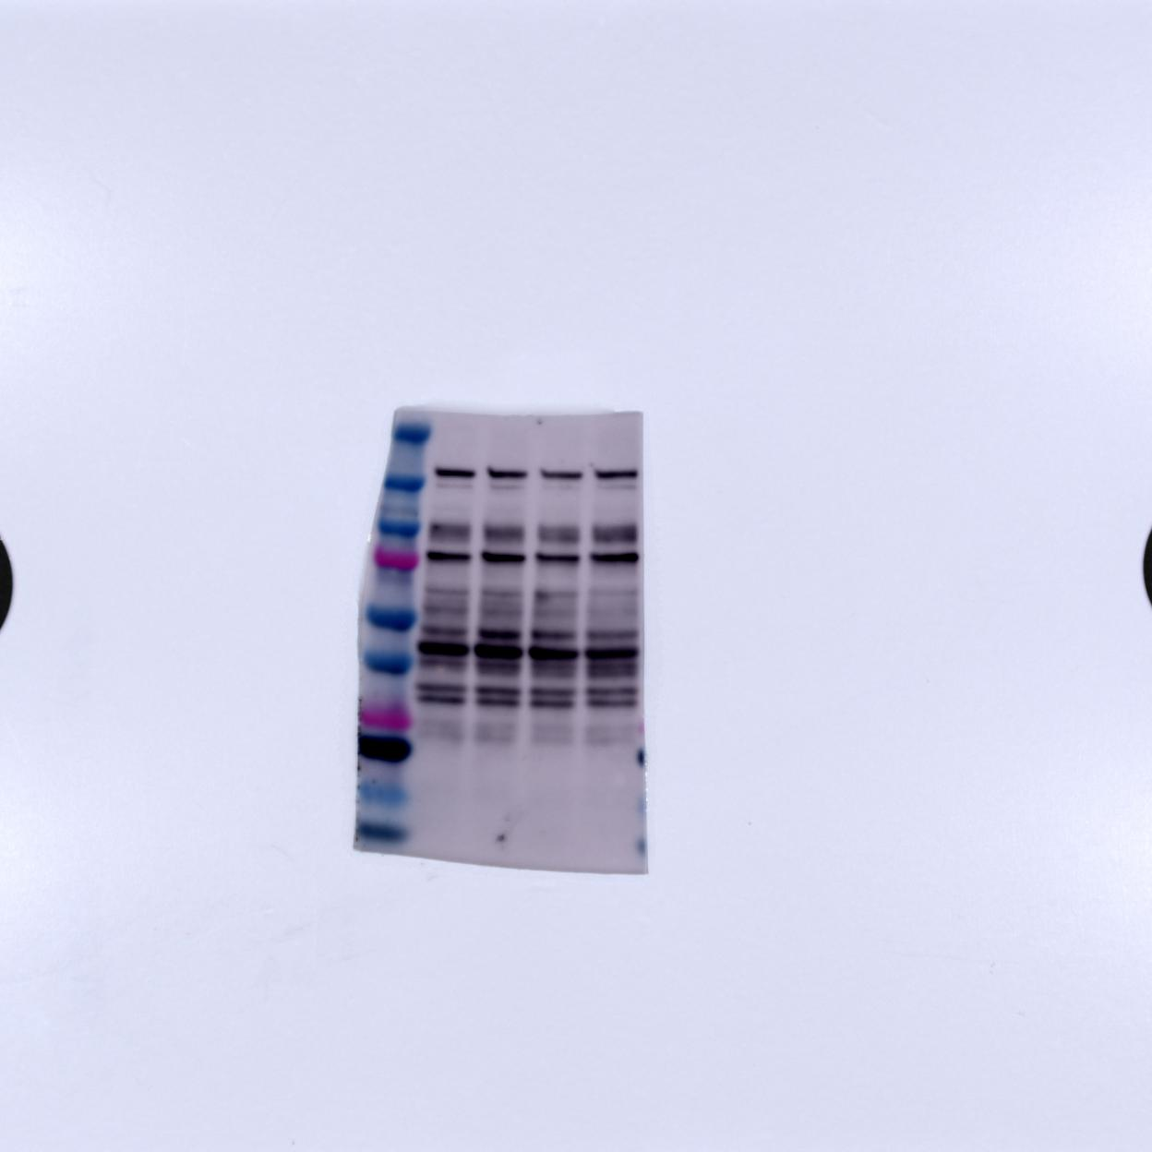
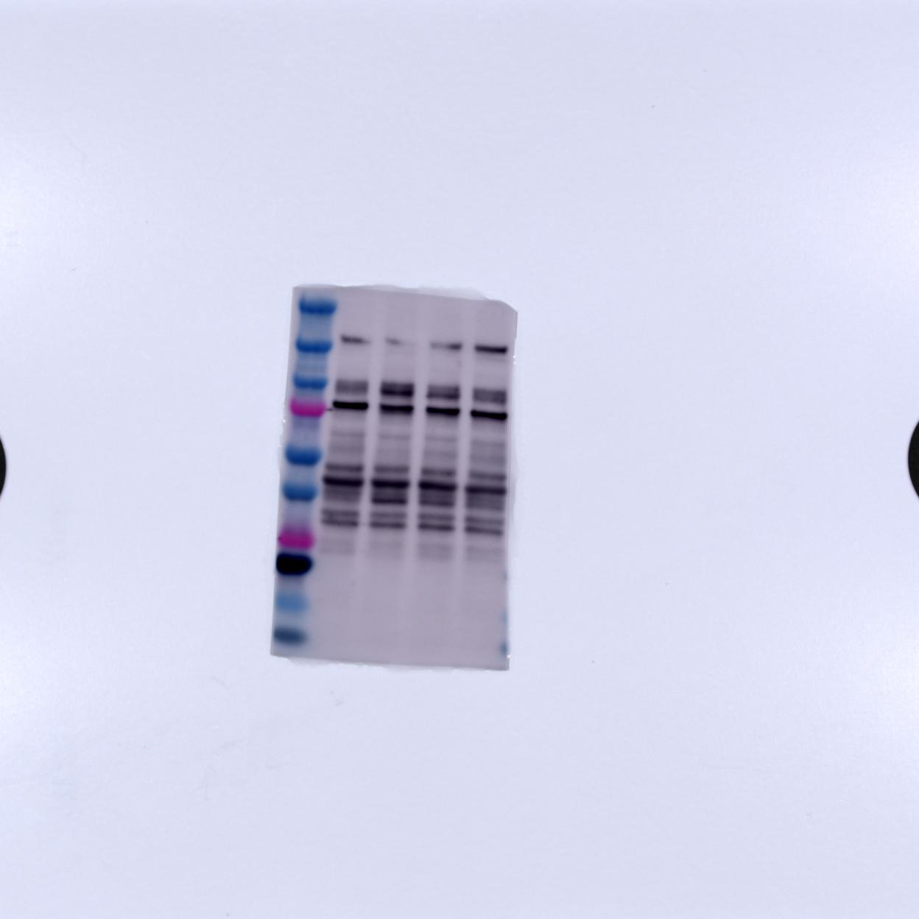
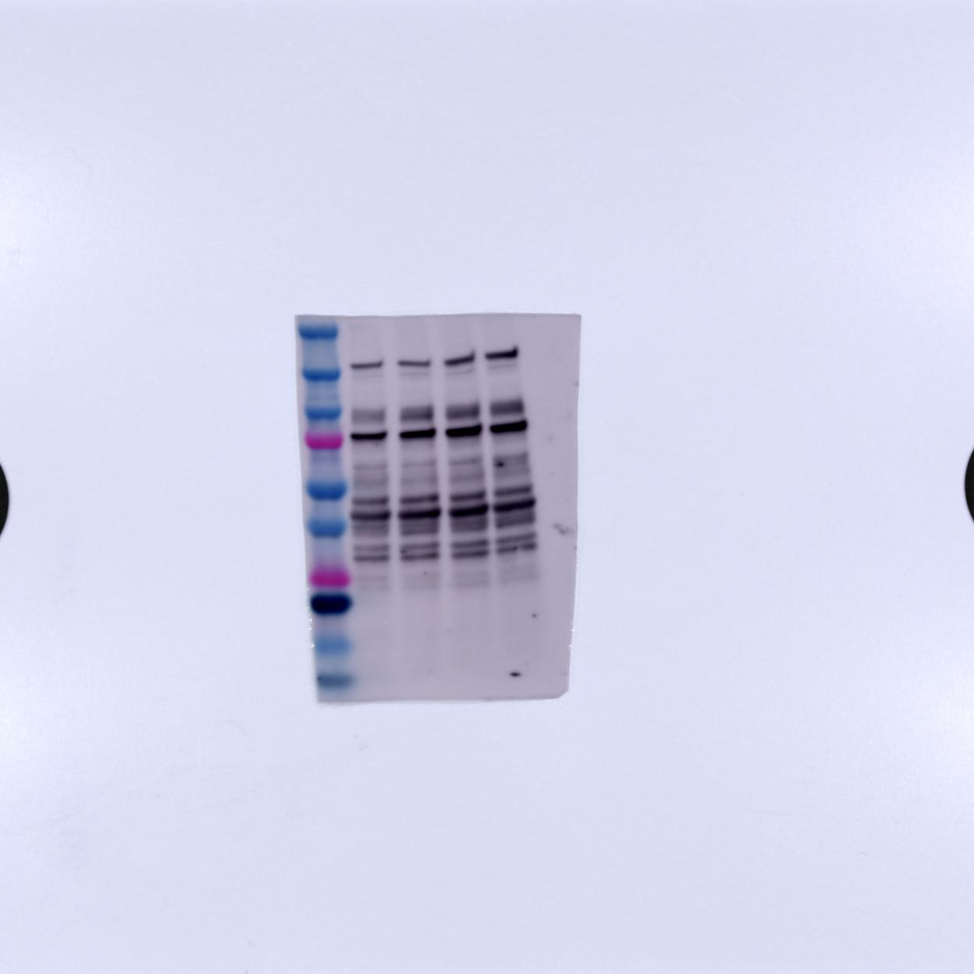
L | BP 1-1 | BP 2-1 | BP 3-1 | BP 4-1 | L | BP 1-2 | BP 2-2 | BP 3-2 | BP 4-2 | L | BP 1-3 | BP 2-3 | BP 3-3 | BP 4-3
L | BP 1-4 | BP 2-4 | BP 3-4 | BP 4-4 | L | BP 1-5 | BP 2-5 | BP 3-5 | BP 4-5 | L | BP 1-6 | BP62-6 | BP 3-6 | BP 4-6
IDE
(118 kDa)
AB32216 anti-rabbit, poly
(1st 1:1000, 2nd 1:10000)
IDE -1 | IDE -2 | IDE -3 | IDE -4 V | IDE -5 | IDE -6

Slide 5
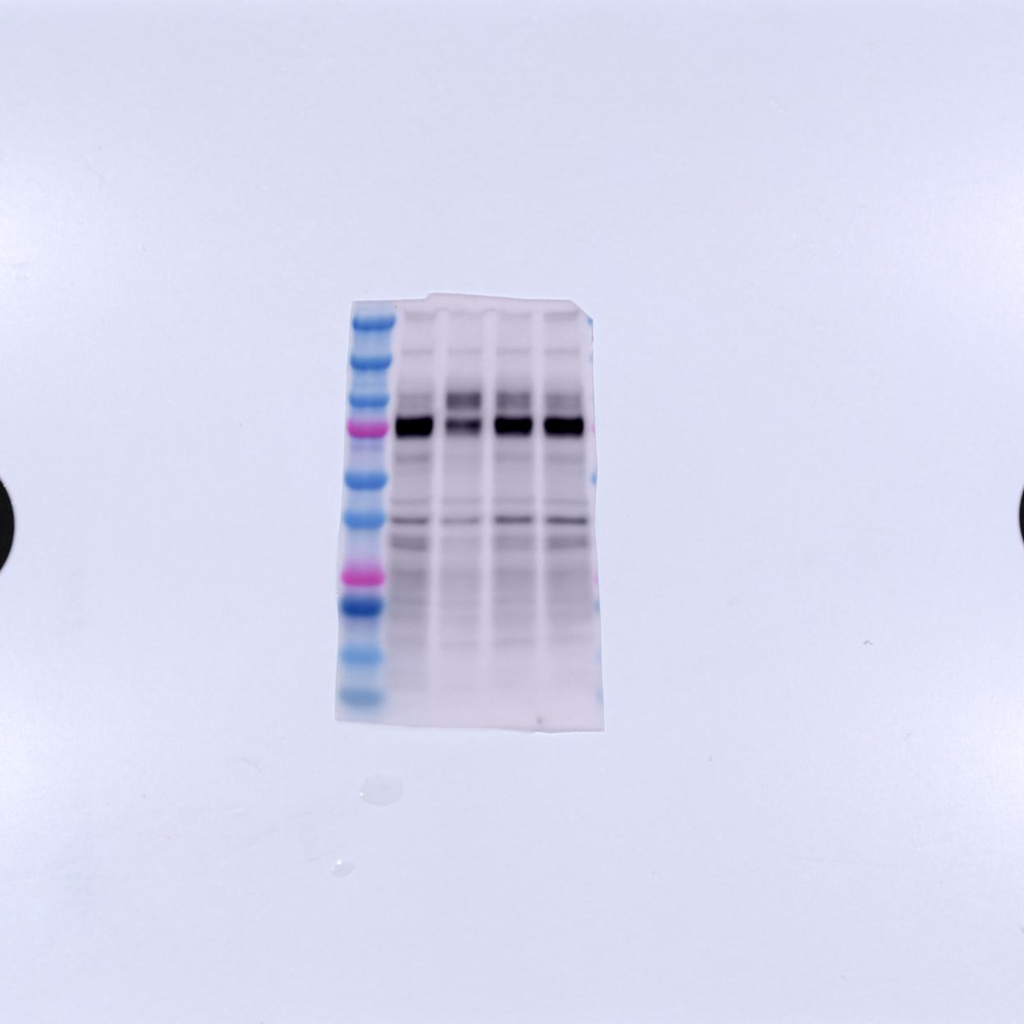
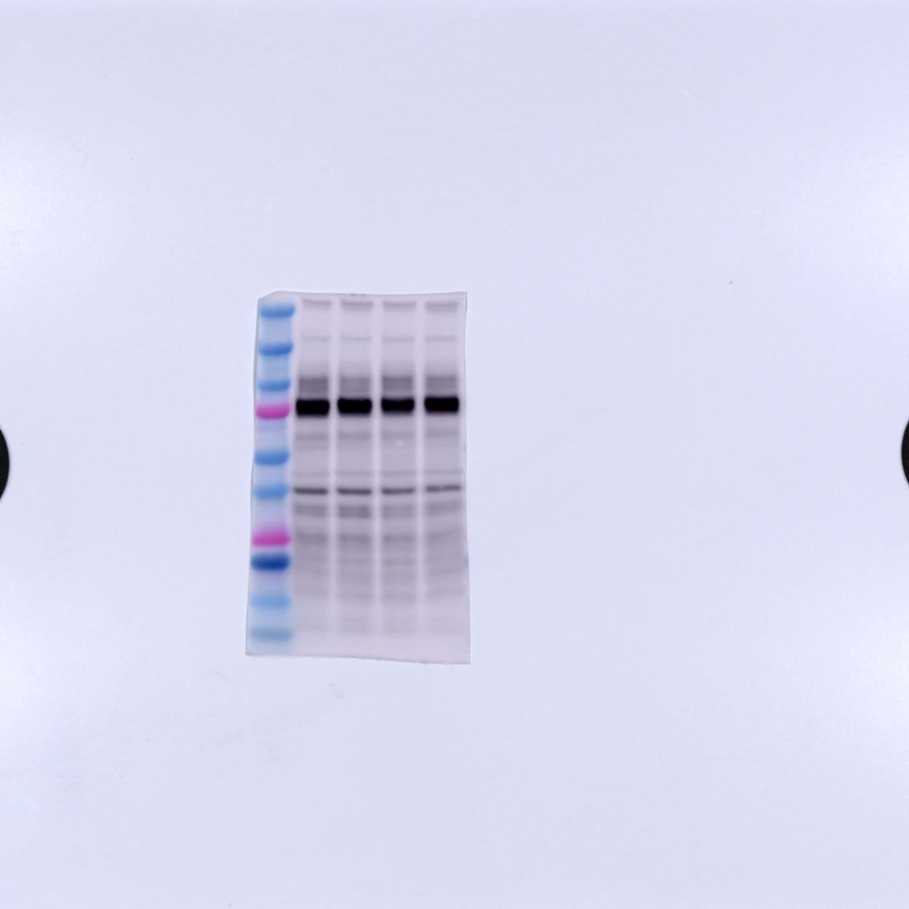
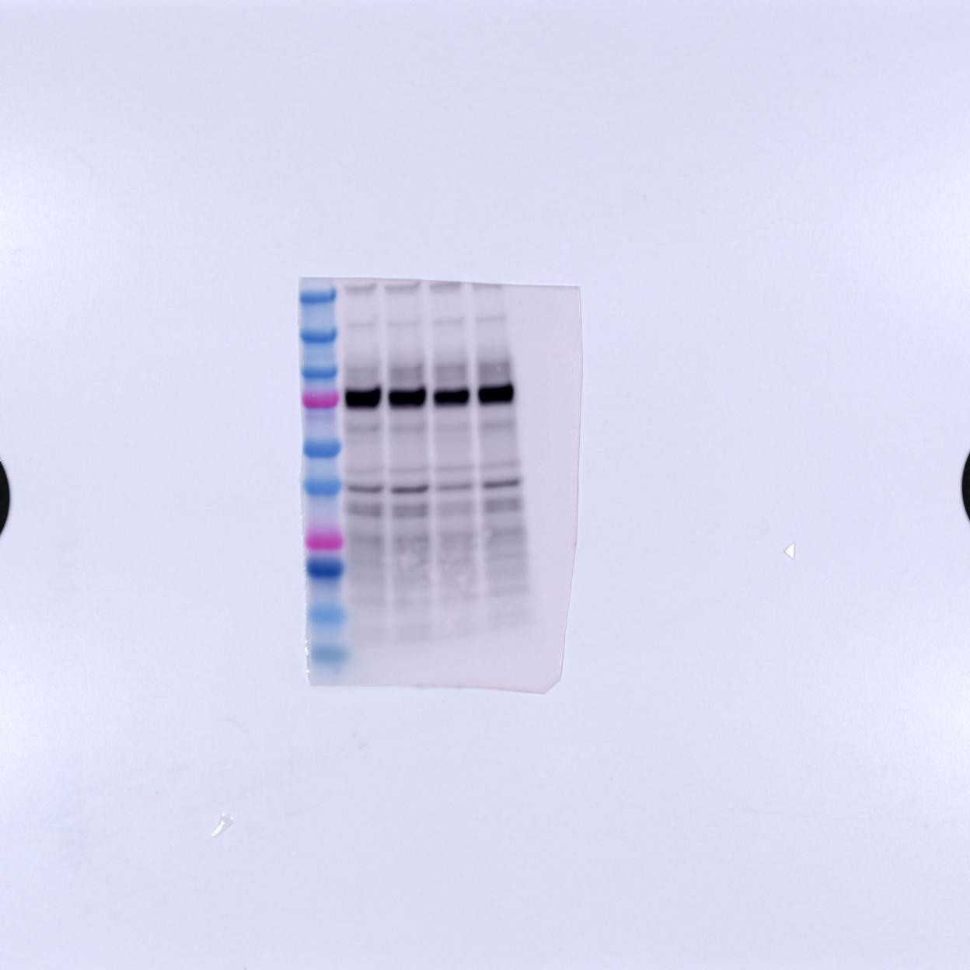
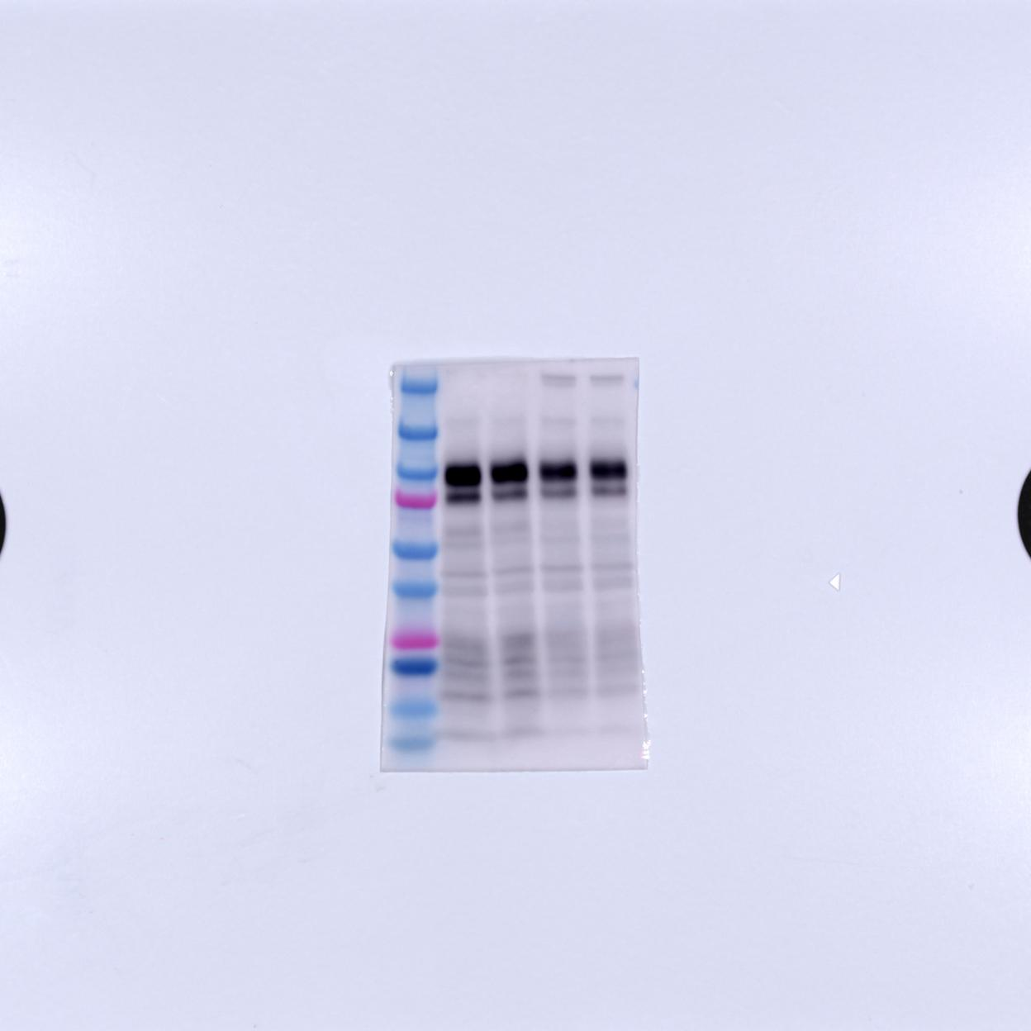
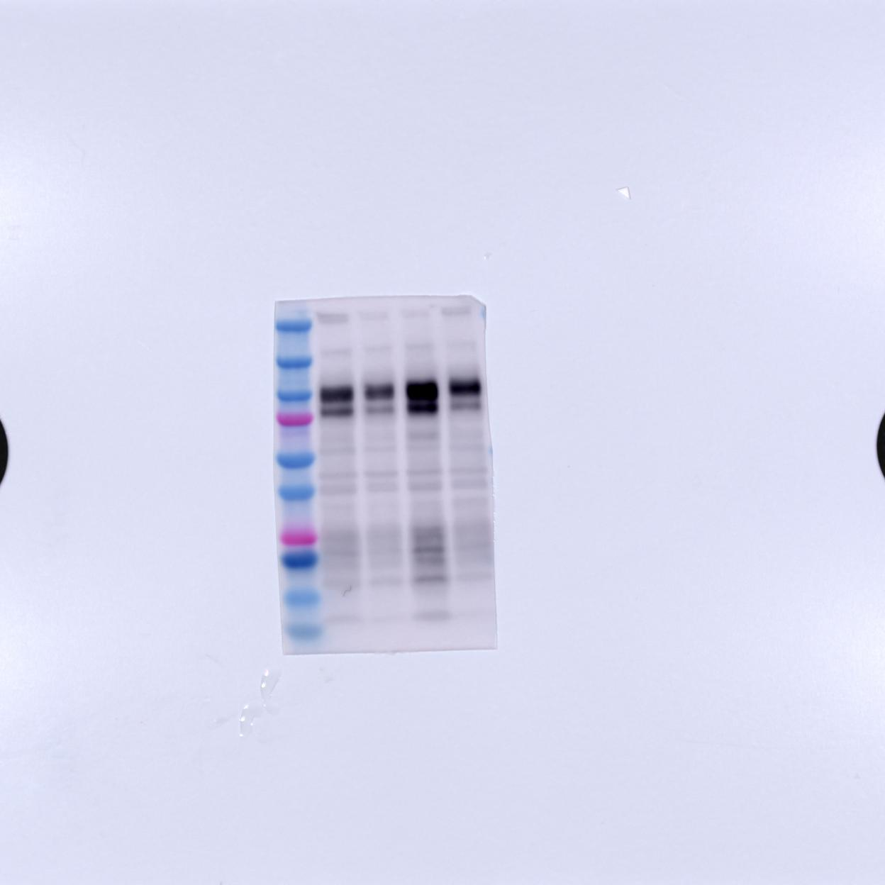
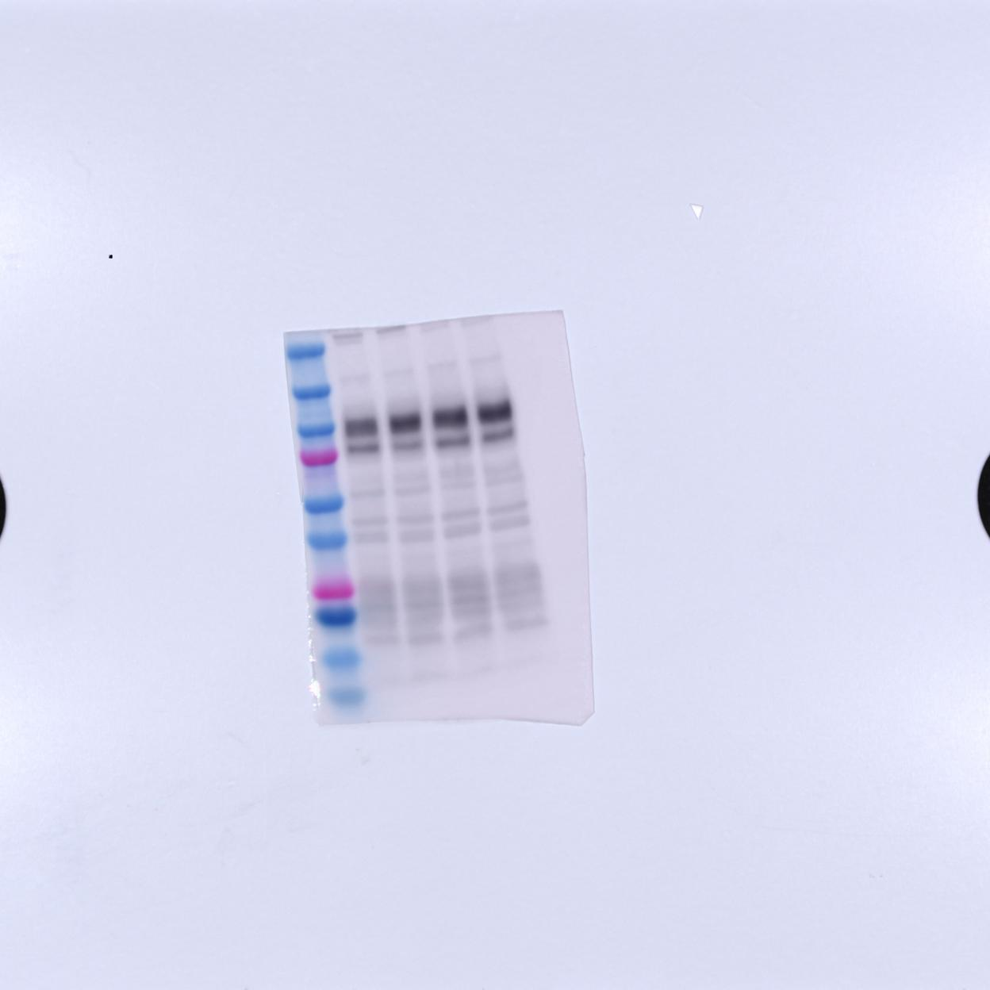
L | BP 1-1 | BP 2-1 | BP 3-1 | BP 4-1 | L | BP 1-2 | BP 2-2 | BP 3-2 | BP 4-2 | L | BP 1-3 | BP 2-3 | BP 3-3 | BP 4-3
L | BP 1-4 | BP 2-4 | BP 3-4 | BP 4-4 | L | BP 1-5 | BP 2-5 | BP 3-5 | BP 4-5 | L | BP 1-6 | BP62-6 | BP 3-6 | BP 4-6
ZIP7
(52 kDa)
AB254566 anti-rabbit, mono
(1st 1:1000, 2nd 1:10,000)
증가
ZIP -1 | ZIP -2 | ZIP -3 | ZIP -4 V | ZIP -5 | ZIP -6

Slide 6
L | BP 1-1 | BP 2-1 | BP 3-1 | BP 4-1 | L | BP 1-2 | BP 2-2 | BP 3-2 | BP 4-2 | L | BP 1-3 | BP 2-3 | BP 3-3 | BP 4-3
L | BP 1-4 | BP 2-4 | BP 3-4 | BP 4-4 | L | BP 1-5 | BP 2-5 | BP 3-5 | BP 4-5 | L | BP 1-6 | BP62-6 | BP 3-6 | BP 4-6
APP
(90-120 kDa)
22C11 anti-mouse, mono
(1st 1:1000, 2nd 1:5,000)
APP -1 v | APP -2 | APP -3 | APP -4 | APP -5 | APP -6

Slide 7
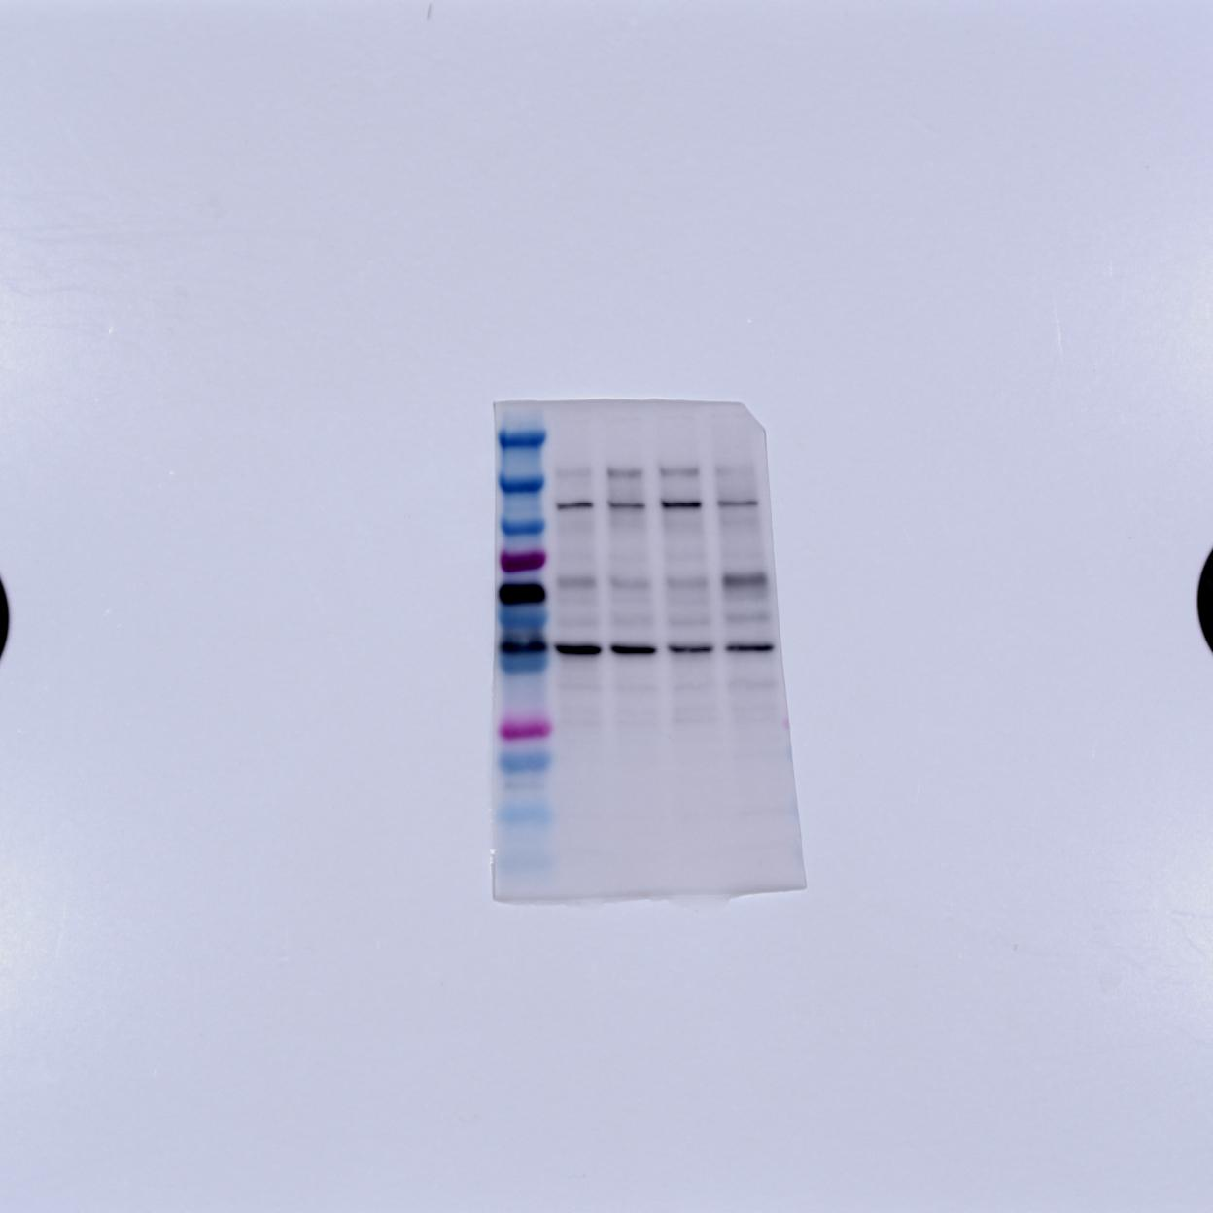
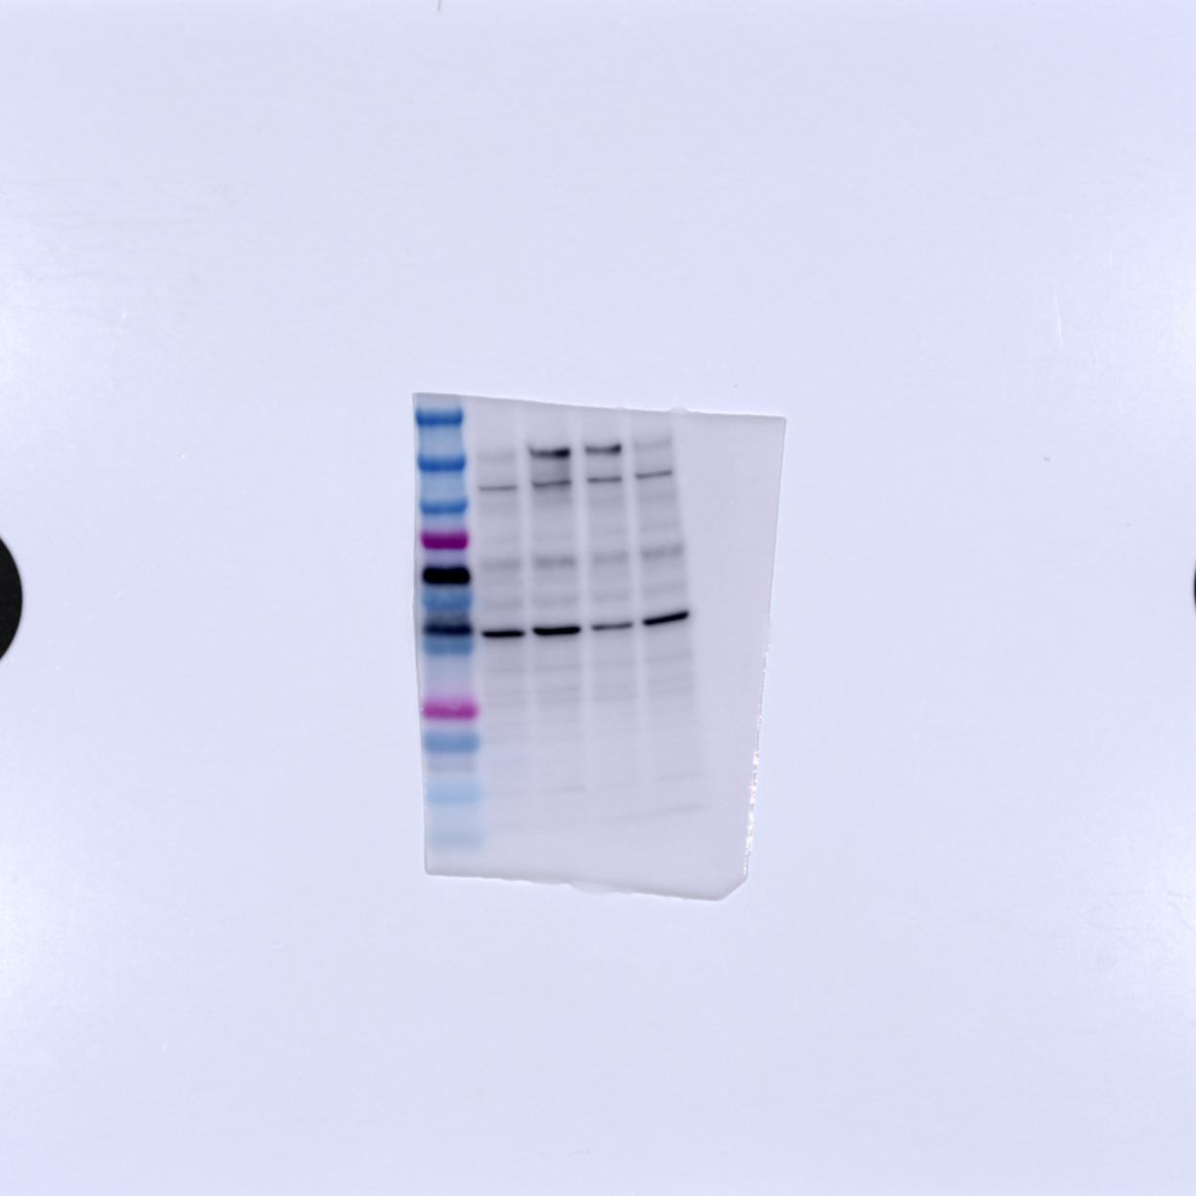
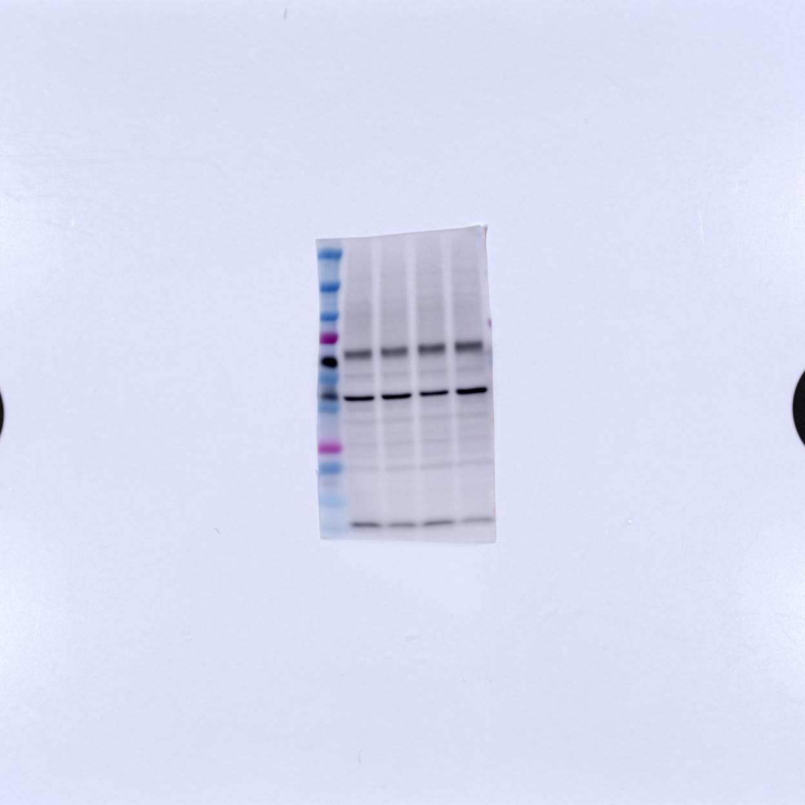
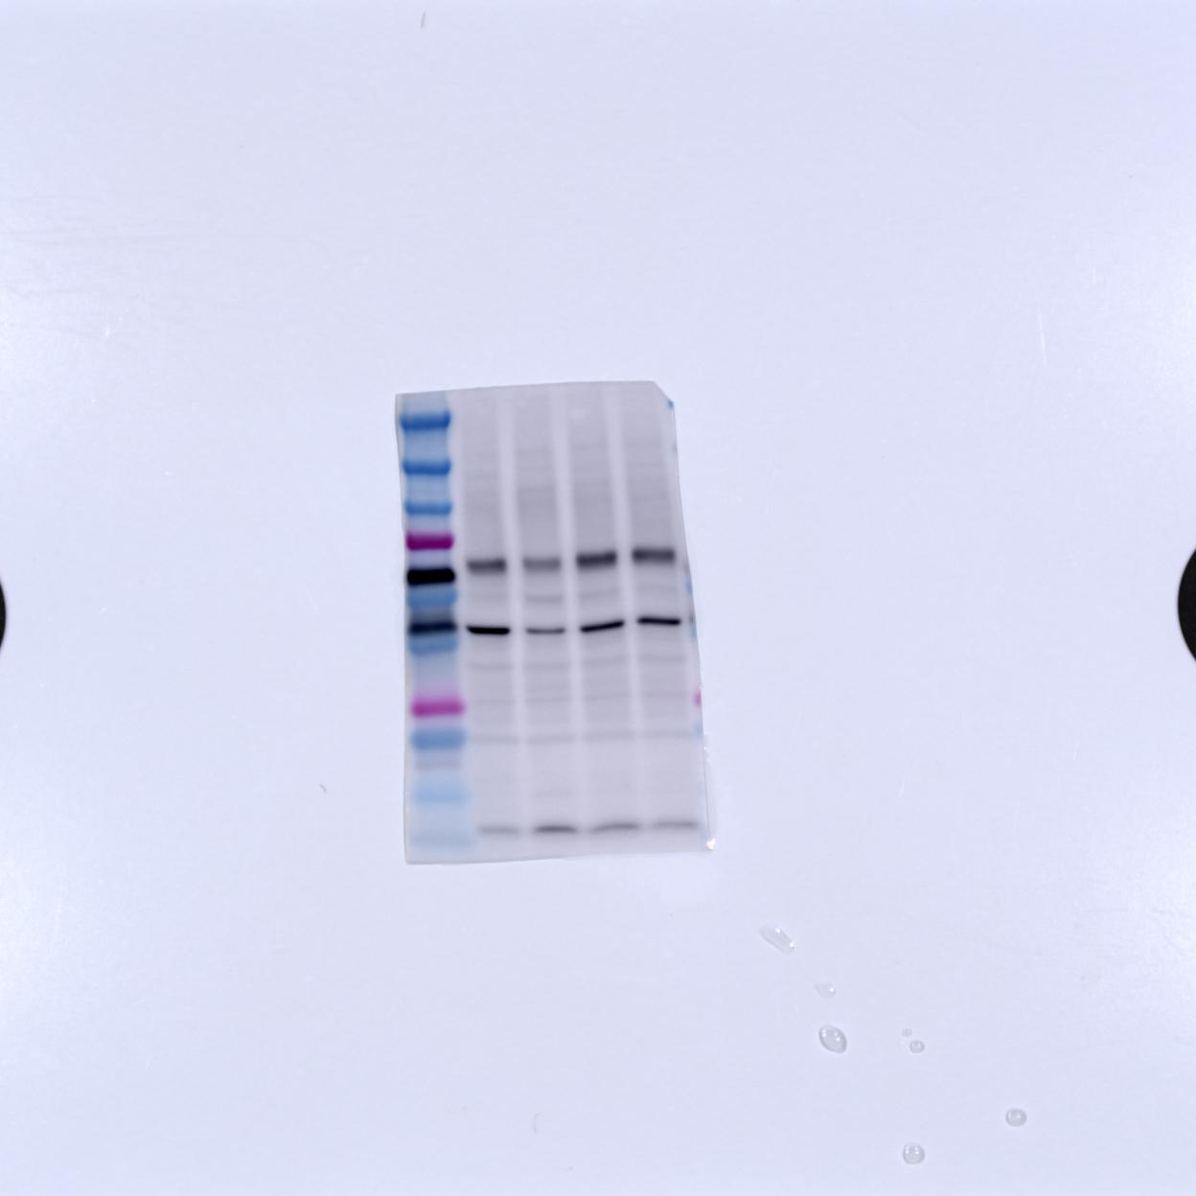


L | BP 1-1 | BP 2-1 | BP 3-1 | BP 4-1 | L | BP 1-2 | BP 2-2 | BP 3-2 | BP 4-2 | L | BP 1-3 | BP 2-3 | BP 3-3 | BP 4-3
L | BP 1-4 | BP 2-4 | BP 3-4 | BP 4-4 | L | BP 1-5 | BP 2-5 | BP 3-5 | BP 4-5 | L | BP 1-6 | BP62-6 | BP 3-6 | BP 4-6
MT3
(11-17 kDa)
AB214314 anti-rabbit, poly
(1st 1:1000, 2nd 1:5000)
MT3 -1 | MT3 -2 | MT3 -3 | MT3 -4 | MT3 -5 v | MT3 -6

Slide 8






L | BP 1-1 | BP 2-1 | BP 3-1 | BP 4-1 | L | BP 1-2 | BP 2-2 | BP 3-2 | BP 4-2 | L | BP 1-3 | BP 2-3 | BP 3-3 | BP 4-3
L | BP 1-4 | BP 2-4 | BP 3-4 | BP 4-4 | L | BP 1-5 | BP 2-5 | BP 3-5 | BP 4-5 | L | BP 1-6 | BP62-6 | BP 3-6 | BP 4-6
NEP(CD10)
(100 kDa)
SC-9149 anti-rabbit, poly
(1st 1:200, 2nd 1:5000)
NEP -1 V | NEP -2 | NEP -3 | NEP -4 | NEP -5 | NEP -6

Slide 9
L | BP 1-1 | BP 2-1 | BP 3-1 | BP 4-1 | L | BP 1-2 | BP 2-2 | BP 3-2 | BP 4-2 | L | BP 1-3 | BP 2-3 | BP 3-3 | BP 4-3
L | BP 1-4 | BP 2-4 | BP 3-4 | BP 4-4 | L | BP 1-5 | BP 2-5 | BP 3-5 | BP 4-5 | L | BP 1-6 | BP62-6 | BP 3-6 | BP 4-6
BACE1
(56 kDa)
AB108394 anti-rabbit, mono
(1st 1:1000, 2nd 1:1000)
BACE1 -1 V | BACE1-2 | BACE1-3 | BACE1 -4 | BACE1-5 | BACE1-6

Slide 10






L | BP 1-1 | BP 2-1 | BP 3-1 | BP 4-1 | L | BP 1-2 | BP 2-2 | BP 3-2 | BP 4-2 | L | BP 1-3 | BP 2-3 | BP 3-3 | BP 4-3
L | BP 1-4 | BP 2-4 | BP 3-4 | BP 4-4 | L | BP 1-5 | BP 2-5 | BP 3-5 | BP 4-5 | L | BP 1-6 | BP62-6 | BP 3-6 | BP 4-6
ADAM10
(56 kDa)
AB108394 anti-rabbit, mono
(1st 1:1000, 2nd 1:1000)
BACE1 -1 V | BACE1-2 | BACE1-3 | BACE1 -4 | BACE1-5 | BACE1-6

Slide 11
L | BP 1-1 | BP 2-1 | BP 3-1 | BP 4-1 | L | BP 1-2 | BP 2-2 | BP 3-2 | BP 4-2 | L | BP 1-3 | BP 2-3 | BP 3-3 | BP 4-3
L | BP 1-4 | BP 2-4 | BP 3-4 | BP 4-4 | L | BP 1-5 | BP 2-5 | BP 3-5 | BP 4-5 | L | BP 1-6 | BP 2-6 | BP 3-6 | BP 4-6
Aβ1-42
(4-46, 90 kDa)
SC-28365 anti-mouse, mono
(1st 1:100, 2nd 1:5,000)
증가
Aβ1-42 -1 V | Aβ1-42 -2 | Aβ1-42 -3 | Aβ1-42 -4 | Aβ1-42 -5 V | Aβ1-42 -6

Slide 12
L | BP 1-1 | BP 2-1 | BP 3-1 | BP 4-1 | L | BP 1-2 | BP 2-2 | BP 3-2 | BP 4-2 | L | BP 1-3 | BP 2-3 | BP 3-3 | BP 4-3
L | BP 1-4 | BP 2-4 | BP 3-4 | BP 4-4 | L | BP 1-5 | BP 2-5 | BP 3-5 | BP 4-5 | L | BP 1-6 | BP62-6 | BP 3-6 | BP 4-6
AQP4
(35 kDa)
PA1937 anti-rabbit, Poly
(1st 1:200, 2nd 1:5000)
AQP4 -1 | AQP4 -2 | AQP4 -3 | AQP4 -4 | AQP4 -5 | AQP4 -6 V

Slide 13


L | BCE 1-1 | BCE 2-1 | BCE 3-1 | BCE 4-1 | L | BCE 1-2 | BCE 2-2 | BCE 3-2 | BCE 4-2 | L | BCE 1-3 | BCE 2-3 | BCE 3-3 | BCE 4-3
L | BCE 1-4 | BCE 2-4 | BCE 3-4 | BCE 4-4 | L | BCE 1-5 | BCE 2-5 | BCE 3-5 | BCE 4-5 | L | BCE 1-6 | BCE 2-6 | BCE 3-6 | BCE 4-6
Β-Actin

Slide 14

L | BP 1-1 | BP 2-1 | BP 3-1 | BP 4-1 | L | BP 1-2 | BP 2-2 | BP 3-2 | BP 4-2 | L | BP 1-3 | BP 2-3 | BP 3-3 | BP 4-3
L | BP 1-4 | BP 2-4 | BP 3-4 | BP 4-4 | L | BP 1-5 | BP 2-5 | BP 3-5 | BP 4-5 | L | BP 1-6 | BP62-6 | BP 3-6 | BP 4-6
AQP4
(35 kDa)
PA1937 anti-rabbit, Poly
(1st 1:200, 2nd 1:5000)

Slide 15

L | BCE 1-1 | BCE 2-1 | BCE 3-1 | BCE 4-1 | L | BCE 1-2 | BCE 2-2 | BCE 3-2 | BCE 4-2 | L | BCE 1-3 | BCE 2-3 | BCE 3-3 | BCE 4-3
L | BCE 1-4 | BCE 2-4 | BCE 3-4 | BCE 4-4 | L | BCE 1-5 | BCE 2-5 | BCE 3-5 | BCE 4-5 | L | BCE 1-6 | BCE 2-6 | BCE 3-6 | BCE 4-6
ZnT3
(42 kDa)
AB214314 anti-rabbit, poly
(1st 1:1000, 2nd 1:5000)

Slide 16

L | BCE 1-1 | BCE 2-1 | BCE 3-1 | BCE 4-1 | L | BCE 1-2 | BCE 2-2 | BCE 3-2 | BCE 4-2 | L | BCE 1-3 | BCE 2-3 | BCE 3-3 | BCE 4-3
L | BCE 1-4 | BCE 2-4 | BCE 3-4 | BCE 4-4 | L | BCE 1-5 | BCE 2-5 | BCE 3-5 | BCE 4-5 | L | BCE 1-6 | BCE 2-6 | BCE 3-6 | BCE 4-6
ZIP1 (slc39a1)
(34 kDa)
ab105416 anti-rabbit, poly
(1st 1:1000, 2nd 1:5000)

