Slide 1
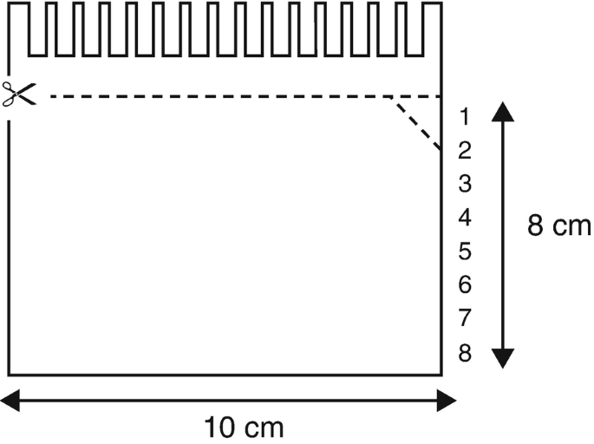
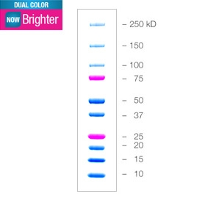
L | BCE 1-1 | BCE 2-1 | BCE 3-1 | BCE 4-1 | L | BCE 1-2 | BCE 2-2 | BCE 3-2 | BCE 4-2 | L | BCE 1-3 | BCE 2-3 | BCE 3-3 | BCE 4-3
L | BCE 1-4 | BCE 2-4 | BCE 3-4 | BCE 4-4 | L | BCE 1-5 | BCE 2-5 | BCE 3-5 | BCE 4-5 | L | BCE 1-6 | BCE 2-6 | BCE 3-6 | BCE 4-6
Β-Actin
(43 kDa)
MA1-140 anti-mouse, mono
(1st 1:5,000, 2nd 1:5,000)

Slide 2
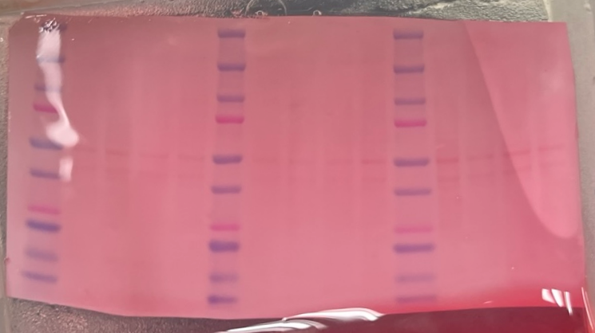
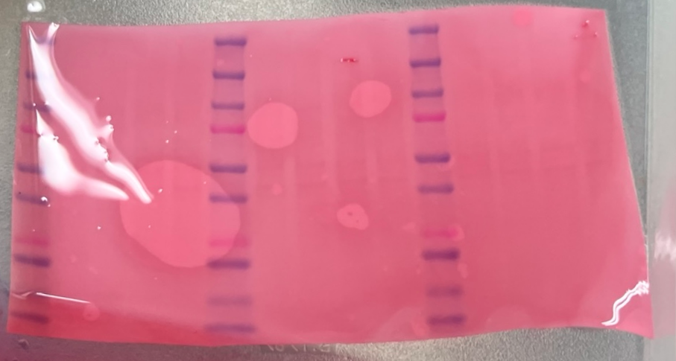
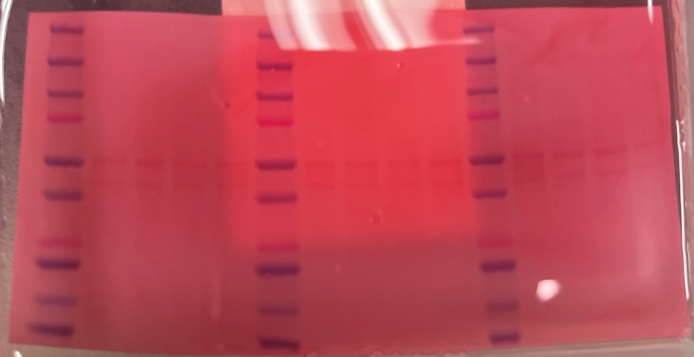
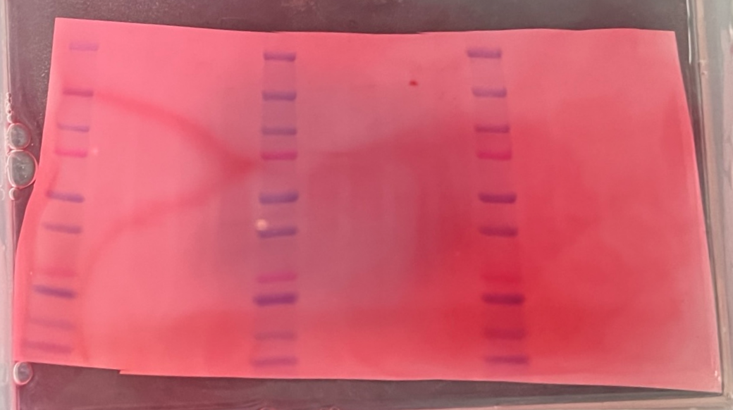
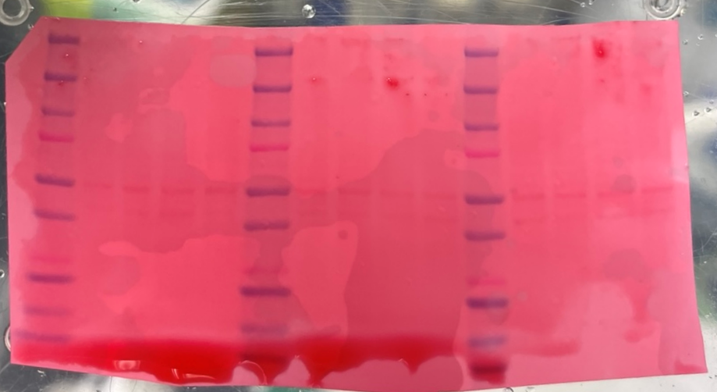
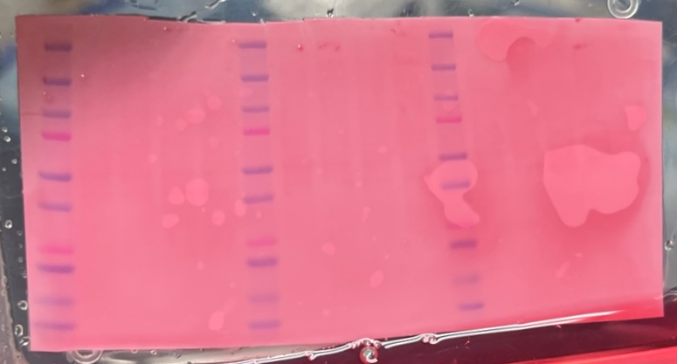
Β-Actin
LRP1 ZIP7-1 | LRP1 ZIP7-2 | LRP1 ZIP7-3 | LRP1 ZIP7-4 | LRP1 ZIP7-5 | LRP1 ZIP7-6
5
6
BACE1 CL5 -1 | BACE1 CL5 -2 | BACE1 CL5 -3 | BACE1 CL5 -4 | BACE1 CL5 -5 | BACE1 CL5 -6
4
3
P-gp RAGE MT3 -1 | P-gp RAGE MT3 -2 | P-gp RAGE MT3 -3 | P-gp RAGE MT3 -4 | P-gp RAGE MT3 -5 | P-gp RAGE MT3 -6
1
2

Slide 3
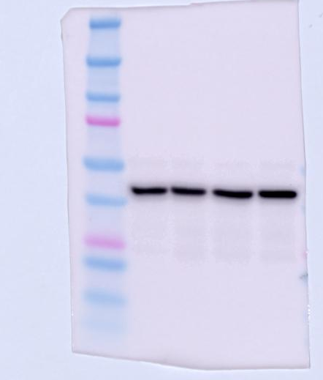
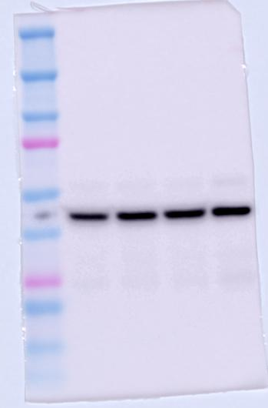
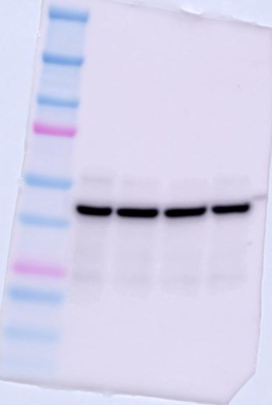
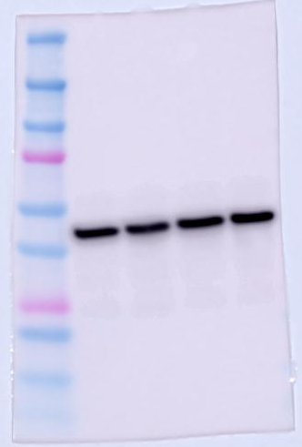
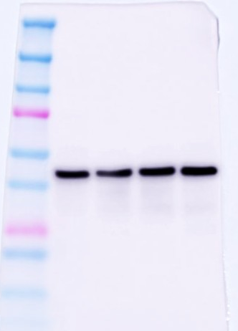
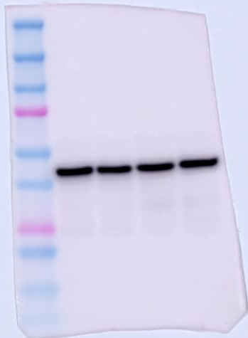
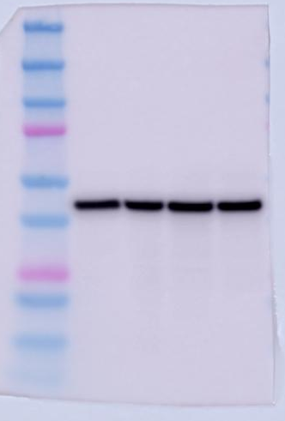
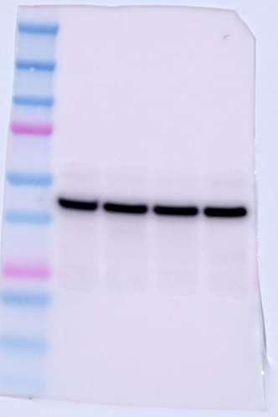
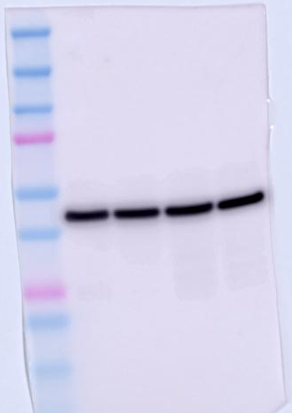
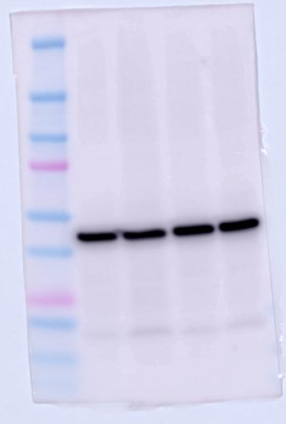
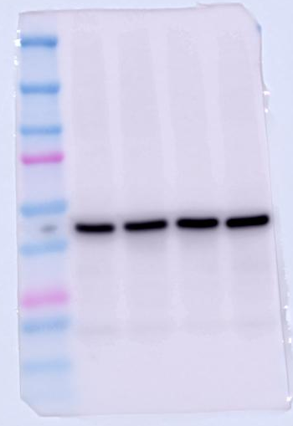
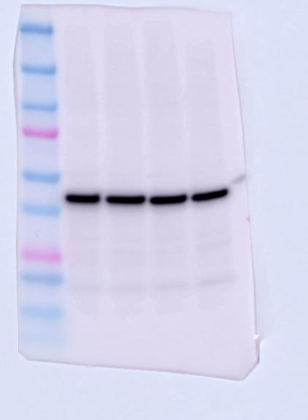
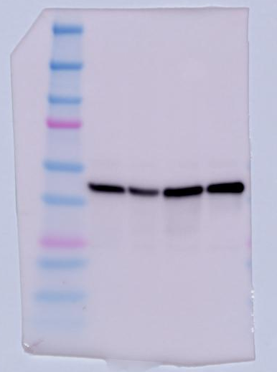
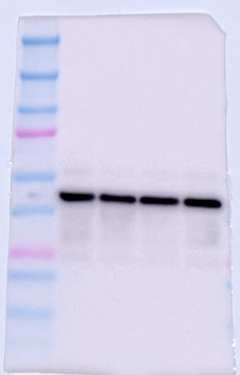
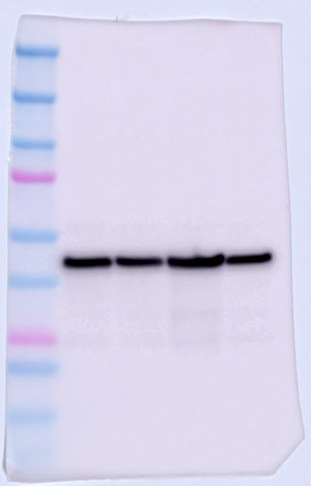
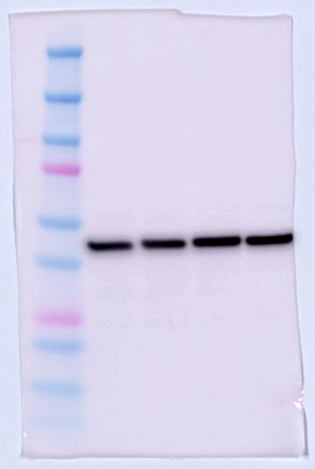
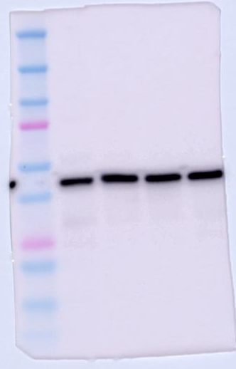
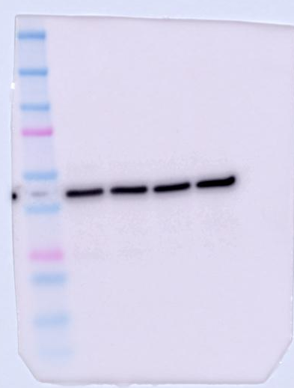
Β-Actin
LRP1 ZIP7-1 | LRP1 ZIP7-2 | LRP1 ZIP7-3 | LRP1 ZIP7-4 | LRP1 ZIP7-5 | LRP1 ZIP7-6
BACE1 CL5 -1 | BACE1 CL5 -2 | BACE1 CL5 -3 | BACE1 CL5 -4 | BACE1 CL5 -5 | BACE1 CL5 -6
P-gp RAGE MT3 -1 | P-gp RAGE MT3 -2 | P-gp RAGE MT3 -3 | P-gp RAGE MT3 -4 | P-gp RAGE MT3 -5 | P-gp RAGE MT3 -6

Slide 4
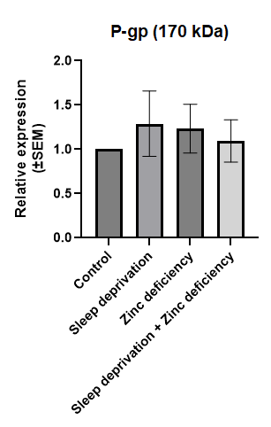
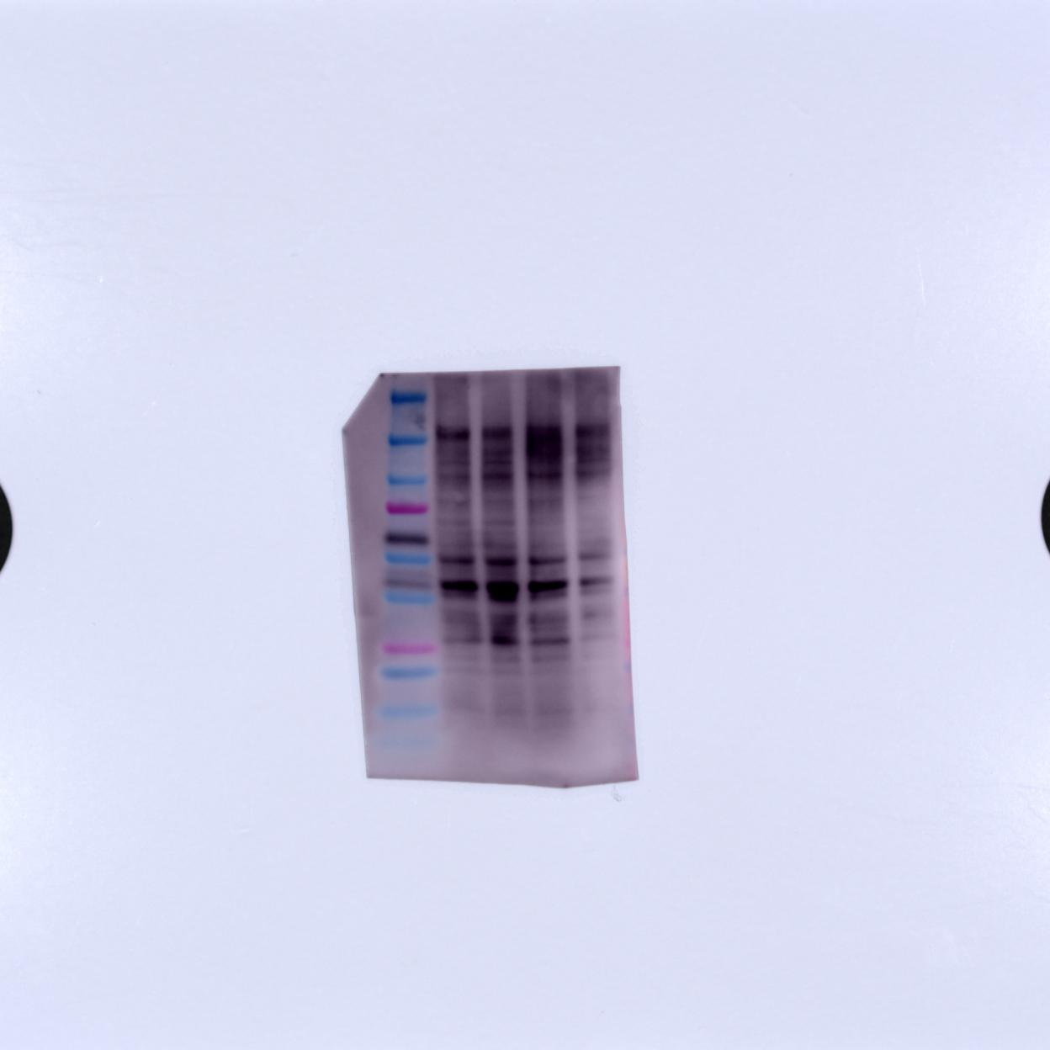
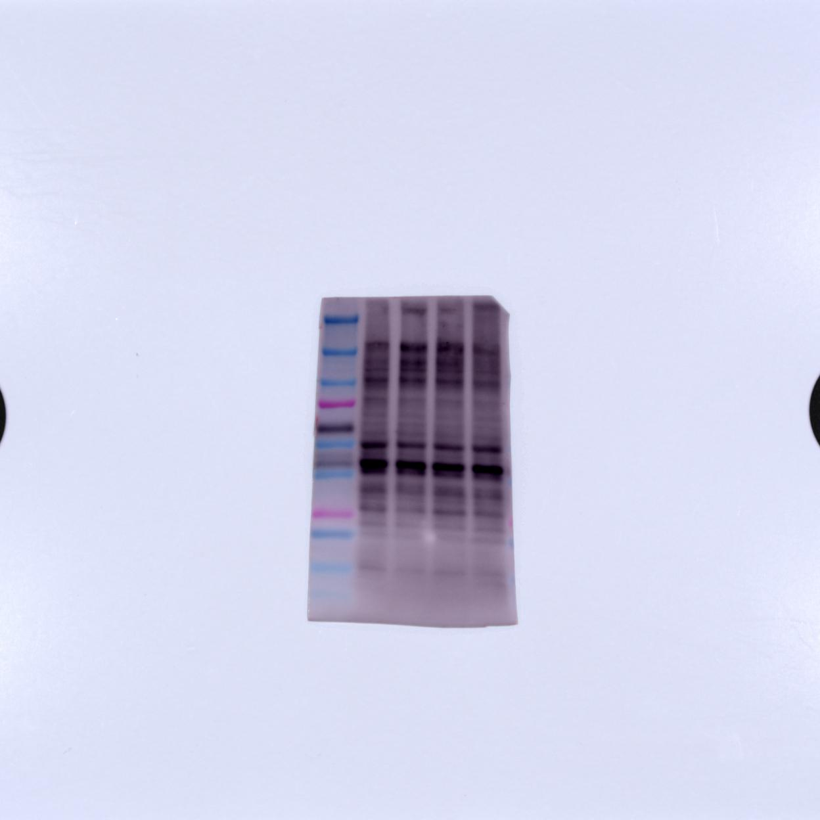
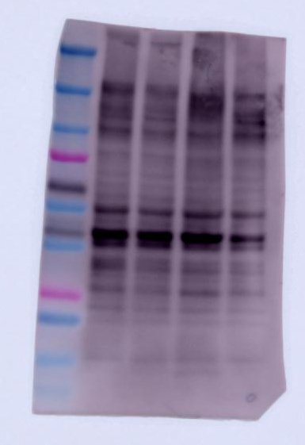
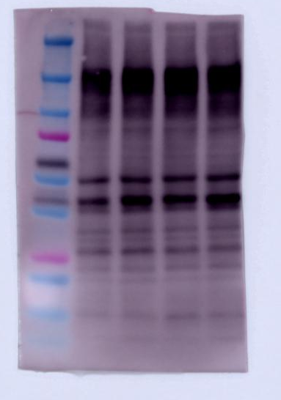
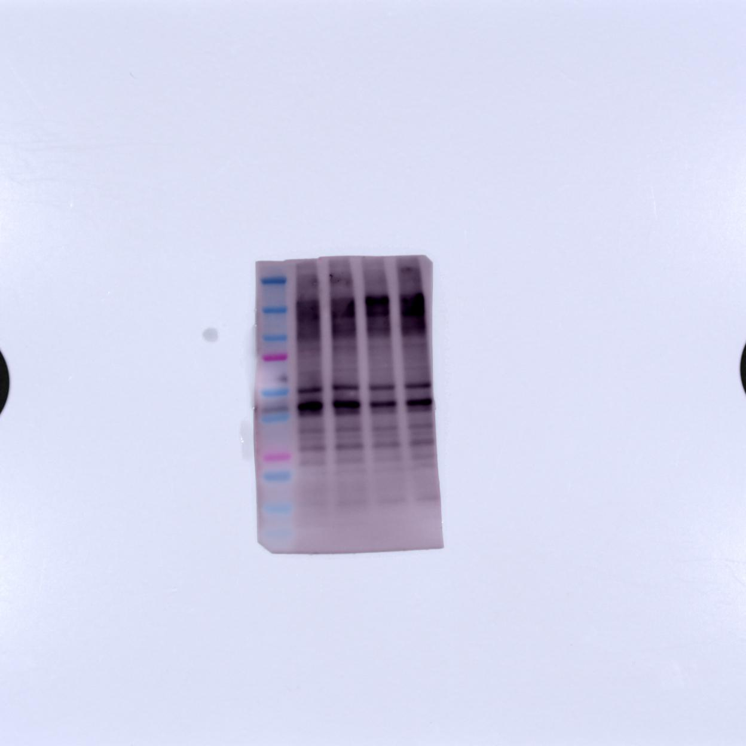
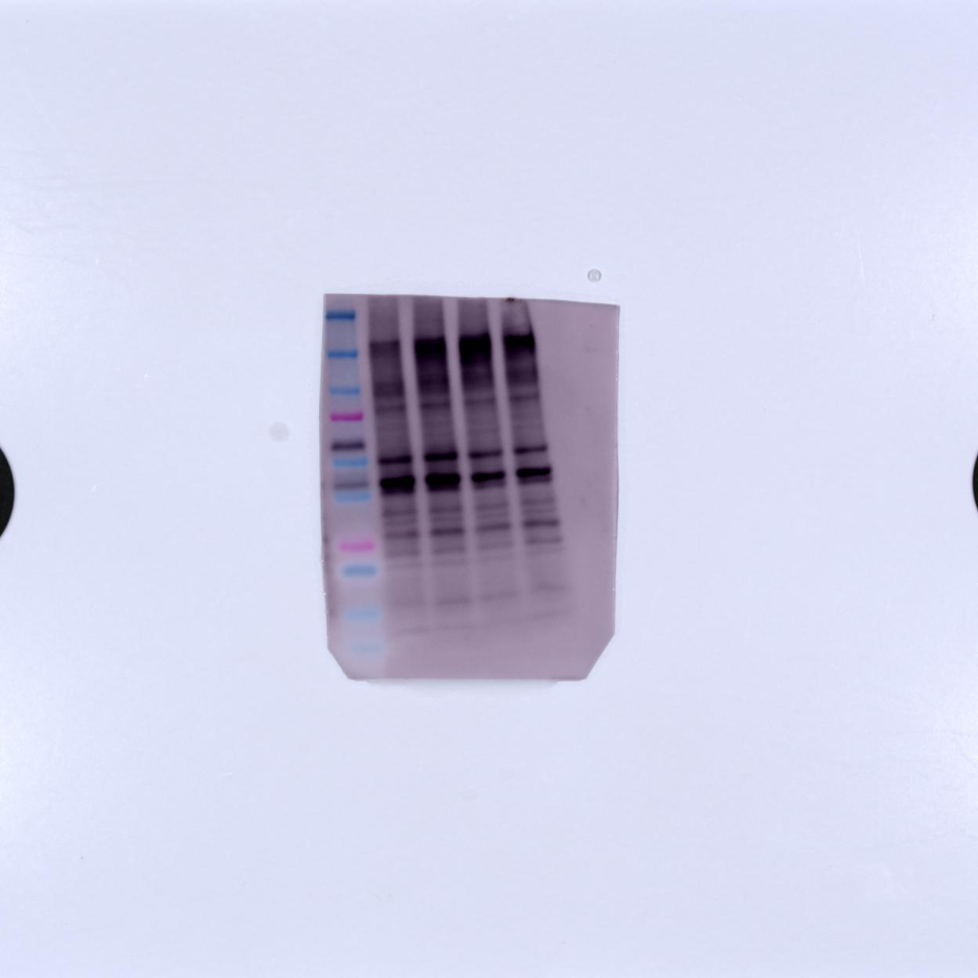
P-gp (170 kDa)
AB170904 anti-rabbit, mono
(1st 1:1000, 2nd 1:5000)
P-gp -1 | P-gp -2 | P-gp -3 | P-gp -4 | P-gp -5 | P-gp -6

Slide 5
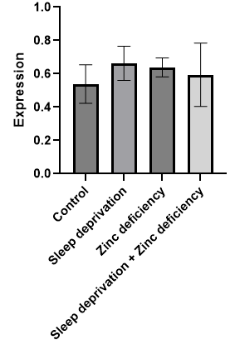
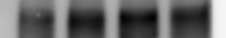
P-gp (170 kDa)
AB170904 anti-rabbit, mono
(1st 1:1000, 2nd 1:5000)

Slide 6
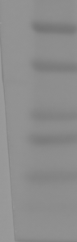
L | BCE 1-1 | BCE 2-1 | BCE 3-1 | BCE 4-1 | L | BCE 1-2 | BCE 2-2 | BCE 3-2 | BCE 4-2 | L | BCE 1-3 | BCE 2-3 | BCE 3-3 | BCE 4-3
L | BCE 1-4 | BCE 2-4 | BCE 3-4 | BCE 4-4 | L | BCE 1-5 | BCE 2-5 | BCE 3-5 | BCE 4-5 | L | BCE 1-6 | BCE 2-6 | BCE 3-6 | BCE 4-6
RAGE (50 kDa)
MAB1179 anti-rat, mono
(1st 1:100, 2nd 1:1000)
RAGE -1 | RAGE -2 | RAGE -3 | RAGE -4 | RAGE -5 | RAGE -6

Slide 7
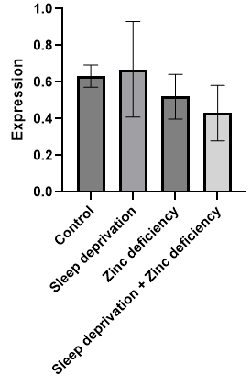
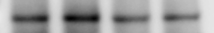
RAGE (50 kDa)
MAB1179 anti-rat, mono
(1st 1:100, 2nd 1:1000)

Slide 8
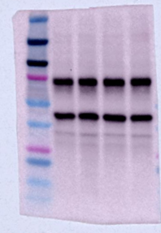
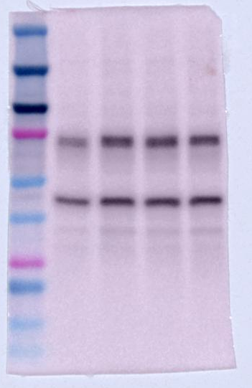
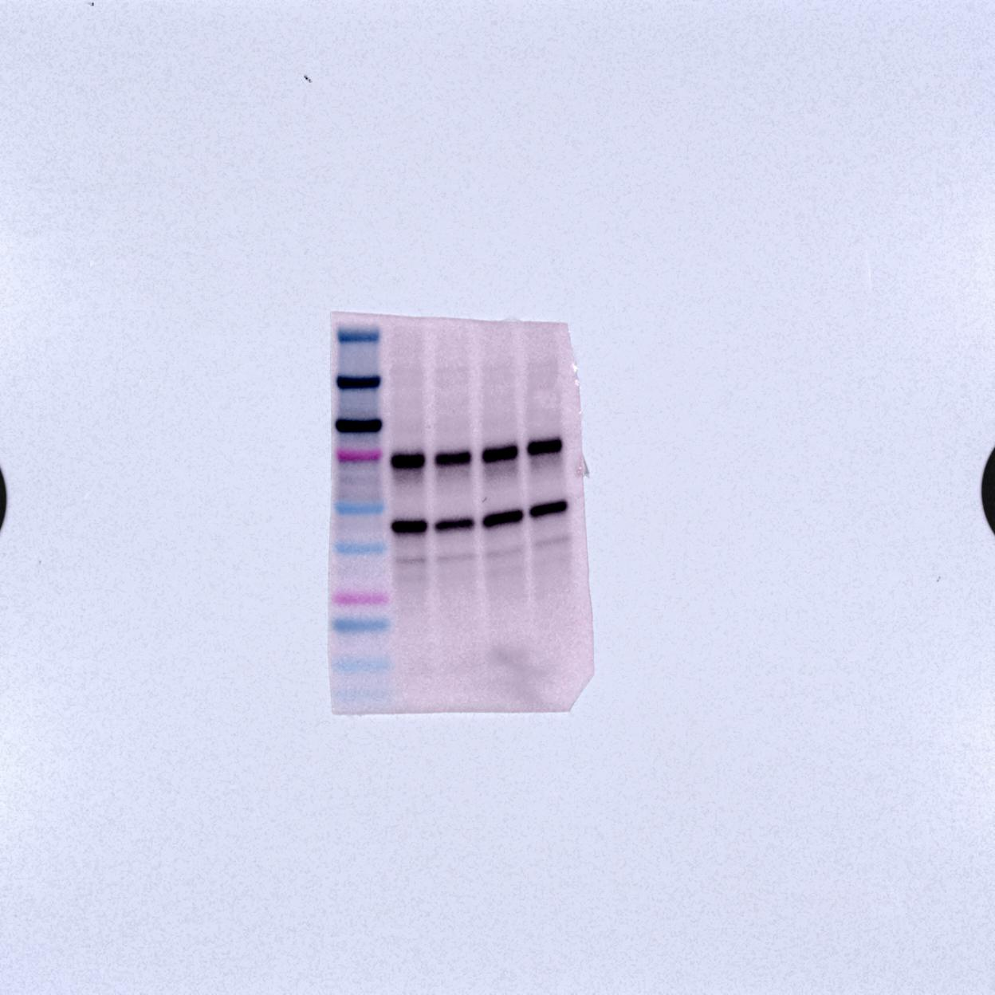
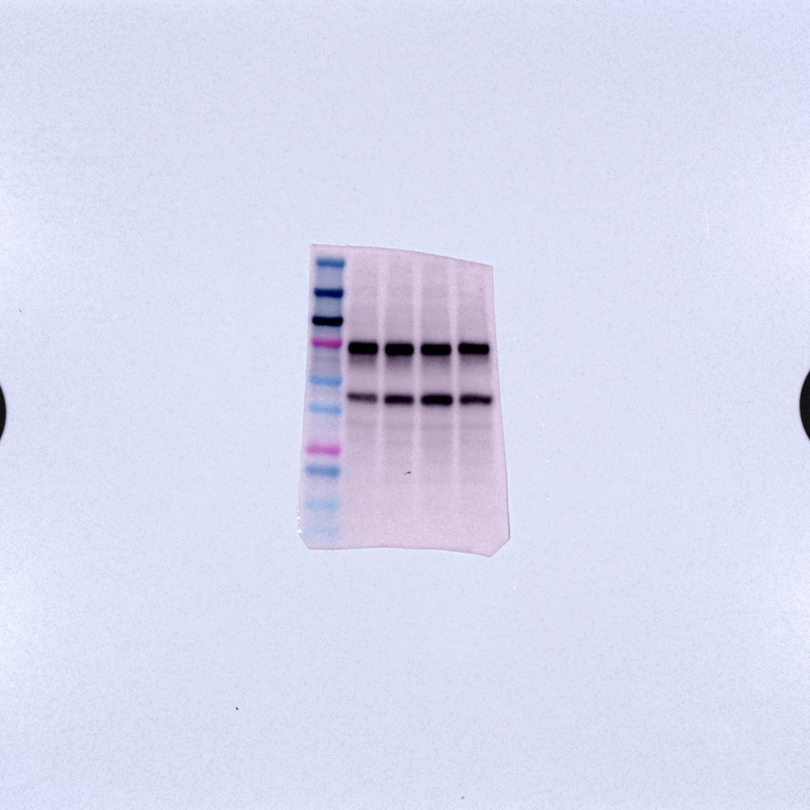
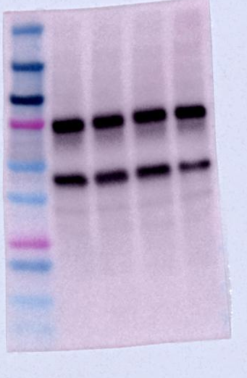
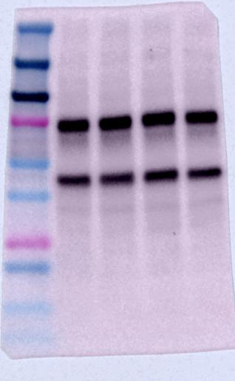
L | BCE 1-1 | BCE 2-1 | BCE 3-1 | BCE 4-1 | L | BCE 1-2 | BCE 2-2 | BCE 3-2 | BCE 4-2 | L | BCE 1-3 | BCE 2-3 | BCE 3-3 | BCE 4-3
L | BCE 1-4 | BCE 2-4 | BCE 3-4 | BCE 4-4 | L | BCE 1-5 | BCE 2-5 | BCE 3-5 | BCE 4-5 | L | BCE 1-6 | BCE 2-6 | BCE 3-6 | BCE 4-6
LRP1
(75-85 kDa)
AB92544 anti-rabbit, mono
(1st 1:50,000, 2nd 1:10,000)
LRP1 -1 | LRP1 -2 | LRP1 -3 | LRP1 -4 | LRP1 -5 | LRP1 -6

Slide 9
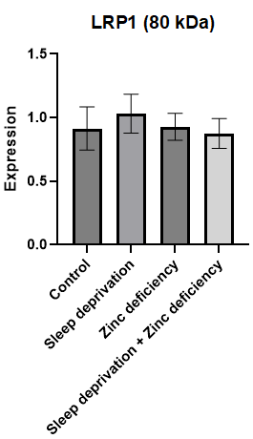
LRP1
(75-85 kDa)
AB92544 anti-rabbit, mono
(1st 1:50,000, 2nd 1:10,000)

Slide 10
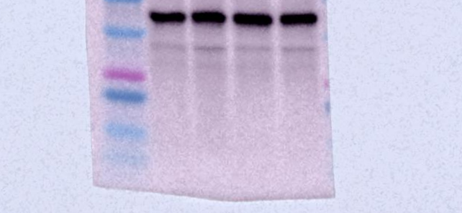
L | BCE 1-1 | BCE 2-1 | BCE 3-1 | BCE 4-1 | L | BCE 1-2 | BCE 2-2 | BCE 3-2 | BCE 4-2 | L | BCE 1-3 | BCE 2-3 | BCE 3-3 | BCE 4-3
L | BCE 1-4 | BCE 2-4 | BCE 3-4 | BCE 4-4 | L | BCE 1-5 | BCE 2-5 | BCE 3-5 | BCE 4-5 | L | BCE 1-6 | BCE 2-6 | BCE 3-6 | BCE 4-6
ZIP-7
(50 kDa)
AB254566 anti-rabbit, mono
(1st 1:1000, 2nd 1:10,000)
ZIP-7 -1 | ZIP-7 -2 | ZIP-7 -3 | ZIP-7 -4 | ZIP-7 -5 | ZIP-7 -6

Slide 11
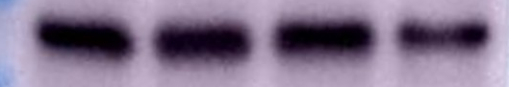
ZIP-7
(50 kDa)
AB254566 anti-rabbit, mono
(1st 1:1000, 2nd 1:10,000)

Slide 12
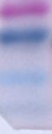
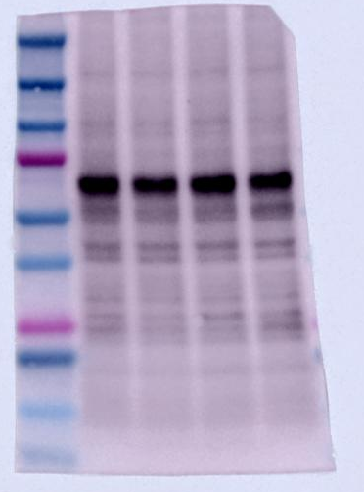
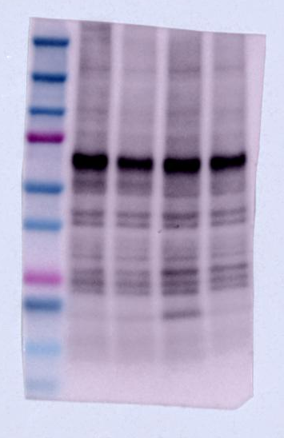




L | BCE 1-1 | BCE 2-1 | BCE 3-1 | BCE 4-1 | L | BCE 1-2 | BCE 2-2 | BCE 3-2 | BCE 4-2 | L | BCE 1-3 | BCE 2-3 | BCE 3-3 | BCE 4-3
L | BCE 1-4 | BCE 2-4 | BCE 3-4 | BCE 4-4 | L | BCE 1-5 | BCE 2-5 | BCE 3-5 | BCE 4-5 | L | BCE 1-6 | BCE 2-6 | BCE 3-6 | BCE 4-6
Claudin-5
(22 kDa)
4C3C2 anti-mouse, mono
(1st 1:1,000, 2nd 1:5,000)
Claudin-5 -1 | Claudin-5 -2 | Claudin-5 -3 | Claudin-5 -4 | Claudin-5 -5 | Claudin-5 -6

Slide 13

Claudin-5
(22 kDa)
4C3C2 anti-mouse, mono
(1st 1:1,000, 2nd 1:5,000)

Slide 14
L | BCE 1-1 | BCE 2-1 | BCE 3-1 | BCE 4-1 | L | BCE 1-2 | BCE 2-2 | BCE 3-2 | BCE 4-2 | L | BCE 1-3 | BCE 2-3 | BCE 3-3 | BCE 4-3
L | BCE 1-4 | BCE 2-4 | BCE 3-4 | BCE 4-4 | L | BCE 1-5 | BCE 2-5 | BCE 3-5 | BCE 4-5 | L | BCE 1-6 | BCE 2-6 | BCE 3-6 | BCE 4-6
BACE1
(56 kDa)
AB108394 anti-rabbit, mono
(1st 1:1000, 2nd 1:1000)
BACE1 -1 | BACE1 -2 | BACE1 -3 | BACE1 -4 | BACE1 -5 | BACE1 -6

Slide 15

BACE1
(56 kDa)
AB108394 anti-rabbit, mono
(1st 1:1000, 2nd 1:1000)

Slide 16






L | BCE 1-1 | BCE 2-1 | BCE 3-1 | BCE 4-1 | L | BCE 1-2 | BCE 2-2 | BCE 3-2 | BCE 4-2 | L | BCE 1-3 | BCE 2-3 | BCE 3-3 | BCE 4-3
L | BCE 1-4 | BCE 2-4 | BCE 3-4 | BCE 4-4 | L | BCE 1-5 | BCE 2-5 | BCE 3-5 | BCE 4-5 | L | BCE 1-6 | BCE 2-6 | BCE 3-6 | BCE 4-6
MT3
(11-17 kDa)
AB214314 anti-rabbit, poly
(1st 1:1000, 2nd 1:5000)
MT3 -1 | MT3 -2 | MT3 -3 | MT3 -4 | MT3 -5 | MT3 -6

Slide 17


MT3
(11-17 kDa)
AB214314 anti-rabbit, poly
(1st 1:1000, 2nd 1:5000)

Slide 18


Β-Actin
L | BCE 1-1 | BCE 2-1 | BCE 3-1 | BCE 4-1 | L | BCE 1-2 | BCE 2-2 | BCE 3-2 | BCE 4-2 | L | BCE 1-3 | BCE 2-3 | BCE 3-3 | BCE 4-3
L | BCE 1-4 | BCE 2-4 | BCE 3-4 | BCE 4-4 | L | BCE 1-5 | BCE 2-5 | BCE 3-5 | BCE 4-5 | L | BCE 1-6 | BCE 2-6 | BCE 3-6 | BCE 4-6

Slide 19

L | BCE 1-1 | BCE 2-1 | BCE 3-1 | BCE 4-1 | L | BCE 1-2 | BCE 2-2 | BCE 3-2 | BCE 4-2 | L | BCE 1-3 | BCE 2-3 | BCE 3-3 | BCE 4-3
L | BCE 1-4 | BCE 2-4 | BCE 3-4 | BCE 4-4 | L | BCE 1-5 | BCE 2-5 | BCE 3-5 | BCE 4-5 | L | BCE 1-6 | BCE 2-6 | BCE 3-6 | BCE 4-6
ZIP1
(34 kDa)
AB214314 anti-rabbit, poly
(1st 1:1000, 2nd 1:5000)

Slide 20
ZIP1 (slc39a1)
(34 kDa)
ab105416 anti-rabbit, poly
(1st 1:1000, 2nd 1:5000)

Slide 21

L | BCE 1-1 | BCE 2-1 | BCE 3-1 | BCE 4-1 | L | BCE 1-2 | BCE 2-2 | BCE 3-2 | BCE 4-2 | L | BCE 1-3 | BCE 2-3 | BCE 3-3 | BCE 4-3
L | BCE 1-4 | BCE 2-4 | BCE 3-4 | BCE 4-4 | L | BCE 1-5 | BCE 2-5 | BCE 3-5 | BCE 4-5 | L | BCE 1-6 | BCE 2-6 | BCE 3-6 | BCE 4-6
ZnT3
(42 kDa)
AB214314 anti-rabbit, poly
(1st 1:1000, 2nd 1:5000)

Slide 22


ZnT3
(42 kDa)
17363-1-AP anti-rabbit, poly
(1st 1:500, 2nd 1:5000)
6번

