Slide 1
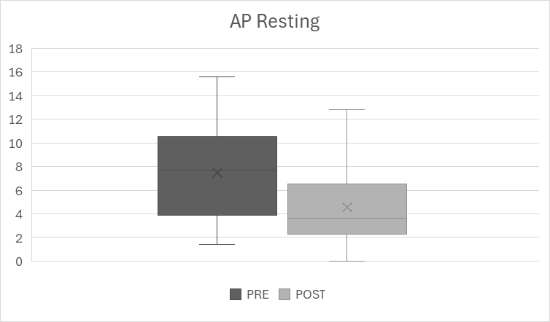
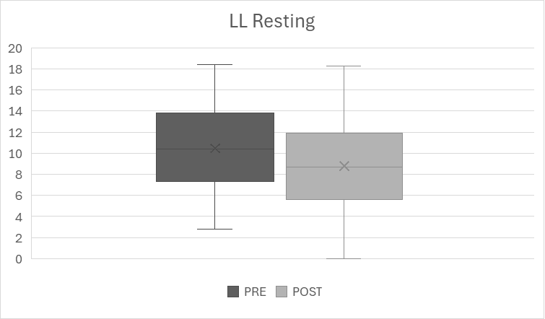
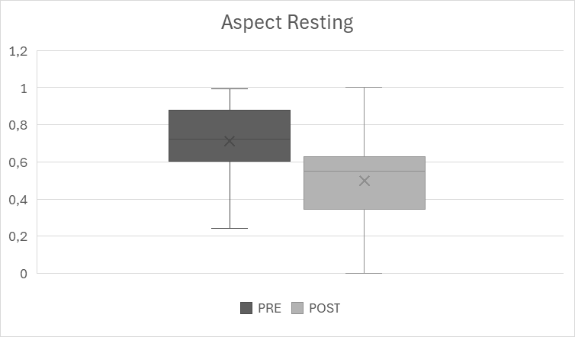
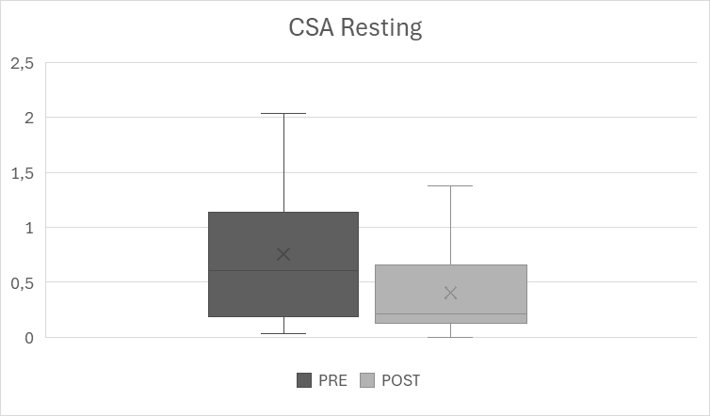
Changes of AP Resting, LL Resting, Aspect Resting and CSA Resting between Pre-HD and Post-HD. Outliers are not shown.

Slide 2
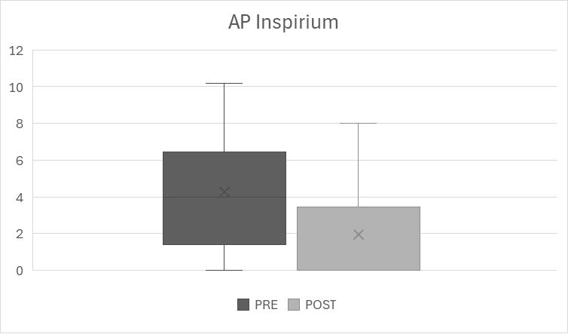
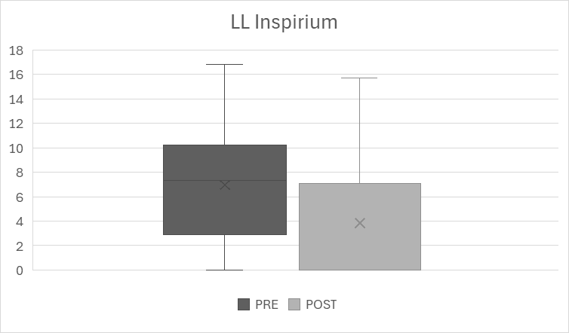
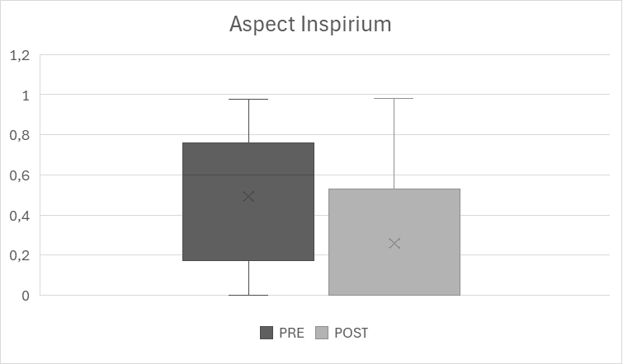
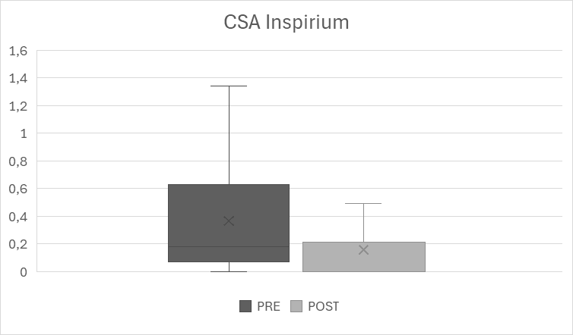
Changes of AP Inspirium, LL Inspirium, Aspect Inspirium and CSA Inspirium between Pre-HD and Post-HD. Outliers are not shown.

Slide 3
Changes of AP Inspirium, LL Inspirium, Aspect Inspirium and CSA Inspirium between Pre-HD and Post-HD. Outliers are not shown.

Slide 4
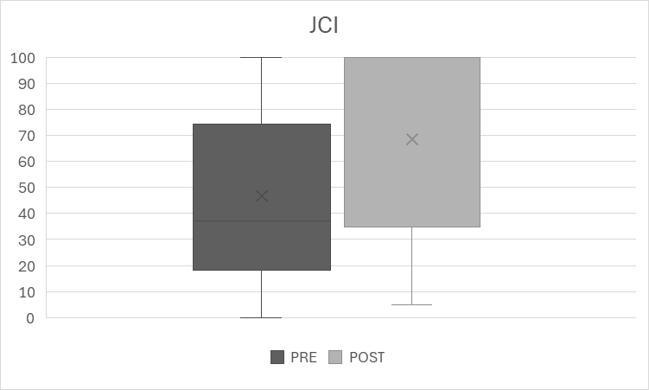
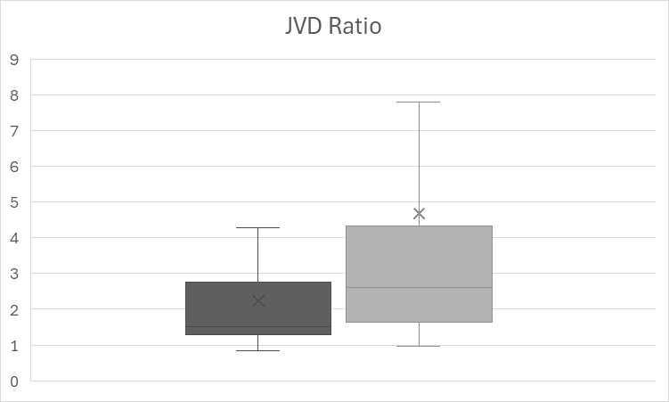
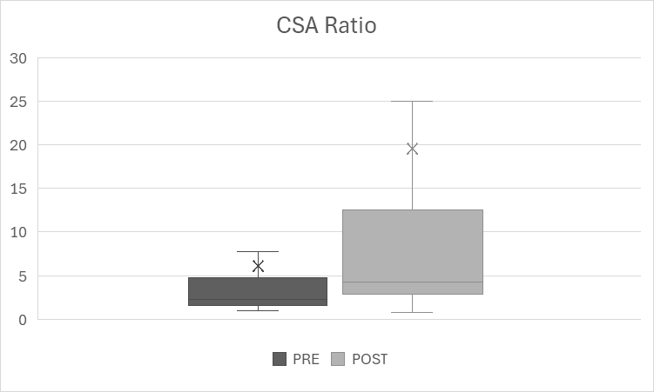
Changes of JCI, JVD Ratio and JCA Ratio between Pre-HD and Post-HD. Outliers are not shown.

Slide 5
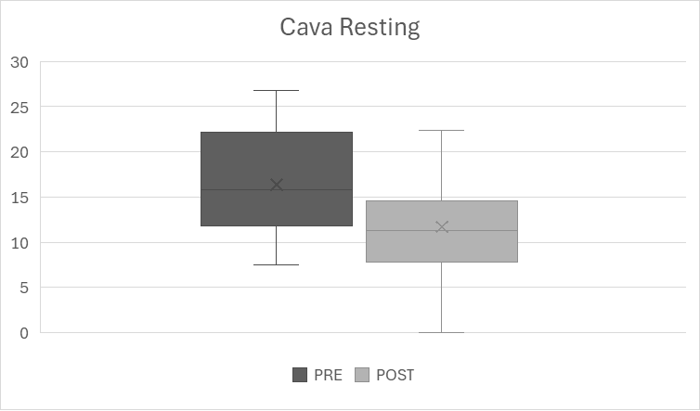
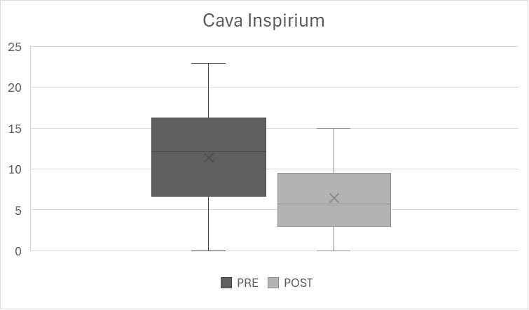
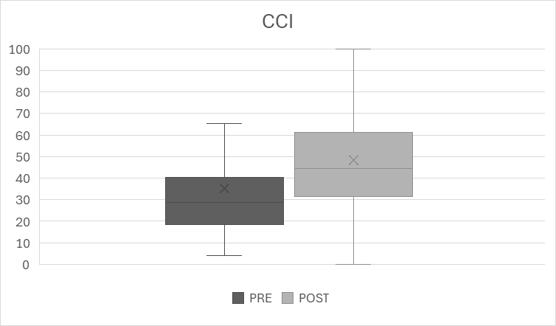
Changes of Cava Resting, Cava inspirium and CCI between Pre-HD and Post-HD. Outliers are not shown.

