Slide 1
Highly activated CD4⁺ T regulatory cells associated with non-responders to immunotherapy in metastatic melanoma
Emily Milodowski^{1*}, Jessica Ball^{1,2*}, Chris Herbert², Abdul-Qader Hadi², Leila Russell¹, Alfredo Addeo³, Helen Winter^{2^}, Francesca Bartoli-Leonard^{1^}, Linda Wooldridge^{1^}
¹ Faculty of Health and Life Sciences, University of Bristol, Bristol, United Kingdom
² Bristol Haematology and Oncology Centre, Bristol, United Kingdom
³Faculty of Medicine, University of Geneva, Geneva, Switzerland
*Shared first author
^Shared senior author
Corresponding Author
Linda Wooldridge, Faculty of Health Sciences, University of Bristol, Bristol, United Kingdom
Linda.Wooldridge@bristol.ac.uk
Abstract
Immune checkpoint inhibitors (ICI) have improved survival in metastatic melanoma, yet up to 60% of patients may not benefit. This study evaluated circulating Ki67⁺ CD4⁺ T-regulatory cells (Tregs) as a potential biomarker of response to ICIs. Increased Ki67 expression by CD4⁺ Tregs was associated with non-response and higher mortality. These findings suggest that Ki67⁺ Tregs may mediate ICI resistance and represent a minimally invasive, early predictive biomarker warranting further validation.
Supplemental Data

Slide 2
Supplementary table 1. Antibodies and Reagents Used for Flow Cytometry.
Antigen | Fluorochrome | Clone | Source | Cat No. | Concentration
CD3 | SB645 | UCHT1 | ThermoFisher | 64-0038-41 | 1:40
CD4 | PE-CY5.5 | SK3 | ThermoFisher | 35-0047-41 | 1:640
CD8α | PE-CY5 | RPA-T8 | Biolegend | 301009 | 1:1280
CD25 | BV421 | 2A3 | BD | 564033 | 1:160
CD25 | BV421 | M-A251 | BD | 562443 | 1:40
FOXP3 | PE | 259D | Biolegend | 320207 | 1:80
CCR7 | BV785 | G043H7 | Biolegend | 353229 | 1:30
CD45RA | APC-Fire750 | HI100 | Biolegend | 304151 | 1:80
2B4 | AF700 | C1.7 | Biolegend | 329525 | 1:80
BTLA | APC | MIH26 | Biolegend | 344509 | 1:40
CTLA-4 | PE-DAZZLE | BNI3 | Biolegend | 369615 | 1:20
LAG-3 | PE-CY7 | 3DS 223H | ThermoFisher | 25-2239-41 | 1:60
PD1 | BV711 | EH12.2H7 | Biolegend | 329927 | 1:60
TIGIT | PERCP-eFluor710 | MBSA43 | eBioscience | 46-9500-41 | 1:30
TIM-3 | SB600 | F38-2E2 | ThermoFisher | 63-3109-41 | 1:20
4-1BB | SB600 | 4B4-1 | ThermoFisher | 63-1379-41 | 1:30
CD27 | PE-CY7 | O323 | Biolegend | 302837 | 1:50
CD28 | APCR700 | CD28.2 | BD | 565181 | 1:50
GITR | BV711 | 101-17 | Biolegend | 371211 | 1:20
ICOS | APC | ISA | ThermoFisher | 17-9948-41 | 1:20
OX40 | PE-DAZZLE | Ber-ACT35 | Biolegend | 350019 | 1:30
CD19 | V500 | HIB19 | BD | 561125 | 1:75
CD14 | V500 | M5E2 | BD | 561392 | 1:75
KI67 | AF488 | B56 | BD | 558616 | 1:100
IgG4 | Biotin | HP6025 | ThermoFisher | A-10663 | 1:200
Streptavidin | BV711 | - | Biolegend | 405241 | 1:100
Zombie Aqua | 405nm | - | ThermoFisher | L34957 | 1:100
Nivolumab | - | - | Selleckchem | A2002 | 10ug/mL
Pembrolizumab | - | - | Selleckchem | A2005 | 10ug/mL

Slide 3
Figure S1. Response after 3 weeks of ICI therapy correlates with increased CD4⁺ TEMRA, Naive and central memory cell population activation. 3-week z-score normalized expression of costimulatory and coinhibitory markers, stratified by responder or non-responder to treatment defined at point of collection. A) CD4⁺ T cells; i) naive, ii) central memory, iii) effector memory, iv) TEMRA B) CD8 T cells i) naive, ii) central memory, iii) effector memory, iv) TEMRA. *P < 0.05, **P < 0.01 statistical tests all one-way ANOVA with mixed effect analysis. Flow cytometry; 3 week non-responder n=11, 3 week responder n=7.

Slide 4
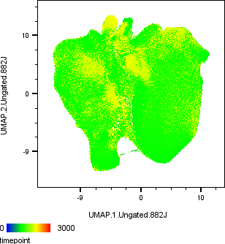
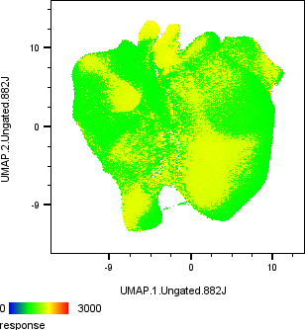
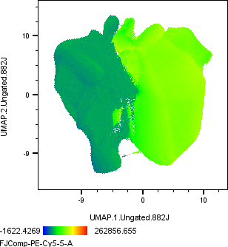
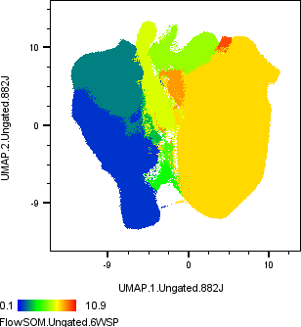


A
Baseline
B
Non-
Responder
C
CD4⁺
3 Week
Responder
CD8⁺
D
i
ii
Cluster | Subset Name
1 | CD8+ Naive
2 | CD8+ TEMRA
3 | CD8+ Ki67+ Effector Memory
4 | CD4-CD8-
5 | CD4+ Effector Memory
6 | CD4+ Central Memory
7 | CD4+ Ki67+ Effector Memory
8 | Ki67+ Tregs
iii
iv
Figure S2. UMAP analysis of multi-parameter flow data stratified by. A) Timepoint B) Response status, C) CD4/CD8 expression D) FlowSOM clustered data as i) non-responder baseline, ii) responder baseline, iii) non-responder 3-weeks, iv) responder 3-weeks. 3 week non-responder n=11, 3 week responder n=7.

Slide 5
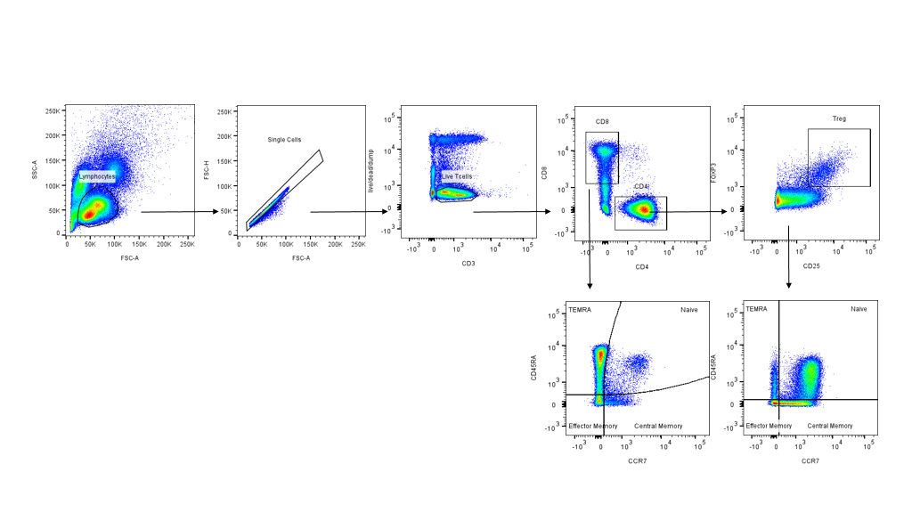
A
B
C
D
Non-responder
Non-responder
Non-responder
Responder
Baseline
3 weeks
Responder
Responder
Baseline
3 weeks
Figure S3. Ratio of CD8⁺ T cells to CD4⁺ Treg cells. Stratified by A) Responder vs non-responder, B) baseline vs 3 weeks C) Baseline responder vs non-responder, D) 3-week responder vs non-responder. Flow cytometry; 3-week non-responder n=11, 3-week responder n=7.
Figure S4. Supervised gating strategy for the identification of T cell populations.

