Slide 1
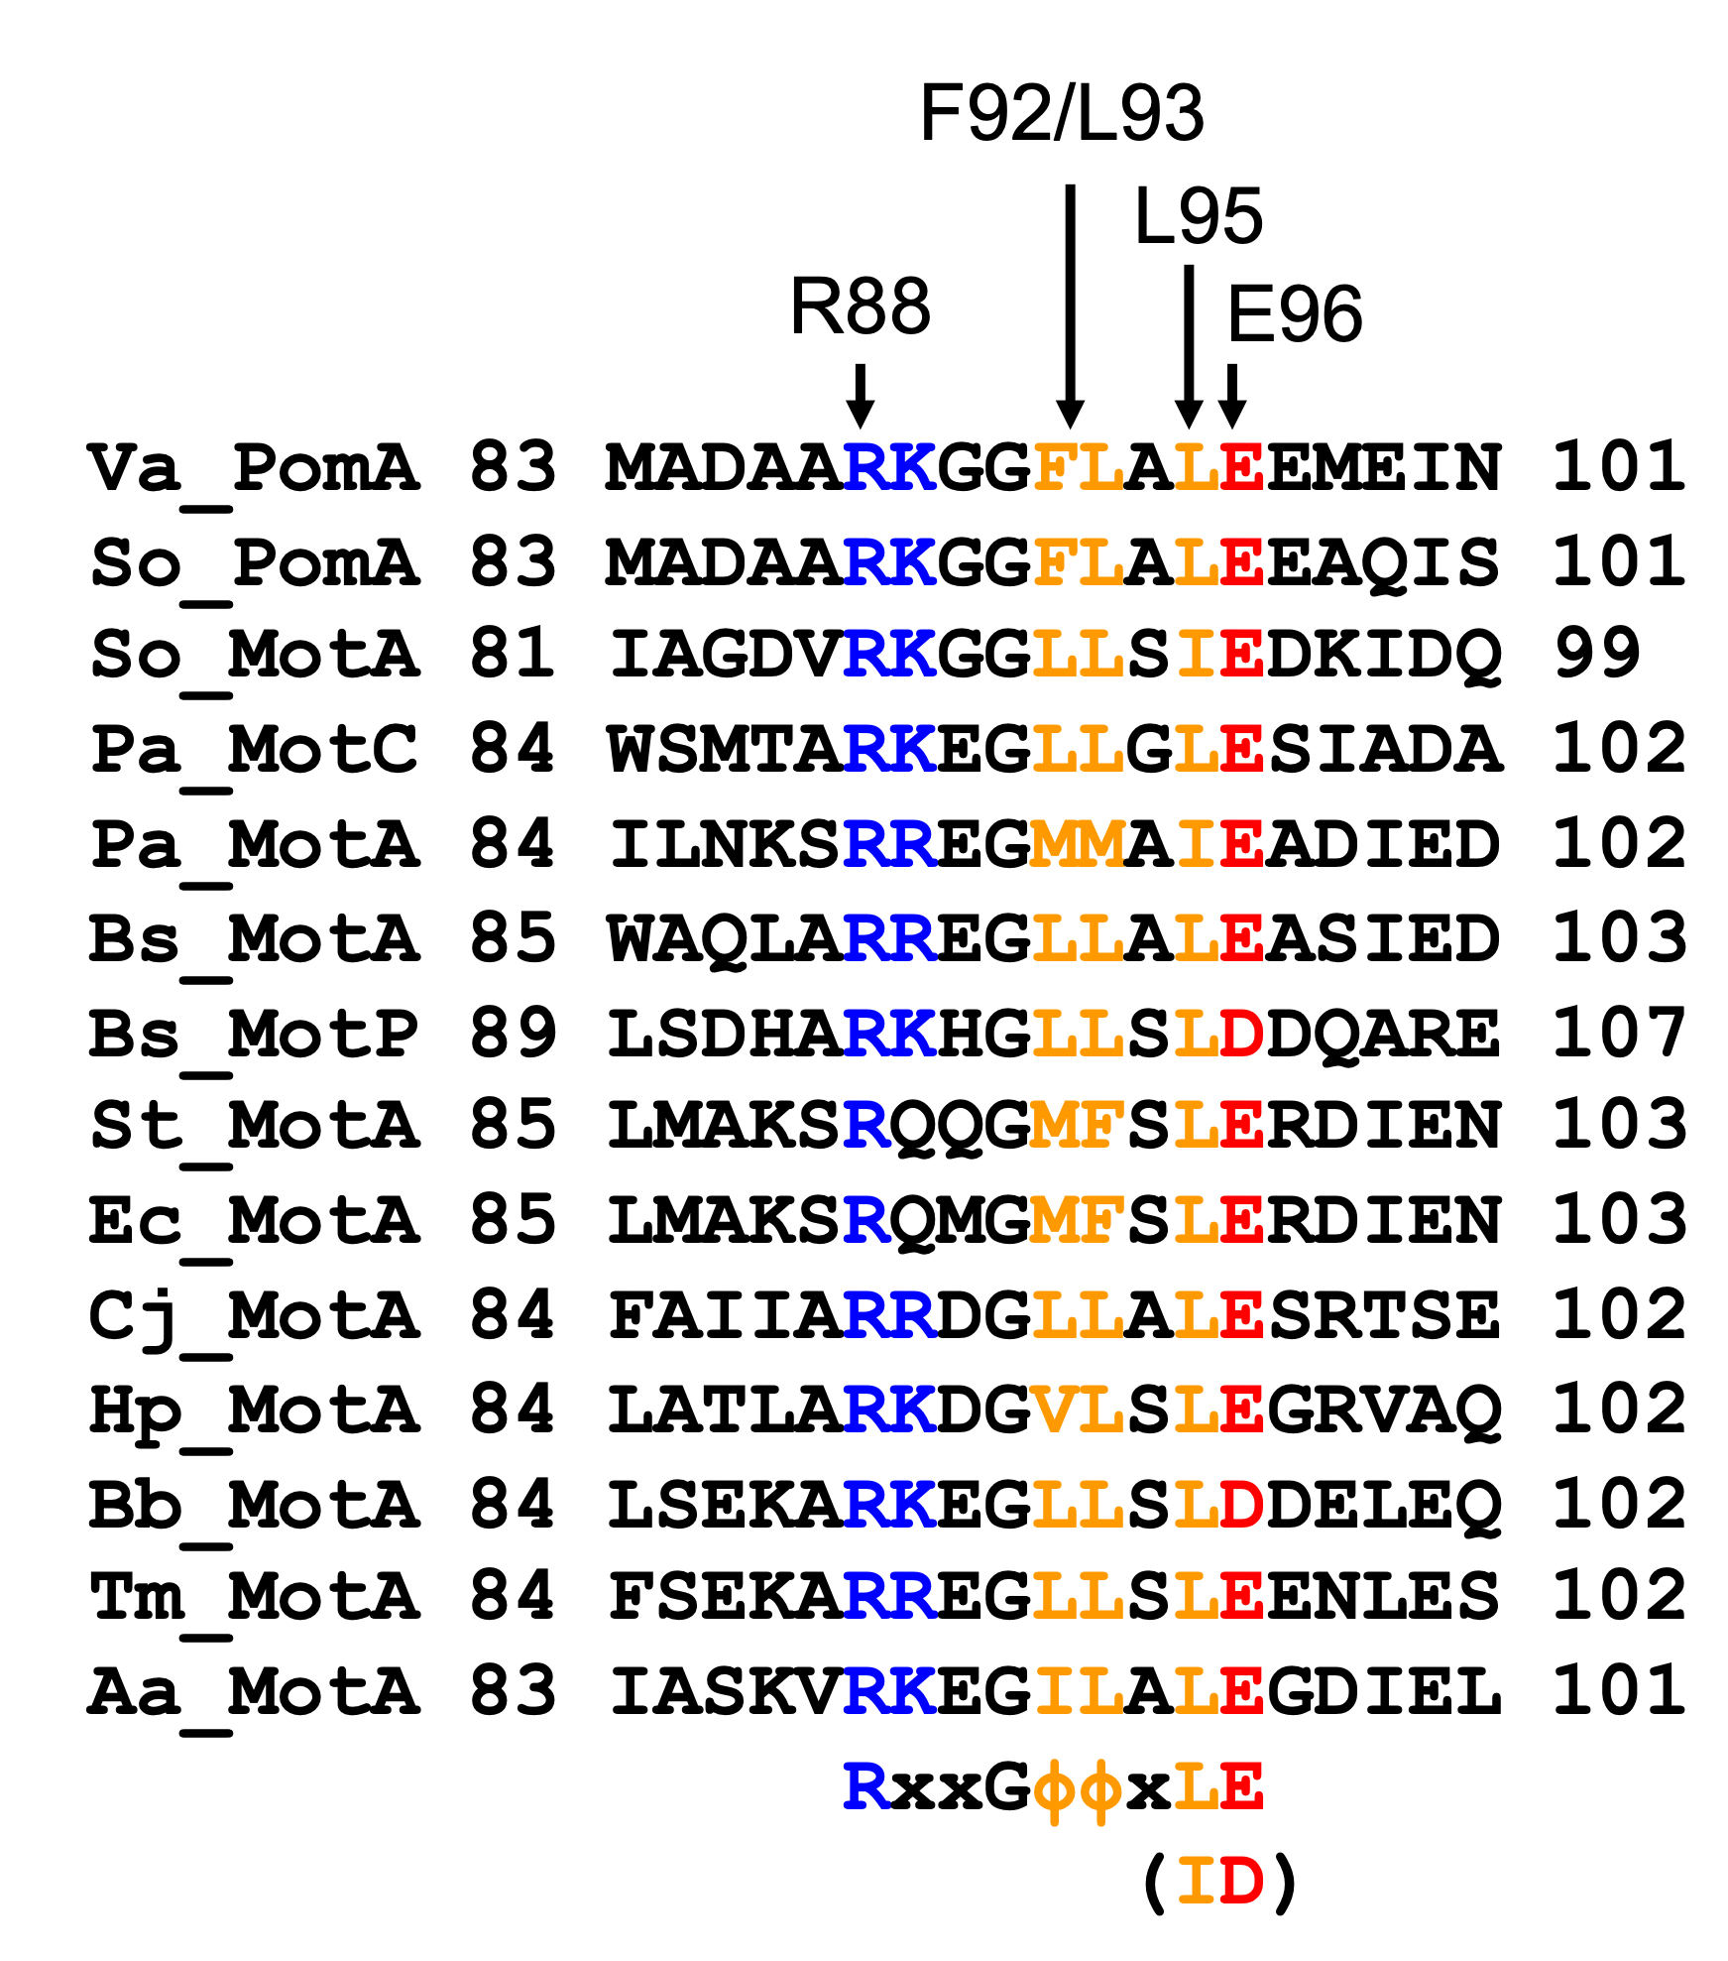
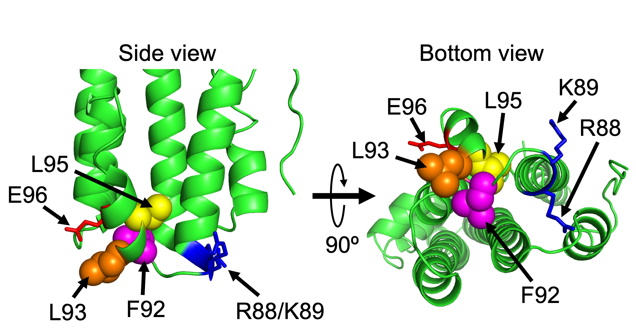
(A)
(B)
Fig. S1. The putative interaction region between rotor and stator. (A) Alignments of the amino acid sequences of PomA and MotA from various species. The conserved charged residues, important for motor function, were represented in blue (positive) and red (negative). The conserved hydrophobic residues were shown in orange. Abbreviations: Φ, hydrophobic residues; Va, Vibrio alginolyticus VIO5; So, Shewanella oneidensis MR-1; Pa, Pseudomonas aeruginosa PAO1; Bs, Bacillus subtilis subsp. subtilis 168; St, Salmonella enterica subsp. enterica serovar Typhimurium LT2; Ec, Escherichia coli K-12 MG1655; Cj, Campylobacter jejuni subsp. jejuni NCTC 11168; Hp, Helicobacter pylori 26695; Bb, Borrelia burgdorferi B31; Tm, Thermotoga maritima MSB8; Aa, Aquifex aeolicus VF5. (B) The ribbon model of the C. jejuni MotA monomer (6YKM). The corresponding residues in V. alginolyticus PomA were represented by arrow and residue numbers.

Slide 2
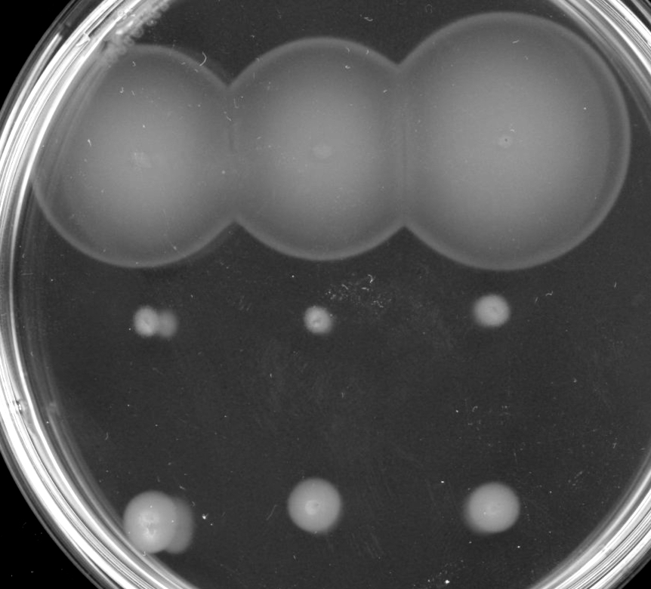
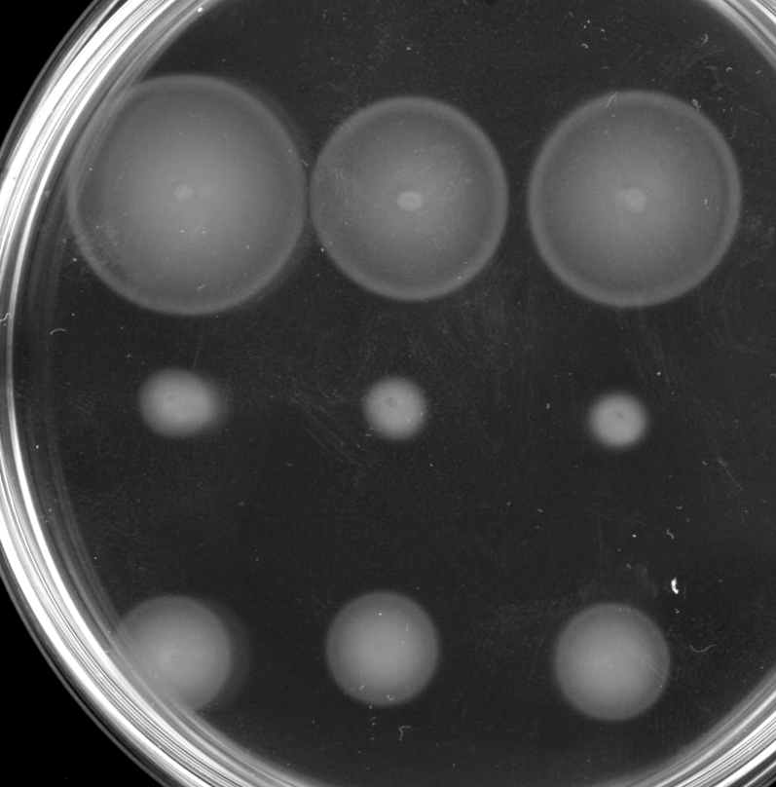
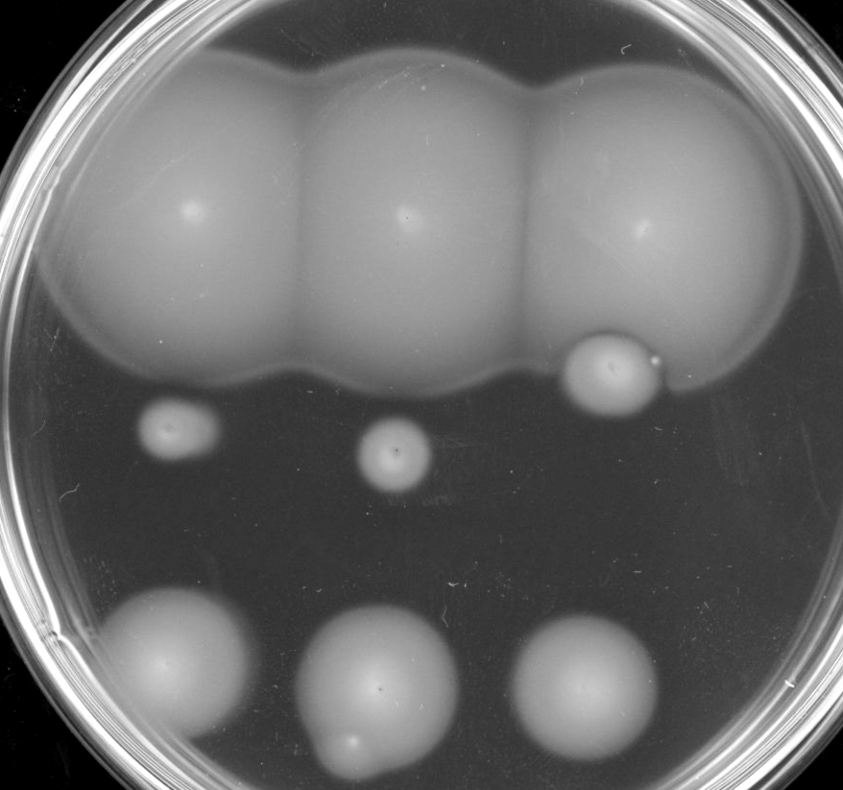
(A) 40℃ 6h
1
2
3
(B) 30℃ 6h
1
2
3
(C) 20℃ 24h
1
2
3
Fig. S2. The effect of temperature on swimming profiles of the PomA mutants. V. alginolyticus ΔpomAB strain NMB191 cells, expressing PomA and PomB from the plasmid pHFAB (WT) and the mutant plasmids (L93E, L95R), were inoculated in a VPG 0.25% (w/v) agar plate with 0.02% (w/v) arabinose and chloramphenicol at 40℃ for 6 h (A), at 30℃ for 6 h (B), or at 20℃ for 24 h (C).

Slide 3
vector
WT
L93E
vector
WT
L95E
s1
re1
s2
re2
s1
re1
s2
re2
s3
re3
s4
re4
s3
re3
s4
re4
L93E
L95E
s5
re5
s6
re6
s5
re5
s7
re7
s8
re8
s8
re8
s9
re9
s10
re10
s6
re6
s7
re7
L95E
s9
re9
vector
WT
L95R
s1
re1
s2
re2
s3
re3
s4
re4
Fig. S3. Motility of the swimming ring-restored mutants in PomA L93E, L95E and L95R. The cells were inoculated in a VPG 0.25% (w/v) agar plate with 0.02% (w/v) arabinose and chloramphenicol at 30 ºC for 4 h. The numbered “s” shows the original swimming ring-restored mutant. The numbered “re” shows the NMB191 cells re-transformed by the plasmid pHFAB extracted from the swimming ring-restored mutants.

Slide 4
60
**
50
*
40
30
Swimming speed (μm/sec)
20
10
0
s1
s2
s3
s4
s5
s6
s7
s8
s9
s10
WT
L93E
Up-motile mutants
60
**
**
**
50
40
*
30
Swimming speed (μm/sec)
20
10
0
s1
s2
s3
s4
s5
s6
s7
s8
s9
WT
L95E
Up-motile mutants
60
50
40
30
Swimming speed (μm/sec)
20
10
0
s1
s2
s3
s4
WT
L95R
Up-motile mutants
Fig. S4. Swimming speed of the swimming ring-restored mutants. V. alginolyticus ΔpomAB strain NMB191 cells, expressing PomA and PomB from the plasmid pHFAB, were observed by dark-field microscopy. The cells were video-recorded at 30 frames/s for 5 s, the swimming speed of the individual 10 cells was measured, and then the average of the swimming speed and SD were calculated. Upper, middle and lower panels showed L93E and its swimming ring-restored mutants, L95E and its swimming ring-restored mutants and L95R and its swimming ring-restored mutants, respectively. Asterisks indicated P < 0.05 (*) and P < 0.01 (**) for wild-type PomA versus the mutants of PomA by the Welch’s t-test.

Slide 5
1.0
0.8
0.6
Fraction of the cells
0.4
0.2
0
s1
s2
s3
s4
s5
s6
s7
s8
s9
s10
WT
L93E
Up-motile mutants
1.0
0.8
0.6
Fraction of the cells
0.4
0.2
0
s1
s2
s3
s4
s5
s6
s7
s8
s9
WT
L95E
Up-motile mutants
1.0
**
**
0.8
0.6
CW
Fraction of the cells
CCW
0.4
0.2
0
s1
s2
s3
s4
WT
L95R
Up-motile mutants
Fig. S5. The profile of the rotation direction of the swimming ring-restored mutants. Cells were observed by high-intensity dark-field microscopy. The ratio of CCW/CW rotation was calculated from video recordings of 10 s. At least 10 cells were tracked in all the experiments, then the average ratio of CCW/CW rotation with SD was calculated. Upper, middle and lower panels showed L93E and its swimming ring-restored mutants, L95E and its swimming ring-restored mutants and L95R and its swimming ring-restored mutants, respectively. Asterisks indicated P < 0.05 (*) and P < 0.01 (**) for wild-type PomA versus the mutants of PomA by the Welch’s t-test.

Slide 6
1.4
1.0
Switching events
per second (times)
*
0.8
0.4
**
**
0
s1
s2
s3
s4
s5
s6
s7
s8
s9
s10
WT
L93E
Up-motile mutants
1.4
1.0
Switching events
per second (times)
*
**
0.8
0.4
**
0
s1
s2
s3
s4
s5
s6
s7
s8
s9
WT
L95E
Up-motile mutants
1.4
1.0
Switching events
per second (times)
**
0.8
**
0.4
0
s1
s2
s3
s4
WT
L95R
Up-motile mutants
Fig. S6. The profile of the switching frequency of the swimming ring-restored mutants. Cells were observed by high-intensity dark-field microscopy. The switching frequency were calculated from video motion of the cells captured for 10 sec. At least 10 cells were tracked in all the experiments, then average of switching events with standard deviation (SD) were calculated. Upper, middle and lower panels showed L93E and its swimming ring-restored mutants, L95E and its swimming ring-restored mutants and L95R and its swimming ring-restored mutants, respectively. Asterisks indicated P < 0.05 (*) and P < 0.01 (**) for wild-type PomA

Slide 7
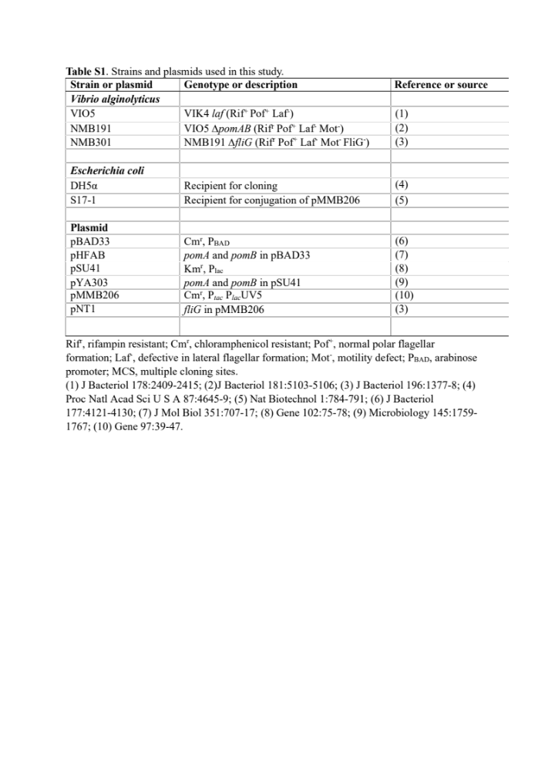

Slide 8
