Slide 1
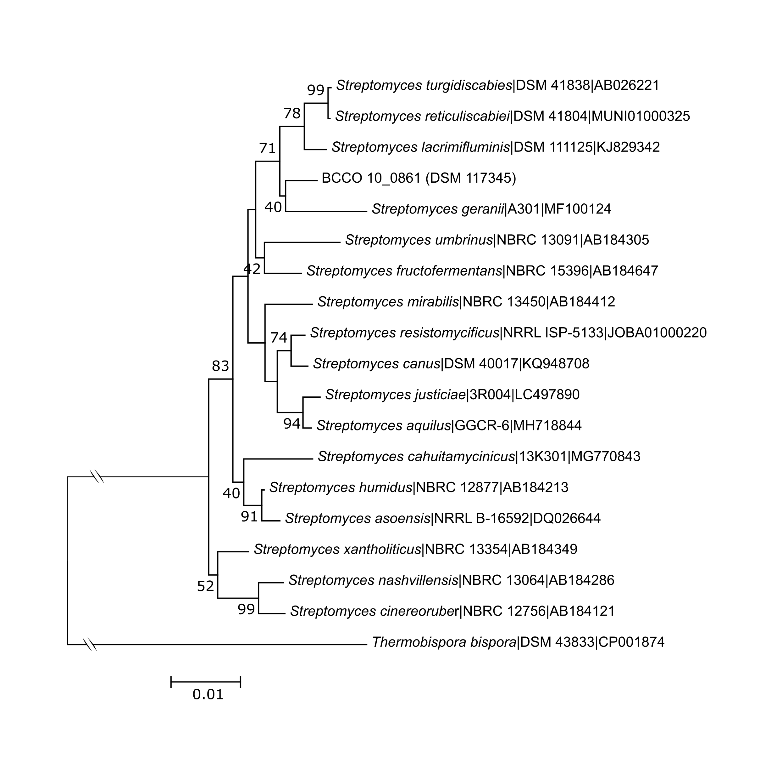
Supplementary Figure 1. Neighboor joining tree based on 16S rRNA sequences showing the phylogenetic relationships of BCCO 10_0861^{T} and the closest relative species with validly published names. Bootstrap values (1000) are indicated in the nodes.

Slide 2
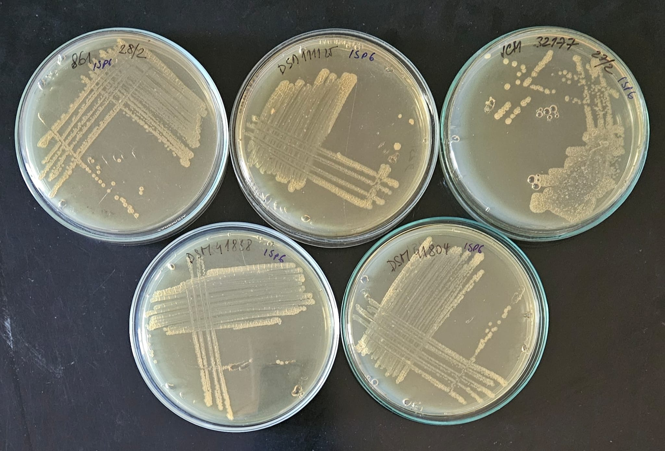
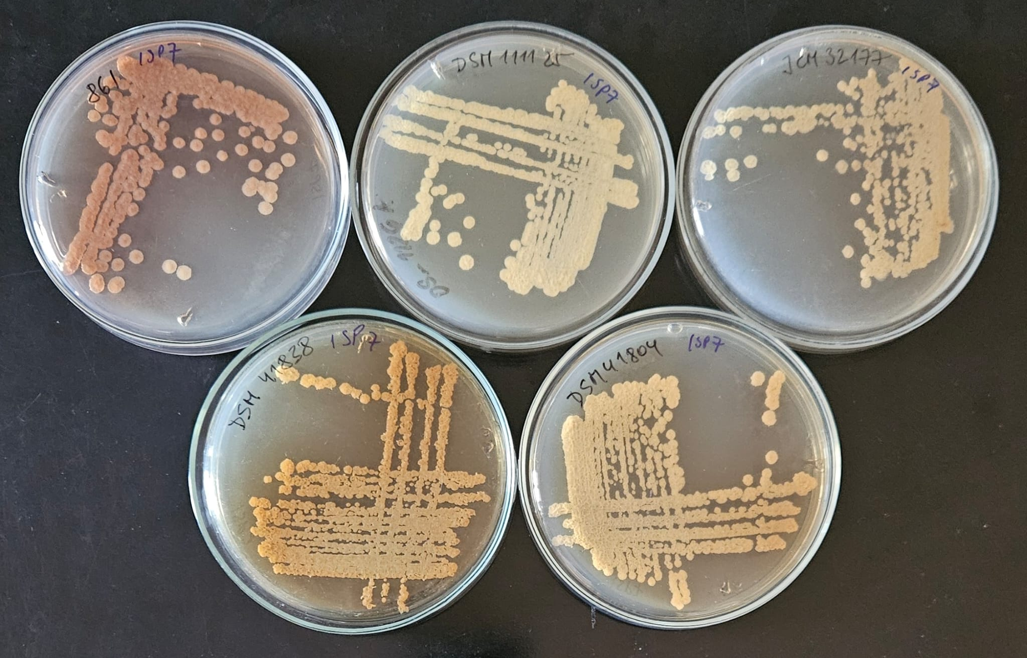
Supplementary Figure 2. Colony morphology development of studied strains on ISP6 (A) and ISP7 (B) media.
A.
BCCO 10_0861^{T}
DSM 111125^{T}
JCM 32177^{T}
B.
BCCO 10_0861^{T}
DSM 111125^{T}
JCM 32177^{T}
DSM 41838^{T}
DSM 41804^{T}
DSM 41838^{T}
DSM 41804^{T}

Slide 3
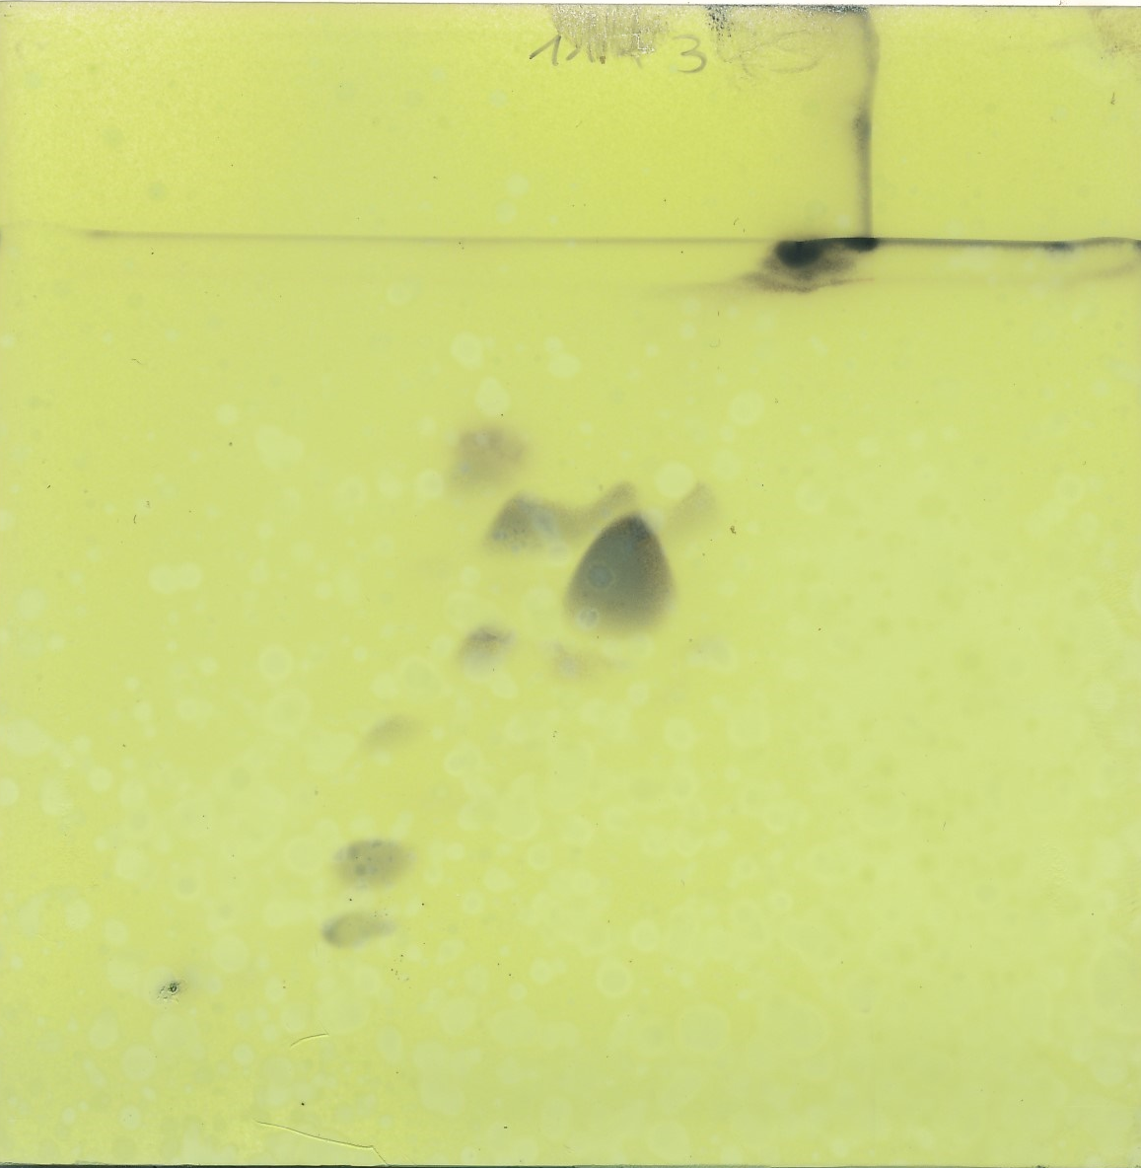
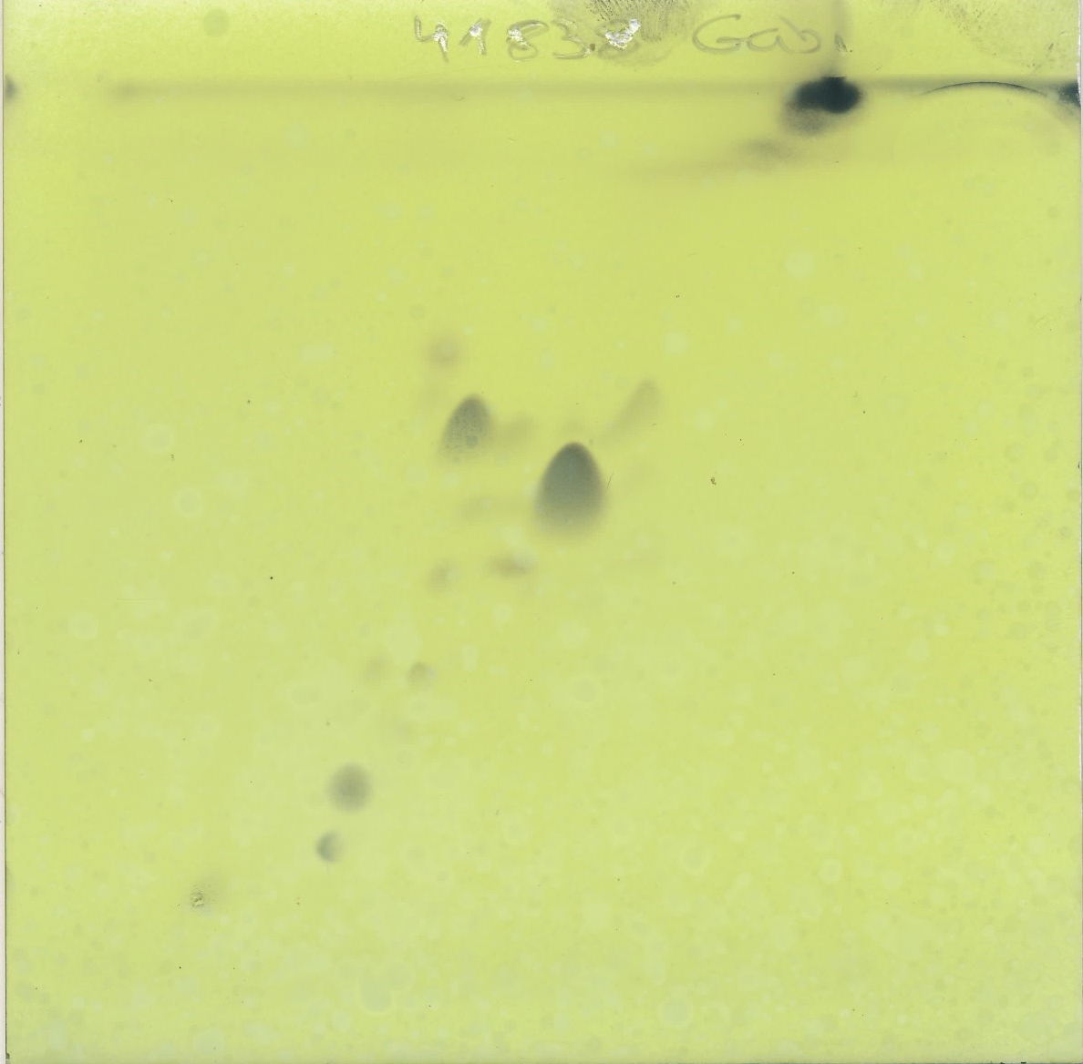
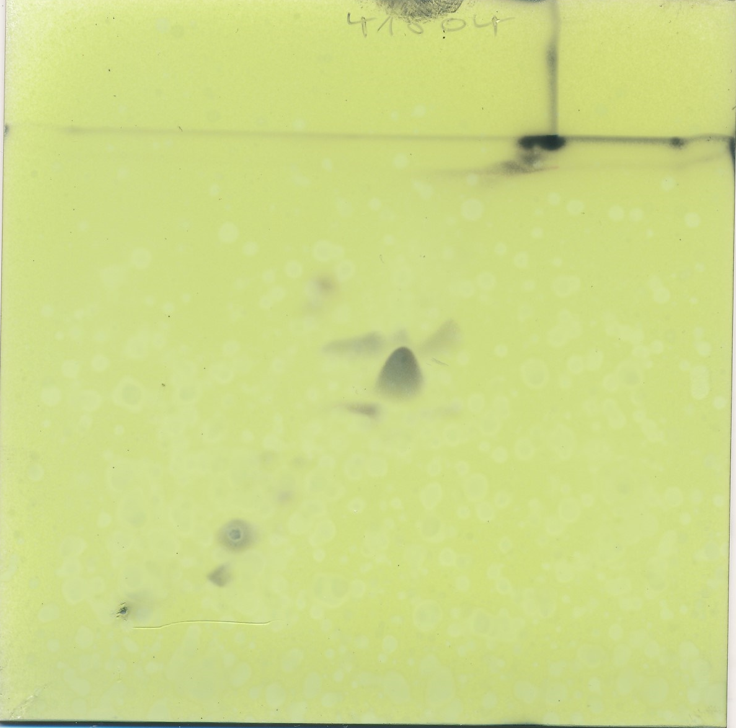
Supplementary Figure 3. Two-dimensional thin layer chromatography of polar lipids of Streptomyces sp. isolate BCCO 10_0861^{T}, S. turgidiscabies DSM 41838^{T} and S. reticuliscabies DSM 41804^{T}. 30 μI of each extract was applied on silica HPTLC plates (Merck.05631.0001) and developed in solvent 1 (chlorophorm-methanol-water; 65:254) in the first direction followed by solvent 2 (chlorophormaceticacid-methanol-water; 80:15:12:4) in the second direction. The results were visualised by phosphomolybdic acid spray (Sigma 319279). Abbreviation: DPG-diphosphatidylglycerol, PE-phosphatidylethanolamine, Pl-phosphatidylinositol, GLP-glycophosphospholipid, APL-aminophospholipid, AL-aminolipid , PL-phospholipid, L-lipid.
Streptomyces sp. BCCO 10_0861^{T}
(=DSM 117345^{T})
S. turgidiscabies DSM 41838^{T}
S. reticuliscabies DSM 41804^{T}
PLs
DPG
PL
PL
PLs
DPG
DPG
PL
PE
PE
APL
AL
PE
APL
PI
PI
PI
GPL
GPL
GPL
1
1
2
2
2
2

