Slide 1
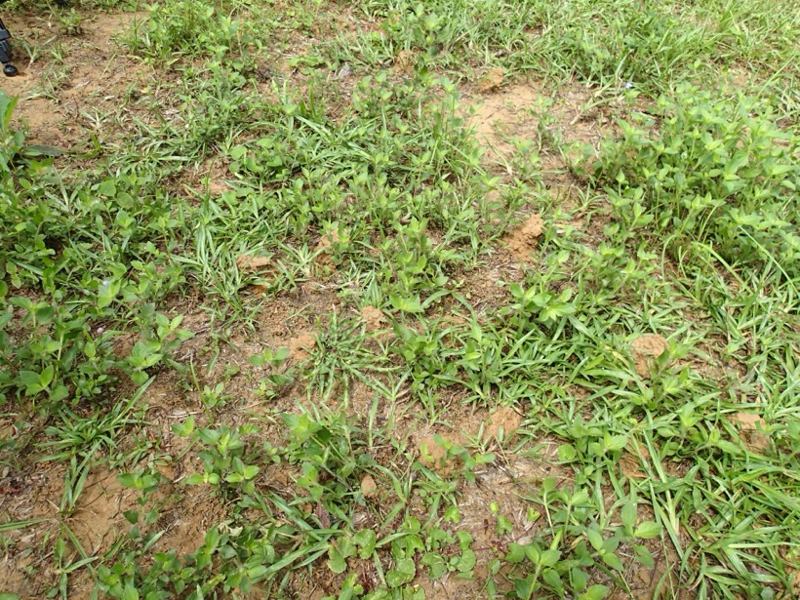
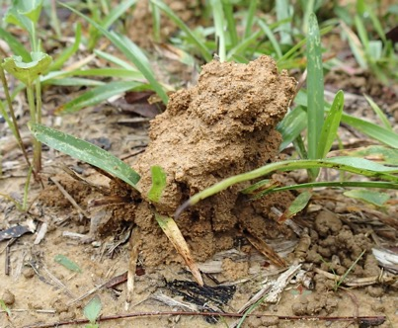
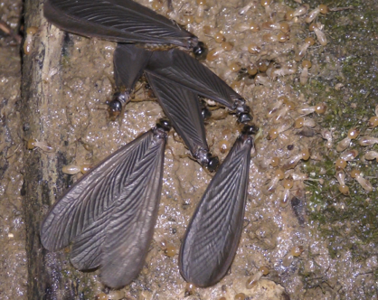
Supporting material
a
Worker Emergence Following Fungal Fruiting May Facilitate Symbiont Acquisition in a Fungus-Growing Termite
Journal of Insect Behavior
Masaru Hojo
University of the Ryukyus, Tropical Biosphere Research Center, Senbaru 1, Nishihara, Okinawa, Japan
Corresponding author: Masaru Hojo
e-mail: masaruhojo0911@gmail.com
ORCID: 0000-0003-0423-1175
b
c
Fig. S1 Small soil mounds used by Odontotermes formosanus for alate dispersal. (a) Field view showing multiple small soil mounds (arrowheads). (b) Close-up view of a representative mound. (c) Alates and workers emerging from beneath a soil mound via an exit during a swarming event

