Slide 1
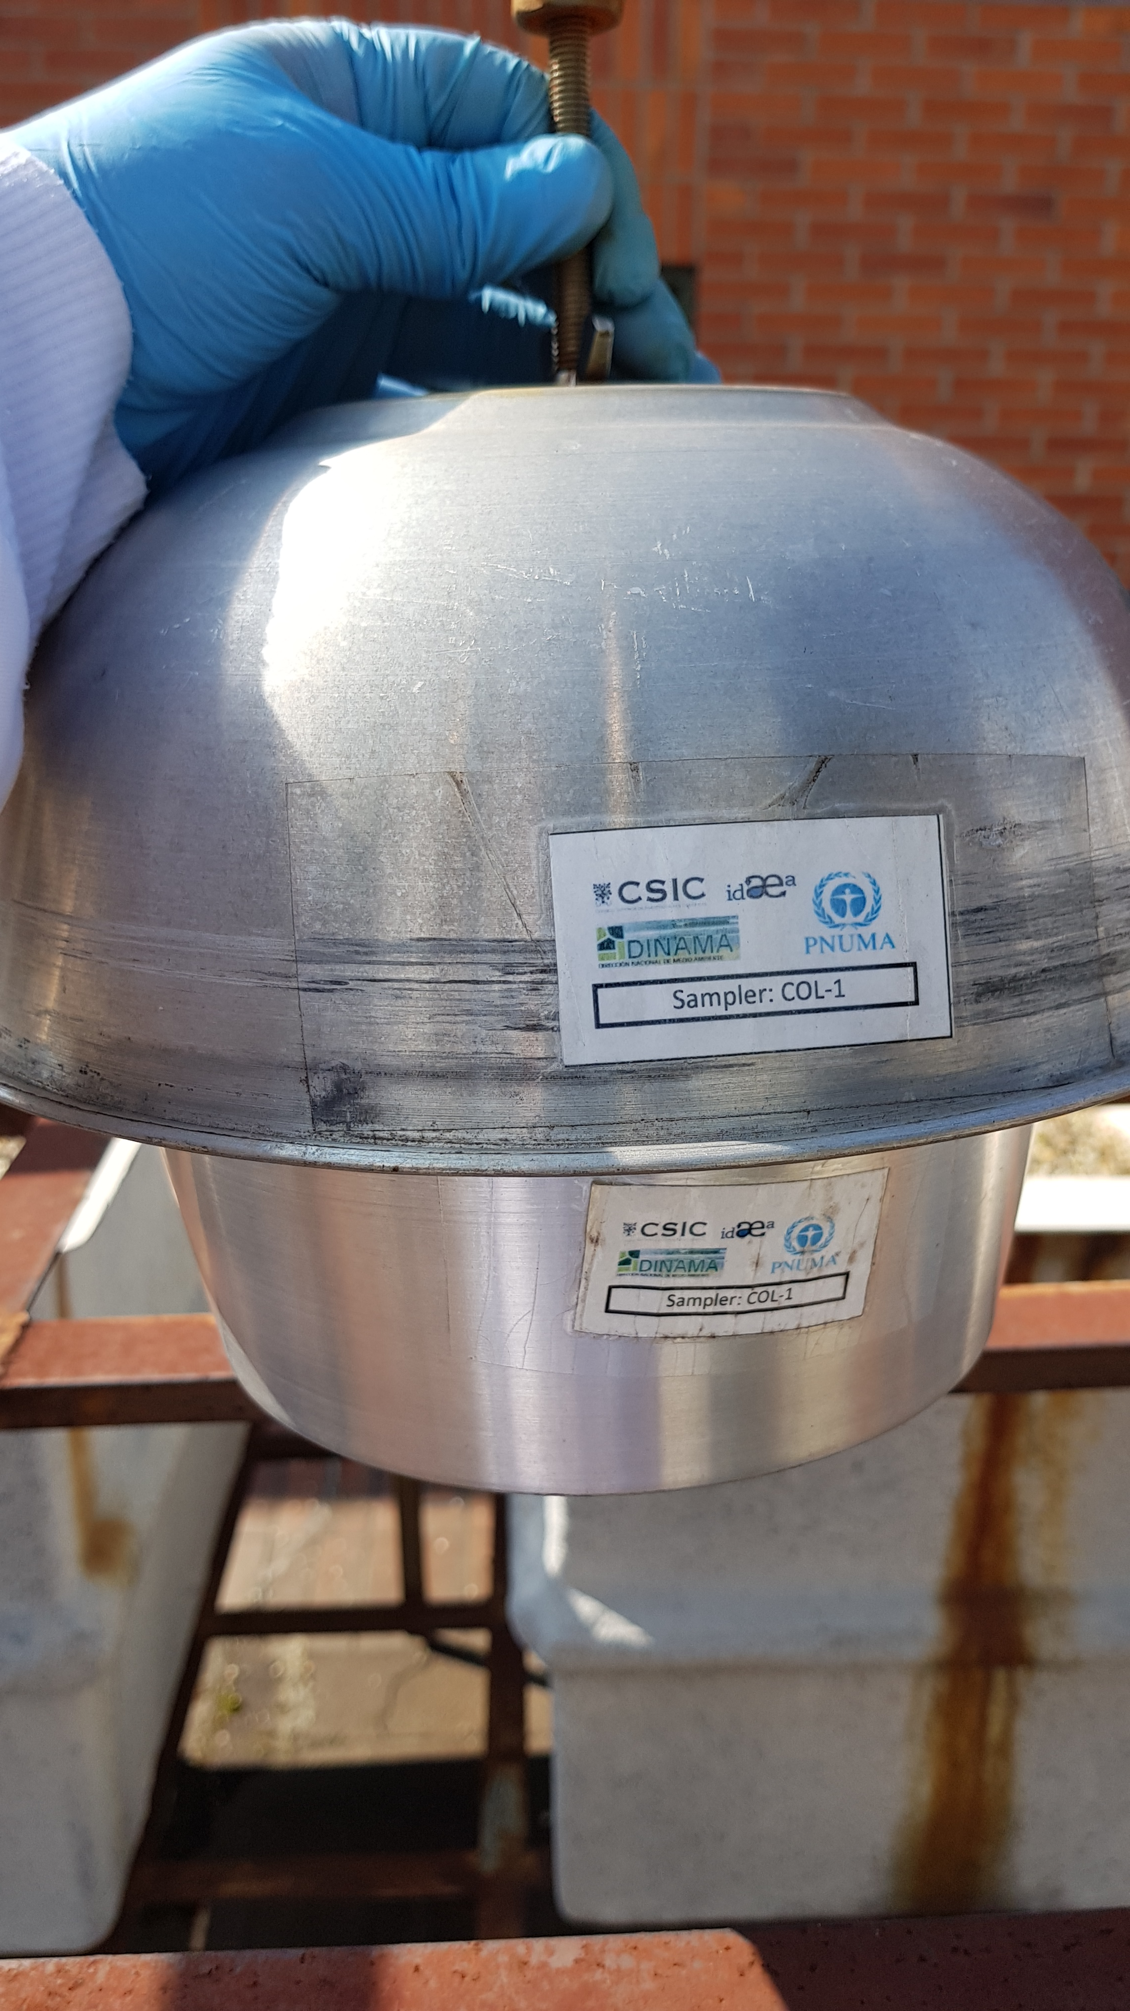


Chlorinated pollutants
Brominated pollutants
PUF-PAS

