Slide 1
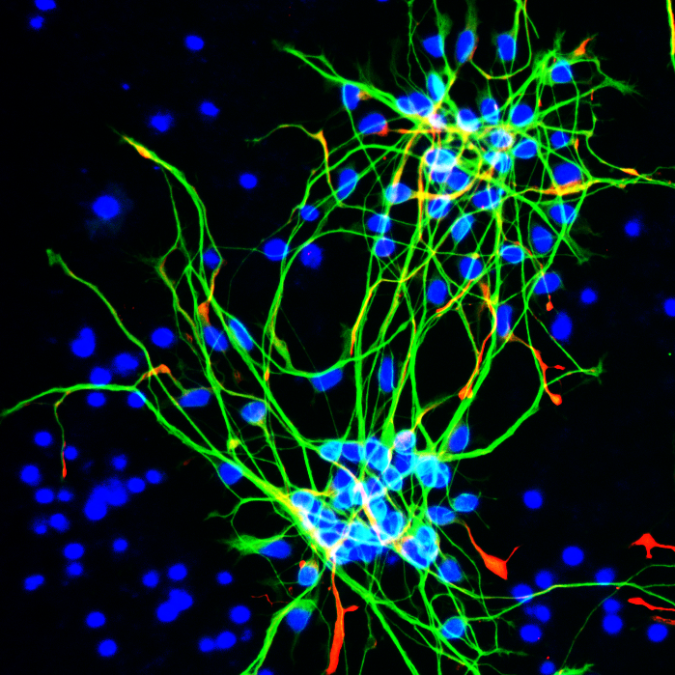
Supplementary Figure 1
Control
PSEN1
Tuj1
Nestin
DAPI
PSEN2

Slide 2
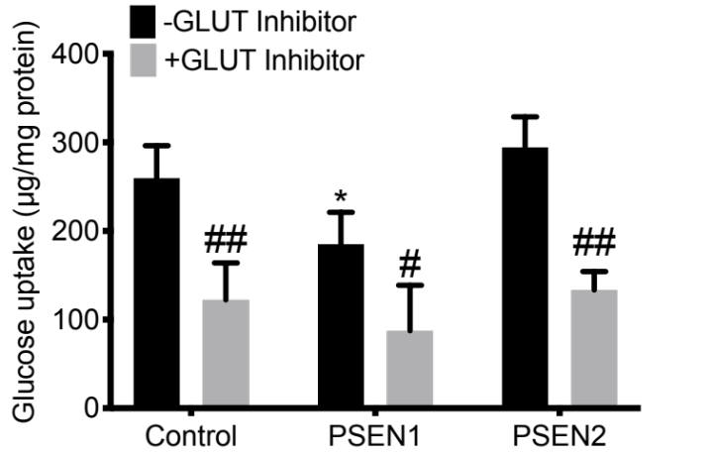
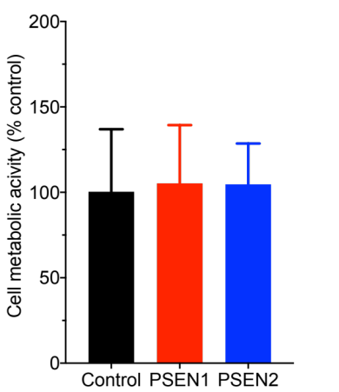
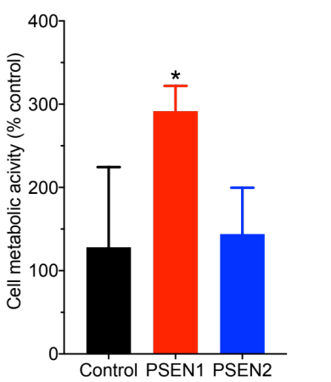
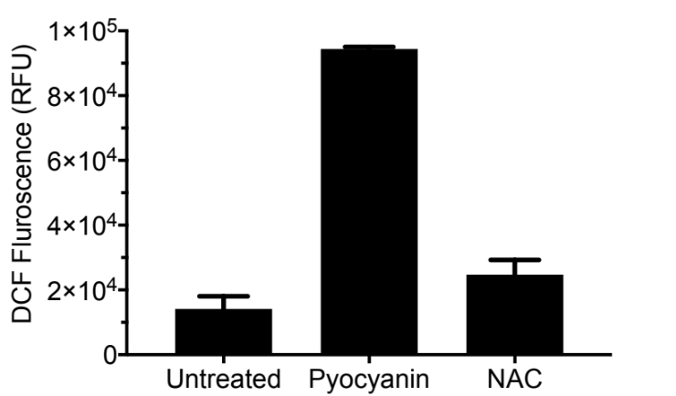
Supplementary Figure 2
A
B
Astrocytes
Neurons
C

Slide 3
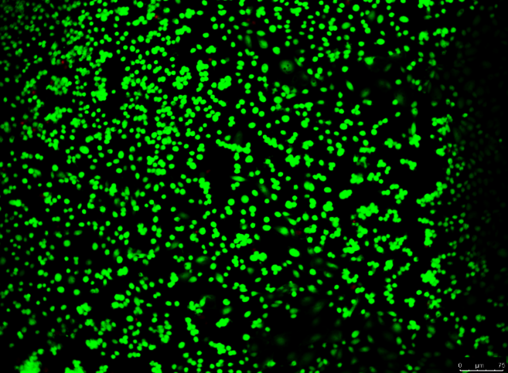
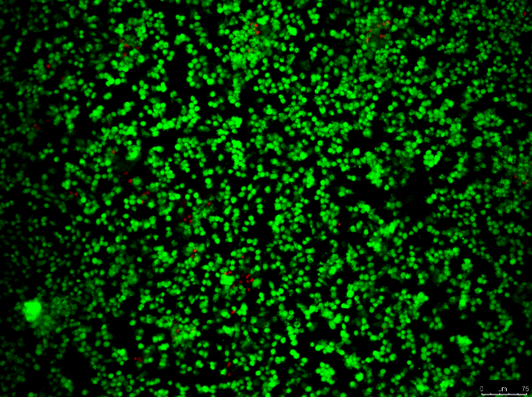
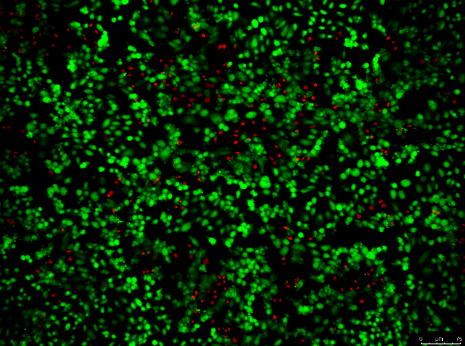
Supplementary Figure 3
A
Control
PSEN1
PSEN2
Calcein-AM
Ethidium homodimer-1

