Slide 1
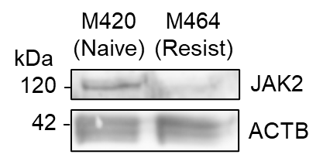
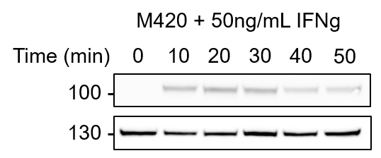
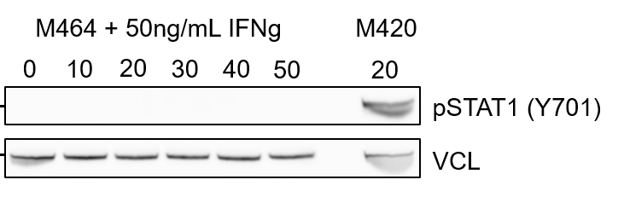
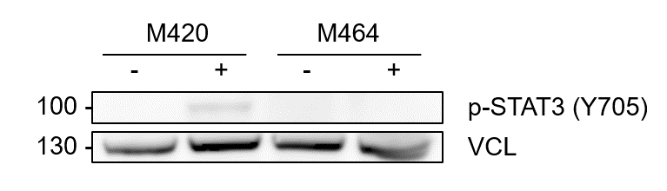
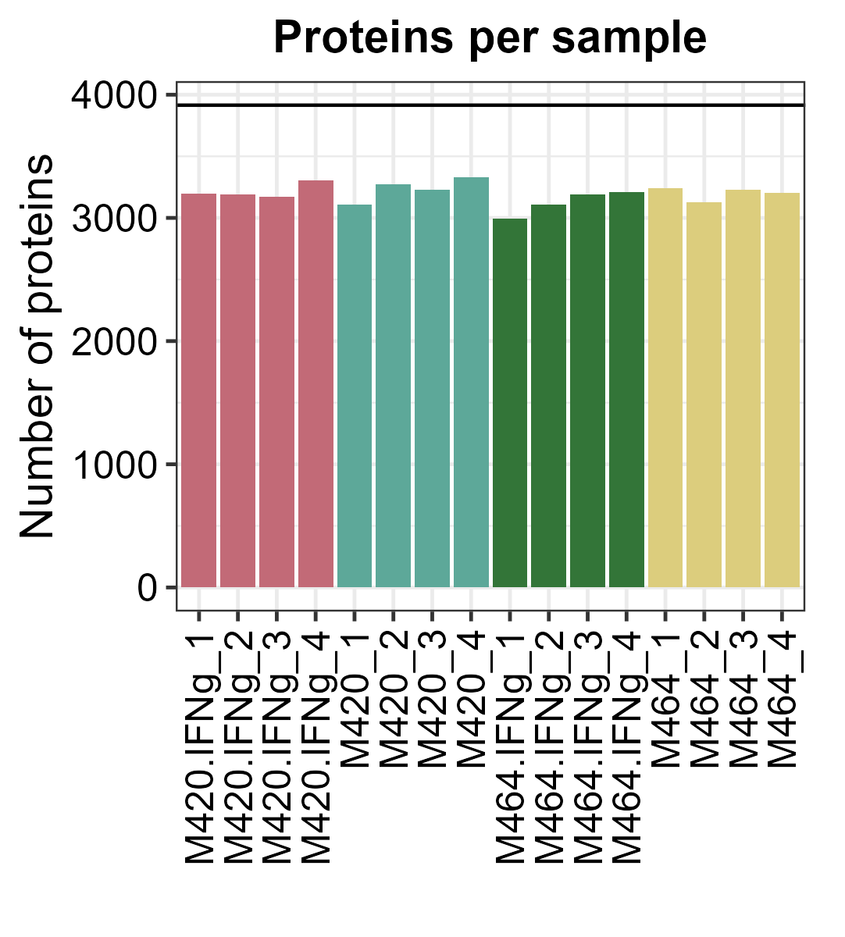
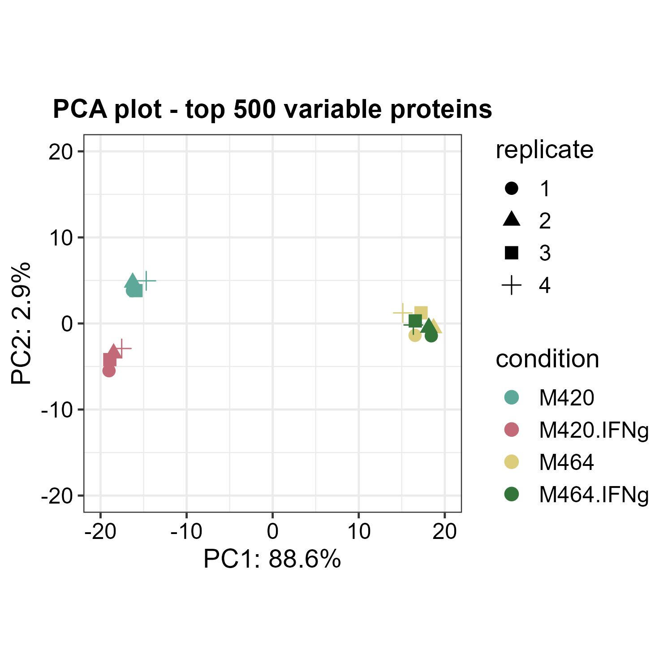
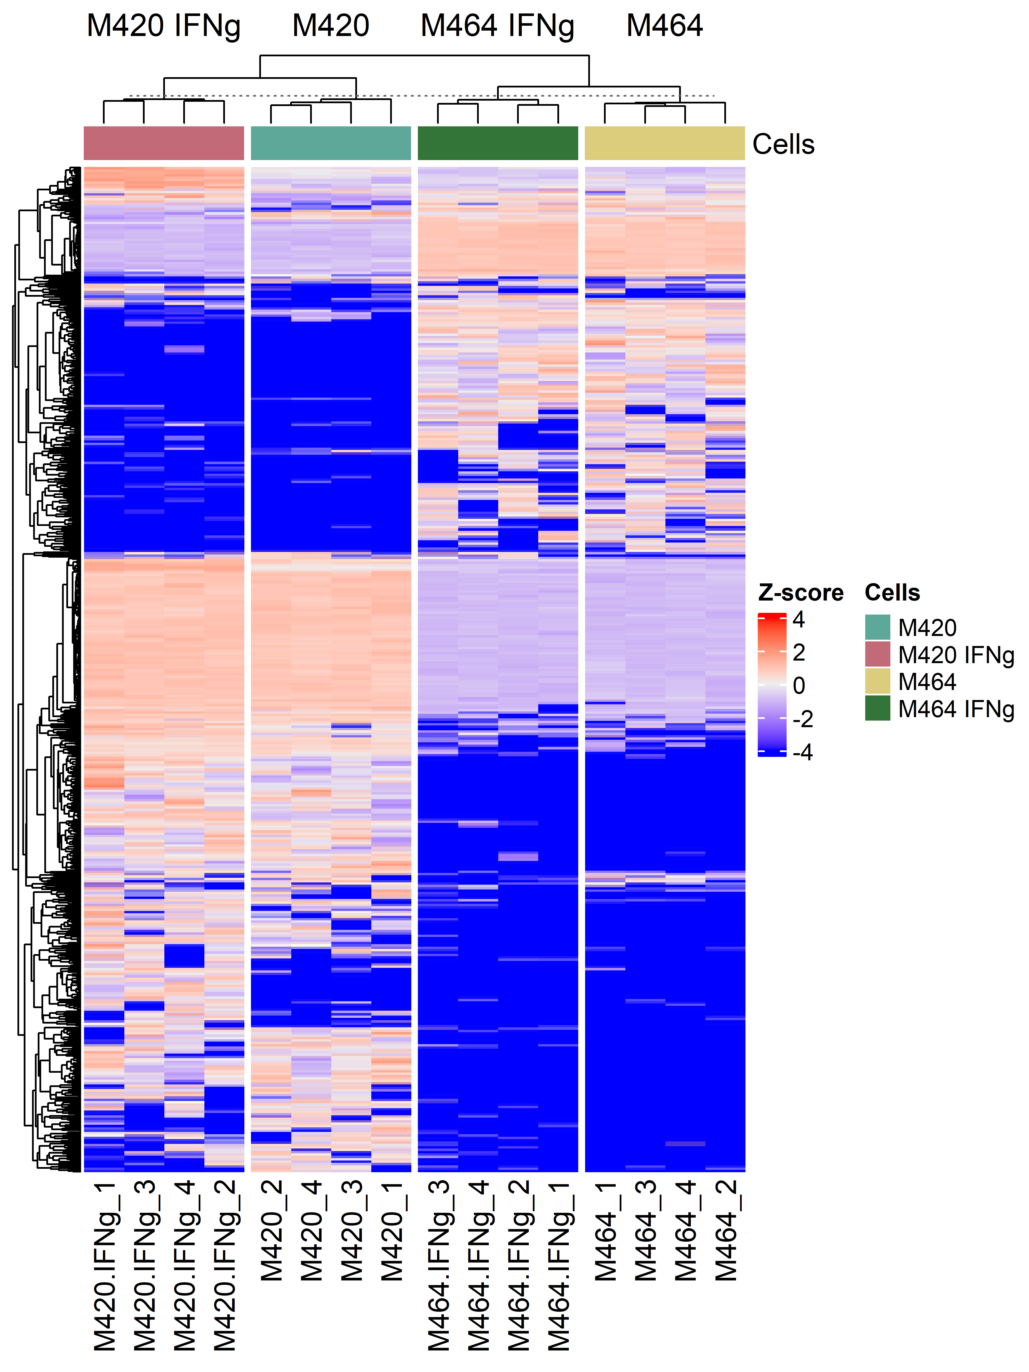
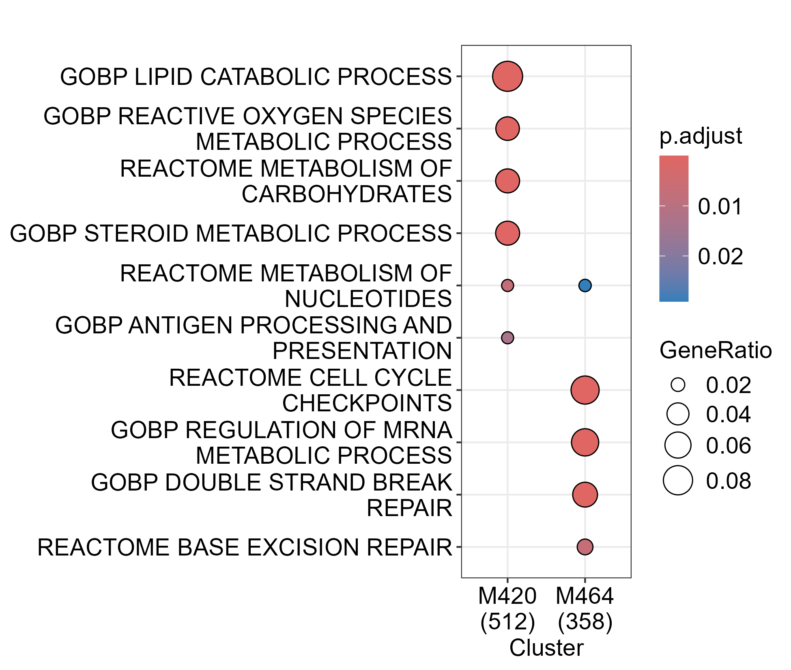
a
b
c
d
IFNg
e
f
g
h
Baseline pathway enrichment
z-score
4
2
0
-2
Not detected
Figure S1
Notes:
Figure S1. Characterization of M420-M464.

Slide 2
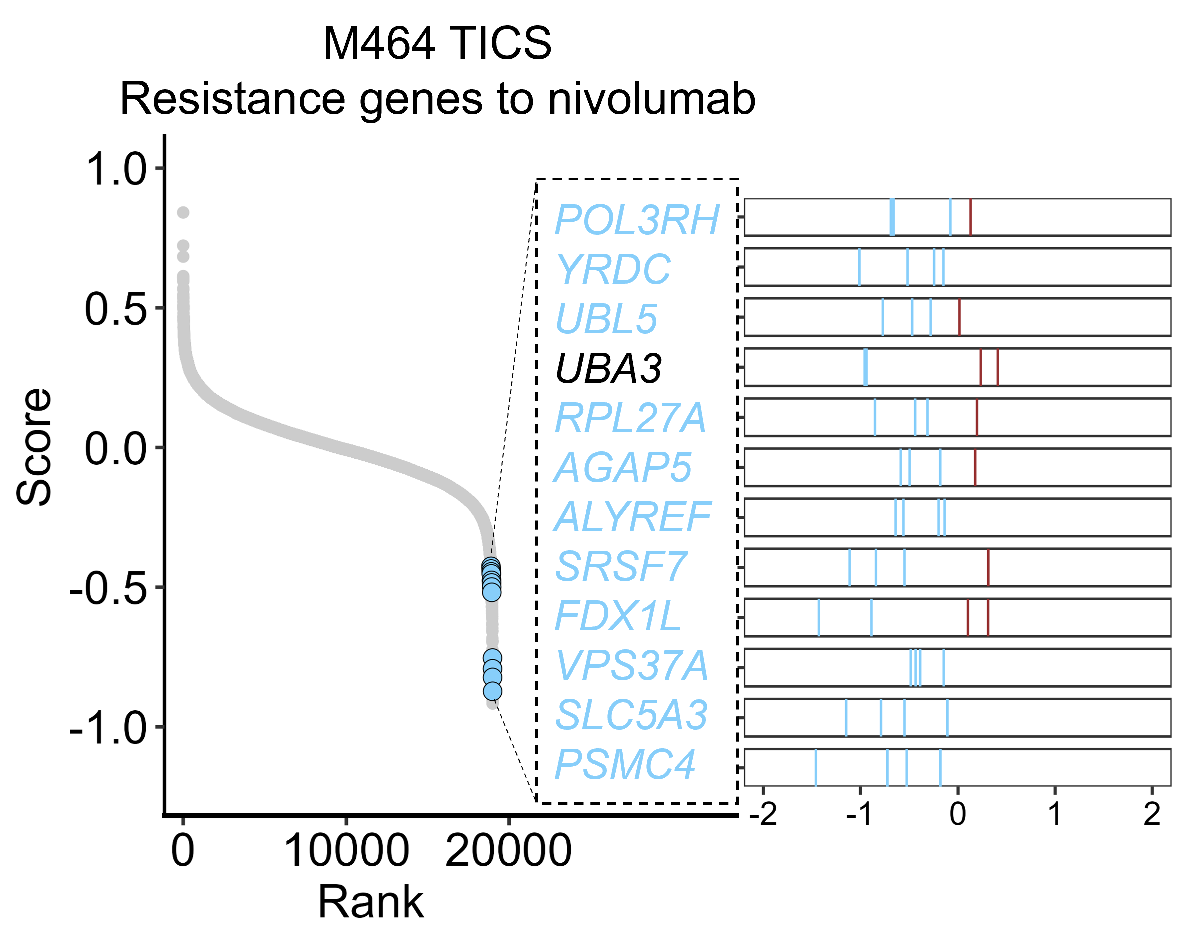
a
Donor 1, E:T 5.3:1
b
Donor 2, E:T 5.2:1
c
Donor 1
Figure S2
Notes:
Figure S1. Characterization of M420-M464.

Slide 3
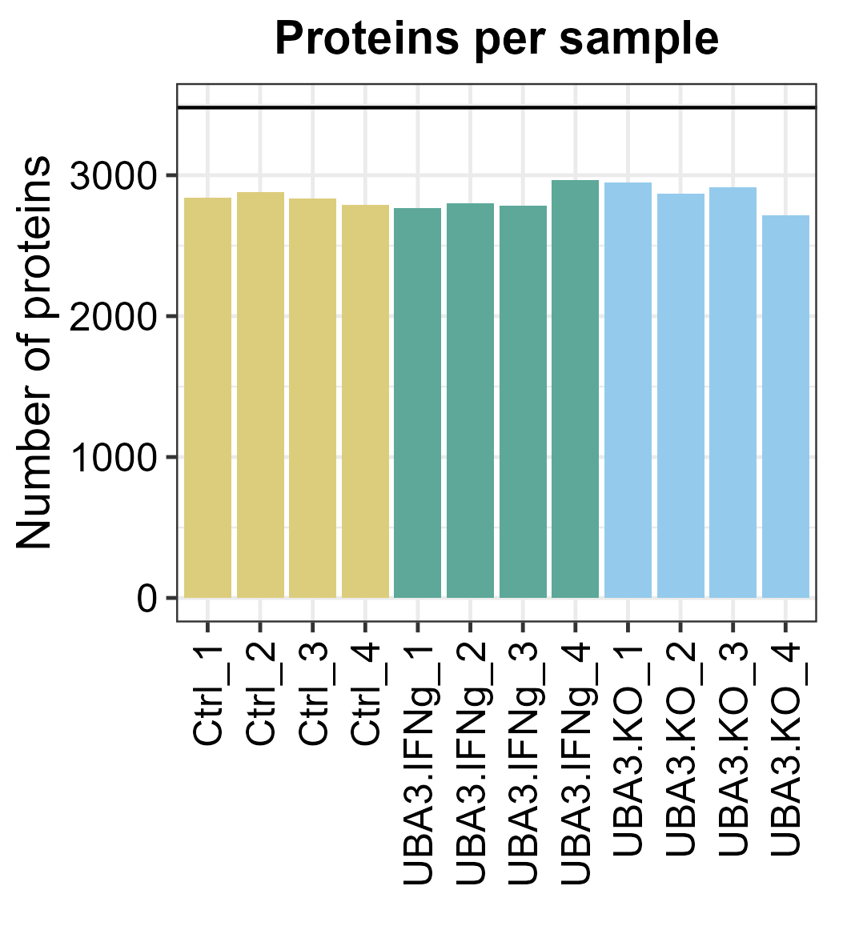
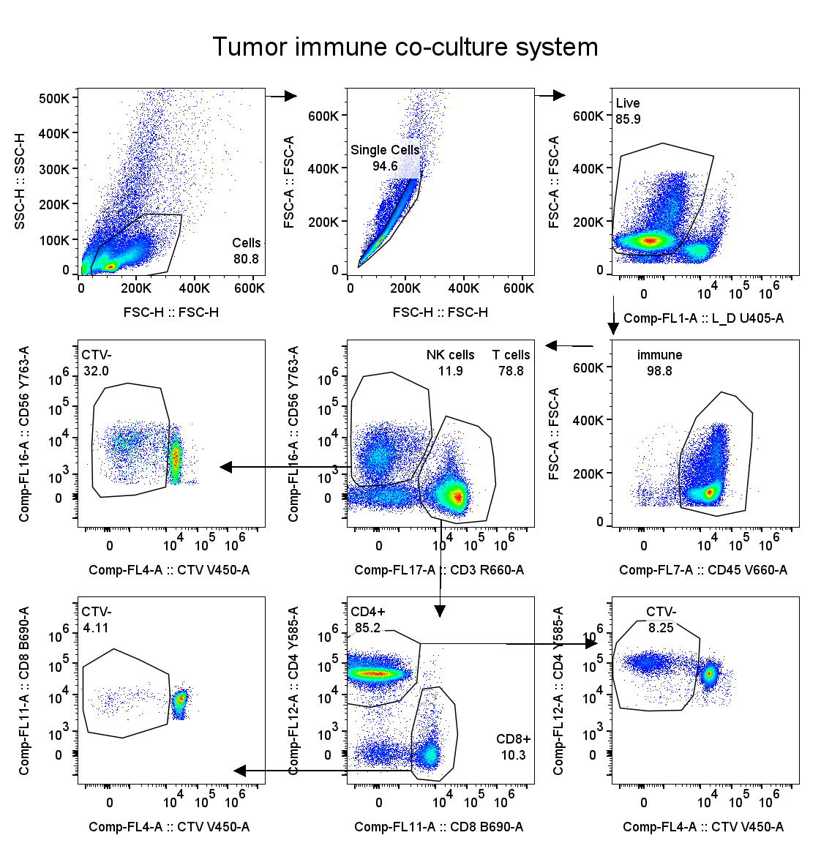
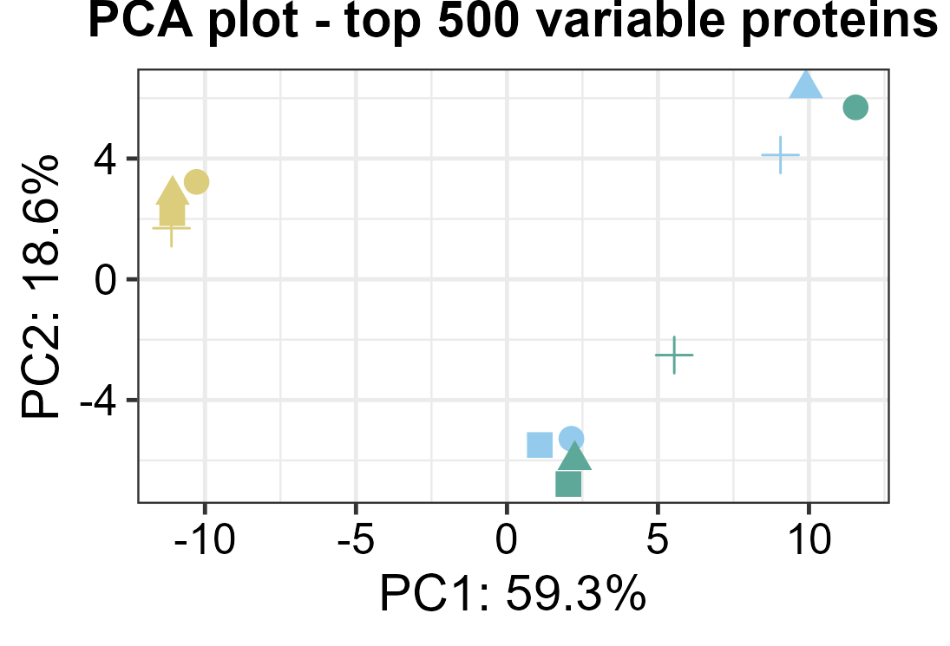
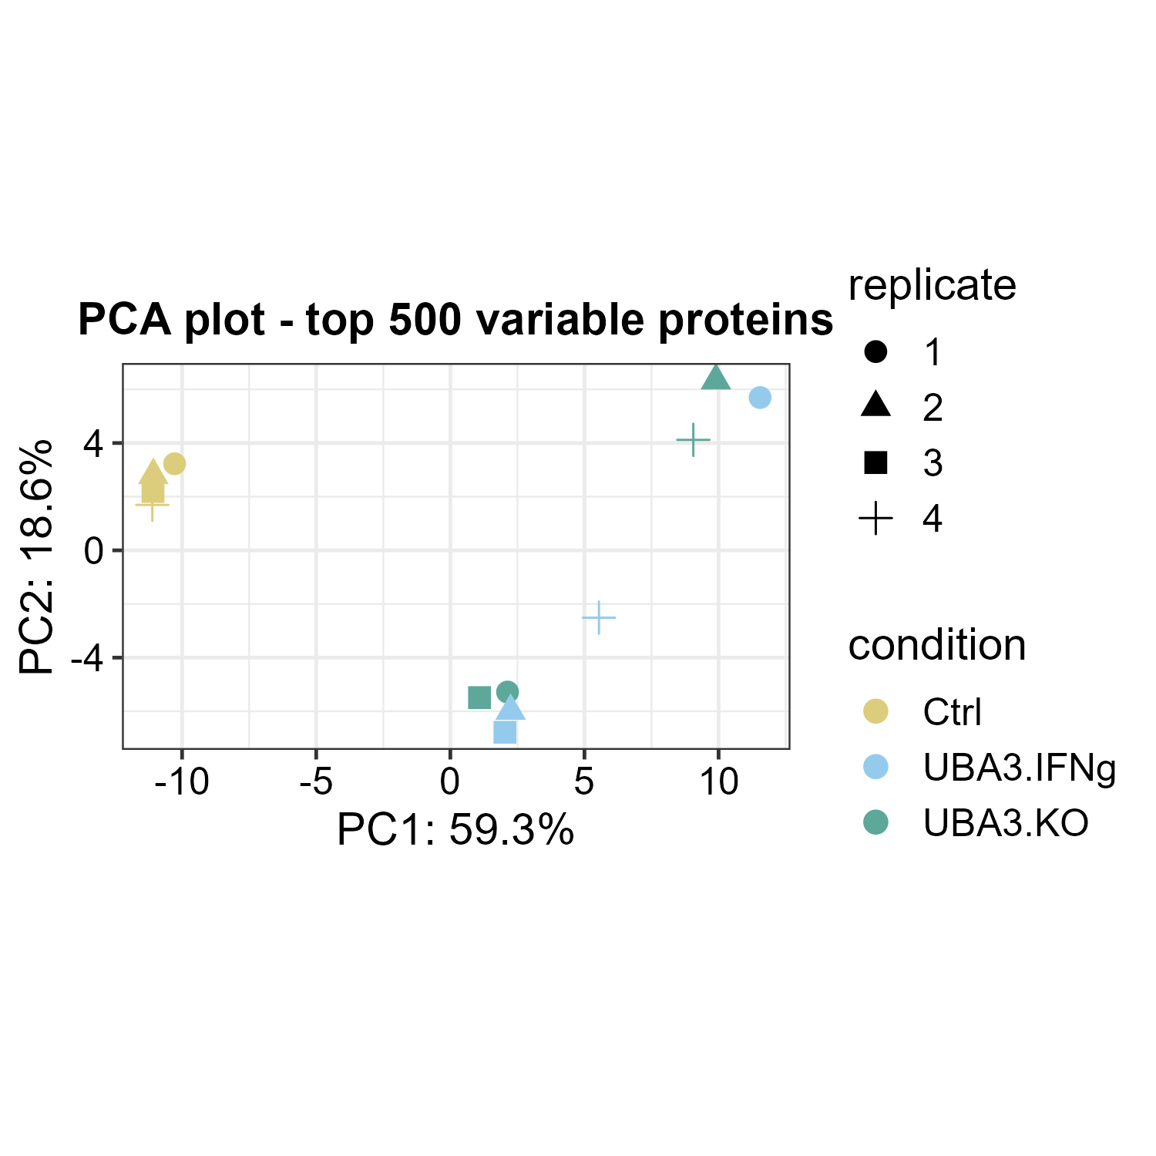
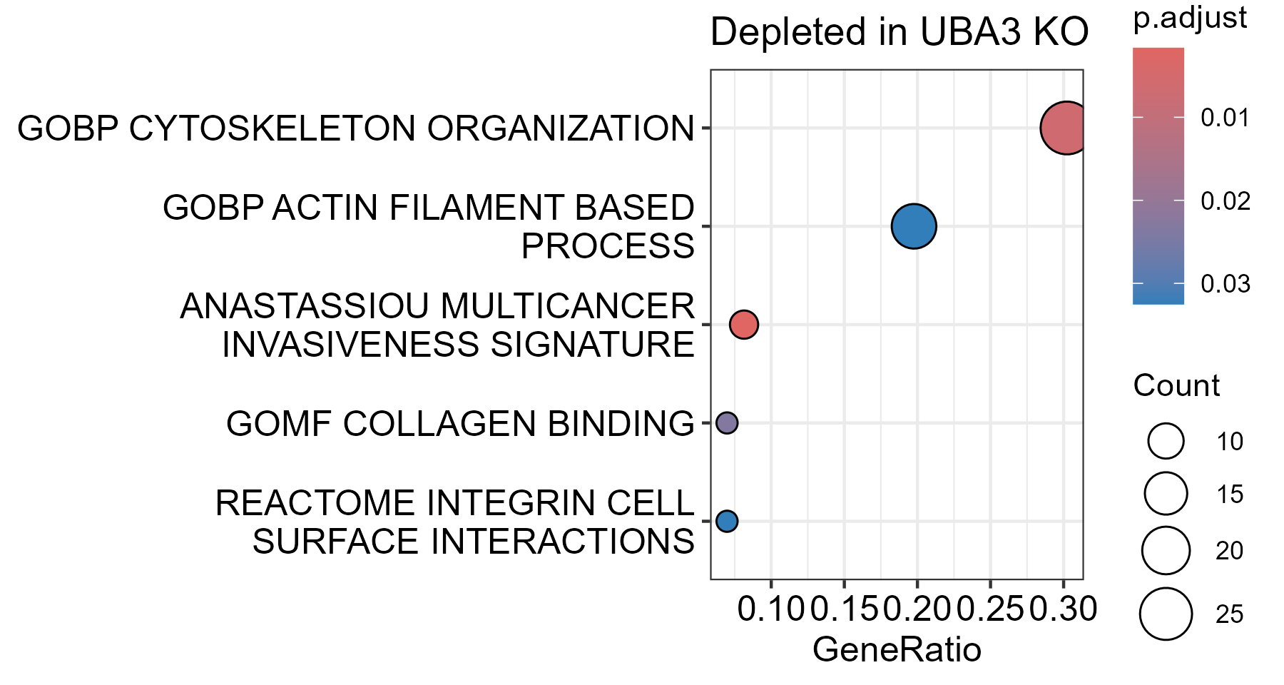
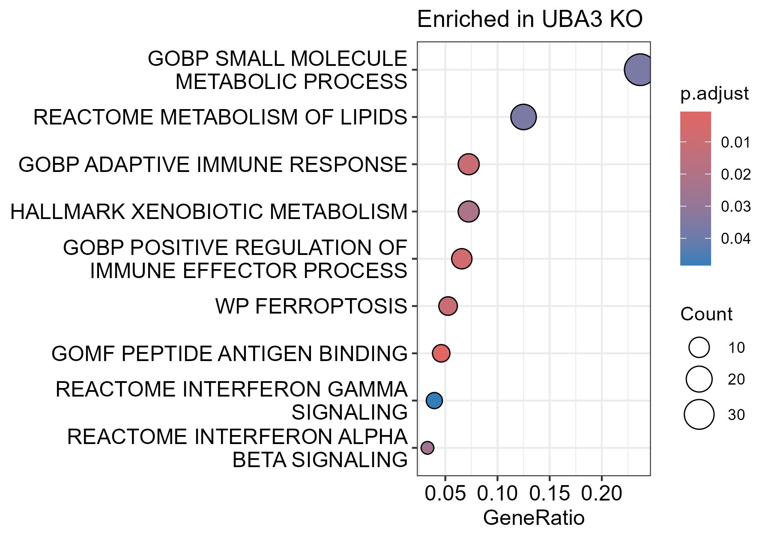
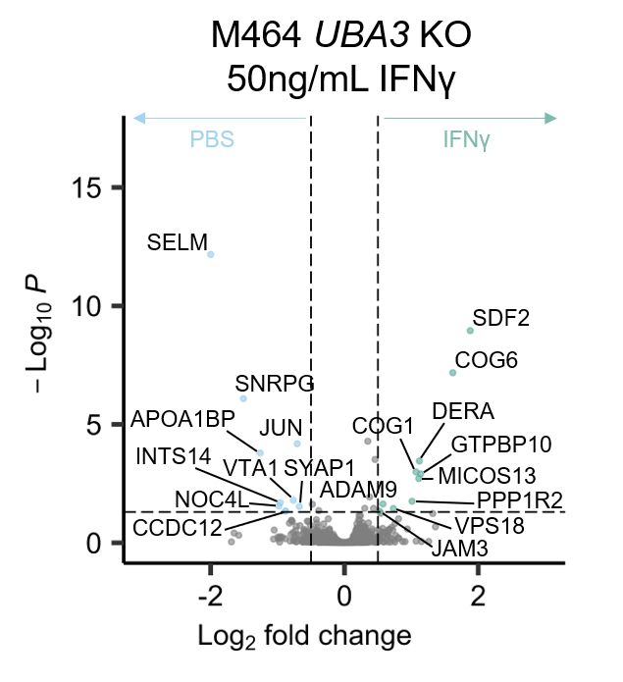
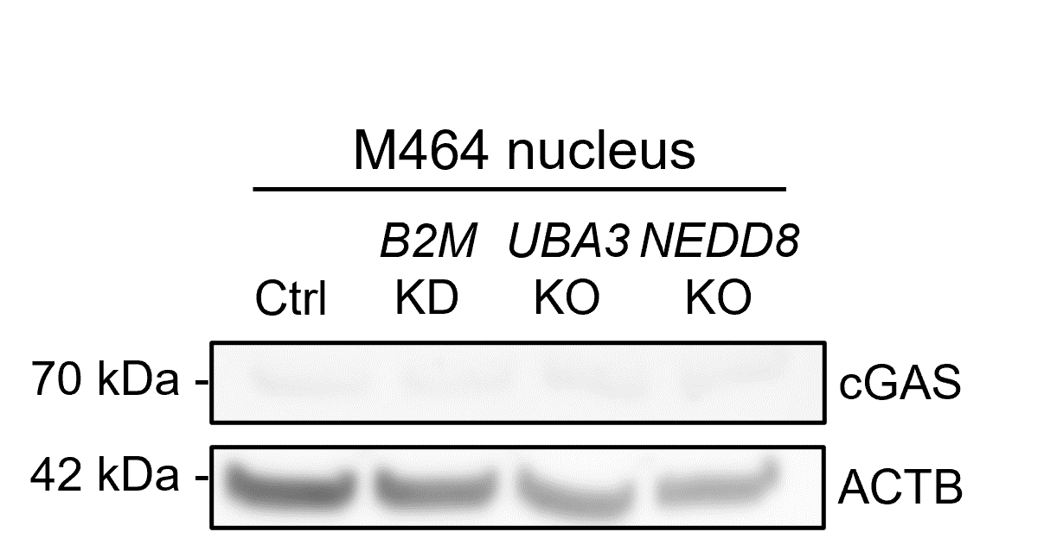
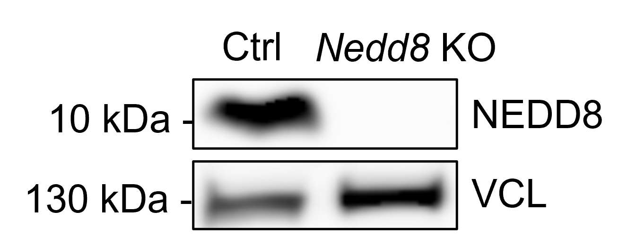
a
b
d
c
e
f
g
h
i
j
k
Ctrl
NEDD8
KO
Figure S3
Notes:
Figure S3. Characterization of M464 Ctrl & UBA3 KO; +pevo.

Slide 4
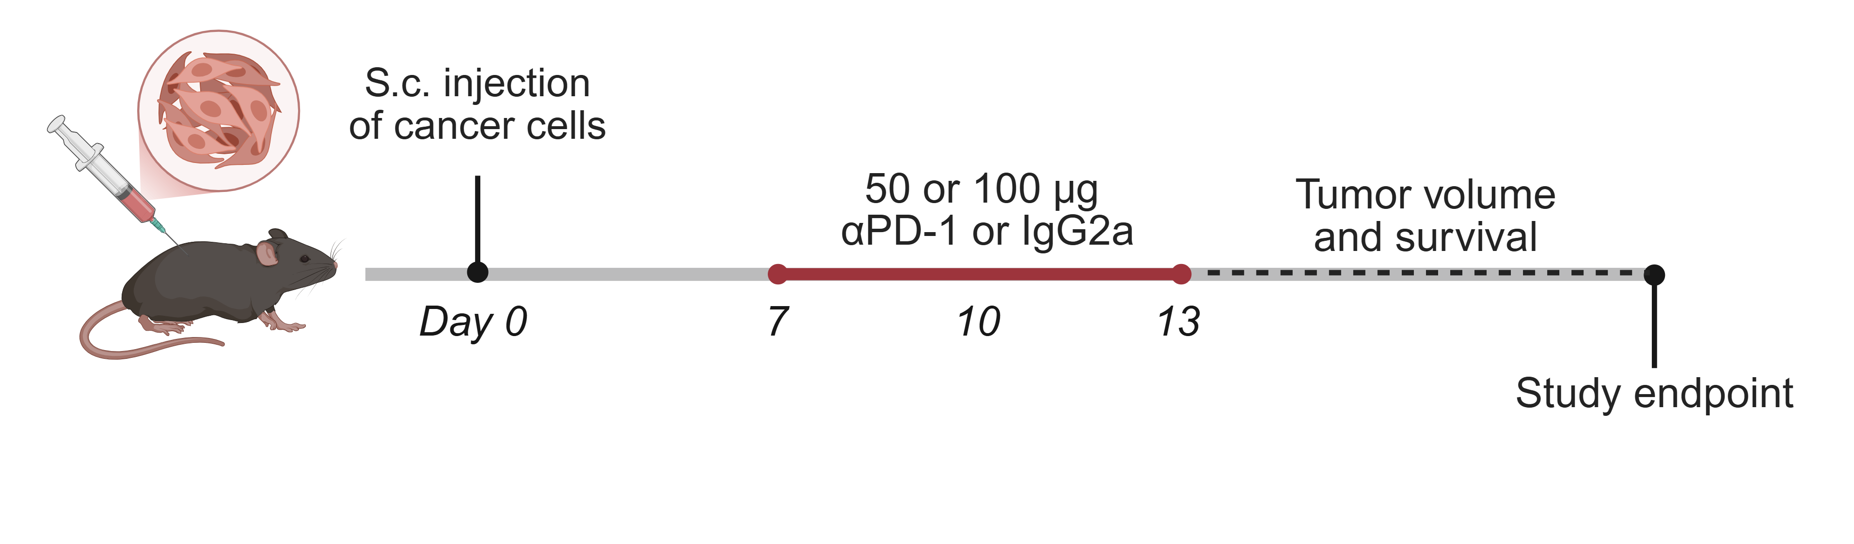
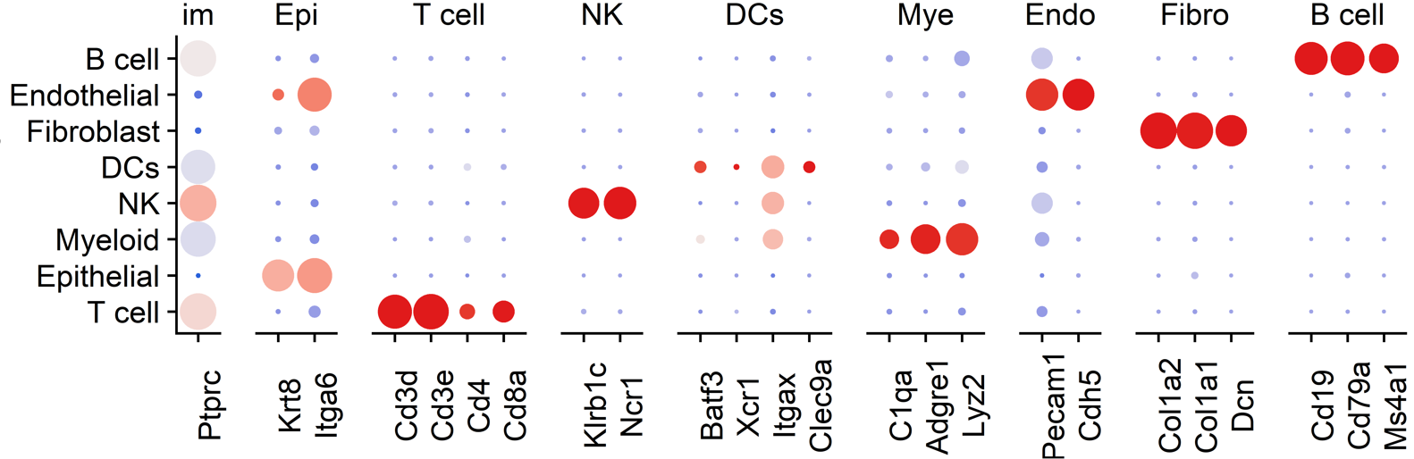
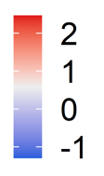
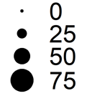
a
b
c
f
d
e
g
h
i
Ave. exp
% exp
Figure S4

Slide 5
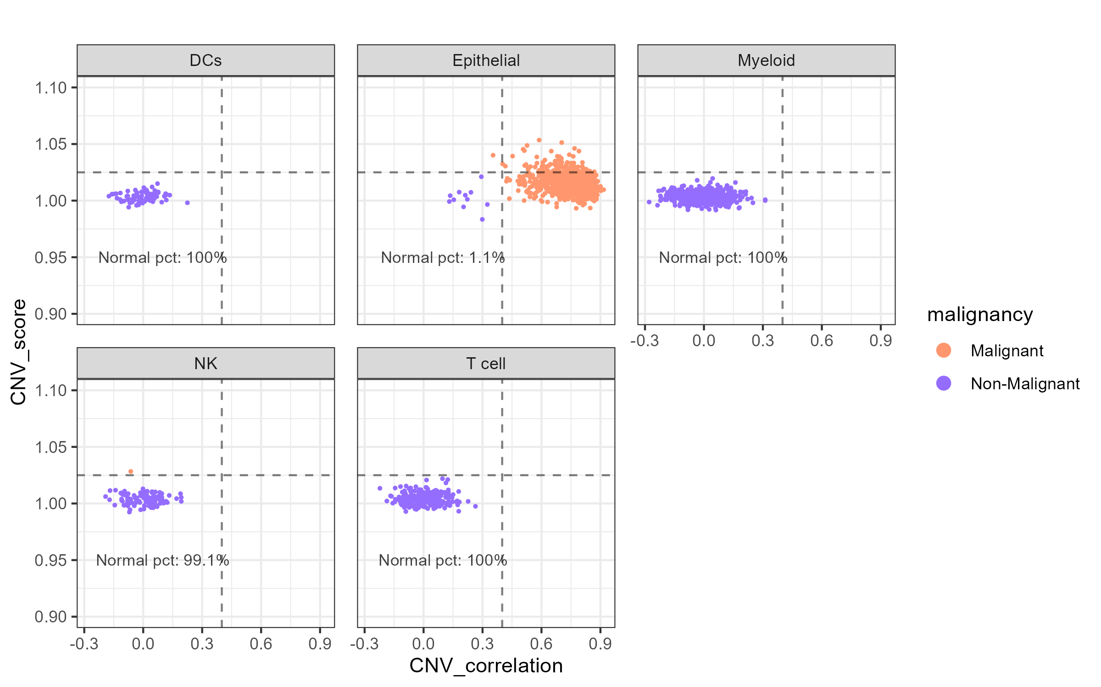
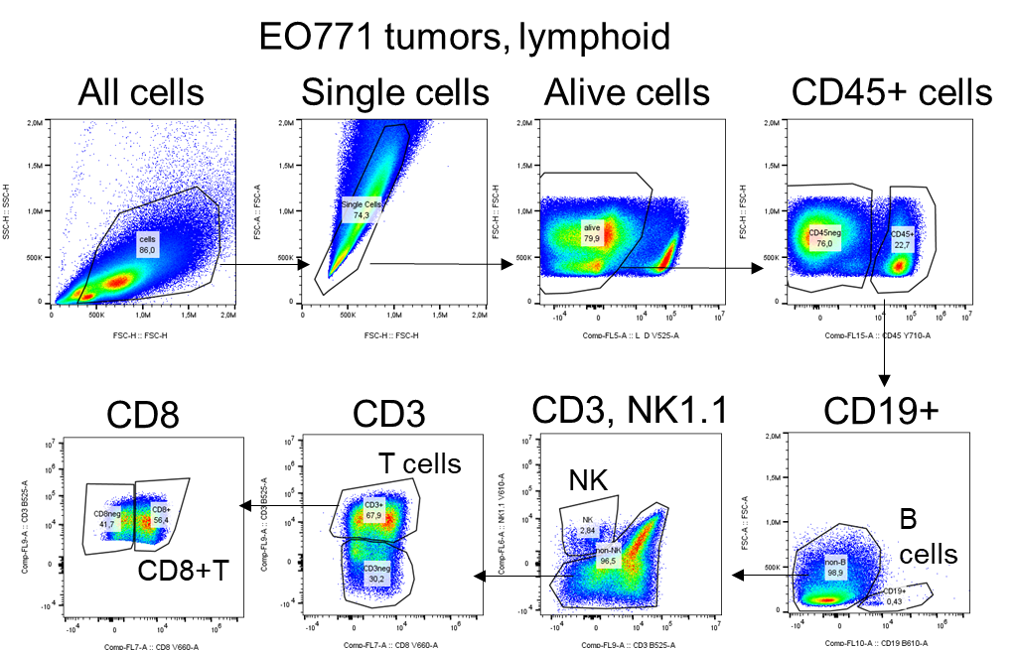
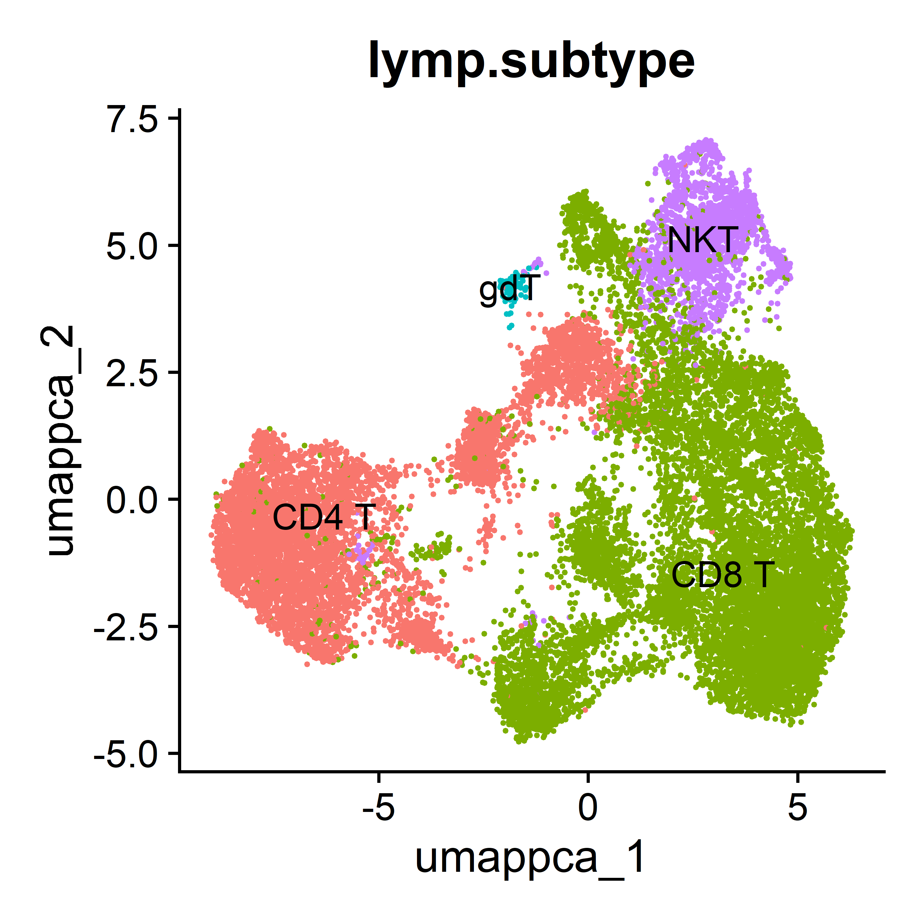
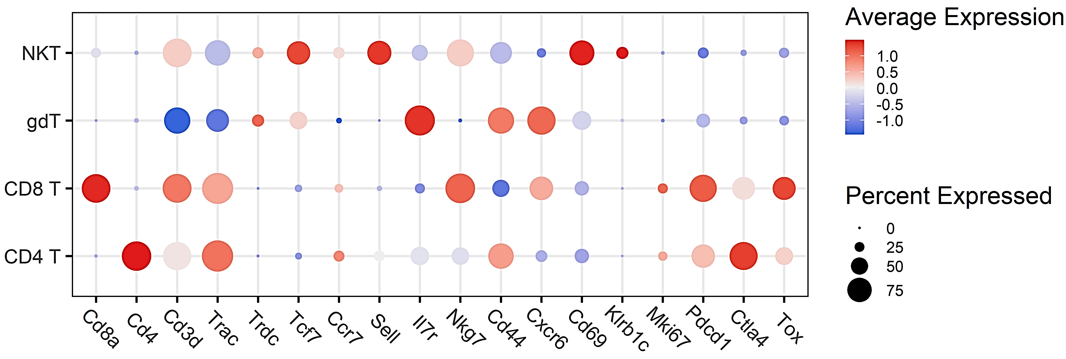
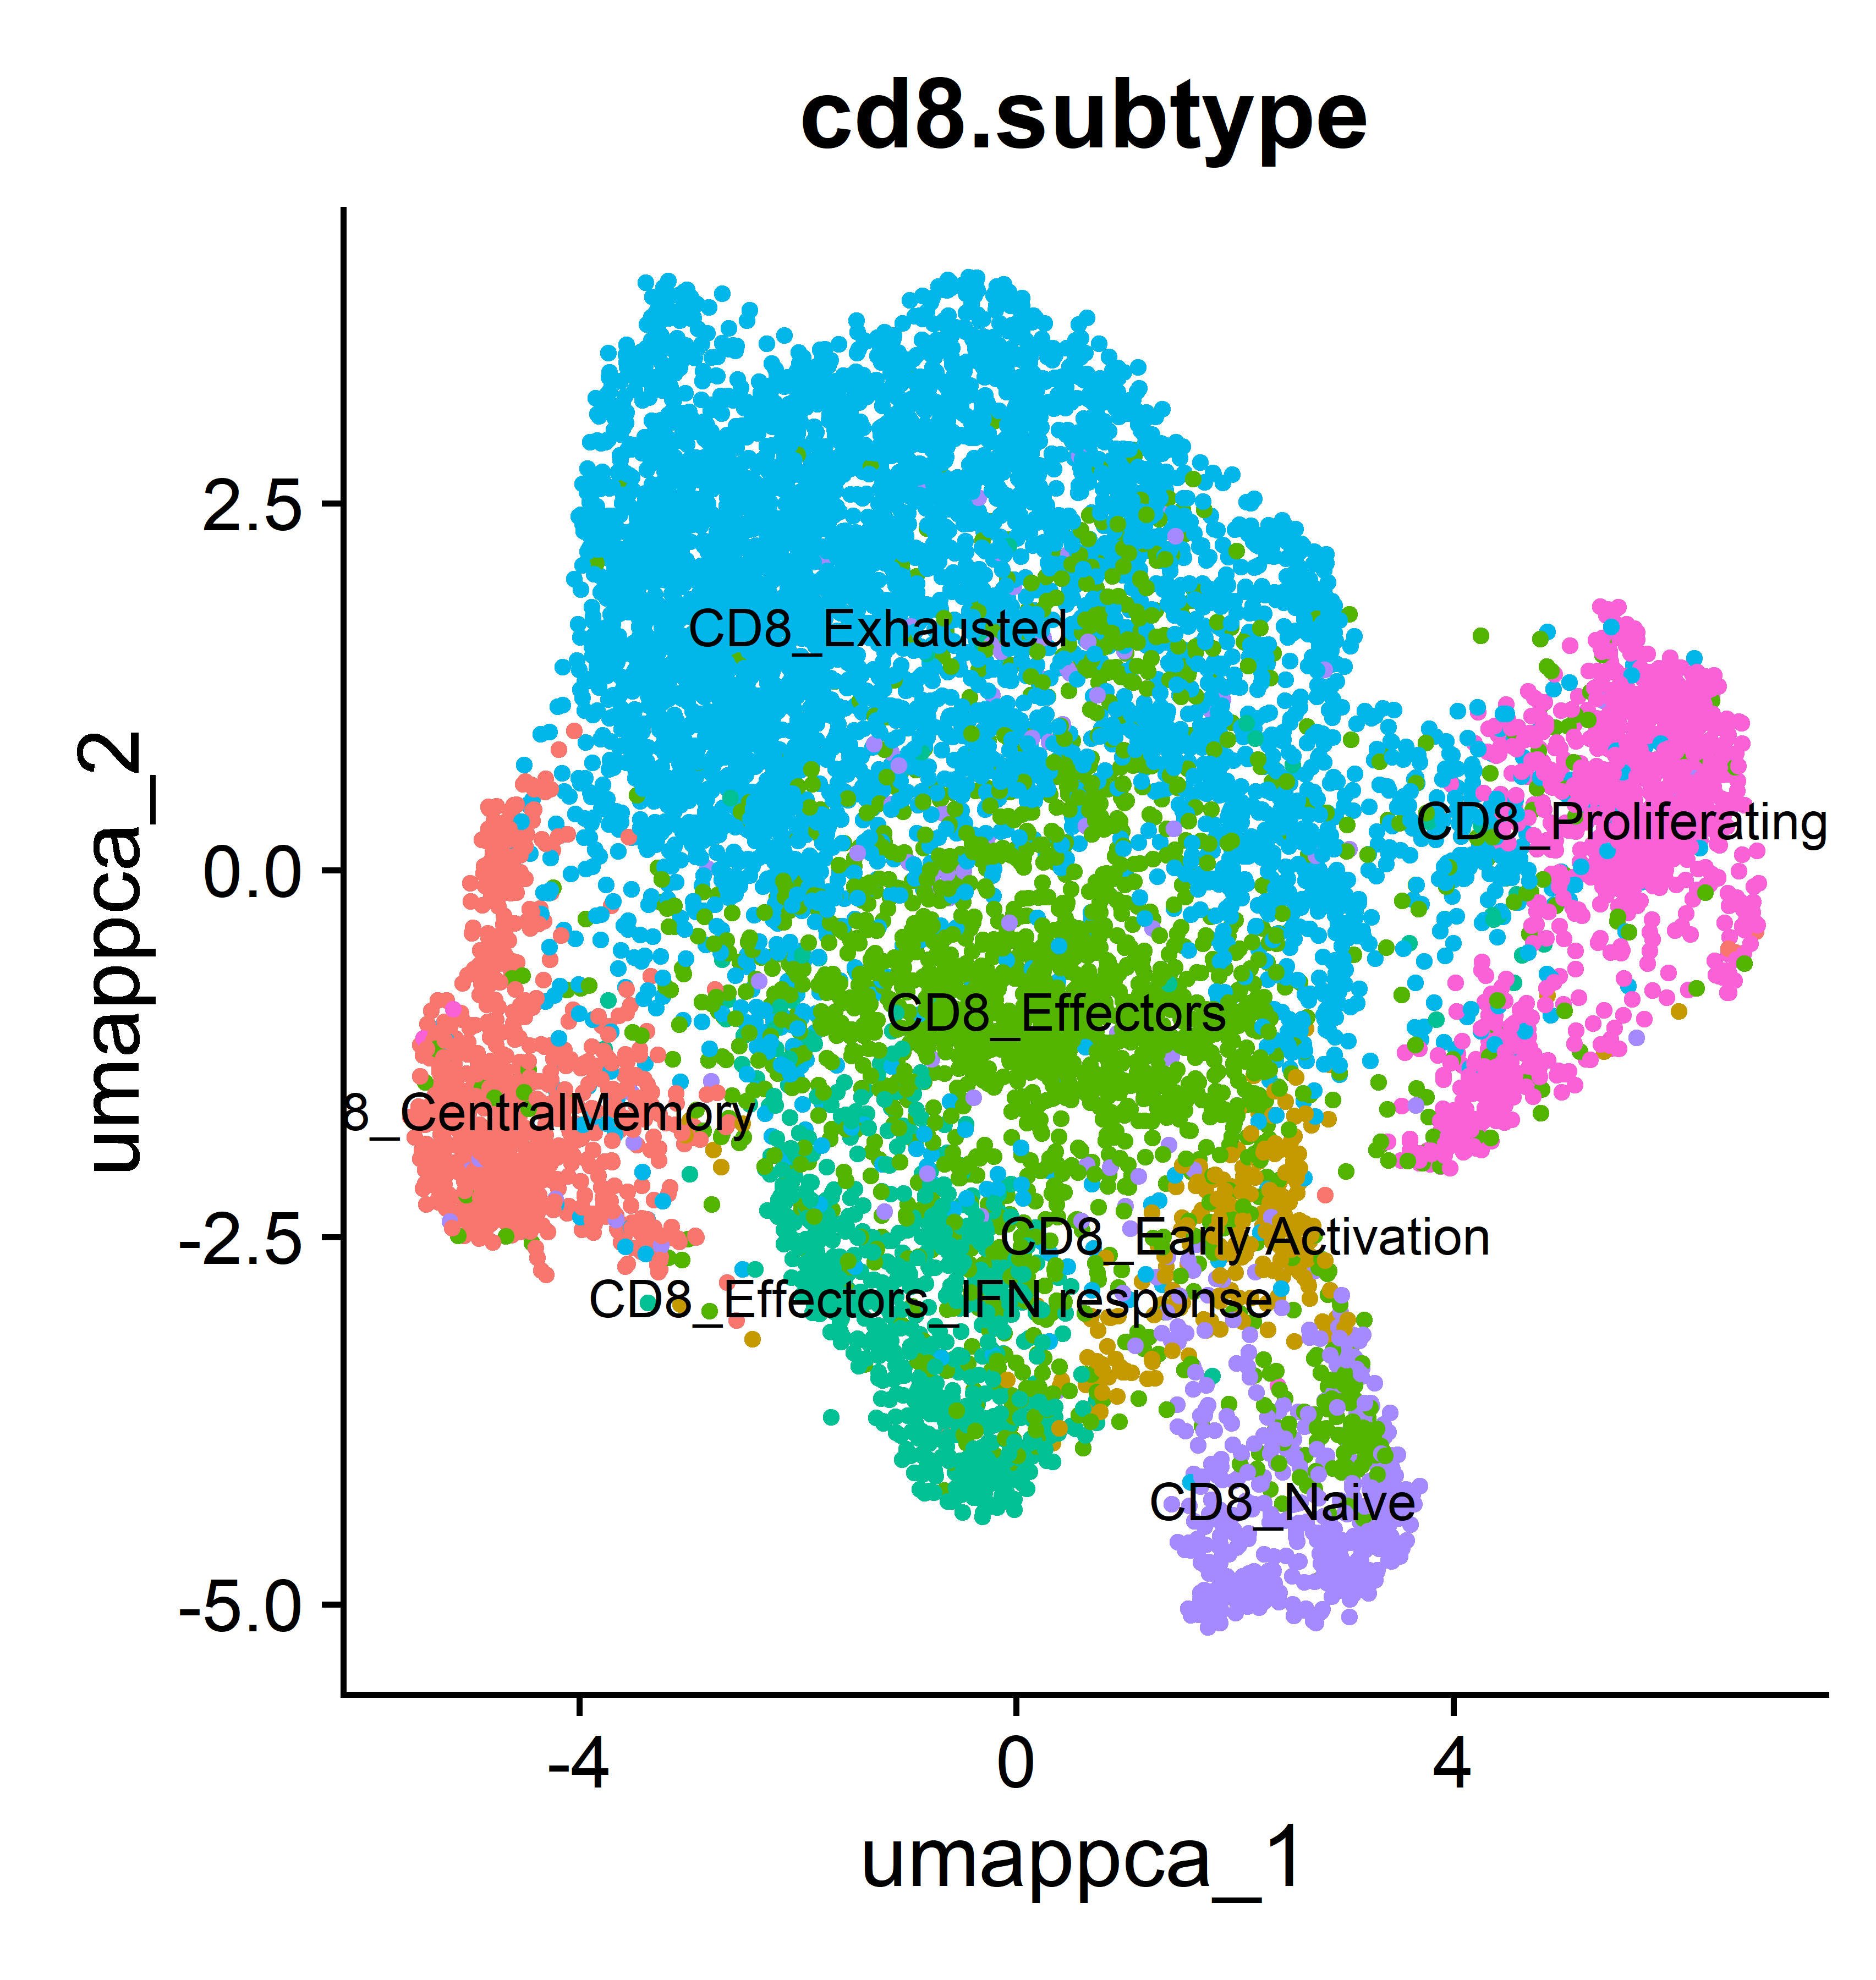
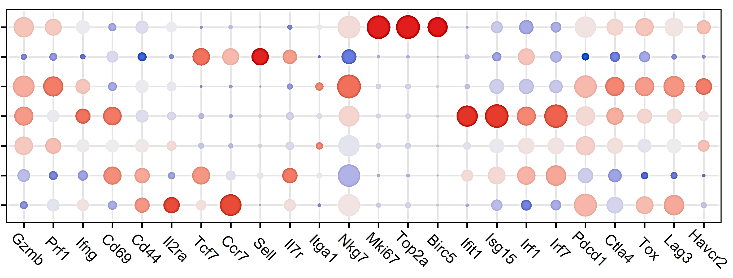
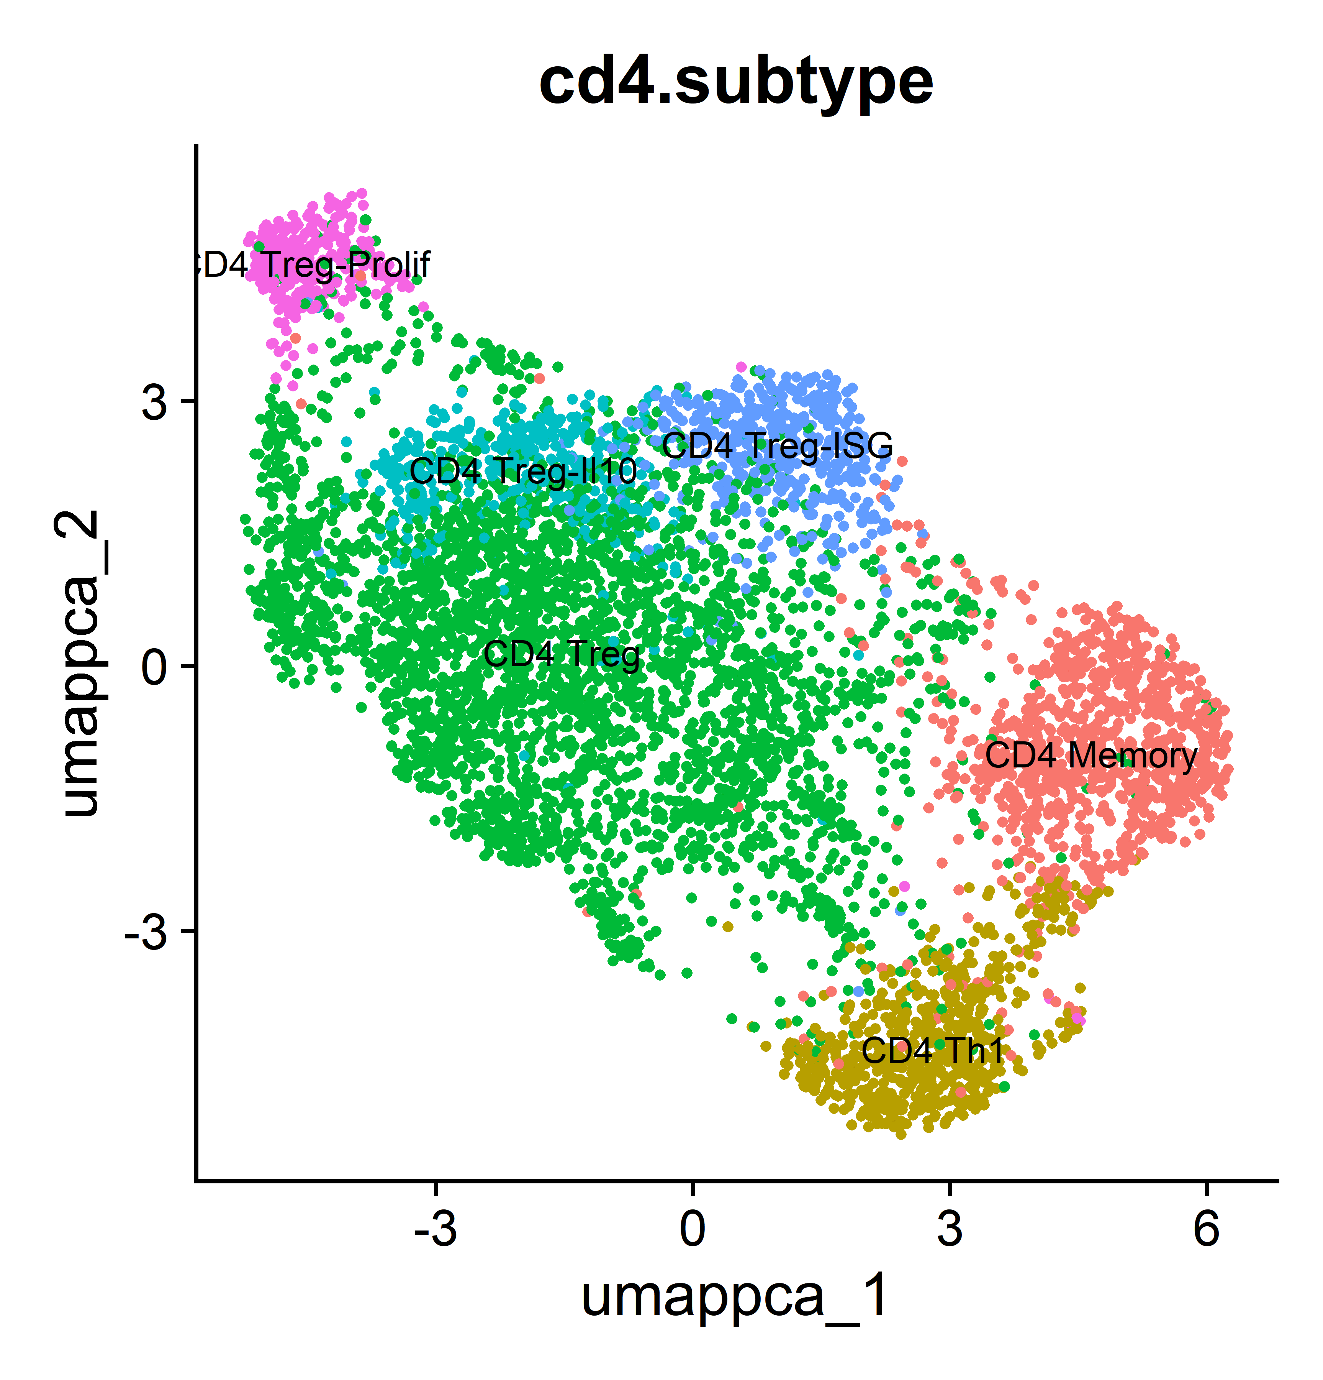
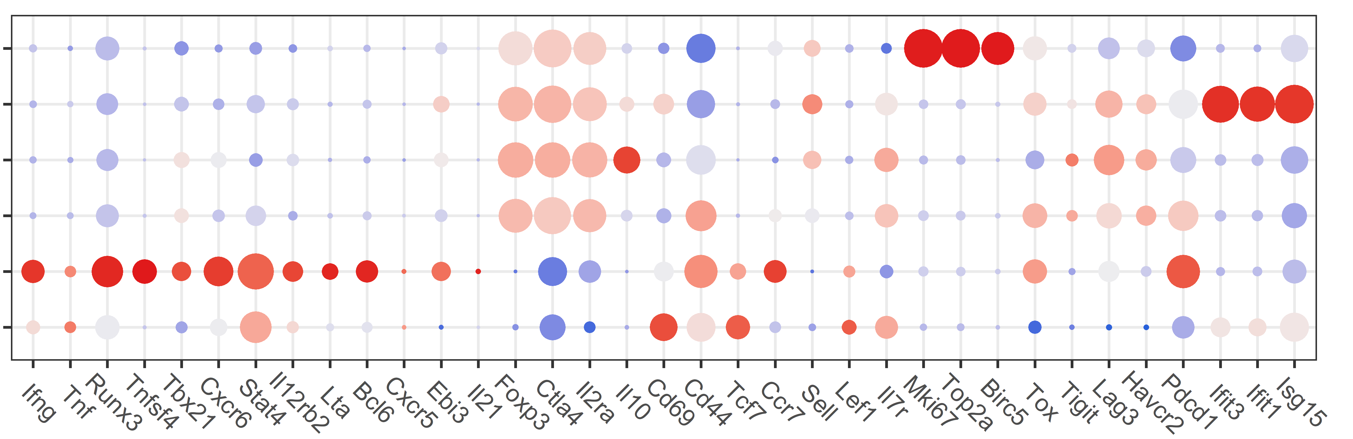
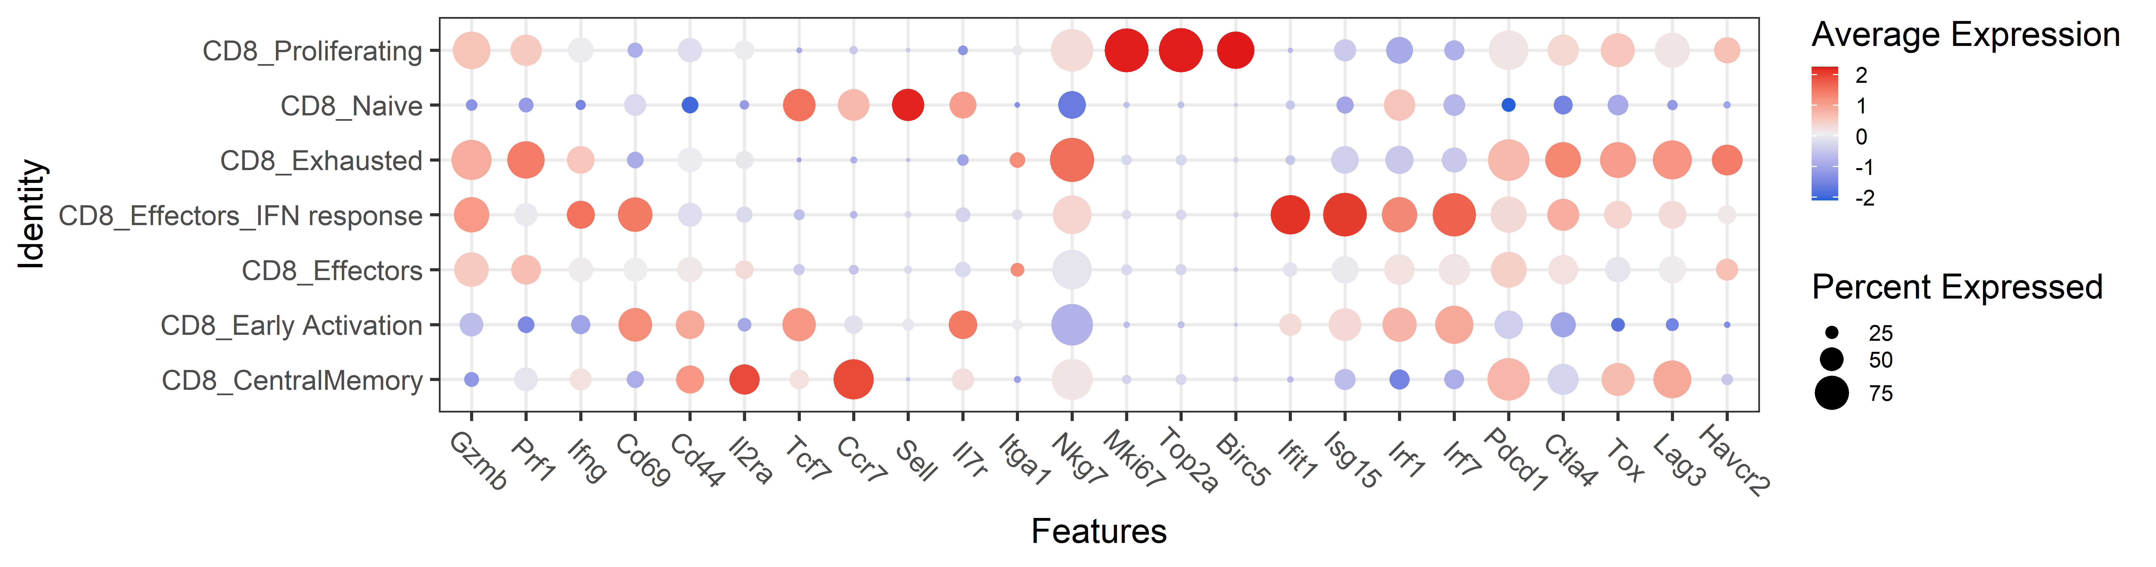
a
Copy Number Variation (CNV) Score
CNV score
CNV correlation
b
Tumors, lymphoid
c
d
e
f
g
h
i
j
k
l
h
Figure S5

Slide 6
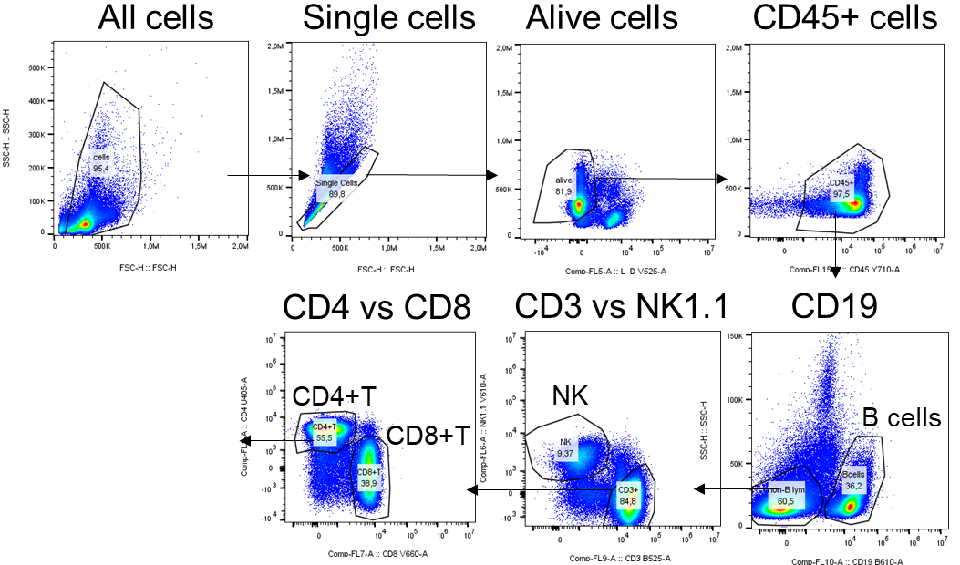
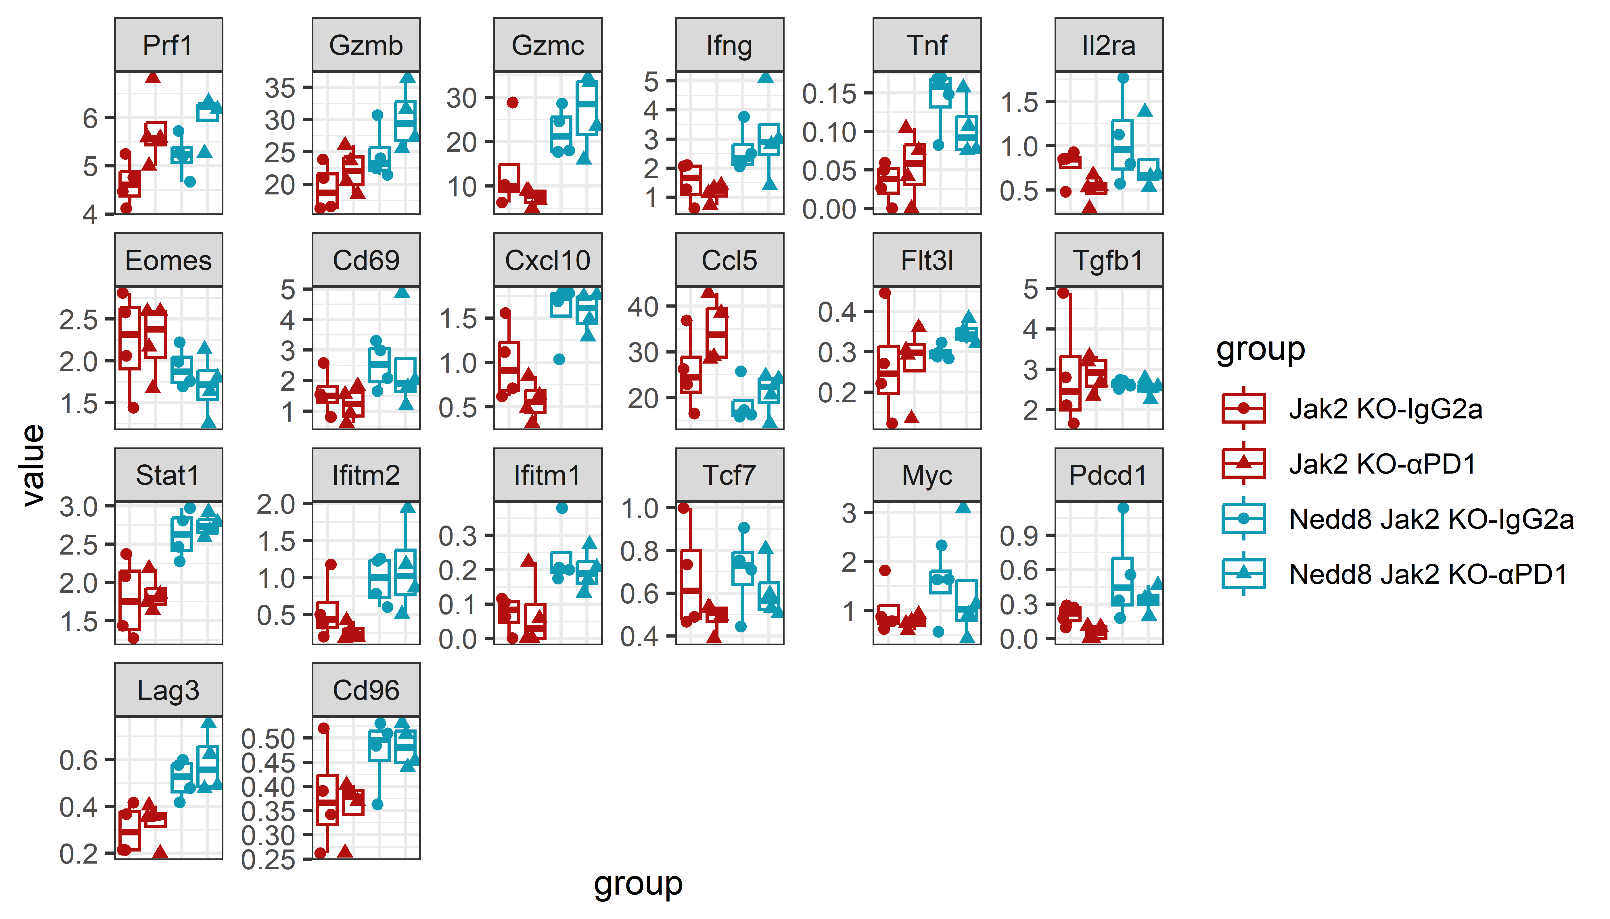
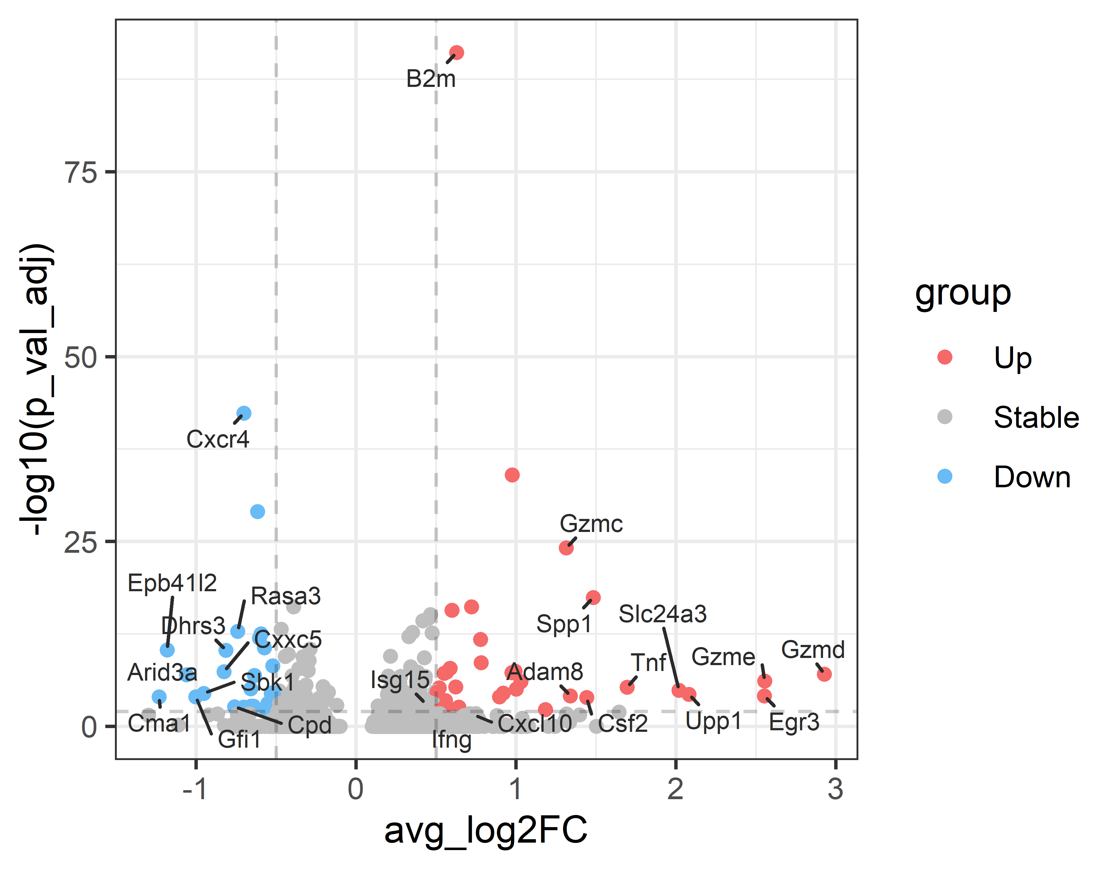
a
b
Spleens, lymphoid
c
d
NK cell markers
e
NK cells, ned-prof vs ned-def IgG
Figure S6

Slide 7
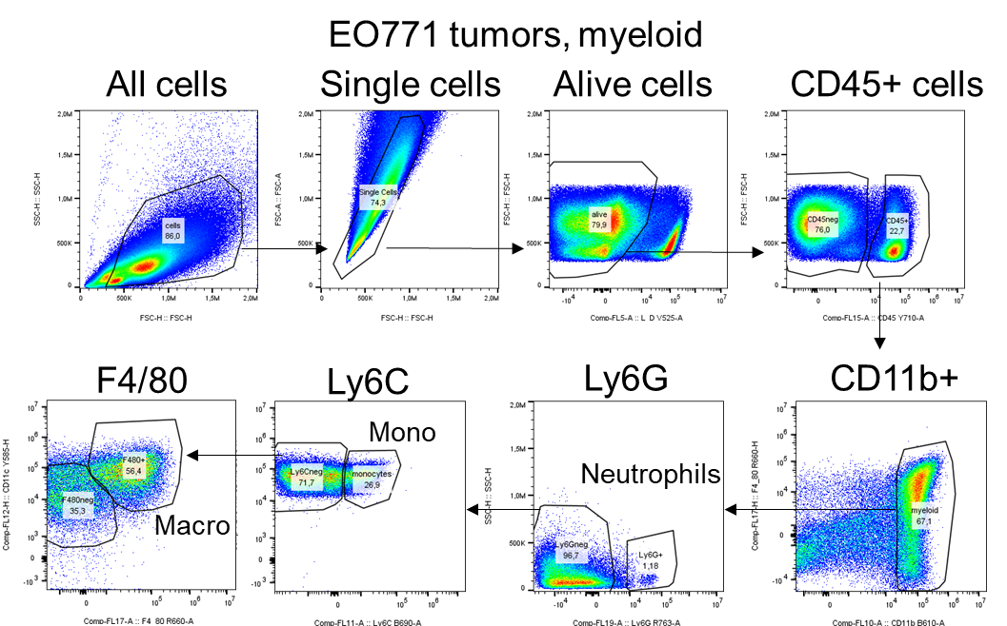
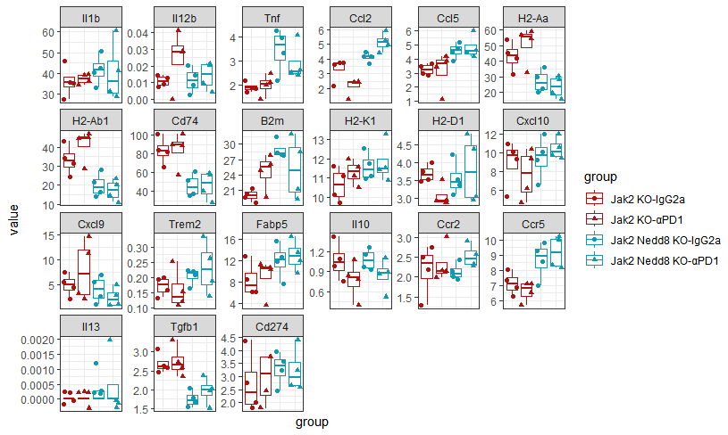

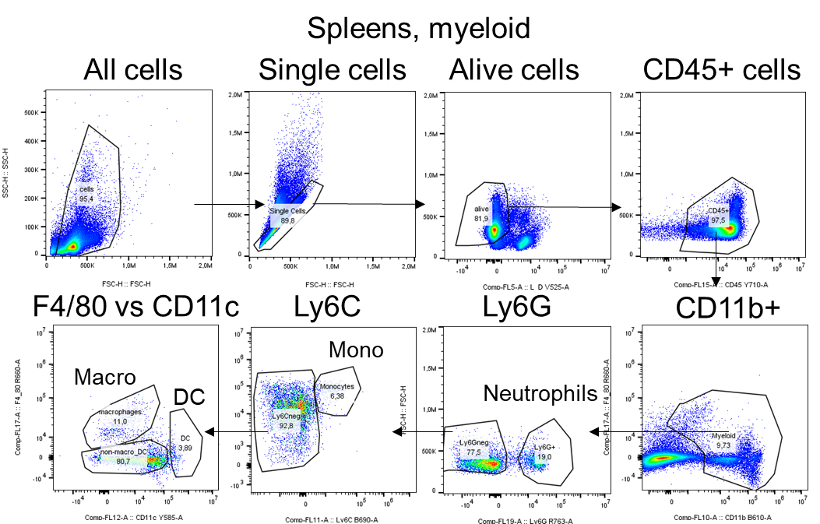
a
b
c
Tumors, myeloid
d
Nedd proficient
Nedd deficient
e
Myeloid cell markers
f
IgG, Ctrl
αPD1, Ctrl
IgG, KO
αPD1, KO
g
h
i
Spleens, myeloid
j
k
Figure S7

Slide 8
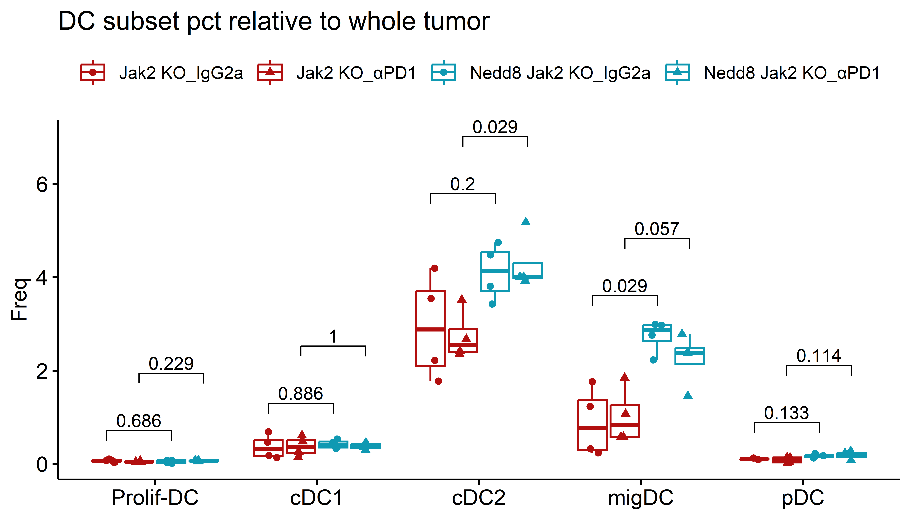
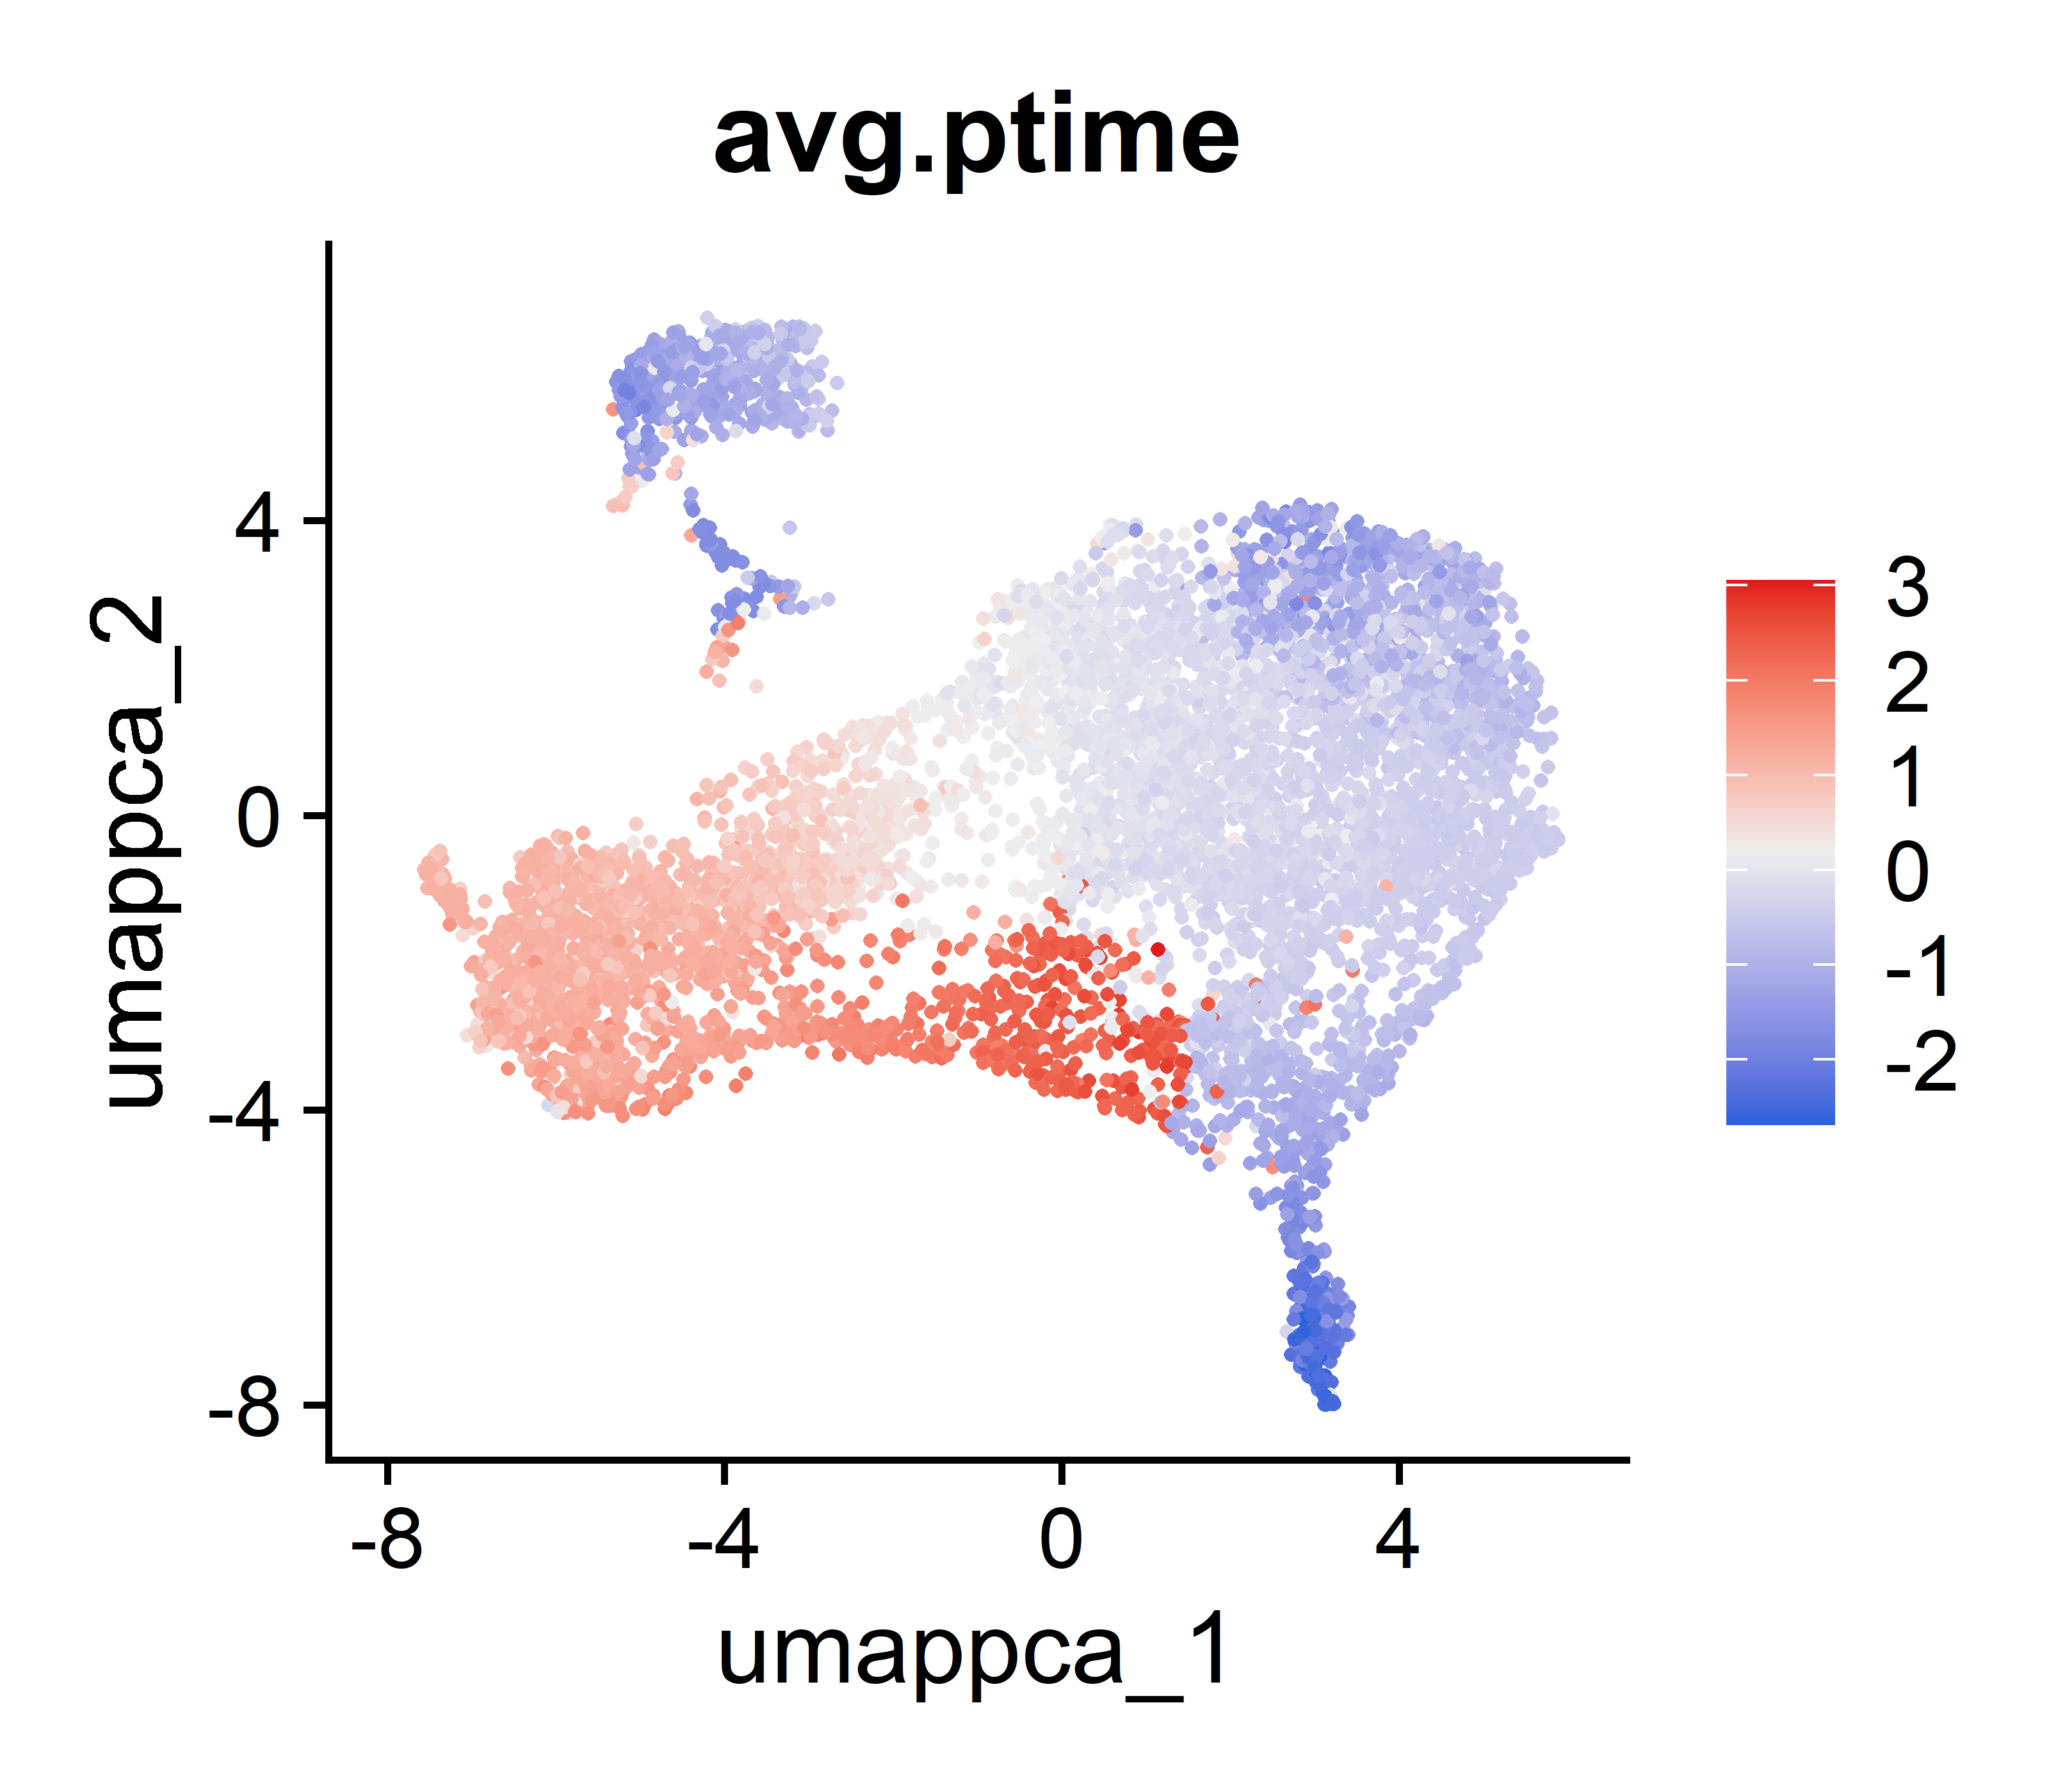
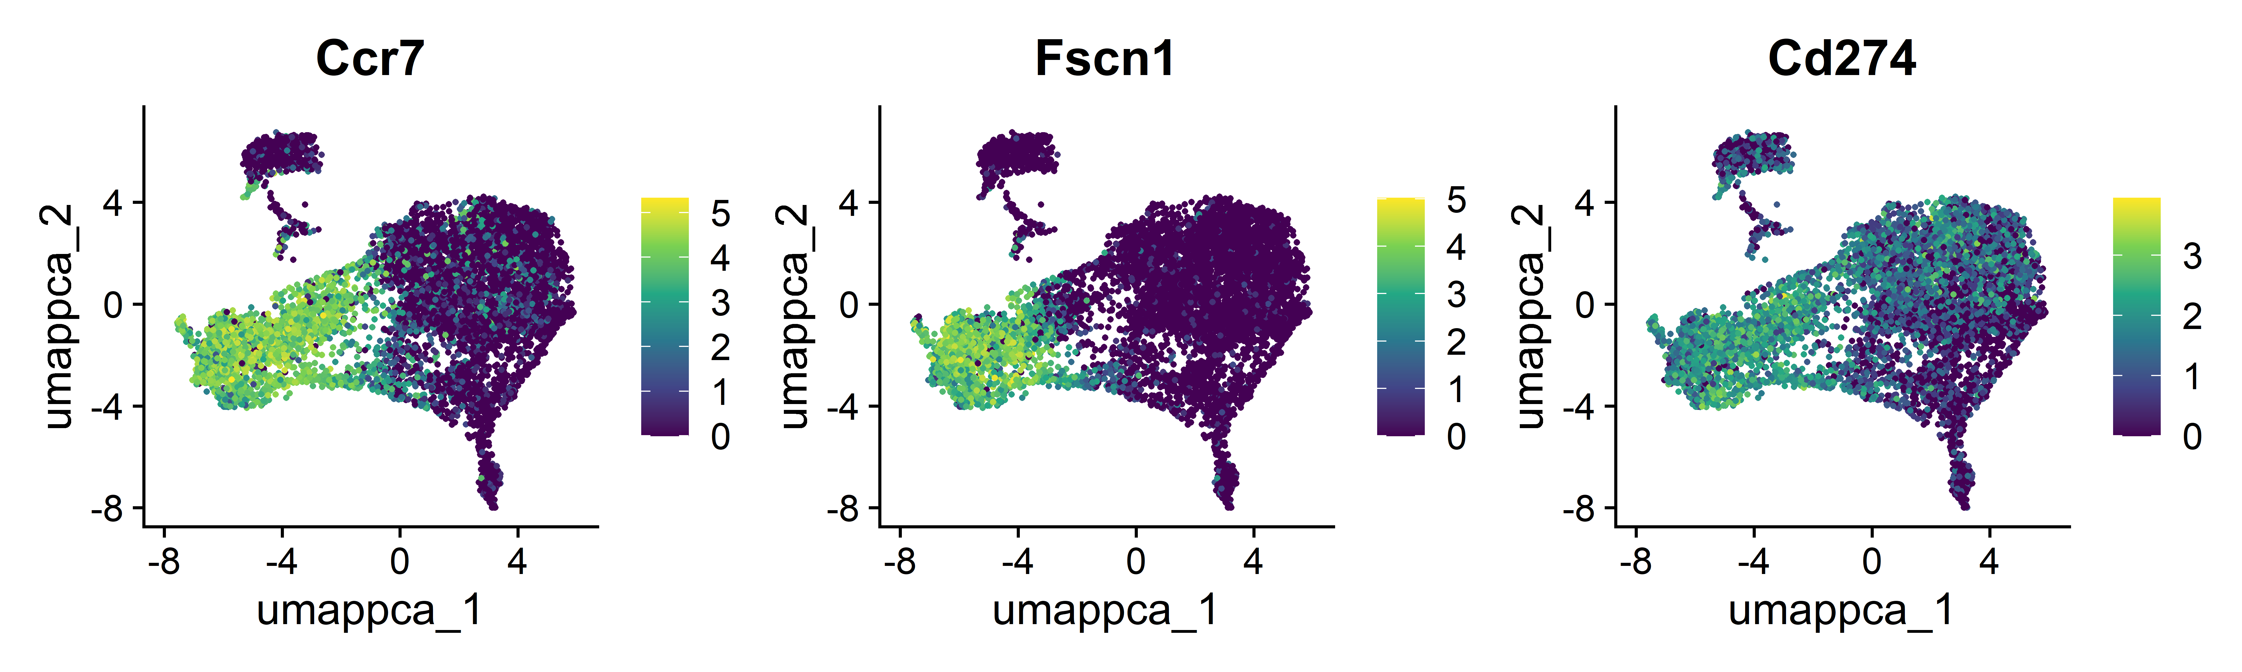
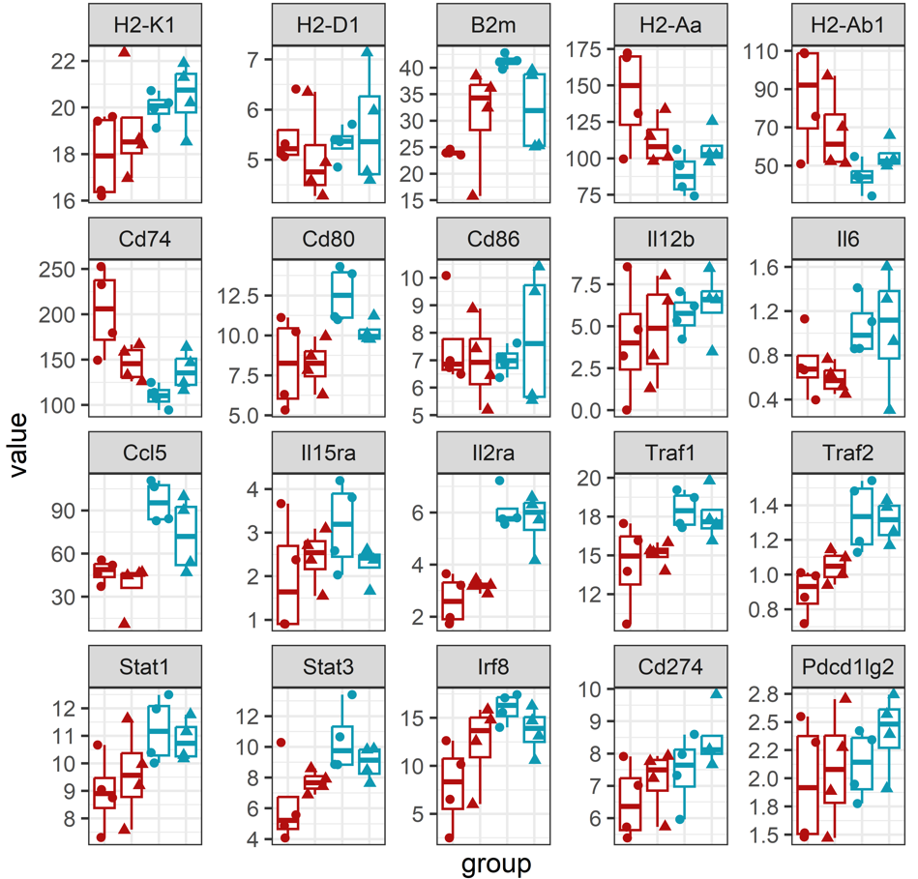
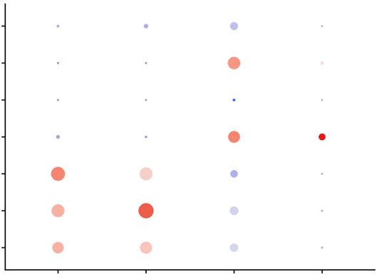
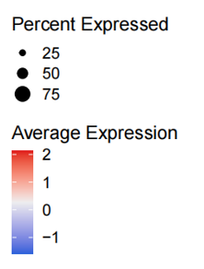
a
Dendritic cell clusters
b
Pseudo-time analysis
(DC subsets)
c
cDC1
cDC2
migDC
pDC
d
e
f
g
Gene expression in migDCs
IgG, Ctrl
IgG, KO
αPD1, Ctrl
αPD1, KO
h
Immune checkpoints cell type
(Jak2 KO tumors)
NK
Myeloid
Cancer
DC
CD8+T
Treg
CD4+T
Pdcd1
Ctla4
Cd274
Cd273
Figure S8

Slide 9
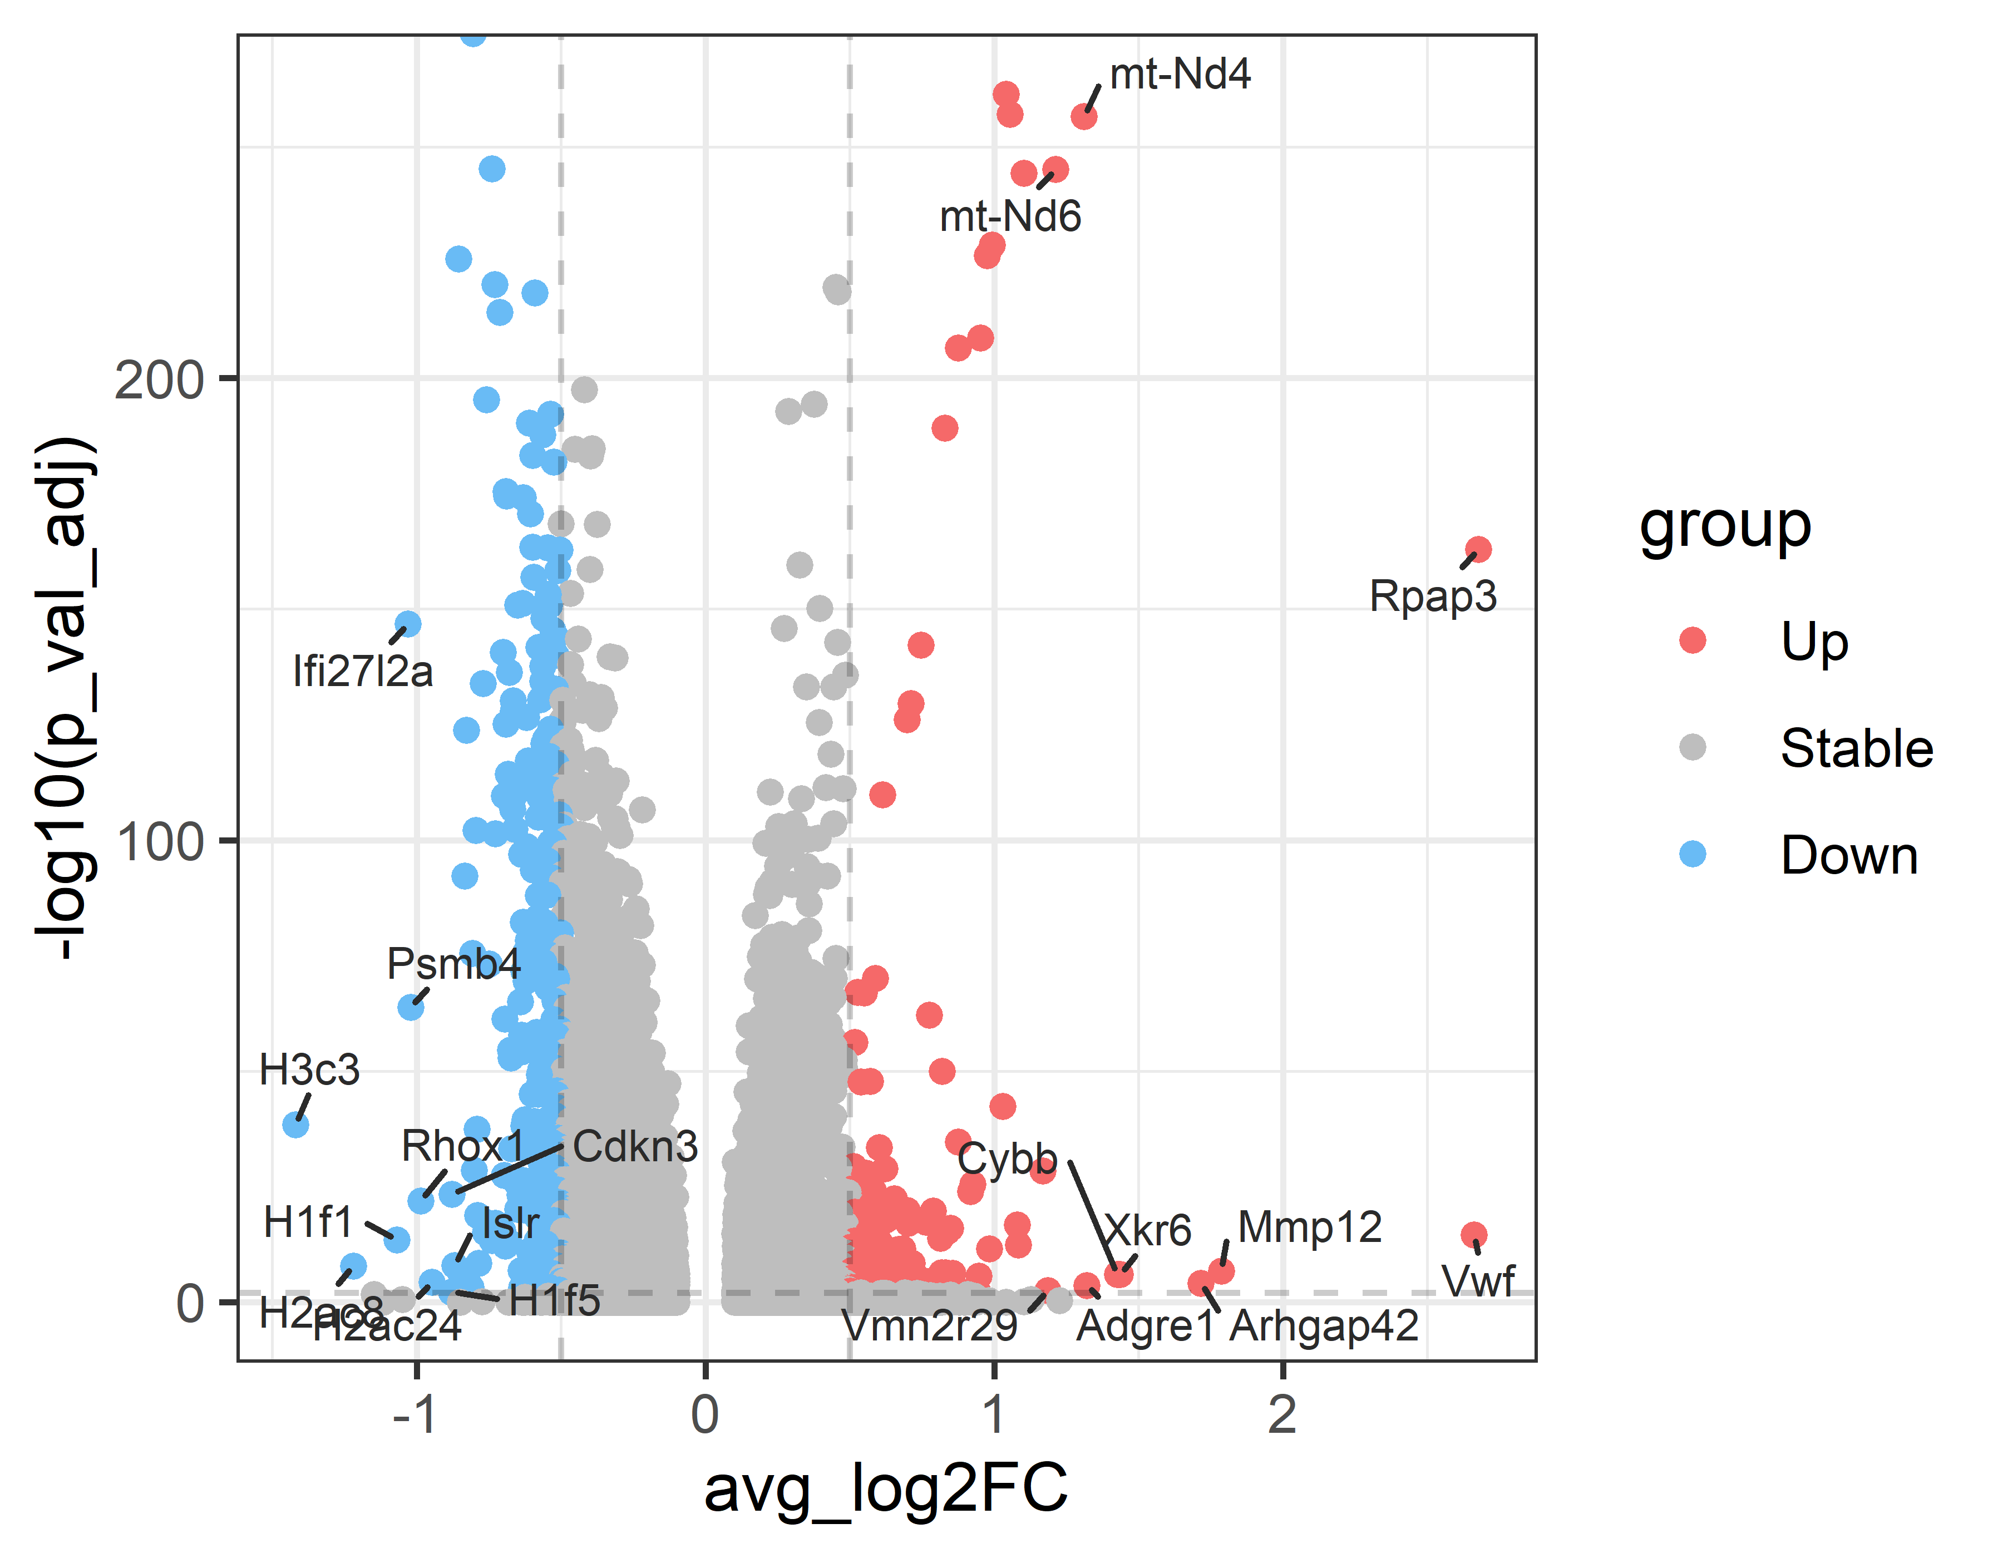
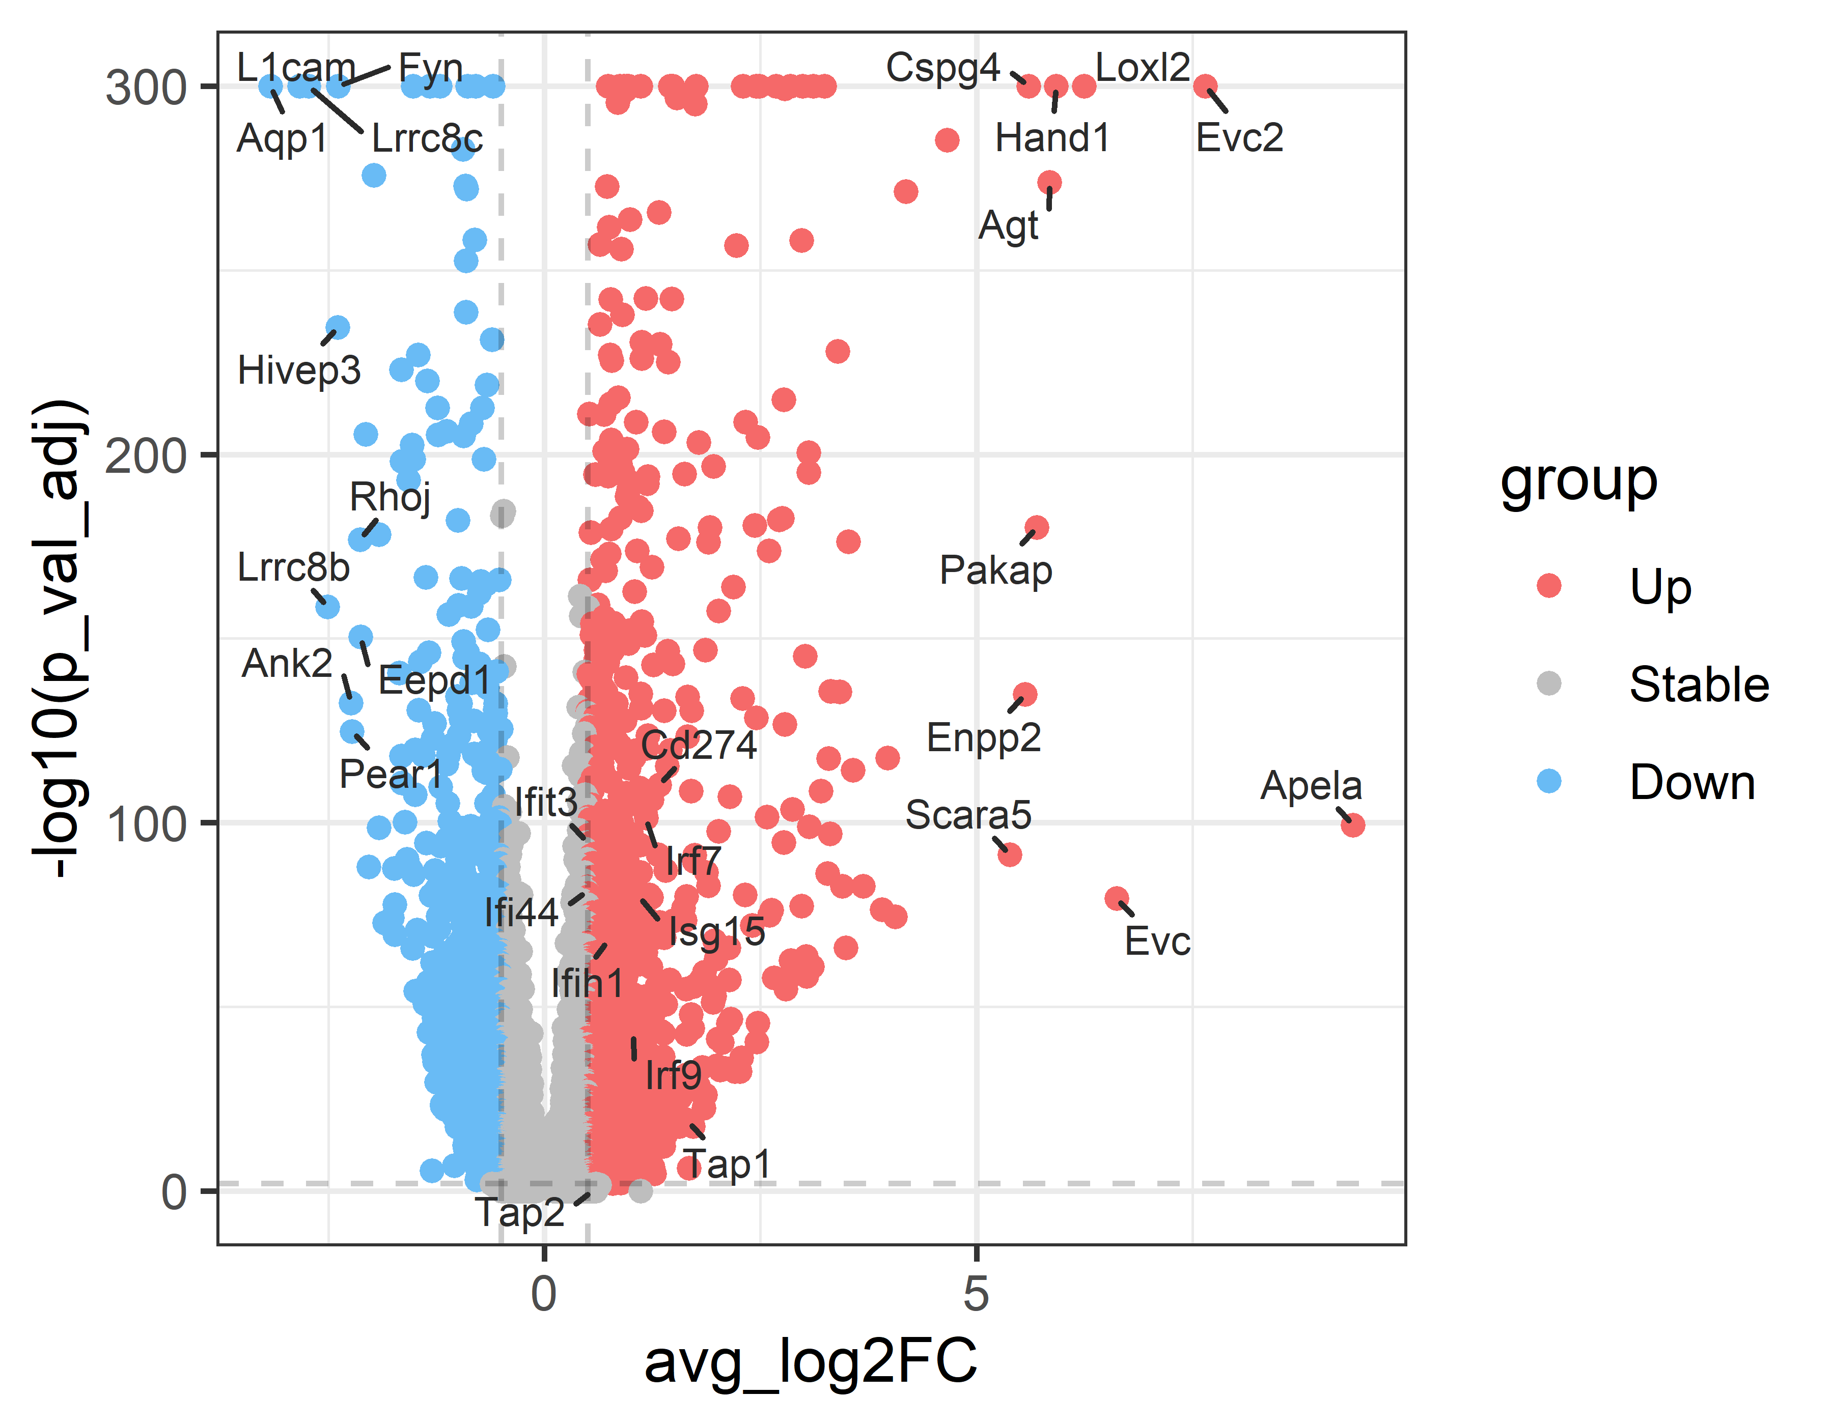
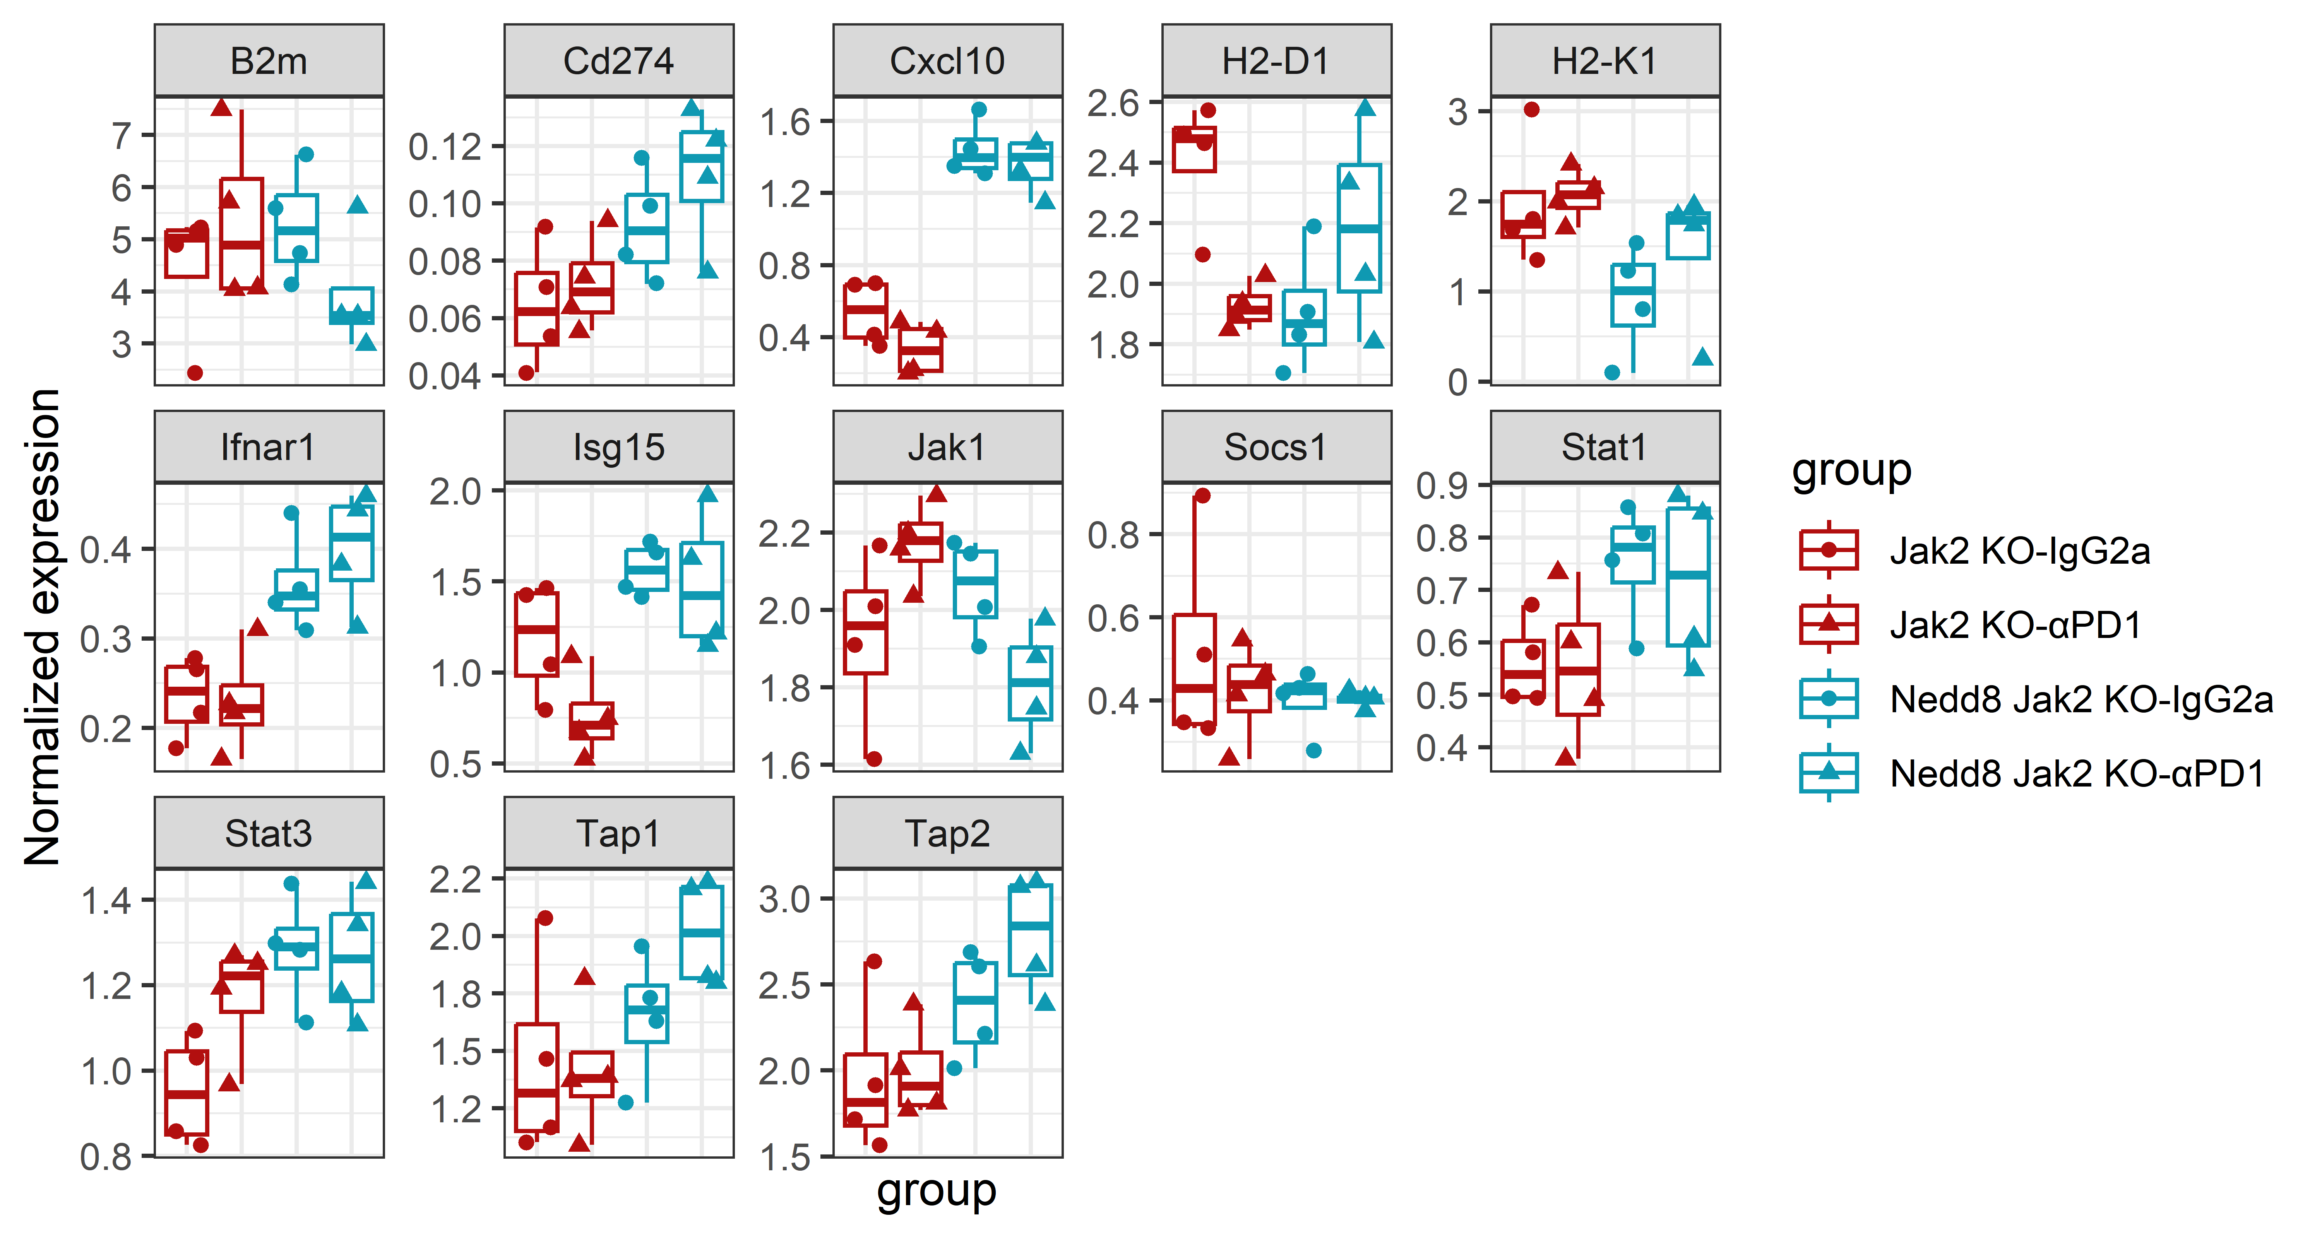
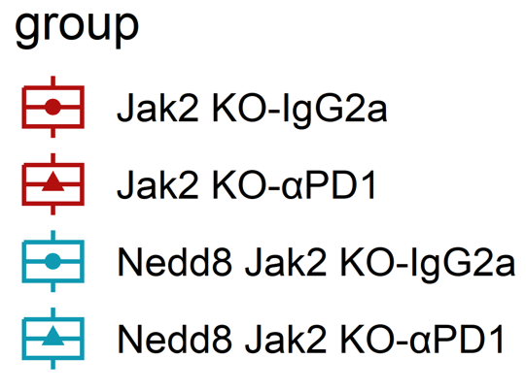
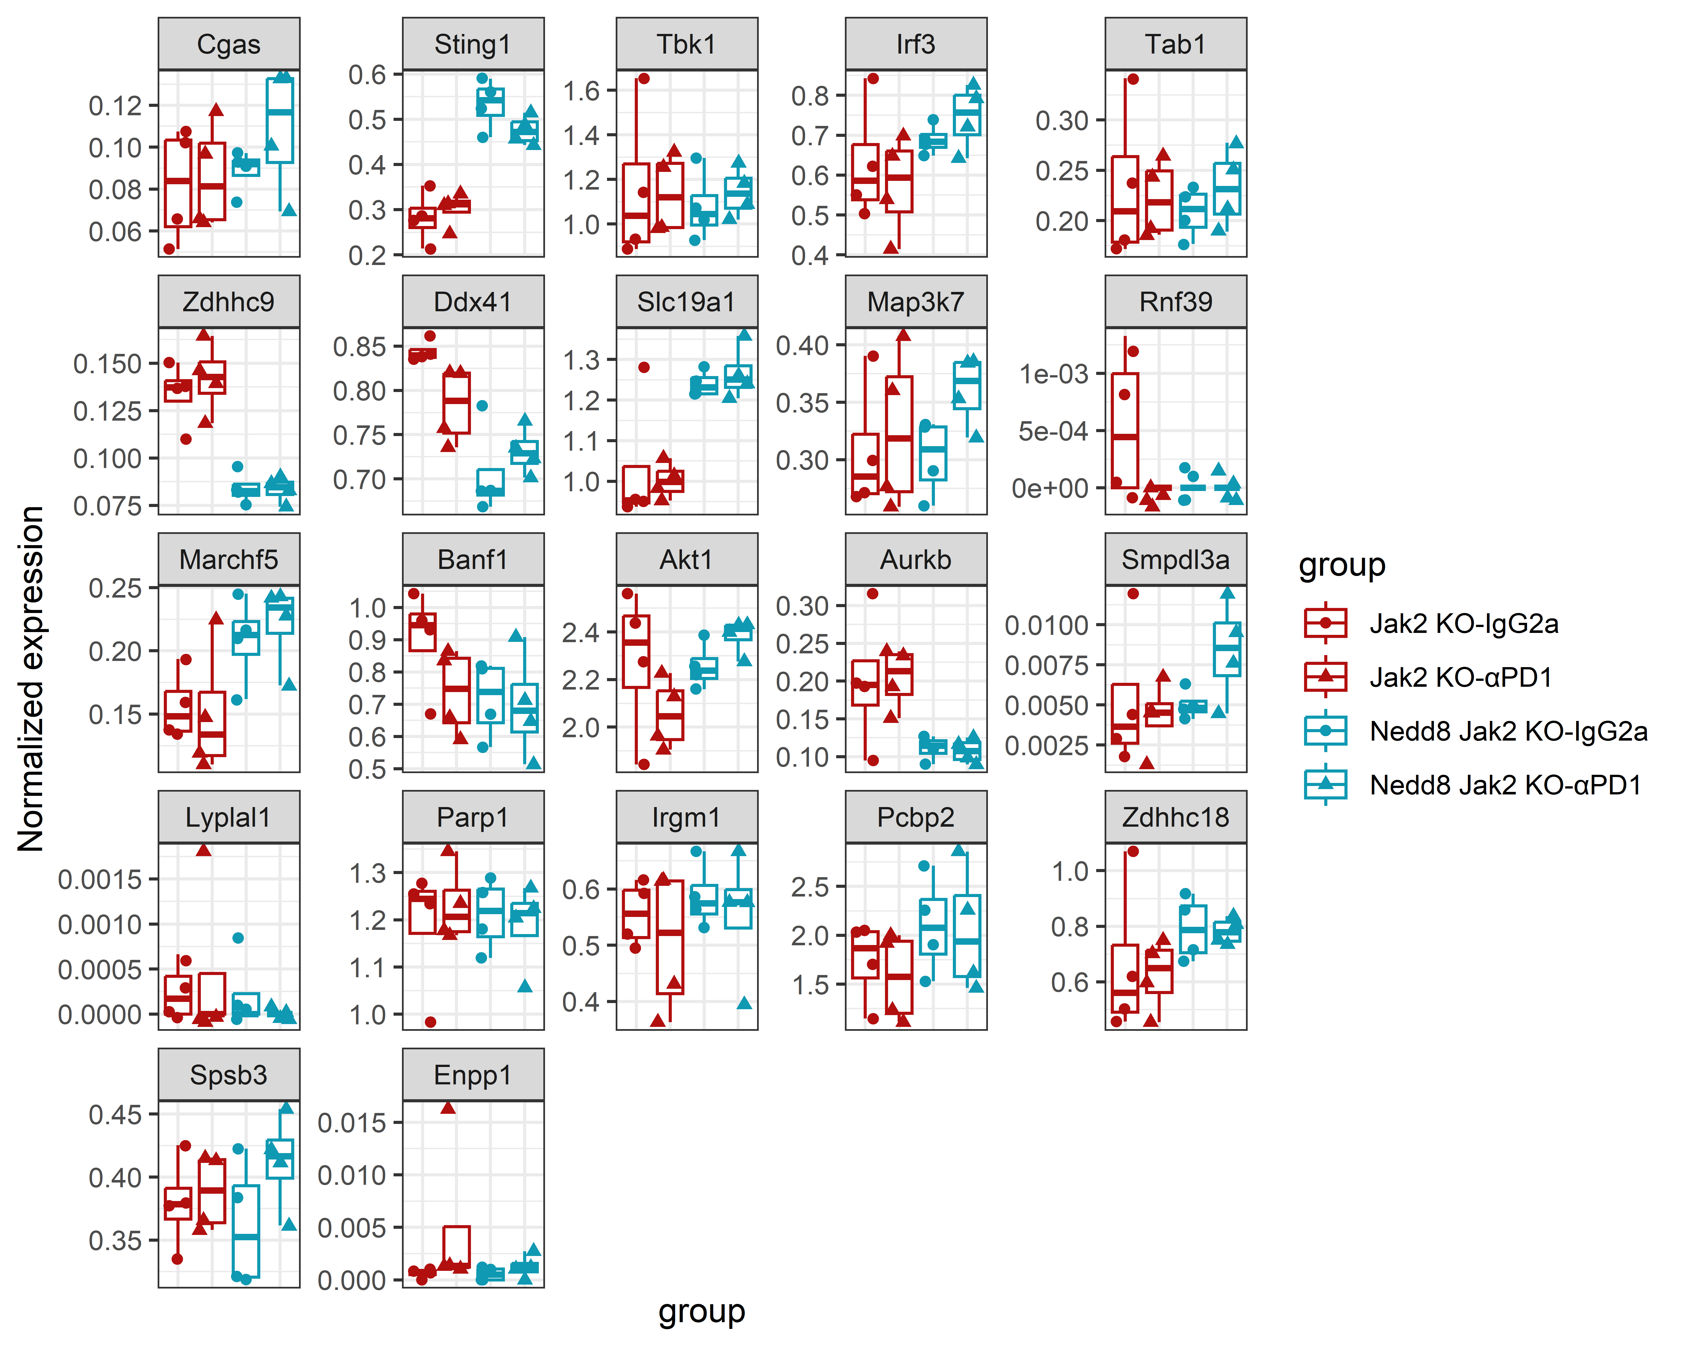
a
Jak2 KO cancer cells
(αPD1 vs IgG, Nedd proficient)
b
Jak2 KO cancer cells
(αPD1 vs IgG, Nedd deficient)
c
Interferon response in cancer cells
Normalized mRNA value
d
cGAS/STING pathway in cancer cells
Normalized mRNA value
Figure S9
Notes:
A – setup

Slide 10
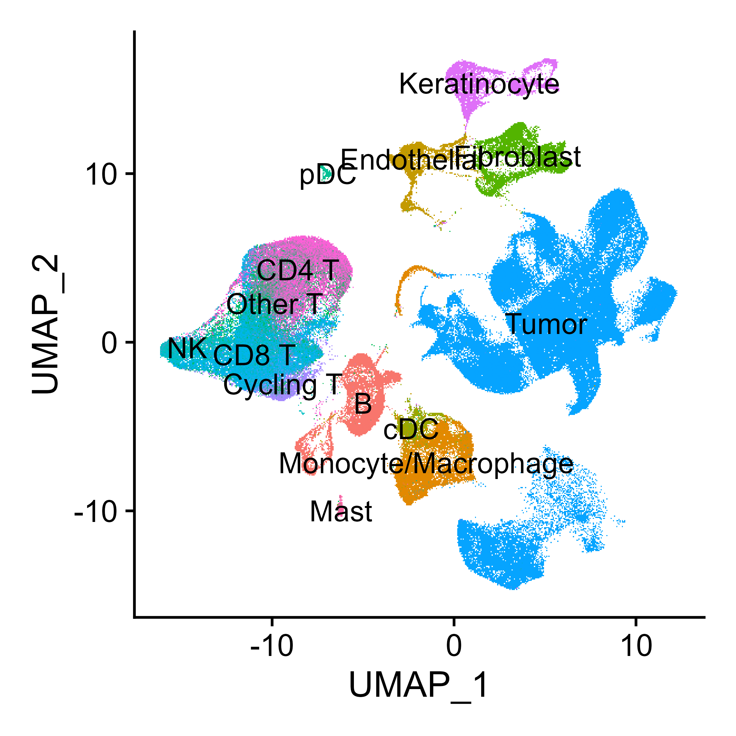
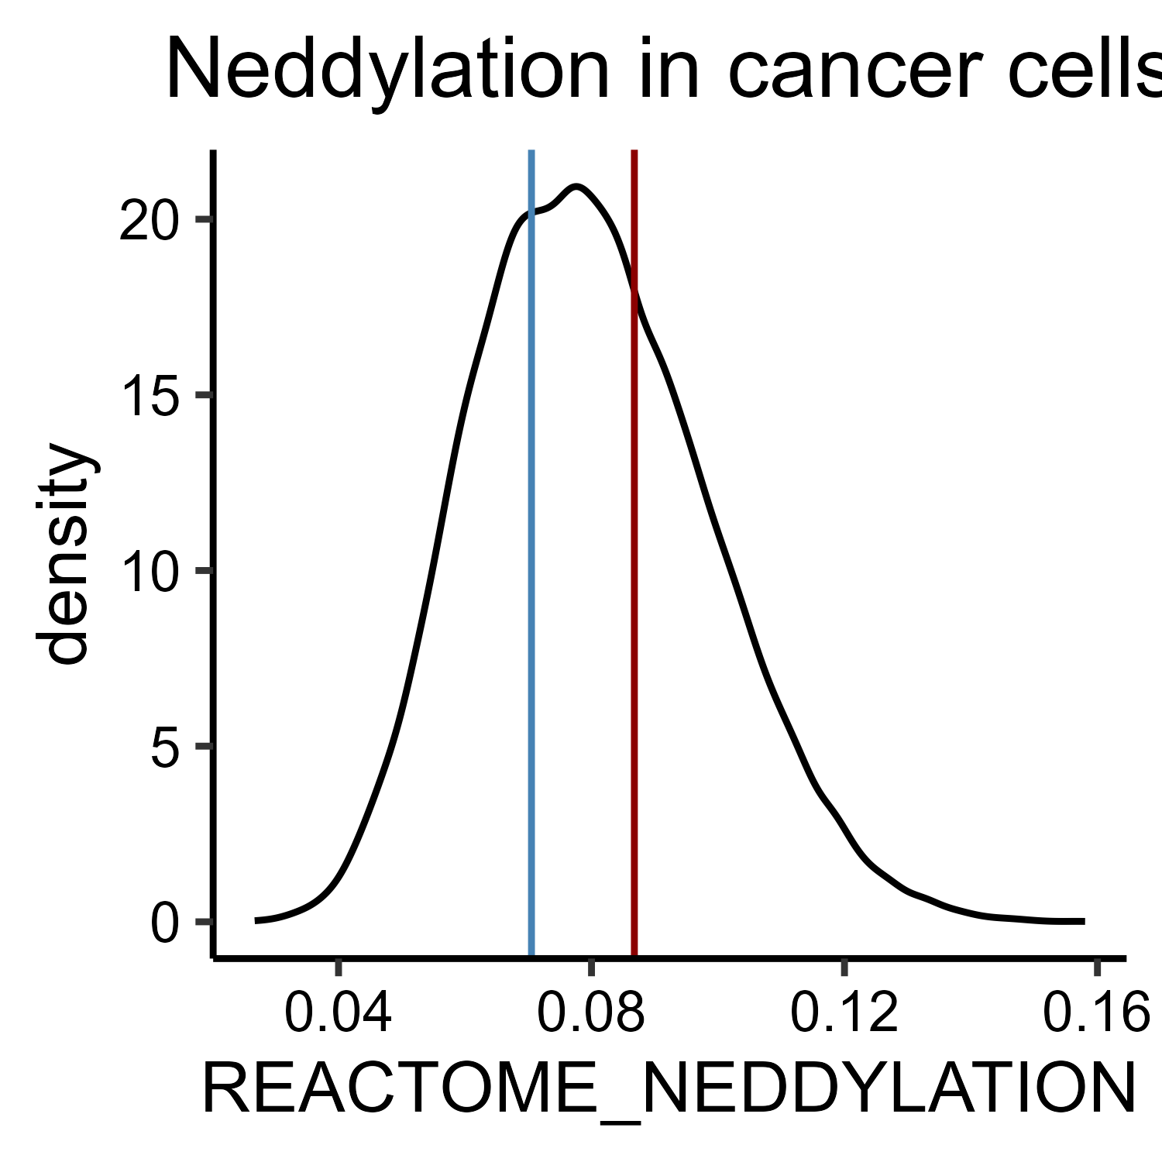


a
Tumors at endpoint, DC panel
b
c
Yang, pre-therapy
d
e
Yang, pre-therapy
Neddylation high > 66th perc.
Neddylation low < 33rd perc.
f
f
Figure S10
Notes:
Add % of DC, etc

