Slide 1
Supplementary Materials
1
Antibody | Fluorochrome | Clone
Zombie Live/Dead | NIR | -
CD14 | Spark Blue 574 | HCD14
CD11c | PE/DazzleTM 594 | BU15
CD38 | PE-Cy5 | HIT2
CD86 | BV 605 | BU63
CD163 | BV 510 | GHI/61
CD206 | PE-Fire 700 | 15-2
CD209 | PE | 9E9A8
MerTK | BV 650 | 125518
IRF4 | PerCP-Cy5.5 | IRF4.3E4
CCR1 | FITC | 5F10B29
CCR2 | BV 785 | K036C2
CCR4 | BV 421 | L291H4
CCR5 | PE-Cy7 | J418F1
CCR8 | APC | S19016
Table S1. PCR forward and reverse primer sequences used in characterising gene expression of macrophages and OC.
2
Gene | Forward | Reverse
CD206 | CCTGGAAAAAGCTGTGTGTCAC | AGTGGTGTTGCCCTTTTTGC
IL-10R | CACCATCTTGCTGACAACTTCC | AGCAGCAAACACAAGCACAG
Arg1 | ACAAAACAGGGCTACTCTCAGG | TGCAACTGCTGTGTTCACTG
CD163 | AAGACGCTGCAGTGAATTGC | ATGCGACGAAAATGGCCAAC
VEGF | TTGCTGTGCTTTGGGGATTC | TCAGAAGCAGGTGAGAGTAAGC
C-JUN | ATCAAGTGGCATGTGCTGTG | TGCCACCAATTCCTGCTTTG
CTSK | ACAGGCAAGGCAGCTAAATG | TTGCATCAATGGCCACAGAG
PGC-1β | ACAAGCTGCCAAAGAAGCAC | TCATGGTCTCCAAAGGAACAGG
NTAFc1 | CTCATGGGCAAGGGTTTCTTTC | CACATAATTATGCGGCCACCAC
GAPDH | AATTCCATGGCACCGTCAAG | ATCGCCCCACTTGATTTTGG
Table S2. Panel of fluorochrome antibodies used in the flow cytometric analysis of macrophage subsets.

Slide 2
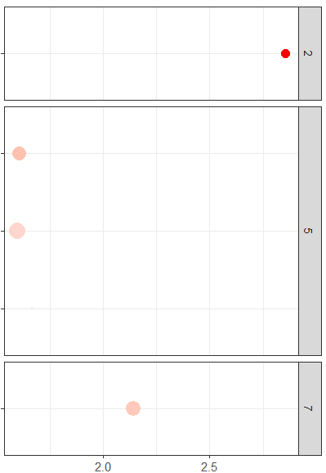
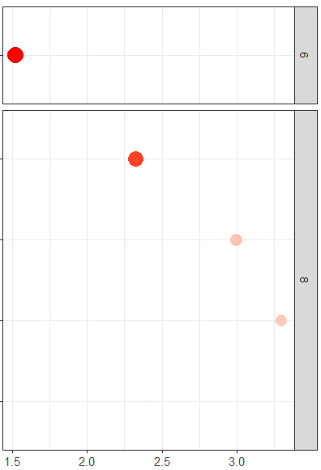
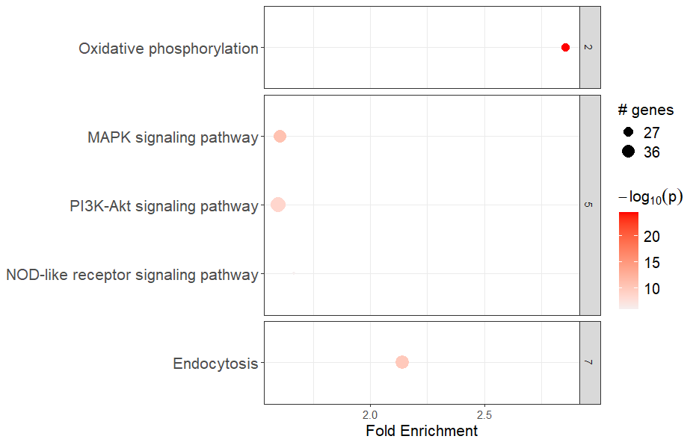
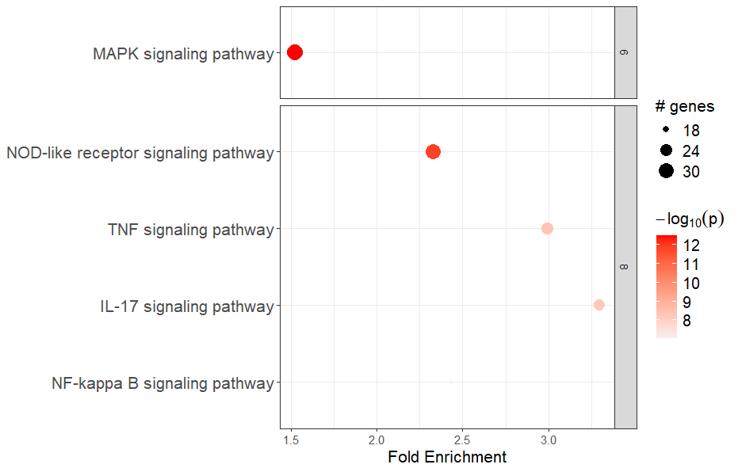
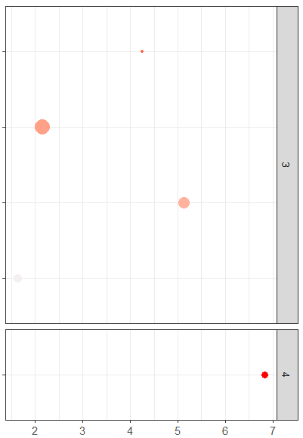
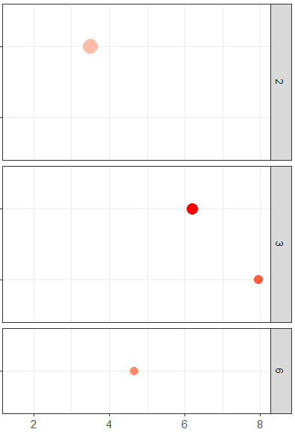
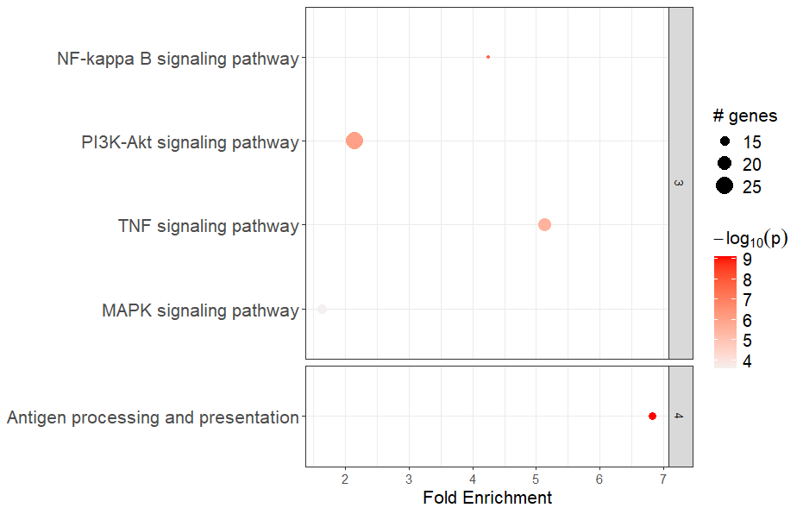
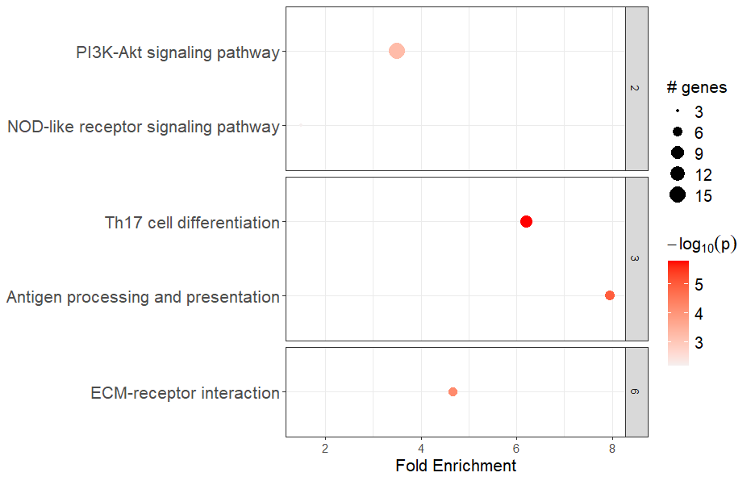
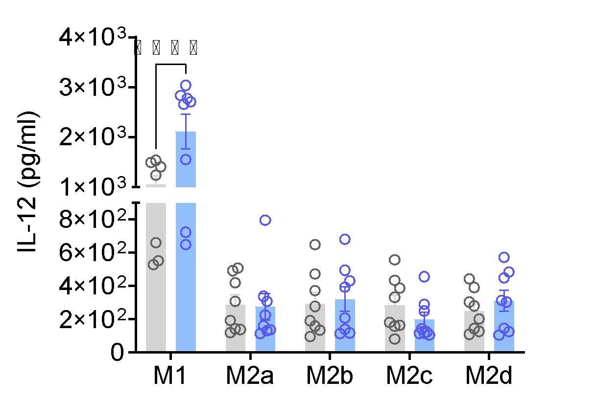
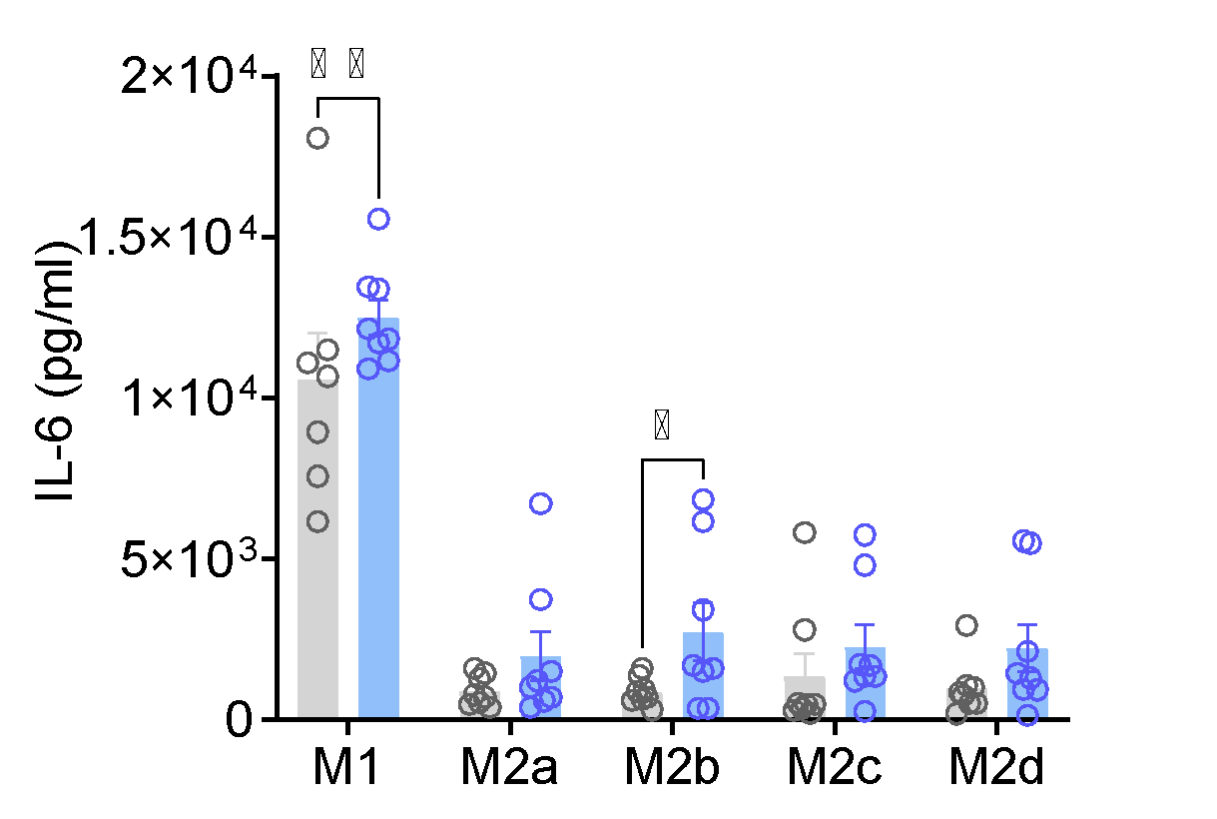
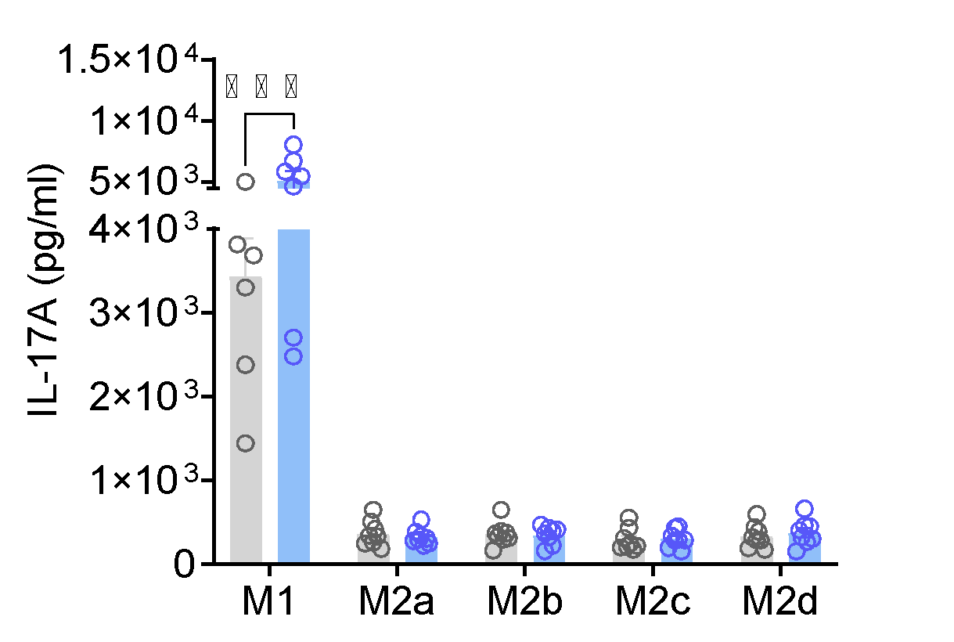
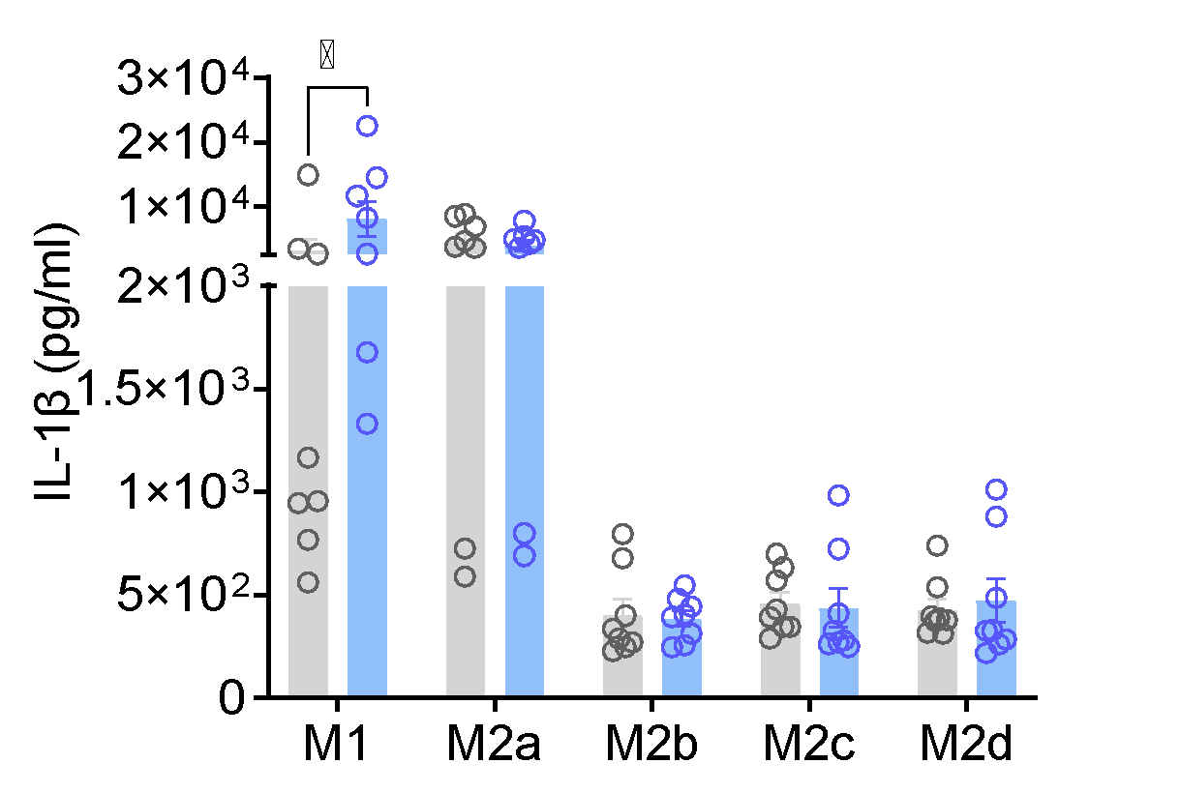
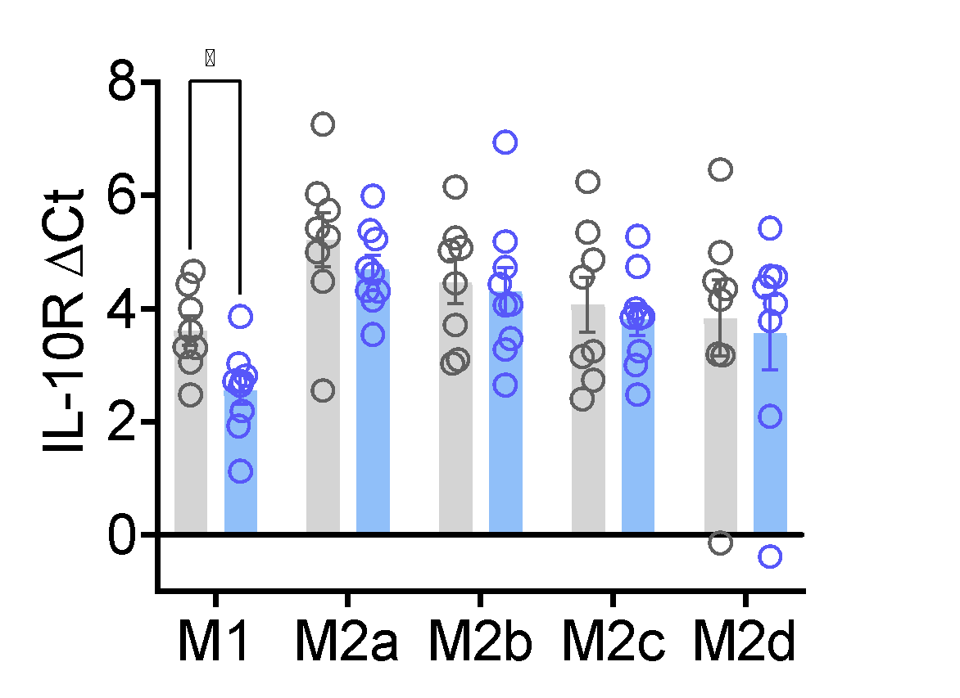
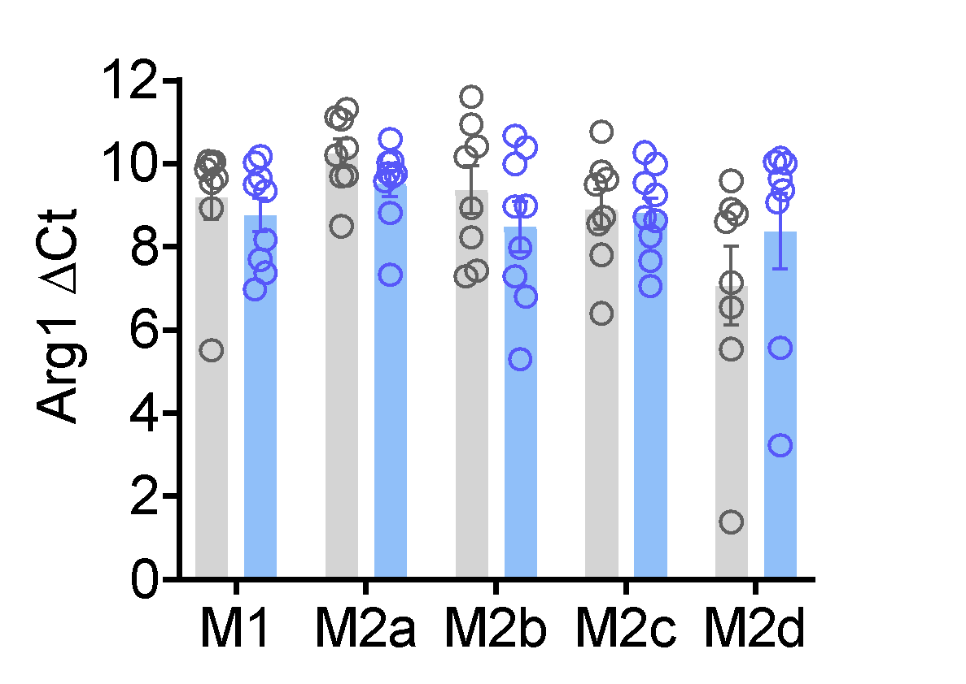
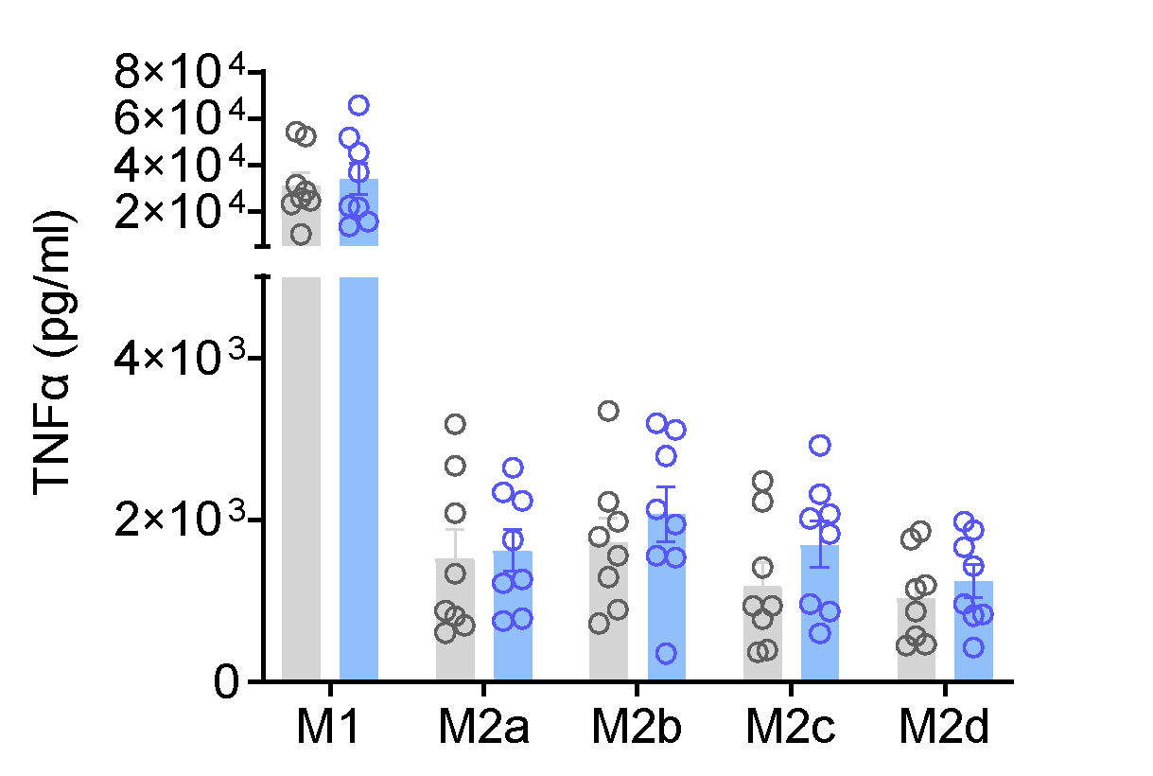
A
Supplementary Figure 1
B
C
M1
M2a
Signalling Pathways
Signalling Pathways
Oxidative Phosphorylation
MAPK
MAPK
NOD-like receptor
PI3K-Akt
TNF
NOD-like receptor
IL-17
Endocytosis
NF-κB
Fold Enrichment
Fold Enrichment
Signalling Pathways
M2b
Signalling Pathways
M2d
NF-κB
PI3K-Akt
PI3K-Akt
NOD-like receptor
TNF
Th17 differentiation
MAPK
Antigen presentation
Antigen presentation
ECM-receptor interaction
Fold Enrichment
Fold Enrichment

Slide 3
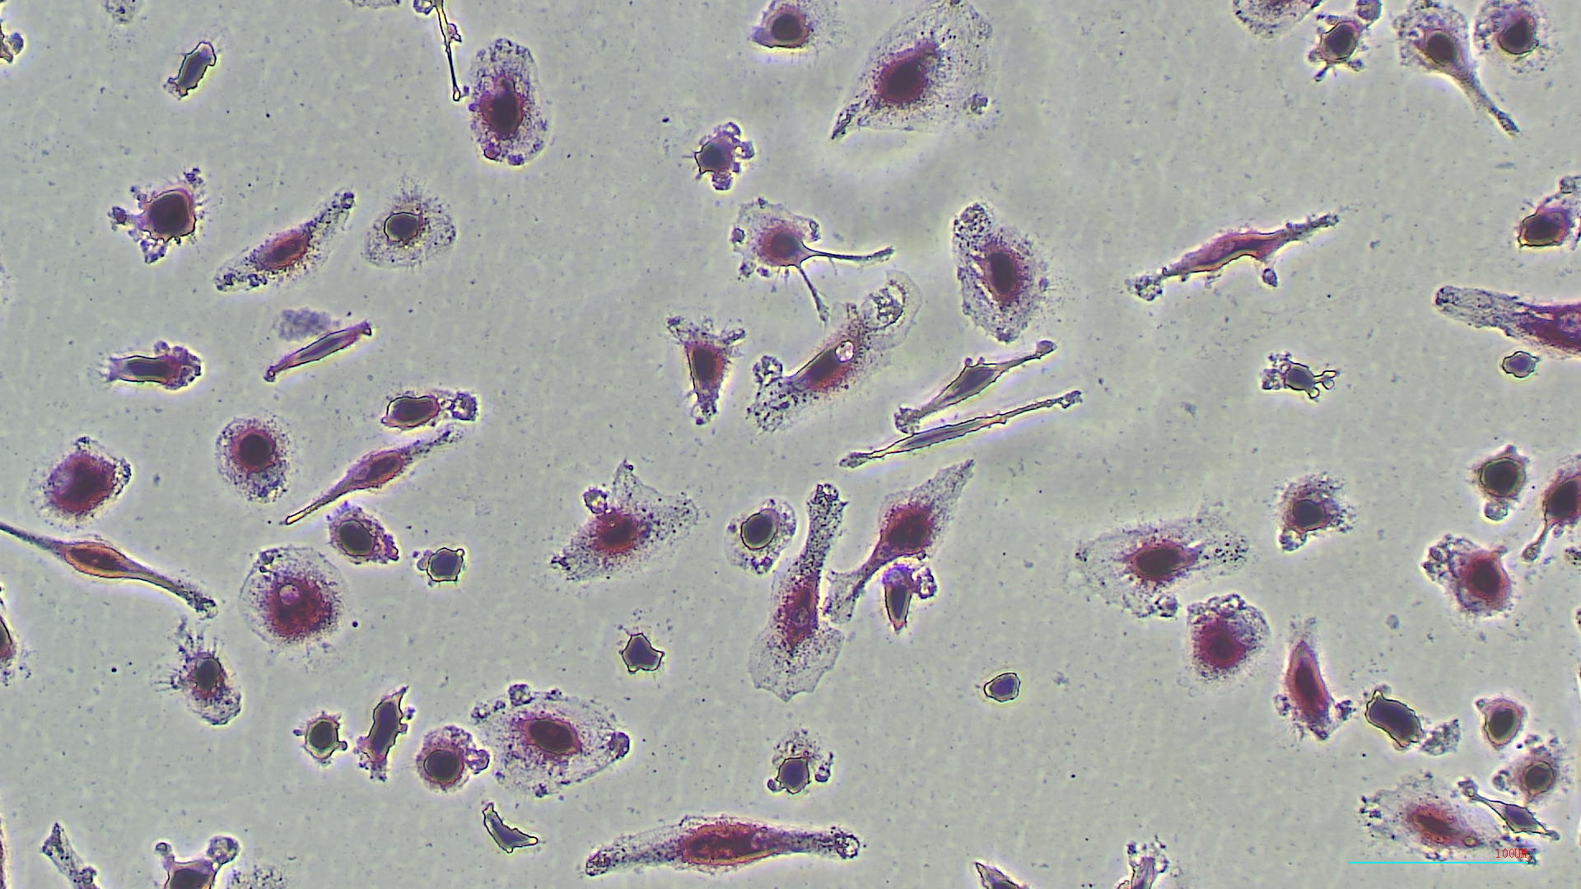
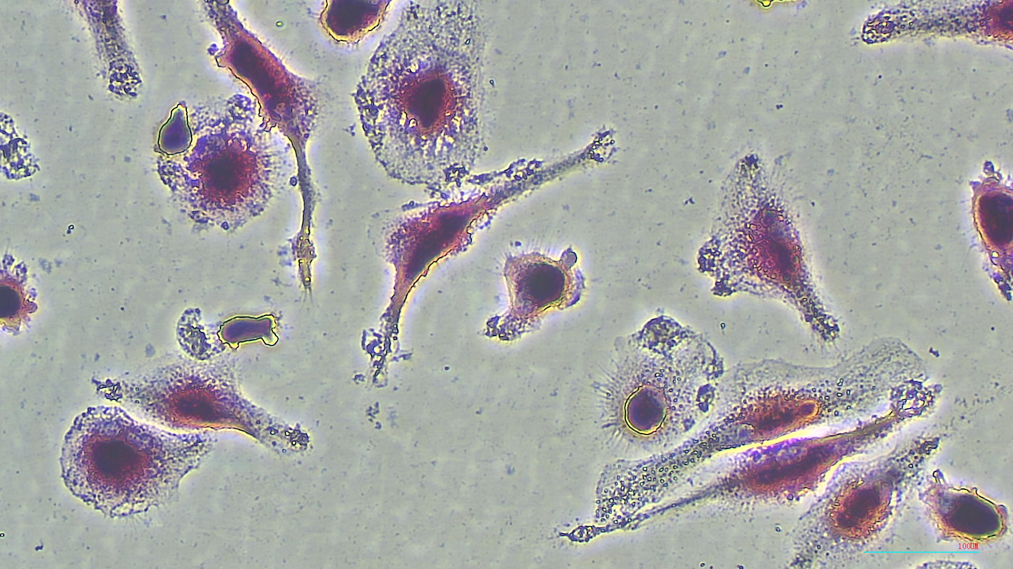
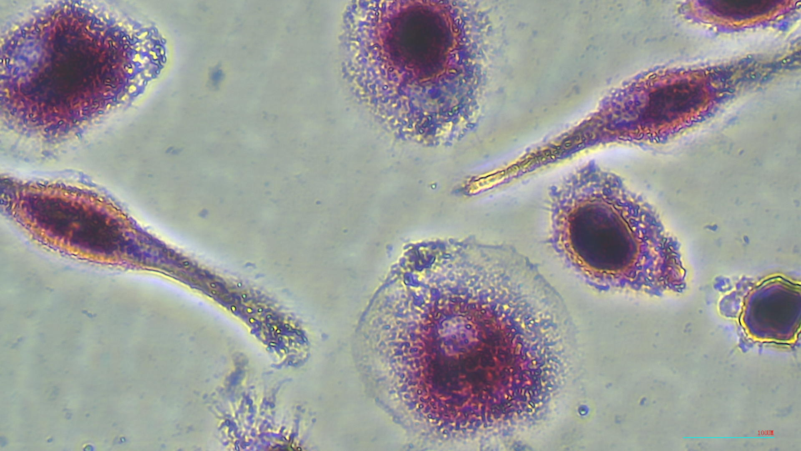
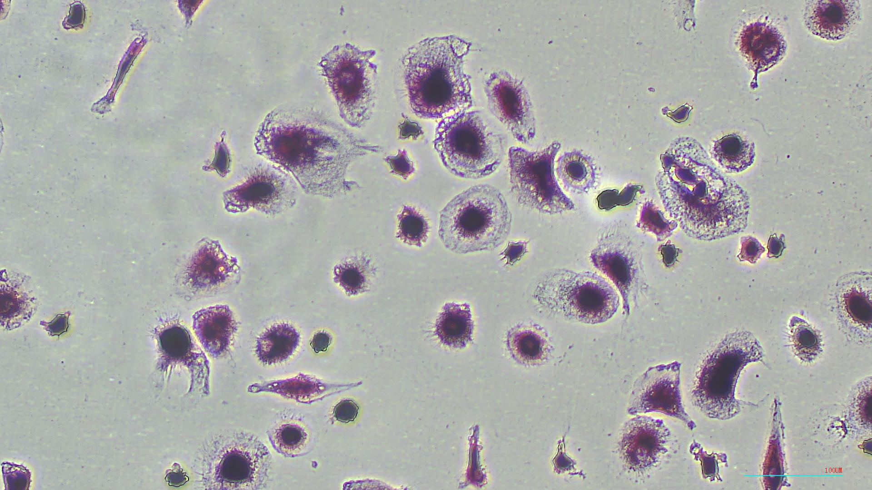
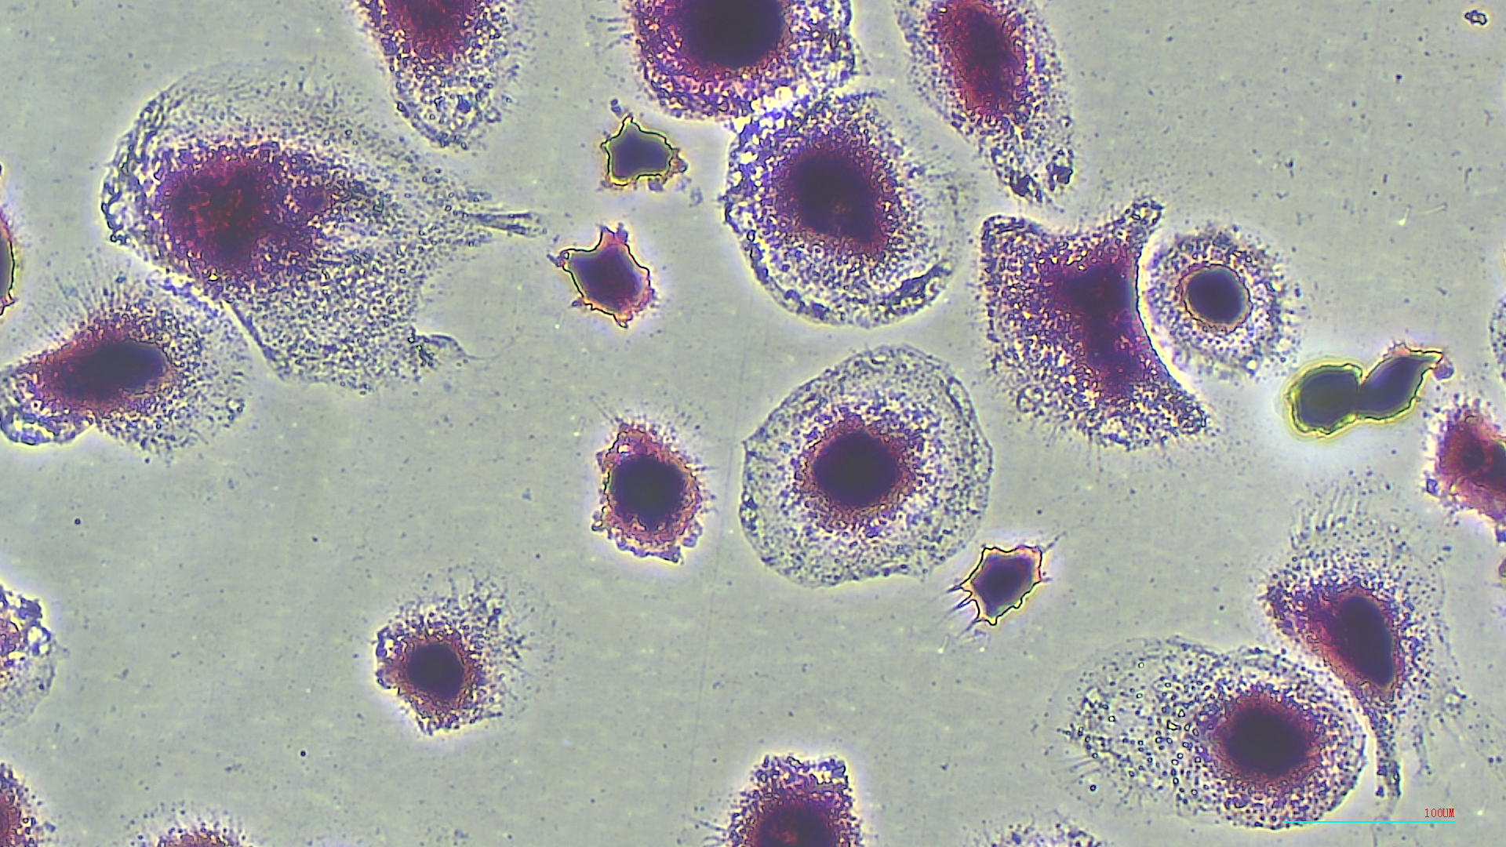
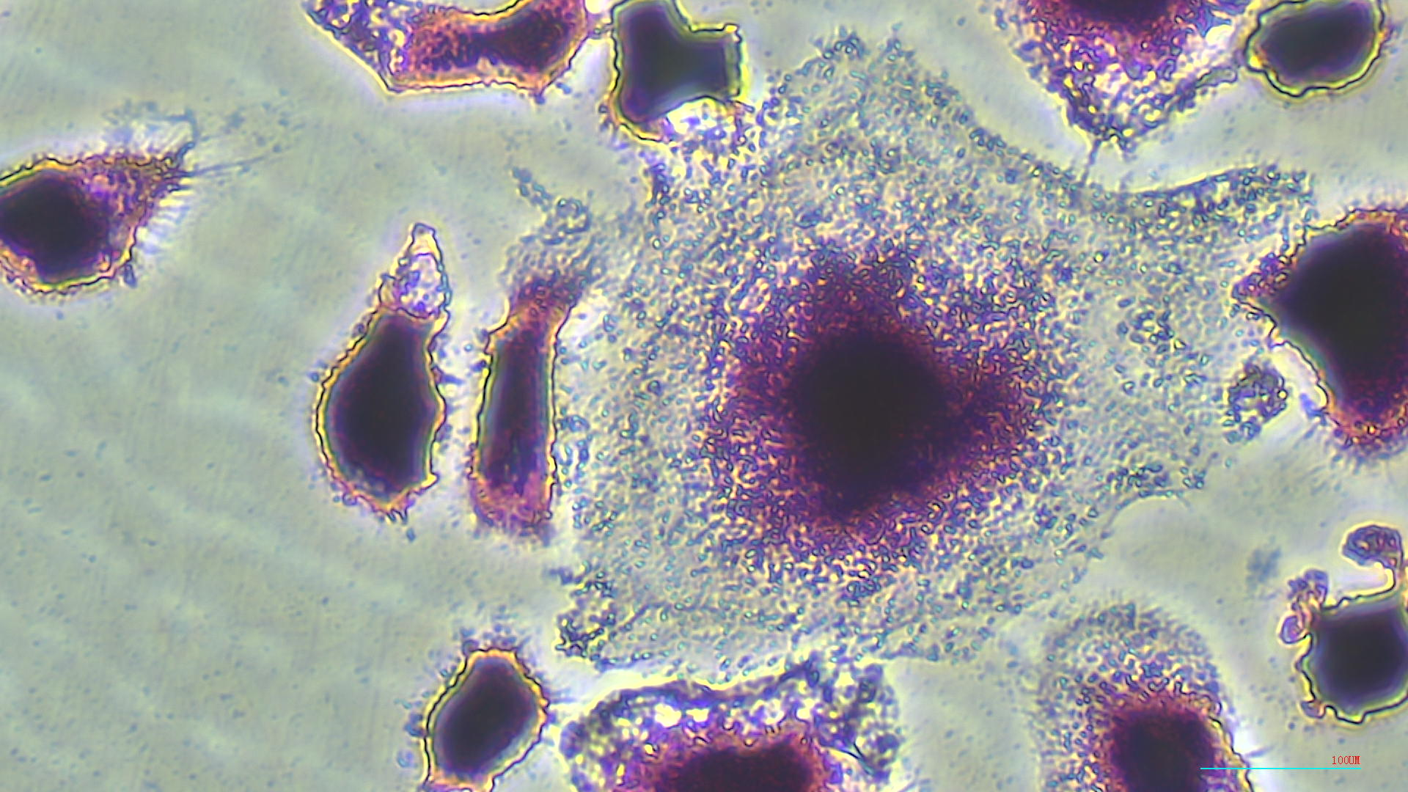
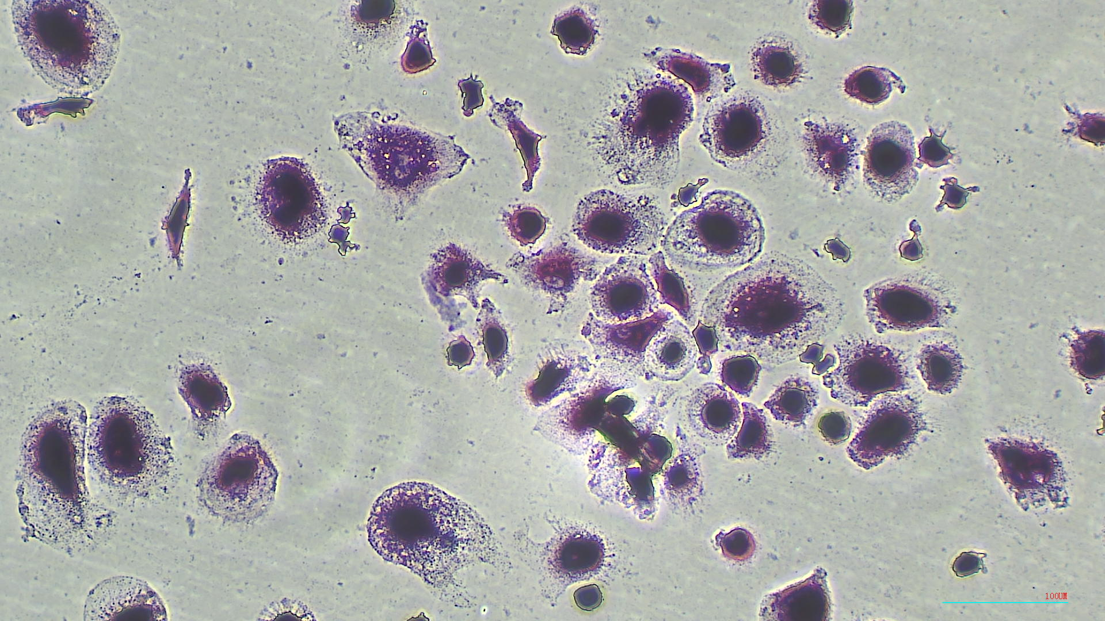
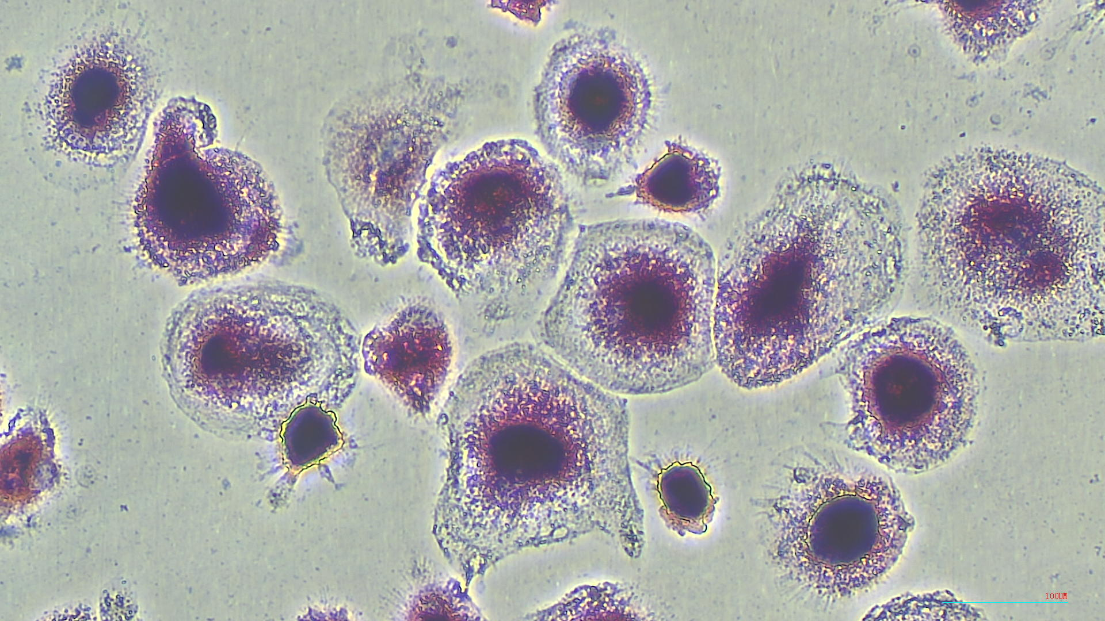
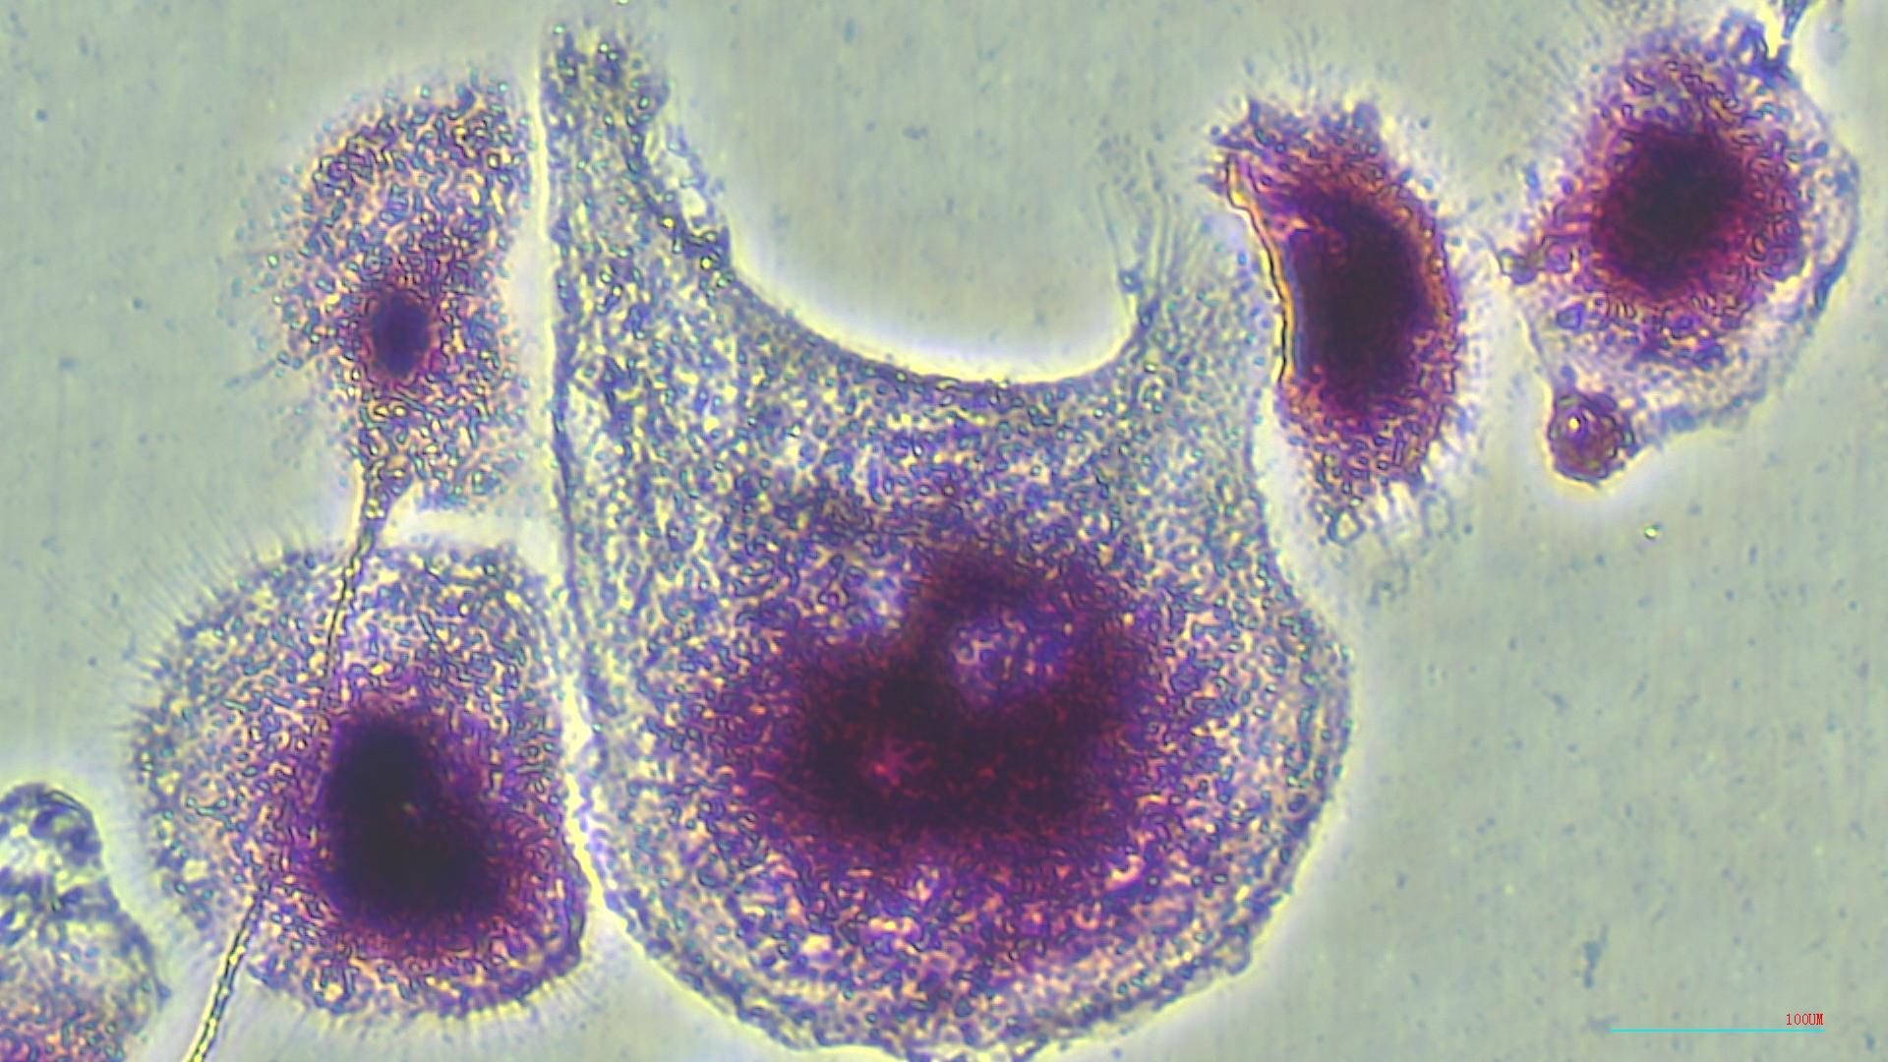
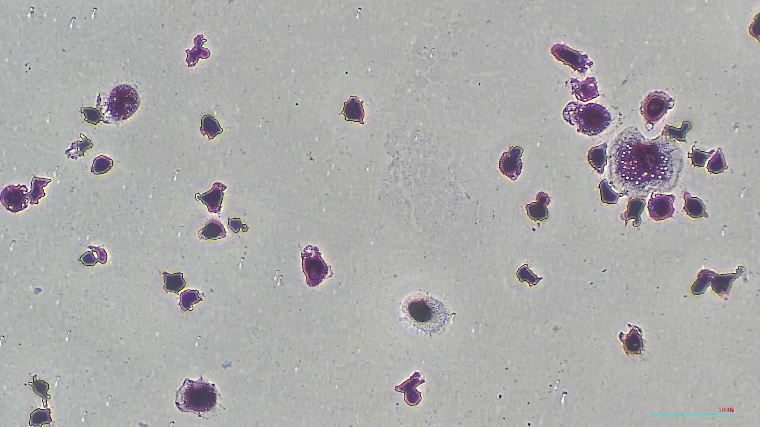
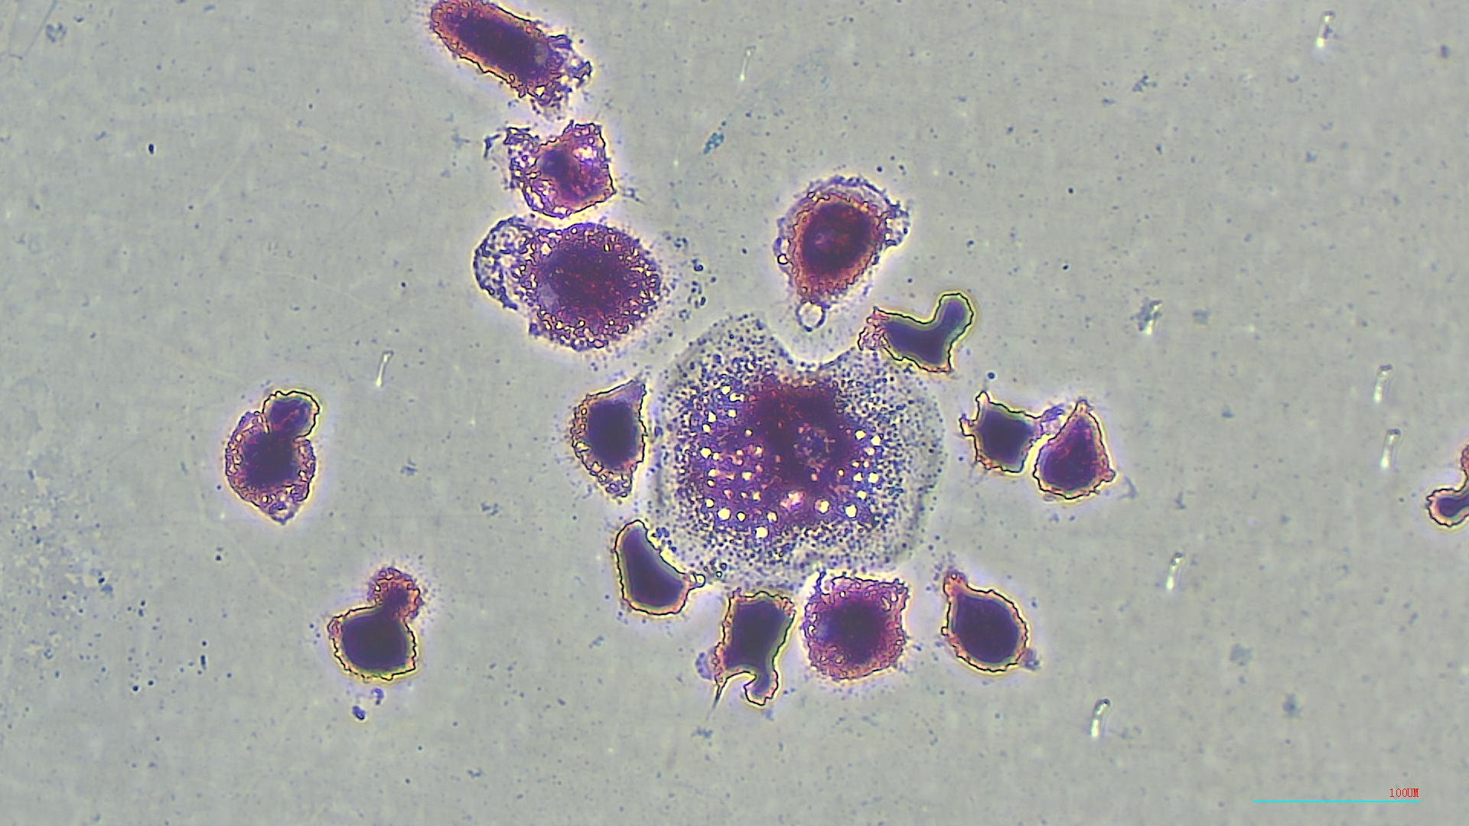
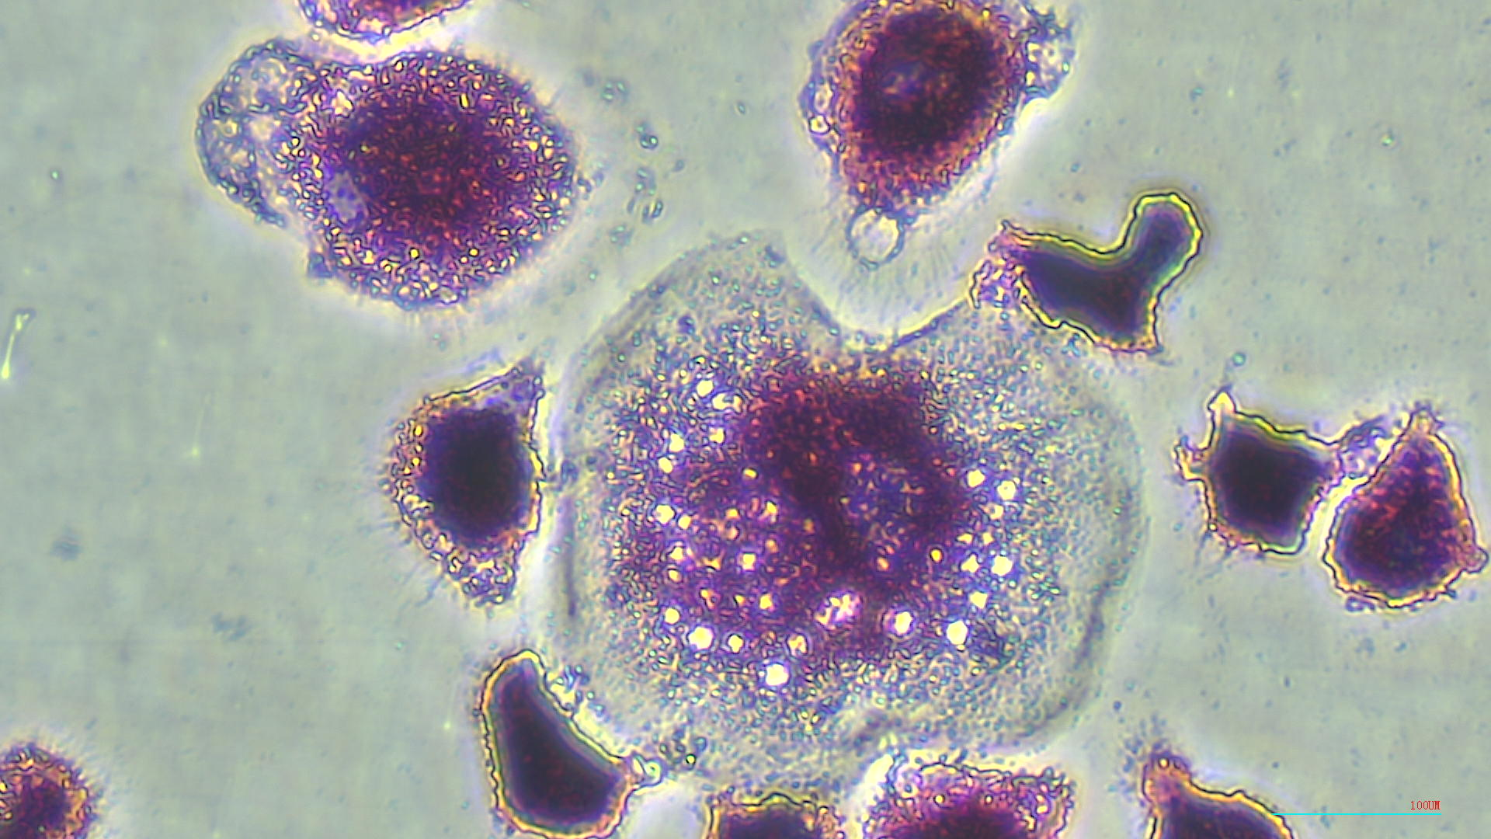
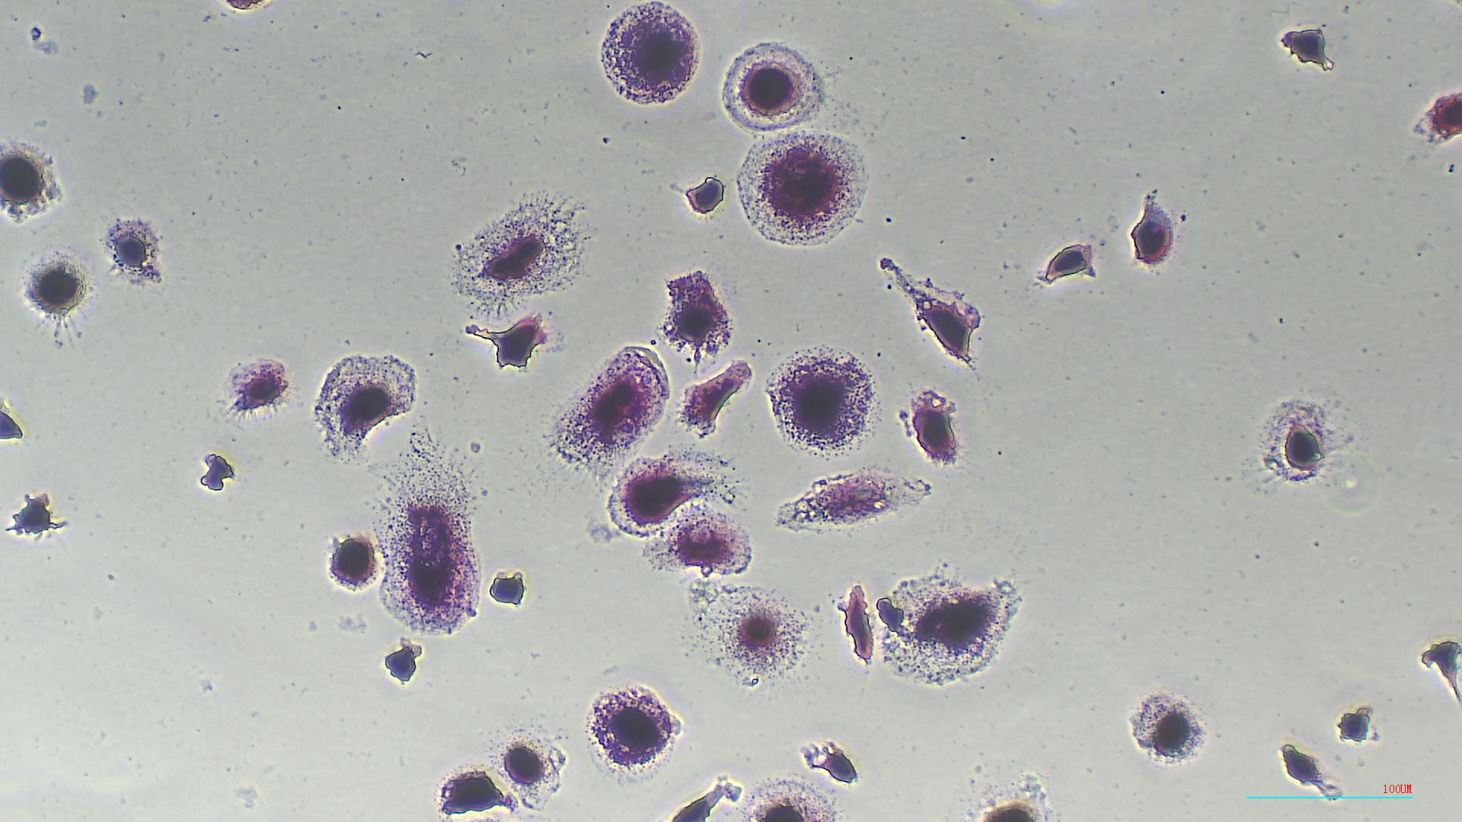
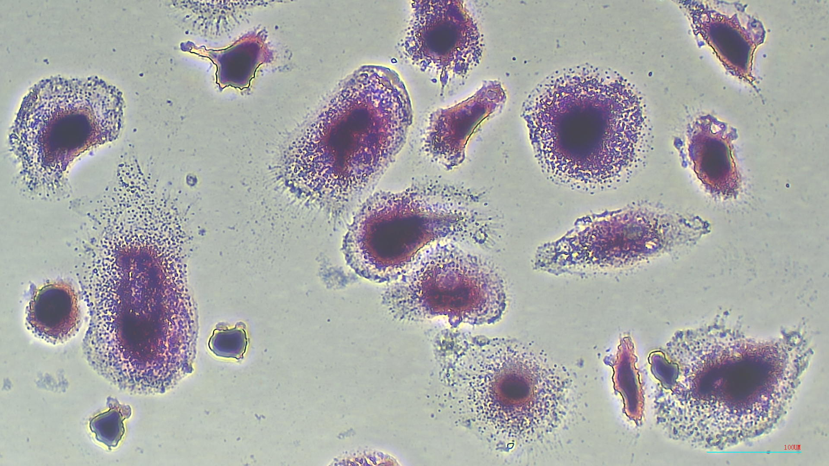
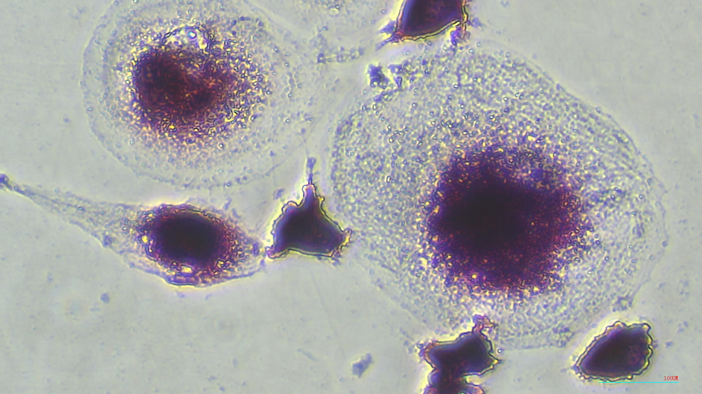
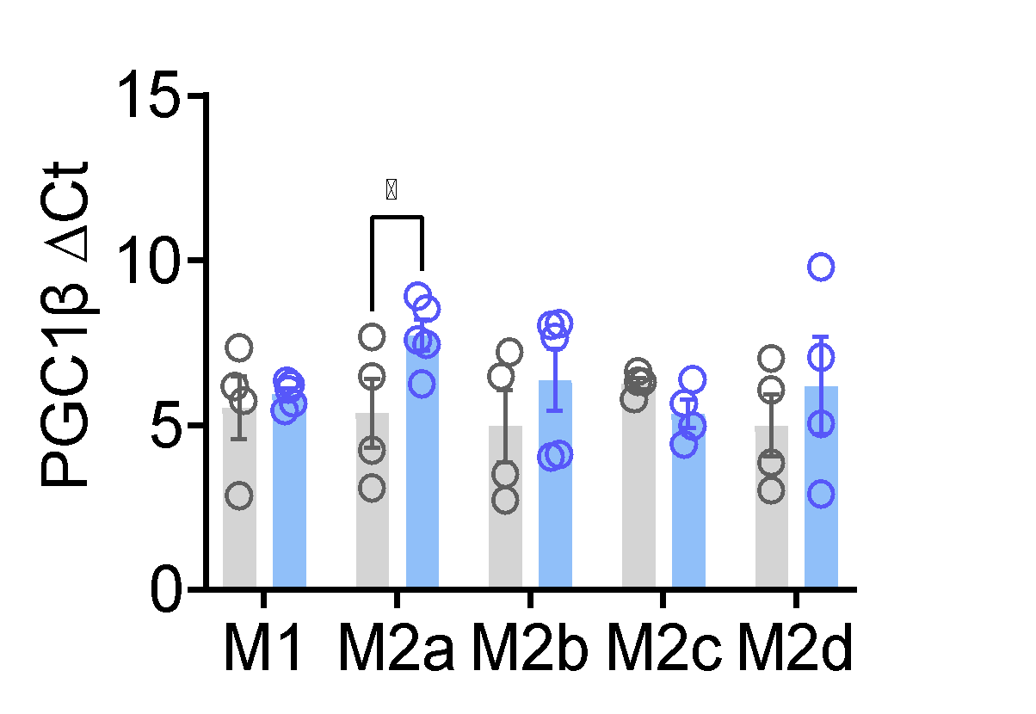
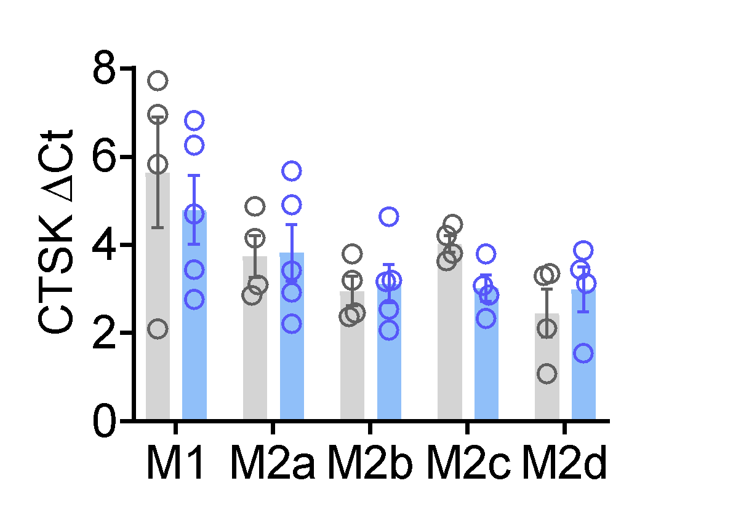
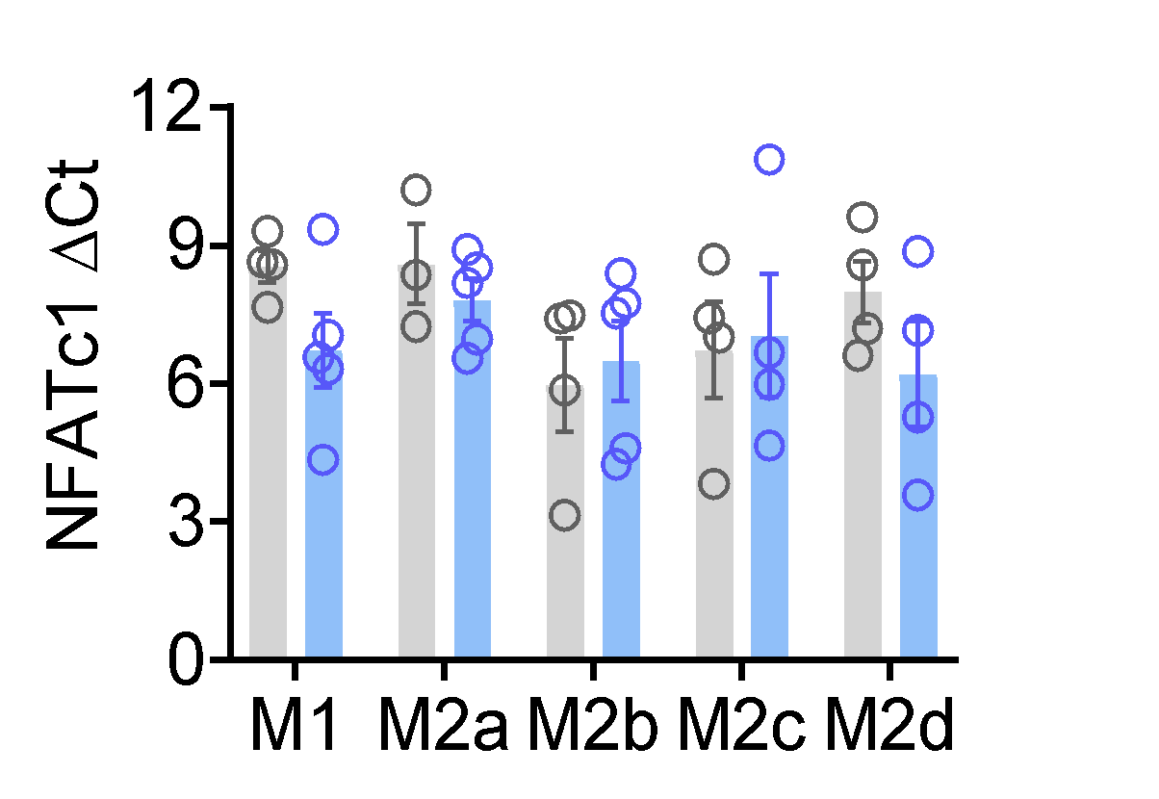
A
Supplementary Figure 2
B
M1 10x
M1 20x
M1 40x
M2a 10x
M2a 20x
M2a 40x
M2b 10x
M2b 20x
M2b 40x
M2c 10x
M2c 20x
M2c 40x
M2d 10x
M2d 20x
M2d 40x

