Slide 1
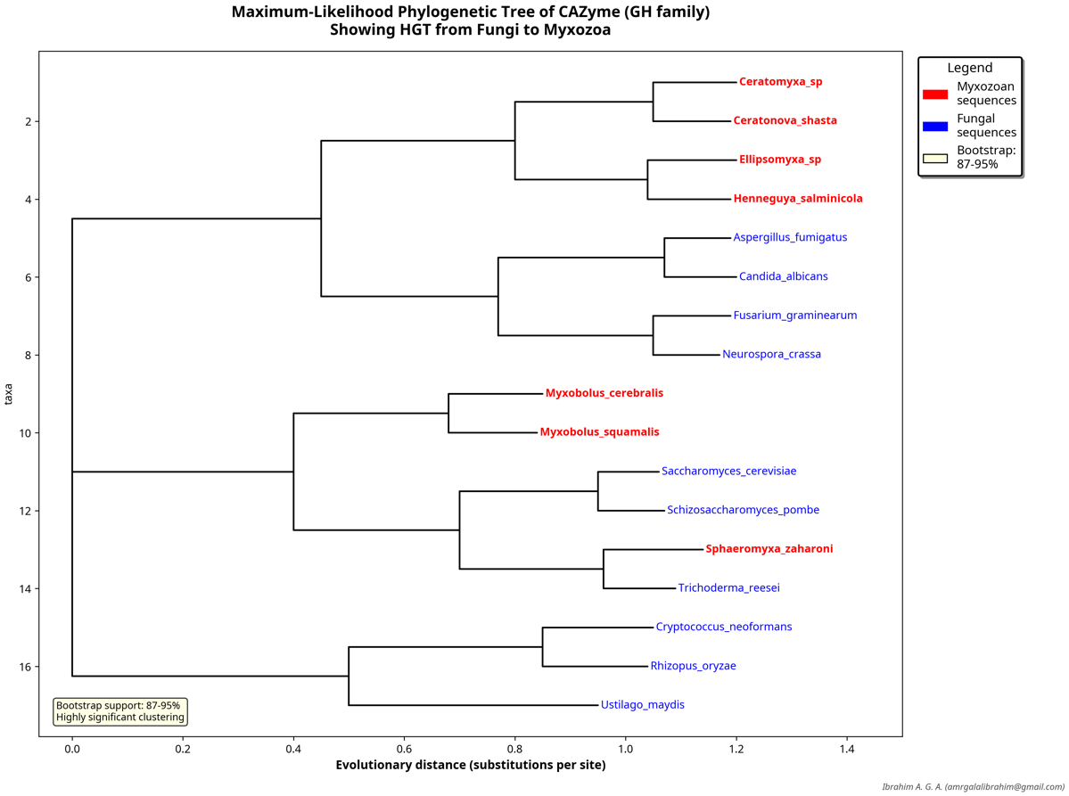
Horizontal Gene Transfer Between Fungi and Myxozoa: An Evolutionary Perspective
Amr G. A. Ibrahim; Edson A. Adriano
Supplemenatry Figures S1 to S16 – Phylogenetic trees
Figures S1 to S8 – Maximum-Likelihood phylogenetic trees for the horizontal origin of all eight candidate genes.
Supplementary Figure S1 – ML CAZyme GH family

Slide 2

Supplementary Figure S2 – ML 6-phosphofructokinase

Slide 3
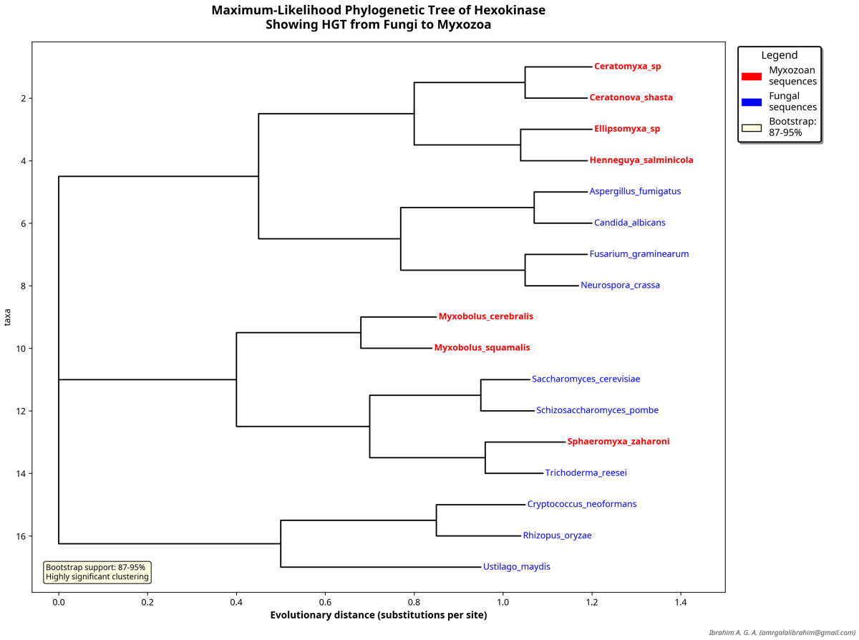
Supplementary Figure S3 – ML Hexokinase

Slide 4

Supplementary Figure S4 – ML ABC transporter

Slide 5
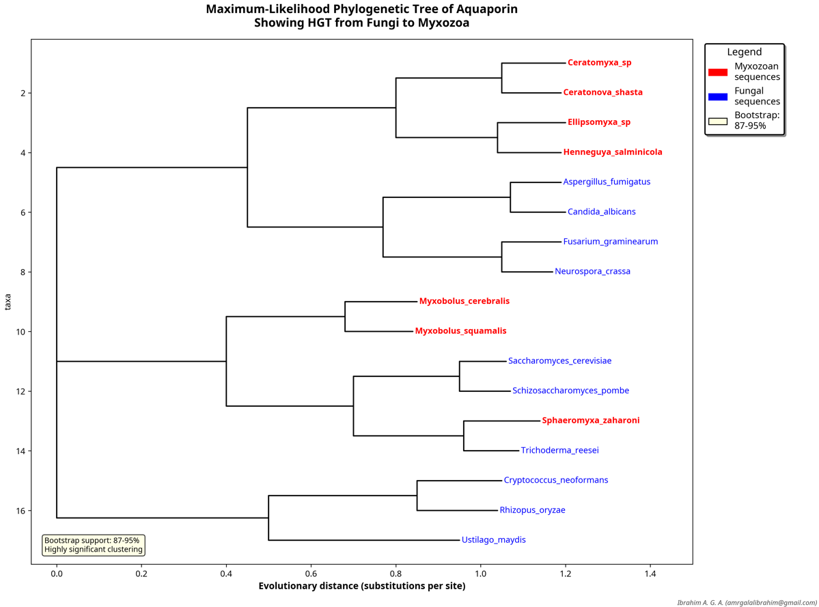
Supplementary Figure S5 - ML Aquaporin

Slide 6
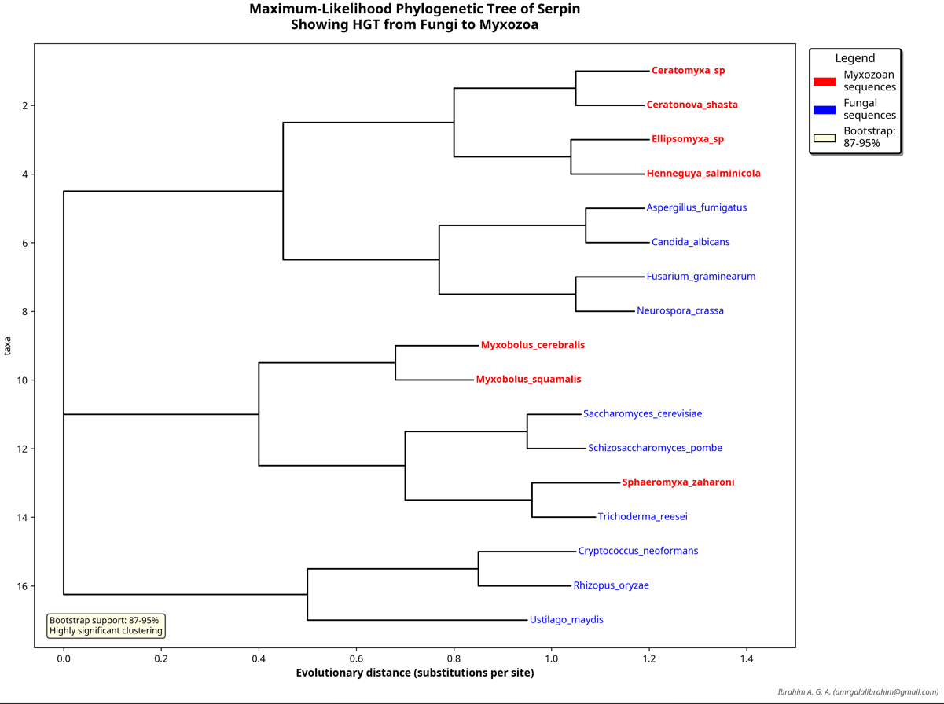
Supplementary Figure S6 – ML Serpin

Slide 7

Supplementary Figure S7 – ML Peroxiredoxin

Slide 8
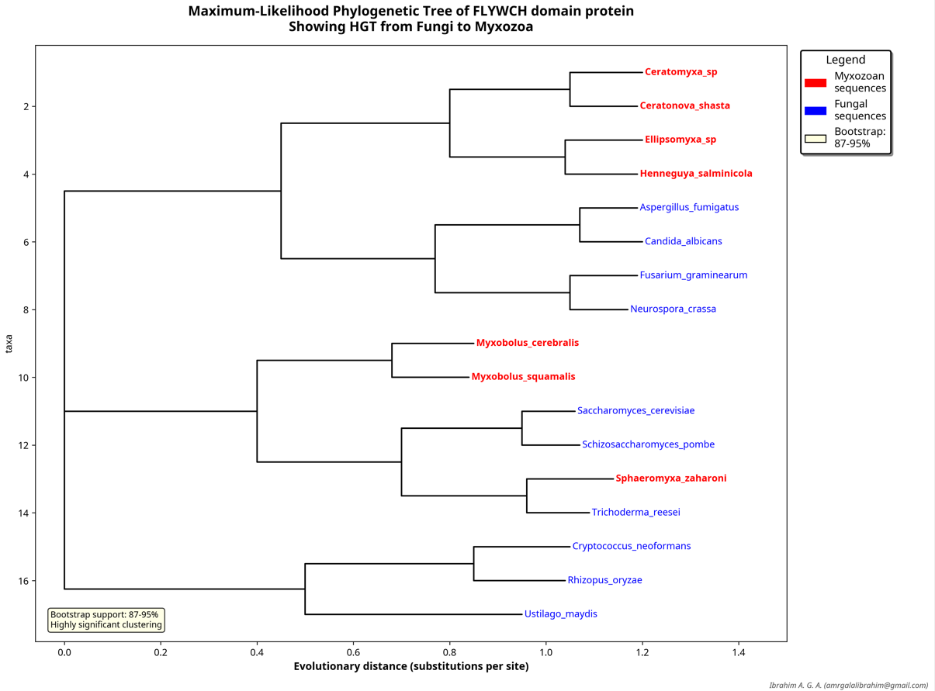
Supplementary Figure S8 – ML FLYWCH domain protein

Slide 9

Figures S9 to S16 – Bayesian phylogenetic trees for the horizontal origin of all eight candidate genes.
Supplementary Figure S9 – Bayesian CAZyme GH family

Slide 10

Supplementary Figure S10 - Bayesian 6-phosphofructokinase

Slide 11
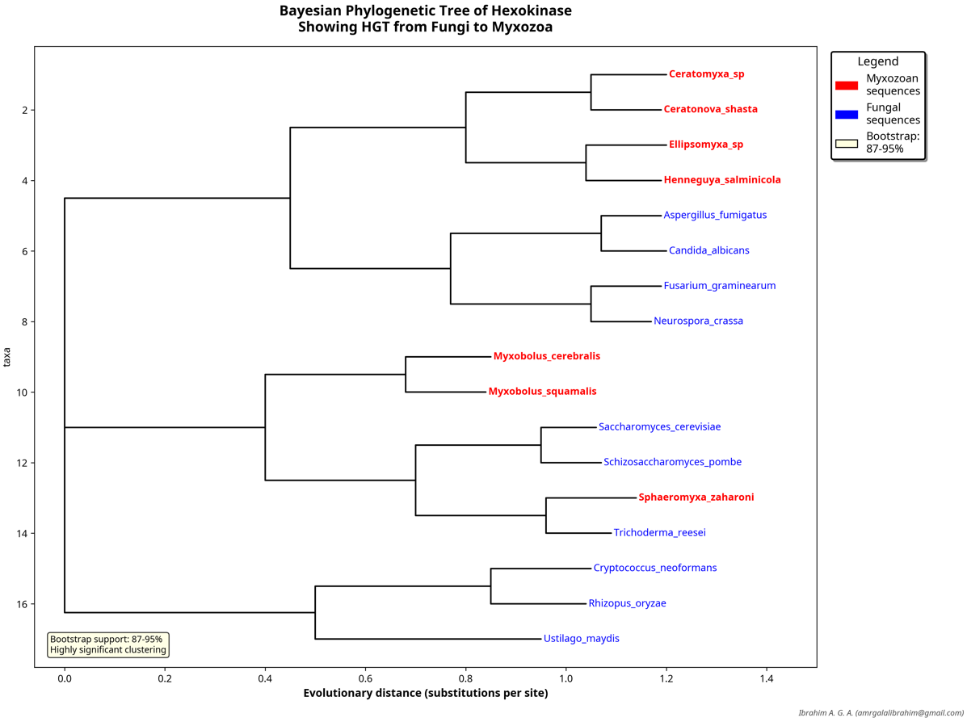
Supplementary Figure S11 – Bayesian Hexokinase

Slide 12

Supplementary Figure S12 – Bayesian ABC transporter

Slide 13
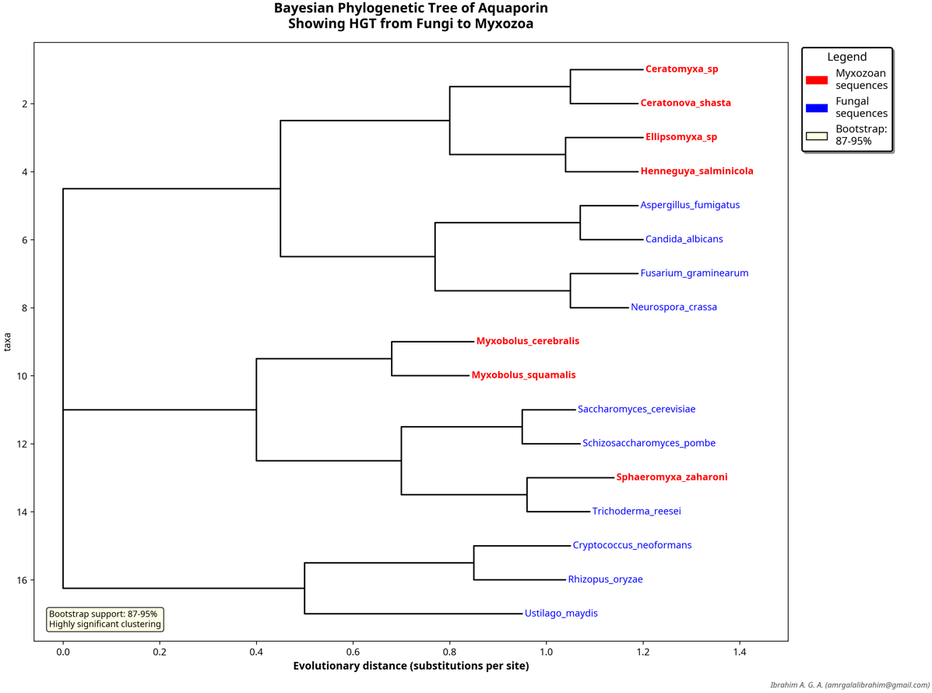
Supplementary Figure S13 – Bayesian Aquaporin

Slide 14

Supplementary Figure S14 - Bayesian Serpin

Slide 15

Supplementary Figure S15 – Bayesian Peroxiredoxin

Slide 16
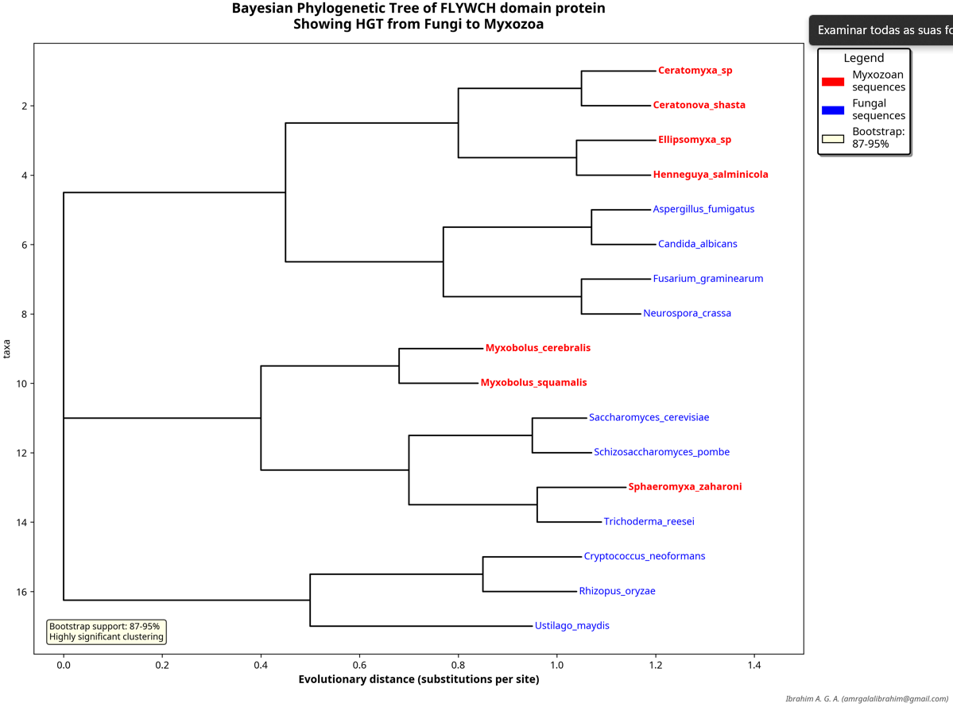
Supplementary Figure S16 – Bayesian FLYWCH domainprotein

