Slide 1
Supplemental Table 1. Patient characteristics (n=55).
Characteristics
Age | Mean | Range
 | 54.2 | 29-79
 | N = 109 | %
Sex
Male | 39 | 71%
Female | 16 | 29%
Cortical/Periventricular
Cortical | 34 | 62%
Periventricular | 21 | 38%
Type of Surgery
Biopsy only | 4 | 7%
STR | 28 | 51%
GTR | 23 | 42%
MGMT Status
Methylated | 17 | 31%
Unmethylated | 23 | 42%
Unknown | 15 | 27%
IDH Status
Mutated | 3 | 6%
Wild Type | 24 | 44%
Unknown | 28 | 51%
VPA
Yes | 12 | 22%
No | 43 | 78%

Slide 2
Supplemental Table 2. Overlap of proteins statistically correlated with volumes between early and late change across CE, NE, and edema volumes. Values in parentheses are the number of proteins significantly correlated with the volume change in the listed interval. Numbers above the diagonal are the number of proteins that overlap between the corresponding intervals. Numbers below the diagonal are the correlation coefficients for the corresponding volumes (i.e., Edema volumes are less correlated between early and late measurements than NE or CE volumes are). The overlap between early and late CE is the only one that is statistically significant. Early and late CE shared the most protein signals, followed by early and late NE. PENK was the only protein shared across all volumes in the early change analysis, and Apo M was the only protein shared across all volumes in the late change analysis (Supplemental Table 3). Cut-offs: r > 0.3 and p < 0.01.
 | Early CE (112) | Early NE (65) | Early Edema (12) | Late CE (83) | Late NE (46) | Late Edema (39)
Early CE |  | 10 | 6 | 65* | 6 | 2
Early NE |  |  | 1 | 5 | 26 | 0
Early Edema |  |  |  | 4 | 0 | 2
Late CE | 0.89 |  |  |  | 3 | 1
Late NE |  | 0.88 |  |  |  | 1
Late Edema |  |  | 0.62

Slide 3
Supplemental Table 3. Shared identified proteomic signals in the late change analysis and the early change analysis. All signals are shown in Supplemental file 2.
Feature | Number of Occurrences | Early |  |  | Late
 |  | CE | NE | Edema | CE | NE | Edema
APOM | 4 | X |  |  | X | X | X
CHMP6 | 4 | X | X |  | X | X
KMT2C | 4 | X | X |  | X | X
PENK | 4 | X | X | X | X
B3GAT1 | 3 | X | X |  | X
CD164L2 | 3 | X | X |  | X
CPN2 | 3 | X |  | X |  |  | X
KCNIP4 | 3 | X | X |  |  | X
P13612 | 3 | X |  | X | X
PAM | 3 | X |  | X | X
SLAMF8 | 3 | X |  | X | X
SNTN | 3 | X | X |  |  | X
TGFBR2 | 3 | X | X |  |  | X

Slide 4
Supplemental Table 4. Chi-square comparison of clinical features in low vs. high survival cohorts.
Survival Cohort | High Survival | Low Survival | Chi Square P Value
Age |  |  | 0.88
Older | 16 | 24
Younger | 5 | 10
Cortical/Periventricular |  |  | 0.15
Cortical | 16 | 18
Periventricular | 5 | 16
Type of Surgery |  |  | 0.07
GTR | 11 | 12
STR | 7 | 21
Biopsy | 3 | 1
MGMT Status |  |  | 0.22
Unknown | 3 | 12
Methylated | 7 | 10
Unmethylated | 11 | 12
IDH Status |  |  | 0.98
Mutated | 1 | 2
Unknown | 11 | 17
Wild Type | 9 | 15

Slide 5
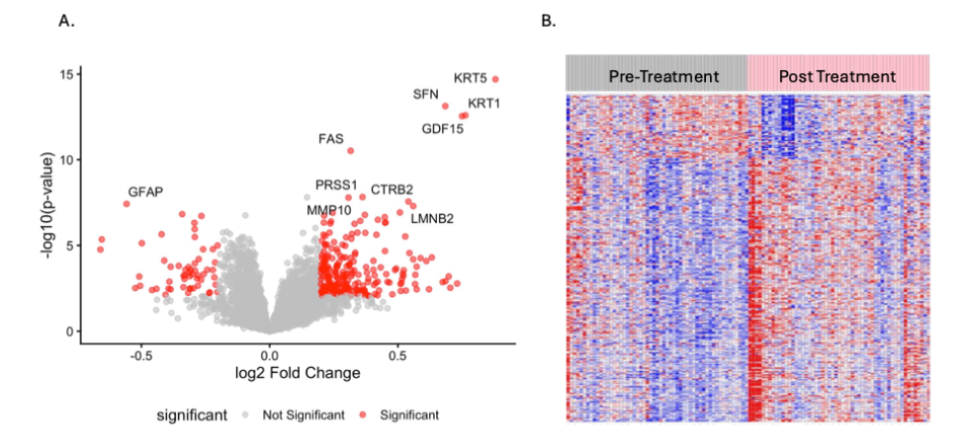
Supplemental Figure 1. A. Proteomic alteration post vs. pre CRT. B. Heatmap of altered proteins pre vs. post chemoirradiation.

Slide 6
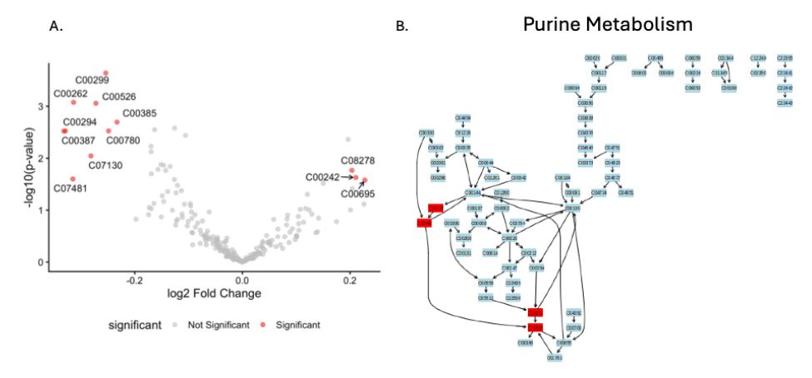
Supplemental Figure 2. A. Metabolomic compound alteration post vs. pre-CRT. B. Identified compounds mapped to the metabolic pathway employing MetaboAnalyst.

Slide 7
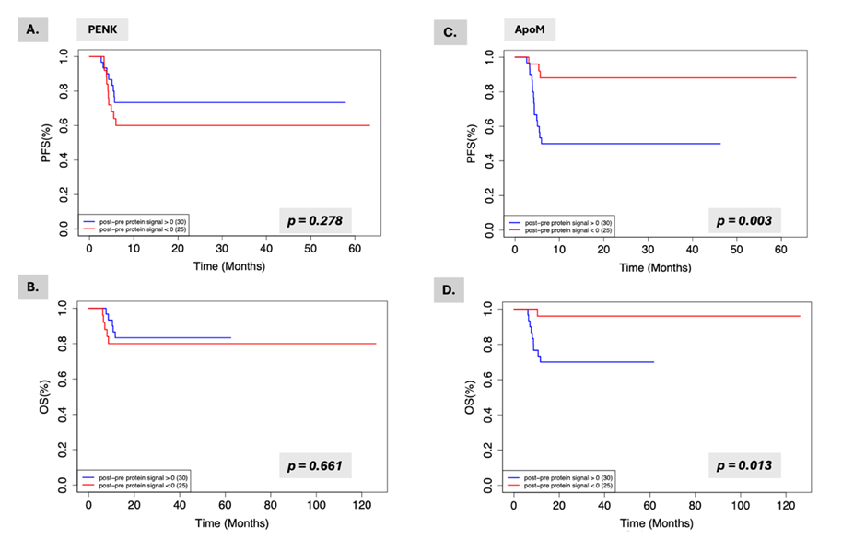
Supplemental Figure 3. Kaplan-Meier progression-free and overall survival analyses for proteins correlated with volumetric changes in tumor or edema. PENK PFS (A.) and OS (B.) ApoM PFS (C.) and OS (D.).

Slide 8
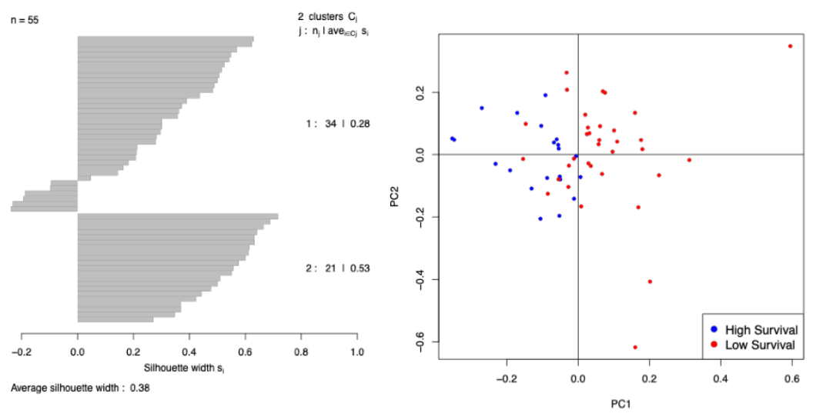
Supplemental Figure 4. A. Silhouette plot of consensus classes. B. PC plot of the low and high survival groups.

Slide 9
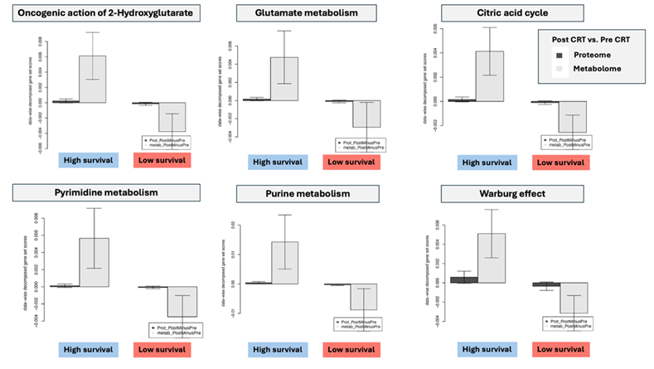
Supplemental Figure 5. Data-wise decomposition of gene-set scores for the Oncogenic action of 2-Hydroxyglutarate, Glutamate metabolism, Citric acid cycle, Pyrimidine metabolism, Purine metabolism, and Warburg effect are shown. The bar plot shows the normalized mean of data-wise decomposed GSSs in each cluster (the black vertical line on the bars shows the 95% confidence interval of the mean).

