Slide 1
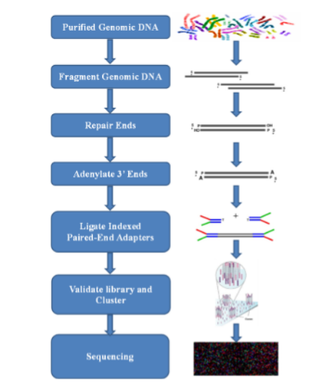
Supplementary Fig S1.

Slide 2
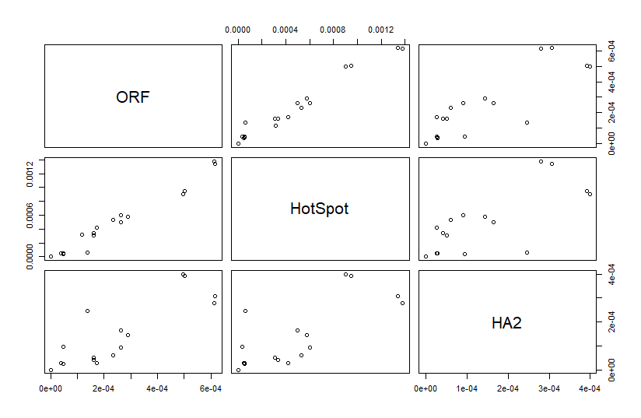
Supplementary Fig S2.

